Slide 1
Another wonder from China - the Hani Rice Terraces

Slide 2
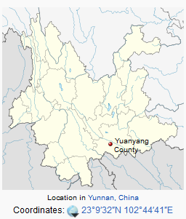
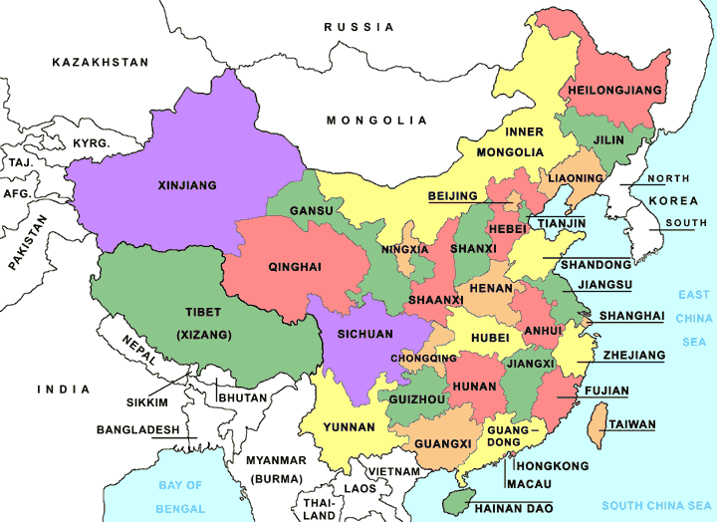

Slide 3
A wondrous thing of beauty nurtured by the industrious will of the people.....
These stunning images showing abstract swirls of colours and patterns could be mistaken for a collection of paintings. But they are in fact photographs of the breath-taking Hani Rice Terraces, found in the mountains above Yuanyang, in south-west China.
They are often described as the 'stairway to heaven' because of the vast layers of land reaching heights of up to 2000 meters above sea level.

Slide 4
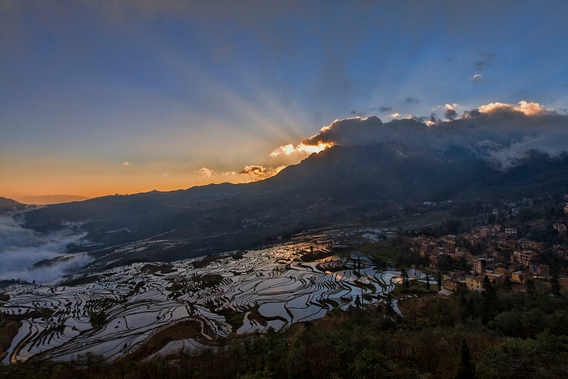
Sunrise over the valley

Slide 5
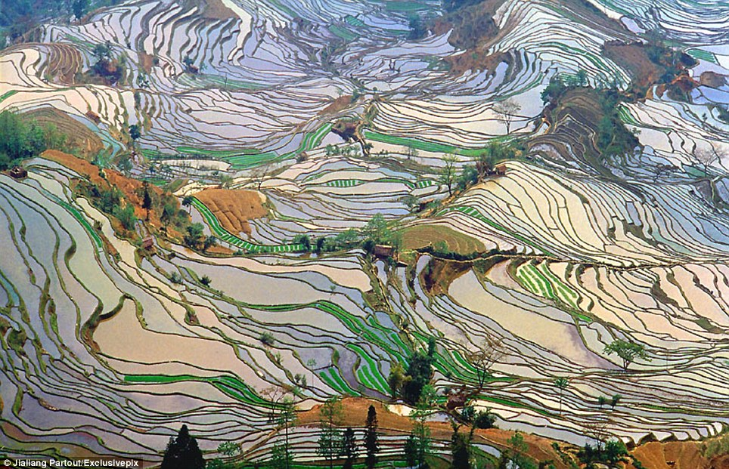

Slide 6
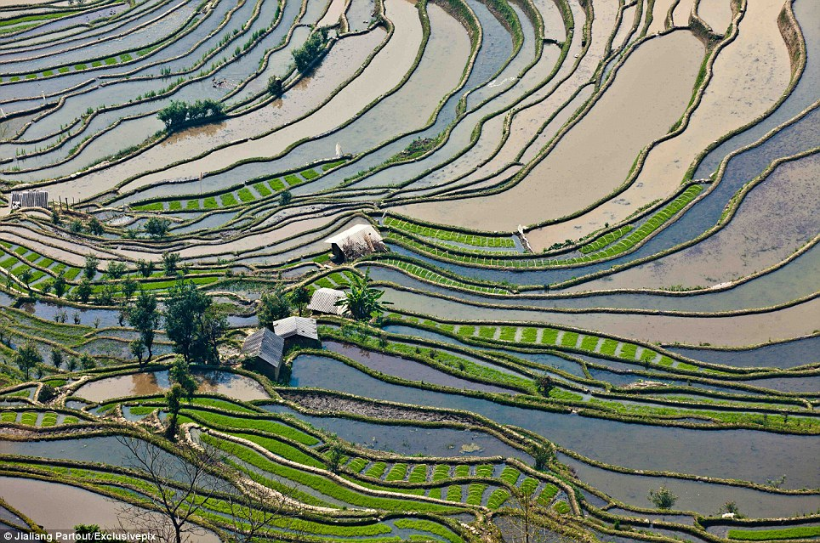
The site is protected by the laws of the People's Republic of China

Slide 7
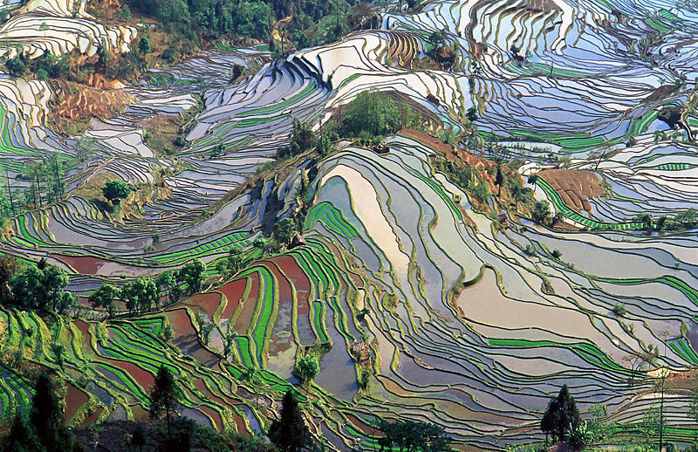

Slide 8
The Hani people's ancestors came to the steep mountain area 2,500 years ago. In their struggle against the difficult terrain they transformed the land into terraced rice paddies where they grew rice to make a living. The creativity of the Hani people has not only transformed the area into a fertile area to grow rice but also a place of artistic beauty. In recognition, the Ming Dynasty emperor granted the title of Skilful Sculpture to the Hani people and the fields have been officially acknowledged by UNESCO as a World Cultural and Natural Heritage site.

Slide 9
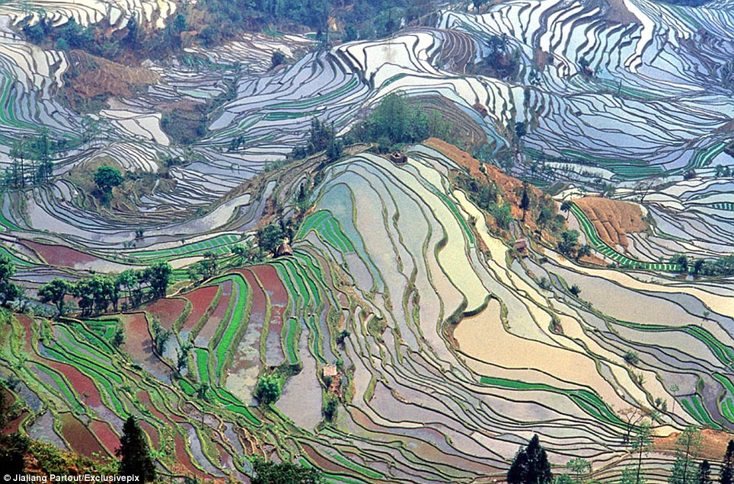
Hani people have created fantastic and perfect land art of vast terraced fields in the heritage site

Slide 10
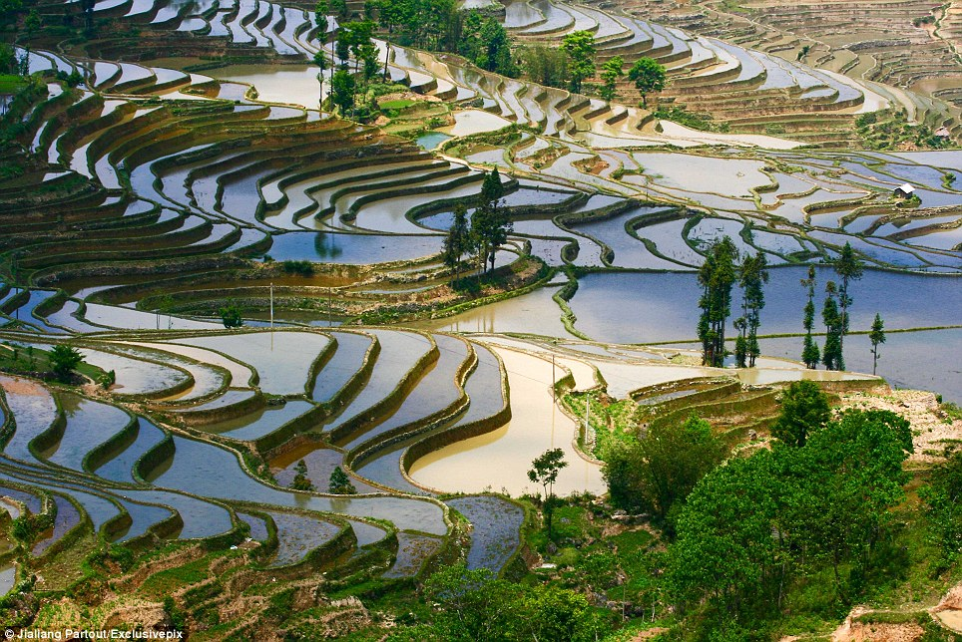
Two thousand five hundred years ago, the ancestors of Hani people came from Tibetan Plateau to work this land

Slide 11
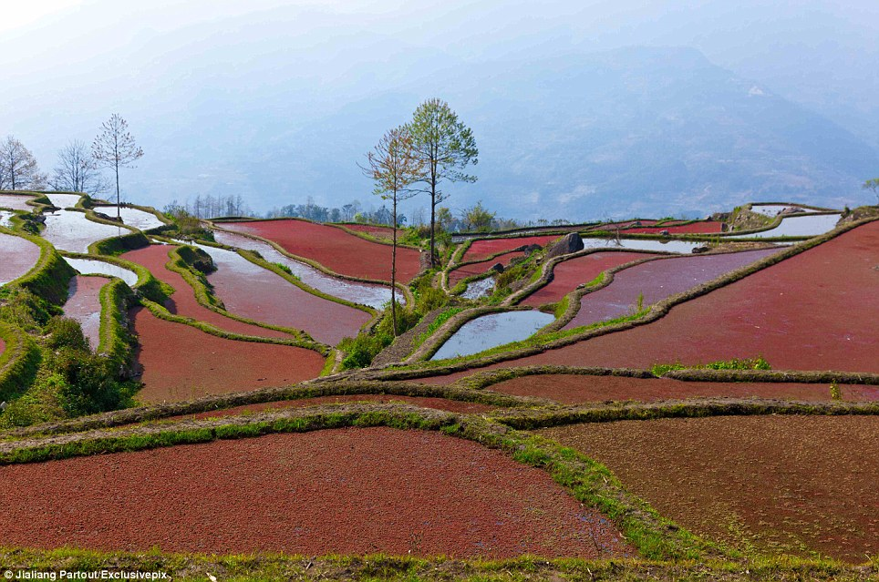

Slide 12
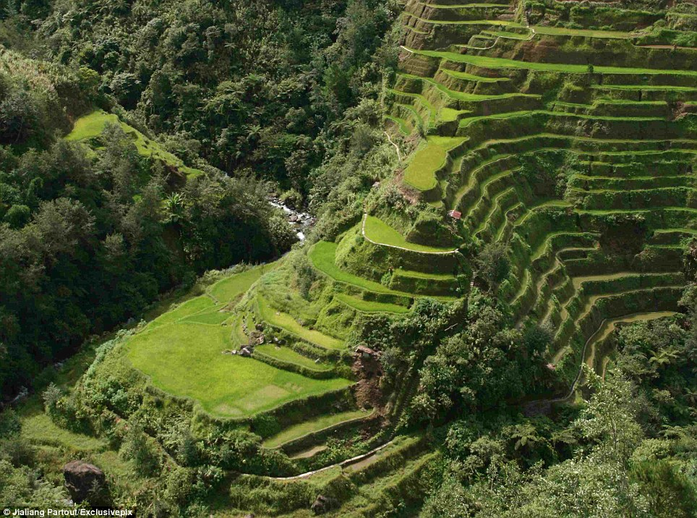
The entire field is irrigated with spring water from the forest above to rejuvenate and prepare for the next growing season

Slide 13
Over quite a long period of time the local people have cultivated a great number of rice species in their farming activities.
The site is protected by the laws of the People's Republic of China and support enough rice for hundreds of thousands of people.

Slide 14
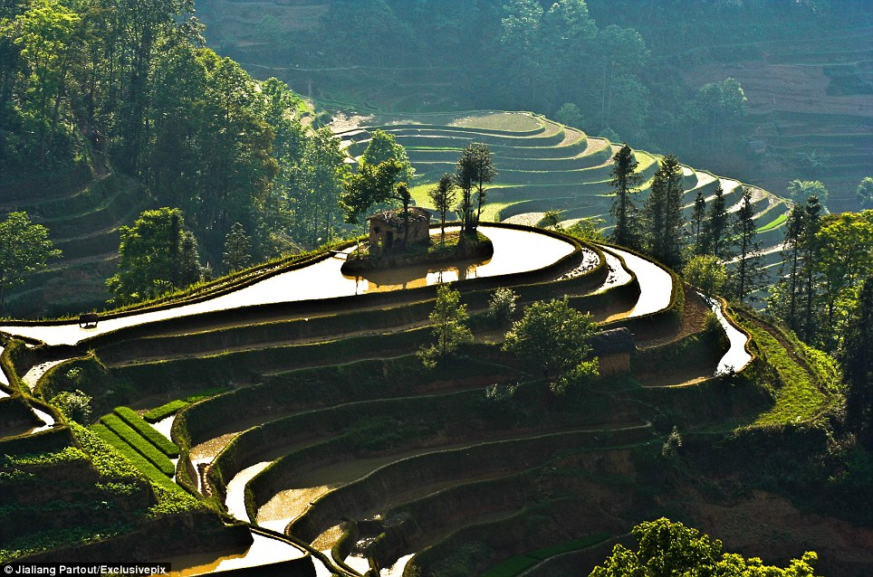
The water flows down the fields creating this amazing natural scenery

Slide 15
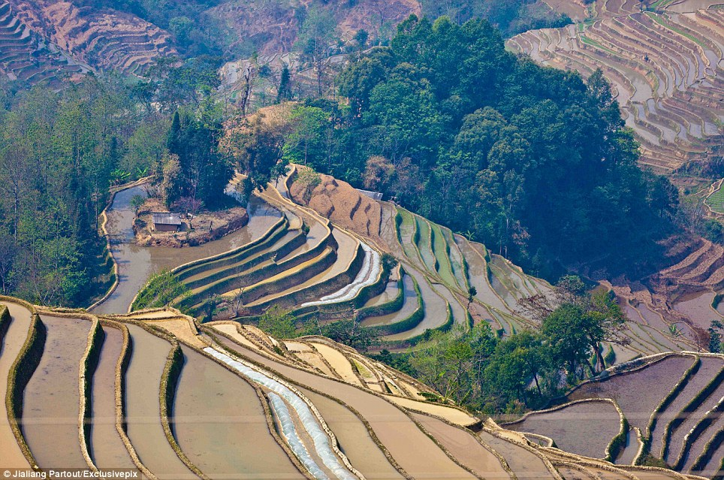

Slide 16
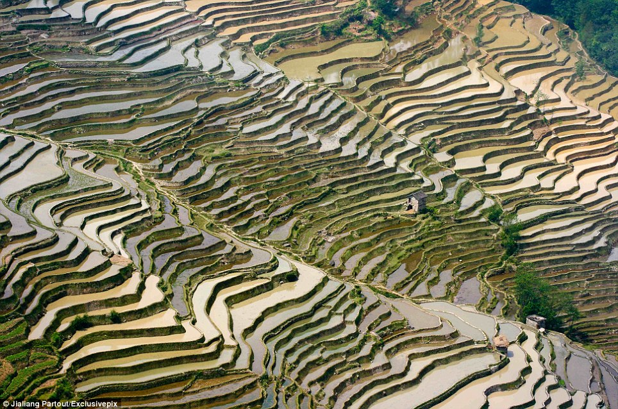

Slide 17
Yuanyang county lies at an altitude ranging from 140 along the Red River up to nearly 3000 metres above sea level in the Ailao mountains and is about 50km north of the border with Vietnam. During the winter to early spring season the entire field is irrigated with spring water from the forest above to rejuvenate and prepare for the next growing season. There is only one harvest per year for the Yuanyang Rice Terrace and planting occurs from March to November every year.

Slide 18
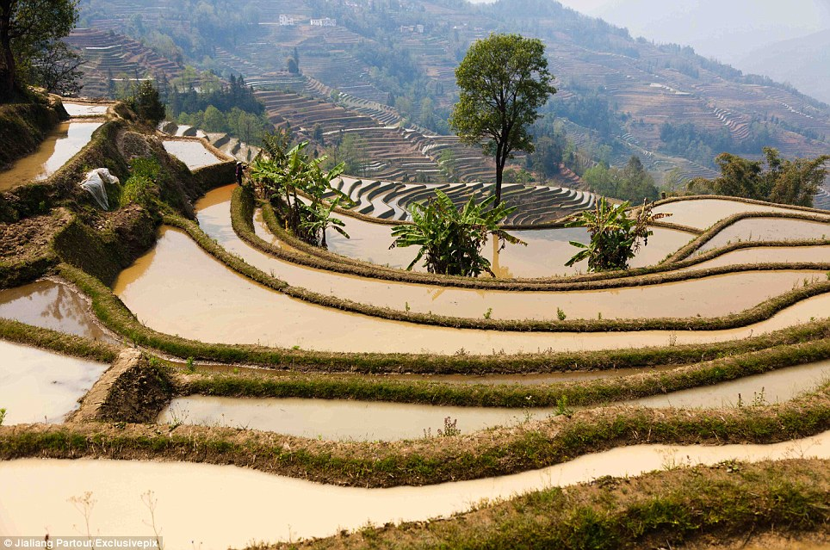

Slide 19
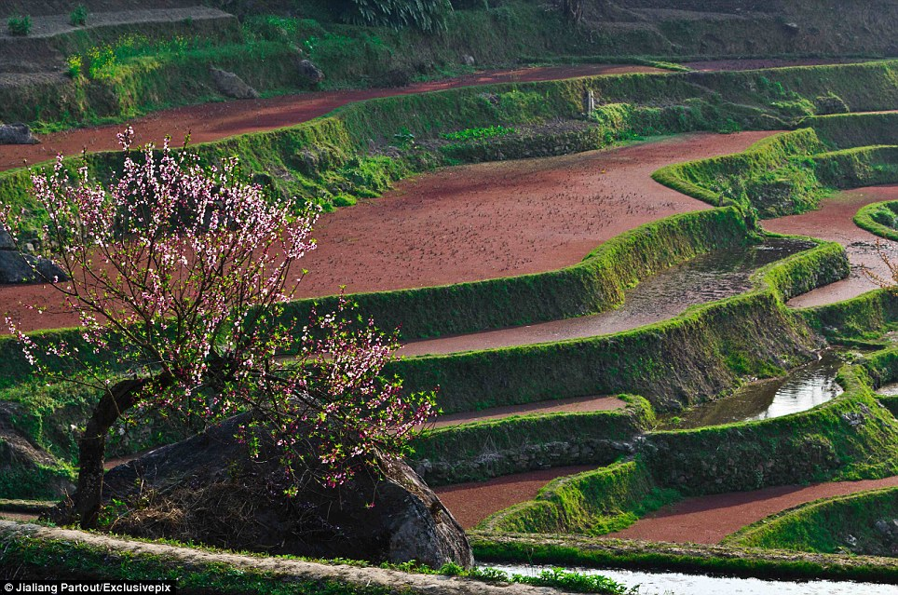

Slide 20
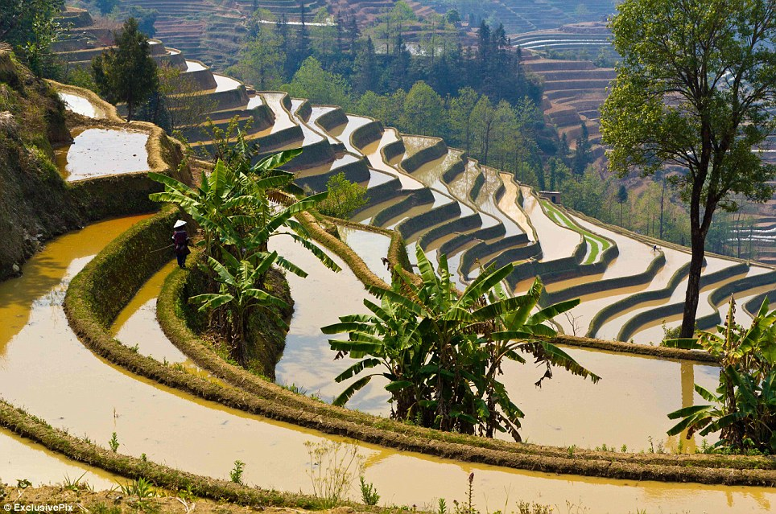
There is only one harvest per year for the Yuanyang Rice Terrace

Slide 21
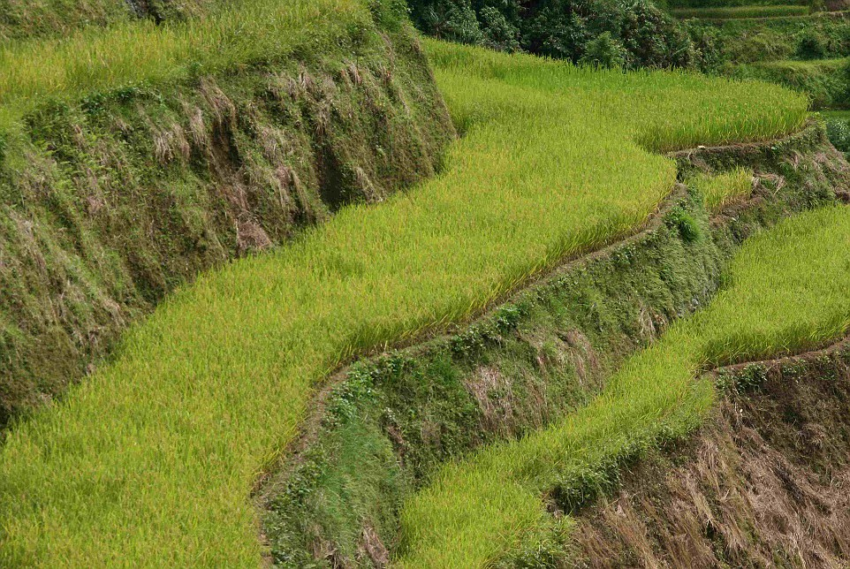

Slide 22
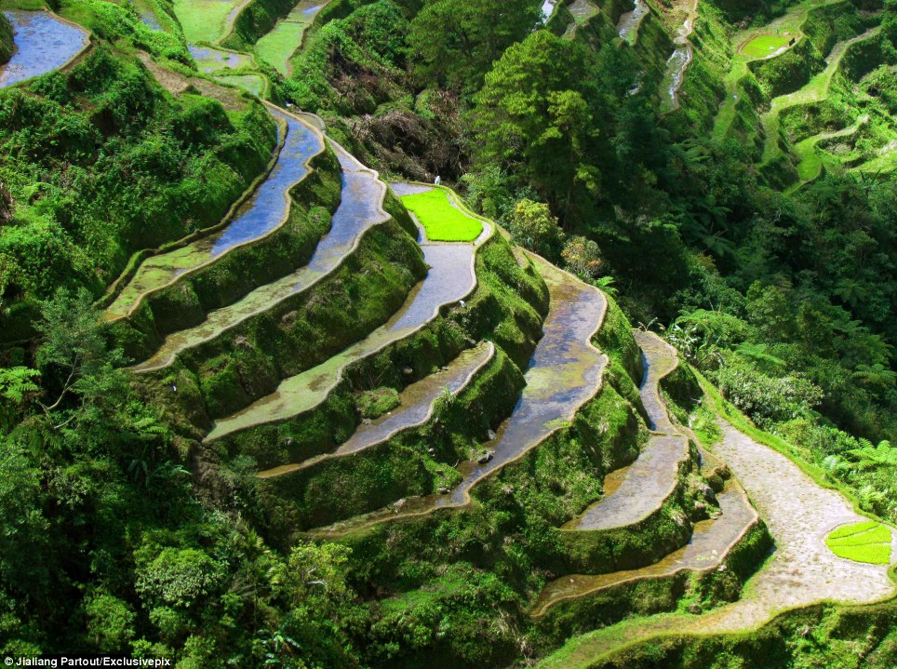

Slide 23
During the winter to early spring season, the entire field is filled with spring water.

Slide 24
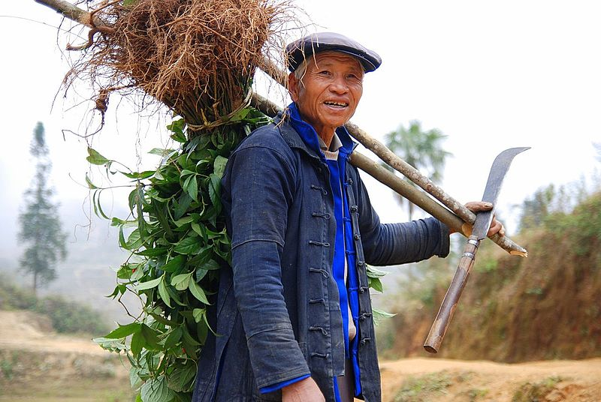
Hani farmer on his way home

Slide 25
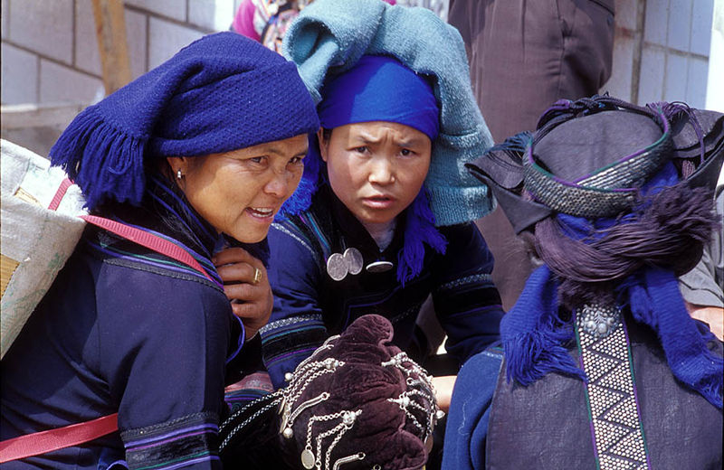
Typical daily attire of ethnic Hani

Slide 26
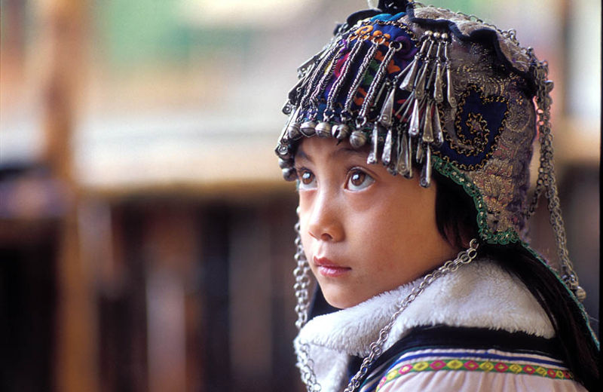
An ethnic Hani girl with the typical headgear for children

