Slide 1
18 Of The Best Wilderness Photos From The Smithsonian’s “Wilderness Forever” Photo Contest
2014

Slide 2
The Smithsonian National Museum of Natural History has unveiled an epic photo exhibit called “Wilderness Forever: 50 Years of Protecting America’s Wild Places.” The exhibit features jury-selected images that perfectly capture the gripping beauty of America’s wildest natural spaces. The exhibit celebrates the Wilderness Act, an integral element of the U.S.A’s conservation efforts that, since its adoption in 1964, has protected more than 109 million acres of American wilderness. The exhibit was selected from more than 5,000 submissions from throughout the U.S. Many of the winning photos come from the stunning mountains and tundras of Alaska, the mossy mountain forests of the Pacific Coast, and the unique sandstone formations of the South-West – all regions worth exploring! The exhibit will run through summer 2015.

Slide 3
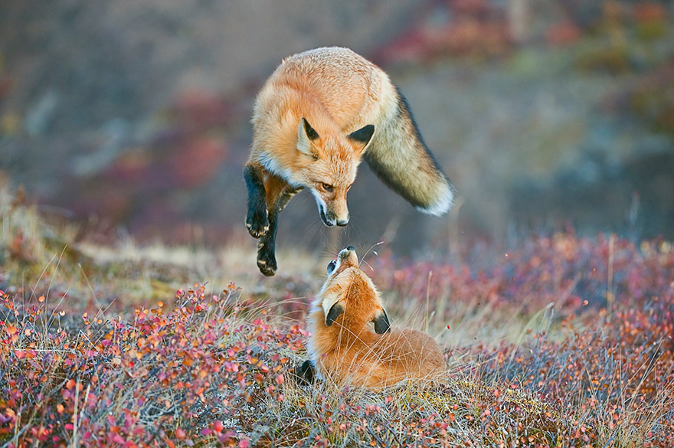
Red Fox, Denali National Park, Alaska

Slide 4
Mountain Goat Kids, Mount Evans Wilderness, Colorado

Slide 5
White Pocket, Paria Canyon-Vermilion Cliffs, Arizona

Slide 6
Brown Bear, Katmai Wilderness, Katmai National Park and Preserve, Alaska

Slide 7
Climbing the Summit Pyramid Of Sahale Mountain, Washington

Slide 8
Bald Eagle, Glacier Bay Wilderness Area, Alaska

Slide 9
Meadow of Wildflowers, Grand Teton National Park, Wyoming

Slide 10
Snowy Owl, Otis Pike Fire Island High Dune Wilderness Area, New York

Slide 11
Banner Peak Alpenglow, California

Slide 12
Aurora Ridge Trail, Sol Duc Valley, Washington

Slide 13
Snowy Meadow, Mount Hood Wilderness, Oregon

Slide 14
Purple Sea Star, Olympic Wilderness, Washington

Slide 15
Aurora Borealis Over Honeymoon Rock, Apostle Islands National Lakeshore, Wisconsin

Slide 16
Alaska Range, Denali Wilderness In Alaska

Slide 17
Sandhill Cranes, Bosque Del Apache, New Mexico

Slide 18
Peak Fall Colors, Ouachita National Forest, Arkansas

Slide 19
American Alligator, Marjory Stoneman Douglas, Florida

