Slide 1

Synthesis of tetraphenylcyclopentadienone

Slide 5
Assume that you ran this reaction using 3 g of benzil and 3 g of diphenylacetone using KOH dissolved in absolute ethanol. The glassware needs to be kept completely dry. The setup is similar to the setup you used to make isoamyl acetate, reflux condenser connected to a 50 mL round bottom flask. The benzyl and 1,3-diphenylacetone are dissolved in a few mL of absolute ethanol and heated to a very gentle reflux. KOH dissolved in absolute ethanol are added dropwise from the top of the condenser. Your reaction should get dark immediately. Gentle reflux is continued for a short period of time. The material you will isolate looks black but is actually purple. The infrared spectrum is shown below. Be sure to identify the functional groups in the molecule.
You should calculate the yield assuming you isolated 4 g of tetraphenylcyclopentadienone. B

Slide 6
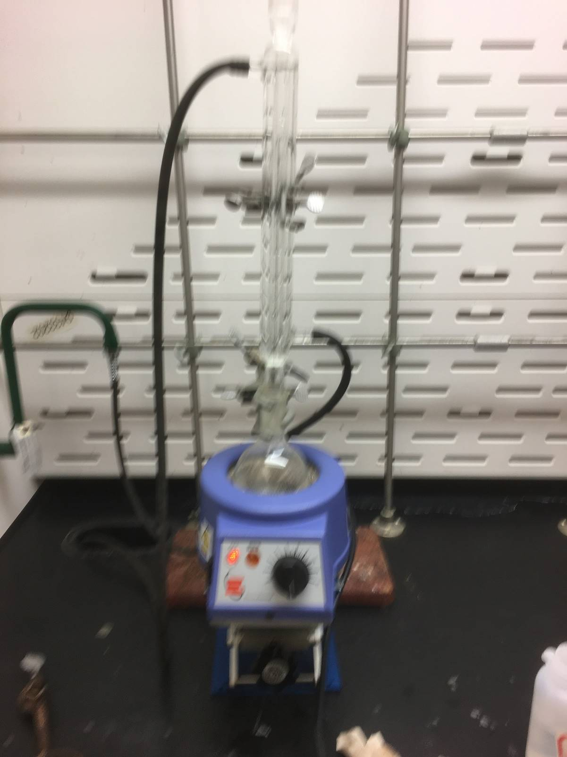

Slide 7
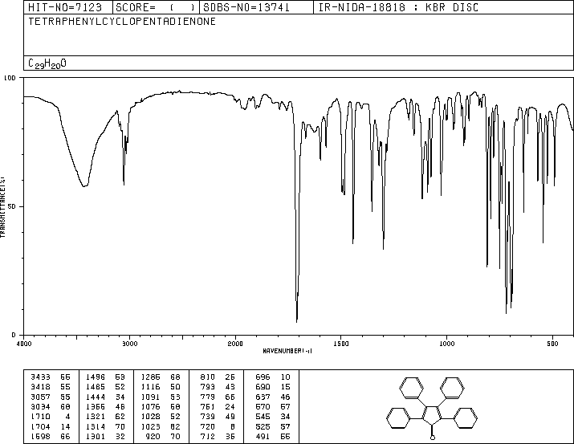
What would you conclude is peculiar about this spectrum. Based on the synthetic procedure, what might you conclude about this spectrum

