Slide 1

Experiment 10: Multistep synthesis Step 1
The Preparation of Benzoin
Benzaldehyde

Slide 2
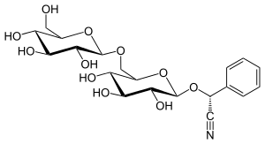


the glycoside amygdalin

Slide 3
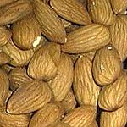
Bitter almond (and other seeds of the rose family) contains the glycoside amygdalin. By damaging the seeds, the amygdalin is enzymatically hydrolyzed to benzaldehyde, hydrogen cyanide and the disaccharide beta-gentiobiose. The powerful 'marzipan flavor is due to benzaldehyde

Slide 4
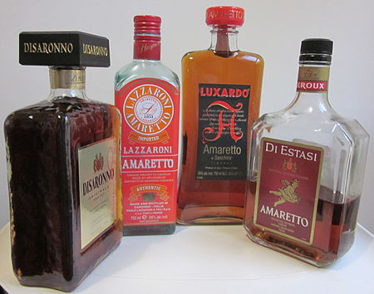
The name amaretto originated from the Italian word amaro, meaning "bitter", the distinctive flavour lent by the bitter almond and amore, love.

Slide 5
Benzoin Condensation
+ OH⁻

Slide 6
Since cyanide is quite toxic, we will use thiamine as our catalyst to replace cyanide
-

Slide 7
Thiamine is heat sensitive so the addition of 5 M NaOH needs to be added dropwise (3 to 5 min) to the thiamine hydrochloride in a cold ethanol-water solution in a small Erlenmeyer flask, maintained in an ice bath with constant swirling at a temperature close to 0 °C.
Once the benzaldehyde is added to.the reaction flask, the flask is sealed with a cork and with Parafilm to keep out air. The flask is placed in your drawer until next week.

Slide 8
Lets fast forward a week and lets assume you were careful in adding the NaOH to the thiamine so that you obtained a fair number of crystals in your Erlenmeyer flask. Since you started with 5 mL of benzaldehyde (d = 1.04 g/mL) and you isolated 4 g of benzoin, what is the yield of your reaction?

Slide 9
benzaldehyde: 5.2 g/106 = 0.047 mol
one mol benzaldehyde yield ½ mol benzoin
0.047mol benzaldehyde yields 0.047/2 mol benzoin
0.047/2mol benzoin * 212 g/mol = 5.2 g theoretical yield
Actual yield = 4/5.2*100 = 77%
Alternatively: 2 benzaldehyde C₇H₆O is converted to C₁₄H₁₂O₂
Since there is no mass loss or gain, conservation of mass says that 5.2 g must be present. Therefore, 4g/5.2 = .77

Slide 10
The IR spectrum of benzoin is on the following page. Please analyze the principle functional groups in this molecule.
Also included is the nmr spectrum. The spectrum is not first order. See if you can identify the methine hydrogen attached to the carbon bearing the OH group

Slide 11
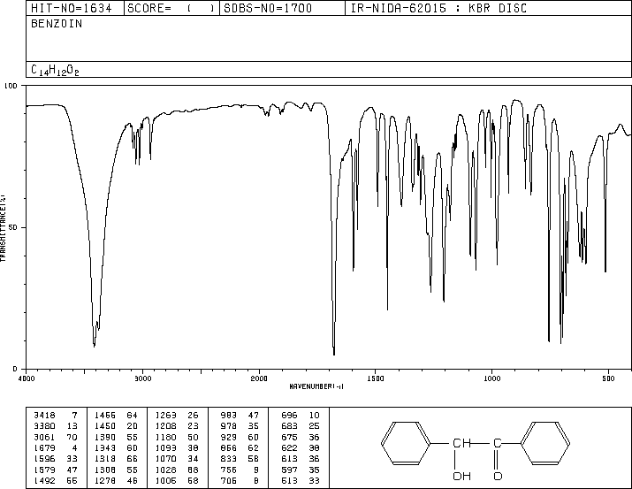

Slide 12
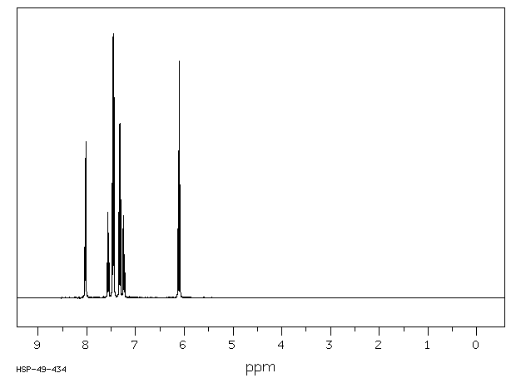

Slide 13
How do I go about figuring out what my unknown is?
From your solubility measurements, you should be able to classify your unknowns according to the solubility classes discussed.
From your solubility measurements and your physical properties, make a list of the possible compounds.
Look up some reference IR spectra in your manual that have the possible functional groups present in your unknown.
Begin to analyze your NMR spectrum using the correlation tables provided.

