Slide 1

Department of Chemistry
University of Missouri-St. Louis
Practice Exam II Chem. 2633
1A. If the boiling temperature of 1,3-diphenylacetone is 330 ° C at 1 atm pressure, at what approximate pressure would you expect it to boil at 280 ° C?
330 320 310 300 290 280
1 .5 .25 .125 0.0625 0.0313*100 kPa = 3.13 kPa
Explain why if the atmospheric pressure above water drops below 4 mm of mercury, the water eventually freezes and then disappears. (Vapor pressure of ice and water at 0 °C = 4 mm)
In the synthesis of methyl salicylate, why was the organic layer washed with water?
Suppose you were asked to determine whether a liquid isolated from a site suspected of arson was an accelerant. What would you do to identify this material based on what you have learned this semester.
E. You take a melting point of your unknown and find that it melts some 10 ° C lower than the value expected for
the compound you believed it to be. What would you do?
F Would you do the same thing if the compound in E above melted 15 ° C higher? Why?

Slide 2
2. A student received an unknown that had a melting point of approximately 130 °C. After looking up all the possible compounds that could be found with a similar melting point, the list of possibilities was narrowed down to the following compounds:
1,4-dinitronaphthalene; 2-amino-4-chloropyridine; 4,4'dimethoxybenzil; benzamide;
1,4,5,8-tetramethylnaphthalene; benzoin; 4-cyclohexylphenol; 2,5-dichlorobenzonitrile
The following solubility test was performed: the compound was not soluble in dilute acid or base; and it had the following infrared spectrum, ¹ H and ¹³ C NMR spectra. What is the most likely structure of the unknown? Show your reasoning.

Slide 3
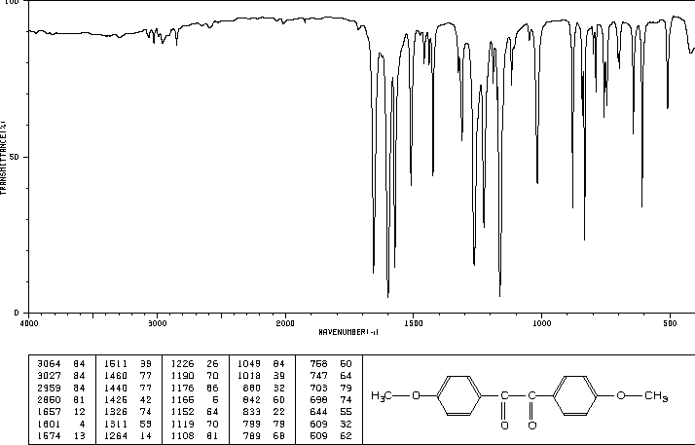
3064 =CH
1674 C=O conj
1601
1574 = aromatic?

Slide 5
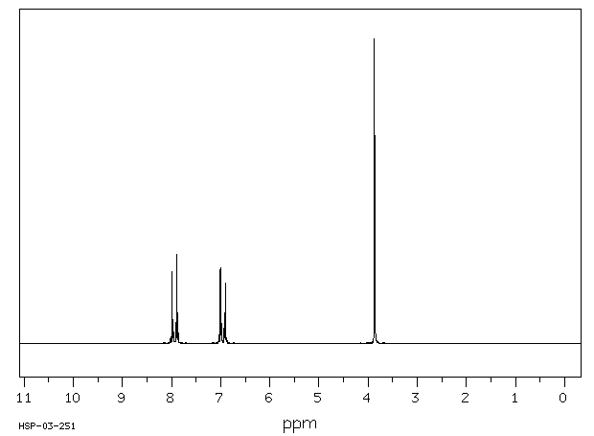
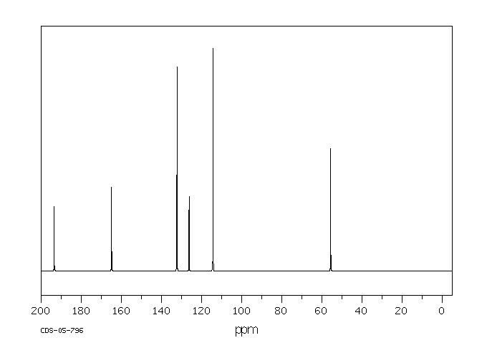
H NMR
area ratio (left to right): 2; 2; 3
7 H must have odd N CH₃CH₂NH₂
area ratio (left to right): 4; 4; 6 14 H
¹³C NMR

Slide 6
(15pts) As some of you may have have experienced, a typical problem associated with the IR spectrometer is
that if you are not careful, you can print a different spectrum than your own. This happened to Iva Problem.
Iva steamed distilled cinnamon and isolated cinnamaldehyde. However, when the spectrum was printed,
it was not clear that the correct spectrum was printed. The spectrum obtained is given below but Iva is not
sure whether this spectrum is the correct one or whether it is one of the other two spectra run by Noel Help
or Kant Bebothered. Noel isolated carvone from carraway and Kant isolated eugenol from cloves.
carvone eugenol cinnamaldehyde

Slide 7
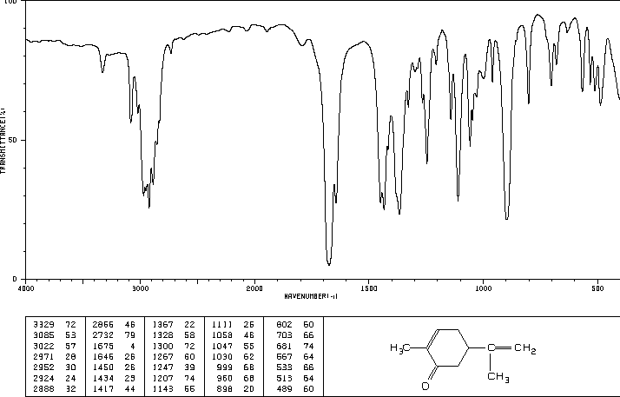
3085 cm⁻¹
1675 cm⁻¹
1646 cm⁻¹

Slide 8
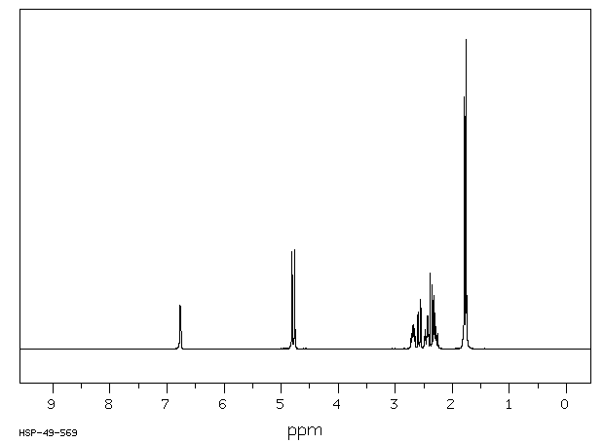
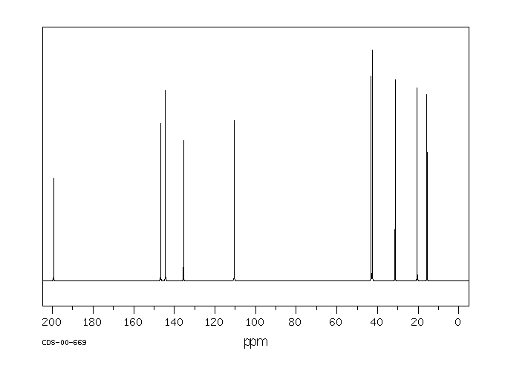
area ratio (left to right): 1; 2; 5; 3; 3
carvone eugenol cinnamaldehyde

