Slide 1

Reduction of Benzil with Sodium Borohydride

Slide 2
Boric acid H₃BO₃
-

Slide 3
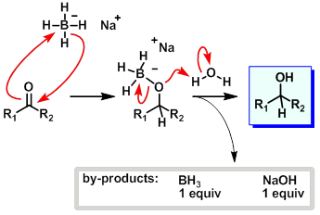
Carbonyl Reduction by Sodium Borohydride

Slide 4
₂⁻
Na⁺ Na⁺
₂⁻
+
H₂O, heat
H₂ + H₃BO₃
+
+
NaBH₂(O₂R) + 4 H₂O Na⁺ B(OH)₄⁻ + R-(OH)₂ + 2H₂

Slide 6
In this experiment you will reduce benzil with sodium borohydide. Unlike previous experiments, this time your product will be a mixture of two diastereoisomers. Both are colorless crystalline solids. Assume you followed the procedure in the book and you started with 0.5 g of benzil and isolated 0.4 g at the end of the procedure. Calculated the overall yield of the mixture.
Since this is a mixture of two compound, suggest a method you have used this semester of determining whether the solid you have isolated is a mixture or not.
An IR spectrum of the meso compound is provided on the next slide. Identify the major functional groups in the molecule

Slide 7
