Slide 1

Laboratory Safety
Techniques for Organic Chemistry 2633

Slide 2
Instructor Information
Dr. James Chickos
Office: B435 (Benton Hall)
Office Phone: 516 - 5377
E-mail: JSC@UMSL.EDU

Slide 3

University Safety Responsibilities
Provide a Safe Lab Environment
Inform you of Potential Hazards
Instruct you in Safe and Proper Procedures

Slide 4

Student Safety Responsibilities
Read all the materials provided and come prepared
Follow all the safety procedures and practices
Wear long pants, closed toe shoes, secure long hair and wear PPE
Notify the instructor immediately if you are injured or observe unsafe working conditions

Slide 5
Personal Protective Equipment
Eye Protection
Safety glasses or goggles must be worn at all times during lab. No Exceptions!
Safety glasses or goggles can be worn over prescription glasses.
Safety goggles are required for procedures that generate mists, aerosols or sprays.

Slide 6
Personal Protective Equipment (PPE)
Hand Protection
Choose the appropriate gloves for the task.
Gloves should be worn whenever there is potential for contact with corrosive or toxic materials.
Gloves should be replaced immediately if punctured or torn.
Remove gloves carefully and immediately wash your hands after handling chemicals.
Watch Video !

Slide 7
Glove Selection
Nitrile and latex gloves are a common choice of disposable glove in the lab.
Glove selection guides can help determine which glove is appropriate for the chemical you are using.
Latex glove allergies can cause mild to severe reactions.
Consider nitrile gloves if symptoms occur.
Notify your lab supervisor if you have a latex allergy
Use heavy, heat resistant gloves for handling hot glassware.

Slide 8

Glove Selection Links
U.S. Department of Energy
ChemRest Glove Directory
Ansell Chemical Resistance Guide

Slide 9
Personal Protective Equipment
Protective Clothing
Skin contact is a potential source of exposure to hazardous materials.
Wear fitted clothing that covers arms and legs.
Lab coats or aprons should be worn when working with toxic, flammable or corrosive chemicals.
Do not wear open toed shoes in the lab, even in the summer.

Slide 10

Practice Good Lab Hygiene
Do not eat or drink in the lab.
Do not apply cosmetics or contact lenses in the lab.
Never taste anything in the lab.
Keep your work area and equipment clean and tidy.
Store backpacks and coats.
Always wash your hands with soap and water as soon as you exit the lab.

Slide 11
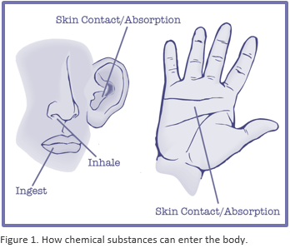
PPE and Good Hygiene Help Protect Common Routes of Exposure
Ingestion
Inhalation of fumes or mists
Open wounds, abraded skin or punctures
Eyes and mucus membranes
Absorbed through the skin

Slide 12

Locate Lab Safety Equipment and Emergency Contact Information
Safety showers
Eye wash stations
First aid kits
Spill kits
Fire extinguisher
Dust pan for cleaning up broken glassware
Emergency contact names and numbers
Campus police for all emergencies 911 or (314)-516-5155
Contact Person: Your instructor

Slide 13

Report any Injuries
Tell the instructor immediately if you are injured in any way during lab.
If the injury requires attention you will be escorted to University Health Services.
If needed, someone will escort you to the nearest medical center.
All injuries require an Incident Report be filed.

Slide 14
Chemical Spills
Report any chemical spill to your instructor immediately.
Do not attempt to clean up a chemical spill by yourself.
For large chemical spills that produce toxic or corrosive fumes, you will be required to exit the lab.
Be sure to notify your instructor if you break a mercury thermometer.

Slide 15
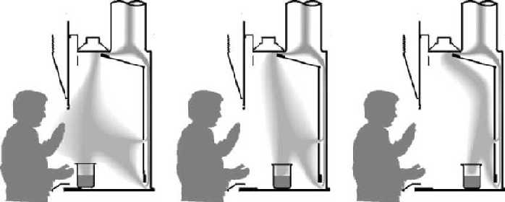
Chemical Fume Hood
Fume hoods should be used for operations which might result in release of toxic chemical, vapors, or dust.
The fume hood should be used at the approved sash height indicated on the front of the hood.
All work should be conducted at least six inches back from the face of the fume hood.
Keep rear baffle openings clear.
Fully close the sash when the hood is not in use.
Watch Video

Slide 16

Lab Equipment and Glassware
Make sure you understand how to use the equipment and glassware you are given.
If you are unsure how to set up an apparatus ask for assistance.
Be sure the vessel you choose has sufficient volume for the reaction.
Never use chipped, cracked, broken glassware or glassware with star patterns in the glass.
Hot glassware and cool glassware look the same.
Do not reach across a steam bath or other heated material. You could be burned.
Be aware of pressure levels in stoppered separatory funnels

Slide 17
Educate Yourself by Reading Chemical Safety Data Sheets
Identify the chemicals you will use in lab.
Chemical SDS are available on line
Note hazard, health, physical data, handling, and spill information.
Familiarize yourself will all the chemical’s names.
Include appropriate safety precautions in your lab write up.

Slide 18

Chemical Safety Data Sheet Vendor Links
Fisher Scientific SDS
Sigma-Aldrich SDS
VWR SDS
Watch SDS Informational Video

Slide 19

Corrosive Chemicals
A corrosive chemical, such as a strong acid or base, is one that causes visible destruction or irreversible alterations of living tissue by chemical action at the site of contact.
They can be in liquid, solid or gaseous form and act on the body tissues by direct contact, inhalation or ingestion.
Liquids are responsible for most corrosive based injuries.

Slide 20

Precautions for Handling Corrosive Chemicals
Wear appropriate PPE.
Follow the handling instructions given by your instructor.
Work in a chemical fume hood as directed.
Take only as much reagent as you need.
Avoid creating splashes.
Report spills to the instructor immediately.

Slide 21

Reactions Involving Acids and Bases are Often Exothermic
Use only heat resistant, dry labware.
Allow for extra volume in reaction vessels to account for potential expansion and/or foaming.
Pre-cool solutions when mixing/reacting may be required.

Slide 22

Flammable Chemicals
Flammable materials can generate sufficient vapors to cause a fire in the presence of an ignition source.
They are categorized based on flash point, the minimum temperature at which a substance gives off vapor in sufficient concentrations to allow the substance to ignite.

Slide 23


Toxic Chemicals
Toxicity relates to the adverse effects a chemical can have on a living system.
Any chemical can result in some toxic effect if a high enough amount (dose) of the substance comes in contact with a living system.
The dose-response relationship for the chemical determines the chemicals level of toxicity.
The Median Lethal Dose or LD50 is the amount of a toxic agent that is sufficient to kill 50 percent of a population of animals usually within a certain time. This value can be found in an SDS.

Slide 24
Acute vs Chronic Toxic Effects
An acutely toxic substance can cause damage as the result of a single, short-duration exposure.
A chronically toxic substance causes damage after repeated or long-duration exposure or causes damage that becomes evident only after a long latency period.

Slide 25
Specific Actions of Toxic Chemicals
Categories of Toxins
Carcinogen
Teratogen
Hepatotoxic
Adverse Health Effects
Causes cancer
Causes birth defect
Causes liver damage
Nephrotoxic
Hematopoietic
Sensitizer
Irritant
Lachrymator
Causes kidney damage
Causes nerve damage
Damages blood cells & bone marrow
Causes allergic reactions
Causes inflammation
Causes eye irritation
Neurotoxic

Slide 26
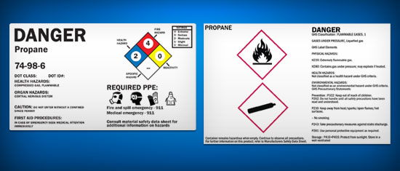
Read Chemical Labels Carefully
Newer chemical labels will have the Globally Harmonized System (GHS) of classification and labelling elements.
Older chemical labels may have the National Fire Protection Association rating diamond.

Slide 27
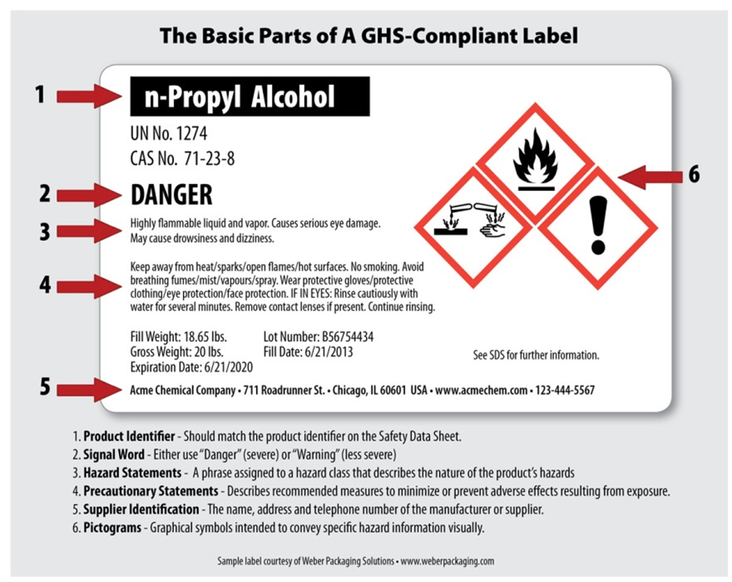
Example GHS Chemical Label
Chemical name
Signal Words: “Danger” or “Warning”
Physical, health or environmental hazard statement
Supplemental information
Supplier information
Hazard Symbols

Slide 28
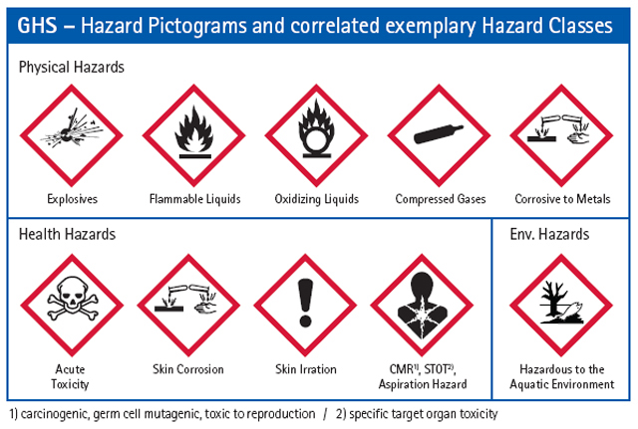

Slide 29
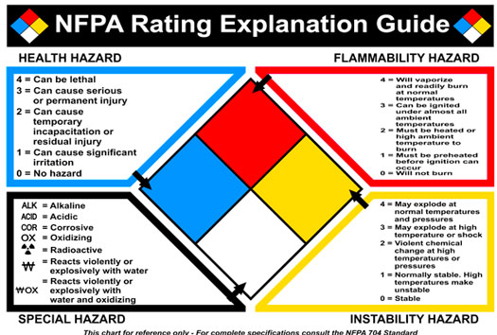

Slide 30
Dichloromethane
Also known as Methylene Chloride.
CAS # 75-09-2
Wear latex gloves.
Symptoms of Exposure
  Skin irritation
  Eye irritation
  Respiratory tract irritation
  Drowsiness
  Dizziness
Notify your instructor immediately if you experience any of the above symptoms.
Commonly selected extraction solvent.
Will be utilized in lab experiments 3, 8, and 9.
Immediately report any symptoms.
Follow all safety guidelines and instructions.

Slide 31

Handling Unknowns
Treat all unknowns as if they are toxic, corrosive, and flammable.
Follow all safety precautions while preforming tests.
Wear your PPE.
Use the chemical fume hood if vapors, aerosols, or mists are likely to be generated.

Slide 32
Unwanted Materials Management
Follow your instructors directions when disposing of unwanted chemicals.
Never pour anything down the sink without express permission from the lab instructor.
Neutralized chemicals must have a pH between 6-9.
Flammable, corrosive, and toxic materials must be placed into the appropriate collection container. Never down the sink.
Do not mix heavy metals with other unwanted chemicals.

Slide 33
Questions?
You can always ask your instructor about any safety concerns you may have.
Feel free to ask questions at any time.
Safety is a top priority at UMSL and we want to make sure we are meeting all your safety needs.

