Slide 1

¹H Nuclear Magnetic Resonance

Slide 2
Gas Chromatograph of Molecular Hydrogen at –100 °C
Thermoconductivity Detector
1
2

Slide 4
H₂ in the presence of certain metals such as Pd

Slide 5
Whats going on?
M
+
Ortho Hydrogen Para Hydrogen
O/P = 1:1 at 80 K

Slide 6
The magnetic moment of a spinning nucleus is colinear with the axis of spin
N
S
For a nucleus with a spin of ±1/2, only two orientations in a magnetic field are allowed

Slide 7

Processional frequency, ν, is proportional to the magnetic field strength, H
      = γ H 1 Hz = 1 cycle/second
For ¹H For ¹³C
At 14,100 Gauss (1.41 Tesla) ν = 60 MHz ν = 14 MHz
At 70,500 Gauss (7.05 Tesla) ν = 300 MHz ν = 70 MHz
At 141000 Gauss (14.1 Tesla) ν = 600 MHz ν = 140 MHz
c = λν; λ= 3*10¹⁰ cm sec⁻¹/600*10⁶ sec⁻¹ = 50 cm

Slide 8
ΔE
Energy difference between the two states
ΔE = hν
0 H →
Magnetic field strength felt by the proton
Summary
If a nucleus experiences a slightly different magnetic field it will precess at a slightly different frequency and absorb at a slightly different frequency (ΔE = hν)

Slide 9
14,100 Gauss 60*10⁶ Hz
60/60*10⁶ = 1/10⁶
141000 Gauss 600*10⁶ Hz
600/600*10⁶ ⁼ 1/10⁶
Since the frequency (cycles/sec) depends on the strength of the magnetic field, chemical shifts are reported relative to a standard, frequently tetramethylsilane (0 ppm).
ν = γ H

Slide 10
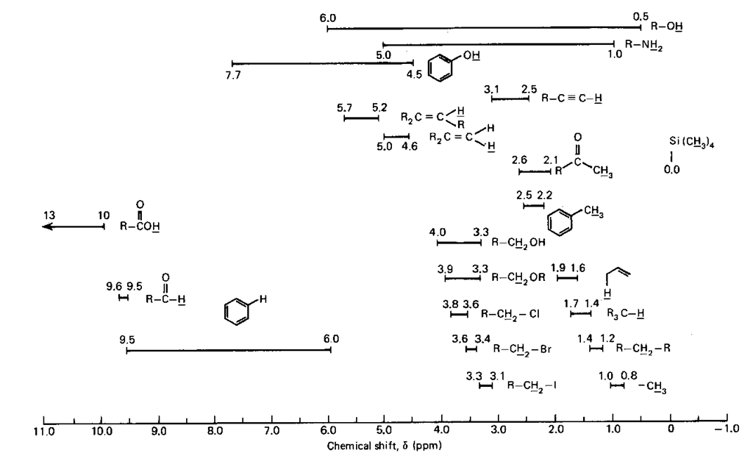
Chemical shifts of different proton enviroments

Slide 11
Information obtained by a NMR spectrum
1. Chemical shift: indicates the type of proton
2. Relative areas: provide a ratio of the number of each type of H nucleus
3. Number of nearest neighbors (first order spectra)

Slide 12
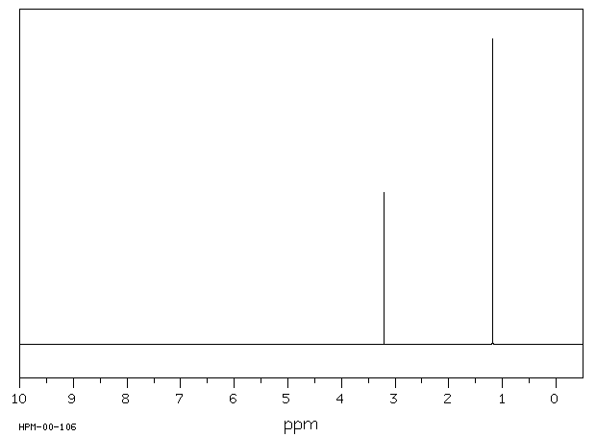
3
1
Figure NMR-2. The NMR spectrum of t-buyl methyl ether

Slide 13
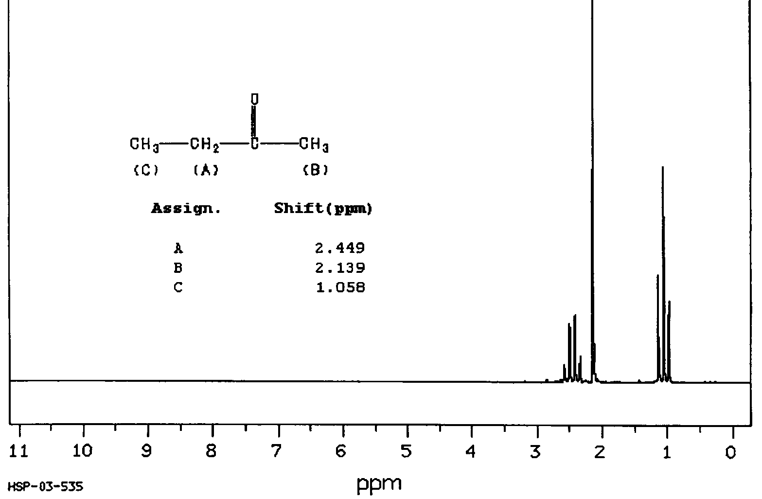
2
3 3

Slide 14
2 3 3
2 1
9
1 3
Why the multiplicity?

Slide 15
Consider the following:
J_{ab}
ν_{a}
If H_{a} has a different chemical shift from H_{b}, roughly 50% of the nuclei of H_{b} will have one orientation of their magnetic moment and the other will have just the opposite
The total field felt by H_{a} will be due to the external field, the local field due to electronic environment and the field due to the proton(s) three bonds removed. The field due to the local proton will either add or subtract to the total field experience by H_{a}. Roughly 50% will have a neighbor with a and 50 % with a neighbor resulting in two lines observed for H_{a}
J_{ab} is called the coupling constant
With two identical neighbors:
J_{ab}
ν_{a}

Slide 16
all J_{ab}
With three identical neighbors:
n+1 rule = number of lines observed equals the number of nearest Hb neighbors + 1

Slide 17
1 1
1 2 1
1 3 3 1
1 4 6 4 1
1 5 10 10 5 1
1 6 15 20 15 6 1
1 neighbor
2 identical neighbors
3 identical neighbors
4 identical neighbors
5 identical neighbors
6 identical neighbors
neighbors are identical in the sense that the coupling constants are the same or very similar

Slide 18
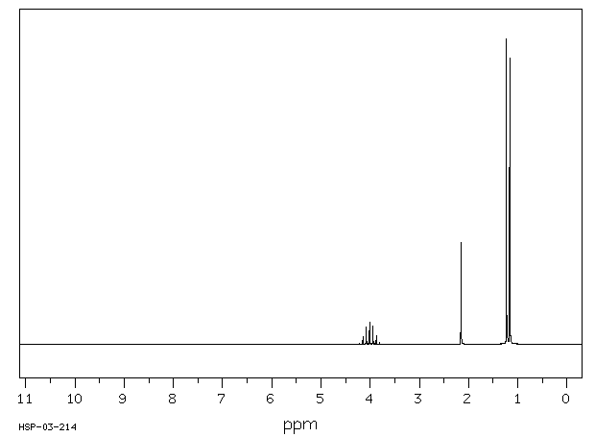
4.0
1 1 6

Slide 19

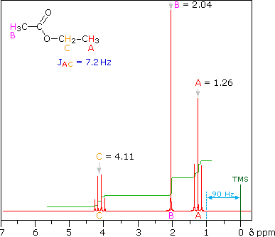
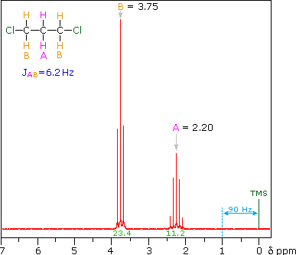
2 3 3 2 1

Slide 20
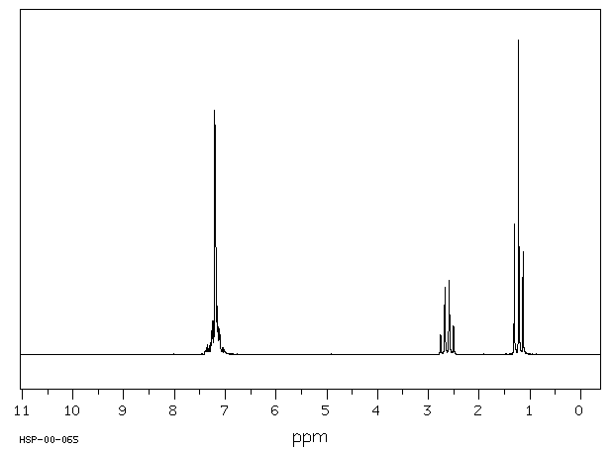
5 2 3

Slide 21
One Criterium for First Order Spectra
The chemical shift difference
between the hydrogens that are
coupled to each other is greater
than 10 times the magnitude
of the coupling constant.
Freq in Hz (cps)
X-CH₂CHY₂

