Slide 1

Virtual Chem 2633
Experiment 9: Preparation of Methyl Salicyclate

Slide 2
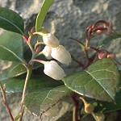
Oil of Wintergreen
Wintergreen (methyl salicylate) Gaultheria procumbens This tiny, North American
plant of the heath family grows in pine forests and on humid ground with sphagnum.
The Indians knew its effects, which is due to methyl salicylate. Like salicylic acid,
it is analgesic and antipyretic.
*bottle

Slide 3
H₂SO₄
Gentle reflux
Salicyclic acid 10 g
H₂SO₄ 10 mL (conc)
CH₃OH 25 mL density 0.8g/mL

Slide 4
Procedure
The reagents are mixed in a round bottom flask
The reaction is heated to reflux

Slide 5
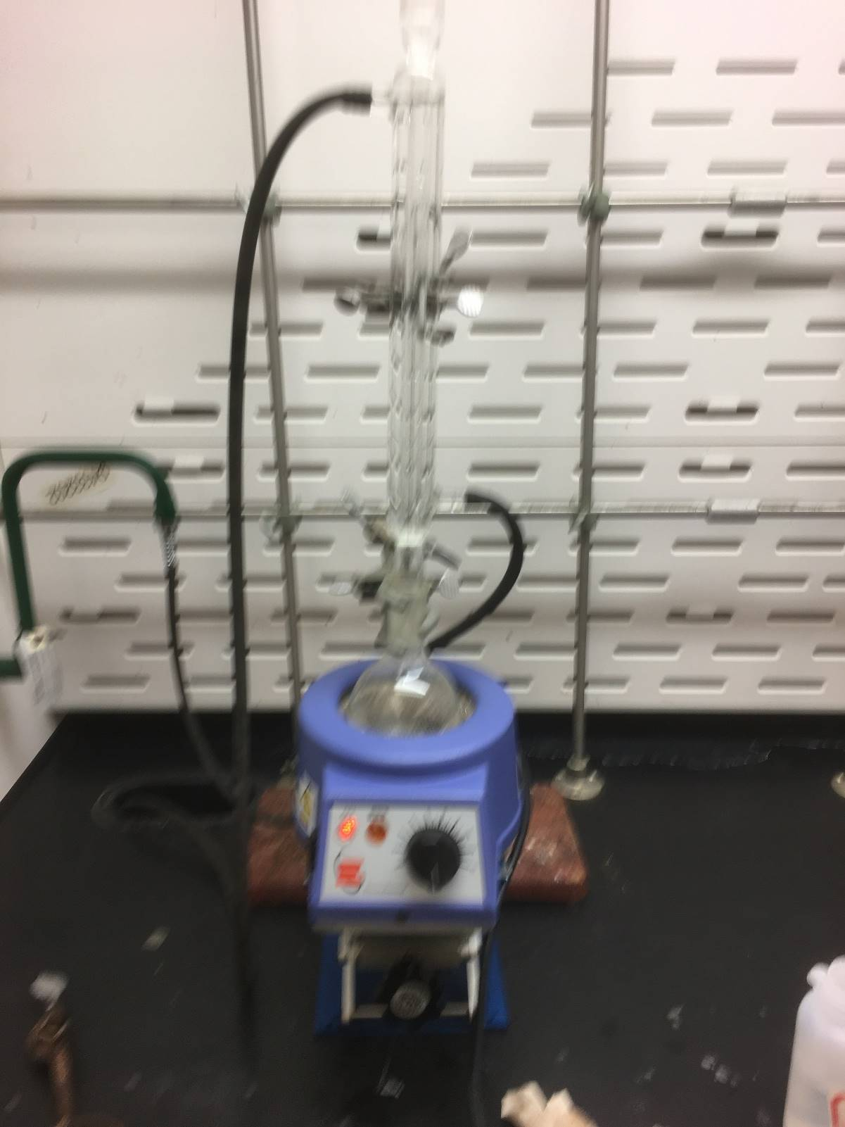
Experimental setup:
total reflux

Slide 6
Separatory funnel
After 1 hour the reaction is cooled and water is added; the layers are separated and the organic layer is washed with NaHCO₃ and separated.
The organic layer is dried over anhydrous MgSO₄ or anhydrous Na₂SO₄.
The organic layer is vacuum distilled.
H₂O
CH₂Cl₂
Water: density 1.0 g/mL
CH₂Cl₂: density 1.34 g/ mL

Slide 7
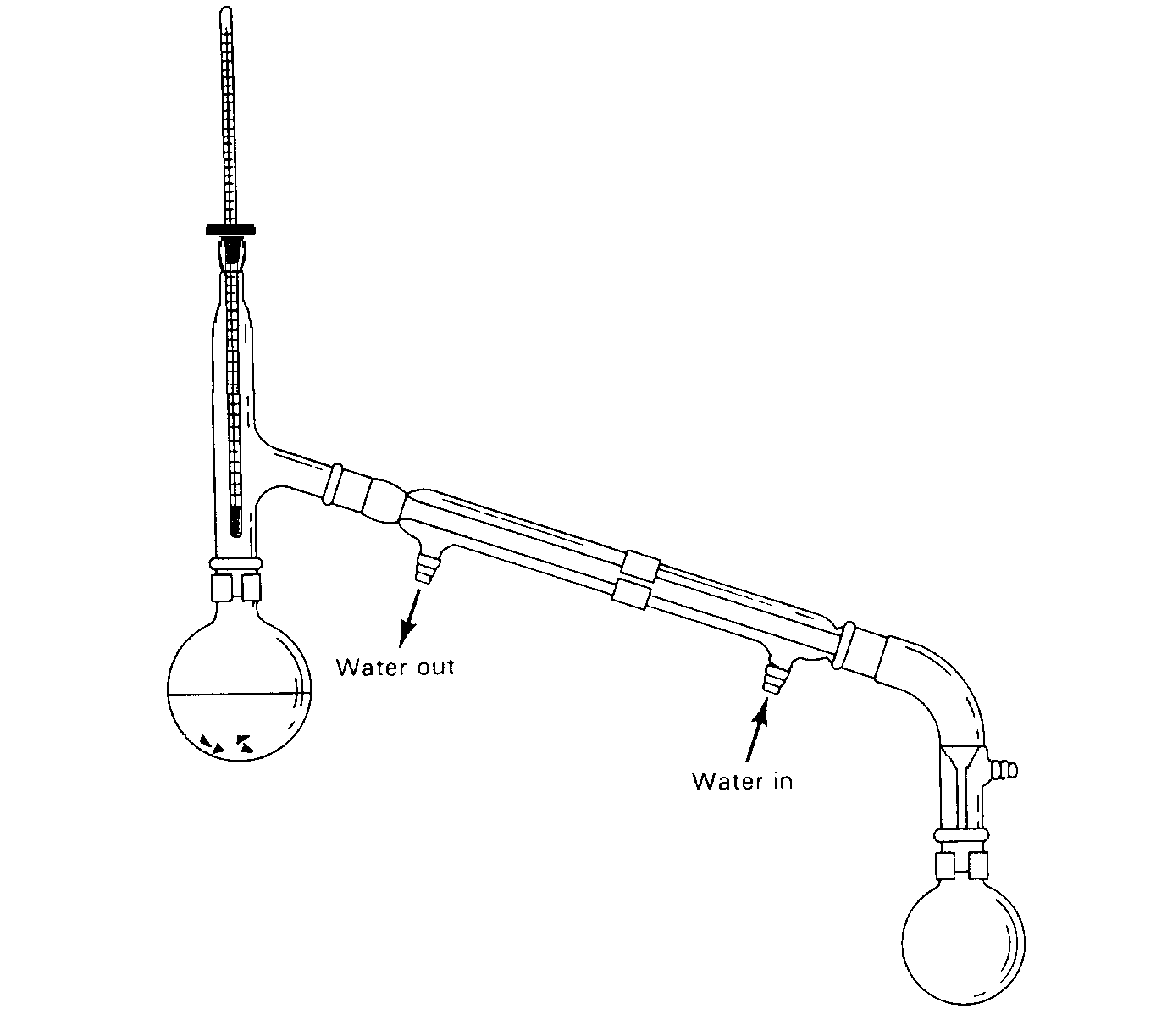
Methyl salicylate BP 220 C

Slide 8
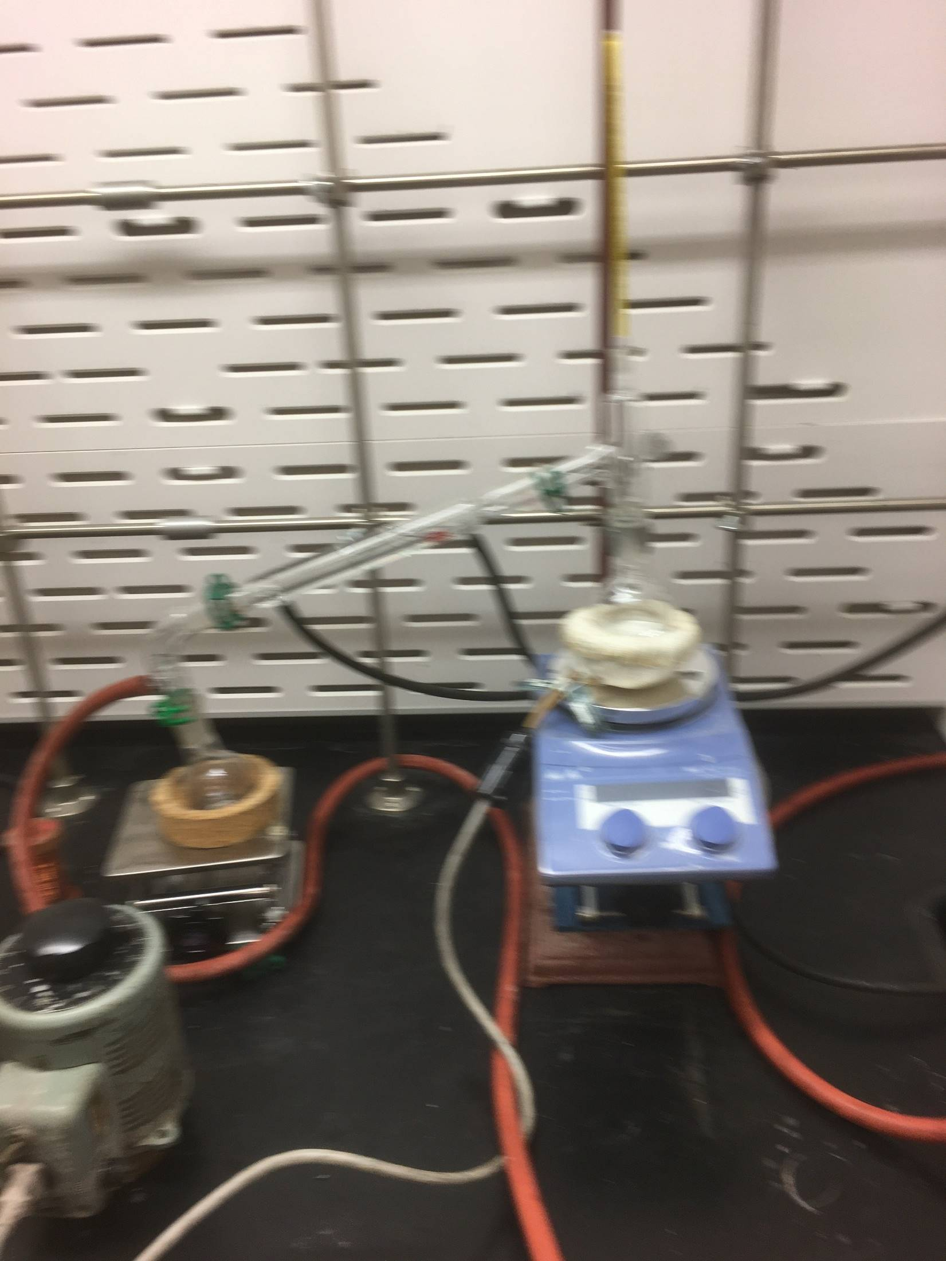

Slide 9
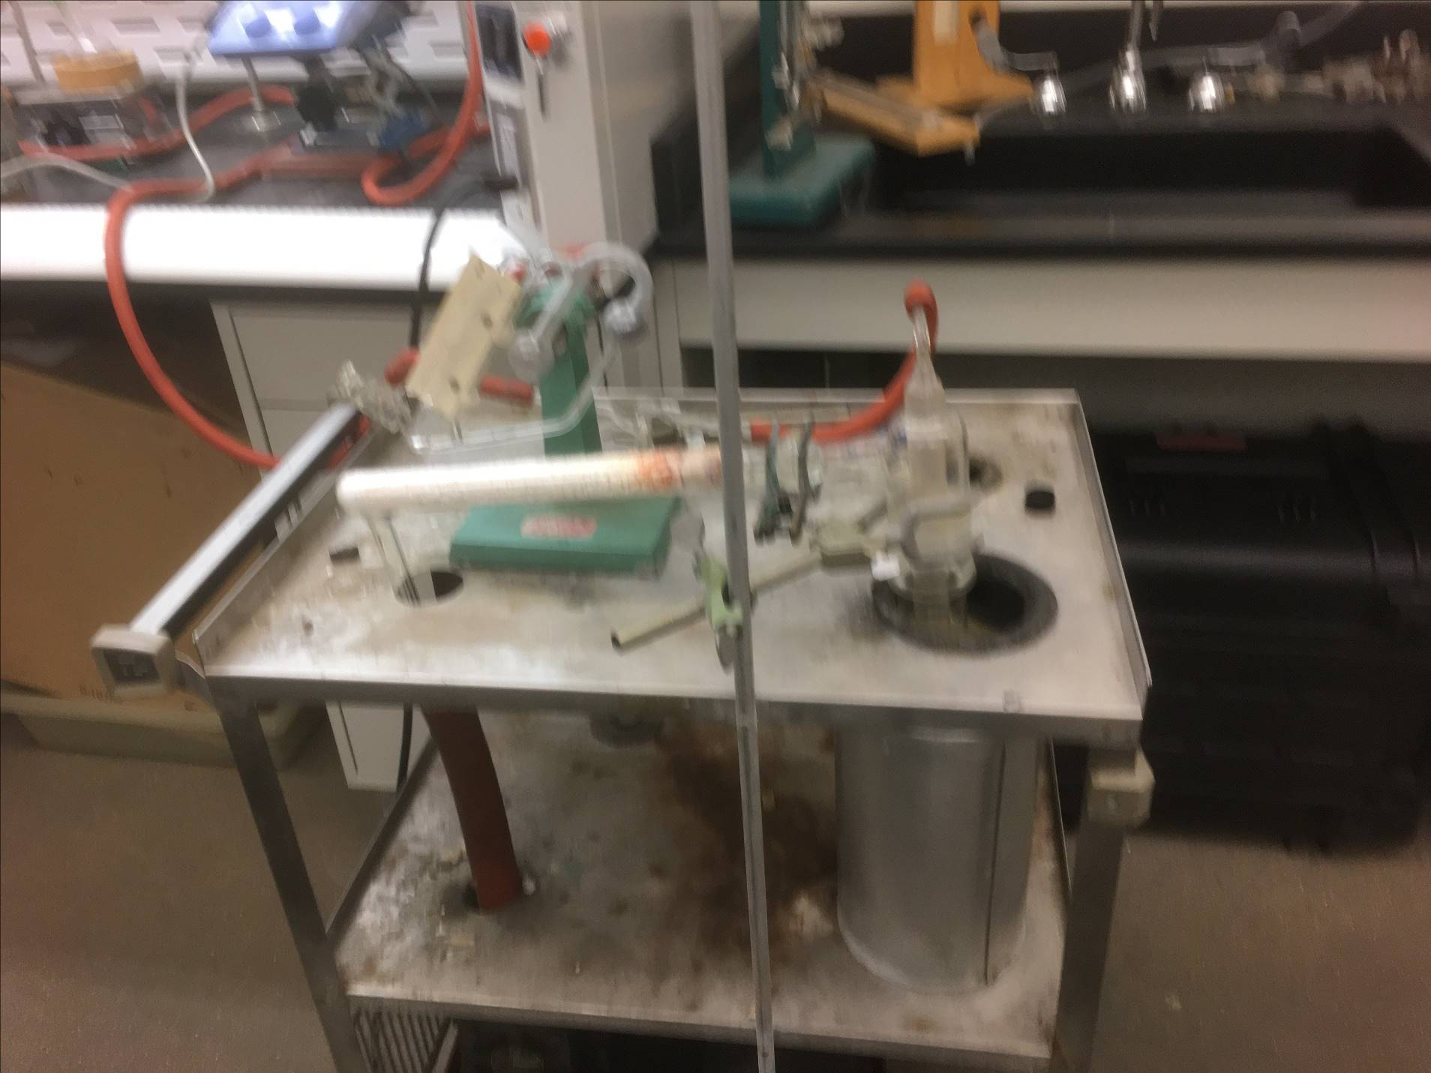
.

Slide 10
Vacuum Distillation
BP 222 °C at 100 kPa
760 mm = 100 kPa
At what temperature will it boil
at 10 kPa?
P/mm | T/ C
760 | 220
380 | 210
190 | 200
95 | 190
48 | 180
24 | 170
12 | 160
6 | 150
3 | 140
Rule of thumb: BP decreases
by 10 °C each time the atm
pressure decreases by ½.

Slide 11
Boiling Point
at pressure
Pressure (mm)
1 atm=760 mm;
Boiling Point
at 1 atm
(760 mm)

Slide 12
A nomographis a devise used to predict possible boiling temperatures. To use it you position a ruler at the pressure of your vacuum distillation (curve at the far right) over the normal boiling point (220 C for methyl salicylate). Where the ruler intersects the line on the far left is the approximate boiling temperature at the pressure of your vacuum.
As an example, distilling methyl salicyclate at 10mm pressure the nomograph predicts a boiling temperature of about 70 C. The experimental value at about 3 mm was 60 C. The nomograph doesn’t extend low enough to use for a compound boiling at 220 C. It is used for higher boiling compounds.
When would vacuum distillation be advantageous to use?

Slide 13
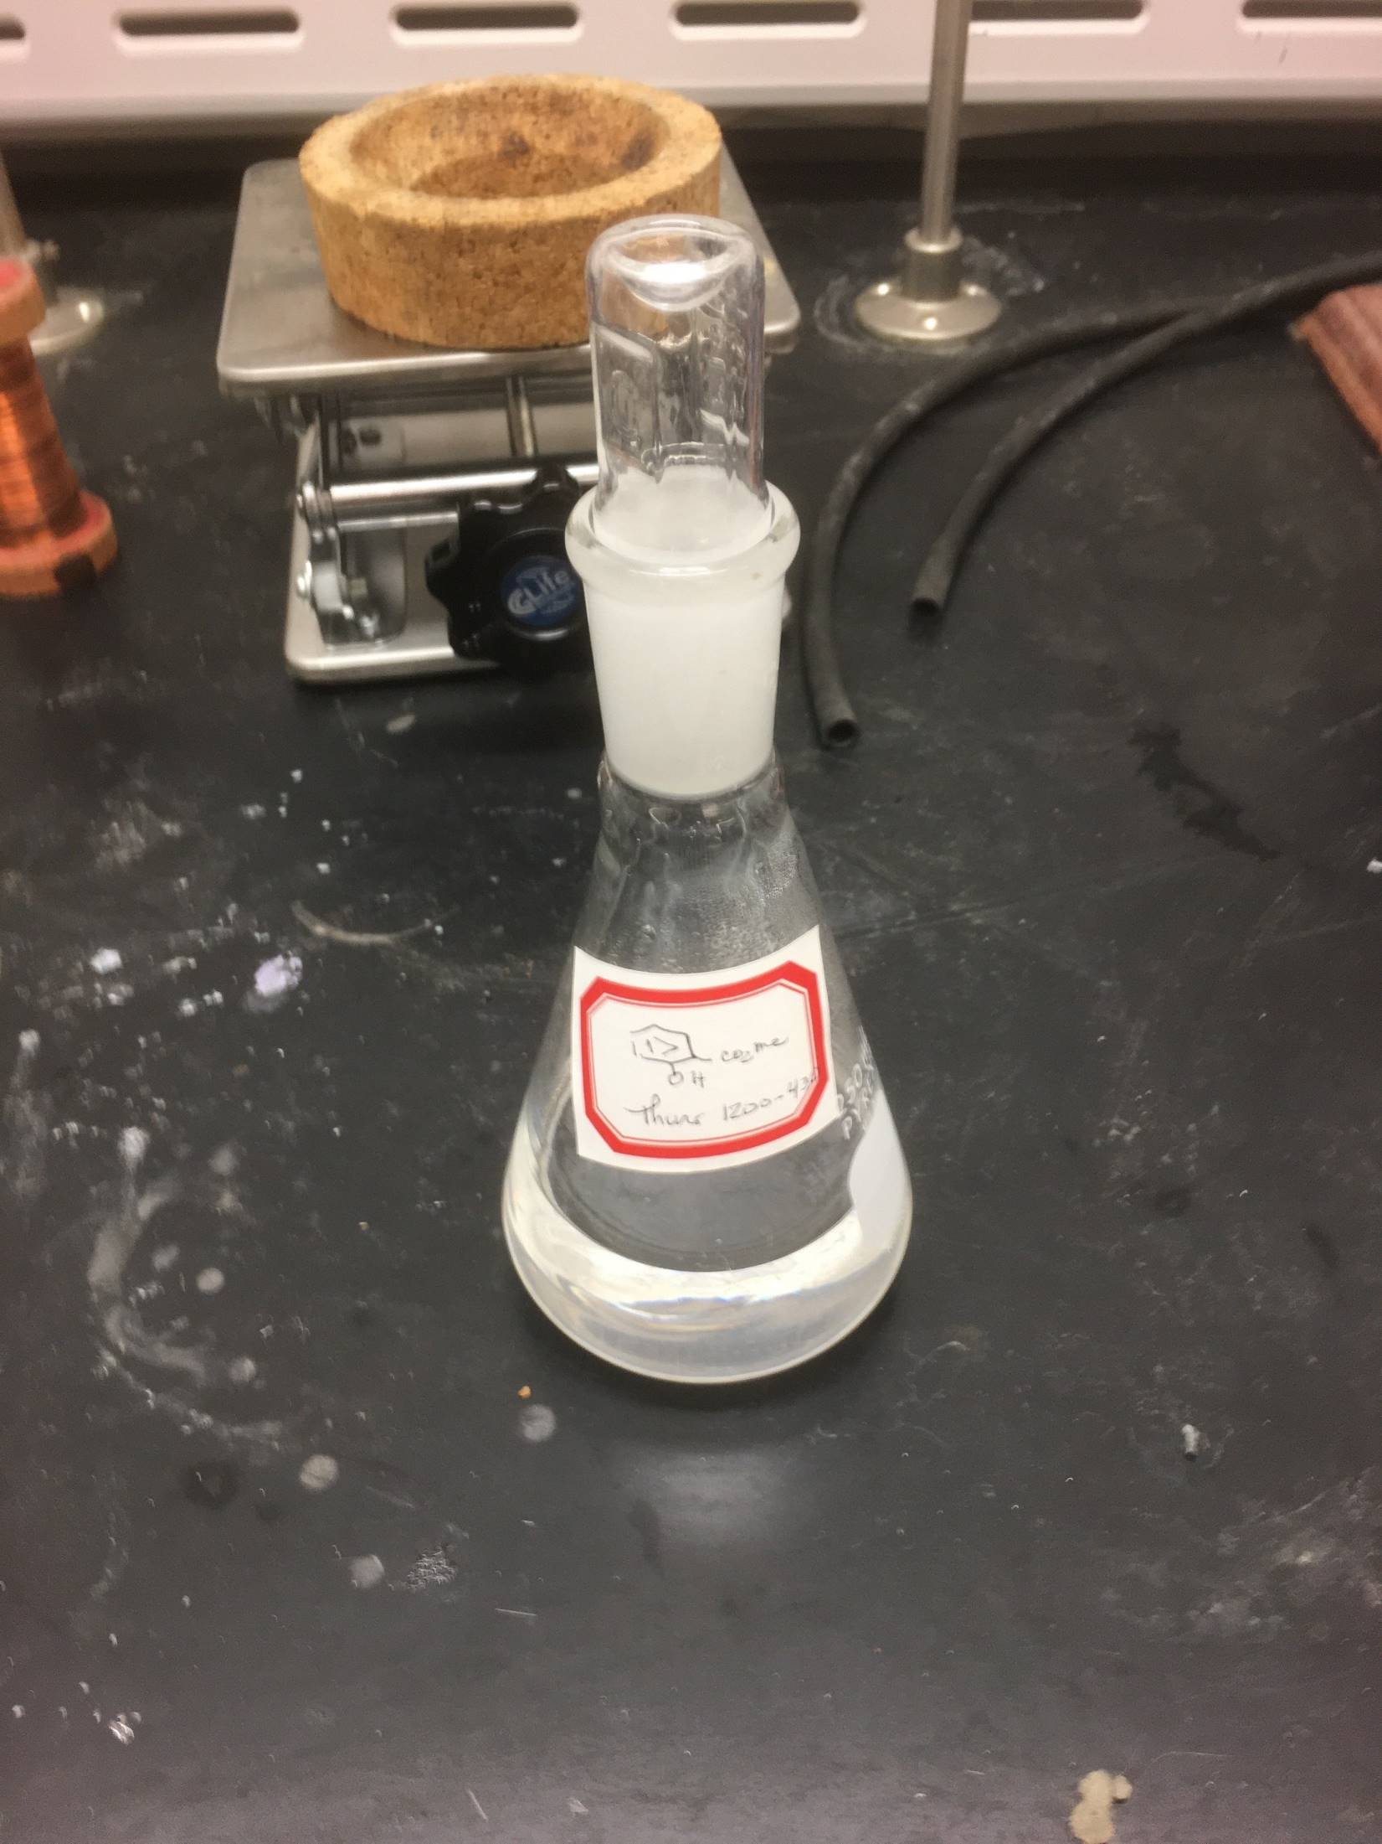
This is your final product. Too bad you can’t smell; its wonderful
We just determined its mass. From 10 g starting material. 8 g were isolated. Please enter the following in your notebook just as if you had performed the experiment.

Slide 14
A balanced equation:
The mols of each reagent used:
What is the limiting reagent?
Calculate the theoretical yield:
What is the % yield.
The infrared spectrum of methyl salicyclate is on the next slide
Identify the major functional groups in the molecule. The functional groups to include are those we have discussed in class and those that will be included in future powerpoint presentations.

Slide 15
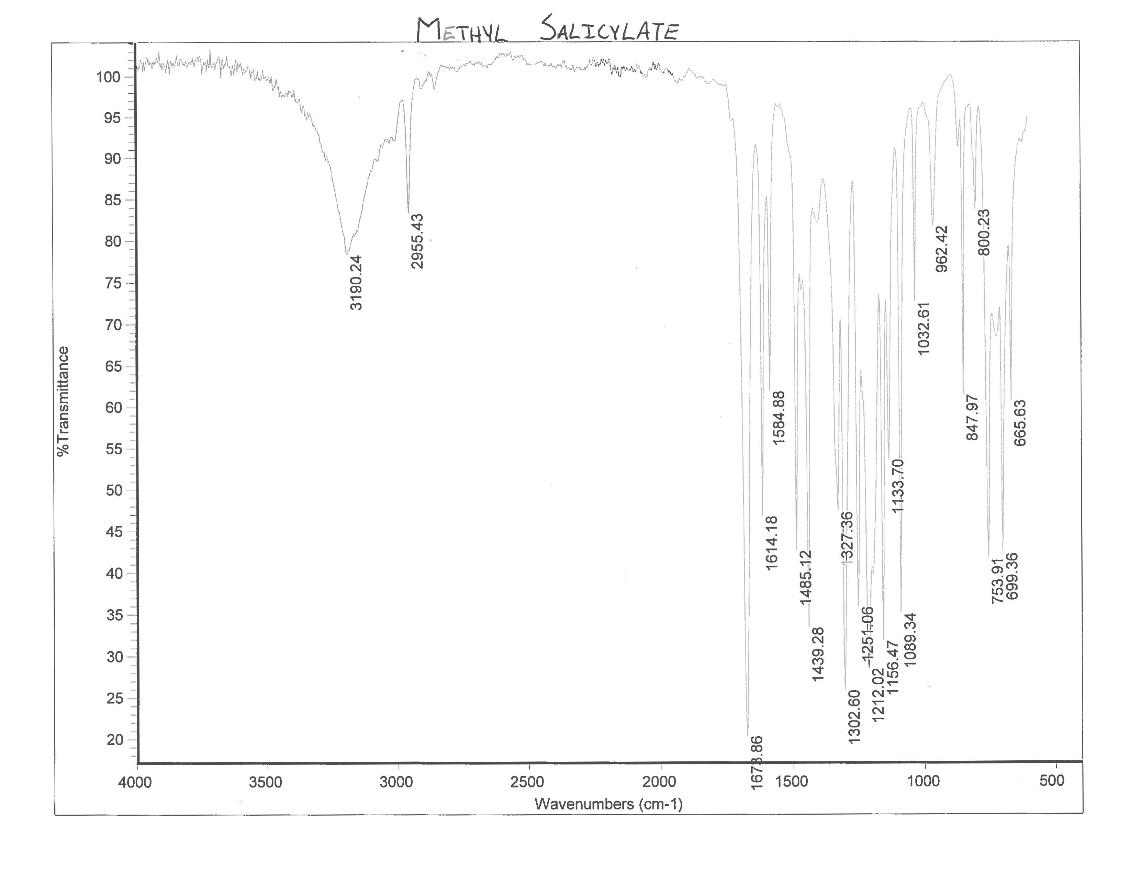

Slide 16
At this point you should go to the powerpoint file dealing with infrared spectroscopy

