Slide 1

Experiment 10: Multistep synthesis Part 2
Oxidation of benzoin to benzil

Slide 2
Run the reaction in the hood on a water bath (~95 °C)
Recrystallize from 95 % ethanol and add a few drops of water
Be sure that the benzil doesn’t oil out first

Slide 3
HNO₃ + C₁₄H₁₂O₂ C₁₄H₁₀O₂ + NO₂ + H₂O
C₁₄H₁₂O₂ C₁₄ ⁻⁸
C₁₄H₁₀O₂ C₁₄ ⁻⁶
+ 2e⁻
HNO₃ N⁺⁵
+1e⁻
NO₂ N⁺⁴
C₁₄H₁₂O₂
C₁₄H₁₀O₂
+ 2e⁻
2 HNO₃
+ 2 e⁻
2 NO₂
2HNO₃ + C₁₄H₁₂O₂ C₁₄H₁₀O₂ + 2NO₂ + 4H⁺ + 2 O⁻²
2HNO₃ + C₁₄H₁₂O₂ C₁₄H₁₀O₂ + 2NO₂ + 2H₂O

Slide 4
Recrystallization of benzil: be sure that the benzil does not oil out first before solidifying. When a material oils out, any inpurites will also dissolve in the oil and subsequently when everything solidifies, your material will remain impure.

Slide 5
Calculation of yields:
If 5 g of benzaldehyde affords 4 g of benzoin, what is the yield?
If 2 g of benzoin affords 1.8 g of benzil, what is the yield?
What is the overall yield benzaldehyde to benzil?

Slide 6
benzaldehyde: 5 g/106 0.047 mol
one mol benzaldehyde yield ½ mol benzoin
0.047mol benzaldehyde yields 0.047/2 mol benzoin
0.047/2mol benzoin * 212 g/mol = 5 g theoretical yield
Actual yield = 4/5*100 = 80%
benzoin 2g/212 = 0.0094 mol;
0.0094 mol *210g/mol =1.98 benzil; theoretical yield
1.8 g/1.98g*100 = 91% actual yield
Overall yield = 0.91*0.8*100 = 72.7%

Slide 7
Assignment for this week
Lets assume you ran the benzoin condensation starting with 6 g of benzaldehyde and you isolated 4.4 g of benzoin in the first step
Then you took 2.1 g of benzoin and you oxidized it with concentrated nitric acid. After workup and recrystallization you ended up with 1.8 g of benzil.
What is the yield of benzoin in the first step?
What is the yield of benzil in the second step?
What is the overall yield starting from benzaldehyde?
The infrared spectrum of you benzil is given on the next overhead; identify the major functional groups in the molecule

Slide 8
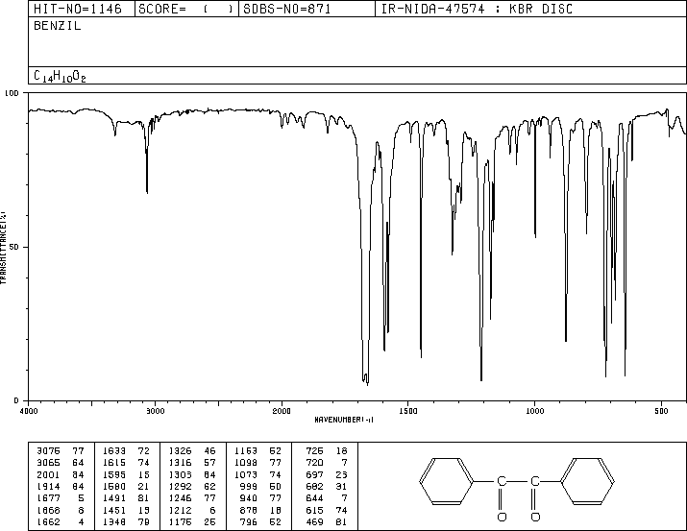

Slide 9
What information can we deduce from this spectrum?
neat liquid

Slide 10
What information can we deduce from this spectrum?
KBr disk

Slide 11
neat liquid

