Slide 1

Extracting Structural Information from IR Specta

Slide 2
What information can we deduce from this spectrum?
freq > 3000 cm⁻¹ sp² C
freq < 3000 cm⁻¹ sp³ C
1700 cm⁻¹ C=O conj
4) ∼1600 cm⁻¹ C=C
neat liquid

Slide 3
What information can we deduce from this spectrum?
3400-2200 cm⁻¹ -OH
1700 cm⁻¹ C=O
∼1600 (2 bands )
C=C, benzene ring
Carboxylic acid
34
KBr disk

Slide 4
1) 3300 cm⁻¹ sp H-C≡
2) freq > 3000 cm⁻¹ sp² C
3) 2120 cm⁻¹ C≡C
4) ∼1600 (2 bands C=C, benzene ring
neat liquid

Slide 5
Structural Information from IR Specta and NMR Spectra

Slide 6
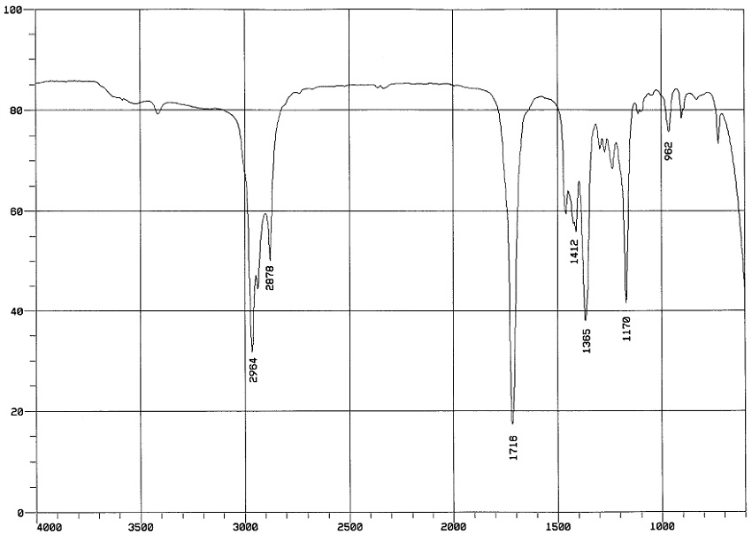
C₅H₁₀O
All aliphatic hydrogens
1718cm-1 carbonyl group; likely a ketone

Slide 7
Degrees of unsaturation C₅H₁₀O
To determine the degrees of unsaturation, draw any acyclic molecule with the same number of carbons and oxygens and any other elements present. Then add enough hydrogens to give each carbon 4 bonds, oxygen two bond and nitrogen 3 bonds. For a C₅H₁₀O molecule:
CH₃CH₂ CH₂CH₂CH₂OH
Count the number of hydrogen in the molecule you have drawn, 12, subtract from this the number of hydrogen in your unknown. 10, and divide by 2. The result 1; the carbonyl group

Slide 8
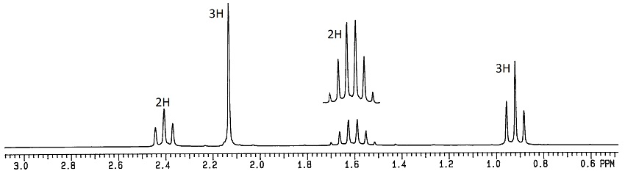
C₅H₁₀O

Slide 10
CH₃C=O
C₅H₁₀O
CH₂CH₂CH₃

Slide 11
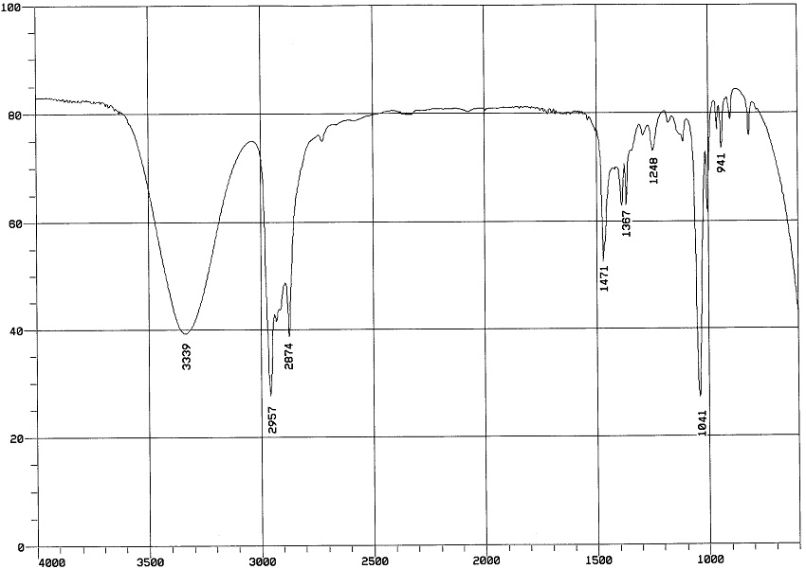
C₄H₁₀O
Aliphatic molecule
alcohol

Slide 12
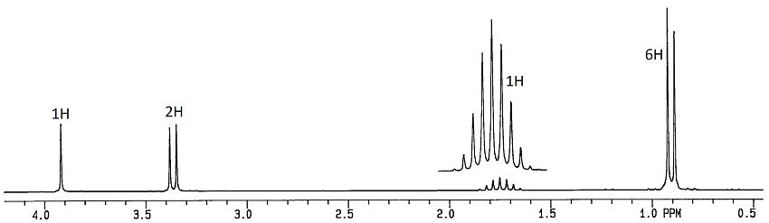
C₄H₁₀O
CH₂OH

Slide 13
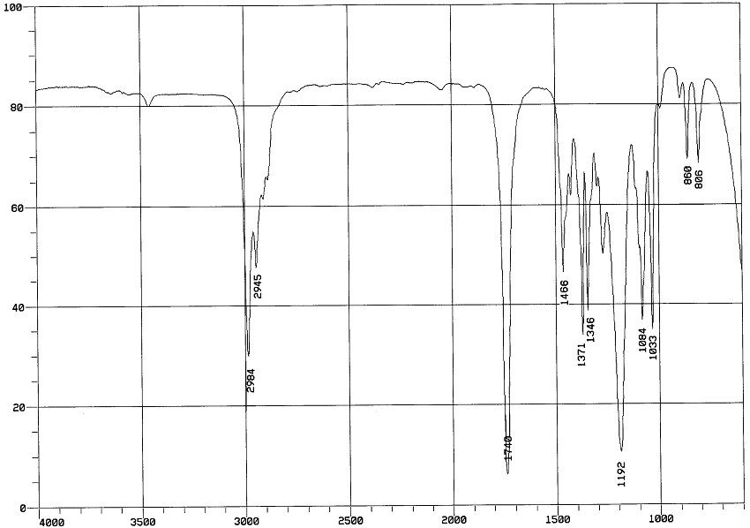
C₅H₁₀O₂
HOCH₂CH₂CH₂CH₂CH₂OH
C₅H₁₂O₂
1 degee of unsaturation

Slide 14
C₅H₁₀O₂
1740 cm⁻¹
Saturated Ester
-CO₂- ; C₄H₁₀ left

Slide 15
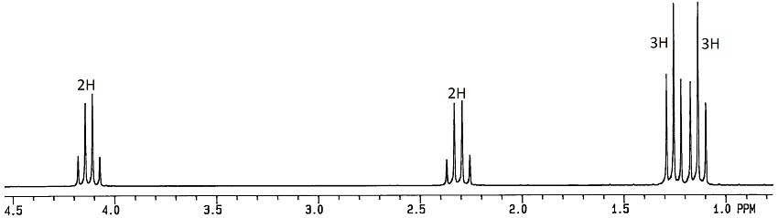
Looks like two different ethyl groups
C₅H₁₀O₂
CH₃CH₂CO₂CH₂CH₃

Slide 16
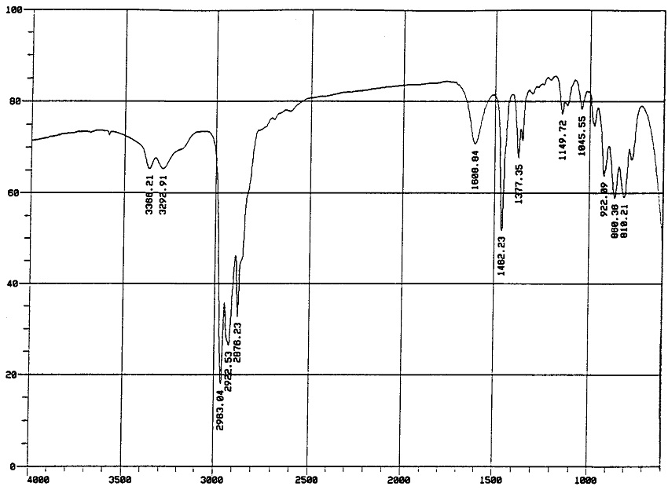
C₅H₁₃N
CH₃CH₂CH₂CH₂CH₂NH₂
R-NH₂

Slide 17
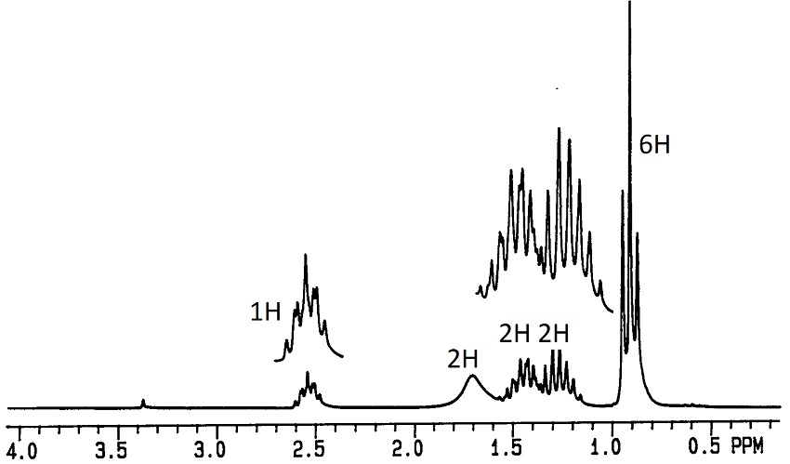
C₅H₁₃N CH₃CH₂CH₂CH₂CH₂NH₂
R₁R₂CHNH₂
R₁ + R₂ = C₄H₁₀
CH₃CHCH₂CH₂CH₃
NH₂
CH₃CH₂CHCH₂CH₃
NH₂

Slide 18
CH₃CH₂CH-CH₂CH₃
NH₂
Are the two hydrogens the same?

