Slide 1

¹³C Nuclear Magnetic Resonance Part 2

Slide 2
Information obtained by a NMR spectrum
1. Chemical shift: indicates the type of proton
2. Relative areas: provide a ratio of the number of each type of H nucleus
3. Number of nearest neighbors (first order spectra)
First order spectra and the n+1 rule
More complex spectra
Criteria for first order specta
The chemical shift in Hz is ten times greater than the coupling constant
Coupling constants are due to the magnetic moment of the proton and are seldom greater than 20 Hz

Slide 3
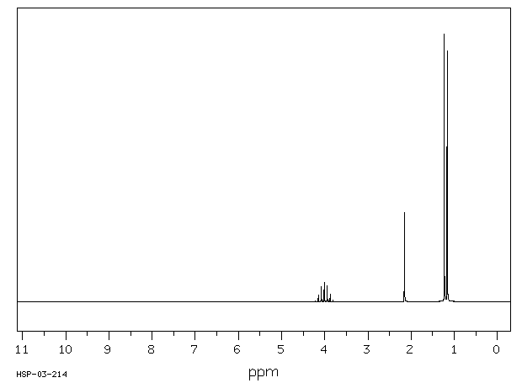

Slide 5
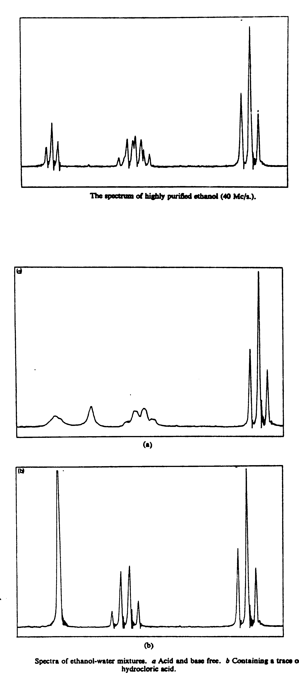
Dynamic Effects in NMR
CH₃CH₂OH
1 2 3
8 lines

Slide 6
¹³C Carbon NMR

Slide 7
¹³ C NMR: natural abundance of 1%, spin of ½ (like hydrogen)
The probability of finding 2 ¹³ C atoms next to each other is 0.01² or 10⁻⁴
Hydrogen and carbon do couple to each other. However because the amount of ¹³ C is so small, spectra are generally decoupled during aquisition. This is done by irradiating all the hydrogens and causing them to rapidly change their spin orientation. It is somewhat analogous to the decoupling observed in alcohols where the hydrogens three bonds removed are decoupled to an OH hydrogen due to rapid chemical exchange
Information from ¹³C spectra
Number of chemically different carbons
Chemical shift information: the chemical environment of the carbon

Slide 8
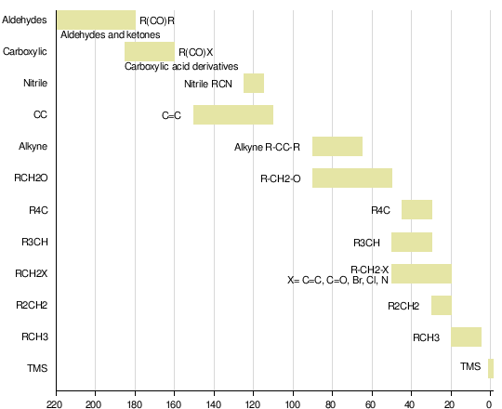
¹³ C NMR Chemical Shifts
carbon environment chemical shift (ppm)
C=O (in ketones) 205 - 220
C=O (in aldehydes) 190 - 200
C=O (in acids and esters) 170 - 185
C in aromatic rings 125 - 150
C=C (in alkenes) 115 - 140
RCH₂OH 50 - 65
RCH₂Cl 40 - 45
RCH₂NH₂ 37 - 45
R₃CH 25 - 35
CH₃CO- 20 - 30
R₂CH₂ 16 - 25
RCH₃ 1
Information from ¹³ C NMR
Carbon count
Chemical Shift

Slide 9
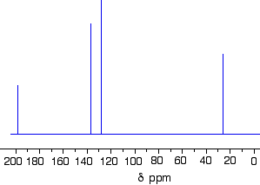
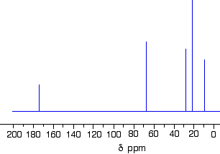
CH₂=CH-CO-CH₃

Slide 10
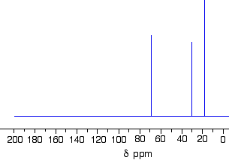
Which of the following alcohols produced the ¹³ C NMR spectrum below?

Slide 11
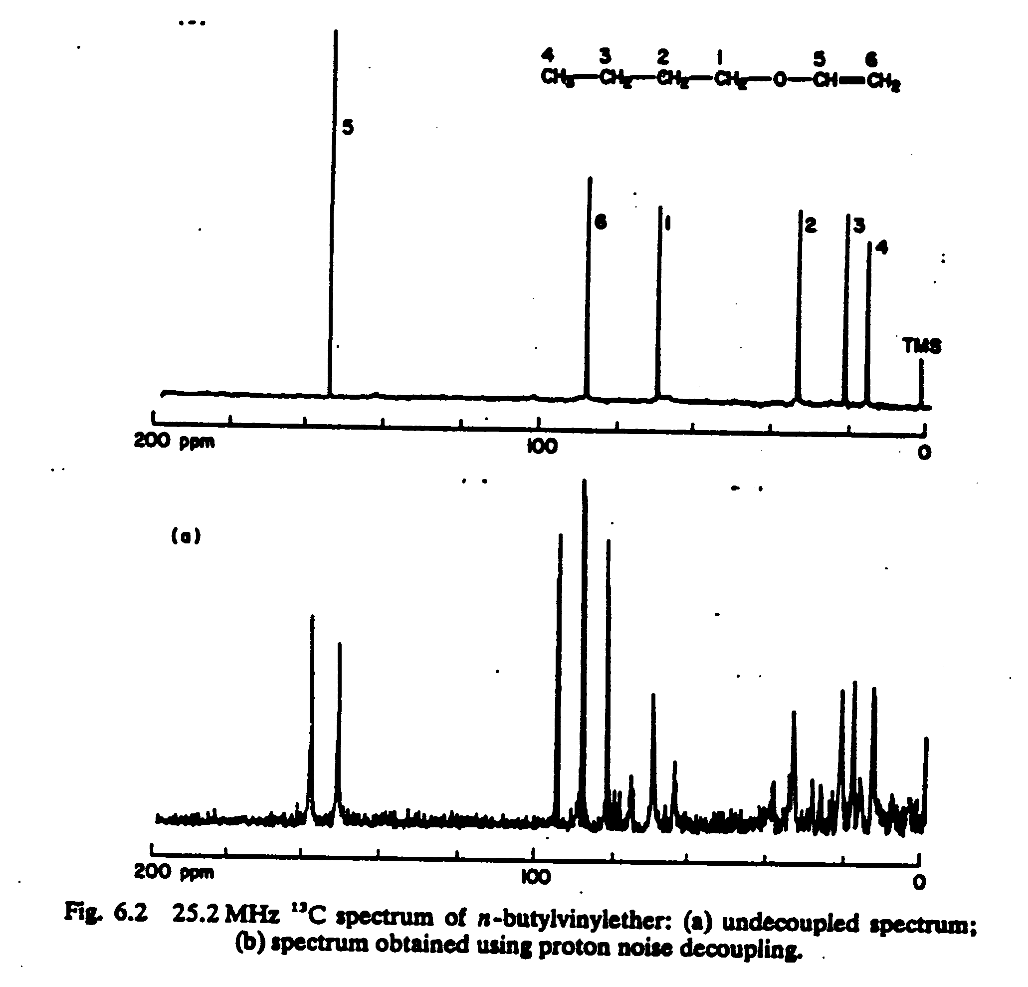

Slide 12
Common NMR solvent: CDCl₃; CCl₄, CD₃SOCD₃; C₆D₆; CD₃COCD_{3; ;} D₂O
Deuterium ²H also has a spin; it has three orientation in a magnetic field
CDCl₃
Solvent Formula H-NMR shift* C-NMR shift multiplet
Chloroform-d CDCl₃ 7.24 (singlet) 77.0 triplet
Carbon tetrachloride CCl₄ 96.7 triplet
Dimethylsulfoxide-d₆ CD₃SOCD₃ 2.49 (pentet) 39.7 septet
Benzene-d₆ C₆D₆ 7.2 (singlet) 128.0 triplet
Acetone-d₆ CD₃COCD₃ 2.04 (pentet) 29.8 septet
Water-d₂ D₂O 4.65 (singlet)
*The H-NMR peak is due to a residual amount of ¹H in the deuterated solvent and is small

Slide 13
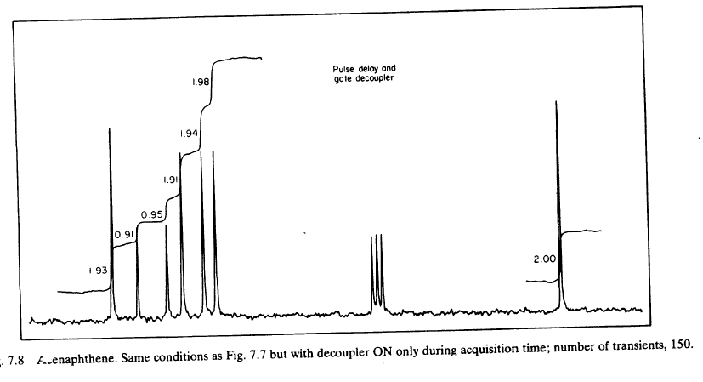
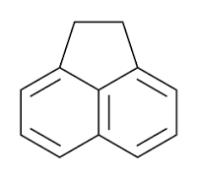
An example of the effect of solvent on a spectrum
¹³ C NMR
CDCl₃
CDCl₃

