Slide 1

Infrared Spectroscopy
This Powerpoint presentation summarizes what we have covered previously in class and contains a few additional functional groups and factors that influence the frequencies of these groups. A more detailed description is covered in the Manual beginning on pg 68.
Additional spectra for familiarizing yourself with IR is provided on my webpage as is a summary of principle infrared bands.
To access this summary click on “IR Frequencies” The frequencies listed are generally for functional groups attached to alkyl groups. Examples for the effects of conjugation and other factors are provided on the second page for the interested reader. The figure numbers refer to spectra found under “IR spectra” on my web page.

Slide 2
n decane
sp³ hybridized CH < 3000 cm⁻¹

Slide 3
sp³ hybridized CH < 3000 cm⁻¹
sp² hybridized CH > 3000 cm⁻¹
C=C 1600 cm⁻¹
Aromatic ring ∼1600 cm⁻¹

Slide 4
sp² hybridized CH > 3000 cm⁻¹
C=C 1600 cm⁻¹
Aromatic ring ∼1600 cm⁻¹
sp hybridized C-H 3300 cm⁻¹
C≡C ∼ 2120 cm⁻¹

Slide 5
CH₃CH₂CH₂CH₂CH₂CH₂OH
-OH no hydrogen bonding ∼ 3600 cm⁻¹
-OH hydrogen bondedg ∼ 3400 cm⁻¹ broad band

Slide 7
The Carbonyl Group
Aldehydes RCH=O
Ketones R₁R₂C=O
Carboxylic acids RC=OOH
Esters R-C=OOR

Slide 8
CH₃CH₂CH₂CHO
-CH=O 2750, 2850 cm⁻¹
C=O ∼1720 cm⁻¹

Slide 9
-CH=O ∼2850 2750, cm⁻¹ -C=O ∼1700 cm⁻¹

Slide 10
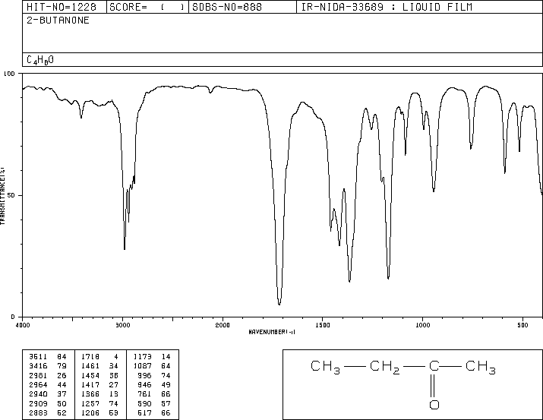

Slide 11
Ethyl vinyl ketone, neat liquid

Slide 12
Decanoic acid, neat liquid, thin film: CH₃(CH₂)₈CO₂H

Slide 13
Benzoic acid

Slide 14
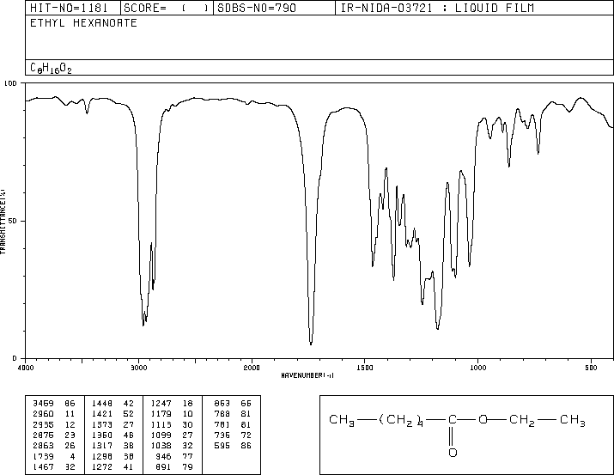

Slide 15
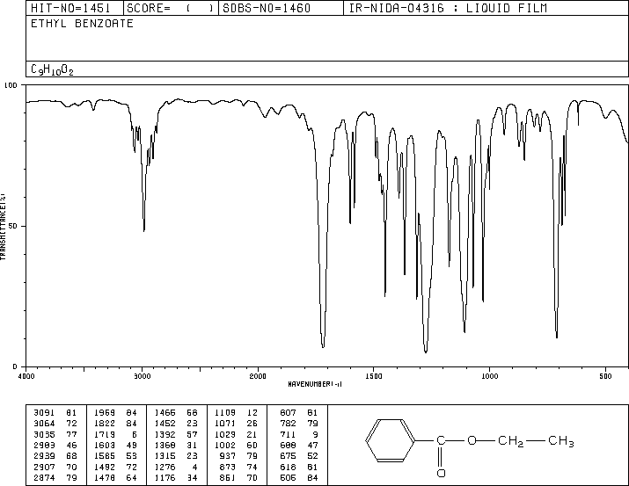
1713 cm⁻¹

Slide 16
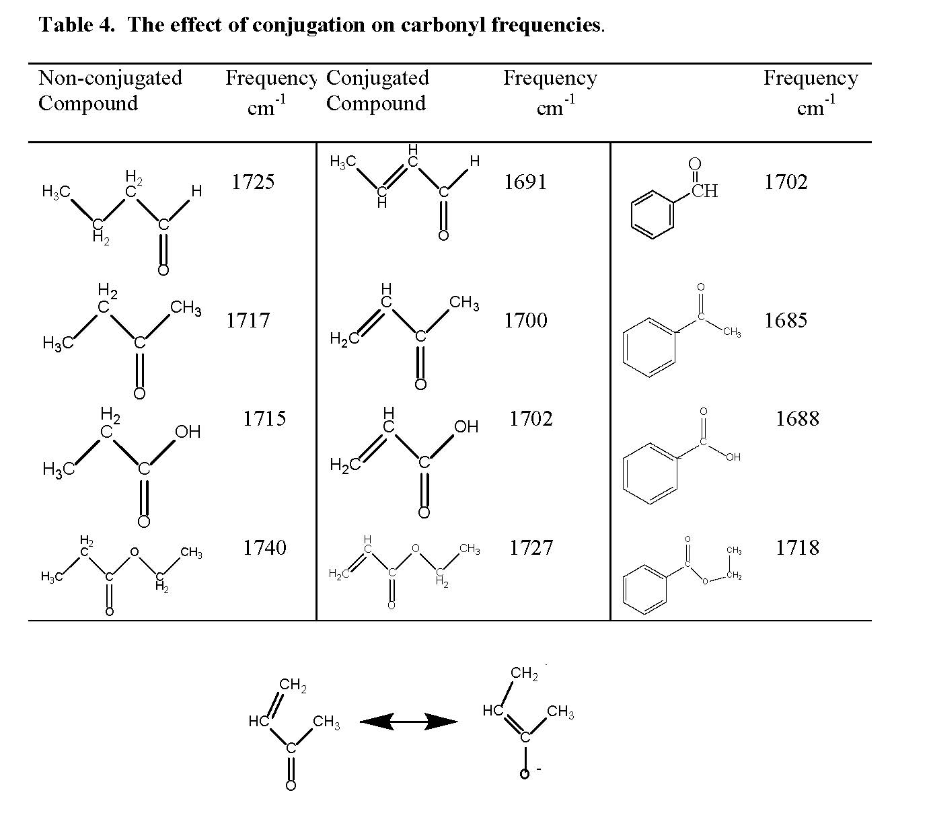
+

Slide 17
Nitrogen compounds
Amines
primary -NH₂
secondary -NHR
tertiary NR₃
Amides
R-C=ONH₂
R-C=ONHR
R-C=ONR₂

Slide 18
Butylamine, neat liquid; thin film: CH₃CH₂CH₂CH₂NH₂

Slide 19
Diethylamine, neat liquid; thin film: CH₃CH₂NHCH₂CH₃

Slide 20
Triethylamine, neat liquid; thin film: (CH₃CH₂)₃N

Slide 22
N-Methyl acetamide, neat liquid; thin film: CH₃CONHCH₃

Slide 23
N,N-Dimethylacetamide, neat liquid; thin film: CH₃CON(CH₃)₂

