Slide 1

Experiment 9 Identification of Organic Unknowns
This experiment will be due at the end of the semester. You will be given one liquid and three solid unknowns to identify. The preliminary report as described in the manual will be provided. This will contain the solubility properties of the unknowns as well as some physical properties, normal boiling points for the liquid and melting points for the solids. The following applies to the properties of the boiling points and melting temperatures provided:
Melting points and boiling points will be provided with an uncertainty
Solids: ± 4° C;
Liquids: ± 6° C
All unknown compounds are included in Appendix 5. Additional details are available on the pdf file
Experiment 9 Identification of Organic Unknowns.
The following describes how to use the solubilities of the unknowns to identify their classification. This would have been the experimental portion of the experiment.

Slide 2
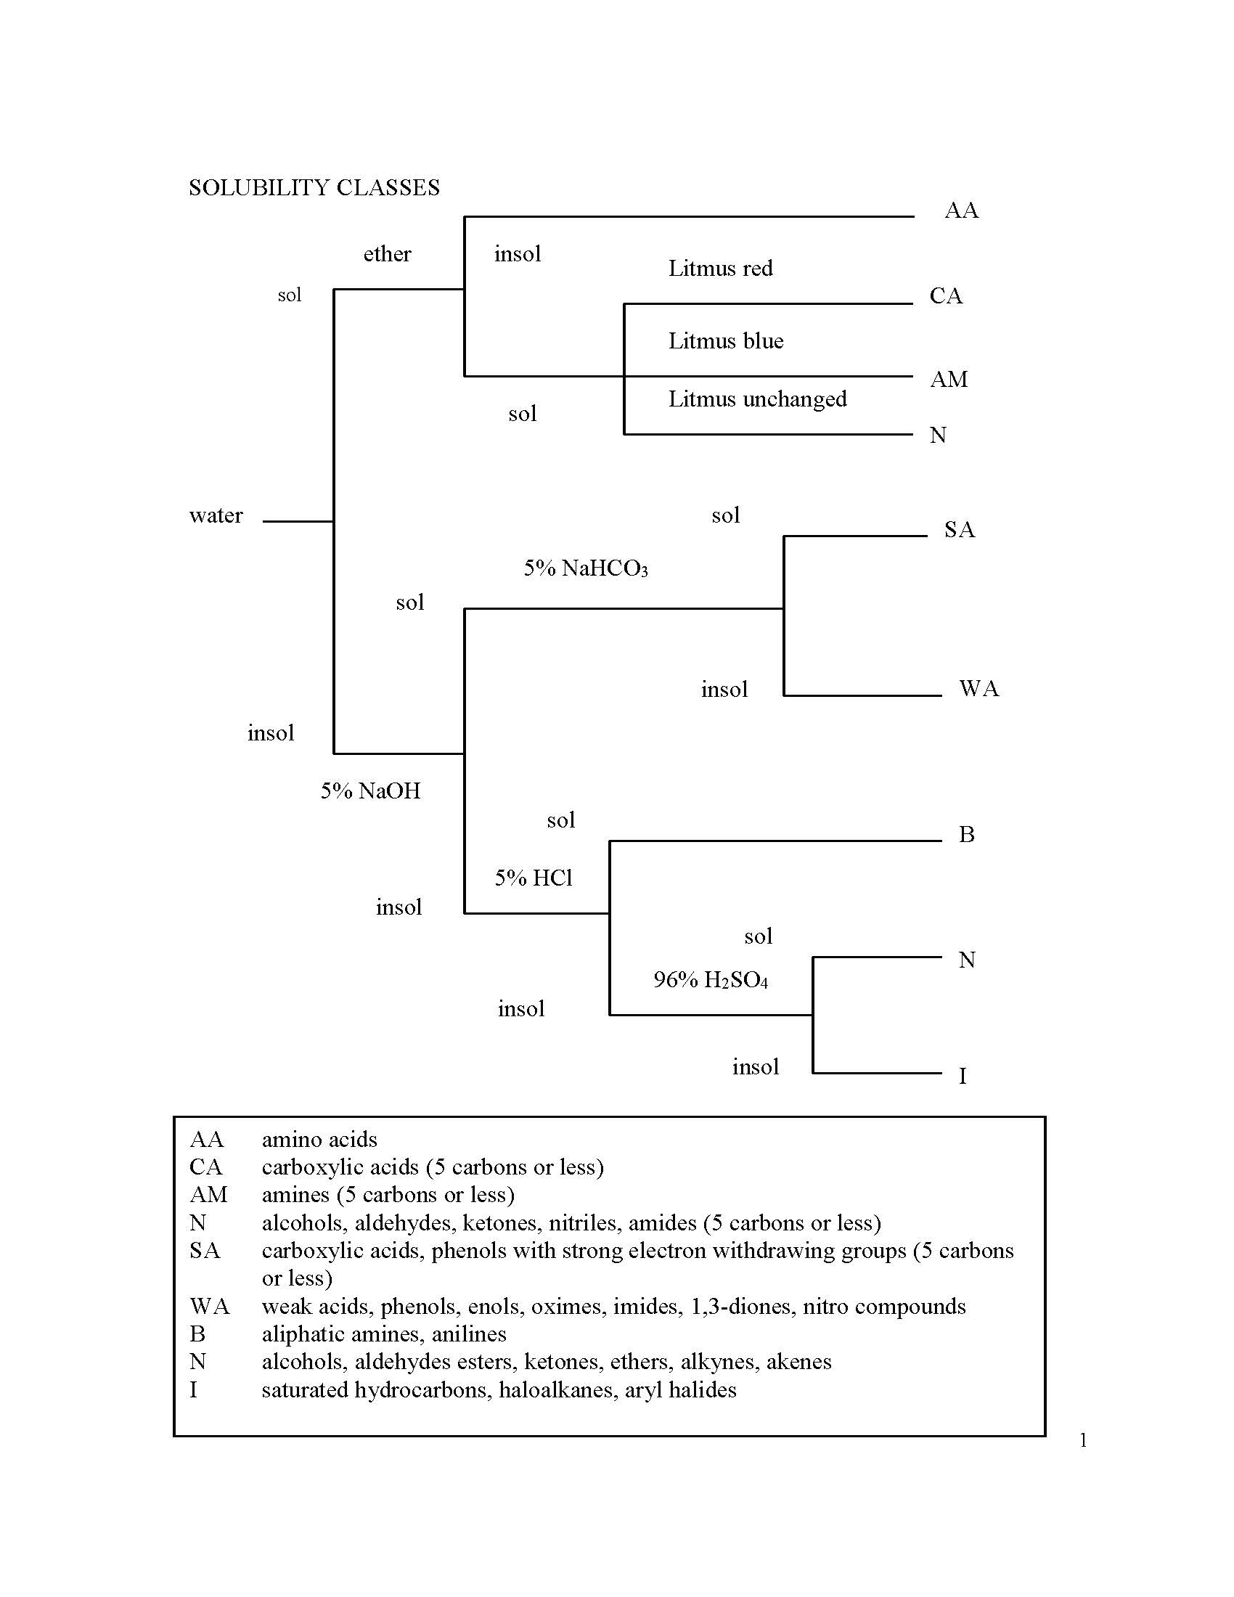

Slide 3
Classification Categories in Appendix 5
Aldehydes
Ketones
Carboxylic Acids
Alcohols
Primary Amines
Secondary Amines
Tertiary Amines
Esters
Phenols
Hydrocarbons
Amides
Nitriles

