Slide 1

TiVo
Kendra Clayborn
Timothy MacFarland
Pat Sokolowski
Ashley Mccabe
Marketing Management
Lindell Chew
15 April 2009

Slide 2
OVERVIEW
What is TiVo?
  Known as the “pioneer” of DVRs (Digital Video Recorders)
  Available first in the U.S
    Canada
    Mexico
    Taiwan
    Australia
    New Zealand
Notes:
is the pioneer of the digital video recorder (DVR). TiVo was introduced in the United States, and is now available in Canada, Mexico, Australia, and Taiwan. It has also just been announced by TVNZ that TiVo will be coming to New Zealand late this year.

Slide 3
Overview (cont’d)
Functions
  Provides an electronic television programming schedule
  Provides Season Pass Recordings
  Provides WishList searches
  Range of features when the TiVo DVR is connected to a home network
Notes:
- Provides an electronic television programming schedule
- Provides Season Pass Recordings (which ensure subscribers never miss an episode of their favorite shows) and WishList searches (which allow the user to find and record shows that match their interests by title, actor, director, category or keyword). TiVo also provides a range of features when the TiVo DVR is connected to a home network, including movie and TV show downloads, advanced search, personal photo viewing, music offerings, and online scheduling.

Slide 4
HISTORY
Teleworld Inc. 1997
Consumer electronics show in 1999
Slow start
TiVo = Microwave?
Turning a profit in 2005

Slide 5
History (cont’d)
Currently offer services in: Canada, Mexico, Australia, Taiwan, and soon in New Zealand.
TiVo Today
  Partnership with Netflix
  TiVo with DirecTV
  Subscribers

Slide 6
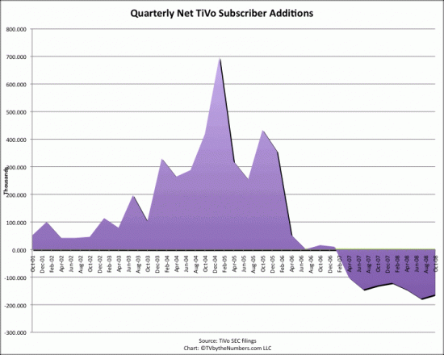

Slide 7
REVENUE
Net Income: $100.6 million ($0.98 a share) in 2008
Economic downturn/revenue is falling

Slide 8
PROBLEMS
Product awareness/definition
Competition
  Microsoft’s UltimateTV
  Replay TV
  Comcast
  Verizon
Backlash from advertisers
Data gathering concerns
Economy and sales falling

Slide 9
SWOT ANALYSIS

Slide 10
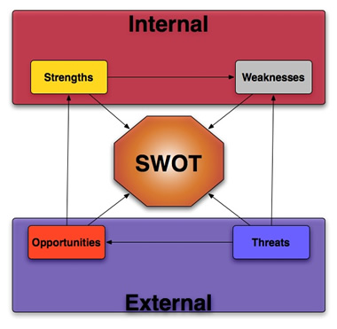

Slide 11
STRENGTHS
Effectively cater to more affluent families with kids
Customers have a deep emotional response with TiVo
High customer satisfaction levels
Easy of use

Slide 12
WEAKNESSES
Number of subscribers is still lower that originally anticipated
Profile of subscribers is quite narrow
Still does not have universal appeal

Slide 13
OPPORTUNITIES
Try to reach potential customers that are more mainstream
Try to capture some of the market that does not view their TV situation as a problem

Slide 14
THREATS
Not being able to overcome the product “Inertia”
Ability to close the gap between intention to buy and action
Ability to convey key benefits of product to non-users

Slide 15
STRATEGIC RECOMMENDATIONS & IMPLEMENTATION

Slide 16
RECOMMENDATIONS
Expand Partnership Bundles
Offer Differentiated Software
Expand Internationally

Slide 17
Recommendations
Expand Partnership Bundles
  Offer unit sales in multiple locations
  Partner with local cable companies to offer services as part of existing bundles

Slide 18
Recommendations
Differentiated Software
  Expand customization
  Continue simple user interface
  Offer Convenient updates
  Heighten parental controls

Slide 19
Recommendations
Expand Internationally
  Currently offered in available in Canada, Mexico, Australia,Taiwan, and New Zealand
  Expansion is possible in the UK

Slide 20
IMPLEMENTATION PLAN
Must be offered as a package plan
Use retail staff as opinion leaders
Advertise its unique custom features

Slide 21





QUESTIONS?

