Slide 1
Prewriting and Invention
“The human mind once stretched by a new idea never goes back to its original dimensions.” -Oliver Wendell Holmes

Slide 2
Brainstorming
Captures a multitude of thoughts and ideas
Often in list-form
Social activity
Focused and relaxed

Slide 3
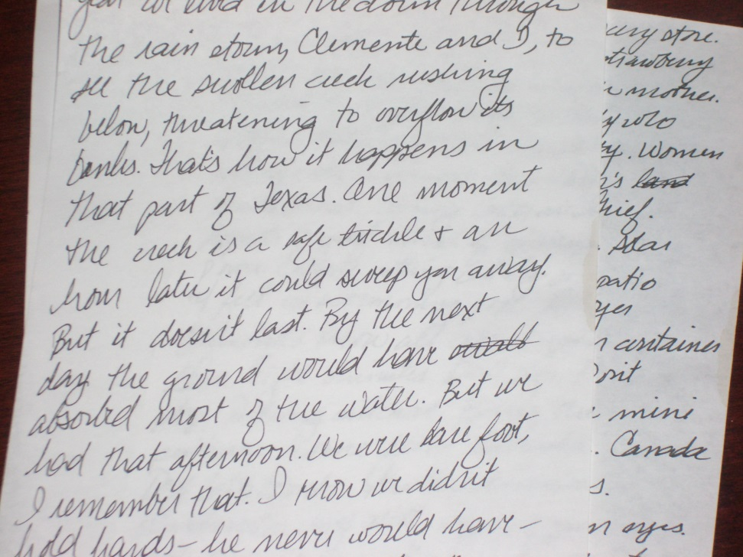
Free Writing/Looping
Scribbling down ideas without worrying about grammar, sentence structure, or even coherence
Often lasts for a predetermined length of time (2 minutes, 5 minutes, etc.)
Looping allows for cycles of freewiritng.

Slide 4
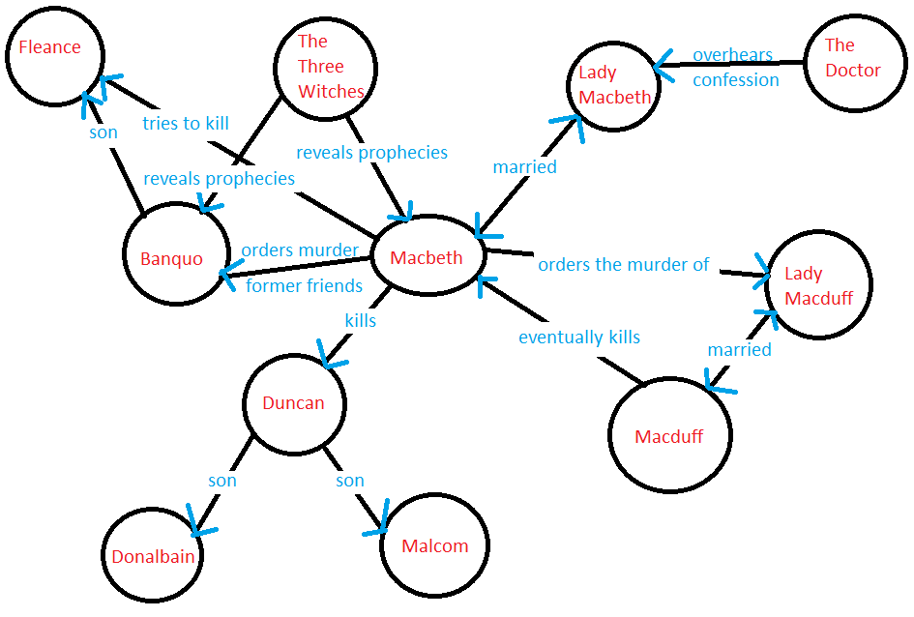
Clustering/Webbing
Allows you to group or organize ideas in a visual way
Shows relationships between groups and ideas

Slide 5
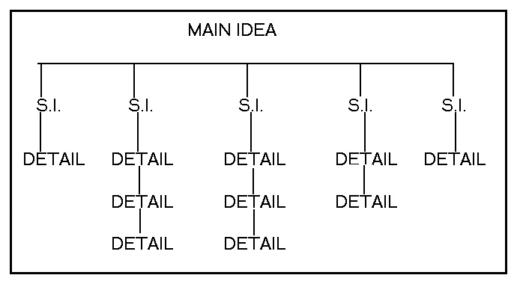
Diagramming

Slide 6
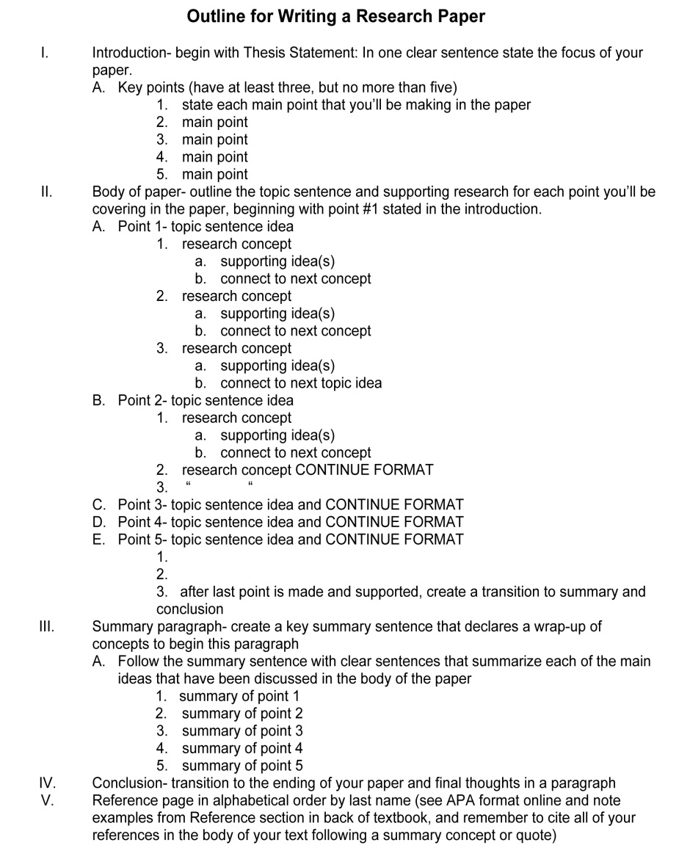
Outlining
Shows the order and relationships between ideas
Often hierarchical
Can be followed too strictly

Slide 7
Chunking/Blocking
Breaking ideas into “chunks,” or “blocks,” in order to help your reader understand your overall message
More flexible than an outline
Create headings for each “chunk” for yourself
Helps with length

Slide 8
Other Strategies?

Slide 9
Practice!
Brainstorming
Freewriting/looping
Clustering/webbing
Diagramming
Outlining
Chunking/blocking

