Slide 1
Narrative Writing Strategies
“Writing autobiography is my way of making meaning of the life I have led and am leading and may lead.” -Murray

Slide 2
Character and Setting Description
Details about what makes the characters and places unique
Use exact names – specificity is key

Slide 3
Example of Character Description
“You should know that my mother’s expressive command of English belies how much she actually understands. She reads the Forbes report, listens to Wall Street Week, converses daily with her stockbroker, reads all of Shirley MacLaine’s books with ease – all kinds of things I can’t begin to understand” (Tan).

Slide 4
Sensory Detail
Information about what the character/narrator sees, smells, hears, feels, and tastes.
Connected to memory.
Vivid description and detail makes the reader feel as if he or she is “really there.”

Slide 5
Example of Sensory Detail
“I knew what the tests were asking, but I could not block out of my mind the images already created by the first pair, “sunset is to nightfall” – and I would see a burst of colors against a darkening sky, the moon rising, the lowering of the curtain of stars” (Tan).
“As we were sitting there, we suddenly heard the sound of an oncoming train – a sound that startled me so that it evoked another long-suppressed memory: that of crossing the train tracks in my father’s car” (hooks).

Slide 6
Realistic Dialogue
Brings the characters to life; gives them realistic voices.
Helps the reader get to know the characters and their personalities.
Advances the action of the story.
Scrap unnecessary dialogue.
Indented and uses quotation marks.

Slide 7
Examples of Realistic Dialogue
“And my mother was standing in the back whispering loudly, ‘Why he don’t send me check, already two weeks late. So mad he lie to me, losing my money.’
And then I said in perfect English, ‘Yes, I’m getting rather concerned. You had agreed to send the check two weeks ago, but it hasn’t arrived’” (Tan).

Slide 8
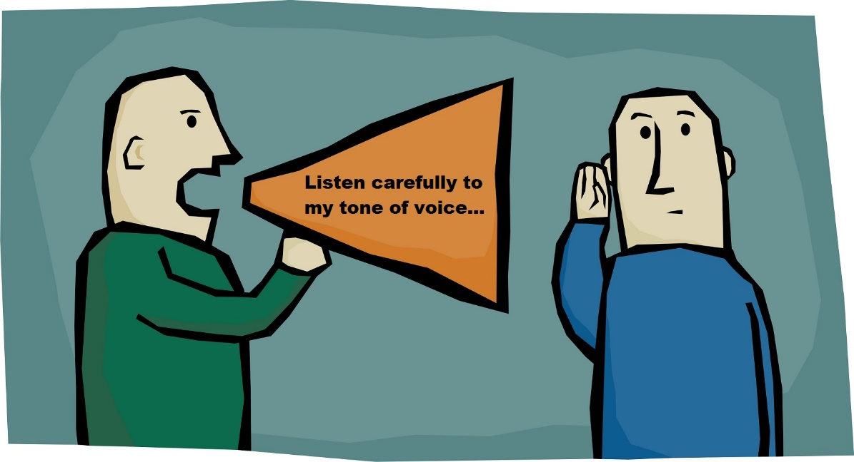
Tone
Humor, anger, sarcasm, frustration, sadness, etc.
Verb choice (not too many adverbs)
“We often contradict an opinion for no other reason than the tone in which it is expressed.” -Nietzsche

Slide 9
Examples of Tone
“She wouldn’t budge. And when the doctor finally called her daughter, me, who spoke in perfect English – lo and behold – we had assurances the CAT scan would be found, promises that a conference call on Monday would be held, and apologies for any suffering my mother had gone through for a most regrettable mistake” (Tan).

Slide 10
Pacing
How fast or slow is the story moves.
Emphasizes certain parts of the story – often through repetition – and keeps the reader’s interest.
Length of sentences.

Slide 11
Examples of a Fast(er) Pace
“I had met a young black man. We were having an affair. It is important that he was black. He was in some mysterious way a link to this past that I had been struggling to grapple with, to name in writing” (hooks).

Slide 12
Comparisons (Metaphors and Similes)
Helps the reader understand how a feeling, place, person, or event is similar to and/or different from something else.

Slide 13
Example of Metaphorical Language
“Conceptually, the autobiography was framed in the manner of a hope chest. I remembered my mother’s hope chest, with its wonderful odor of cedar, and thought about her taking the most precious items and placing them there for safekeeping. Certain memories were for me a similar treasure” (hooks).

Slide 14
Talking Directly to the Reader
In most stories, the narrator talks to an ambiguous “someone.” Sometimes, though, the narrator breaks this writer/reader barrier by addressing the reader directly.
Maintain the device throughout.

Slide 15
Example of Talking Directly to the Reader
“I am not a scholar of English or literature. I cannot give you much more than personal opinions on the English language and its variations in this country or others” (Tan).
“So you’ll have some idea of what this family talk I heard sounds like, I’ll quote what my mother said during a recent conversation” (Tan).
“You should know that my mother’s expressive command of English belies how much she actually understands” (Tan).

Slide 16
Reflection
Explains the significance of the event or experience.
Provides resolution and insight.
Very important!

Slide 17
Example of Reflection
“But [these labels] seemed just as bad, as if everything is limited, including people’s perceptions of the limited English speaker. I know this for a fact, because when I was growing up, my mother’s “limited” English limited my perception of her. I was ashamed of her English. I believed that her English reflected the quality of what she had to say. That is, because she expressed them imperfectly, her thoughts were imperfect” (Tan).

