Slide 1
Questions and concerns about ethnographic writing
A “brown bag” session of challenges for Paper 3.

Slide 2

Challenge #1: I’m having trouble finding an interesting community to study. What do I do?

Slide 3

Solutions
Expand your definition of “interesting.”
“Making the familiar strange.”
Pull back the layers.
Write/present in interesting ways.
Resources in your area, what makes you unique, your major/job, etc.

Slide 4

Challenge #2: I’m am so stressed out and overwhelmed that I cannot find the time to observe my group. What do I do? How can I manage my time better?

Slide 5

Solutions
One step at a time.
Get organized – write a research plan.
Find moments of silence for relaxation, concentration and creativity.
Use writing rituals that allow you to “selectively and temporarily shut out the daily world” (Wyche 53).

Slide 6
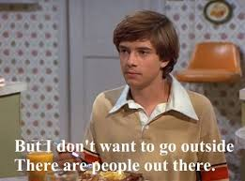
Challenge #3: I feel uncomfortable asking people that I don’t know if I can research them. What do I do?

Slide 7
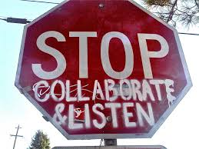
Solutions
Find an “in” by connecting with one person in the group.
Give back (reciprocity), possibly through this project.
Develop “a relationship of collaboration and trust” (Kahn 15).
“Making the strange familiar.”

Slide 8
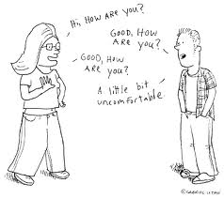
Challenge #3: I feel uncomfortable asking people that I know if I can research them. What do I do?

Slide 9

Solutions
“Making the familiar strange.”
Seeing people in new and different ways.
Embrace your inner nerd/scholar/writer.
Develop “a relationship of collaboration and trust” (Kahn 15).

Slide 10

Challenge #4: I’m afraid that I won’t be able to stay objective/unbiased in my research. What do I do?

Slide 11
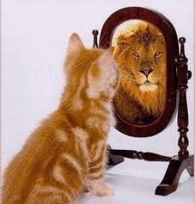
Solutions
Being “distanced” and being an “outsider” mean something different than being “objective.”
“You can’t help but see cultures in terms you’re comfortable with” (Kahn 187).
Guard against the colonial critique - acknowledge your subjectivity.
Recognize your biases (ethics).
Ethnography is not a science.

Slide 12

Challenge #5: I don’t know what to write down when I take field notes. What do I do?

Slide 13
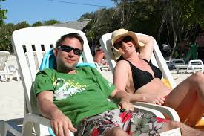
Solutions
The more, the better.
“Thick description” and specificity
Focus on communication and language (tone, body language, direct quotations etc.)

Slide 14
More on collecting data
Other methods?
Look at the model of field notes.
Collect other texts (posters, newspapers, menus, etc.) from the community.
Don’t worry about significance until you reach the analysis stage.
Look at the questions for analysis on the assignment sheet.

Slide 15

Challenge #6: I’ve noticed multiple groups within my discourse community. Can I compare and contrast these sub-groups?

Slide 16

Solutions
Good sign – recognize the levels of community
Depth of analysis overrides breadth
Compare and contrast the literacies in your group with academic literacies

