Slide 1
essay ORGANIZATION and STRUCTURE
“Prose is architecture, not interior decoration.” –Ernest Hemingway
Notes:
This presentation demonstrates the new capabilities of PowerPoint and it is best viewed in Slide Show. These slides are designed to give you great ideas for the presentations you’ll create in PowerPoint 2010!
For more sample templates, click the File tab, and then on the New tab, click Sample Templates.

Slide 2
Building a Structure
The structure, or form, that we give a piece of writing depends on the subject and the audience (recall the rhetorical triangle).
Ex. Writing a resume

Slide 3
The Basic Essay Structure
1
2
3
Introduction
Body Paragraphs
Conclusion
The common thread that links all of these parts together is your thesis.

Slide 4
Writing Introductions
1
What’s the point?

Slide 5
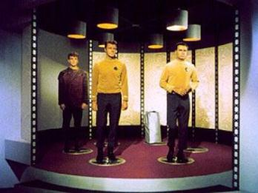
Why are introductions important?
Introductions are the “bridge” that transports your reader into the your essay, your frame of mind.
Your introduction is your first impression.

Slide 6
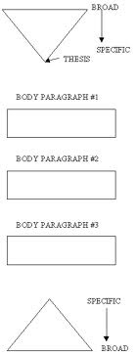
What are the parts of an introduction?
Grab the reader’s attention with a thought-provoking opening line.
Give relevant background information (explain the context of your argument, define your terms).
Present a road map of your paper by introducing the parts of your argument. As you do this, move from broad statements to specific statements.
State your thesis.

Slide 7
Opening Sentences that Put Readers to Sleep
The Webster’s Dictionary introduction
Ex. Webster's dictionary defines “marriage” as “a social union or legal contract between people that creates kinship.”
The “Dawn of Man” introduction
Ex. Since the dawn of man, people have fallen in love and joined together in marriage.
The Placeholder introduction
Ex. Marriage has been an important institution in American culture throughout history. There are many different kinds of marriage. Each involves different traditions for different groups of people.

Slide 8
Opening Sentences that Grab a Reader’s Attention
An Intriguing Example
Ex. Many Americans remember the infamous Casey Anthony trial, which took place after a two-year-old girl was reported missing from her home in Florida.
A Thought-Provoking Question
Ex. Given that recent studies suggest that two women can raise children more effectively than a man and a woman, why do so many people resist the idea of homosexual adoption?
A Puzzling Scenario
Ex. Viewers cannot hear what Bill Murray whispers to Scarlett Johansson at the end of Lost in Translation, yet the film’s underlying meaning centers around that very scene.
A Vivid Anecdote
Ex. Last year, a man in Springfield came home from his job at the local grocery to discover his wife lying in a pool of blood on the floor.

Slide 9
How do you write introductions?
Strategies for Writing an Introduction
Write the introduction last.
Write a tentative introduction and then change it later.
Any ideas, strategies, or suggestions?

Slide 10
Body Paragraphs
2
Developing ideas, clarifying your points, and illustrating concepts

Slide 11
The MEAL Plan: Introducing Evidence
Main idea (topic sentence, promise to the reader)
Evidence (quotations, statistics, specific details)
Analysis (what the evidence shows)
Link back to your thesis (“Consequently,” “Therefore,” “This supports the idea that…”)

Slide 12
1. Main Idea/Topic Sentence
Transitions from previous paragraph – shows the connection, or relationship, between the two
States the overall subject of the paragraph
Makes a promise to the reader
Do we always see topic sentences in writing?

Slide 13
2. Evidence
Dialogue or quotations (entire lines, parts of lines, single words)
Ex. The author of the article, Smith, attempts to incite fear in his readers when he writes, “Unless we act now, our children will suffer the consequences of this decision.”
Description
Ex. Bush uses short sentences, allowing the reader to process this information at a quick pace.

Slide 14
3. Analysis
What does the evidence mean or show?
Everyone notices different parts of the quote, so explain and elaborate on which parts of the quote are relevant to your argument.
Ex. In Cather in the Rye, Holden Caulfield quips, “All morons hate it when you call them a moron.” This comment exemplifies his sarcastic tone.

Slide 15
4. Link Back To Thesis
Show how that paragraph, and the claims or evidence within that paragraph, supports your main argument.

Slide 16
Writing a Conclusion
3
Transitioning your reader back into their lives and leaving a lasting impression

Slide 17
Restating your thesis or main points Introducing new examples or pieces of evidence
Strategies to Avoid

Slide 18
Strategies for Writing Conclusions
Play the “so what” game.
Make your readers feel glad that they read your paper. Give them a gift that they can use in the future.
Re-consider the terms or background information that you used in the introduction, and show how your paper has contributed to those issues.
Pull your ideas together.
Provide further questions, conclusions, results, solutions, or a course of action.
Pay special attention to the last few lines.

Slide 19
Words that Indicate Relationships between Ideas
To show place - above, below, here, there, etc.
To show time - after, before, currently, during, earlier, later, etc.
To give an example - for example, for instance, etc.
To show addition - additionally, also, and, furthermore, moreover, equally important, etc.
To show similarity - also, likewise, in the same way, similarly, etc.
To show an exception - but, however, nevertheless, on the other hand, on the contrary, yet, etc.
To show a sequence - first, second, third, next, then, etc.
To emphasize - indeed, in fact, of course, etc.
To show cause and effect - accordingly, consequently, therefore, thus, etc.
To conclude or repeat - finally, in conclusion, on the whole, in the end, etc.

Slide 20
Organizing your Ideas with Prewriting Strategies
Blocking (or “chunking), outlining, clustering, listing

Slide 21
Questions for Organizing your Ideas
How many blocks/clusters/headings of material will I need?
What information and ideas go into each one?
What is the best order for them?
What is each block/cluster/heading supposed to do? That is, what does each block tell, show, explain, argue, demonstrate, persuade, etc.?
How much space do I want each block to take up on the page? That is, how many paragraphs will I need in order to write about each block?

Slide 22
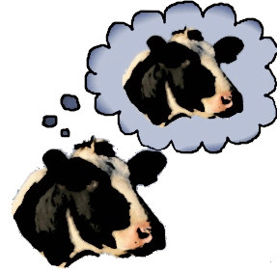
Benefits of Organizing your Ideas through Prewriting:
Readers need manageable chunks of information to process at a time.
Organizing your ideas helps you consciously lead the reader through your paper (recall the importance of metacognition).

