Slide 1
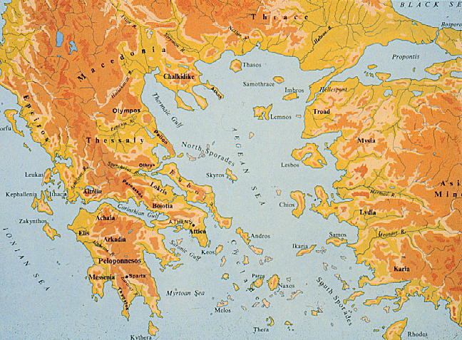
Walking Tour of Athens
Life in Athens in 403 BCE
Notes:
Look at map and photos of place – how would geography and climate affect human relations? (23-4). Plato compares Greeks to “frogs around the pond.” Reliant on neighbors, must live with extreme climates, smaller farms versus large-scale agriculture. (Grew grains, olives, grapevines).

Slide 2
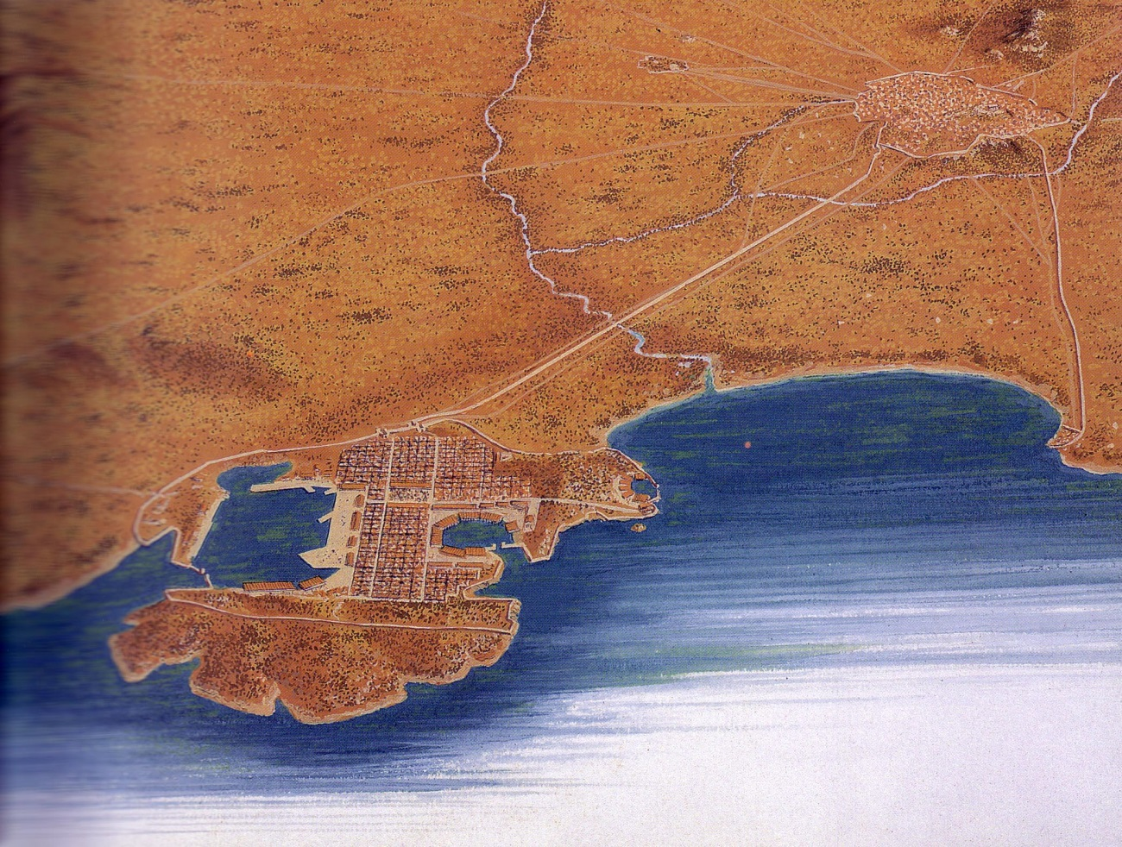
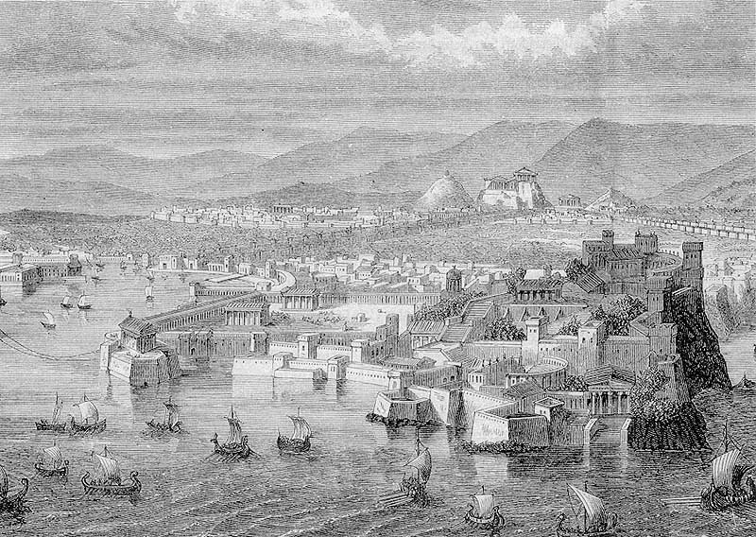
The Piraeus
Notes:
Welcome to the Piraeus, port of the city of Athens. Look on page 24 of book. Many metics and slaves in Piraeus. Many visitors and merchants, ship builders.

Slide 3
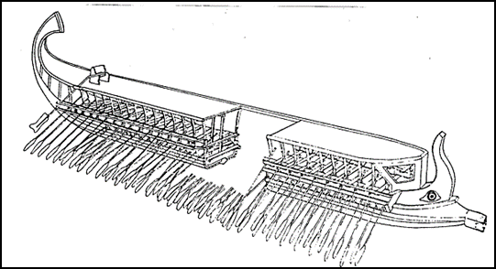
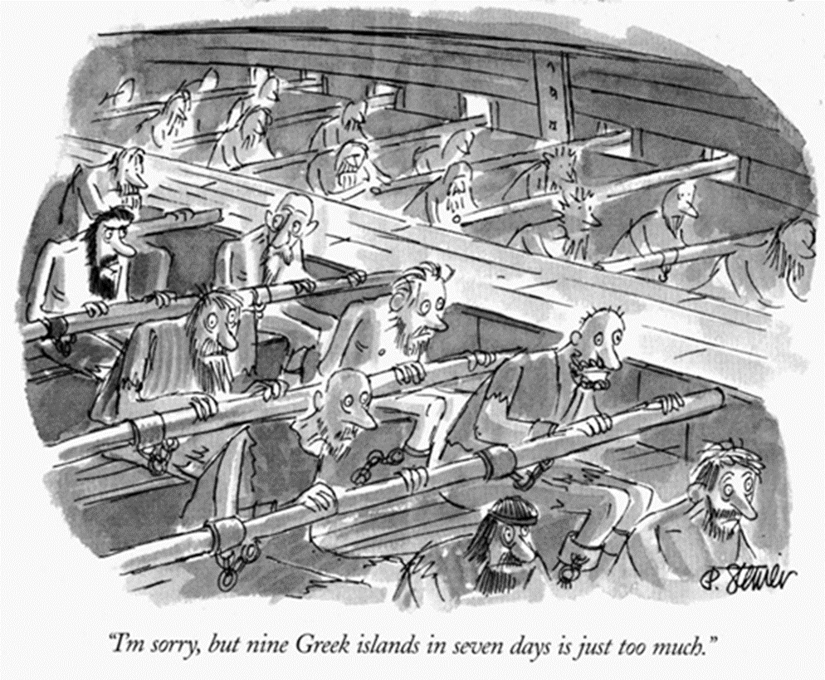
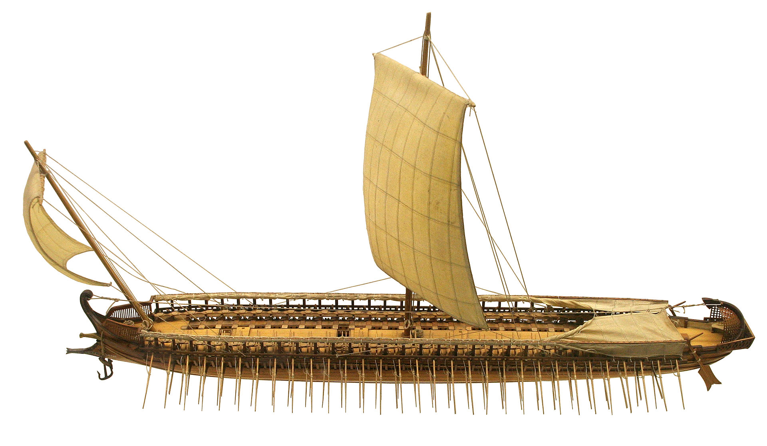
The Power of Triremes
Notes:
Trireme (three-rower) helped Athenians maintain power, used on slaves too.

Slide 4
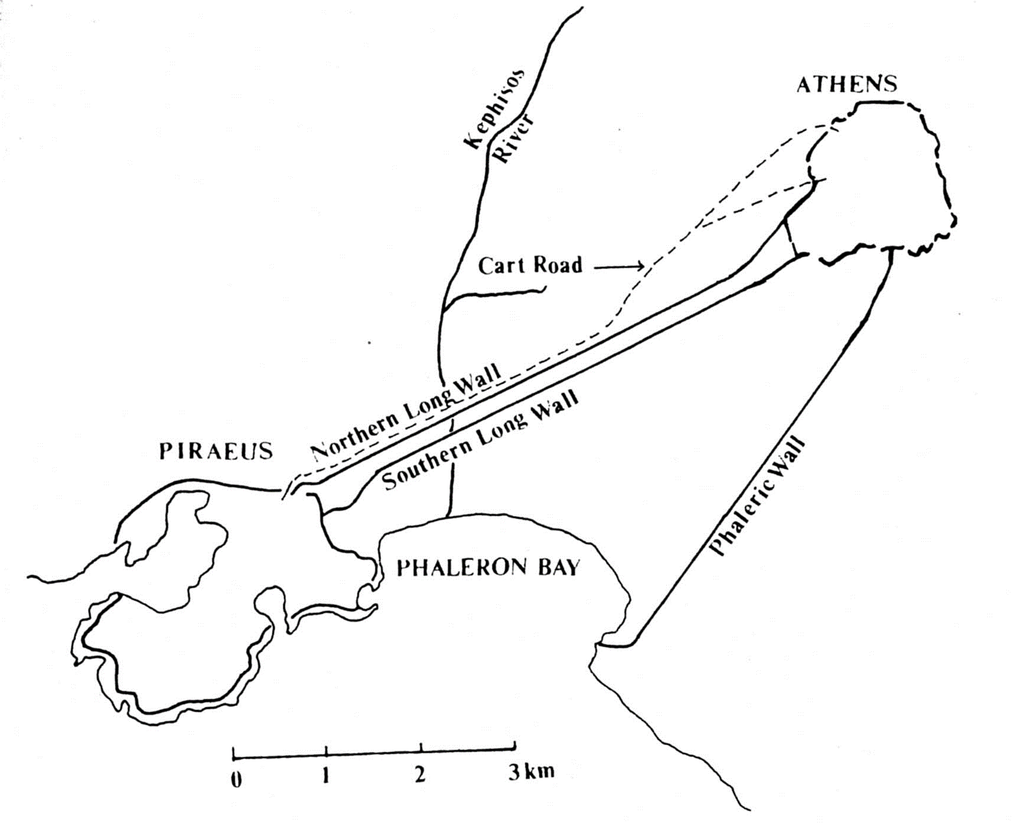
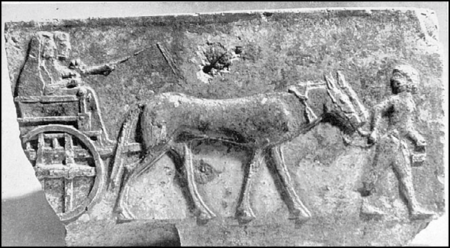
From Piraeus to Athens
Notes:
The Long Walls
The cart road to Athens leads to Dipylon Gate
Journey to Athens: 4 miles

Slide 5
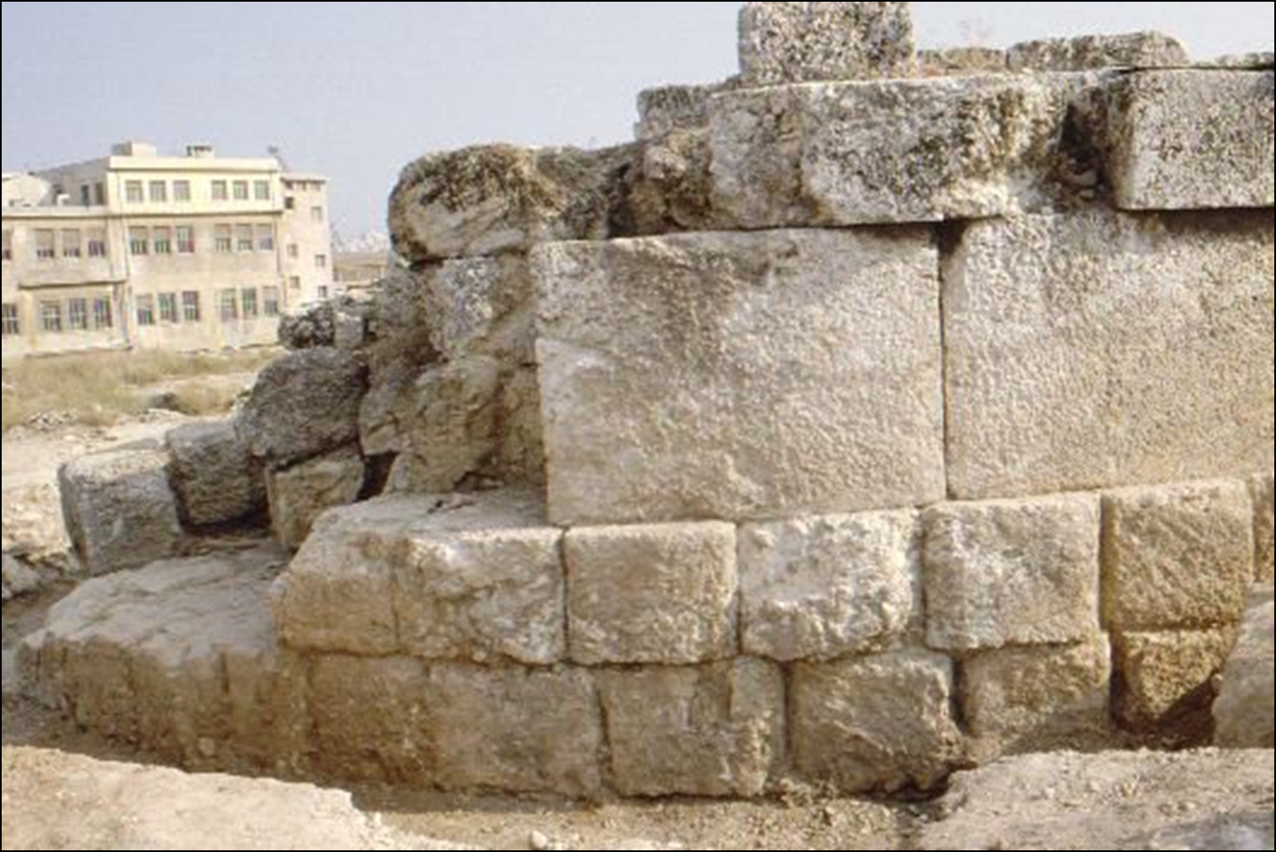
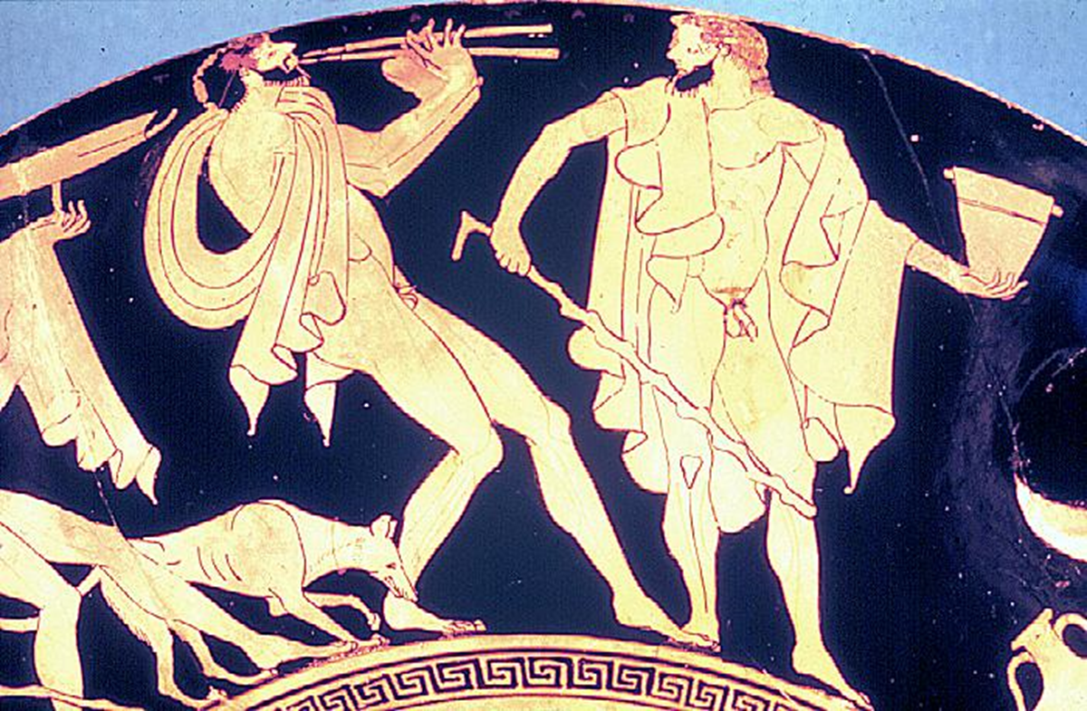
Remains of the Long Wall
Notes:
Purposes of the wall? Protection/fortification, supplies to ships. Pericles helped to build the wall. (Map on page 34). Spartans demanded that people dismantle the Long Walls, they hired flute players to accompany the demolition crews for humiliation.

Slide 6
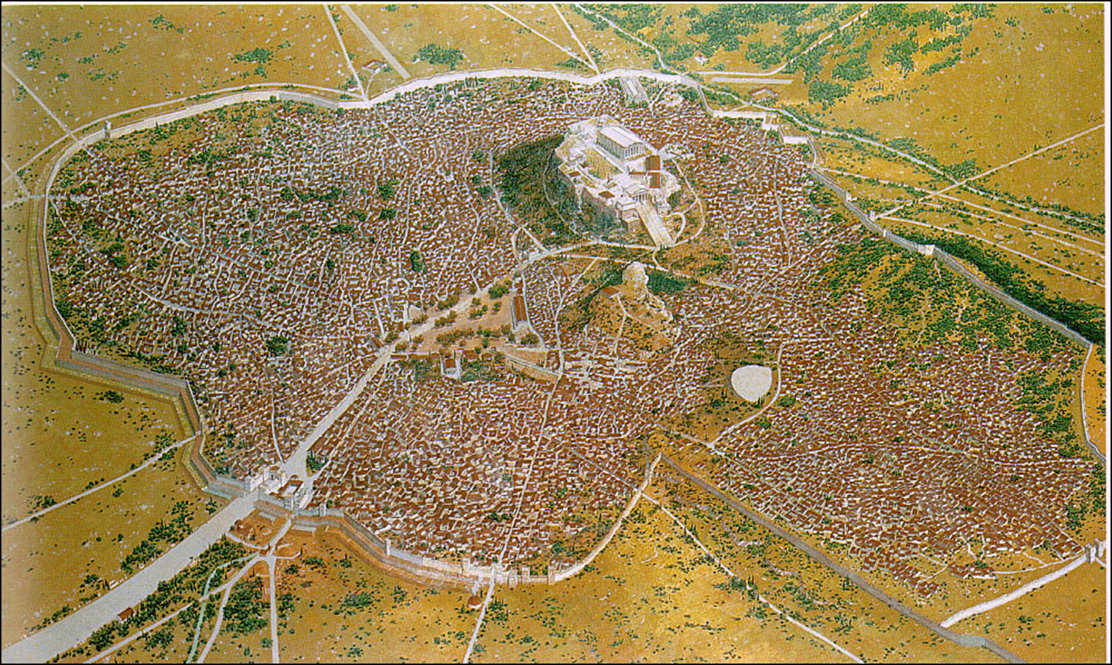

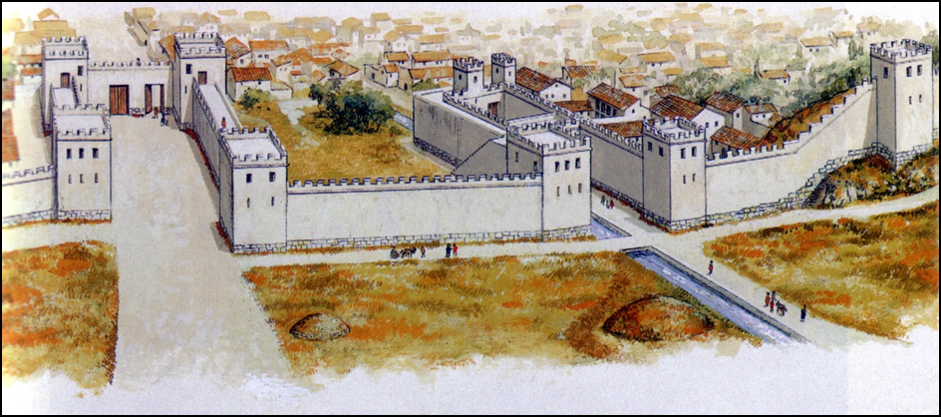
The Dipylon Gate
Pnyx
Dipylon Gate
The Agora
Akropolis
Notes:
The Akropolis is a natural outcropping of limestone, ca. 120 meters high.
Believe me, it's a real sight to see all the cows in the Panathenaic procession trying to climb up to the top of the sacred rock just before they are sacrificed. There’s a lot of slipping and sliding on the rock. It's a very noisy and smelly affair but somehow it seems an exactly right way to honor our goddess, Athena. I’m sure she takes great delight in it each year and looks forward, especially, to the really big festival we hold every five (e.g., four) years.

Slide 7
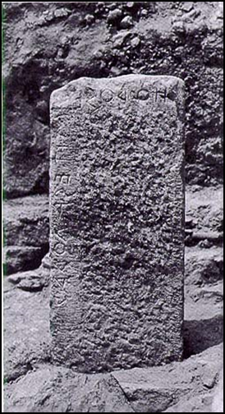
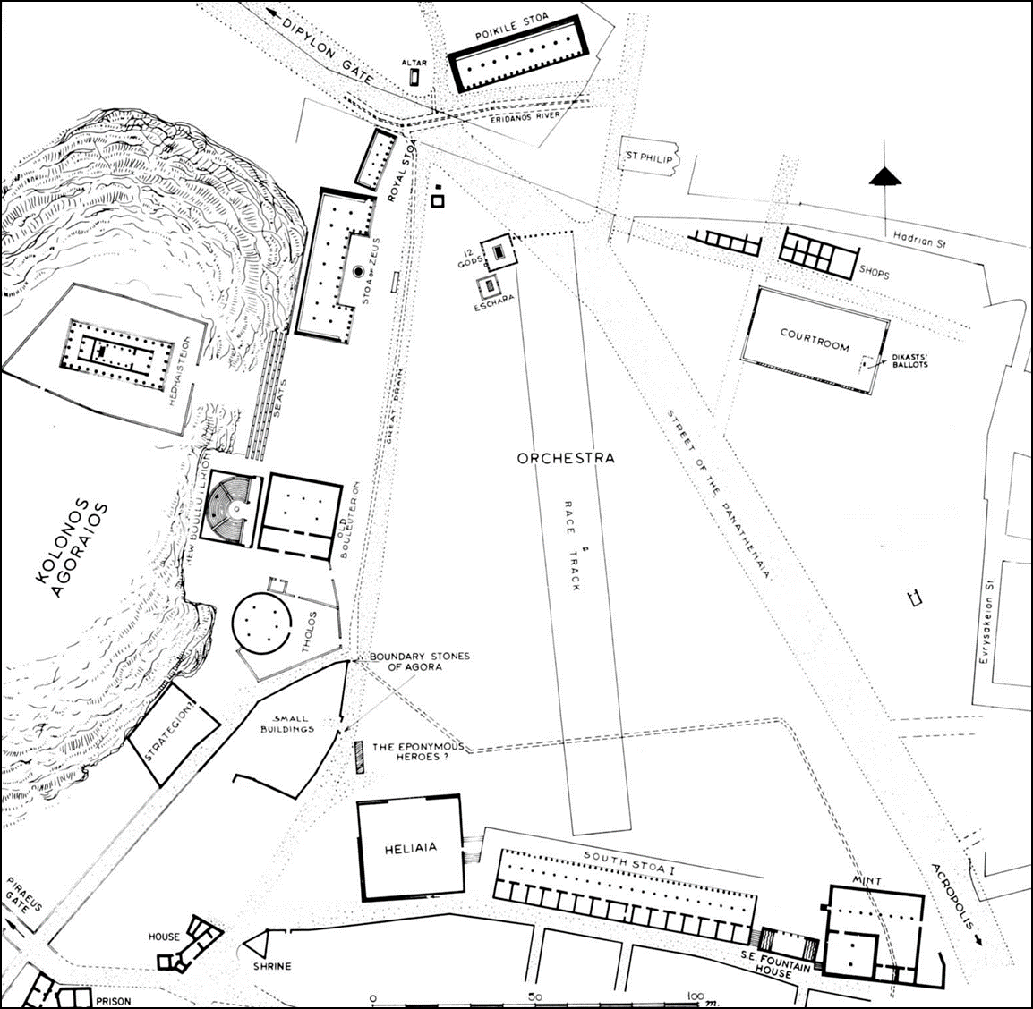
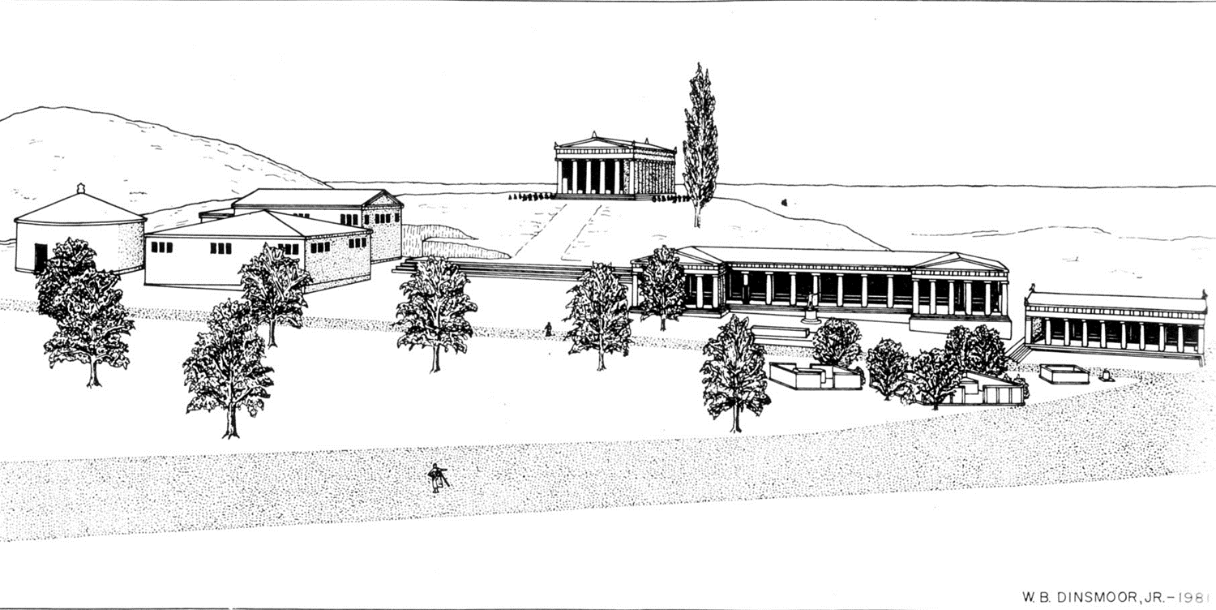
The Agora
Location of Agora boundary stone
Notes:
Here's the boundary stone that tells us we have crossed over into the civic space of the agora. If any of you are carrying weapons, you must not enter the agora. Or if you are a “draft dodger” or a deserter, have mistreated your parents, committed murder or are otherwise polluted – I will have to let you off here, for the agora is off limits to you. If it's markets or law courts or civic buildings that you are looking for, the agora is the place.
Also temple of Athena (worshipped as the mistress of arts and crafts) and a market for craftsmen.

Slide 8

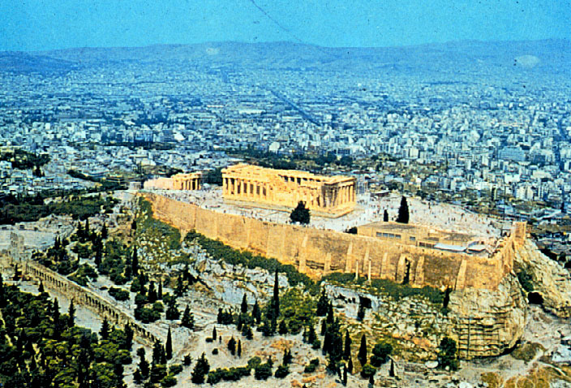
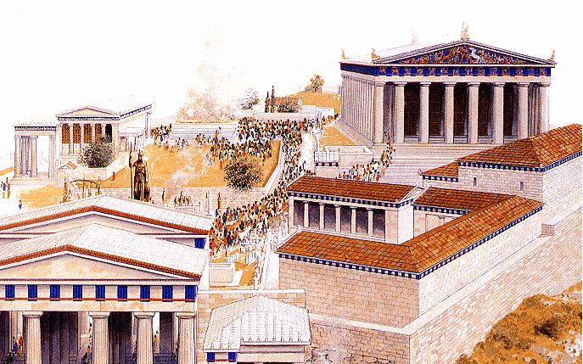
The Akropolis
Notes:
The Akropolis is a natural outcropping of limestone, ca. 120 meters high. It was occupied from earliest times.
Acropolis (“polis” meaning a “city state” and forms the basis of “politics”).
Festival to honor our goddess, Athena every four years. Home of Parthonon, temple and treasury building. On the exterior is the story of the birth of Athena emerging from Zeus’ head fully grown and armed.

Slide 9
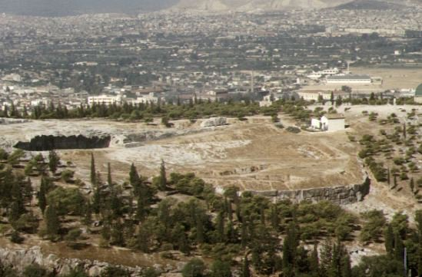
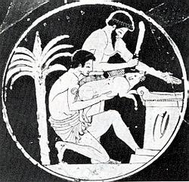
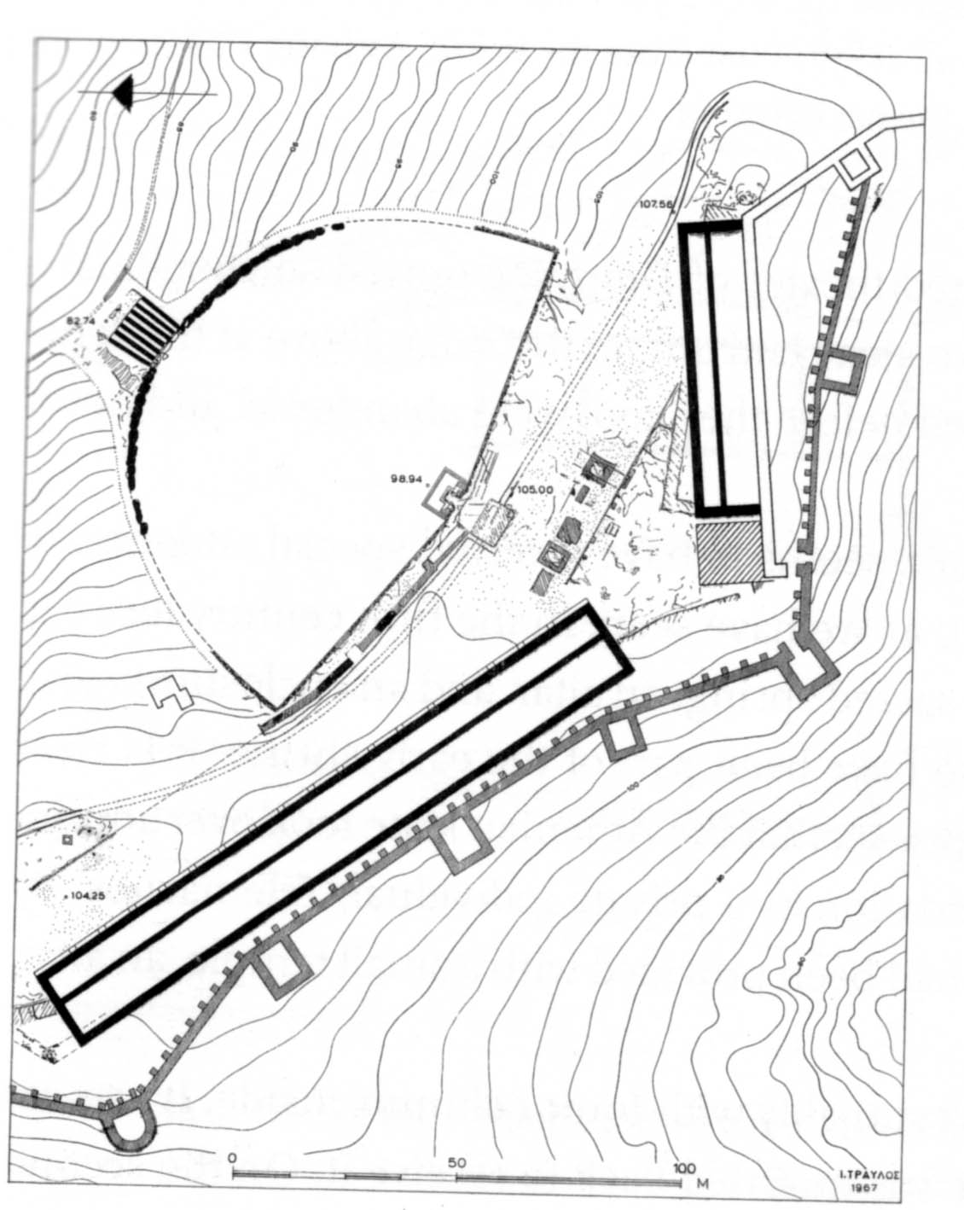
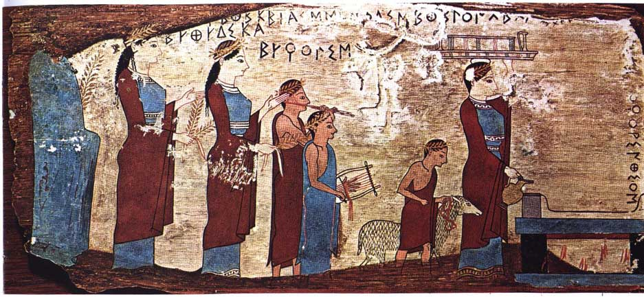
The Pynx
Notes:
The Pnyx has existed for just over 100 years and is a symbol of our Athenian democracy. For years we sat on the slope and looked out towards the Peiraieus. What a magnificent view we could enjoy as we listened to the speakers who came forward to address the Assembly.
he'll perform the pig sacrifice to open the next Assembly. I told him that I would help him get a good pig for the sacrifice. He needs one that is big enough to feed the people – at least a small morsel – but not too big. You know if the sacrificial animal is too big, it becomes almost impossible to wield the axe and sacrifice it. I also have to help train my cousin in recognizing that the pig is willing to be sacrificed because our customs demand that the animal can not be sacrificed unless it assents to the sacrifice. I hope I remember to tell him that, if the animal doesn't seem willing, he can always throw some cold water on its neck. The shock of the cold water usually makes the animal shake his head in assent.

