Slide 1
Analyzing Photographs
“Representing the past, photographs serve the present’s need to understand itself and measure its future. Their history lies finally in the political visions they may help us realize” (Trachtenberg 489).

Slide 2
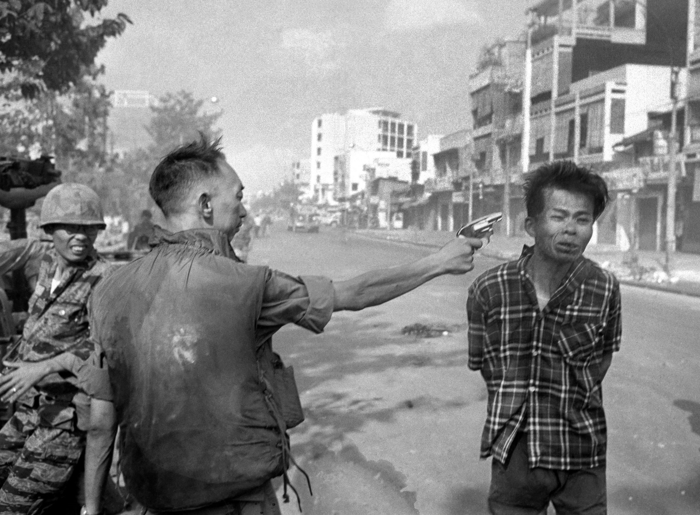
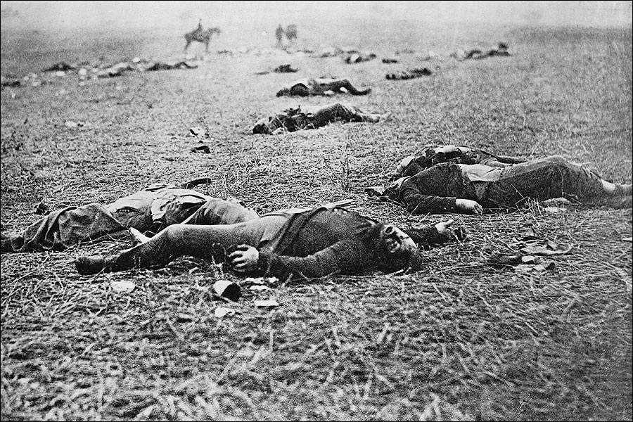
Conceptual versus Narrative Representations
Conceptual representations depict situations, scenes, and states of being.
Narrative representations show actions.

Slide 3
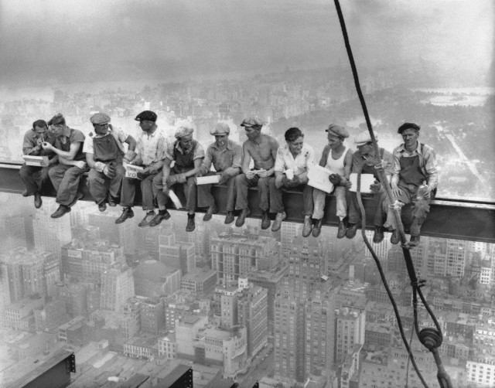
Page Design and Layout
Arrangement of elements on a page (ratios, color, size, style).

Slide 4
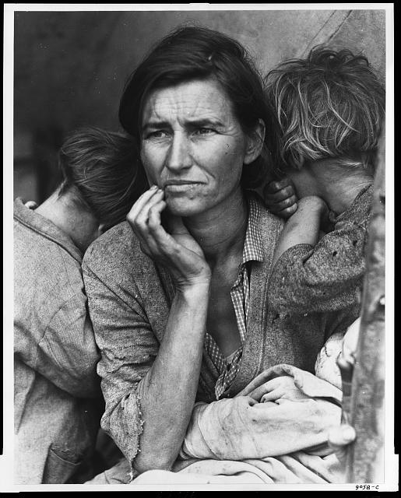
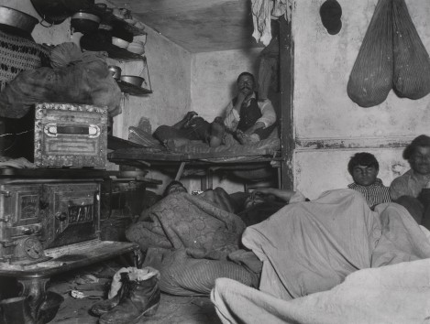
Distance
How near or far the camera is from the subject. Distance influences the viewer’s response to the text.

Slide 5
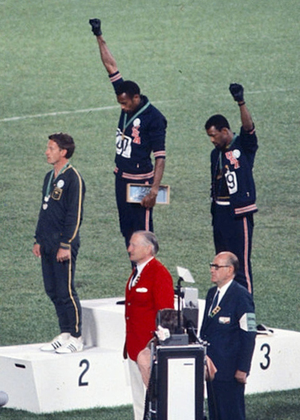
Perspective
The angle of vision.
Frontal angle (as in Migrant Mother) or oblique angle (as in the “Black Power Salute at 1968 Olympics”)
High angle (camera looks down on people) versus low angle (camera looks up)

Slide 6
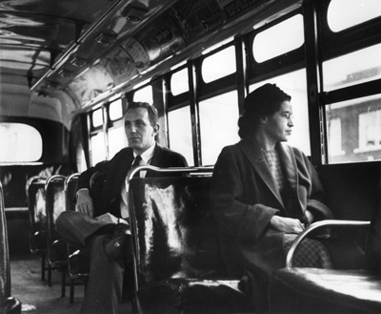
The Gaze
The direction in which a subject looks at or away from the viewer. Often creates an offer or a demand.

