Slide 1
Staff (Benefit Eligible) Job Posting Process
Notes:
We are going to be chatting about the process for filling either a new or vacant position.
Before we go through the steps, I’d like to show you a flowchart of the process – from start to finish.

Slide 2
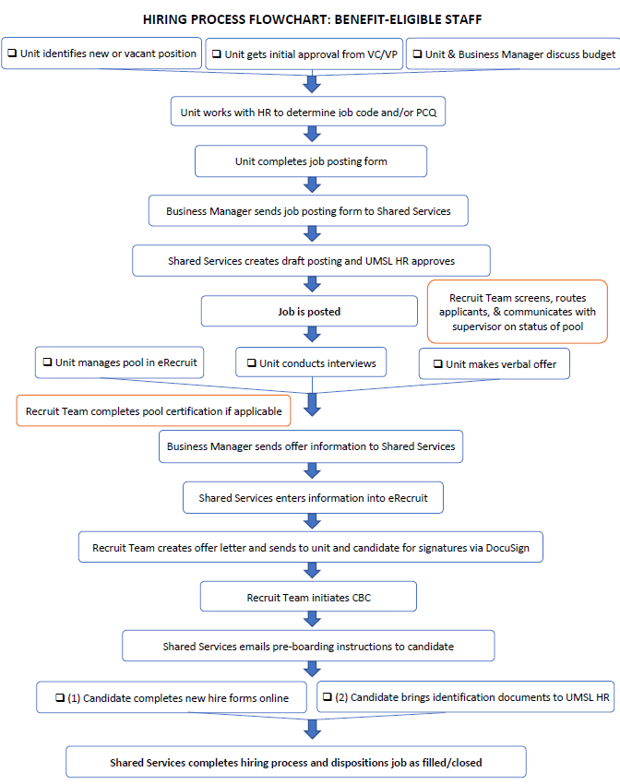
Notes:
As you can see – this is a multiple-step process. The points in blue are the steps that are handled within our HR recruit team.
Now that we’ve see the overview, let’s talk about the steps.

Slide 3
Job Process Steps
Vacancy
Justification – if applicable
Complete & Submit Job Posting Form
Posting
Pool Certification – if applicable
Interviewing & Selecting
Preparing/Presenting Offer

Slide 4
VACANCY: 1st, receive initial approval to fill it from your VC/VP. 2nd, ensure your Business or Fiscal Manager has this position budgeted. 3rd, collaborate with your HR Partner to determine best approach to the vacancy (replacement hire, internal vs. external, redistribute/reorganize/reclassify existing staff).
JUSTIFICATION: Prepare for Justification if applicable. Your Business Managers have access to a chart that will guide you.
JOB POSTING FORM: You will complete and submit the job posting form to your Business Manager – who will then send it to employment@umsl.edu.

Slide 5
POSTING: Shared Services will post the job, and if the form is accurate, this is generally done in 24-48 hours. Weekly, Units will receive an email about their postings.
Pool Certification: If this position is a Staff position of GGS 10 and above or in any job group identified as under-utilized in the University’s Affirmative Action Plan (link on our website under pool certification) – you will be required to do a pool certification.
Interview & Selection: We have interview guides on our site to assist you with the interviewing process. The Unit is responsible for conducting their own reference checks.
Preparing/presenting the offer: Unit determines pay based on guidelines provided previously by HR Partner and/or Business Manager. Unit extends the verbal offer to selected candidate and negotiates as needed. Finally, the Unit’s Business Manager notifies Shared Services (Stripes) of the offer.

Slide 6
Breaking down the form
Note: most updated form will always be found on HR website

Slide 7
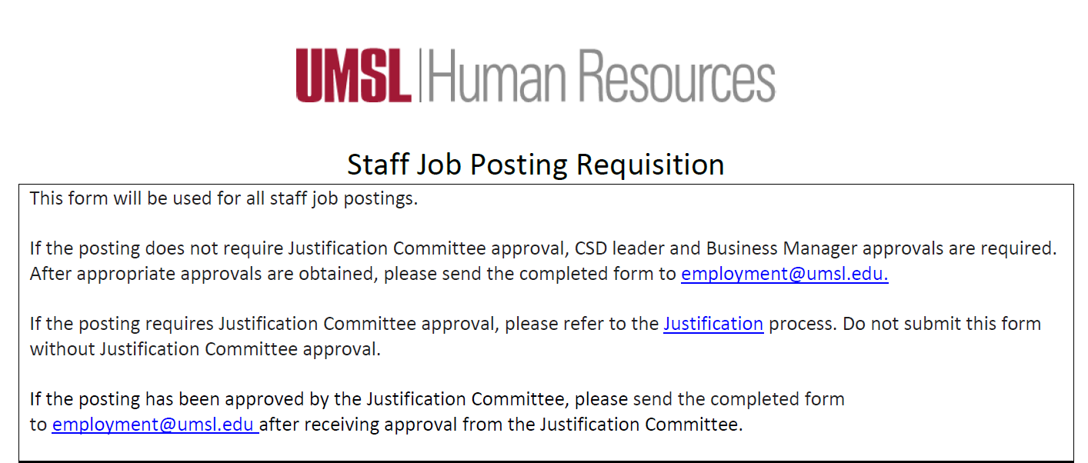
Notes:
The first section of this form just provides instructions.
Your Business Manger will be the one to submit the completed form. If you send directly to the recruit team or to Shared Services, it will be sent back to you in order to follow the established process.

Slide 8
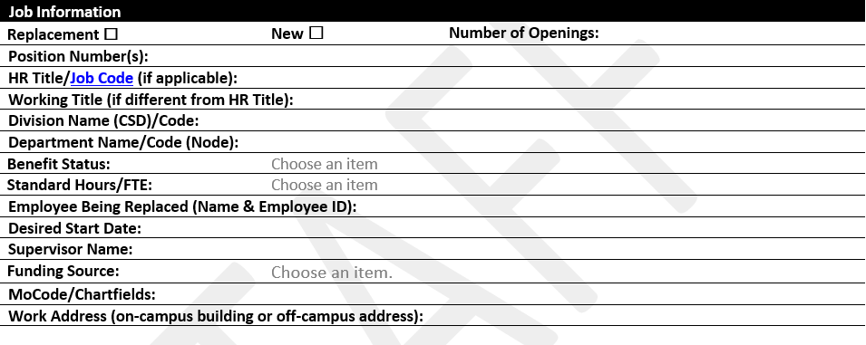
Every field must be completed.
Notes:
I really want to highlight the date. As you saw on the overview – bringing someone into the UMSL community takes time. Generally, two weeks from start to finish. You also want to be cognizant of new employee orientation. (We have a list of those dates on our website)

Slide 9
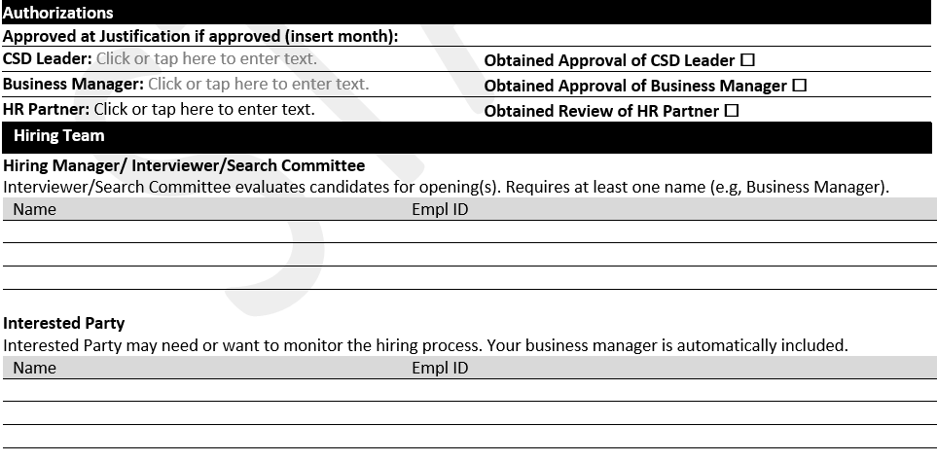
Notes:
Just put all hiring team members into one field “hiring manager, interviewer, search committee” .
We have to have the empl ID for the Hiring team members.

Slide 10
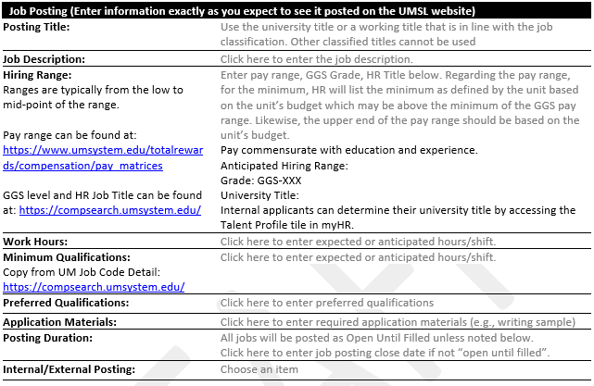
The job description must be typed into the form. It cannot be submitted as a separate attachment. Note that all jobs are “open until filled” unless you specify a close date.
Notes:
Note that the job description must be inserted into this form. We cannot accept any attachments.
We really want to stress that you utilize your Business Manager to ensure you have equity in your Units.
I also want to call out the Posting Duration. Unless specified, all positions will be open until filled. When determining the duration – keep in mind that it can take 2 weeks to bring your candidate into hire status.

Slide 11
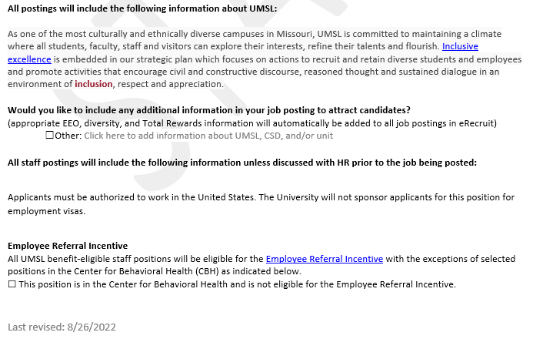
Please always grab a new form from our website to ensure you have the most recent version.
Notes:
This last section provides a disclaimer for you as to what will be included as well as allows you to add anything specific about your unit that might attract candidates.
I also want to point out the last revised date. Based on feedback from you – we make updates to this form. Please be sure to always go to our webpage for the form as opposed to downloading one to your computer. This ensures you are always using the most recent form.

Slide 12
What happens after the form is submitted?

Slide 13
After your Business Manager submits the form to our recruit team, they review it and send it to our Shared Services partners.
Generally, positions go live 24-48 hours. Approved positions post every hour at the top of the hour.
Weekly, Units receive an email that their job has been posted, this message includes internal equity for the unit as well as a statement that you need to discuss the salary offer (internal equity and budget) with your Business Manager. Please note that we give equity information based on the CSD, on occasion you may get UMSL-wide information.
Positions post to external sites within 48-72 hours (usually less). Units are encouraged to advertise the positions as well. For advertising ideas, please reach out to our Recruitment Team.
Everyday we route applicants who meet the minimum qualifications. Keep in mind that we certify pools that are staff GGS 10 and above as well as all faculty positions.
Notes:
** Give us one or the other – monthly or hourly. We strongly prefer you to give us either as opposed to the annual salary.

Slide 14
What causes delays?

Slide 15
Form not complete
Salary listed not matching job code detail (hourly vs. monthly)
Wrong job code
Missing job description
Missing MO code
Needing to change dates
Consistency of Title and Job Code
Incorrect Department
Job Code doesn’t match position number

Slide 16
What happens when I’m ready to hire someone?

Slide 17
Make the verbal offer
You do not need HR permission to do so – just stay in line with the salary range that has been approved.
Be thorough in your search, but do not wait unnecessarily. Keep in mind, candidates applying to a role with you are likely applying for other roles, too.

Slide 18
After verbal offer has been accepted
Let your Business Manager know. They will reach out to our Shared Services Partners to initiate the hiring process.

Slide 19
Additional Resources
Umsl.edu/services/hrs/index.html
Notes:
On the HR site, we have additional resources for you regarding this process including information about
Pool Certification,
Interviewing Guides (including a warm up question guide aka a phone screen,
a verbal offer guide,
information about the CBC,
as well as orientation dates, and info about post offer.

Slide 20
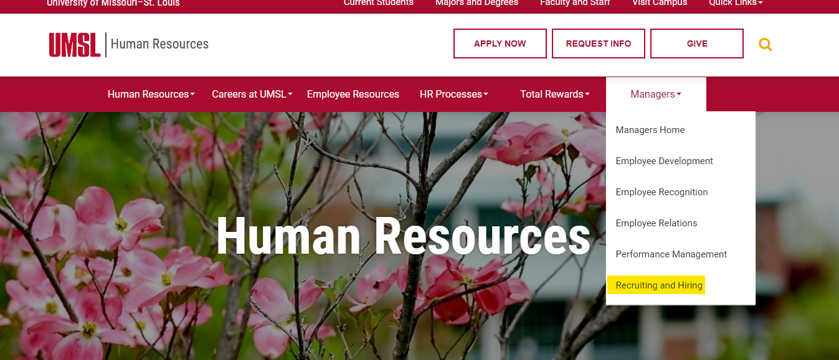
Umsl.edu/services/hrs/index.html
Notes:
If you go to the righthand side of our website, you will see Managers – use the drop down to find Recruiting and Hiring.

Slide 21
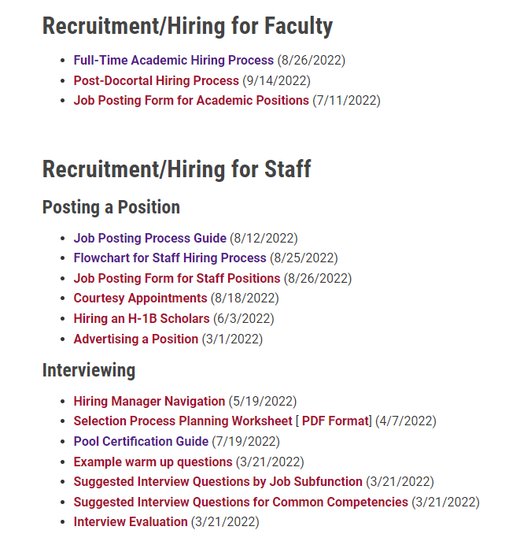
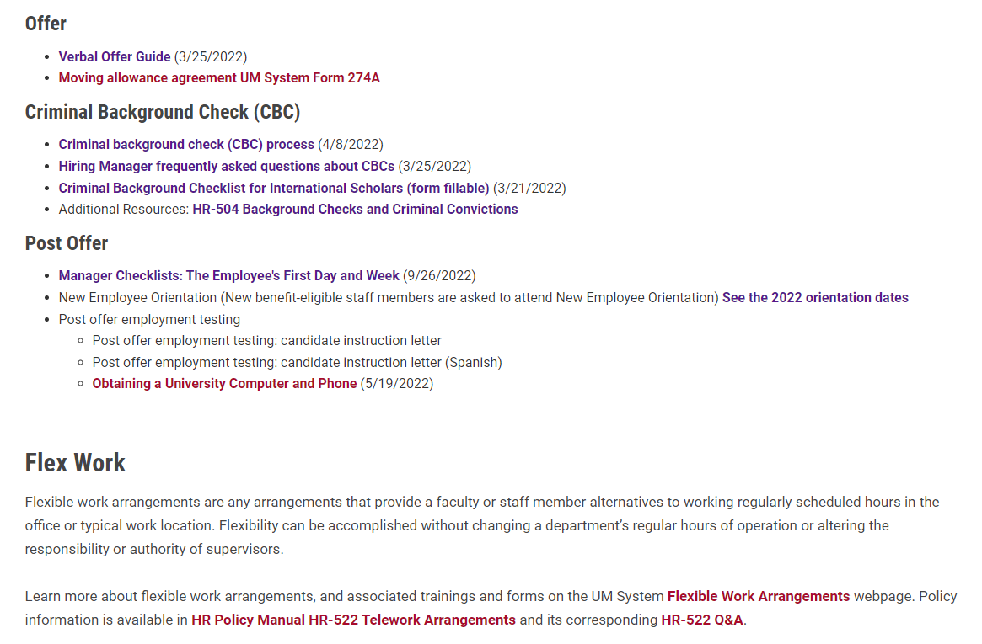
Notes:
Here you will find the job posting form along with information about:
Pool Certification,
Interviewing Guides,
a verbal offer guide,
information about the CBC,
as well as orientation dates, and info about post offer.

Slide 22
Questions?
Umsl.edu/services/hrs/index.html
Notes:
Questions?
If you found this presentation helpful – please let others know.
We also have an anonymous feedback link at the end of our email signatures as well as on the main page of our website. We would love to hear from you as to how we are doing and how we can improve.
Thank-you!

