Slide 1
Spring Faculty Meeting
2021-2022

Slide 2
Faculty Senate Report Jon McGinnis
Senate Chair

Slide 3
Faculty Senate Highlights for 2021-2022
The Senate conducted its 5-year review with input from faculty, staff, students, and administrators.
The Senate approved changes to the ATP Promotion Guidelines.
The Budget and Planning Committee endorsed the Campus Master Plan and recently endorsed the proposal for differential tuition.
The Senate approved a proposal for an award for the Chancellor’s Award for Excellence in Collaborative Research and Creativity.

Slide 4
Election of IFC Member
Election of member to serve on the Intercampus Faculty Cabinet (IFC)
Continuing members are:
- Dr. Sanjiv Bhatia, Computer Science Department, (2021-2023)
- Dr. Jon McGinnis, Philosophy Department, by virtue of election as 2022-2023 Faculty Senate Chair
Vote for the following candidate as the third UMSL representative on the IFC or make a nomination:
- Pamela Stuerke (Accounting Department) is willing to serve again. (2022-2024)

Slide 5
Election – University Faculty Committee on Tenure
Election of members to serve on the University Faculty Committee on Tenure (This is a UM System Committee.)
Three vacancies:
- one member to complete the last year of Uma Segal’s term since she has retired.
- two members – one member and one alternate to serve 2022-2024
Continuing member:
- Andrew Hurley, History Department, alternate (2021-2023)
Vote for the following candidate to replace Uma Segal for last year of her term:
- Anne Winkler, Economics Department, member (term will end in 2023)
Vote for the following candidates who are willing to serve 2022-2024:
- Paulette Isaac-Savage, Education Sciences & Professional Programs, member (2022-2024)
- Dinesh Mirchandani, Information Systems & Technology, alternate (2022-2024)

Slide 6
Academic Affairs Remarks
Steve Berberich
Provost &
Interim Vice Chancellor
for Academic Affairs

Slide 7
ATP Promotions (Effective September 1, 2022)
Promotion to Associate Professor with Tenure
Sharlee Climer – Computer Science
Marisa Omori – Criminology and Criminal Justice
Rachel Wamser-Nanney – Psychological Sciences
Granting Tenure
Kimberly Werner – Nursing
Promotion to Professor
Eike Bauer – Chemistry and Biochemistry
Adrian Clingher – Mathematics and Statistics
Joseph Pickard – Social Work

Slide 8
NTT Promotions (Effective September 1, 2022)
Promotion to Associate Teaching Professor
Amy D’Agrosa – Language and Cultural Studies
Amanda Finley – Nursing
Jennifer Fisher – Art and Design
Dana Klar – Psychological Sciences
Shawne Manies – Nursing
Lynda McDowell – Chemistry and Biochemistry
Johnna Murray – Accounting
Paula Prouhet – Nursing
Kate Votaw – Pierre Laclede Honors College

Slide 9
NTT Promotions (Effective September 1, 2022)
Promotion to Associate Clinical Professor
Casey Hamm – Optometry
Emily Oliveira – Education Sciences and Professional Programs
Promotion to Teaching Professor
Michael Costello - Finance and Legal Studies
James Craig - Sociology

Slide 10
Sabbatical Leaves for AY 2022-23
Professor Steve Bruce Arts and Sciences Psychological Services
Professor James Campbell Business Admin. Supply Chain & Analytics
Assoc. Prof. Vanessa Garry Education Ed. Prep. & Leadership
Assoc. Prof. Kara Moskowitz Arts and Sciences History
Assoc. Prof. Lauren Obermark Arts and Sciences English
Cur. Prof. Gualtiero Piccinini Arts and Sciences Philosophy

Slide 11
Strategic Enrollment Management - A Reflection
Reggie Hill
Associate Vice Chancellor for
Strategic Enrollment

Slide 12
Enrollment Objective
Strategic Recruitment Plan
I. Achieve projected enrollment goals through adaptable and effective recruitment strategies. We will achieve our objectives by building a solid foundation—then creating an environment for evolving and adaptable tactics.
a. Fine-tuning the admission operation to create a unit that is responsive, efficient, precise and more refined
b. Re-envision a communication plan that is segmented, relevant, consistent, and creative
II. Enhance the quality of the student body as measured by increasing economic diversity, ethnic and cultural diversity, and academic preparation.
a. Refining lead acquisition, territory management, community outreach and engagement
34%+ Male, 108%+ Black Students, 100%+ Hispanic/LatinX, and 267%+ Bordering States
b. Redesign the financial aid awarding strategy
Close of the Gap Grant
Gateway Scholarship Program

Slide 13
Enrollment Objective
Strategic Recruitment Plan
III. Develop a data-driven business process to enhance customer relationships, efficiency, and productivity
a. Developing and communicating enrollment goals and projections
b. Measuring and monitoring metrics on a daily and weekly basis
IV. Develop an adaptive, efficient, and effective enrollment management team by emphasizing dialogue, collaboration, inclusivity, professional development and assessment.
a. Encourage a more customer center enrollment team
b. Develop a comprehensive approach to prospective student engagement by building a cohesive internal operation—unifying analytics, CRM experience, digital engagement, and campus visit experience

Slide 14
Strategic Enrollment Plan
Strategic Enrollment Priorities
Priority #1: Significant Increase in New Students Enrollment by Spring 2023 and Fall 2023 (New Recruitment Plan)
Priority #2: Increased Retention Rate for the Fall 2022 Cohort
Priority #3: Expand Access and Academic Support for FTC, Adult, Transfer and Graduate Students
.

Slide 15
Student Success Beth Eckelkamp
Vice Provost for Student Success & Academic Innovation

Slide 16
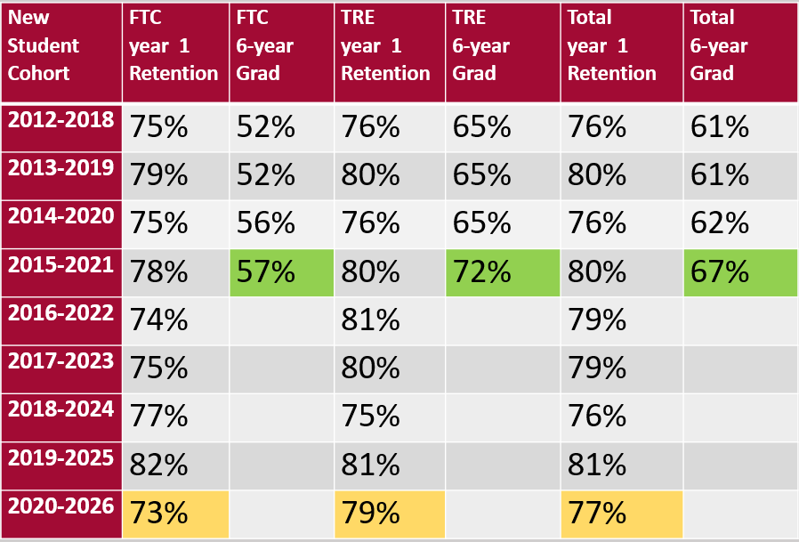
UMSL Strat Plan – Student Success Compact Goals: Increase first- to second-year retention rates from 79% to 82% by 2023. Increase six-year graduation rate from 60% to 65% by 2023.

Slide 17
Campus Graduation Rates by Student Group
 | FTC | FTC | FTC | TRE | TRE | TRE | Comb | Comb | Comb
 | 2013-19 | 2014-20 | 2015-21 | 2013-19 | 2014-20 | 2015-21 | 2013-19 | 2014-20 | 2015-21
Honors College | 72% | 77% | 78% | 84% | 83% | 89% | 75% | 78% | 80%
Transfer with AA | - | - | - | 75% | 77% | 78% | 75% | 77% | 78%
Student Athletes | 71% | 55% | 66% | 68% | 82% | 70% | 66% | 67% | 68%
Pell Recipients | 44% | 49% | 53% | 63% | 63% | 71% | 58% | 59% | 66%
First Generation | 48% | 49% | 53% | 61% | 61% | 69% | 58% | 58% | 64%
Under-represented | 49% | 49% | 52% | 59% | 58% | 65% | 55% | 55% | 60%
Veterans | - | - | - | 63% | 48% | 68% | 63% | 47% | 67%
International | 62% | 74% | 80% | 89% | 74% | 74% | 75% | 74% | 78%
Total | 52% | 56% | 57% | 65% | 65% | 72% | 61% | 62% | 67%

Slide 18
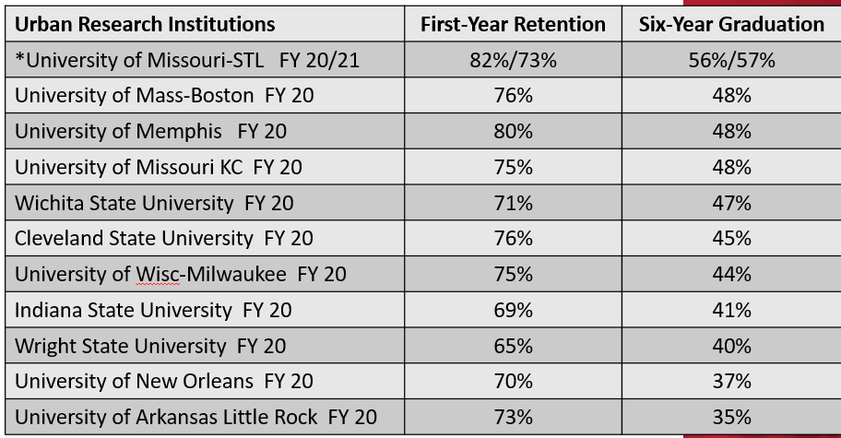
Narrowed Peers ranked by FTC Grad Rates
*FY21 numbers for our urban peers are not available yet, but UMSL should remain on top for
6 year graduation.

Slide 19
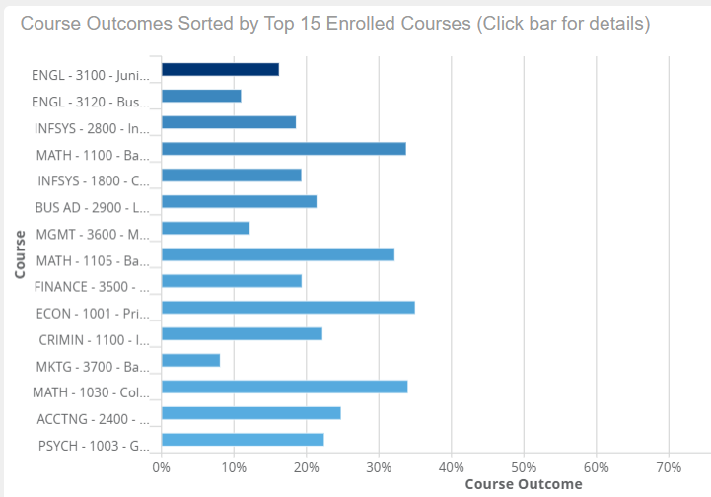
Starfish Analytics
An investment in predictive analytics at the course and student level has provided models based on long-term historical data and rolling 4-year data that assist with:
Targeting resources and supports to courses and students that need them the most
Designing interventions to impact velocity scores
Strategic curriculum planning to remove roadblocks to completion

Slide 20
Access, Academic Support & Workforce Integration Natissia Small
Vice Provost for
Access, Academic Support,
& Workforce Integration

Slide 21
SASS
Precollegiate Student Services
K-12 Students and Parents
School Administrators, Teachers, Counselors, etc.
Community Organizations
Academic Affairs
Division of Student Academic
Support Services
TRIO Student Support Services
Eligible transfer students who meet at least one of the federal TRIO criteria: (1) First-Generation (2) Pell Eligible (3) Documented Disability
Students with cumulative 2.49 and below campus-wide:
(1) Conditional admits (2) Academic probation
(3) Suspension reinstatements (4) Financial Aid SAP Back on Track referrals (5) Manages all campus early alerts for all 2.49 and below (6) Academically challenged;
(7) Oversight for Early Alert System
Student Enrichment & Achievement
Leadership Team
Dr. Channon Peoples, PSS-Bridge Director
Dr. Maya Scruggs-Hicks, SEA Director
Derrick Freeman, M.Ed., MSS Director
Jake Long, M.Ed., TRIO Director
Multicultural Student Services
All students 2.5 and above campus-wide:
(1) Diversity Scholarship Recipients
(2) SEA non-probationary students
(3) Early alerts for 2.5 & above students
nts
University Tutoring Center
All UMSL student tutoring options:
(1) Paired Peer (individual) (2) Walk-in
(3)Student Organization Study Night (4) Alumni
(5) NetTutor Online (6) Triton Online Tutors
Workforce Integration
Serving workforce needs to increase the St Louis region and beyond talent pool by creating a variety of educational pathway options for: (1) Adult learners (2) High School (3) Employers (4) Mid-Career Learners (5) Justice Community and more.

Slide 22
Strategic Plan Pillars: Marketing & Outreach / Student Success / Academic Programs & Pathways - Outcomes
Maintained efficient and effective holistic academic support coaching model for all students
Managed 74.3% of the campus wide academic performance flags with 99.8% clearance
Managed over 1,500 flags per semester for Fall 2021 and Spring 2022
90% Triton LEAP probationary admits enrolled Summer Transition Enrichment Program (STEP) persisted with 2.51 cumulative gpa & prob. transfer admits earned an average term 2.40 gpa
Triton LEAP students completed an average of 13 credit hours during the Fall 2021 semester
1063 connected to tutoring with 90% average students who met with averaging C or better
UTC employed more than 200 graduate and undergraduate students as tutors (94 SST grant funded)
Enhanced asynchronous coaching & tutoring options for students (evening/weekends)
PSS provided dual enrollment courses in English & Psychology to 20+ junior and senior students
PSS (Bridge) continues to serve more than 4000+ students and parents yearly
PSS (Bridge) collaborates with more than 143 local public/private/home schools and 99 middle schools; 9 Bridge sponsored math and science after school clubs
Launched major specific pipeline programs in partnership with 3 academic colleges
Launched virtual “College Prep Talks” w/600+ high school and expanded academic support “Commit to Success” workshops
Office of Workforce Integration (WI) department implemented & launched
WI launched key partnerships with Amazon, Generations/Verizon, STL County, etc.
Cross-collaboration from yield to enrollment with Enrollment Management

Slide 23
2022-2023 Initiatives
Access, Academic Support, & Workforce Efforts
Campus, Community & Corporate Collaborations
Access
Academic Support
Workforce Integration
College Access Programming (pipeline efforts)
Summer Transition Program (full scale)
Comprehensive Support & Coaching Model
Student Academic Support Committee (SAS-C expansion)
St Louis Graduates
Early Alert Program
Mentoring
gender-specific
diversity\research focus
McNair (applicant)
Tutorial Centralize Support
SST Grant
Workforce Integration & continuing education

Slide 24
Center for Teaching and Learning Keeta Holmes
Assistant Vice Provost for
Academic Innovation and
Director, Center for Teaching and Learning

Slide 25
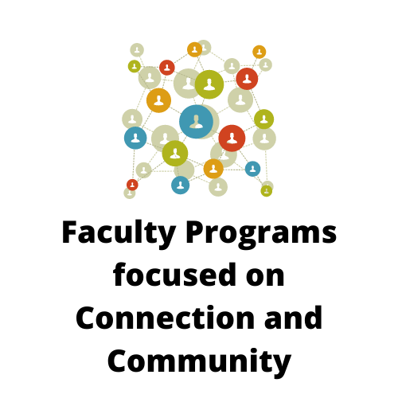
Center for Teaching and Learning
Summer CAMP (Collaborating to Advance Meaningful Partnerships) – (53 faculty across 3 cohorts)
Faculty Learning Communities
Creative/Alternative Assessments (12 faculty)
Transparency/Designing Writing Assignments (12 faculty)
Statistics Teaching Circle (14 faculty)
Anti-Racist Educators Group (12 faculty)
ACUE Lunch n Learn monthly meetings (53 faculty)
Part-Time Faculty Advisory Group (9 Faculty) Part-Time Faculty Teaching Circle (22 Faculty)
New Faculty Orientation (Extended Orientation) (6 Faculty) and Part-Time Faculty Orientations (72 Faculty)
20th Annual Focus on Teaching and Technology Conference (1,950 Participants representing over 465 institutions)

Slide 26
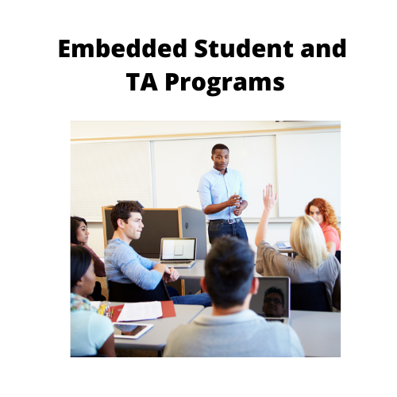
Center for Teaching and Learning
Embedded Student Leaders
Supplemental Instruction (SI)
Active Learning Assistant (ALA)
Students as Partners
Summer CAMP (13 student partners)
Designing Writing Assignments FLC (3 students)
Teaching Assistants and Graduate Assistants
Teaching Assistant Academy (60 students)
Certificate in University Teaching (30 students)

Slide 27
CTL Plans for 2022-2023
Summer CAMP (Collaborating to Advance Meaningful Partnerships)
Faculty Learning Communities
Writing Assignments
Culturally Responsive Teaching *New in 2023
Anti-Racist Educators Group
ACUE Lunch n Learn monthly meetings
Part-Time Faculty Advisory Group Part-Time Faculty Teaching Circle
New Faculty Orientation (Extended Orientation) and Part-Time Faculty Orientations
Annual Focus on Teaching and Technology Conference
Teaching Assistant Academy
Certificate in University Teaching
Supplemental Instruction (SI) program
Active Learning Assistant (ALA) program
Tritons as Partners (partnering students with new faculty)

Slide 28
UMSL Global Liane Constantine
Executive Director of UMSL Global

Slide 29
UMSL Global Celebrating comebacks after pandemic limitations and planning for robust campus internationalization
Student and faculty mobility opportunities are on the rise.
In-person international student events are back.
The International Performing Arts Series is back!
Hosted 50 international events since September 2021 with you and for you.
International Fellowships – pathway to global partnerships and research.
UMSL Global provides campus growth. High value: cultural, tuition/revenue, impact on rankings.

Slide 30


Outlook 2022 / 2023
Initiative | Details
UMSL Global Strategic Plan | Develop bold, exciting and feasible 5-year plan
Alignment with campus enrollment strategies | Consultancy assessment, marketing and diversified messaging.
Spring / summer 2022 | CRM and other technology tools build-out for increased efficiency levels in international student enrollment and partnerships management.
UMSL Global staff | Hiring, training and retaining team members
Faculty networks and partnering opportunities | GFAN, Fellowships, committees, and events
Endowed professorships and culture centers | Core of international community outreach and campus internationalization.
Increase international enrollment | Direct recruiting, agents, partnerships, retention activities and through improved technology and staffing levels. Off-shore programming.
Our “currency” for success | Our faculty community, their expertise, ideas and commitment

Slide 31
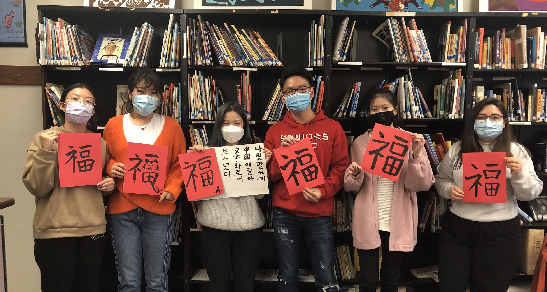
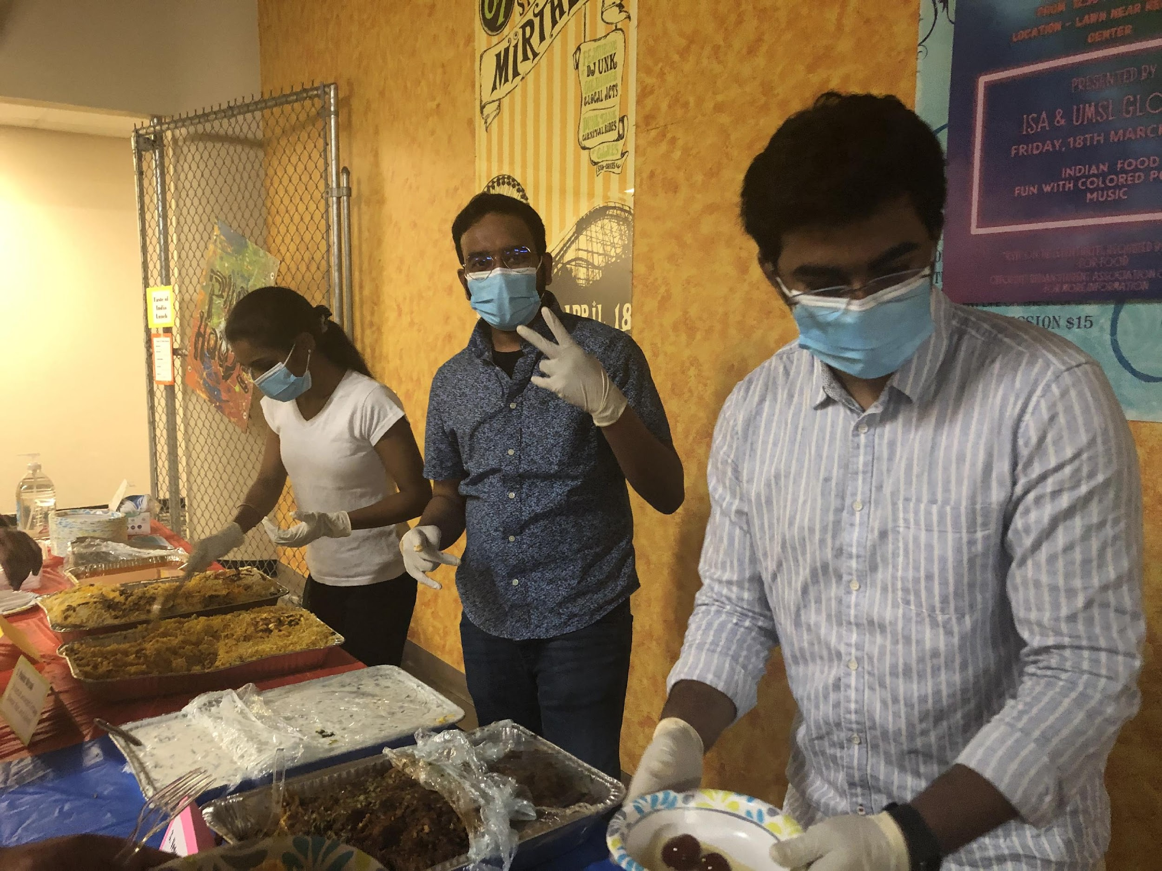

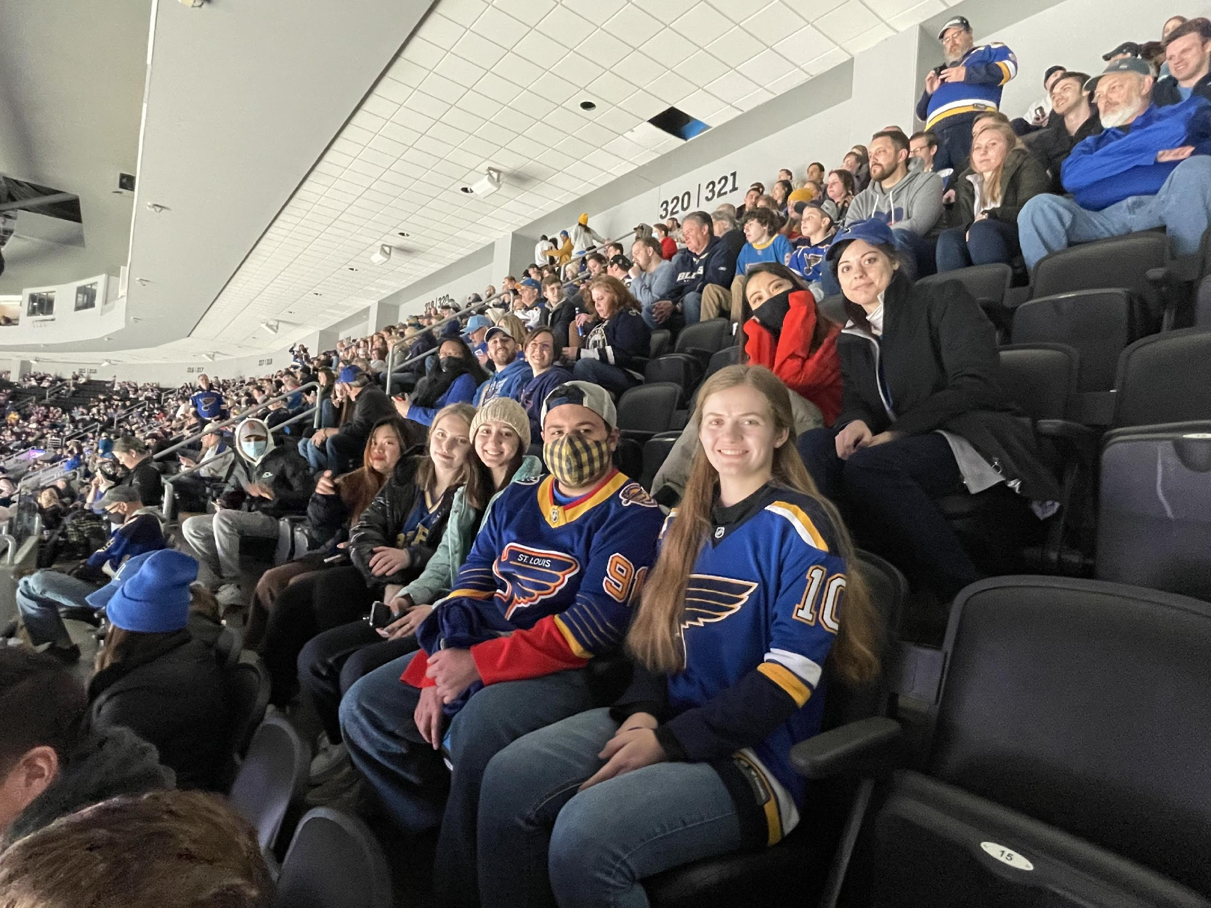
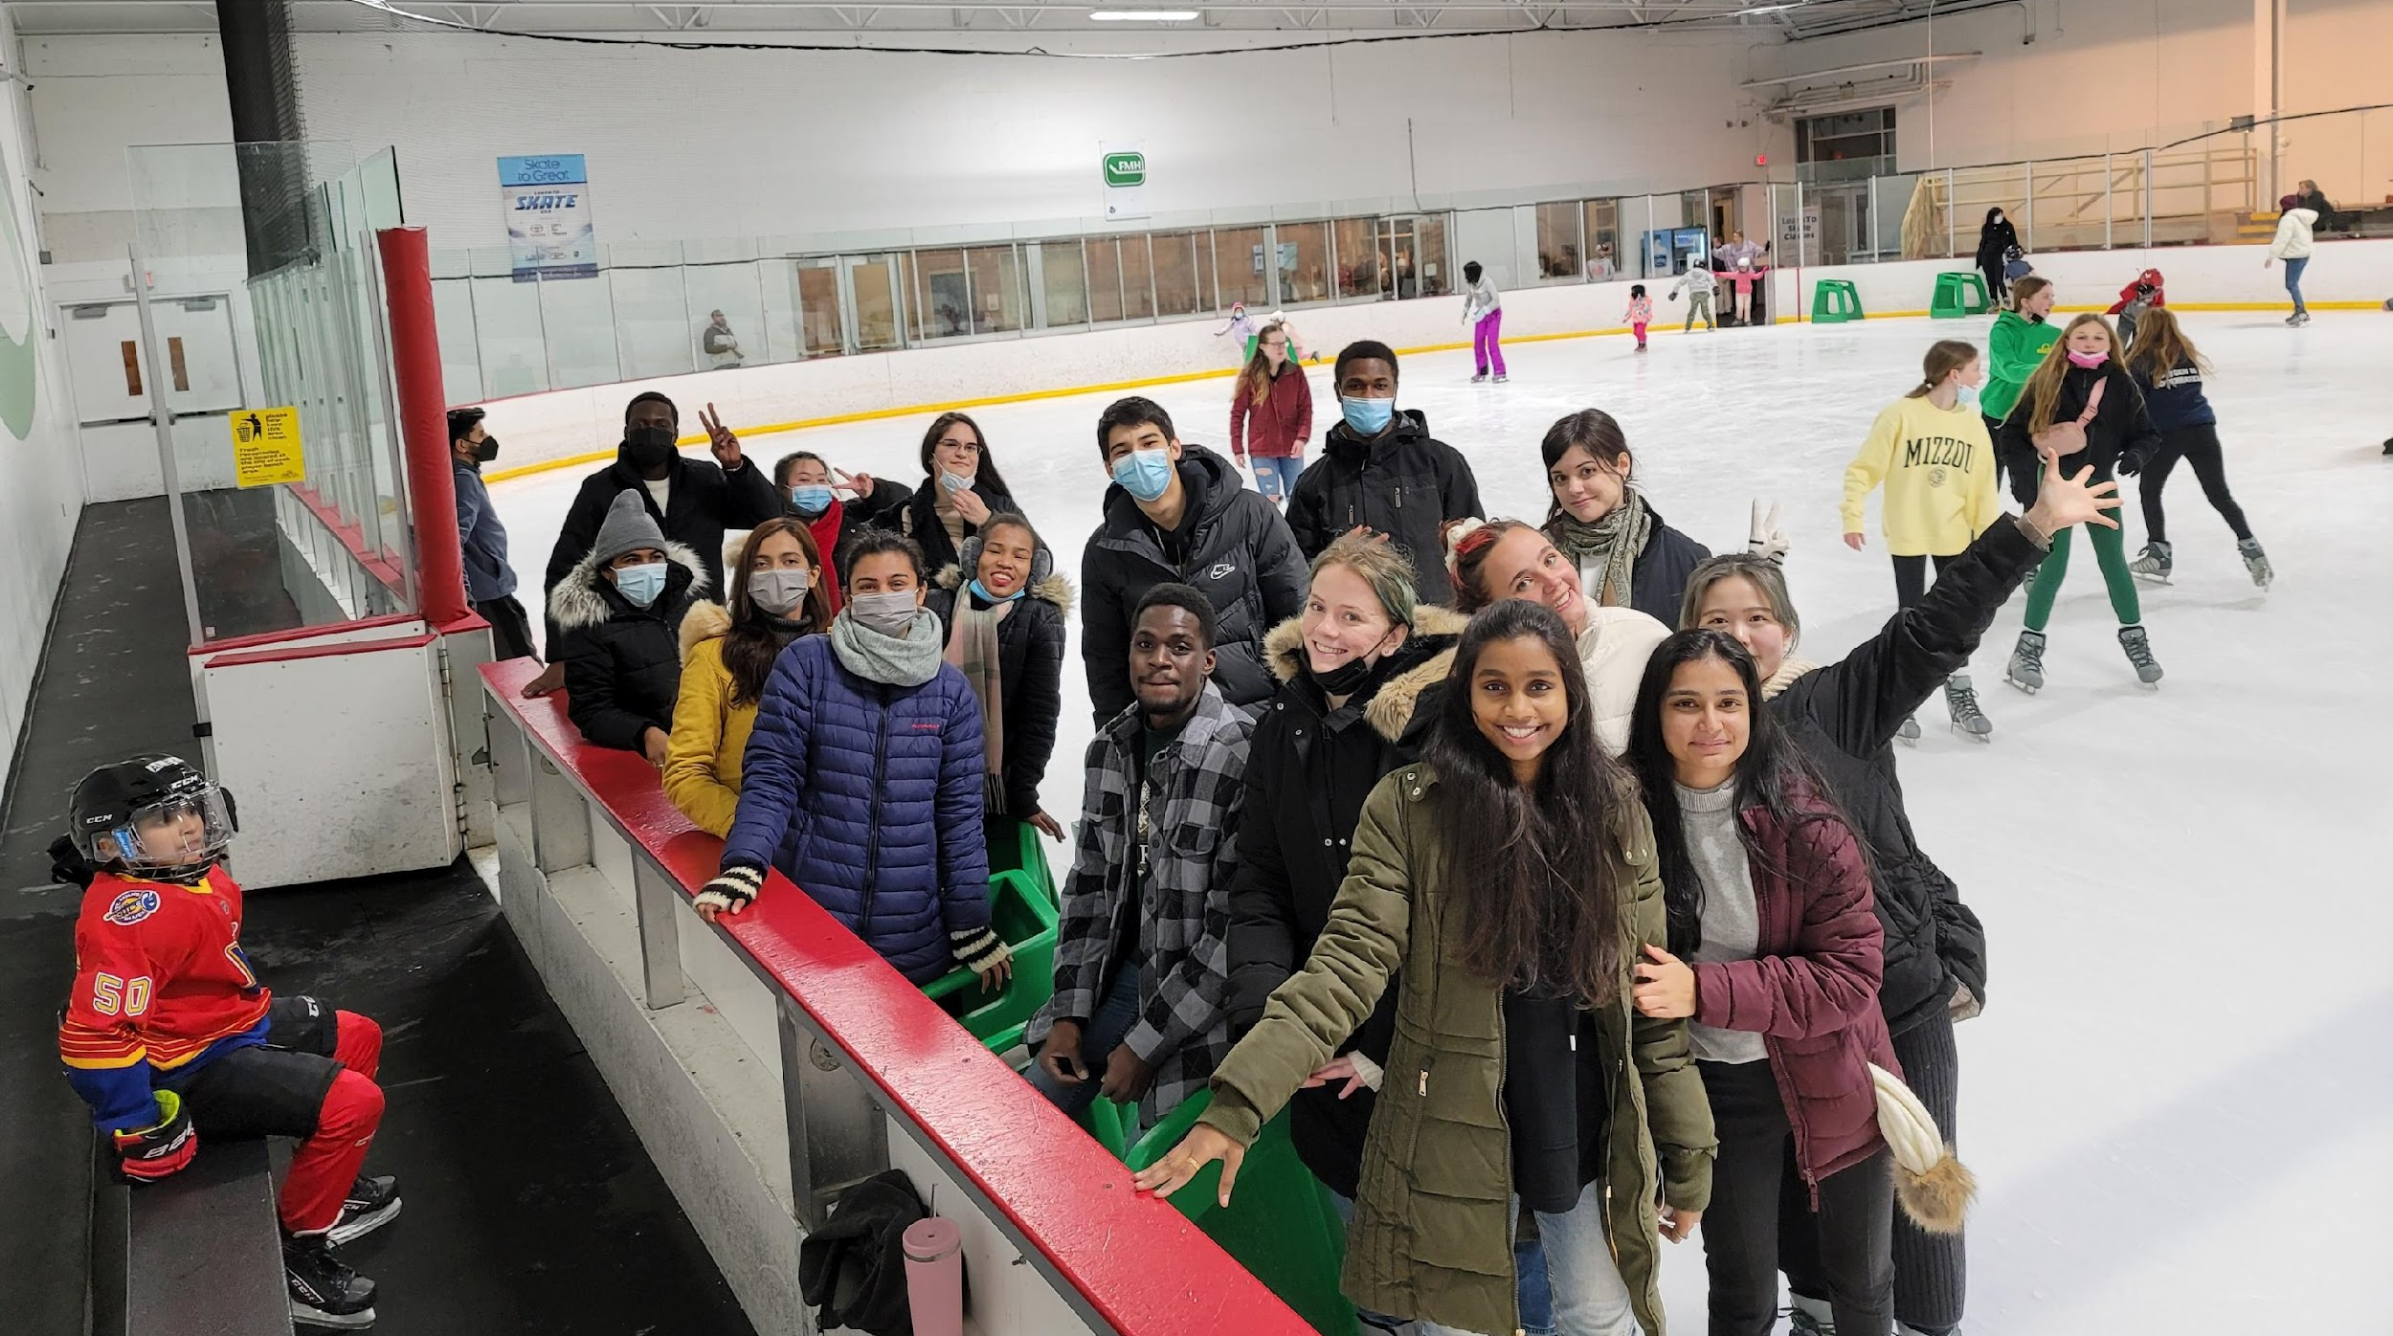
Holi
Lunar New Years Calligraphy
Ice Skating
Blues Hockey Night

Slide 32
Student Affairs D’Andre Braddix
Associate Vice Provost & Dean of Students
Jessica Long-Pease
Associate Vice Provost for Campus Life

Slide 33
Student Affairs Initiatives
Handshake
Prayer Rooms on North and South Campus
Triton Technology Loaner Program
Campus Dining and Vending Contracts
Triton Connect
Centralized Event Services

Slide 34
Student Affairs Highlights
Student Services
2,211 employer/student meetings during career fairs
150 conduct cases investigated: 94 academic integrity and 56 student conduct
Contact tracing for over 1,000 COVID-19 reports
573 students supported through CARE
$17,000 Grant for UMSL Veterans Center
Campus Life
51 customized live streams to expand access to campus events
6,054 program attendees during the 2021-2022 academic year
919 bookings in Touhill Performing Arts Center
75 summer interns and 13 conference groups in residential housing for Summer 2022
U-Create Summer Camps Full for Summer 2022

Slide 35
Academic Affairs
Amber Reinhart
Associate Provost for Academic Affairs

Slide 36
AA Highlights: 2021-2022
Monthly meetings with department chairs, program directors, and associate deans
Formalized hiring process
Added Office of Institutional Research
Faculty Development
Open Office Hours
New Degree Programs
Student Success Initiatives
Diversity Requirement Changes

Slide 37
Five-year reviews by the numbers
(Summer 21-Spring 22)
Total of 18
8 Academic Departments
Criminology and Criminal Justice
Economics
English
Global Leadership and Management
Marketing and Entrepreneurship
Philosophy
Political Science
Supply Chain and Analytics
4 Colleges/Schools
College of Arts and Sciences College of Education
School of Social Work Joint Engineering Program
2 Centers/Units
Children’s Advocacy Center
Faculty Senate
4 Administrative Units
Academic Affairs
Office of Diversity, Equity and Inclusion
Research and Economic & Community Development
UMSL Global

Slide 38
Five-year reviews (Summer 21-Spring 22)
18 External Reviewers
59 Campus Reviewers (faculty and staff)

Slide 39
Five-year reviews (Summer 21-Spring 22)
Alice Hall Haitao Li David Stofer Danielle Faucett Michael Elliott
Annie Vandermause Carl Bassi Jim Craig Marvin Berkowitz Timothy Makubuya
Aimee Dunlap Keri Jupka Lara Zwarun Michael Gearhart Nancy Magnuson
Theresa Coble Shaji Khan John Meriac Gaiyan Zhang Kevin Fernlund
Suahn Cho Matt Taylor Anne Winkler Adrian Clingher Amanda Bequette
David Kimball Vivek Singh Dan Gerth Marc Spingola Lon Chubiz
Steve Moehrle Dan Sise Andy Goodman Laura Westhoff Eiji Goto
Ekin Pellegrini Jennifer Nolan Andres Pedraza Sheila Grigsby Shea Kerkhoff
Justin Roberts Lynn Staley Joe Pickard Seemantini Pathak Shirley Porterfield
D'Andre Braddix Julie Bertram Leigh Heisel Deborah Cohen Keith Stine
Andrew Black Nancy Singer Emily Gerstein Dan Lauer
Emily Ross Ann Steffen Michael Nichols
Perry Drake Qingtang Jiang

Slide 40

Five-year reviews (Summer 21-Spring 22)
Alice Hall Haitao Li David Stofer Danielle Faucett Michael Elliott
Annie Vandermause Carl Bassi Jim Craig Marvin Berkowitz Timothy Makubuya
Aimee Dunlap Keri Jupka Lara Zwarun Michael Gearhart Nancy Magnuson
Theresa Coble Shaji Khan John Meriac Gaiyan Zhang Kevin Fernlund
Suahn Cho Matt Taylor Anne Winkler Adrian Clingher Amanda Bequette
David Kimball Vivek Singh Dan Gerth Marc Spingola Lon Chubiz
Steve Moehrle Dan Sise Andy Goodman Laura Westoff Eiji Goto
Ekin Pellegrini Jennifer Nolan Andres Pedraza Sheila Grigsby Shea Kerkhoff
Justin Roberts Lynn Staley Joe Pickard Seemantini Pathak Shirley Porterfield
D'Andre Braddix Julie Bertram Leigh Heisel Deborah Cohen Keith Stine
Andrew Black Nancy Singer Emily Gerstein Dan Lauer
Emily Ross Ann Steffen Michael Nichols
Perry Drake Qingtang Jiang

Slide 41
Research Activities
Chris Spilling
Vice Chancellor for Research and Economic and Community Development

Slide 42
Grant Expenditures
Grant Awards
So far in FY2022, a total of 194 awards have been received through March for $27,454,807 for research and other sponsored activities.
In FY2021, a total of 183 awards were received for $28,324,729 through March and $32,353,483 (229 awards) for the year
In FY2020, a total of 167 awards were received for $25,503,180 through March and $29,597,437 (207 awards) for the year.
 | 2013 | 2014 | 2015 | 2016 | 2017
Instruction | 523,804 | 596,094 | 498,258 | 227,326 | 376,737
Other Sponsored Activities | 12,127,085 | 10,344,314 | 9,740,270 | 10,166,399 | 12,118,343
Research | 9,889,902 | 7,812,963 | 6,155,407 | 7,229,336 | 7,548,681
Grand Total | 22,540,791 | 18,753,371 | 16,393,935 | 17,623,061 | 20,043,761
2018 | 2019 | 2020 | 2021 | 2022*
453,229 | 798,208 | 690,450 | 739,108 | 1,992,683
15,010,248 | 17,471,481 | 17,239,105 | 17,157,126 | 18,066,745
8,723,940 | 8,975,001 | 8,877,924 | 8,693,684 | 6,318,053
24,187,418 | 27,244,690 | 26,807,479 | 26,589,918 | 26,377,482
*through April 2022

Slide 43
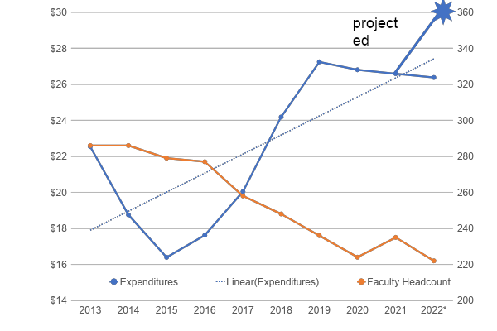

Grant Expenditures
*

Slide 44
New Programs to Stimulate Research
Already Achieved
Early career research network (ECRN)
Faculty research data base (IRL@UMSL) (and academic insights from academic analytics)
Additional grant writer/reviewer
Mid career faculty programs
Grantsmanship workshops, expert proposal review, agency specific boot camps, etc.
External mentoring program for ECRN cohort
Junior faculty symposium to foster collaboration
Statistical training for faculty
Qualitative methods training
Research Enabled
Federal white papers
And more…….
New
Increased seed funding for individual and collaborative research
Research infrastructure and research data base access (FRSDC)
Travel costs to meet with program officers
UMSL Research Board

Slide 45


Slide 46
Academic Campus Consolidation
Matt Prsha
Interim Executive Director of Facilities

Slide 47
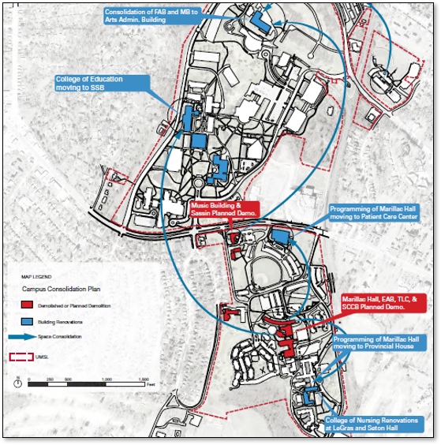
Objectives of the UMSL ARPA Projects
Rightsizing campus by reducing square footage and making smart use of existing space
Unify campus
Improve building quality across the board
Create a sense of community through engagement areas
Employ landscape as low-cost strategy to improve engagement and connectivity

Slide 48
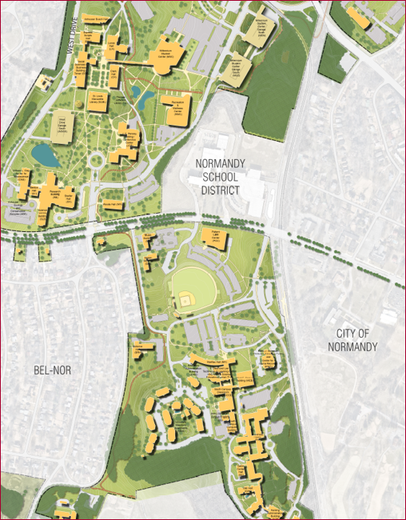
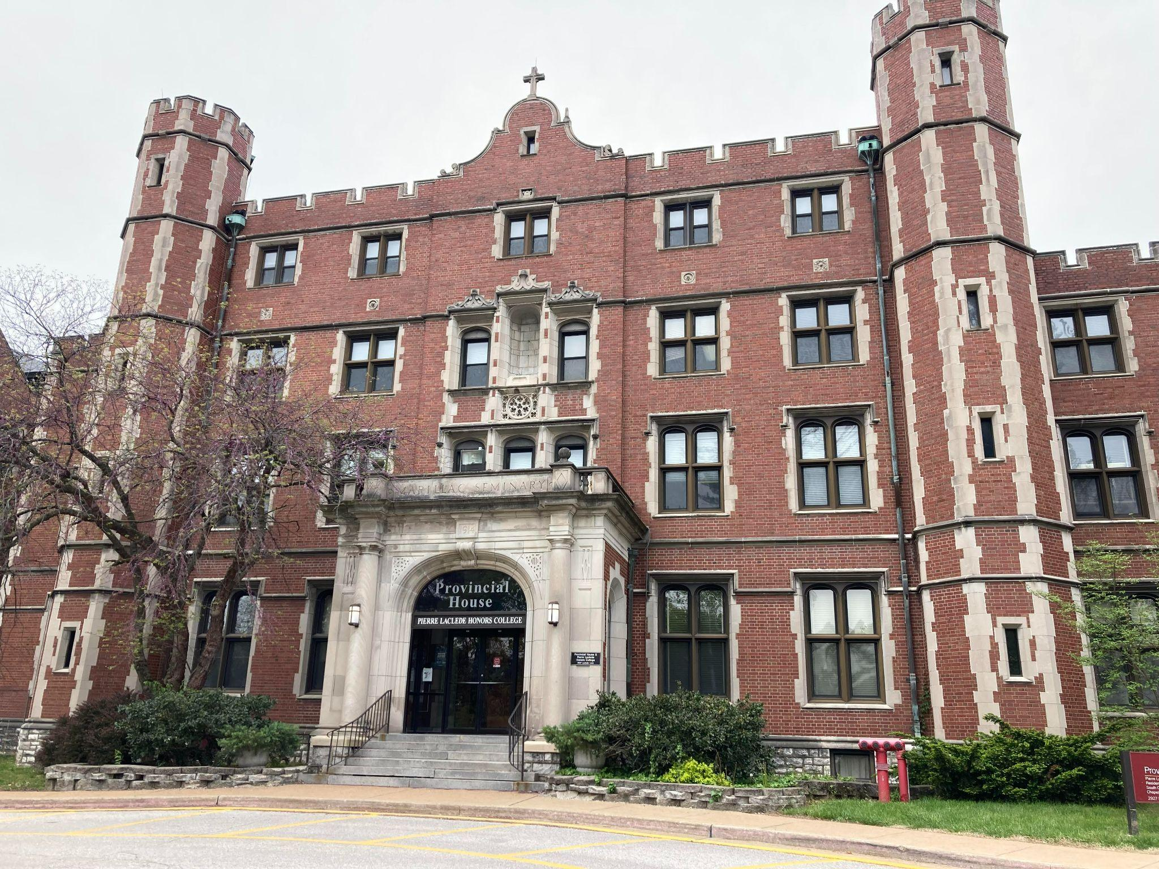
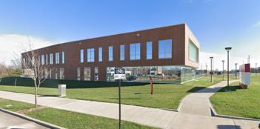
Optometry to PCC
Optometry and Honors Consolidation
Scope
Renovate the Patient Care Center and Provincial House, relocate Optometry, and demo Marillac Hall. The demolition of Marillac will remove $16 M from campus deferred maintenance and the College of Optometry will move into a new renovated Patient Care Center (PCC). The remainder of coursework outside of the PCC will be conducted in Provincial House.
Build-out shell space on the 2nd floor of the Patient Care Center (PCC) for the College of Optometry
Renovate additional space in Provincial House for Honors and Optometry
Demo Marillac
Demo
Marillac Hall
Area: 31,500 Sqft
Renovate
Patient Care Center (PCC)
Area: 13,000 Sqft
Provincial House
Area: TBD

Slide 49
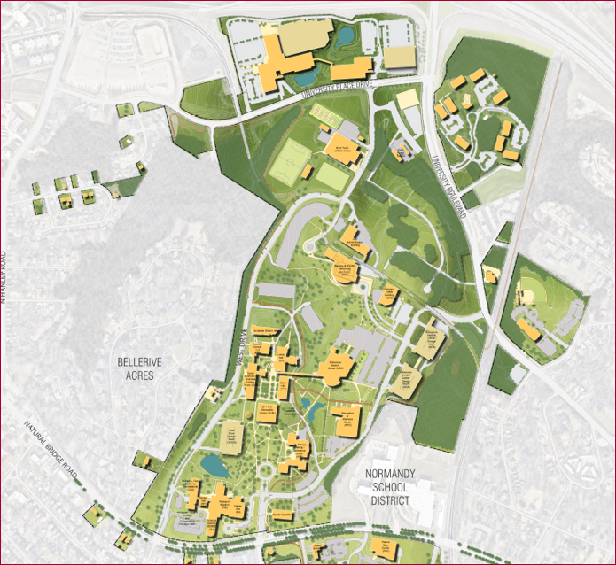
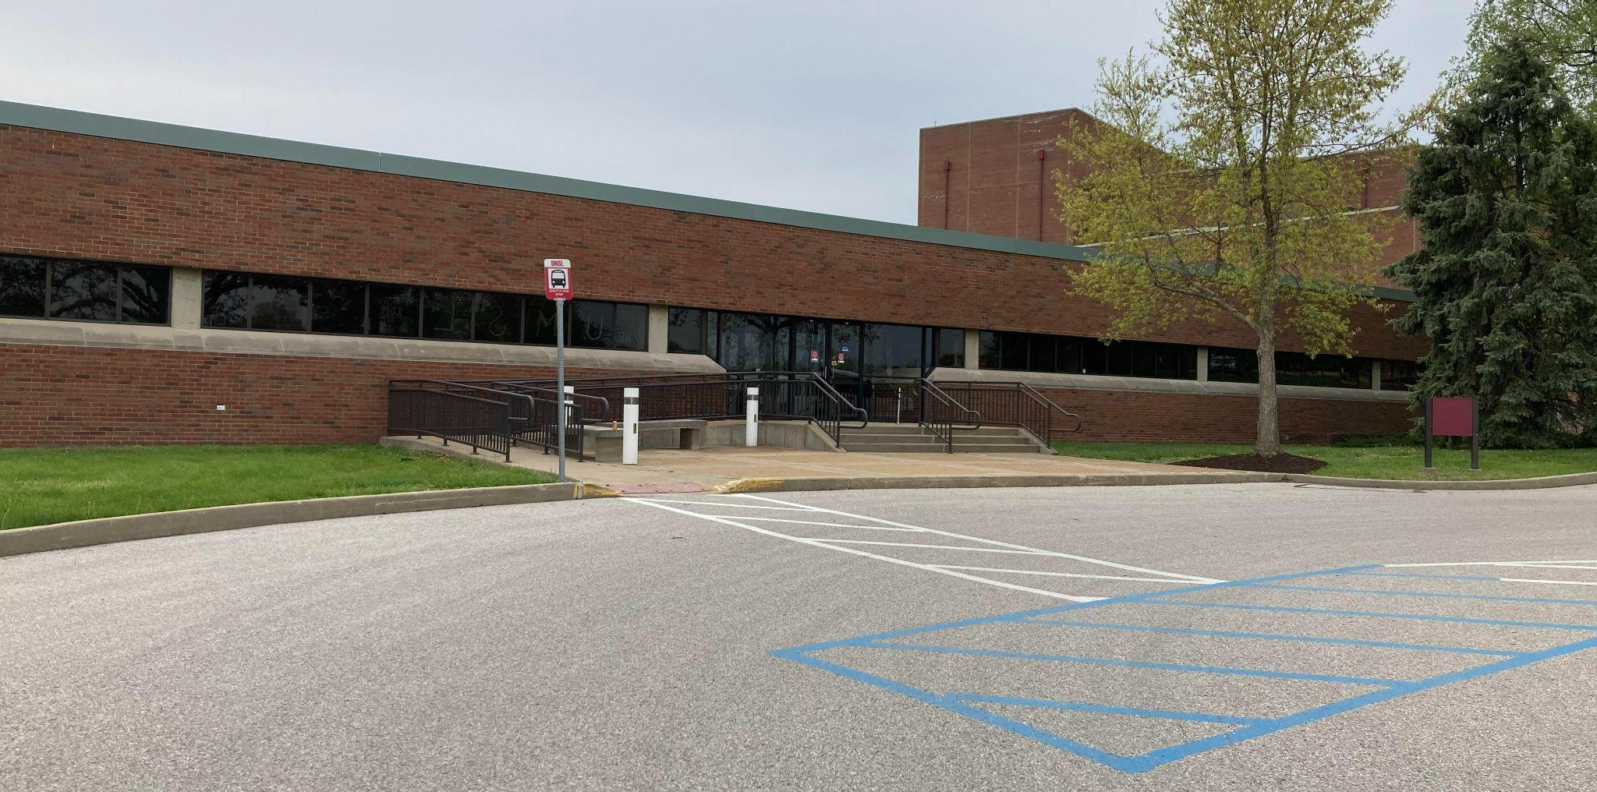
3) Music and Fine Arts to AAB
Scope
Consolidate music and fine arts to the Arts & Administration Building (AAB) on the North Campus. Includes interior renovation and infrastructure improvements to AAB
Demo Music Building
Demo
Music Building
Area: 25,300 Sqft
Relocate
Fine Arts Building
Area: 31,400 Sqft
Renovate
Arts and Administration Building
Area: TBD

Slide 50
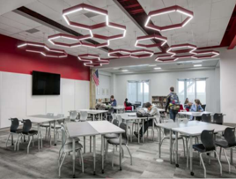
4) College of Education to Quad Area
Scope
Renovate Social Sciences & Business Building (SSB). Scope includes interior renovations and improvements to building infrastructure
Relocate the College of Education from South Campus to the quad area on North Campus
Demo existing COE spaces on South Campus
Demo
South Campus Classroom
Area: 55,500 Sqft
E. Desmond Lee Technology and Learning Center
Education and Administration Building
Marillac Hall
Area: 31,500 Sqft
Renovate
Social Sciences & Business Building (SSB)
Area: 143,800 Sqft

Slide 51
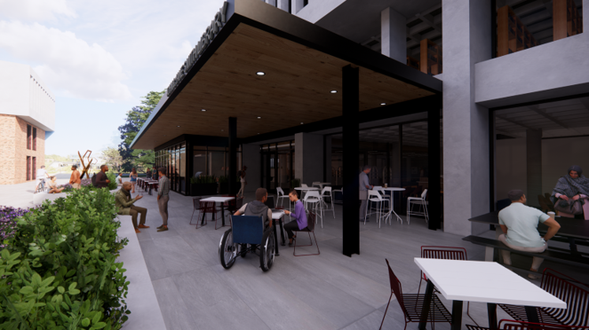
5) Library Renovation
Scope
Renovate Thomas Jefferson and Mercantile libraries. Includes new student-focused spaces on the main level, a cafe area, and an additional entrance on the north side of the library to improve connection with the quad
Relocate existing SSB computer lab to TJ library
Relocate library staff to a new administrative suite on the 5th floor
Relocate
SSB Computer Lab
Renovate
TJ / Mercantile Library
Area: 35,000 Sqft

Slide 52
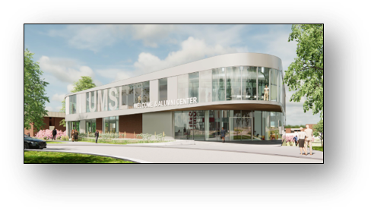
6) Welcome / Alumni Center
Scope
Renovate the J.C. Penney Building into a state-of-the-art Welcome / Alumni Center to enhance the campus experience for prospective students and visiting alumni
Renovate
J.C. Penney Building
Area: 25,000 Sqft

Slide 53
Summary
Renovations
Arts Administration Building (AAB) | Provincial House
JCPenney - Welcome / Alumni Center | Social Sciences & Business (SSB)
Patient Care Center (PCC) | Thomas Jefferson / Mercantile Library
Demo Buildings
E. Desmond Lee Technology and Learning Center (TLC) | Music Building
Education Administration Building | Sassin Building
Marillac Hall | South Campus Classroom Building

Slide 54
Academic Year
2022-2023
Steve Berberich
Provost &
Interim Vice Chancellor
for Academic Affairs

Slide 55
Fall 2022
Strategic Planning
Task Force on Graduate Support
Sabbatical Leaves for AY 23-24
NTT Leave process (Faculty Senate)
15 to Finish Campaign
Faculty and Staff Leadership Program

Slide 56
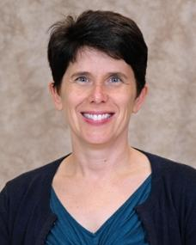
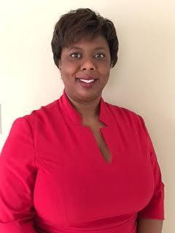
New Associate Provosts
Alice Hall - Associate Provost for Faculty Affairs
Colette Dixon - Associate Provost for Student Success

