Slide 1
SEO and Content Strategy

Slide 2
Content
1. The Importance of SEO and Content
2. Identifying and Understanding Your Audience
3. Crafting Effective Content
4. Best Practices for SEO and Accessibility in Images

Slide 3
Section 1
The Importance of SEO and Content

Slide 4
SEO serves as the backbone of effective content creation by ensuring that content is discoverable and relevant to search queries, thereby increasing visibility and driving organic traffic to websites.
Understanding the Role of SEO in Content Creation
High-quality content that meets user intent not only enhances engagement but also positively influences SEO rankings, as search engines prioritize content that provides value and satisfies user needs.
Bounce rate
Time on page
Did the query lead to an answer?
Linking Authority

Slide 5
Section 2
Identifying and Understanding Your Audience

Slide 6
Meeting Audience Needs with Relevant Information
Understanding Audience Intent
Content Accessibility
Feedback Mechanisms
Ensuring that information is easily accessible for the target audience through intuitive navigation and clear organization allows users to find what they need quickly, reducing frustration and improving overall experience.
Implementing feedback tools enables continuous improvement of content relevance, allowing organizations to adapt to changing audience needs and preferences effectively over time.
Identifying the specific needs and questions of your audience is crucial for creating relevant content that directly addresses their interests, enhancing user satisfaction and engagement.

Slide 7
External Audiences: Prospective Students and Community
Engaging External Stakeholders
Developing targeted content strategies that resonate with prospective students and community members is essential for fostering interest and building relationships, as it addresses their specific needs and aspirations while enhancing the institution's visibility and reputation.
Prospective Students (Admissions, Individual Departments)
Parents (SFS, Spanish)
Alumni
Donors (Development, Colleges)
Other professors (Faculty directories, Research website)
Other professionals who may want to work here (HR, main site)
Community Members (Child Advocacy/NEST, Touhill)

Slide 8
Internal Audiences: Students and Staff
01
02
03
Understanding Internal Needs
Engagement through Relevant Content
Streamlined Communication Channels
Recognizing the unique information requirements of students and staff is essential for tailoring content that effectively addresses their specific concerns, such as academic policies and HR resources.
Creating content that resonates with internal audiences fosters a sense of community and belonging, encouraging active participation and feedback from both students and staff members.
Establishing clear and accessible communication pathways ensures that internal audiences can easily find and engage with the information they need, enhancing overall satisfaction and productivity.

Slide 9
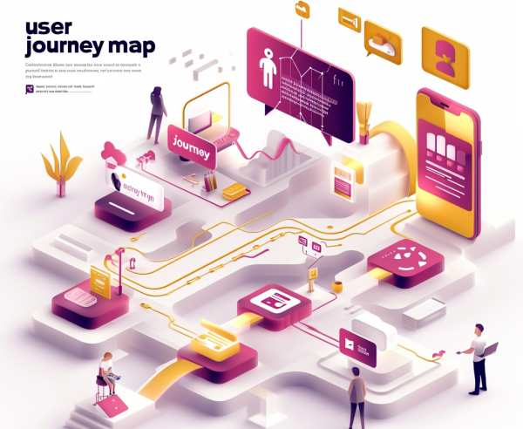
Creating High-Quality Content for Diverse Audiences
Understanding Audience Diversity
Content Relevance and Accessibility
Utilizing Feedback for Improvement
Recognizing the varied backgrounds, interests, and needs of different audience segments is crucial for tailoring content that resonates and engages effectively across diverse groups.
High-quality content must be relevant and easily accessible, ensuring that all audience members can find the information they need quickly, enhancing their overall experience and satisfaction.
Actively seeking and incorporating audience feedback allows for continuous refinement of content strategies, ensuring that the material remains relevant, engaging, and aligned with audience expectations.

Slide 10
Section 3
Crafting Effective Content

Slide 11
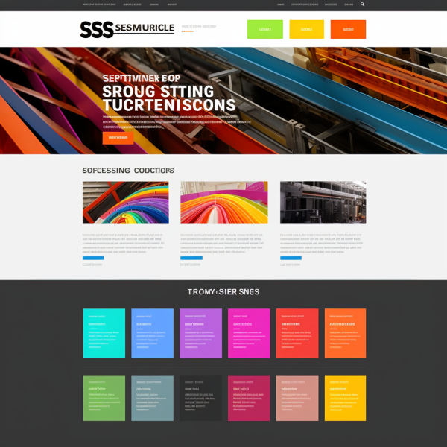
Content-First Design Principles
Prioritizing Content Clarity
Content-first design emphasizes the importance of delivering clear, concise, and relevant information to users before visual elements, ensuring that the primary message resonates with the audience's needs and enhances overall engagement.

Slide 12
Building a Strong Brand Identity through Content
01
02
03
Consistency in Messaging
Visual and Verbal Cohesion
Engagement through Storytelling
A strong brand identity is built through consistent messaging across all content platforms, ensuring that the audience recognizes and relates to the brand's values and mission.
Integrating visual elements with verbal content enhances brand recognition, as cohesive design and language create a unified experience that resonates with the target audience.
Utilizing storytelling techniques in content fosters emotional connections with the audience, reinforcing brand identity and encouraging loyalty among stakeholders.

Slide 13
Aligning Content with Institutional Goals
Strategic Content Alignment
Measuring Impact and Effectiveness
Ensuring that content aligns with institutional goals is essential for reinforcing the mission and vision of the organization, as it creates a cohesive narrative that resonates with both internal and external audiences, fostering a unified brand identity.
Regularly assessing the effectiveness of content in relation to institutional objectives allows for data-driven adjustments, ensuring that content not only meets audience needs but also contributes to the overall success and strategic direction of the institution.

Slide 14
Enhancing User Experience through Navigation
Intuitive Navigation Structures
Implementing clear and logical navigation paths allows users to find information effortlessly, reducing frustration and enhancing overall satisfaction with the website experience.
Scannable Content Design
Utilizing headings, bullet points, and concise paragraphs makes content more digestible, enabling users to quickly scan for relevant information and improving their engagement with the material.
Responsive Design Considerations
Ensuring that navigation is optimized for various devices enhances accessibility, allowing users to have a seamless experience whether they are on a desktop, tablet, or mobile device.

Slide 15
User-Centric Design
Quick access to information is vital for enhancing user satisfaction and engagement, as it minimizes frustration and encourages users to explore further, ultimately leading to a more positive perception of the brand and its offerings.
The Importance of Quick Information Access

Slide 16
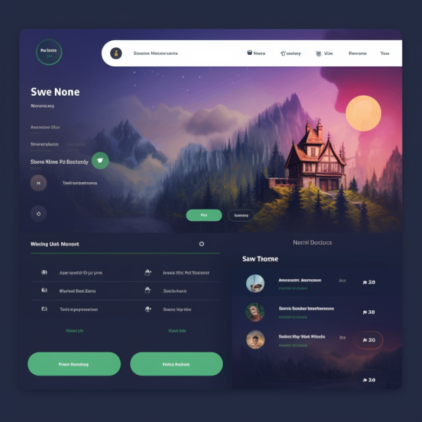
Enhancing User Experience and Engagement
Implementing intuitive navigation structures and scannable content significantly enhances user experience by allowing visitors to locate information quickly and efficiently, thereby increasing engagement and reducing bounce rates.
Familiar navigation terms (contact us)
Check nav on mobile, make sure title and length of menus is not bad
Clear calls to action

Slide 17
Building Trust through Narratives
Engaging storytelling creates relatable narratives that foster trust and emotional connections within the community, encouraging participation and strengthening relationships among stakeholders such as students, alumni, and local residents.
Imagery, Testimonials, UMSL Daily pitches
Utilizing Storytelling for Community Engagement

Slide 18
Section 4
Best Practices for SEO and Accessibility in Images

Slide 19
Writing Descriptive Alt Text for Images
Importance of Alt Text
Descriptive alt text enhances accessibility for visually impaired users and improves SEO by providing search engines with context about the image, thereby increasing the likelihood of appearing in relevant search results.
Concision and Clarity
Alt text should be concise yet descriptive, ideally under 125 characters, accurately conveying the image's content without unnecessary phrases like 'image of' or 'picture of,' ensuring clarity for all users.
Keyword Integration
Including relevant keywords naturally within alt text can boost SEO performance; however, it is essential to maintain a balance between optimization and providing a genuine description of the image content.

Slide 20
Optimizing Image File Names and Sizes
Descriptive File Names
Image Compression Techniques
Responsive Image Sizing
Use clear, keyword-rich file names for images to enhance SEO. This practice provides context to search engines and improves the likelihood of images appearing in relevant search results.
Implement responsive image techniques to ensure images display correctly across various devices. This approach improves accessibility and user experience, contributing positively to overall site performance.
Optimize image sizes through compression to enhance page load speed, which is crucial for user experience and SEO. Utilize formats like JPEG for photos and PNG for graphics to maintain quality.

Slide 21
Ensuring Accessibility and Compliance Standards
01
02
03
Understanding Accessibility Standards
Regular Compliance Audits
Training and Awareness
Conduct regular audits of your website to assess compliance with accessibility standards, identifying areas for improvement and ensuring that all content remains accessible to diverse audiences over time.
Provide training for content creators on best practices for accessibility, fostering a culture of awareness and responsibility that prioritizes inclusive design in all aspects of content development.
Familiarize yourself with key accessibility standards such as WCAG (Web Content Accessibility Guidelines) to ensure that all content is usable by individuals with disabilities, promoting inclusivity and compliance.

Slide 22
Policies and Guidelines
Style Guide
Grammar Guide
Web Policies
Social Media Guidelines
&, en-dash

Slide 23
Thank You
Contact: womblest@umsl.edu, msmoore@umsl.edu

