Slide 1
Participant Feedback
UMSL Literacy Clinic-Spring 2025

Slide 2
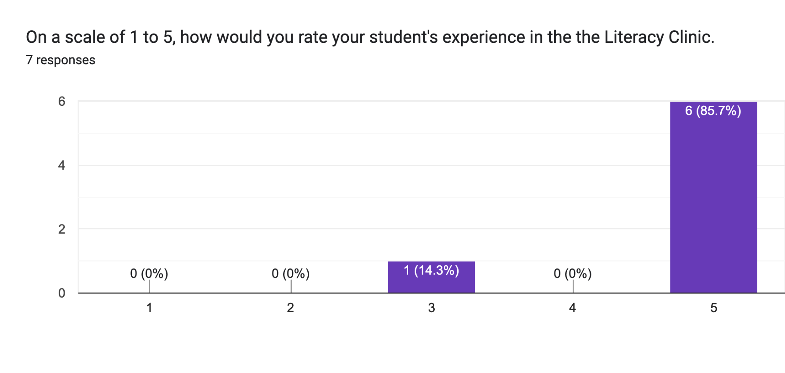
The seven participants who answered the survey rated their student’s experience as 1(out of 3) and the remaining 6(out of 5) the highest rating.

Slide 3
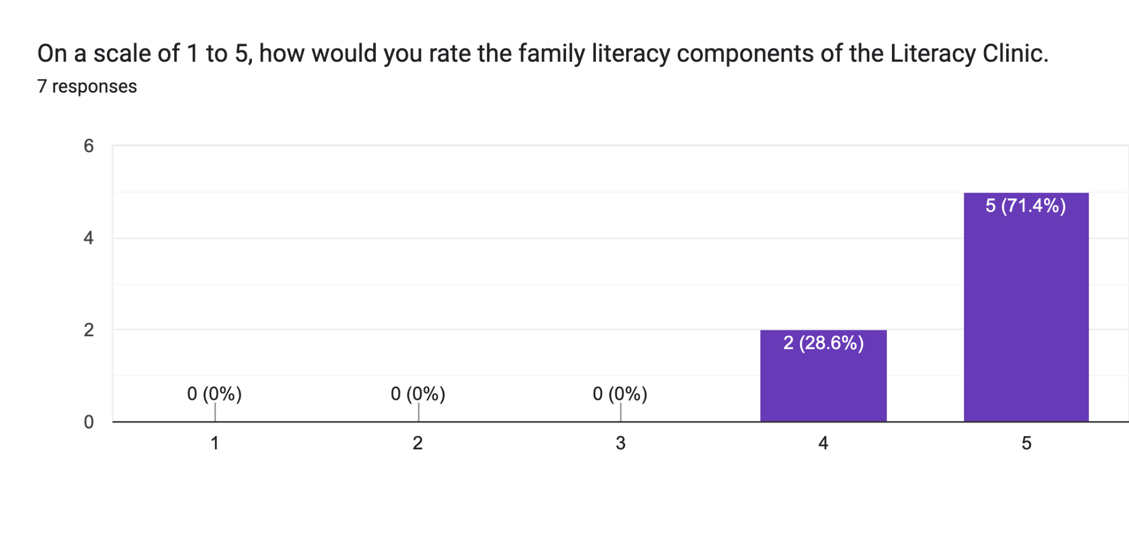
71.4% of the participants responded a (5) on a scale of 1 to 5, and 28.6% responded a (4) out of 5 regarding the Family Literacy Components of the Literacy Clinic.

Slide 4
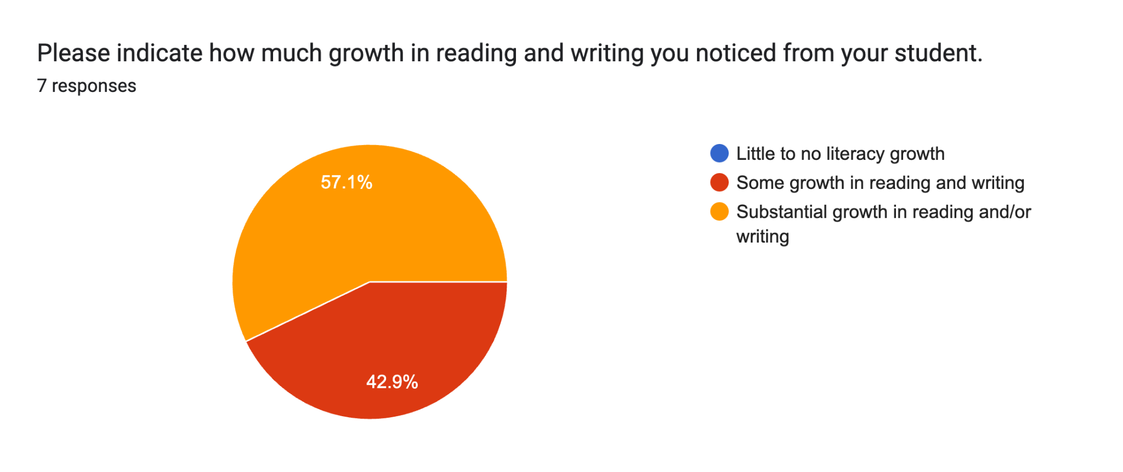
All of the participants responded that their student made growth in literacy 57.1% felt their student made “substantial growth” in literacy, and 42.9% felt they made “some growth” in literacy. None of the participants felt that their student made “little to no literacy growth”.

Slide 5
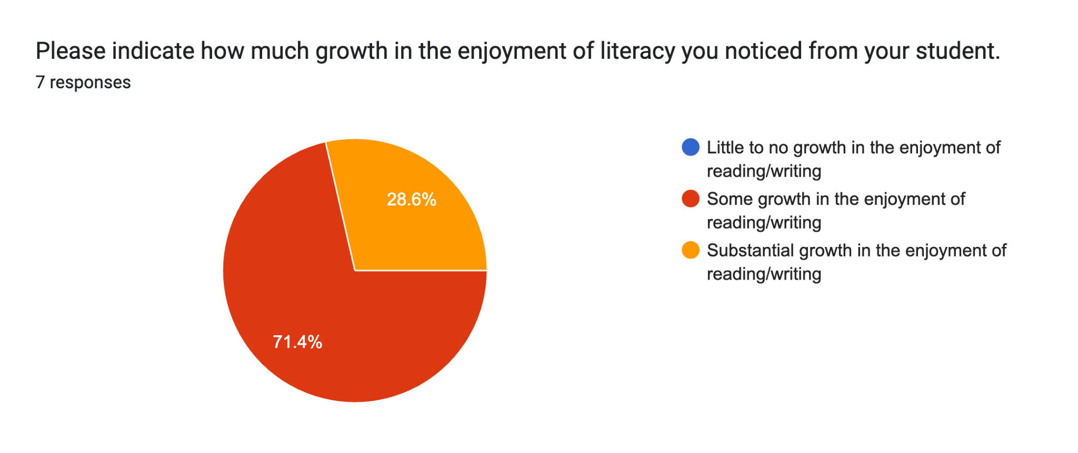
All of the participants responded that their student enjoyed reading/writing more. 71.4% felt that their student made a “substantial growth” and 28.6% felt their student made “some growth” in enjoyment of reading/writing.

Slide 6
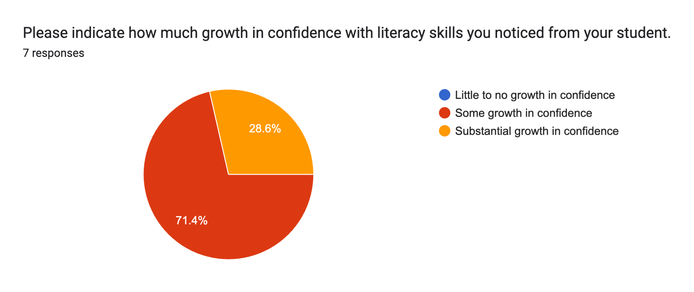
All of the participants responded that their student grew in confidence with literacy skills, with the majority of participants reporting 71.4% “some growth” in confidence. The remaining participants reported 28.6% of the students gained “substantial growth” in confidence.

Slide 7
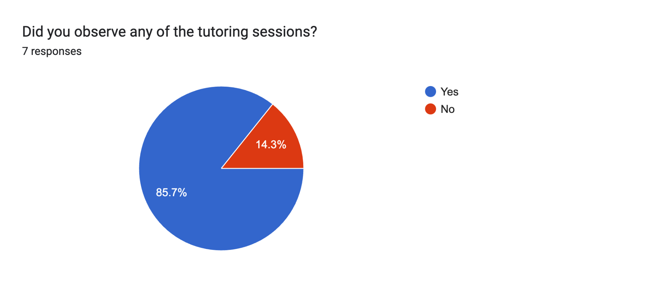
85.7% of the participants reported that they observed the tutoring sessions, while only 14.3% did not observe the sessions.The majority of the participants also attended the Family Literacy Nights sessions throughout the semester.

Slide 8
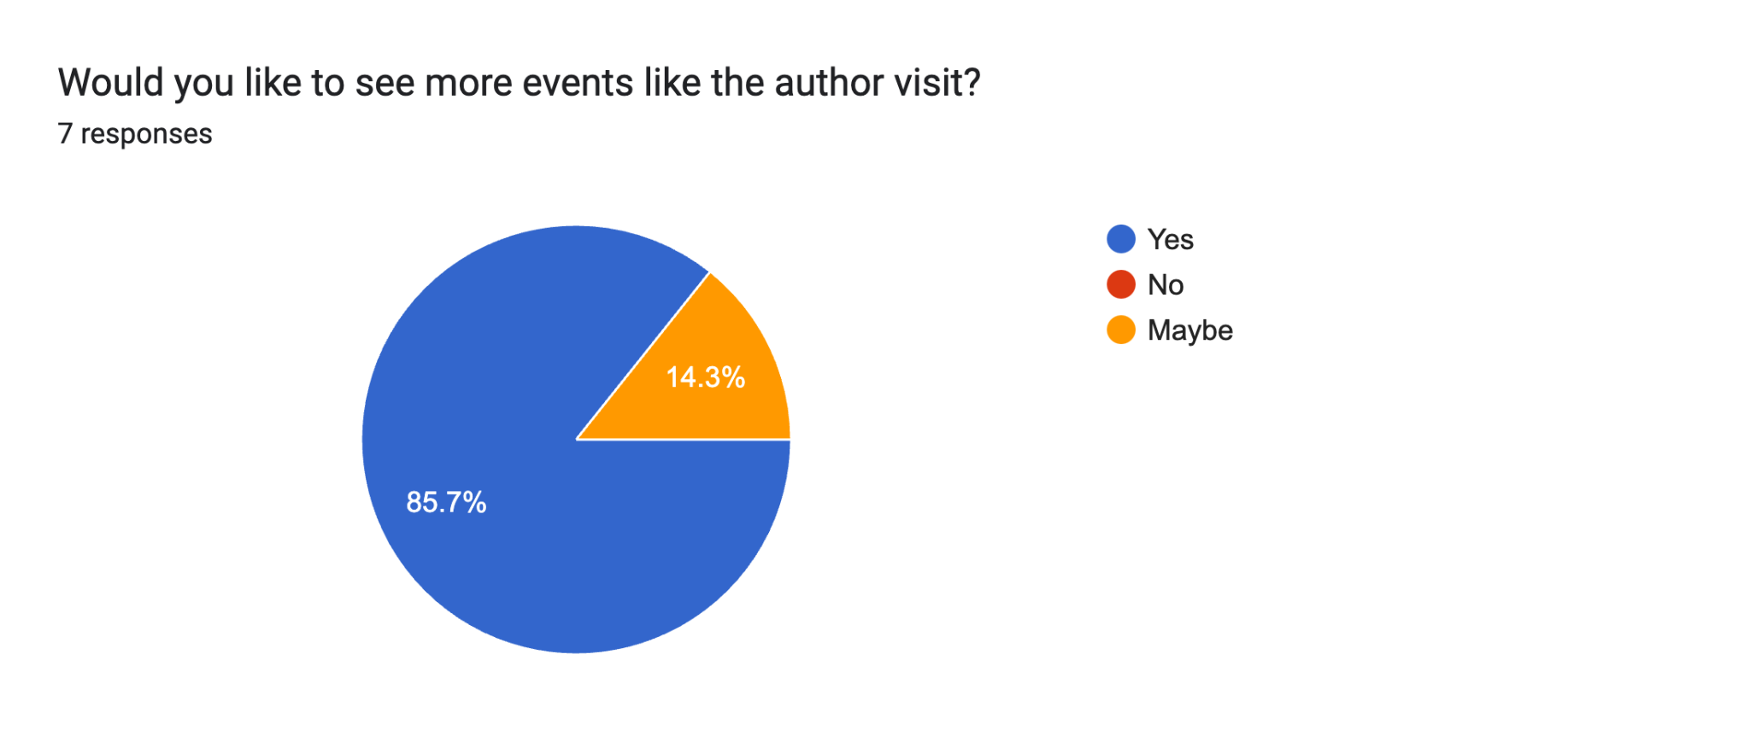
85.7% responded that they would like to see
more events like the author visit, while 14.3% responded maybe for additional visits.

Slide 9
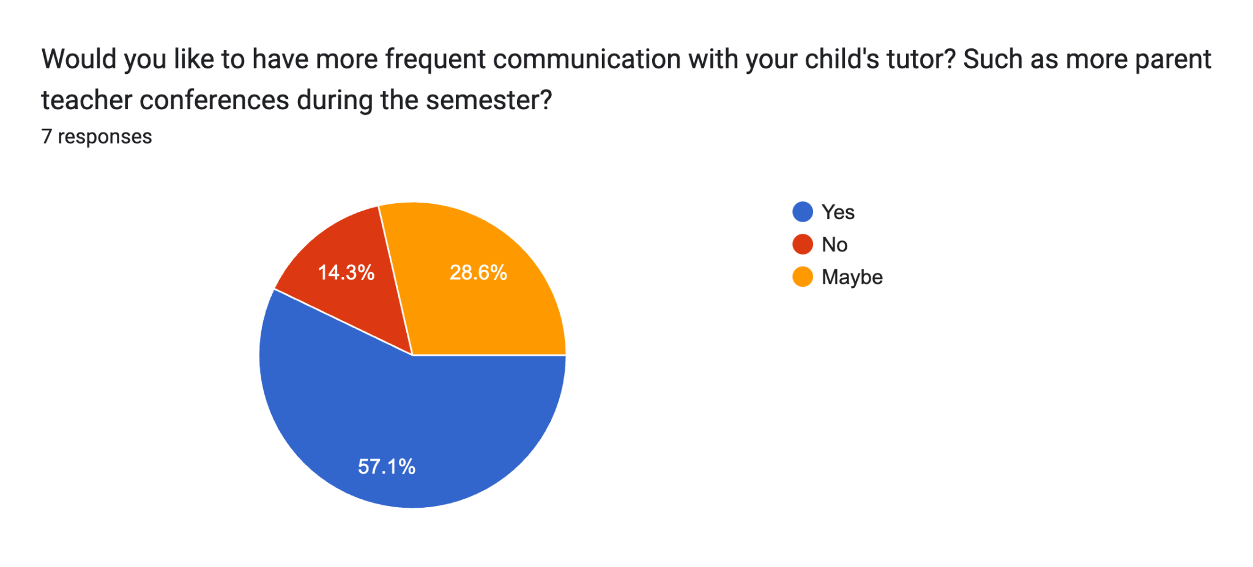
57% of the parents stated that they would like to have more frequent communications with the tutor,28.6% responded “Maybe”, and 14.3% responded that they didn’t want any more communication outside of the normal communication.

Slide 10
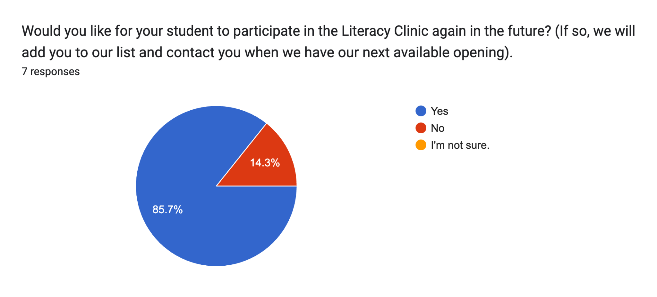
87.5% of participants stated that they would like for their student to participate in in the future,while 14.4% responded that they would not like to continue on in the future.

Slide 11
What did your student like best about the tutoring sessions?
Being able to talk about and write about his favorite thing he likes to, which is playing volleyball.
Reading the books
The titles they work with.
Marks least favorite subject is reading and writing. He was ready to go on all of the sessions, never gave me any problems getting on. In fact he was ready to go before I even had to remind him. He thoroughly loved it.
Socializing
She enjoyed her tutor
She was nice and took time to get to know him which made it easier for a weekly hour zoom. This was such a great experience for him!

Slide 12
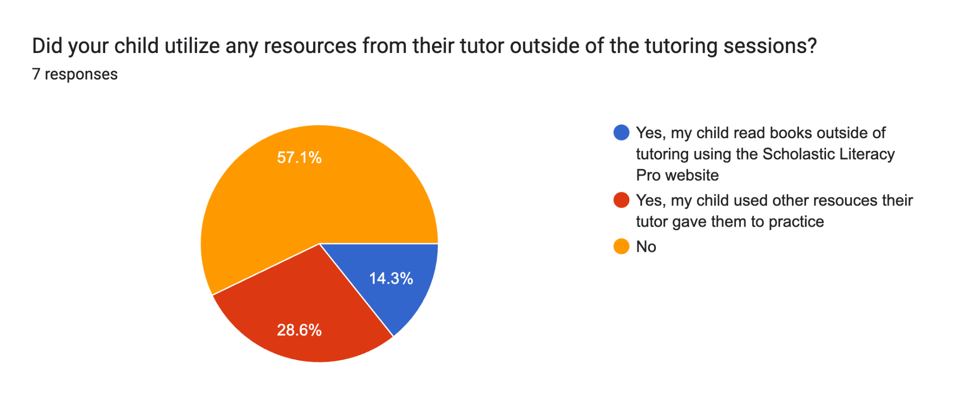
14.3% of the participants stated that their child read books utilizing the Scholastic Pro platform, and 28.6% stated that they utilized some other resources that were provided. 57.1% stated that they didn’t utilize any other suggested resources.

Slide 13
What suggestions do you have for the tutor/teacher to improve the literacy sessions?
The teacher did a good job in engaging with the student and being personal. I suggest the teacher to do that and keep up the great work.
I really like how student focus is the program and how teacher look way to motivate my son. However I think he still struggling with reading and writing so just may question of time to gain more confidence from my son.
No suggestions. Everything she did was great for Mark!
More practice on reading and writing
I thought it was really great! With the younger kiddos maybe a couple more smaller breaks to just stretch or do something else for 3 mins. Then get back to it. It was at night after a long day of school so keeping the engagement up is high.

Slide 14
Are there any improvements that you would recommend for the online literacy clinic?
Everything went well
N/a
No.
No, you guys are doing great. Thank you for the opportunity.
More than just once a week
None
I would say recommend on books for him to read and just getting them excited to read on their own.

Slide 15
Please give us any feedback you have on resources your child utilized outside of tutoring or let us know if there are any additional resources might you like to see us offer to support your student’s literacy learning.
After reading the questions above, I would like to know more about the Scholastic Pro Literacy. We went to the library to pick out books. I’d also like to know more about Dyslexia.
If they can recommend printed books as well. I could try to find them in the library. I believe that it’s easier for me and my son to read on paper.
Meet more than once a week
Read more books at home

Slide 16
Do you have any additional questions/comments about the Literacy Clinic?
No
Ms Angie was friendly encouraging patient and knowledgeable. We would love to continue to work with her!
NA
Thank you for everything! We loved the opportunity.
N/A
None
I think this is a great program and we are very interested in doing more!!

