Slide 1
Projects and Resources Optimization for IT Enterprises
Cipriano (Pano) Santos
(Homo Habilis)
Deep Analytics Distinguished Technologist
HP-IT Global Program Management Office
‘ In preparing for battle, I have always found that plans are useless, but planning is indispensable”
Dwight D. Eisenhower

Slide 2
Practice of mathematical Optimization:
A personal view

Slide 3

Practice of mathematical Optimization
Reality
Perceived Problem
Modeling
Stage
Reformulation
Stage
Algorithm
Stage
Mathsmith
OR-Practitioner
(Applied Mathematician)
Computer-Scientist
Mathematician
Notes:
+ Retrazos de vuelos de Aerolineas
+ Baja utilizacion de recursos en un centro computo de gran escala y al mismo un pobre servicio a clients
+ Disaster Recovery ..
When solving a real life problem a mathematician or a set of mathematician can play 3 different roles ….
Mathsmith is the craftsman, OR-Practitioner is the applied mathematician, Computer Scientist is the magician

Slide 4
Polyhedra Combinatorics
In Polyhedra Combinatorics the art of modeling is
to translate a business problem into a set linear inequalities
2) and the LP model should be tight (“good” representation)
Polyhedra Combinatorics enables a declarative approach
Formulate your problem as an LP (MILP), and Linear Programming solution techniques solves your problem
If your problem change, modify formulation but same Linear Programming solution techniques solves your
problem
Polyhedra Combinatorics are easier to develop and maintain

Slide 5
Workforce Planning and Polyhedral Combinatorics

Slide 6
Workforce Planning
People is the most important asset in the Knowledge Economy, in particular in the Services Industry … such as IT companies/organizations
  Large IT organizations employ thousands of IT professionals to deliver a wide variety of services (jobs) to customers, consequently labor is the IT Industry most expensive cost
  Resource supply-demand matching in large IT organizations is challenging when one considers that there are thousands of employees, with thousands of skills to be optimally mapped to thousands of services (jobs).
  It is clear that the manual spread-sheet-driven approaches used today in most organizations of the IT Industry cannot be sustained if we want to optimize both the workforce and the financial growth of the industry

Slide 7
Workforce Planning for IT organizations
attrition
Labor
Fulfillment
Plan
SDLCM
Project
Tasks
Big Data
Mining
Sup/Dem
Matching:
=
Optimal
Gap
Closing
Projects
Portfolio
IT Service
Demand
Service
Demand
Forecast
BoL
Labor
Requirements
Forecast
IT Labor
Supply
Big Data
Mining
Process
Flow
Labor
Transformation
& Procurement
Plans
Contact
Centers
Calls, or
Transactions
Big Data
Mining
Notes:
The process of workforce planning reduces to matching resource requirements with resources available

Slide 8
Vision
Workforce Planning Hierarchical Architecture

Slide 9
Workforce Planning –
Hierarchical Planning Architecture
Project Staffing
Strategy Inputs
Labor Inventory
(Supply)
Vital Data
Strategic
Revenue/Headcount
Pyramids
TCOW or margin targets
Local labor content rules
Assignments
Inventory
Demand
Forecaster
Bill-of-Labor
Estimation
Attrition rate
Learning curve
Account level ($)
Portfolio/offering level ($)
Job level (HC)
Revenue Forecast
Bill-of-Labor templates
Labor Strategy
Optimizer(LSO)
Attrition
Forecaster
Attrition rate
forecast
Aggregated
Project
Staffing
Hiring bounds
Labor Pyramids
Project Win
Probability Correction
Demand: SOW/RFQ, ..
Supply: Resume (SABA/Linkedin)
Project Portfolio
Optimization (PPO)
Tactical
Detailed
Project
Staffing
Opportunities
Funnel
RP-Miner
Processing
Unstructured Info
Structured
supply/demand
information
Resource Planner
(RMO)
Operational
Project winning probabilities
HPL Modules Ready
Account/Project
Execution Optimizer(PPMC)
HPL Module Q1-2014
Structured
supply/demand
information
Input
PPMC

Slide 10
Hierarchical Planning
Strategy model
    Given a Target revenue of business units of the Service Enterprise determine budgets for Location Strategy: onshore/offshore, Labor mix strategy: RWF/CWF (role & capability) and 3PP , and Labor Transformation strategy: Training/re-skilling, hiring/Layoffs, Promotions/demotions
    in such a way Enterprise total gross margin is maximized while satisfying resources and business constraints.
Tactical model
    For a given labor mix strategy (RWF/CWF), labor location strategy (onshore/offshore), labor transformation, and a given collections of projects (recommended, in-flight, on-hold, etc.),
    select and schedule a portfolio of projects that optimizes the trade-offs of conflicting business objectives while considering budgets, labor resources, and other business constraints. This model determines the labor resource requirements to fill the jobs of selected projects
Operational model
    Given the resource requirements that fill the jobs of selected projects during the duration of the projects,
    determine “best” resources (by name) available to fill the resource requirements of jobs of selected projects in optimal portfolio.
Execution
    Track execution and provide feedback loops to Operational/Tactical/Strategy models

Slide 11
Labor Strategy Optimization … LSO

Slide 12
Labor Strategy Optimization (LSO) model
Operational framework:
  Business Unit
  Geography: Global, Region, Country,
  Planning Horizon and time period
  Period Rolling horizon and Frozen window
  Demand: Apps Service Lines
  Labor Nomenclature: Job function or role, JAI Level
Inputs:
  Demand signal forecast:
    Revenue (ASPIRE).
    Funnel of project opportunities. .
    Ongoing projects
    Attrition Replacements
  Service Line target labor pyramids.
  Labor financial & time productivity
  HR Corp TCOW reduction strategies:
  Onshore/offshore RWF inventories.
  Training & career path rules
Inputs (continue)
  Costs (Onshore/offshore, RWF/CTW), : Salary & Benefits, hiring/on-boarding costs, severance costs, training costs
Output:
  Location ([Onshore, Offshore] –current & new ), Labor Mix (RWF, Off_On_shore Temporal relocation, CTW), Workforce Transformation (Training, Career Path, Hiring, WFR), Attrition Replacement Management and Planned Labor Pyramids
Execution:
  Inputs for Labor Tactical Optimization:
    Planned capacity of RWF onshore/offshore
    Planned inventory/budget of CTW onshore/offshore
    Planned inventory/budget for training and career path
    Planned inventory/budget for hiring
  Inputs for demand planning
    Onshore/offshore quotas for sales and pursue teams
  Inputs for supplier consolidation
    Planned inventories and reserved price for total CTW based on labor nomenclature
Notes:
Funnel of opportunities labor requirements will be aggregate through a probability convolution of opportunities and attrition replacement probability distributions

Slide 13
CCP algorithm
REVPM = $3.5M/PM
ASO% = 18%
3PP% = 14%
1-ASO% - 3PP% = 68%
Revenue:
$14.706M
$RATE = $10K/day
$10M
$2.647M
$2.058M
1000 Billable days
NbDays
HP
&
CTW
ASO
3
P
-
Sold
Revenue
Revenue
Partners
Revenue
[ CORE%*(1 -- CTW%) + (1 – BID)*CTW% -- RISK% ] = 0.64
Work Utilization
CORE% = 70%
CTW% = 20%
BID% = 10%
RISK% = 10%
1562.5 working days
NbDays
Number of
12.02 FTE
Needed
FTE
WDAYS = 130 days/person
needed
Internal
9.62 FTE
CTW
2.4 FTE
SA% = 10%
BC% = 3%
HP FTE
4.202
0.962
0.287
4.369
FTE Requirements
PM
SA
BC
TC
4
1
0
4
3
0
0
0
GAP = FTE_Req --- FTE_Inv
PM
SA
BC
TC
1
1
0
6
FTE Inventory
Notes:
To generate $10M of revenue at a rate of 10K/day, we need to bill 1000 days. How many working days Do we need?

Slide 14
CCP Linear Programming model
Max GM = Revenue –(3PP + Offshr + CTW) costs
Revenue:
$14.706M
Rev = XHPCTW+XOffshr+X3PP
CTW cost = ctwcost*XCTWREQ
Offshr cost = XOffshr*offshrcst%
3PP cost = X3PP*ppcost%
(Cross train costs)
Labor
Strategy
XHPCTW
NbDays
HP
&
CTW
ASO
3
P
-
Sold
Revenue
Revenue
Partners
Revenue
XOffshr> Rev*Offshr% (18%)
X3PP > Rev*3PP% (14%)
WDAYS*[ CORE%*XHPREQ + (1 – BID%)*XCTWREQ ]*$RATE = XHPCTW
NbDays
Number of
XFTEREQ = XHPREQ + XCTWREQ
Needed
FTE
needed
Labor split rates:
FTE Requirements
XCTWREQ > XFTEREQ*CTW% (20%)
REVPM*XPMREQ = Rev
Internal
CTW
XSAREQ = XHPREQ*SA%
XBCREQ = XHPREQ*BC%
HP FTE
XHPREQ = XPMREQ + XSAREQ + XBCREQ + XTCREQ
HP FTE Requirements
PM
SA
BC
TC
XPMREQ (+ XTOUT) < pminv (+ XTIN)
XSAREQ (+ XTOUT ) < sainv (+ XTIN)
XBCREQ (+ XTOUT) < bcinv (+ XTIN)
XTCREQ (+ XTOUT) < tcinv (+ XTIN)
PM
SA
BC
TC
1
1
0
6
FTE Inventory
Notes:
Mathematical Optimization model based on spreadsheet model

Slide 15
Project Portfolio Optimization … PPO

Slide 16

Problem Description
LSO provides planned labor capacity of resources (and associated budgets) to support target revenues of BUs… BUs in turn generates projects to match the target revenues
… Then the question is
How to optimize the selection and scheduling of a portfolio of HP-IT projects such that the trade-offs among various objectives are optimized
  While satisfying resource constraints
    FTE (differentiated by skills and role)
    and budget (differentiated by various types of IT costs such as Labor IT costs,
    Non-Labor IT costs, Total IT costs, Business costs, Total costs) constraints
  Other business constraints
    Project precedence constraints
    Project Release date and due date
    Project composition Mix
    Logical constraints
    Pre-select and de-select decisions
Notes:
LSO provides planned labor resources (and associated budgets) to support target revenues of BUs… BUs in turn generates projects to match the target revenues … Then the question is which projects to pursue and when while satisfying labor and budget constraints and optimizing the trade of conflicting business objectives …

Slide 17
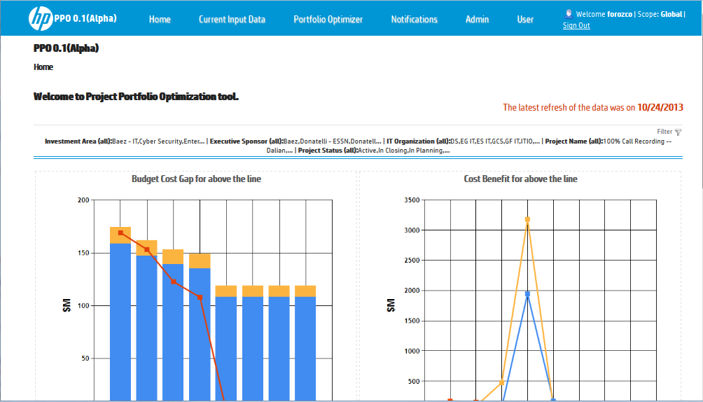
PPO Tool
PPO is a decision support tool
That automates current manual number crunching process
  And provides What if analysis capabilities
PPO helps planners (users)
  To shape a project portfolio
  that “optimize” the trade-offs of the various objectives and constraints
    (Project Ranking, Project Score, Project Benefit, Project ROI, Budget limits, and Resource utilization)

Slide 18
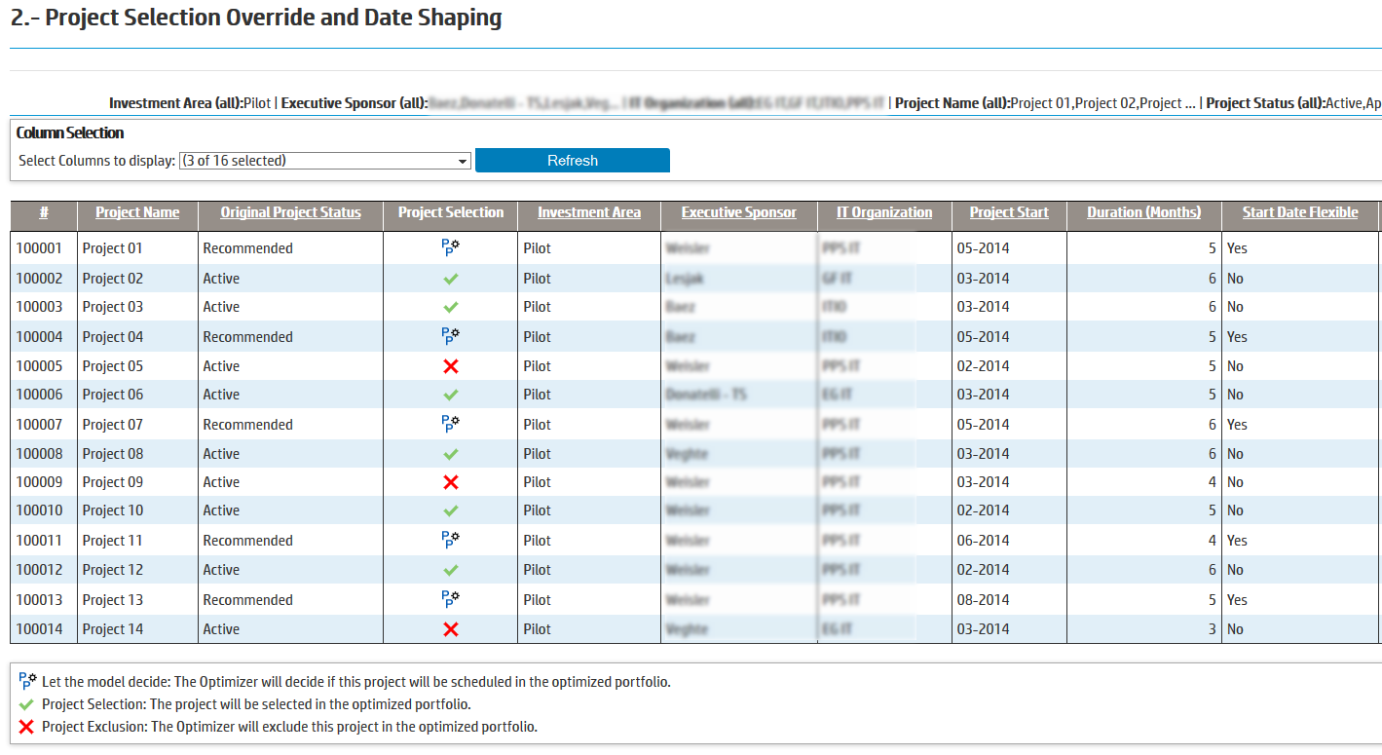
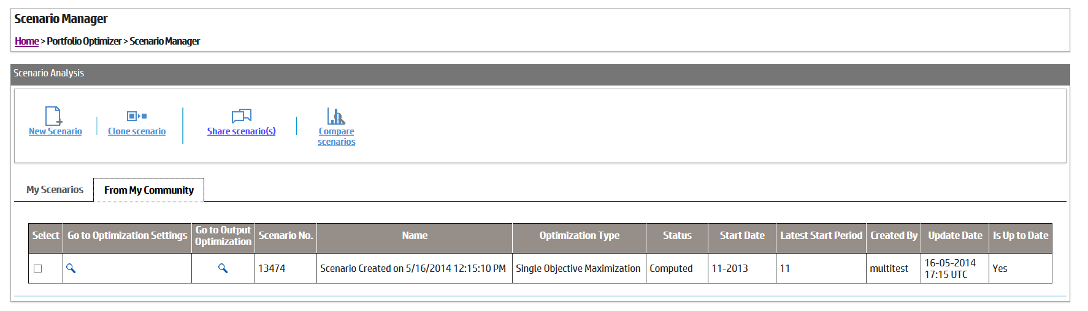
  Why This Matters
  Data driven decisions
  User completely drives optimization engine
  Powerful scenario analysis
  Team Optimization
Notes:
Data driven decisions
+ Objectively shows impact in terms of business objectives criteria of forcing selection or removal of a project … or imposing a business rules that most be satisfied by optimal portfolio (at least 5% of the selected projects in the portfolio should be from HR organization)
+ Portfolio adjustments when budget amounts change
- Build a business case to justify increased budget
- Help selecting best set of projects, once final budget is received
User completely drives the optimization … by defining business objectives to optimize and business rules that should be satisfied
Powerful scenario comparison analysis … allowing user to select the best portfolio by simulating various business scenarios and comparing multiple business objectives values
Team Optimization … Share and compare optimization scenarios with team members

Slide 19
The Project Portfolio Optimization tool is a multi-objective decision support tool for choosing the optimal portfolio
Set constraints for optimization, these could include:
  Project Release and due date
  Budget (& Labor) capacity constraints
  Portfolio Shaping
    ensure that at least 20% of the HC of selected projects corresponds to R&D investment area
  Planners (user) preference guidelines
    Select/de-select project constraints
    Fix (flexible) start time of project
  XOR logical constraints
    Select at most 1 option among several alternatives (FTE, Budget) of deploying same project)
  IFF logical constraints
    For a Program of projects either select all projects in program or none of them
  Project precedence constraints
    Project P2 can start after completing 80% of project P1
Load project and resource data from PPM and value data from BVP
0. Load portfolio & value data
1. Set constraints
& Optimization
Mechanism
Repeat steps 1 through 3 until portfolio decision reached
3. Review output and select
Optimization Mechanisms:
BOM: In this optimization mechanism, the decision-maker considers a single objective for optimization
  MCRM: In this optimization mechanism, the decision-maker considers multiple objectives for optimization
    The decision-maker has a priority order for the set of objectives
  POM: In this optimization mechanism, the decision-maker is interested on a pair of conflicting criteria and wants to optimize the tradeoffs between these pair of conflicting criteria
Review output and repeat process using different models or constraints as necessary
2. Run PPO model
The model can find inconsistencies in the data and make recommendations about
how to correct the data inconsistencies
Notes:
PPO Tool philosophy: The user defines the multiple objectives to optimize and the constraints and business rules that defines the feasible set of portfolios, then the PPO optimization engine computes an optimal portfolio in the “sense” of the multiple objective defined that satisfies all constraints and business rules

Slide 20
 | Regular PPO formulation | Optimized PPO formulation
# Yp variables | 108 | 108
# Xpt variables | 3062 | 3062
# Zpt variables | 3062 | 0
# Zipto variables | 3062 | 0
Total # of variables | 9307 | 3183
Total # of constraints | 6461 | 337
Gurobi solving time | 8.53 s | 7.97 s
Gurobi solving time no presolve | 156.1 s | 19.9 s
Coin-OR | 40291.24 s | 82.3 s

Slide 21

PPO Stories: other ways PPO technology can help
#0 – Project portfolio optimization
#1 – Projects Scheduling
#2 – There are many ways to get a project done
#3 – React to change
#4 – Next generation “What-if” analysis
#5 – Top-Down portfolio optimization

Slide 22
Resource Matching Optimization … RMO

Slide 23
Resource Planning
Assume an Optimized Project Portfolio: you know which projects to pursue and when the projects starts. Each project has a set of jobs to be done, each job has duration and labor resource requirements
  … Then the question that Resource Planning address is: How to identify the employees that can fill the jobs
  The main objectives of Resource Planning in the Services Industry are to
    Increase workforce utilization
    Optimize labor costs
    Optimize the matching of job requirements with employee qualifications
  The fundamental problem of Workforce Planning is to provide the workforce resources
    with the right skills,
    for the right job,
    at the right time,
    at the right location,
    and at the right cost

Slide 24
Resource Planning (2)
Workforce planning faces both demand and supply uncertainty
Demand main sources of uncertainty:
  Uncertainty about winning a project opportunity
  Uncertainty about starting time, (duration, resource requirements of projects)
Supply main sources of uncertainty:
  Attrition
  Uncertainties around hiring
Long hiring and labor transformation lead times
Workforce planning under uncertainty cannot be done at the detailed skill-set level
  A standard labor Taxonomy is required
Objective: Optimal (cost & skill) demand fulfillment
    Balance workforce utilization and availability
    Quantify and cope with associated risks

Slide 25
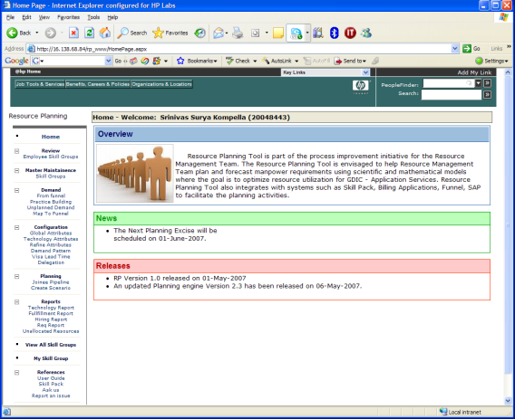



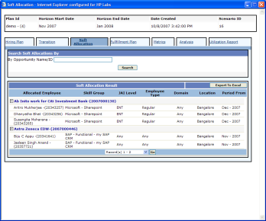
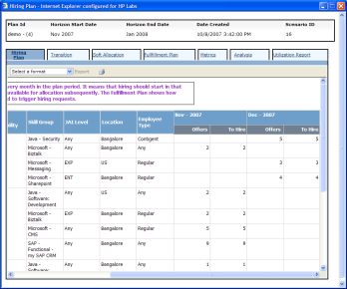
1) Supply data:
Employee classified by
skill group/Job Attributes.
2) Demand data:
Job requirements by
opportunities and periods.
3) Planning Scenario
Input data (demand &supply)
set to run planning engine.
4) Output Plan Reports
List of planning engine
suggestions by given scenario.
Resource Planner
Demand & Supply Consolidation
Input
+List of selected projects
+Job-project requirement
+ Employee Qualifications &
Trainability, moves
+job attrition rates
emp
Job-Projects
Output
+Supply & Demand expressed in terms of jobs
+ Flexible Mapping
Mathematical Optimization
1) Allocation Plan
2) Workforce
Transformation
Plan
Input
+Availability of Resources
+Hiring & training lead-times
+ Job-Opportunity requirement
+ employees job qualifications & trainability
+Job replacement requirements due to attrition
3) Hiring Plan
Engine
Notes:
After labor strategy has been defined, sales engineers will start filling a funnel of projects opportunities based on Aspire target revenues
Practice mangers will go to the RP tool and fill in labor requirements for new opportunities in the funnel, update labor requirements for old ones, and update resources qualifications.
RM runs RP tool on a weekly basis to keep RP plans aligned with the dynamics of the business
The RP engine takes the input data which is …

Slide 26
Employee-job characterization
RP Matching Taxonomy
Employee
Labor Demand
Job Attributes
Qualified for
Specified as
Defined as
Technical Attributes
Organizational Attributes
Belongs to
Capability
Role
Job
Level
Industry
Domain
WF
Type
Location
(site)
Location
Type
Job Code
Resource
Pool
Business
Segment
Technology/Platform
uses
  Example
  Capability–Apps Development, IT Admnistration
  WFtype – RWF or CWF
  Job level – ENT, INT, EXP, MAS
  Role – Developer, Manager
  Industry Domain – Manufacturing, Aerospace, Finance,
  Location Type: Onsite, Offshore
  Location – Bangalore, Chennai (offshore), USA, Germany, UK (on site)
  Job Code: ENG0001
  Resource Pool: AMS Healthcare Applications
  Business segment: Apps
Skills
Tools
Notes:
This e-j characterization represents the instance that we have in RP. We have six attributes, and we have the hierarchy of importance as is defined.

Slide 27
Employee scoring algorithm
There are no real cost associated to mapping employees with job requirements of projects in the optimal portfolio there is the problem of discriminating “good matches” from “bad matches “ automatically
RP engine computes employee scoring based on the individual matching of each attribute and their importance expressed as weights.
Resource1
Job Requirement
Max Weight
Similarity Score
Java
Java
50
50
Resource1 is not fully qualified
Manufacturing
training
Manufacturing
20
20
Entry
Intermediate
15
2.625
Any
Regular
10
7
Offshore
Offshore
4
2.8
Any
Bangalore
1
0.7
Employee Ranking
83.125 %
Hierarchy
dependency
Resource2
Job Requirement
Max Weight
Similarity Score
Similarity Score
Java
Java
50
50
50
Manufacturing
training
Manufacturing
20
20
20
Entry
Intermediate
15
0
15
Any
Contingent
10
10
0
Offshore
Onshore
4
4
0
Any
US
1
1
0
Employee Ranking
Similarity
function
85
85 %
No hierarchy
Notes:
27
27
let’s assume that we have a resource entry level, and the job requires intermediate.
Now, traditional approaches will produce this score ambiguity, if we just consider a weighted similarity function. Then assume anohter resource with other qualifications., then we end up with the same scoring even their qualifications are not equally, so
However, with our scoring mechanism. Let assume the attribute hierarchy and this weights. Since we have a missing attributes, then we use a reschaling factor for the rest of the attributes. Son we are capturing more information on our scoring mechanism.

Slide 28
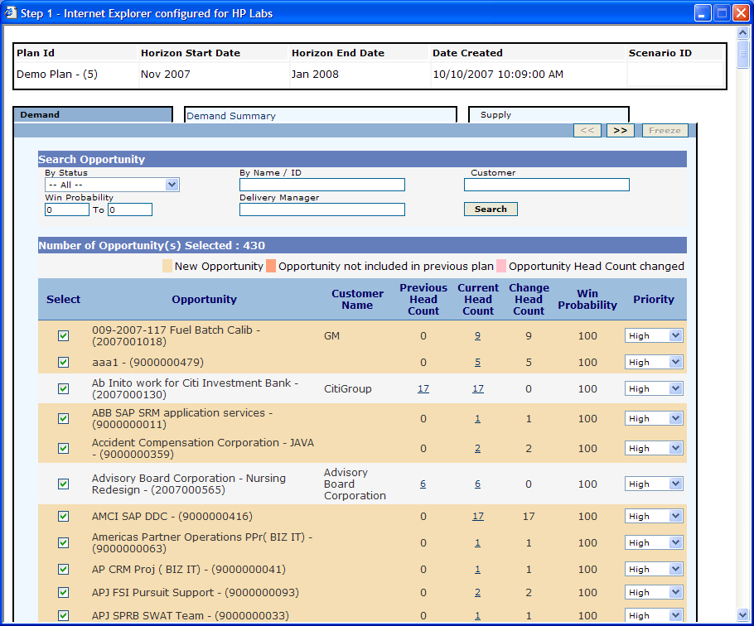
RP mathematical models
Matching future availability of employees with future job requirements is quite complex
  GDAS has thousands of employees in delivery roles, with thousands of skills; hence the number of combinations of people, skill, time, and location is astronomically large.
    Mathematical Optimization
Bench
Convolution
GDAS Funnel of Opportunities
Bernoulli: Prob distribution
of SG requirements
by opportunity
Service
Level
Prob of total SG requirements
Computed as a convolution.
SG Demand at SL
Staff projects with deterministic demand using MIP
Staff Bench at SL for all SG –Bench includes attrition replacements
Optimization model must encode business rules
  high probability opportunities are first staffed with available employees.
    Gaps are filled by training employees
    Remaining gaps are filled with hiring
  Low priority opportunities are staffed with hiring/gap
  Practice building requirements are satisfied with people hired
Constraints
  Satisfy priority opportunity requirements
  Satisfy employee capacity & capability constraints

Slide 29
HP proprietary algorithm
IP for PPO/RMO technology
  3 patents granted
  15 patent applications in progress
Patent US 8639562 B2: Cost entity matching
Inventors:
Marcos Cesar Vargas-Magana, Cipriano A. Santos, Carlos Valencia, Lyle H. Ramshaw, Robert E. Tarjan, Ivan Lopez-Sanchez, Maria Teresa Gonzalez Diaz

Slide 30
Mathematical Optimization model
Subject to:
1)
5.1)
2)
6)
3)
7)
4)
8)
5)
Notes:
Q: unexplained variables: “winprb”, “CT”, “CH”, “Cia”, “Cix”, “R_w,\tau”, “CU”, “honly”, “REQ”, “QT”, “hpipeline”, “atmosthire”, “hglobal”
Q: it seems the only reason to separate job and opportunity is because probabilities apply to opportunities, which are sets of jobs. I don’t see the value of this – it just makes the formulas more complex. You base the constraints on expected values anyway, so to my untrained eye the fact that job win probabilities are correlated seems irrelevant... Please explain.
+The new optimization model keeps explicit the opportunity-job relationship
+The penalties in the objective function captures the prioritization scheme of the business utility function in terms of priority given to opportunities and win probabilities. Also by suggestions of Alex Zhang and Jose Luis we capture penalties of idle employees which turn out to be as important as penalties for gaps… later I will give more details about the business utility function embedded in the optimization model.
+We also enable the functional requirement that establish that practice building most be satisfied with hire only.
0) Objective Function. Minimize costs and penalties.
Satisfy demand. If demand cannot be satisfied with qualified workforce y variable captures a shortage that may be fulfilled with hiring. For each (j, t) satisfy
2) An employee at most can be assigned to a single job. For each (w, t) satisfy
3) A shortage may be filled with hiring or declared a gap. For each (j, t) satisfy
4) Hired inventory balance equations
5) Ensure employees are consistently assigned to same job over planning horizon. For this purpose we associated a fixed cost to the variable u. For each (w, j) satisfy
5.1) An employee is assigned to only ONE job. For each
6) An employee is considered to be available during and after his release date. Also, if an employee has been trained for a job then the employee is qualified to perform that job after completing the training. Training can only start if the employee is available (released). For each (w, j, t) satisfy
7) Employees are at most trained once over planning horizon.
8) Satisfy upper limit on the number of people we can hire per skill group and satisfy overall upper limit on the number of people we can hire.

Slide 31
RP Assignment Problem Formulation
Problem: Let’s assume we have four job requirements, two employees, and we can hire only one resource.
Nodes in the graph represent
either resources or jobs.
+ Resources can be employees, people to hire, unfilled positions (gap).
Arcs in the graph map resources
with jobs whenever the resource
can fill the job
+ Qualified employee for job
+ Train and qualified employee for job
+ New hire for a job
+ Gap
Penalties at arcs represents the
“cost” of filling a job with the linked
resource.
+ Penalty reflects skill matching, resource availability, allocation costs (job level), and
Other business objectives
Gap for job1
g1
Penalties
Qualified
Employee 1
e1
jb1
job1
Train then
Qualified
Gap for job2
g2
Employee 2
e2
jb2
job2
Hire then
Qualified
New Hire
h1
Unfilled
Demand
jb3
job3
Gap for job3
g3
Gap for job4
g4
jb4
job4
Resources
Jobs
(Resource Planning -Bipartite Graph)

Slide 32
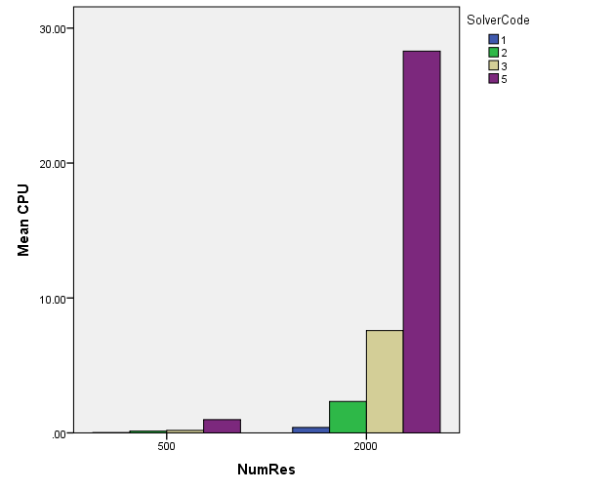
RMO Results and comparisons (2012)
Preliminary results
Seconds
g1
e1
jb1
g2
e2
jb2
h1
g3
jb3
g4
jb4
Solver Code:
1 – Auction Algorithm
2 – Flow Assignment Algorithm
3 – Hungarian Method
5 - Gurobi
    Lyle Ramshaw and Robert E. Tarjan. "A weight-scaling algorithm for min-cost
    imperfect matchings in bipartite graphs",53rd Annual IEEE Symposium on
    Foundations of Computer Science (FOCS'12), pp. 581--590, 2012
Notes:
There are Job requirements for the 50%, 75%, and 95% of the total capacity

Slide 33
Suitability Score: Multi-objective optimization
To compute the employee-job suitability score we consider the weighted average of various resource matching objectives
  Skill matching score
  Capacity Availability Score
  Allocation (cost) score
  Weights reflecting the relative importance of the matching objectives can be defined by the user
    Or we have developed a proprietary methodology that determines the objectives weights by a pairwise comparison reflecting the preference intensity of one objective respect to the other one
Suitability Score = (weight)*skill matching score + (weight)*Capacity score + (weight)*Allocation score
Notes:
OB(i-1) is as important as OB(i), OB(i-1) is moderately more important than OB(i), OB(i-1) is strongly more important than OB(i), OB(i-1) is extremely more important than OB(i), OB(i-1) is absolutely more important than OB(i)

Slide 34
RP Planning Process
input
Uncertainty
Demand
& labor supply
Demand
& labor supply
Forecast
Demand
& labor supply
Demand
& labor supply
Forecast
Demand
& labor supply
action
RP
RP
Today - 3
Today +3
Planning Horizon
Today
Planning
Execution
Execution
Planning
Execution
output
Assignment & Project Schedule
Soft Allocation & Fulfillment Plan Metrics
Assignment & Project Schedule
Soft Allocation & Fulfillment Plan Metrics
Assignment & Project Schedule
Workforce planning cycle represents a connection between execution and planning for labor demand and supply under uncertainty.
The planning cycle is fed by the current status of the resources and the expected labor demand for future periods, then the planning tool forecasts resource capacity to satisfy the future demand minimizing gap and maximizing utilization. The managers execute project scheduling based on soft allocation and fulfillment plans planned to anticipate future demand and labor supply.

Slide 35
Questions ??

Slide 36
Back up slides

Slide 37
Questions: Strategy and Planning Objectives
What do you interpret as planning in your business?
    A Services Enterprise needs a planning process to address complexity and uncertainty –you cannot wait and see, there are lead times to hire/procure and transform.
    Complexity:
      There are many dimensions to consider, hence an astronomical number variables –courses of action, and there are limited resources.
        Thousands of employees with thousands of skills and capabilities that needs to be allocated to the right job, at the right time, at the right location, at the right cost
      In addition, when choosing the “best” course of action, the Services Enterprise typically have several criteria to consider; where these criteria is aligned with the Enterprise business strategy
        During the optimization of the selection and scheduling of an IT project portfolio several business objectives are considered: Direct/Indirect Benefit, Customer Satisfaction, Strategic Alignment, Technical Alignment, Employee Satisfaction, etc
      Finally, several key decision makers might be in conflict, so having a data driven mechanism helps resolving the conflict in a more objective way
        Provide the data that make the planning mechanism to favor decision maker desired course of action

Slide 38
Questions: Strategy and Planning Objectives (2)
How does your business model drive the principles and characteristics of your planning approach?
    Due to the complexity of Service Enterprises the planning approach should be driven by the principle of “Think globally and act locally”
    “Instrumentation: Measure what is measurable, and make measurable what is not”. Galileo Galilei
      Collect and transform data into actionable information
    Planning processes need to scale: It is imperative to have high levels of automation for the planning approach
      Benefits of Automation
        Enables decision making based on data
        Enables process transparency
        Increases speed and accuracy of data processing
        Reduces labor costs
  Does this vary across your different businesses or assets?
    Not recommended, this creates fragmentation and inefficiencies

Slide 39
Questions: Planning Processes
What planning methodologies do you use? How does this vary by time horizon and decision type?
    A hierarchical planning process is recommended
      Business strategy is translated into quantifiable criteria that in turn drives strategic decisions while considering various BUs constraints and limited resources.
        A planning horizon of 3 or 5 years with quarterly time periods is recommended
      Strategic decisions create a framework for tactical planning
        The planning horizon of 12 or 18 months with monthly time periods is recommended
      In turn tactical decisions create a framework for operational planning and execution
        For operational planning, the planning horizon of 3 or 6months with weekly time periods is recommended.
        For execution, planning horizon of a week with daily (or shift based) time periods is recommended
      A hierarchical planning process -with feedback loops monitoring execution, enables a homogeneous and integrated planning system that efficiently/effectively addresses the complexity of the Service Enterprise and the uncertainty about resource requirements and resource availability

Slide 40
Questions: Planning Processes (2)
How do you manage uncertainty and options in your planning?
    Need a good forecasting process that determines an accurate forecast error, your planning process addresses uncertainty based on forecast error
    Your planning process should help identifying mechanism to reduce forecast error
      Is the forecast error large because of lack or inaccurate data? What is the right level of aggregation that reduces forecast error and at the same time you can make decision and implement them? Or the forecast error reflects the random nature of the system?
    What if scenario analysis can be use to address uncertainty during planning
      Simulation and Stochastic Programming can be used … requires mathematical sophisticated user ..
    Create buffer capacity covering a quantile of the forecast probability distribution
      How much buffer capacity you need that allows to satisfy SLA and at the same time does not hurt resource utilization?
What is the cadence of your planning process, and what triggers change?
    Hierarchical planning drives the cadence of the planning process
      Rolling planning horizon for scheduled re-planning
      “Significant” deviations from the assumptions/input data of the strategic/tactical/operational plans triggers change

Slide 41
Questions: Planning Processes (3)
How does your planning approach respond to disruptive events? Can you dynamically re-plan?
    Plans are useless, planning is essential. Planning processes and tools should enable re-planning to address complex dynamics and uncertainty associated with your environment
How do you achieve integration and alignment (timeframes, value chain, functions, suppliers)?
    Hierarchical planning with feedback loops from execution
How do you incorporate risk management in your planning approach?
    By considering forecast error
How is planning performance and execution performance measured?
    Comparing cost and benefits derived from your plans with the actual cost and benefits realized during execution

Slide 42
Questions: Planning Technologies
What planning technologies do you currently use and why (data; analysis; simulation; automation)?
    Big Data/Data Sciences
      Data Mining, Machine Learning, Predictive Analytics, Statistics, distributed computing
        HPSW/Idol, HPSW/Vertica, R
    Resources Scheduling and Allocation technology
      Mixed Integer Linear Programming (MILP)
        MILP solvers: Gurobi, IBM/Cplex
    Commercial SW tools for Project Portfolio Planning and Resource Management
      HPSW/PPM Center, Microsoft/Enterprise Project Management, Planisware, Oracle/Primavera Enterprise Project Portfolio Management
How do you use technology for communications and alignment?
    Skype technology is critical for project coordination
What new planning technologies are you planning to adopt and why? What do we need to watch out for?
    Cloud bases planning services

Slide 43
Questions:
Planning Organization
    How is your planning function structured? How do you incorporate diversified business and geographies?
    How is planning integrated with broader business?
    How do you build and sustain the required capability?
      We are re-organizing and this information is confidential
    What culture are you trying to create, and what levers are you pulling to achieve this? Incentives?
      Kay Yut is an expert in market mechanism design and incentives
South32 Recomendation
    Which fundamental principles should South32 have for their planning process to maximise value?
      Have a clear vision of your business
      Translate vision into a business strategy with clear quantifiable objectives
      Optimize the trade-offs of conflicting business objectives while considering budget and resources constraints, and business rules/constraints
      Consider hierarchical planning (Strategic/Tactical/Operational) with feedback loops
      Always look for opportunities to reduce forecast which in turn reduces uncertainty
    Which aspects of planning methodologies, technologies and organisation should South32 focus on?
      Become a data driven organization, where decision making is done transparently based on facts
      Develop/acquire processes and tools that generates data that is accurate, complete, current
      Keep historical data that can be mined, enabling continues improvement of your planning processes

Slide 44
LSO Labor Strategy Optimization Model
Attrition
Forecast
Business
Strategy
Constraints
Inventory
Attrition
Rates
FTE actual
Country/SL/
Job Level/
Role/Skill
-Cost
-Budget Constraints
-Transformation Rules
-Metrics
Labor Nomenclature Standardization
Demand
Signal
Forecast
Optimization
Engine
Learning
Curve
Forecast
FTE Forecast
Split Rates
Productivity
Metric
-Labor Mix + location + transformation strategies
-FTE Plan
-Budget Plan
-Metrics
Execution
Process
PPO
FTE Forecast

Slide 45


The Model Components: How We Represent the Various Aspects of Labor Strategy Optimization
Geography (location)
  Demand Region ← → Resource Country
  On-Shore, Off-Shore, Off-Shore Travel relationships (between a Demand Region and a Resource Country)
Labor pyramid
  Job Code structure: Cost Category, Cost Sub-Category, Job Family,
  Job Level Global
  Transformation: Promotion, Transition, Transition-Promotion
  Pyramid bands: % lower and % upper limits
Demand
  Revenue at (Segment, Region, Quarter) level
  Revenue % that must be delivered using on-shore resources
  Revenue % range (LB and UB) that is to be delivered by 3P
Time dimension
  Quarters
  Number of working hours in a quarter varies with country and quarter
Country headcount capacity
  Attrition, Hiring, Transform (Transit, Promote, Transit-Promote),
  Move (redeployment between sites), WFR
45

Slide 46
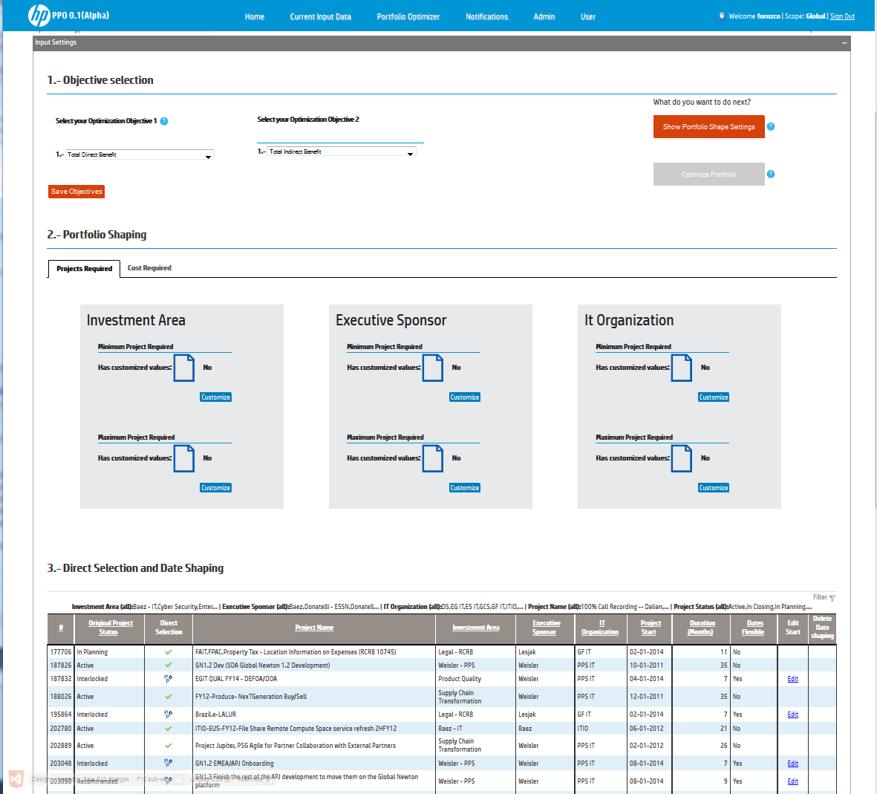
Features and Functionality of PPO Prototype
Portfolio Shaping Capability: At least (or at most) percentage of projects, FTE, or Dollars allocated to
  Investment Area… e.g. R&D, Sales Compensation, Cloud Services BU, … etc.
  IT organization… e.g. ES-IT, GF-IT,… etc.
  Executive Sponsor … e.g. Keogh, Lesjak, Nefkens,… etc.
Decision Maker has the ability to select or de-select projects directly
  Active projects may be selected automatically
    Option to reschedule active projects
  On hold projects may be de-selected automatically
  Planning Projects are selected (or not) based on Optimization Mechanism considered
Decision Maker has the ability to define start time of project (fixed or flexible)

Slide 47
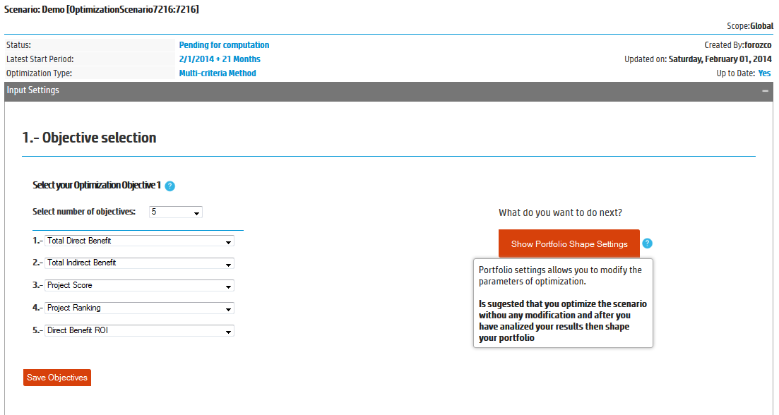
Multiple-Objective Modeling Capability:
  Total Project Ranking Maximization
  Total Project Score Maximization
  Total Project Benefit (direct or indirect) Maximization
  Total Project ROI Maximization
  Maximization total project score respect to specific Business Objective
    e.g. Customer Satisfaction, Strategic Alignment, Technical Alignment, Capabilities Roadmap, Employee Satisfaction, Legal / Regulatory / Audit

Slide 48
 | Regular PPO formulation | Optimized PPO formulation
# Yp variables | 108 | 108
# Xpt variables | 3062 | 3062
# Zpt variables | 3062 | 0
# Zipto variables | 3062 | 0
Total # of variables | 9307 | 3183
Total # of constraints | 6461 | 337
Gurobi solving time | 8.53 s | 7.97 s
Gurobi solving time no presolve | 156.1 s | 19.9 s
Coin-OR | 40291.24 s | 82.3 s
Regular PPO formulation presolve behavior
Presolve removed 6354 rows and 7427 columns
Presolve time: 0.05s
Presolved: 107 rows, 1880 columns, 6825 nonzeros
Variable types: 6 continuous, 1874 integer (1874 binary)
Optimized PPO formulation presolve behavior
Presolve removed 230 rows and 1303 columns
Presolve time: 0.04s
Presolved: 107 rows, 1880 columns, 6825 nonzeros
Variable types: 6 continuous, 1874 integer (1874 binary)

Slide 49
PPO Stories: other ways PPO technology can help
#0 – Project portfolio optimization
#1 – Projects Scheduling
#2 – There are many ways to get a project done
#3 – React to change
#4 – Next generation “What-if” analysis
#5 – Top-Down portfolio optimization

Slide 50

#1 - Projects Scheduling
Projects are already selected, PPO advises when to execute them
Optimize different goals
    Business value delivery preference (as fast as possible / balanced over execution period)
    Minimize projects completion time
Respects scheduling constraints:
    Projects dependencies
    Group projects by program
    Respect critical projects deadlines
  Build your case to meet objectives
    “I can only deliver all projects this year with an extra 800 k$ budget / 10 more headcounts”

Slide 51
#1 - Projects Scheduling (cont’d)
Related scheduling problems:
Single Project scheduling (tasks from a single project)
Program Scheduling (Projects or Summary tasks from a program)

Slide 52

#2 – There are many ways to get a project done
One project can be done in different ways:
different teams
Different technical choices (buy or build)
different costs
different delays
even different business value
List all the ways to get your projects done, PPO will pick the best ones.

Slide 53

#3 – React to Change
What to do when a change is required in a Project Portfolio being executed?
Change can take many forms
    Critical project running late
    Sudden budget reduction
    Workforce reduction
    New project opportunity
One must react to change fast (not next year)
    Cancel projects
    Put projects on hold
    Select new project in the portfolio

Slide 54

#4 – Next generation “What-if” analysis
From “What happens if” to “What to do if”
Traditional “What-if” analysis:
    Make a change to current portfolio and see impact on business
    value and budget & resources consumption
Next-gen “What-if”:
    Make a change and PPO comes up with an action plan to minimize impact to the project portfolio
    Compare PPO proposed plan impact with “do-nothing” option
    Adjust PPO proposed action plan as needed
    Helps you prepare “mitigation plans” for risks scenarios before portfolio execution starts
Notes:
Prepare contingent plans, while minimizing disruption of project portfolio

Slide 55

#5 – Top-Down Portfolio Optimization
Top-Management driven optimization
Top Management sets budget & strategy
    Where money should go
    Portfolio Mix: at least 40% of investment in innovation projects,
    no more than 30% in maintenance, …
Each investment area executes selection
    Direct visibility to Top management of strategy VS actual selection
    Portfolio Mix decisions can be enforced during optimization
    Strategy violations can be annotated with explanations and tracked

Slide 56
PPO User CASES
PPO Global: Centralized Planning (input data, key output results, how to implement them?, when? By whom?)
PPO by IT organization: Decentralized Planning (input data, key output results, how to implement them? when? By whom?)
Project Optimization: consider one project where tasks of project can be implemented in different ways .. Multi-modal project scheduling. This model will optimize the project by selecting the optimal mode for each task given business objectives –minimize completion time and maximize project benefit.
PPO Hierarchical Planning: Strategic model feeding information to tactical model feeding information to operational model (input data, key output results, how to implement them? when? By whom?) …
  here the strategic model might be a capital budgeting problem –considering uncertainty, where budgets by IT organization and time periods are defined;
  the tactical model is the PPO model as is today.
  The operational models are determined as follows. Each Project is optimized by solving the multi-modal problem –we will know when each selected task should start (using ML we should determine FTE/capabilities requirements for each task) and then the RP model should assign resources to fill task requirements while optimizing several allocation objectives and satisfying resource constraints

Slide 57
RP Optimizer Service
4. Operational Output
Optimal Allocation Plan
Hiring Plan
1. Open Positions & Job Requirements for deals & projects
RP Optimizer
DB
2. Resource Profile and
Assignments
5. KPI Analytics
Demand Fulfillment Trend
Utilization Trend
Qualification Levels
3. Engine Configurations:
Matching Preferences,
Hiring bounds
Optimization as
  FTE weekly allocation
  Work placement guidance
  Flexible matching score for resource qualification
  Hiring bounds by geography and workforce type
  Minimum availability threshold for Allocation
Resource planning output as
  Resource recommendation plan
  Resource hiring plan
  Demand fulfillment and resource utilization KPI’s summary

Slide 58
Work placement guidance by resource pool structure
RP Service extends automatically the resource scope of matching
using the primary and secondary pools of resources.
Region
BU
POSITION Resource Pool (primary pool)
India Center
Primary Pools
Equally
preferred
Secondary resource pools
Testing: Windows Group
Testing: Web Group
Secondary pools equally preferred
eee
Team 1
Team 3
Team 1
Team 3
Team 2
Team 2
Target Delivery Resources available for allocations
Structure Resource Pools for the Organization

Slide 59
IT Analytics Vision
I am particularly interested in
Big Data and Decision Making
+ Machine data
+ Business Data
+ Social Networks data
+ Human Data
Convergences of IT Technologies
  From High Performance Sensors, mobile devices, and laptops to next generation computing:
    “The Machine”: high density memory and fiber optic computing environments
  From next generation computing to Cloud Computing
  From Cloud Computing to Analytics (Vertica & Autonomy)
  From Analytics to Decision Supports Systems (PPM)
Why DSS ? IT Business & Engineering decisions are complex
  There might be an astronomical number of alternatives/courses of action
    Mathematical Optimization
  There is uncertainty about outcomes from decisions
    Statistics, Stochastic Modeling, Simulation
  Several objectives & Decision Makers might be in conflict
    Game Theory, Behavioral Economics, Experimental Economics
Computing Services
Anywhere + Anytime
(Structured Data & Unstructured Data)
Internet of Things (IOT)
Big Data → Number Crunching Automation → Actionable information (Recommendation)

Slide 60
Questions
    How is your planning function structured? How do you incorporate diversified business and geographies?
    How is planning integrated with broader business?
    How do you build and sustain the required capability?
    What culture are you trying to create, and what levers are you pulling to achieve this? Incentives?
    Which fundamental principles should South32 have for their planning process to maximise value?
    Which aspects of planning methodologies, technologies and organisation should South32 focus on?

