Slide 1
High Schools &
UMSL’s ACP:
Learning Together
A strategic partnership with the University of Missouri-St. Louis to support your success through education

Slide 2
Who We Are
Tier 1, public research university located in St. Louis County, Missouri
Part of the University of Missouri System (Mizzou, S&T & UMKC) with nearly 70,000 students enrolled across all campuses
UMSL established 1963
Known for a diverse student body, with more than 75,000 alumni calling the St. Louis region home
We educate and graduate diverse students as they seek different and better lives
Award-winning faculty
Offer 60 bachelors, 30 master’s and 17 doctoral programs
41 undergraduate and 44 graduate certificates

Slide 3
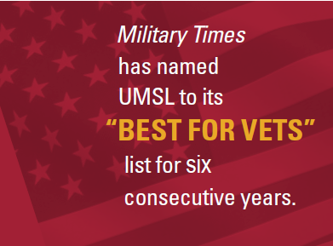
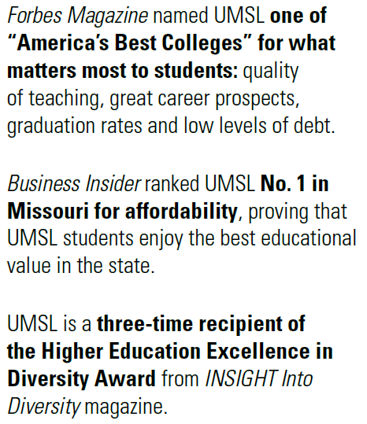
Points of Pride
72%
of graduates work in the St. Louis Region
No. 140
US News
Top Public University
No. 1
in Missouri for online education
Top 3%
College of Business Administration
TOP 100
in Social Mobility
Notes:
Military Times has named UMSL to its “Best for Vets” list for six consecutive years
U.S. News & World Report rankings
#96 (tie) in Social Mobility
#140 (tie) in Top Public Universities
#52 (tie) in Best Online Bachelor’s Programs
Business Insider ranked UMSL #1 in Missouri for affordability
Great Value Colleges ranked UMSL #5 on “50 Best Colleges for Adult Education”
UMSL’s international undergraduate business program has been ranked in the top 25 nationally by U.S. News and World Report for 17 consecutive years.
UMSL is designated as a NSA/DHS Center of Academic Excellence in Cyber Defense Education and also holds the only CAE-CDE Security Policy Development and Compliance focus area designation in the Midwest.

Slide 4
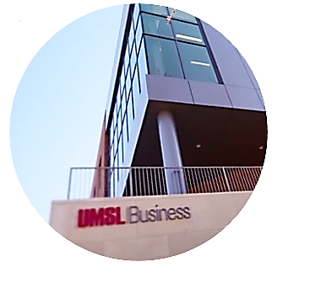
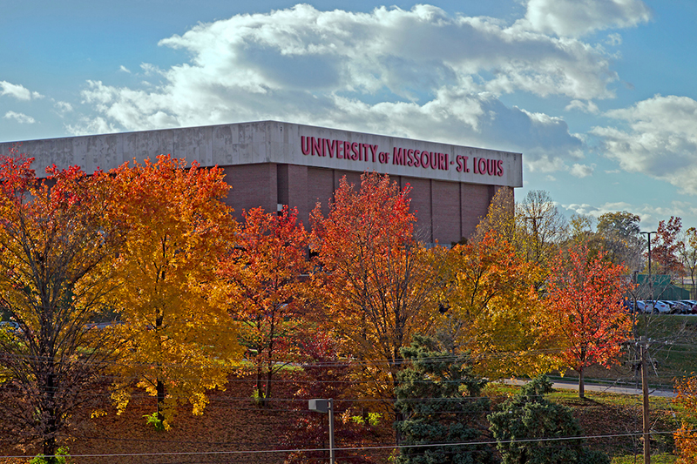
UMSL Schools and Colleges
College of Arts and Sciences
College of Business Administration
College of Education
School of Fine and Performing Arts
College of Nursing
College of Optometry
Honors College
School of Social Work
Joint Engineering Program

Slide 5
Why Choose ACP Dual Credit?
Save Money
High school students pay only $70 v $379 per credit hour for current on campus students. That is a savings of over $300 per credit hour or $900 for one 3 credit hour class.
Save Time
95% of colleges and universities accept dual credit
Every credit/course means one less that you will need to take in college (min for 4 year degree is 120 credit hours)
Professor Excellence
High school instructor is a fully qualified adjunct professor
Instructors major focus is on student success
Transferability
The ACP is fully accredited by the National Alliance of Concurrent Enrollment Partnerships increasing the likelihood of transfer.

Slide 6
Will my credits transfer?
Resources
National database provide by UCONN
http://eceapps.uconn.edu/credit_transfer_database/
OR contact your prospective institution directly.

Slide 7
How to Enroll in ACP courses
Log in to www.umsl.edu/acp
Create an account using Google or Yahoo.
Complete the online application and select your courses.
Then your parent/guardian will get an email with a link to approve.
Finally your ACP high school contact person will approve.
Bills will be mailed by the 18th of the month and will be due by the 10th of the following month

Slide 8
Important Dates
1st Semester Registration
Opens August 23rd
Closes September 12th
Last day to drop - December 1
9 week semester schools will have a 2nd registration period in late October
2nd Semester Registration
Opens January 3
Closes January 30
Last day to drop - April 1

Slide 9
Contact Us
Questions?
314-516-7005
acp@umsl.edu

