Slide 1
Chapter 6 INTERNATIONAL DECISION SUPPORT SYSTEMS
Decision Support Systems
For Business Intelligence

Slide 2
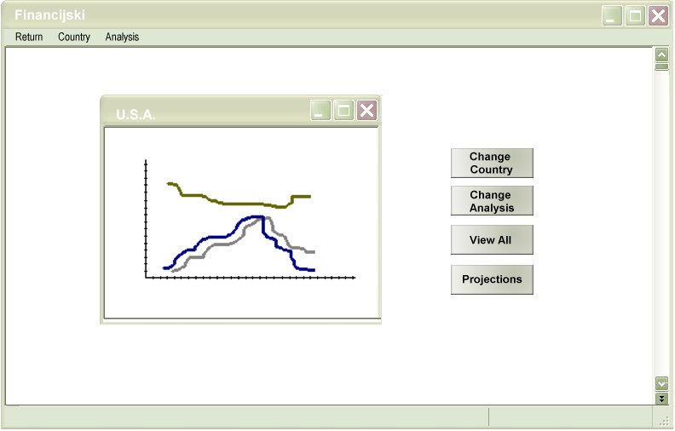
Figure 6.1: User Interface Implications

Slide 3
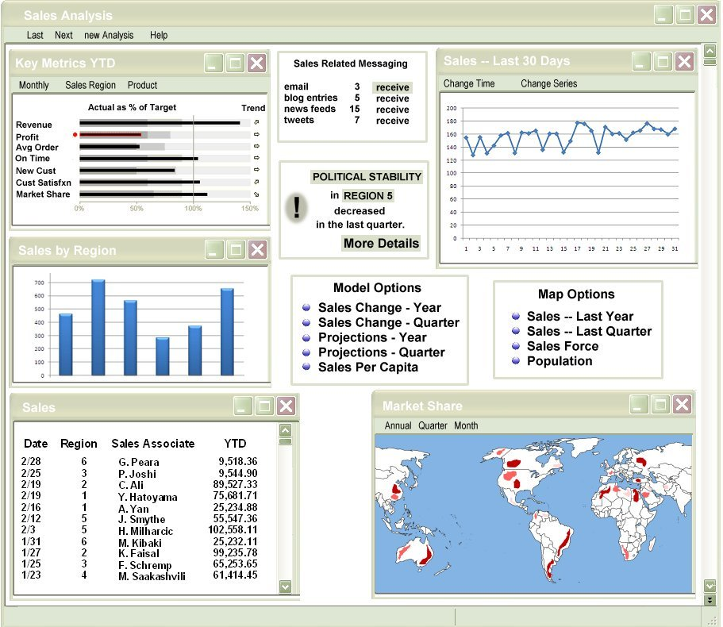
Figure 6.2a: Language Effects on Screen Design (English)

Slide 4
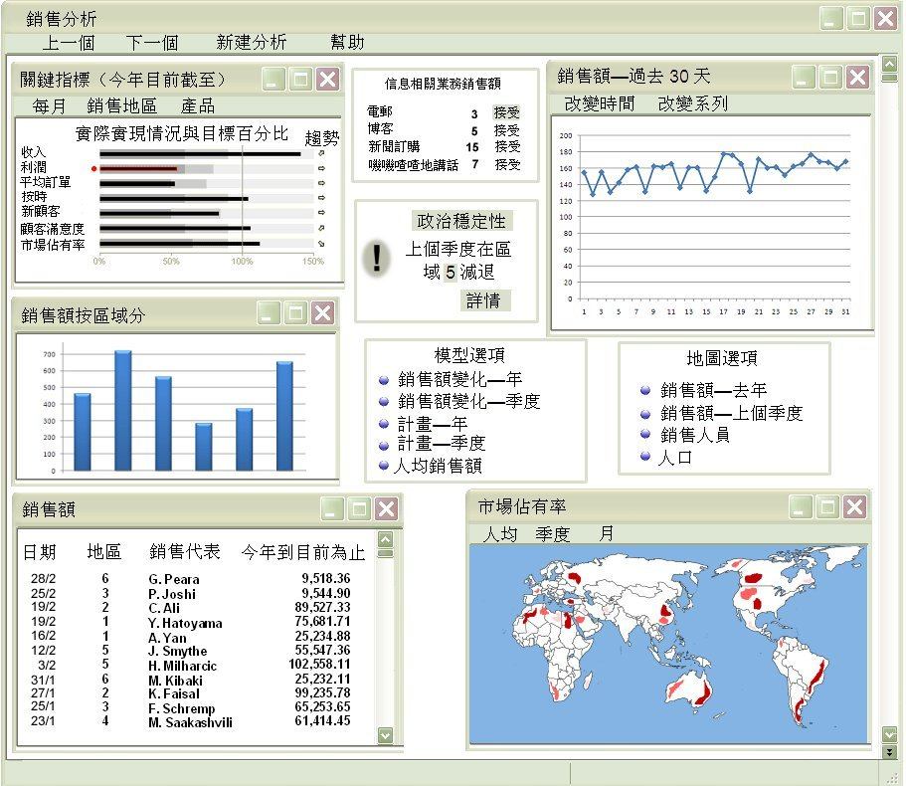
Figure 6.2b: Language Effects on Screen Design (Chinese)

Slide 5
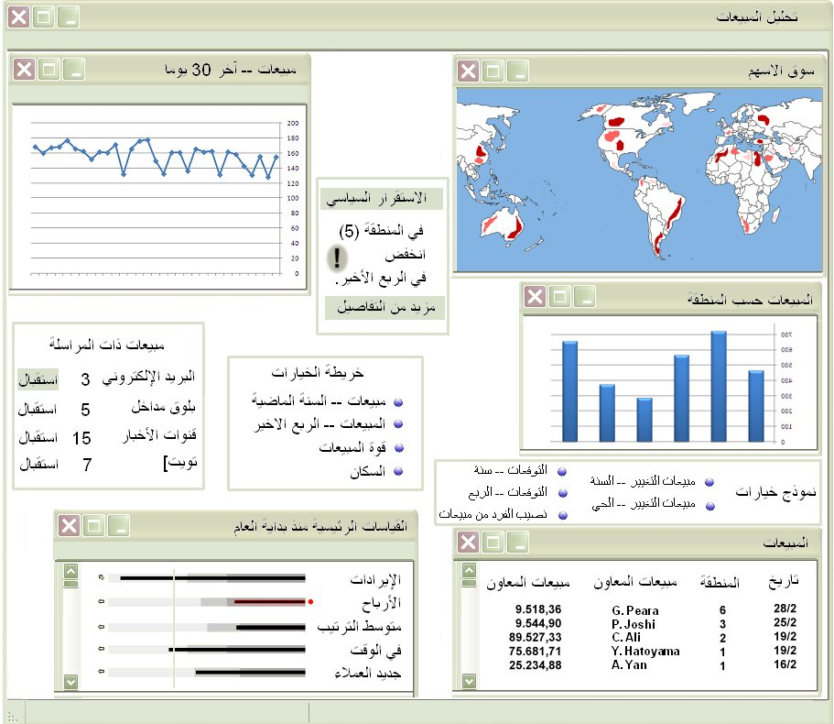
Figure 6.2c: Language Effects on Screen Design (Arabic)

Slide 6
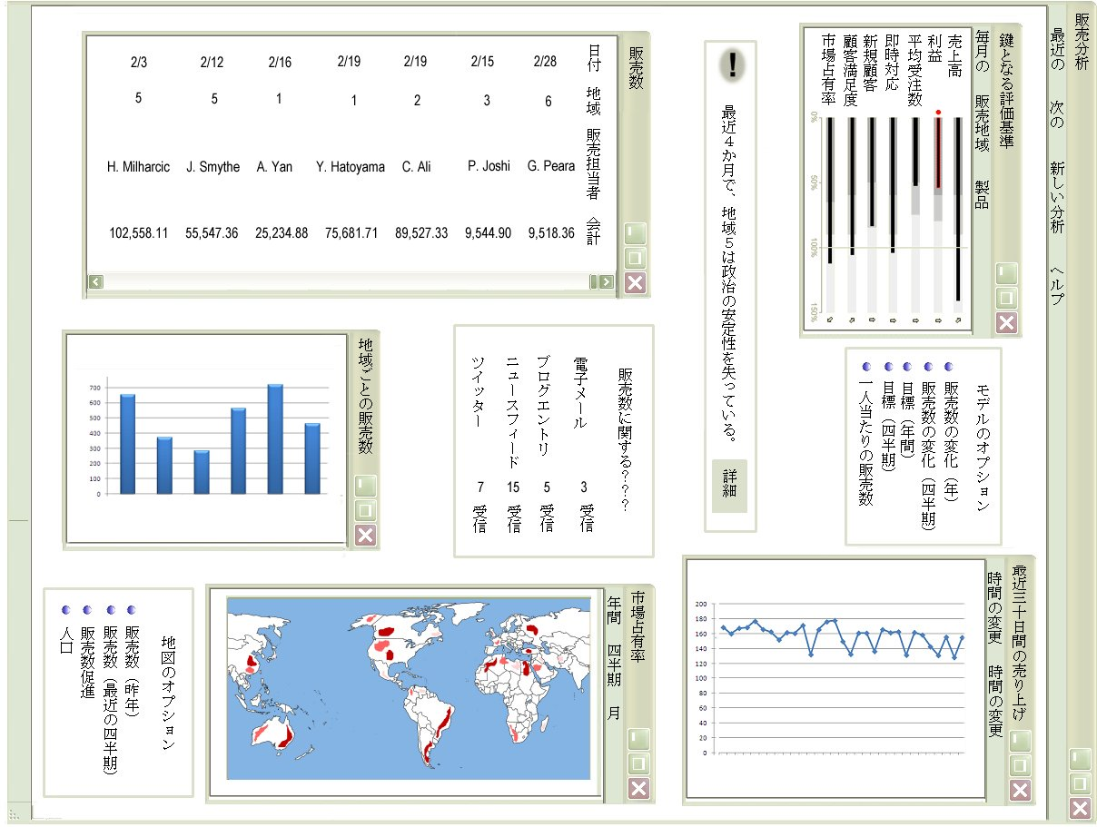
Figure 6.2d: Language Effects on Screen Design (Japanese)

Slide 7
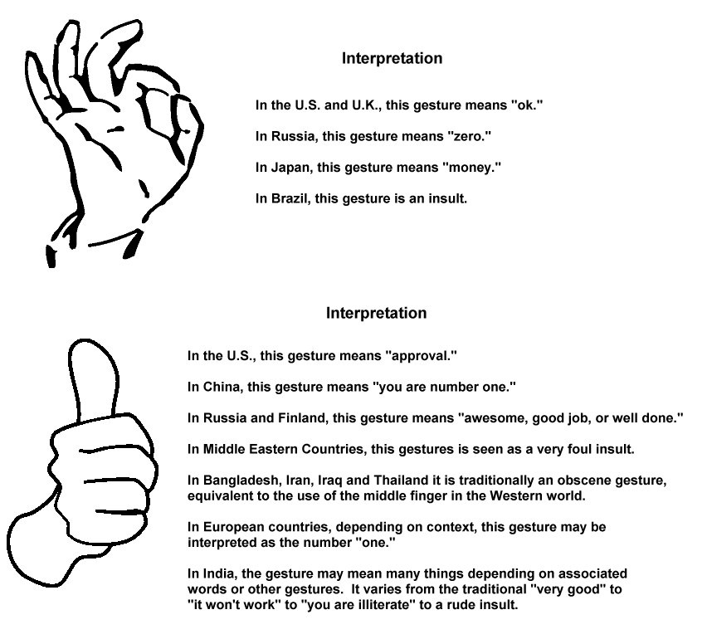
Figure 6.3: Gestures and their Interpretation Cross Culturally

Slide 8
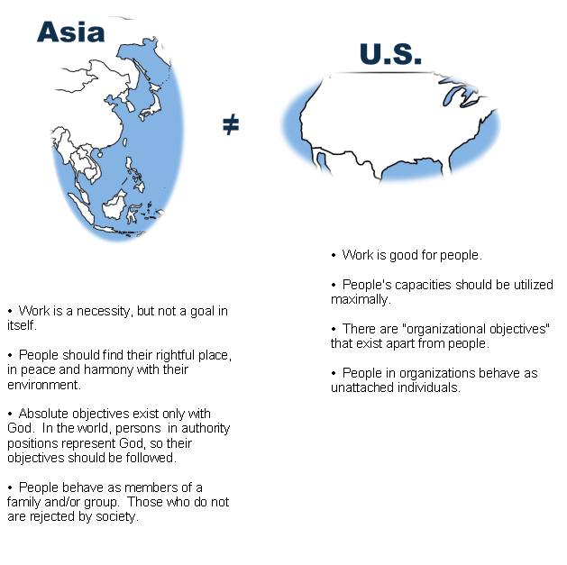
Figure 6.4: Comparison of Cultural Assumptions

Slide 9
Table 6.1: Possible Dimensions of Culture
Long Term Orientation
Attitude about Uncertainty
Person-Nature Relation
Activity Index
Human-Nature Attitudes
Power Distance
Individualism
Masculinity Index

Slide 10
Table 6.2: Cultural Scores for 12 Countries
Power Uncertainty Masculinity Long-Term
Country Distance Avoidance Individualism Index Orientation
Arab Countries 80 68 38 53
France 68 86 71 43
Germany 35 65 67 66 31
Great Britain 35 35 89 66 25
Netherlands 38 53 80 14 44
Hong Kong 68 29 25 57 96
Indonesia 78 48 14 46
Japan 54 92 46 95 80
Brazil 69 76 38 49 65
Mexico 81 82 30 69
United States 40 46 91 65 29
West Africa 77 54 20 46 16
*Adapted from Hofstede, G., “Management Scientists are Human,” Management Science, 40(1), January, 1994, p. 4-13.
It is reprinted from Management Science with permission from the Institute for Operations Research and the
management Sciences and the author. No further reproduction is permitted without the consent of the copyright owner.

Slide 11
Table 6.3: Cultural Differences and Their Effects on DSS Design
Choice of Model
Descriptive v. Optimization
Need for Strategic Planning
Use of Standards
Variables Used
Need for Monitoring
Variety Needs for Models
Pre-Modeling Need: Alternative Generation
Post-Modeling Needs: Sensitivity Analyses
Temporal Aspects
Orientation of Data
Static vs. Dynamic
Desired Access
Scope of Access
Individual v. Joint Use

Slide 12
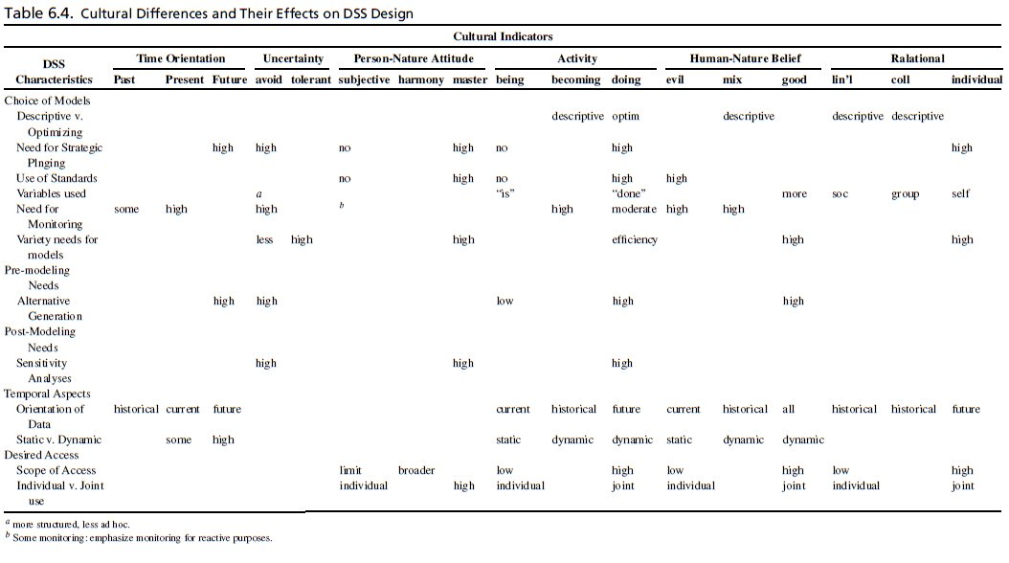
Table 6.4: Cultural Differences and Their Effects on DSS Design

Slide 13
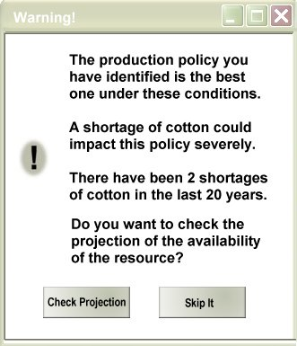
Figure 6.5: Intelligent Assistance

Slide 14
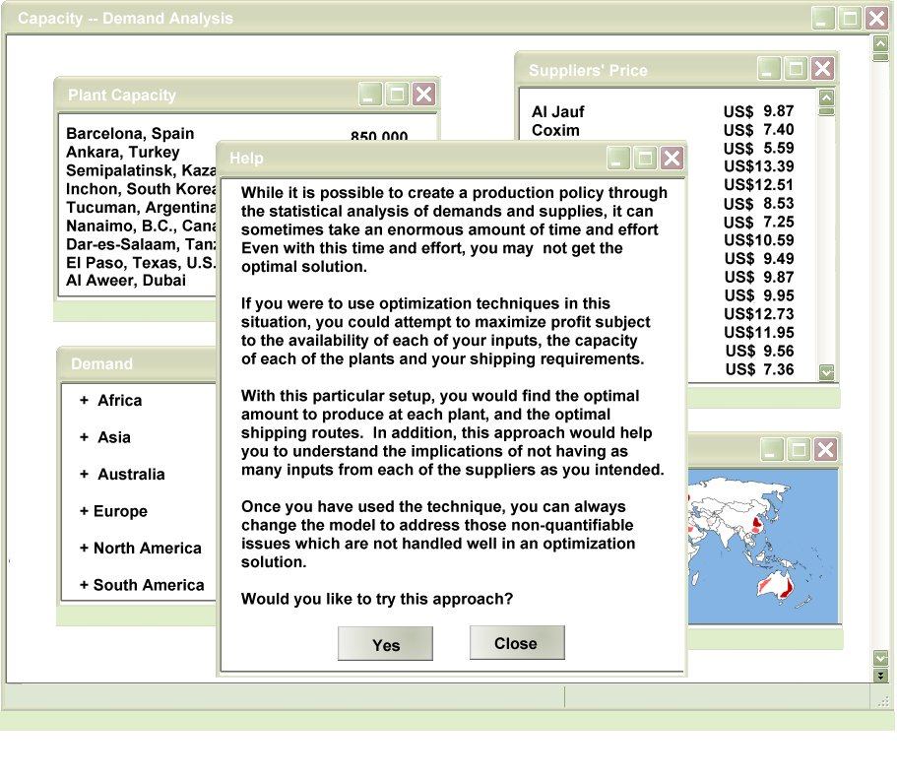
Figure 6.6: Intelligent Assistance Encouraging Further Models

Slide 15
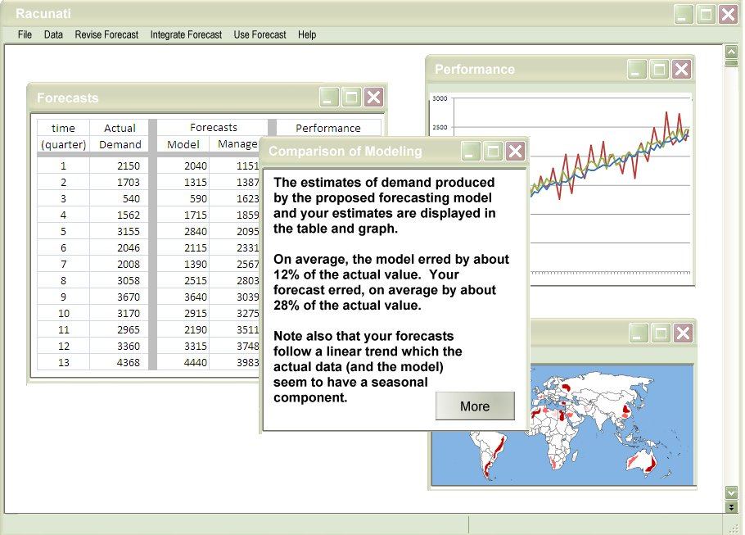
Figure 6.7: Modeling Assistance

Slide 16
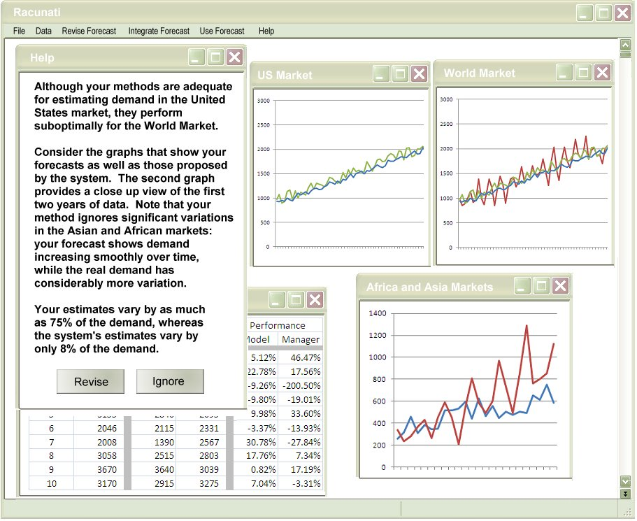
Figure 6.8: Transnational Support

