Slide 1
Chapter 2 Decision Making
Decision Support Systems
For Business Intelligence

Slide 2
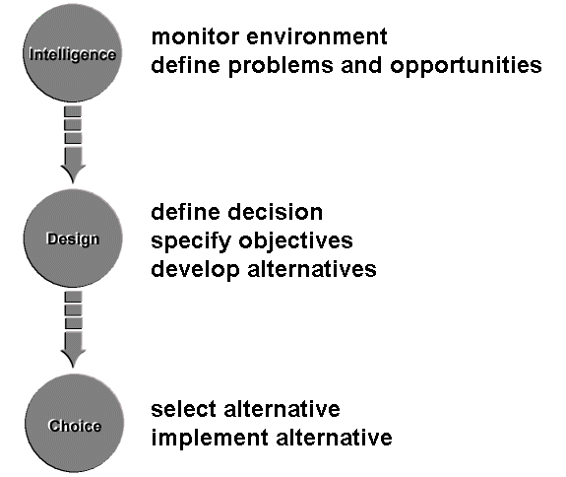
Figure 2.1: Nature of Decision Making

Slide 3
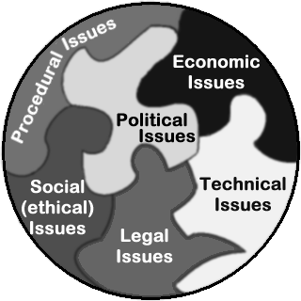
Figure 2.2: Forms of Rationality

Slide 4
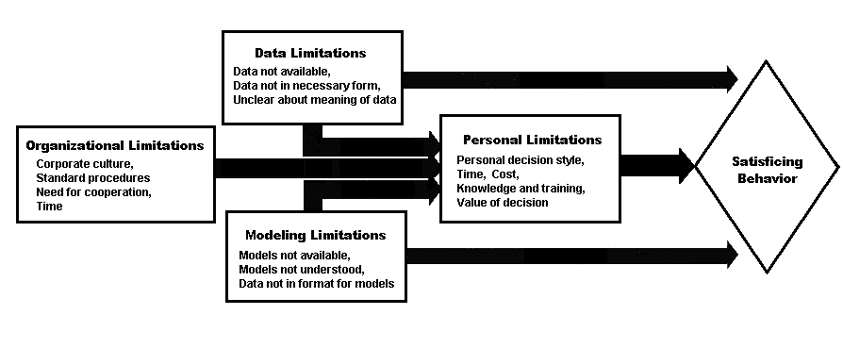
Figure 2.3: Causes of Satisficing Behavior

Slide 5
Figure 2.4: Perception is Not Always Obvious

Slide 6
Figure 2.5: Is This a Car or a Truck?

Slide 7
Figure 2.6: Attributes of Information

Slide 8
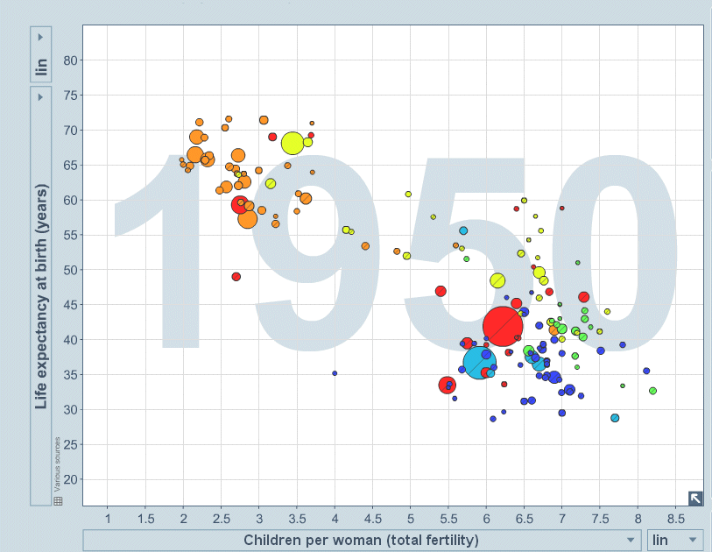
Figure 2.7: Using Data to Challenge Assumptions

Slide 9
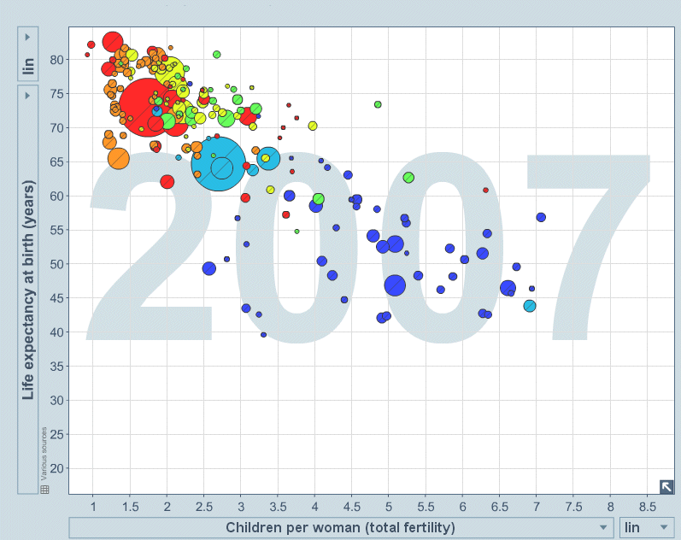
Figure 2.8: Using Data to Challenge Assumptions

Slide 10
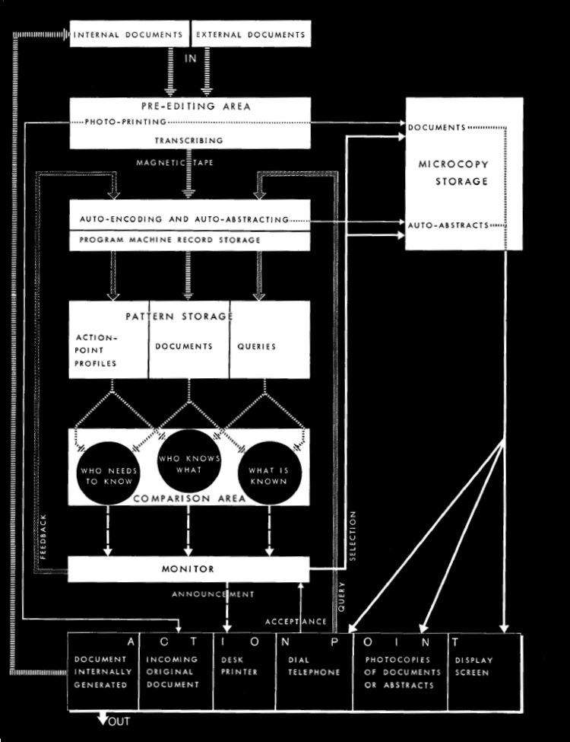
Figure 2.9: An Early View of BI

Slide 11
Table 2.1: Measures of Success of BI Projects
Measures of Success of BI Projects*
Improved Business Performance 70%
Better Access to Data 68%
Support of Key Stakeholders 53%
User Perception that it is Mission Critical 50%
ROI 43%
% of Active Users 31%
Cost Savings 31%
Number of Defined Users 17%
Other measures of success included:
Number of BI Applications
Number of New Requests for BI Applications
Number of Standard ad hoc Reports
Elimination of independent (shadow) spreadsheets
Increased Employee Satisfaction
Increased Customer Service
Time Reduced
*Adapted from Howson, C., Successful Business Intelligence: Secrets to making BI a Killer Application, New York: McGraw Hill, 2008.

Slide 12
Table 2.2: Necessary Features of Successful BI
Necessary Features of Successful BI
• High data quality and “clean” data
• Reliability of the system
• Availability of relevant subject areas
• Appropriate and effective BI tools
• Fast query response time
• BI being continually improved (both data and tools)
• Integration of BI into organizational processes
• Near real time updates to the data warehouse

Slide 13
Figure 2.10: Demonstration of Microsoft’s Tool, Pivot

