Slide 1
Church History
The Protestant Reformation
Part 1
1516-1563

Slide 2
Points to Ponder
What events led to the Reformation?
Who are the major players in the Reformation?
What happened during the Reformation?
What were the lasting effects of the Reformation?
What can we learn today?

Slide 3
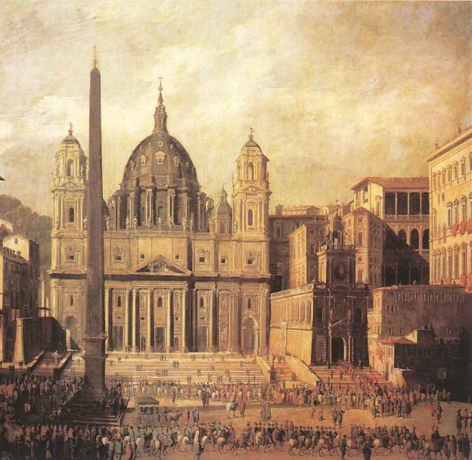
Events Leading to the Protestant Reformation
Catholicism, Corruption and Control

Slide 4
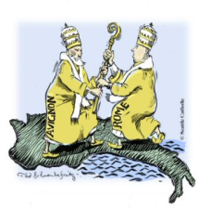
Pre-Reformation Events
Papal Power Begins to Weaken
  The Western Schism Occurs in 1378
  Also called the Papal Schism
  More than one claimant to office of Pope
  From 1309 to 1377 seven French Popes ruled from Avignon.
  In 1376 Gregory XI moved the Papal Residence back to Rome
  Avignon promptly sets up a rival Pope
  Between 1378 and 1417 two Papal Residences vie for power.
  Finally resolved by the Council of Constance in 1417

Slide 5
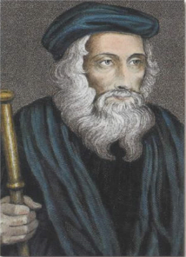
Pre-Reformation Events
The Church’s Magic Wanes
  Various scholars begin to arise and question the authority of the Church.
  1381 – John Wycliffe denies that the substance of bread and wine are miraculously changed in the Eucharist.
  Hoc est enim corpus meum
  Latin: This is my Body
  Probably the origin of the phase Hocus Pocus as non Latin speaking peasants misunderstood the priest’s words at Mass
Wycliffe also Denies Authority of Pope
Denounces Auricular Confessions

Slide 6
Pre-Reformation Events
The Church is drunk on corruption.
  Catholicism was a money making scheme
  Everything in the church came at a price.
  One Cardinal quipped:
    “God does not desire the death of sinners, but that they should live and pay!”

Slide 7
Pre-Reformation Events
The use of Relics was out of hand!
  Relics = sacred items venerated and worshiped
    Pieces of the True Cross
    Bones of apostles
    Sacred artifacts from the life of Jesus
  The faithful would come, venerate the relics and pay their money to get whatever spiritual benefit they could.
John Calvin noted that there were 15 skulls of John the Baptist and enough wood from the cross of Jesus to build a cross so tall you couldn’t see the top!

Slide 8
Pre-Reformation Events
Other Events Leading to The Reformation
  Dawn is breaking on the Dark Ages
  European Renaissance – new emphasis on learning and literature as well as art and science.
  A rise in nationalism which made people see themselves as “German,” “French,” etc. rather than just “Catholic.”
  Capitalism – status no longer came due to one’s ancestry or title.
  Guttenberg and the printing press and mass communication.
  Fear of the Church begins to diminish.

Slide 9
Pre-Reformation Events
Significant Dates that set the Stage
  1381 Wycliffe intensifies work on English translation of Bible
  1452 Leonardo Da Vinci born - The Renaissance Comes Alive!
  1453 Sack of Constantinople by the Turks
  1455 Gutenberg invents the printing press
  1469 Erasmus is born – most influential scholar of Renaissance.
  1473 Copernicus is born
  1483 Martin Luther is born
  1494 William Tyndale is born

Slide 10
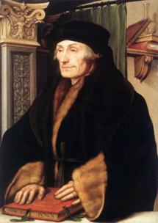
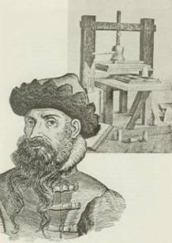
Pre-Reformation Events
The Curtain is Lifted . . .
Gutenberg and Erasmus lift the veil of biblical ignorance giving rise to mass distribution of God’s Word and better translations of the Scripture.
1516
Erasmus Publishes the Greek Text showing the corruption of the Latin Vulgate!
1455
Gutenberg invents the Printing Press

Slide 11
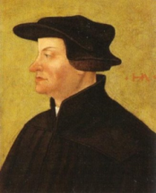
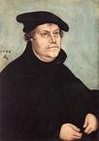
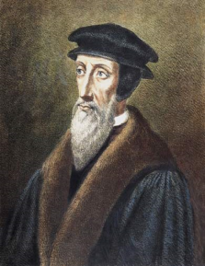
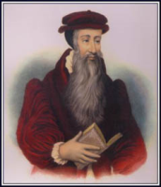
Pre-Reformation Events
Enter, the Main Actors . . .
Zwingli
Switzerland
Martin Luther
Germany
John Calvin
France
Knox
Scotland

Slide 12
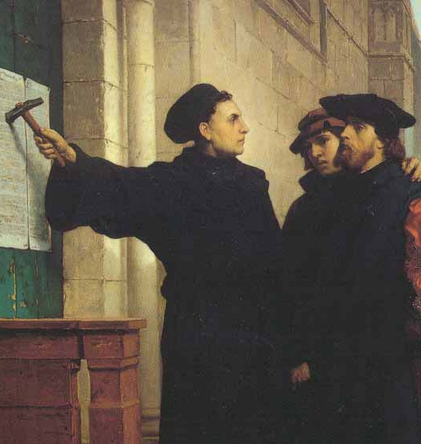
The Reformation
Germany and Beyond!!!

Slide 13
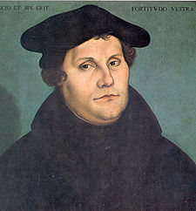
The Reformation
Martin Luther
“Hero of the Reformation”
“The Mouse that Roared”
  Born November 10, 1483
  Born to a poor German mining family
  At first wanted to study Law
  After reading Bible enters monastery at age 21
  Becomes an Augustinian Monk
  Preacher and professor at Wittenberg in 1508
  Dedicated himself to intense fasting and prayer in hopes of drawing closer to God.

Slide 14
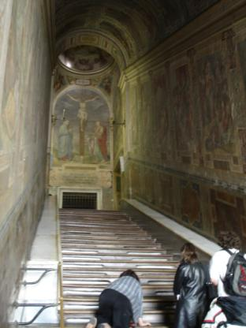
The Reformation
Luther Visits Rome in 1510
  Visits Rome on official religious business
  Appalled at corruption in Rome
  Saw “relics” as a dishonest sham.
  While ascending the Scala Sanctum on his knees he is reported to have been convinced that “The Just Shall Live by Faith” rather than by Works!
Scala Sanctum
Pilates Stairs - Rome

Slide 15
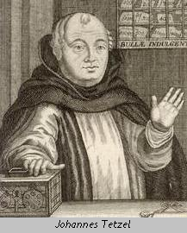
The Reformation
John Tetzel and Luther
  In attempt to raise funds to build St. Peter’s Basilica, Pope Leo X sends out John Tetzel, a Dominican Fryer, to sell indulgences.
  Indulgences – forgiveness purchased in advance for sin
  Luther opposed whole system.
“As soon as the coin in the coffer rings, the soul from purgatory springs”

Slide 16
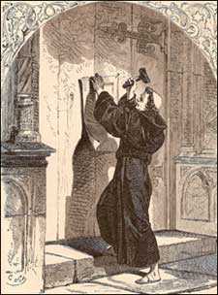
The Reformation
Luther’s Ninety Five Theses
  October 31, 1517 Luther posts his objections to the sale of indulgences on the door of Castle Church in Wittenberg. The Reformation Begins!
  Two interesting facts:
  1. In the 1520’s one third of all books in Germany were written and published by Luther.
  2. Church doors were public bulletin boards.
  3. Luther’s works were being read across Europe

Slide 17
The Reformation
The Papal Response:
  At first Luther was dismissed as “a drunken German who, when sober, will change his mind” - Pope Leo X
  Eventually Luther grew in popularity with masses coming to hear him speak. Luther came to be seen as a danger!
  Luther was excommunicated in 1521 and is forced into Exile

Slide 18
The Reformation
A Diet of Worms Leaves a Bad Taste!
  April 1521 Luther brought before the Diet at Worms
  Was asked to recant his writings to which he refused
  His statement:
  "Unless I shall be convinced by the testimonies of the Scriptures or by clear reason ... I neither can nor will make any retraction, since it is neither safe nor honourable to act against conscience."[
  “Here I stand. I can do no other. God help me. Amen."

Slide 19
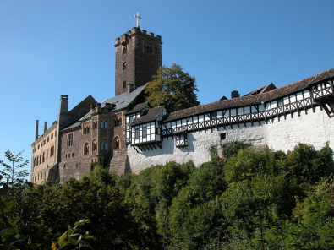
The Reformation
Luther Cont. . .
  Pronounced an Outlaw
  Flees/Exiled to the Castle of Wartburg where he lives for 11 months and translates the New Testament.
The Luther Bible contributed to the emergence of the modern German language and is regarded as a landmark in German literature. The 1534 edition was influential on William Tyndale’s translation.

Slide 20
The Reformation
The Reformation Spreads . . .
  The Reformation Movement begins to spread across the continent.
  However, men like Luther did not set out to develop their own “denominations”
  Their goal was to “reform” the Catholic Church.

Slide 21
The Reformation
The Reformation Spreads . . .
  Disagreement with various Catholic doctrines fueled the Reformation Movement.
  1. Forced Celibacy of Priesthood
  2. Purgatory
  3. Devotion of Mary
  4. Authority of the Pope

Slide 22
The Reformation
The Reformation Splits . . .
  Uniformity was never achieved in the Reformation period. Unity at first came more on the basis of dissatisfaction with Catholicism rather than a single doctrinal issue.
  The Reformation Movement soon split along doctrinal lines.
  Disagreements arose between Luther and Zwingli and then later between Luther and Calvin.

Slide 23
The Reformation
Results of the Reformation
  In time major religious divisions and movements occurred.
    ( Luther) Lutheranism
    (Calvinism) Reformed/Calvinists/Presbyterians
    (King Henry VIII) English Reformation/Anglicanism
    (Pope Paul III) Catholics led a Counter Reformation

Slide 24
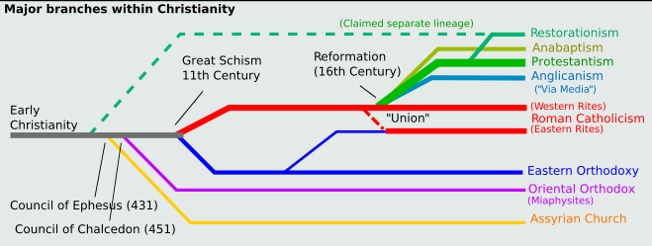
The Reformation
Legacy of the Reformation

Slide 25
The Reformation
A Mighty Fortress Is Our God
A mighty fortress is our God, a bulwark never failing;
Our helper He, amid the flood of mortal ills prevailing:
For still our ancient foe doth seek to work us woe;
His craft and power are great, and, armed with cruel hate,
On earth is not his equal.
Did we in our own strength confide, our striving would be losing;
Were not the right Man on our side, the Man of God’s own choosing:
Dost ask who that may be? Christ Jesus, it is He;
Lord Sabaoth, His Name, from age to age the same,
And He must win the battle.
Words and Lyrics: Martin Luther

Slide 26
The Reformation
End of Part 5

