Slide 1
Contemporary Paganism

Slide 2
Symbols
Like many religions, pagans employs certain symbols both as representations of their faith and as images and objects that contain power in and of themselves. The pentacle is probably the most common in paganism, often depicted in art and jewelry. Some say its five points represent the four directions plus the sacred spirit.

Slide 3
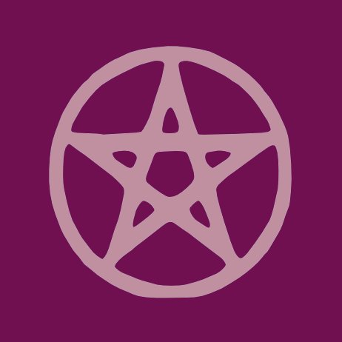

Slide 4
As Harvard's Pluralism Project notes, it is difficult to determine the number of pagan adherents around the world as estimates vary widely. The number may be anywhere between 200,000 and 1 million, or possibly more.
Most pagans don't exhibit their religious identity outside of the ritual space (unless they wear clothing or jewelry depicting pagan symbols such as the pentacle.) According to The Pagan Census, modern pagans are distributed fairly even throughout the U.S., with a slight majority on either coast. Men and women of all ages, races and backgrounds practice paganism, though the census said the community tends to skew toward white, middle class women.

Slide 5
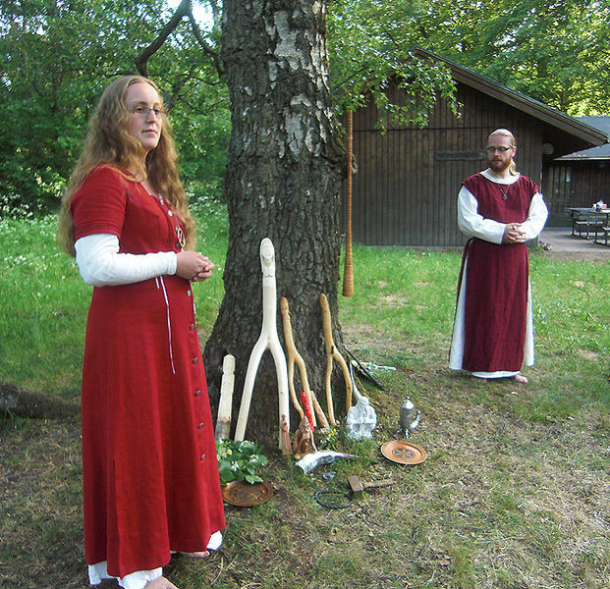

Slide 6
Sects
Contemporary paganism is widespread and somewhat scattered, hence the difficulty counting adherents. Modern paganism does not descend from a singular ancient religion but rather many ancient indigenous and folkloric traditions, and there is no central text to refer to that can shed light on doctrine.
There are, however, subtle distinctions that delineate Celtic and northern European sects, Baltic and Slavic sects, Greek and southern European sects, American neopaganism, and other groupings around the world. Some covens (organized groups) worship specific deities, such as Diana or Odin. Others practice ancient Druidism, such John Rothwell ("Arthur Pendragon") pictured, while some focus on activism, such as the Reclaiming tradition.

Slide 7
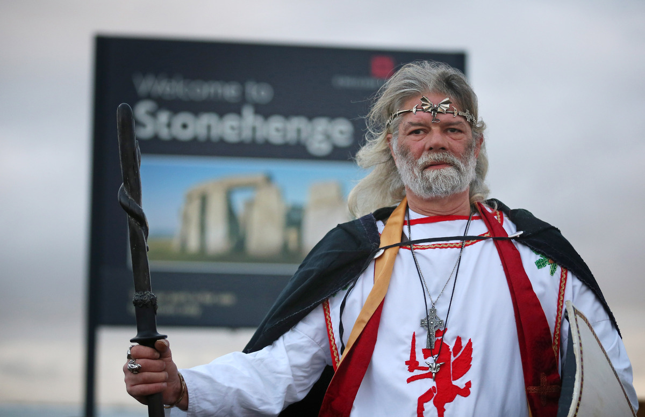

Slide 8
Sites
In general, pagan worship centers around earth and spirit, as opposed to specific structures imbued with sacredness (ie. a church, Mecca, the Vatican, etc.) Forests, hilltops, urban warehouses and individual's homes can operate as ritual sites, especially because many pagans take measures to "create sacred space" for rituals regardless of where they are. That said, some natural or ancient sites, such as Stonehenge or Machu Picchu, may hold particular importance for some pagans.

Slide 9
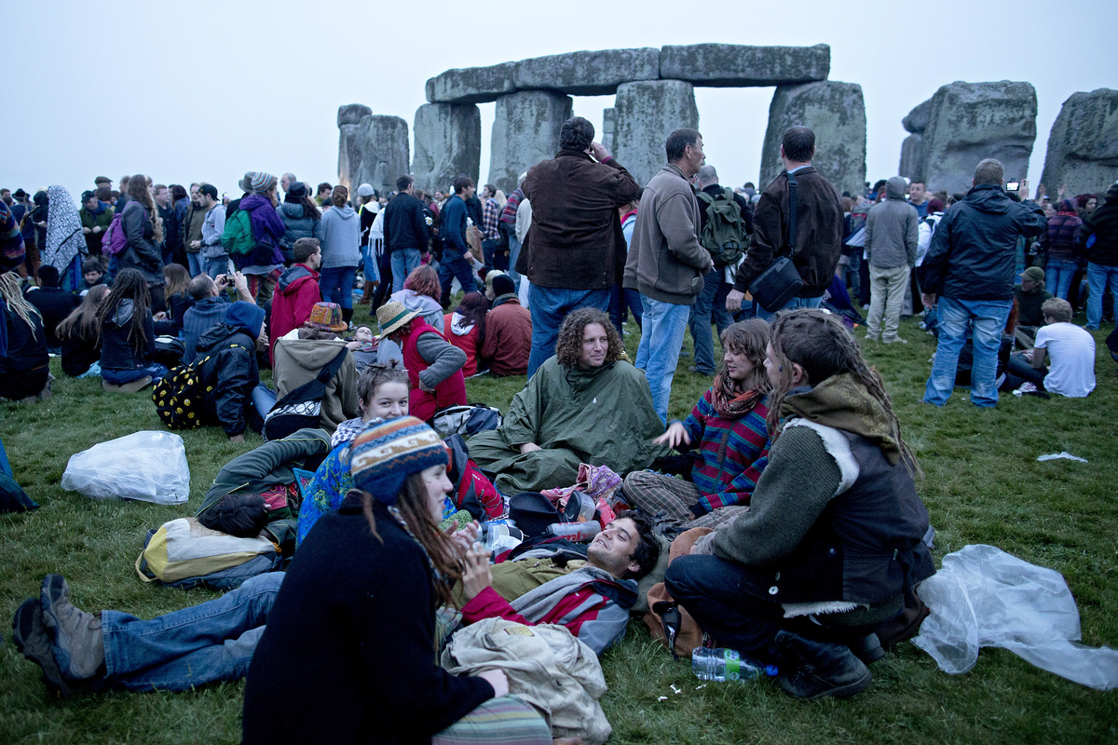

Slide 10
Triple Goddess
The triple goddess in modern paganism embodies the maiden, the mother and the crone. These three aspects are meant to encompass the full power of the goddess, reflected in the moon's cycles. The waxing moon represents the maiden; the full moon represents the mother; and the waning moon represents the crone. Pagans will often hold gatherings or do personal meditation to observe these moon phases.
In addition to the goddess, some pagans worship a masculine divinity, occasionally in the form of the Horned God or the Green Man. Many also revere the natural world as divine, as well.

Slide 11
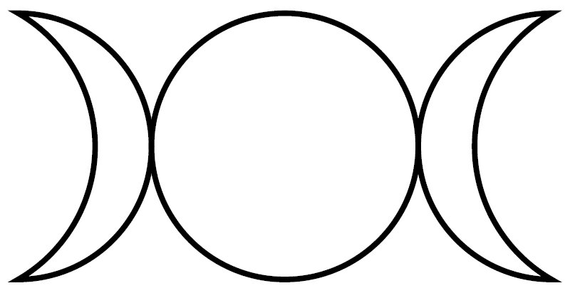

Slide 12
Sabbats - Quarter Days
There are eight sabbats that make up the pagan "wheel of the year," though not all pagans observe all eight. Each sabbat corresponds with different seasonal events of the year. Pagans celebrate the winter solstice, spring equinox, summer solstice and autumn equinox (or "quarter days") to mark the deepest part of the season and the lengthening or shortening of daylight.

Slide 13
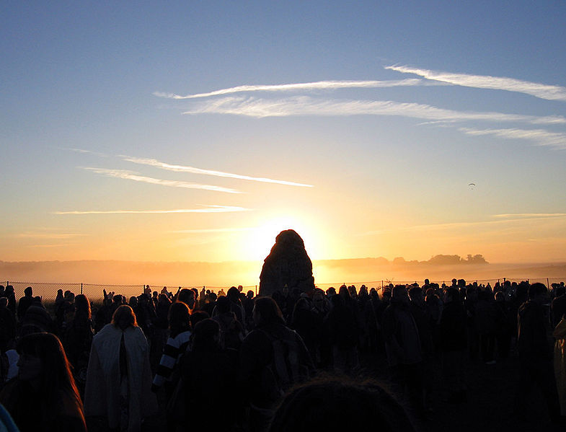

Slide 14
Sabbats - Cross Quarter Days
The other four sabbats, or "cross quarter days," are Imbolc, Beltane, Lughnasadh and Samhain. Imbolc falls in early February and celebrates the onset of springtime, encouraging the sprouting of seeds and new life. Beltane is an early summer celebration in May, often seen as a fertility festival. Lughnasadh falls in August and is the first of several harvest festivals. Samhain coincides with the western Halloween and is a holiday for paying tribute to the deceased. It is often seen as a time when the veil between this world and the afterlife is thinnest.

Slide 15
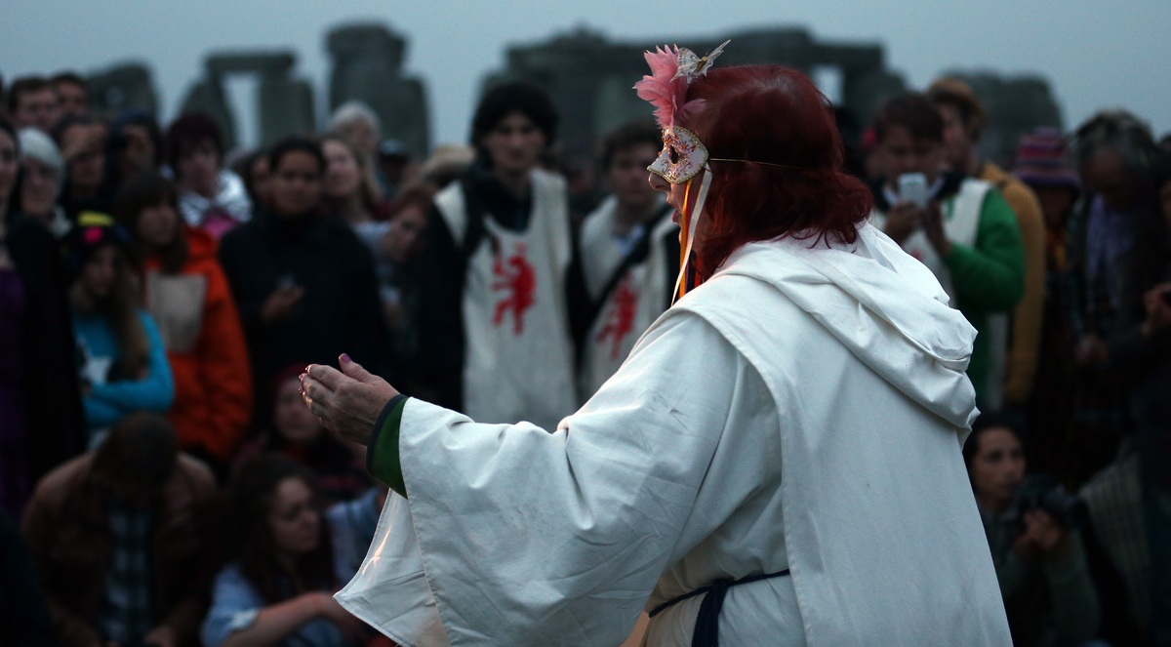

Slide 16
Altars
Pagans often construct altars for rituals and to keep in their homes, and these may act as offerings to specific deities or to 'the goddess' more generally. Each object holds certain meaning, such as rocks to symbolize earth, seeds to symbolize intentions and new life, bread to symbolize bounty, and so on.

Slide 17
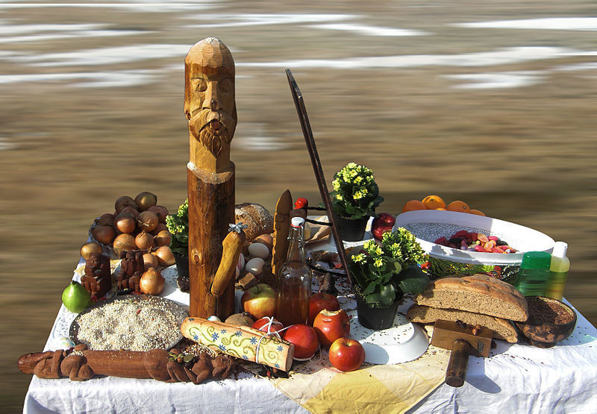

Slide 18
Tools
Pagans occasionally employ tools in rituals and personal practice that may either function in ritual procedures (such as an athame, pictured), aid in divination (such as a pendulum), assist in cleansing (such as water or incense) or pay respects to a specific deity (such as a statuette). Other tools may include drums, candles, ribbons, cauldrons and more, depending on the specific ritual or practice for which they will be used.

Slide 19
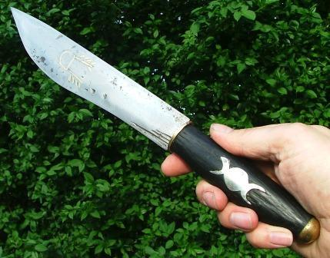

Slide 20
Fire
Fire plays a prominent role in many pagan rituals and in personal practice (through candles and incense.) During some rituals pagans circle around a large fire, which is seen to hold transformative power. Fire may also be used in cleansing, divination, trance and ecstatic dancing.

Slide 21
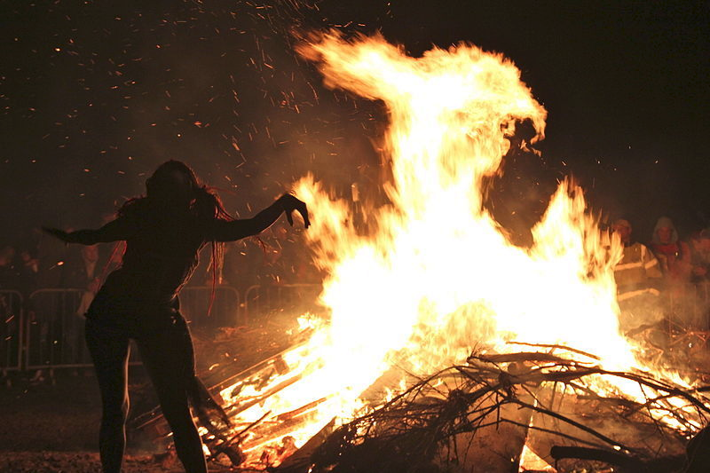

Slide 22
Rituals
The anatomy of any pagan ritual will vary from group to group, but Reclaiming -- one of the best-known American pagan groups -- identifies several key components. Typically rituals begin with grounding and cleansing, then move to the 'casting' of a circle. Leaders and/or participants will often invoke deities, then guide one another into trance or magic work. At the end, participants often share food and drink before closing the ritual by devoking and opening the space once again.

Slide 23
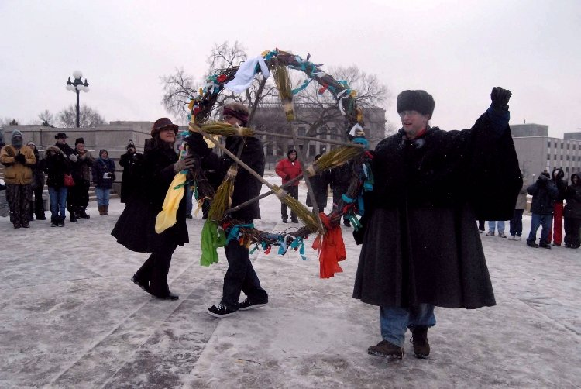

Slide 24
Magic
Magic in paganism and witchcraft is primarily about change and transformation. By some accounts, magic allows practitioners to remove the barriers of what they think is possible so that they can manipulate the physical or spiritual world. Most groups shun what is sometimes referred to as "black magic" and instead employ magic crafts that encourages practitioners to draw health and fortune into their lives and the lives of others. Some magical activities include chanting, trance, craft work and more elaborate manipulations of objects.

Slide 25
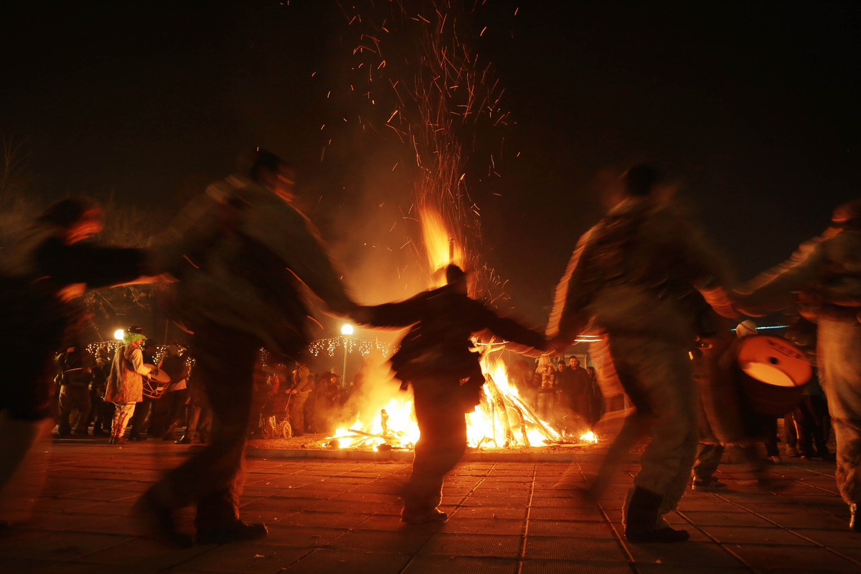

Slide 26
Invoking Deities
One of the key elements of pagan rituals and personal practice is the invocation of specific deities. The chosen deity may correspond to a certain sabbat (such as Brigid for Imbolc). The invocation is intended to invite the god or goddess to assist the ritual or so the participant may come to know the divine through embodiment.

Slide 27
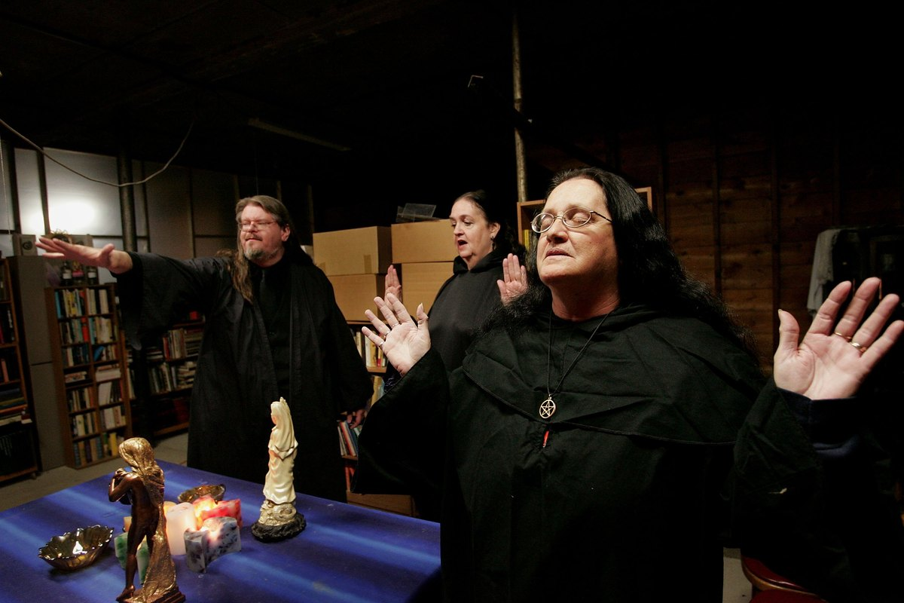

Slide 28
Personal Practice
The Pagan Census found in 2003 that just over 50% of respondents said they were solitary practitioners. This means they do not belong to a coven and may not have been 'trained' by a larger spiritual organization. Solitary practitioners observe rituals and practice magic on their own, or perhaps occasionally in small groups. Even for those involved in covens, personal practice is seen as key for developing magic skills and deepening spiritual connection.

Slide 29
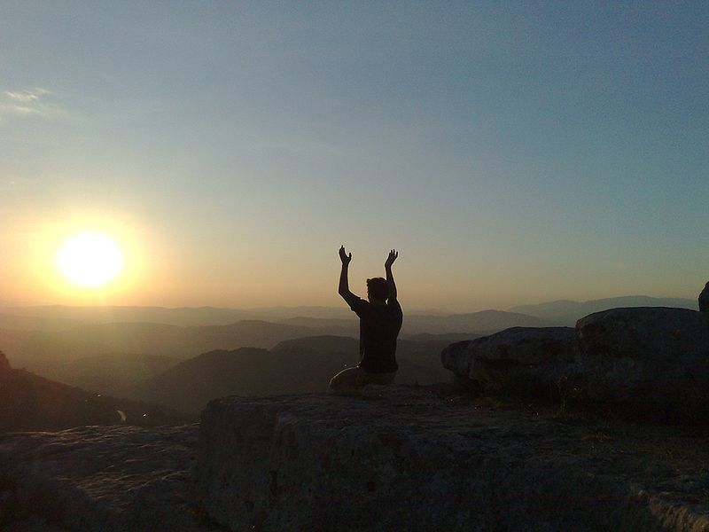

Slide 30
Pagan Leaders
Modern pagan leaders are often hard to identify due to the dispersed nature of the faith. Individuals may be trained and ordained by specific seminaries or by independent groups (such as Reclaiming). In general, pagan sects are non- or semi-hierarchical, but certain individuals may hold sway in the community due to their large followings (Such as Starhawk, pictured) or their influence through authorship.

Slide 31
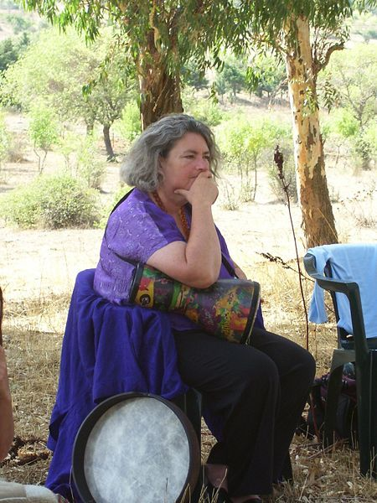

Slide 32
Marriage
Along with legal marriage and domestic partnership, some pagans practice handfasting, a ritualistic but not legal form of marriage. According to BBC, handfasting rituals are believed to predate Christianity and was certainly present by medieval times. During the ceremony, the couple will tie their wrists together with ribbons or twine to represent their union.

Slide 33
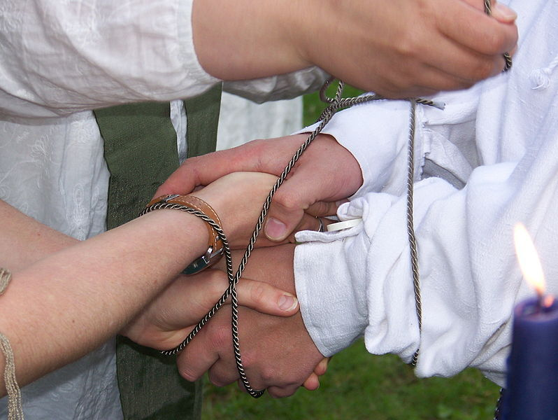

Slide 34
Community
Paganism is by no means an adults-only tradition. The 1999 Pagan Census found that just over 40% of participants reported that they had children. The growing number of children in the pagan community has lead some groups to open their rituals to families and youth, adjusting some practices that may not have been appropriate or accessible for young people.
In some traditions pagans pass on traditions and lore to children through trainings and camps, a form of spiritual education common in many religions. In her book, "Circle Round", pagan leader Starhawk outlines practical tools and lessons for conveying pagan traditions to children, as well as for raising pagan families.

Slide 35
Activism
Though not a rule for pagan communities, some groups make activism and community work central to their practice. Some of the causes promoted by pagan groups include environmental protection, gender and racial equality, LGBT rights and the preservation of sacred indigenous sites.

Slide 36
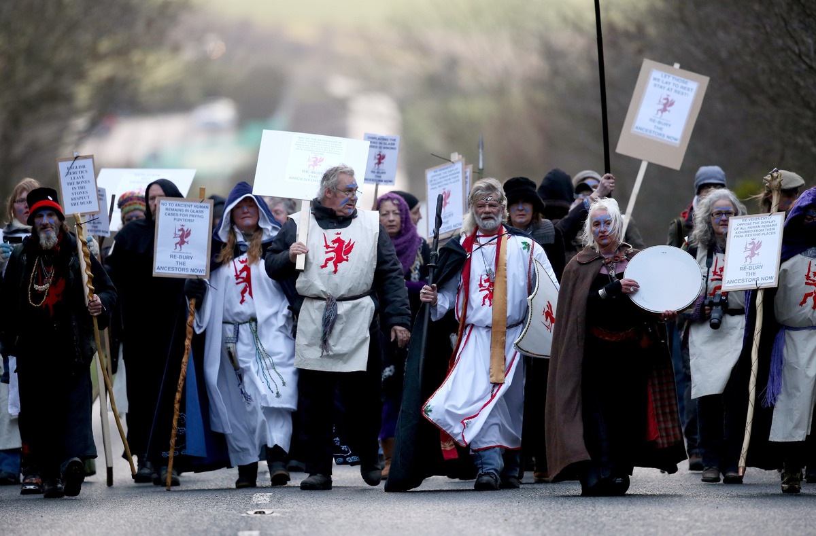

Slide 37
Additional Material

Slide 38
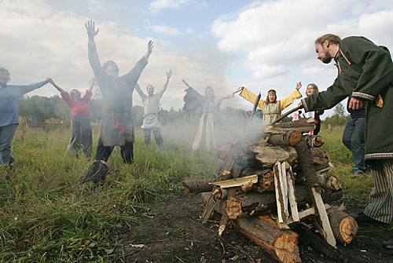
Slavic Rodnover
A Slavic Rodnover ritual in modern Russia. Slavic Rodnovery is an ethnic religion that attempts to recreate forms of Slavic polytheism.

Slide 39
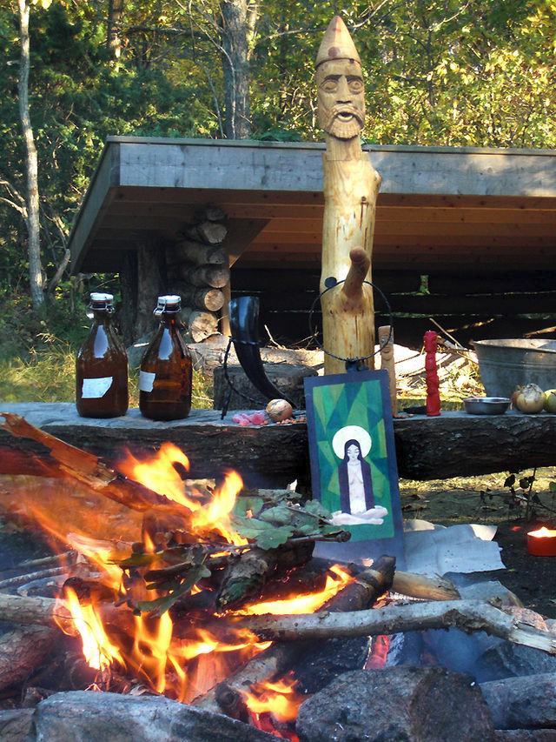
Heathen altar for Haustblot in Björkö, Westgothland, Sweden. The larger wooden idol represents Frey (Ing), the picture in front of it Sunna, and the small red idol Thor.

Slide 40
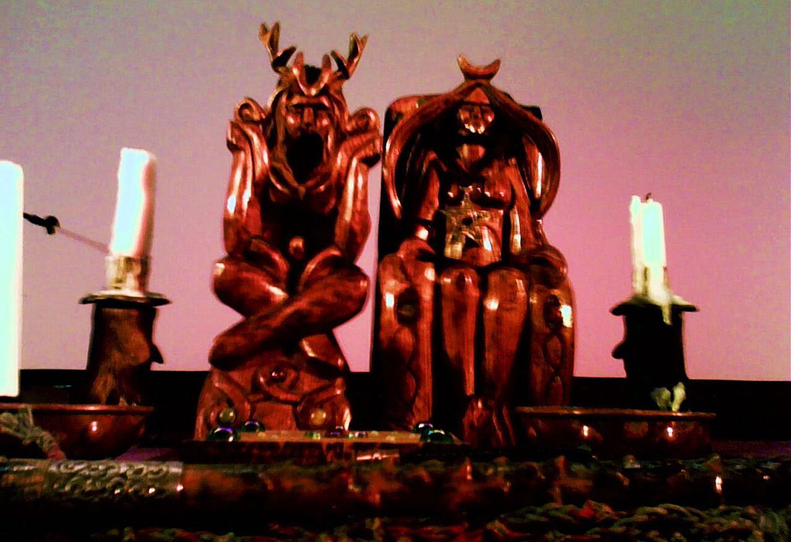
Wiccan Altar
A Wiccan altar belonging to Doreen Valiente, displaying the Wiccan view of sexual duality in divinity.

Slide 41
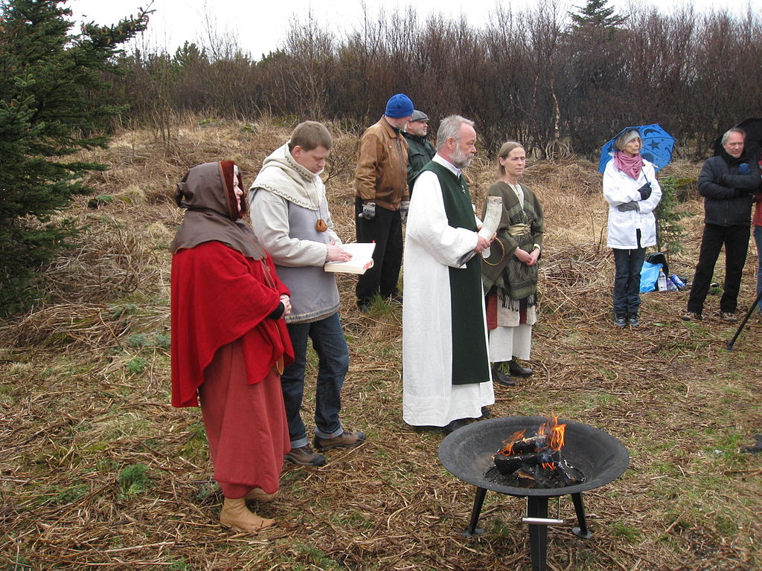
Icelandic Ásatrúarfélagið
Hilmar Örn Hilmarsson and other members of the Icelandic Ásatrúarfélagið conduct a blót on the First Day of Summer in 2009.

Slide 42
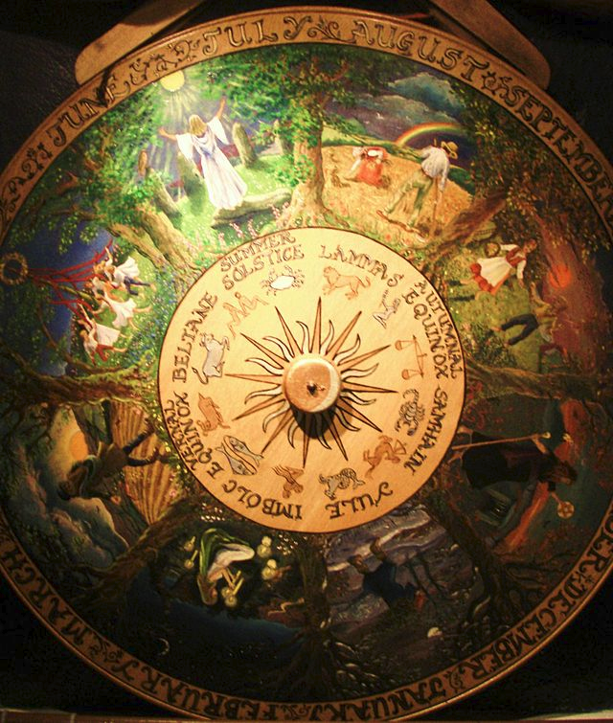
A painted Wheel of the Year at the Museum of Witchcraft, Boscastle, Cornwall, England, displaying all eight of the Sabbats.

Slide 43
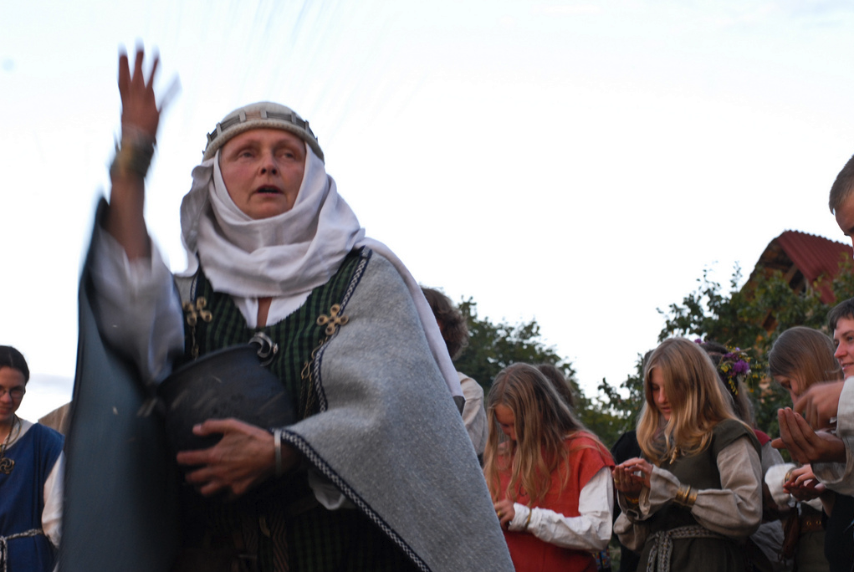
Romuvan priestess leading ritual.

Slide 44
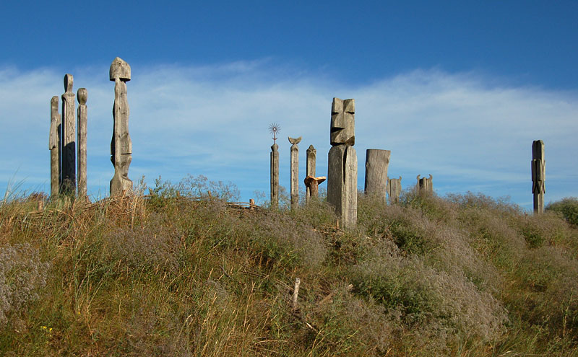
Contemporary Romuvan sacred space in Šventoji, Lithuania.

Slide 45
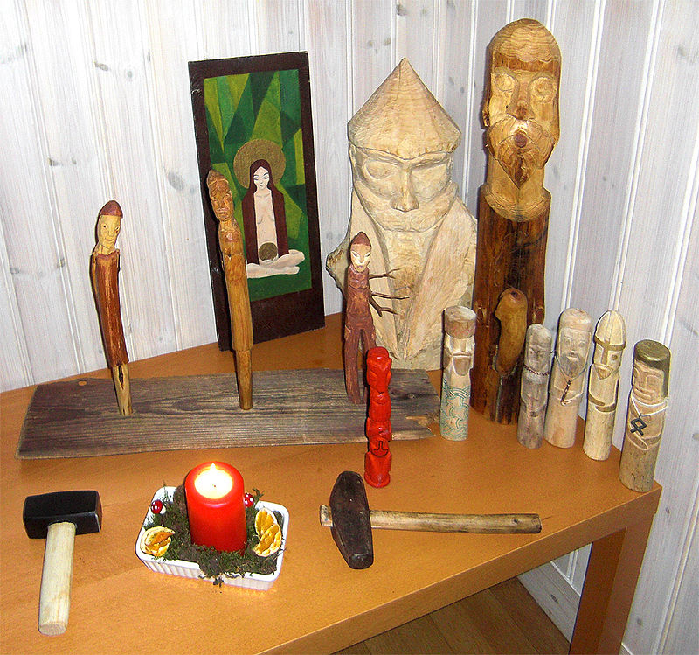
A Heathen altar for household worship in Gothenburg, Sweden. The painted tablet on the back depicts Sunna, the two larger wooden idols Odin (left) and Frey (right), in front of them there are the three Norns, and in the front row a red Thor and other idols. In front of the cult images are two ritual hammers.

Slide 46
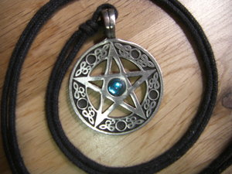
This pentacle, worn as a pendant, depicts a pentagram, or five-pointed star, used as a symbol of Wicca by many adherents.

Slide 47
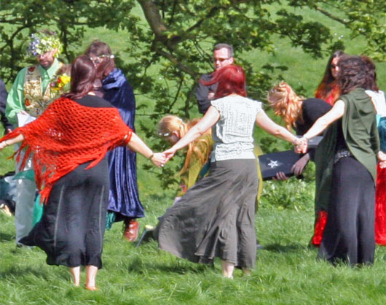
Wiccans gather for a handfasting ceremony at Avebury in England.

Slide 48
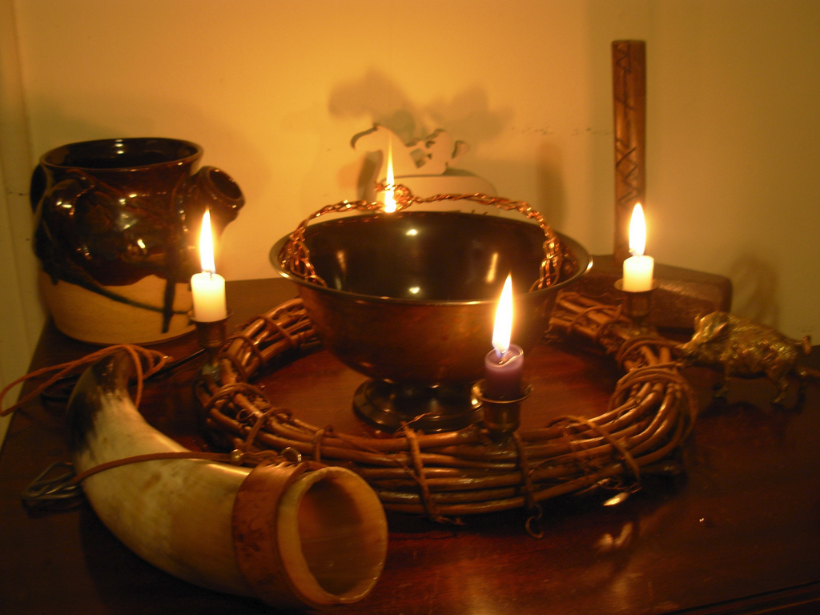
A simple Pagan altar.

Slide 49
Sites for further information
http://en.wikipedia.org/wiki/Modern_paganism
http://en.wikipedia.org/wiki/List_of_Modern_pagan_movements
http://www.paganlibrary.com/introductory/modern_paganism.php
https://www.circlesanctuary.org/index.php/about-paganism/introduction-to-the-wiccan-religion-and-contemporary-paganism

