Slide 1
Spain (Part 9)
Valencia
Murcia

Slide 2
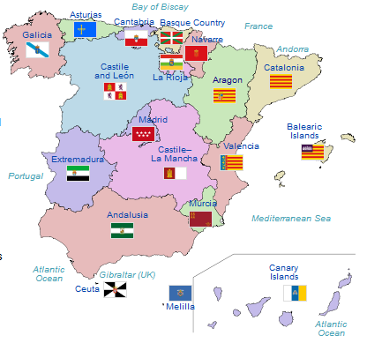
Autonomous Community of Valencia, Spain

Slide 3
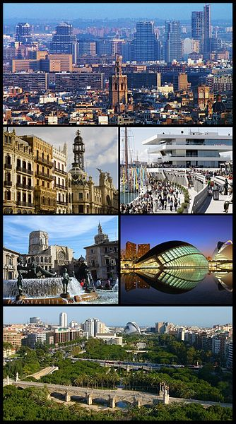
City of valencia

Slide 4
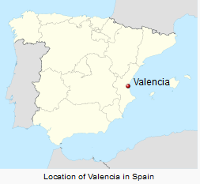
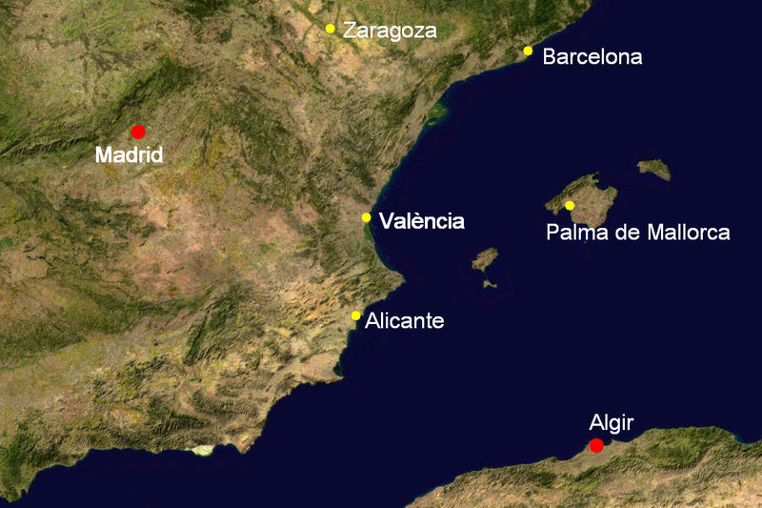

Slide 5
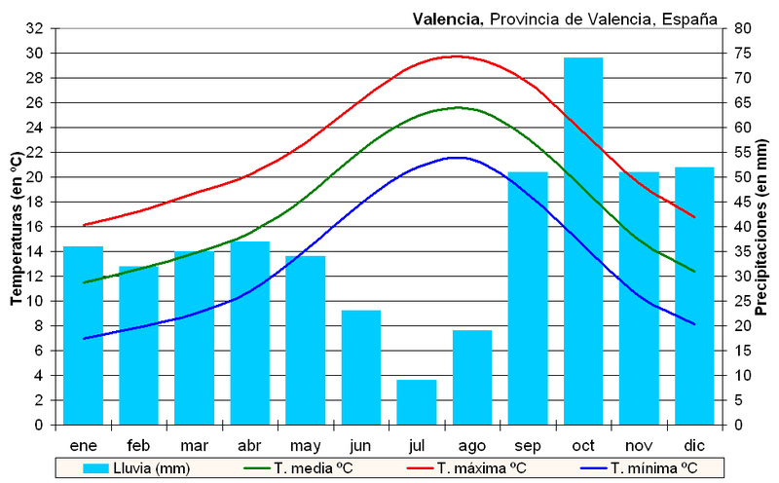
Climograph

Slide 6
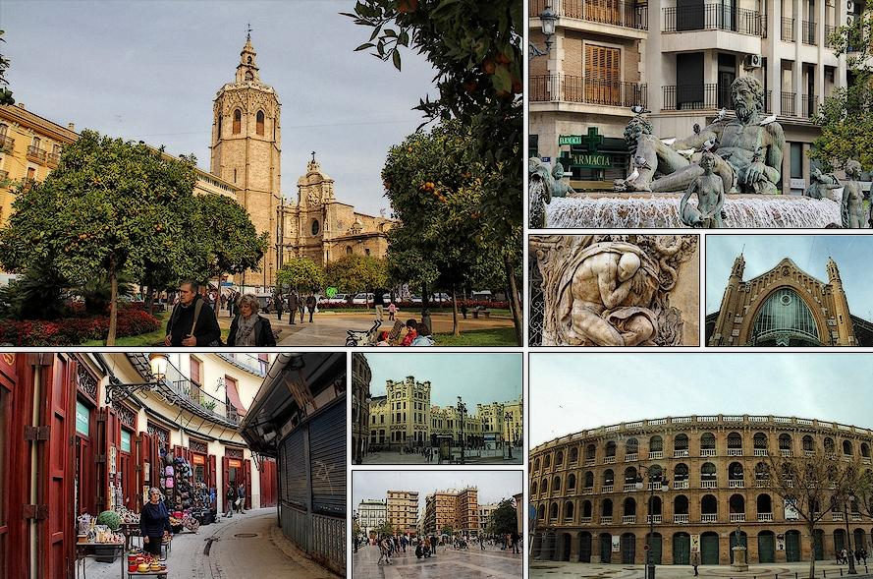

Slide 7
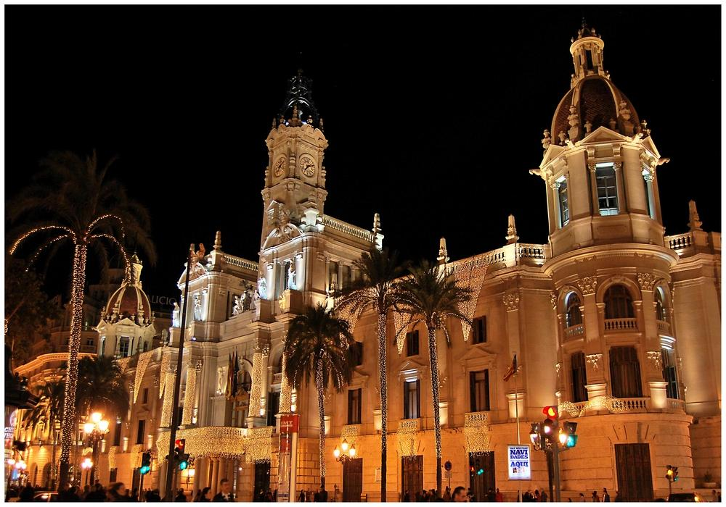

Slide 8
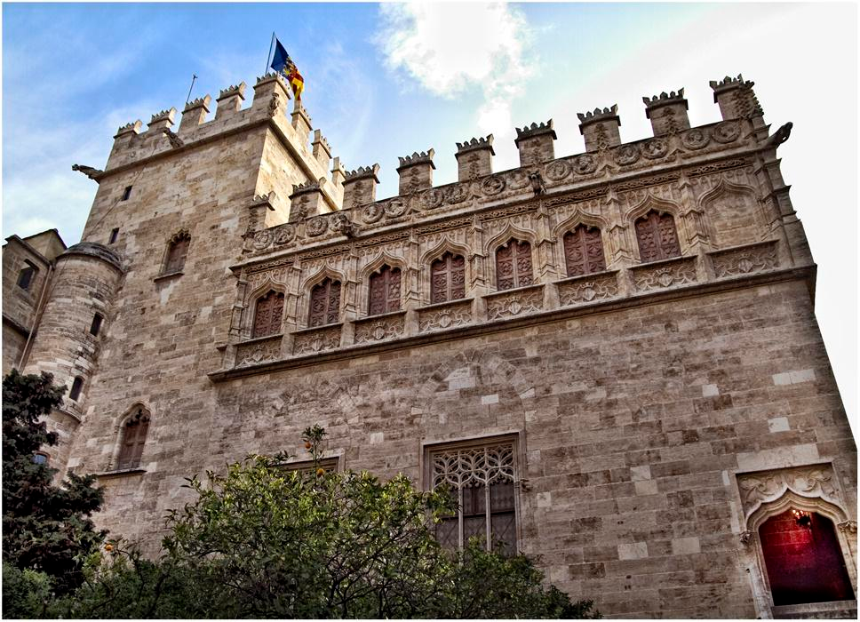
The old Silk Exchange (16th century)-Valencia

Slide 9
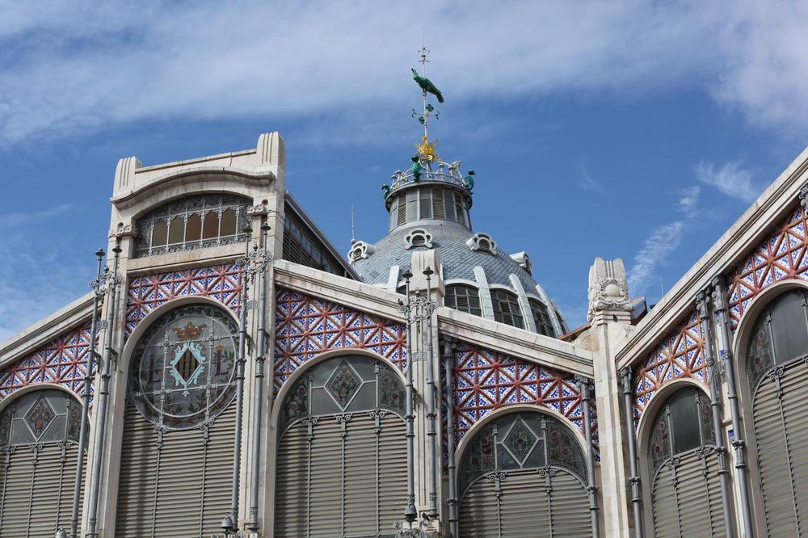
Central Market-Valencia.

Slide 10
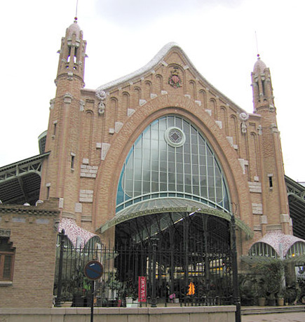
Columbus Market

Slide 11
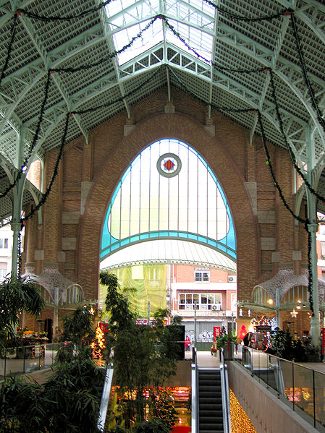
Columbus Market Interior

Slide 12
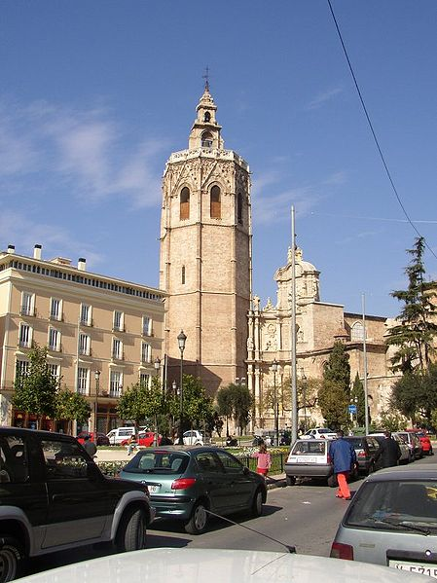
Cathedral

Slide 13
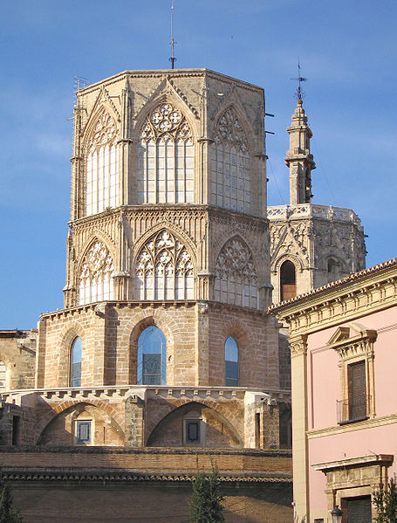
Cathedral Dome

Slide 14
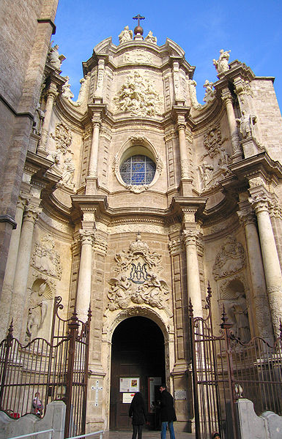
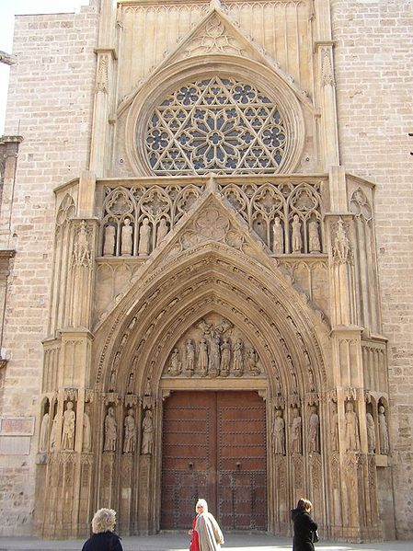

Slide 15
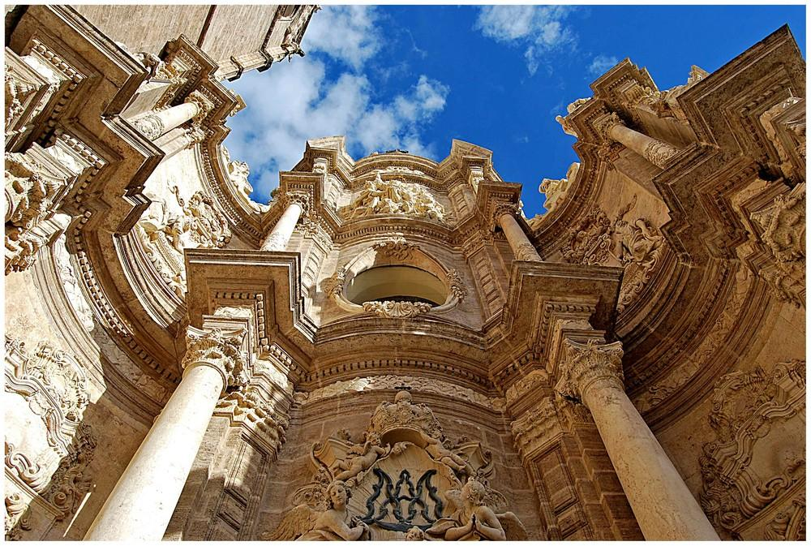
Valencia Outside detail of the Cathedral

Slide 16
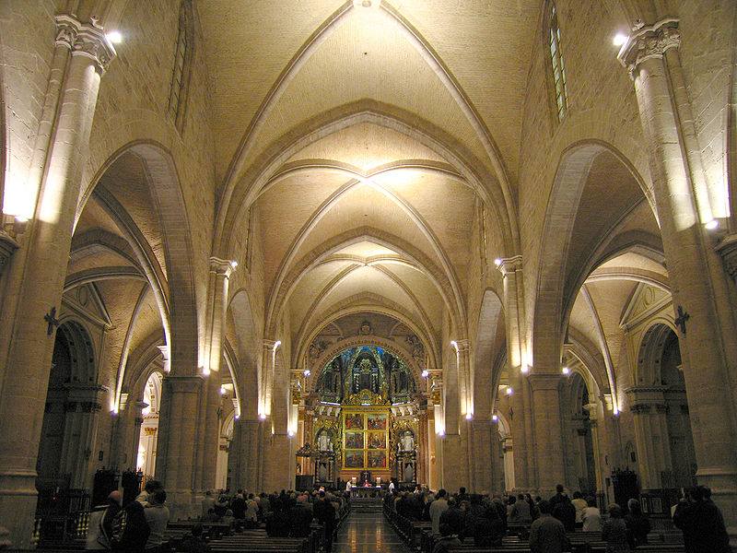

Slide 17
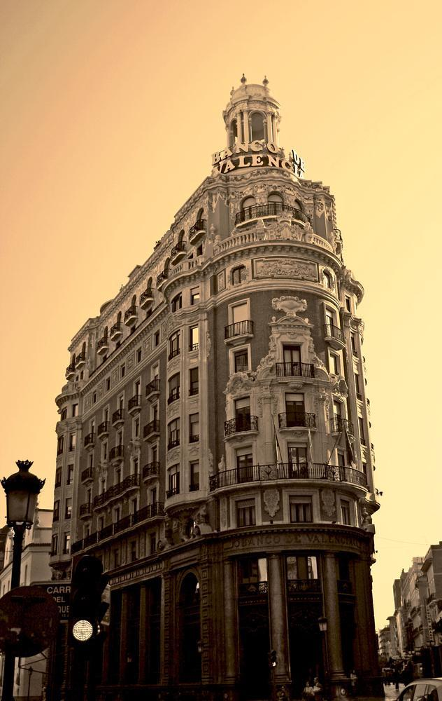
Banco-de-Valencia

Slide 18
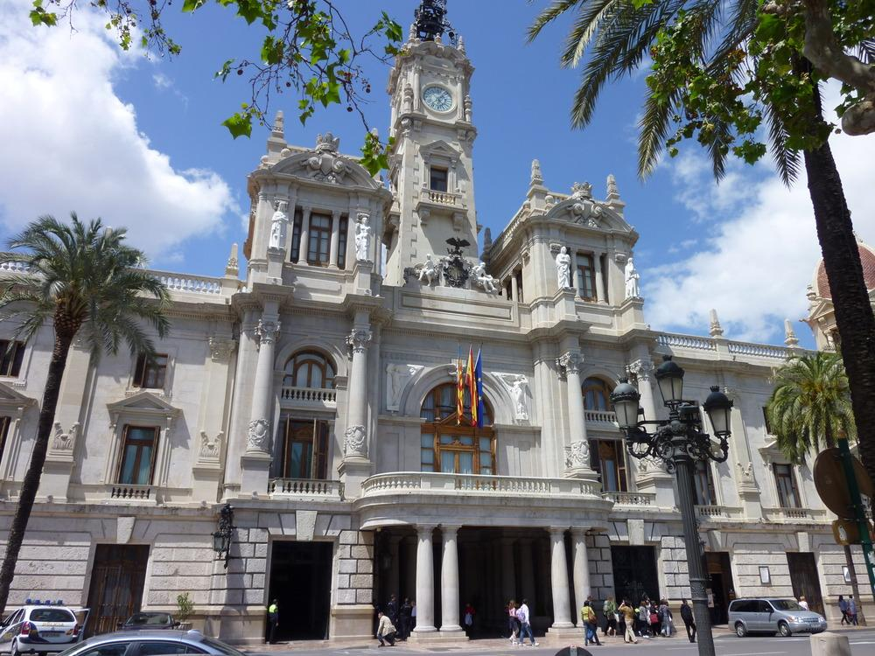
City hall-Valencia

Slide 19
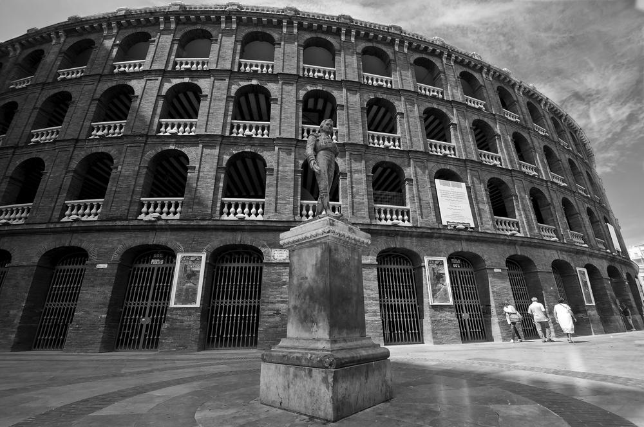
Bull ring

Slide 20
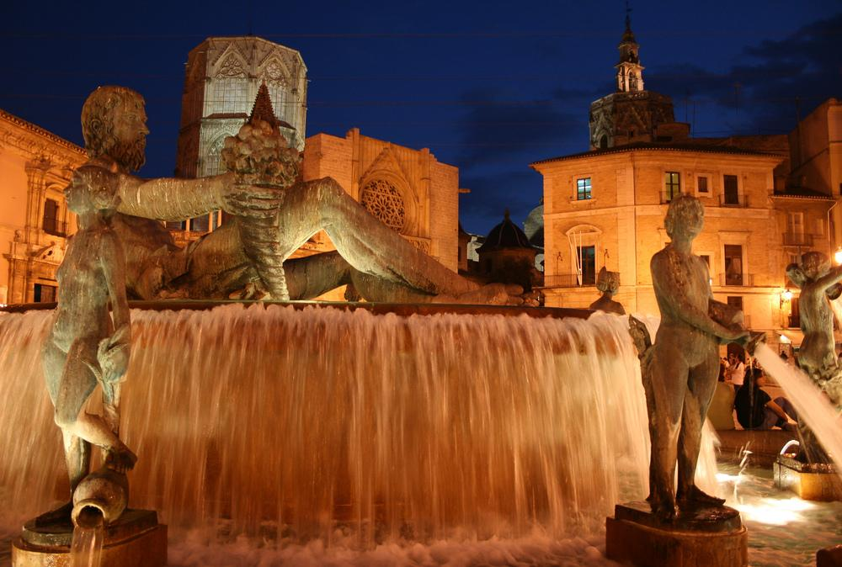
Neptune fountain

Slide 21
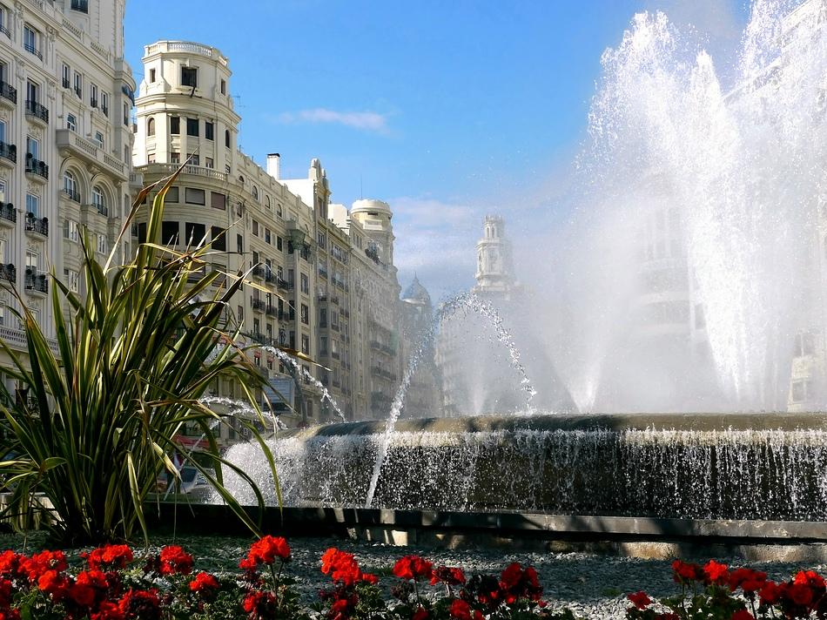

Slide 22
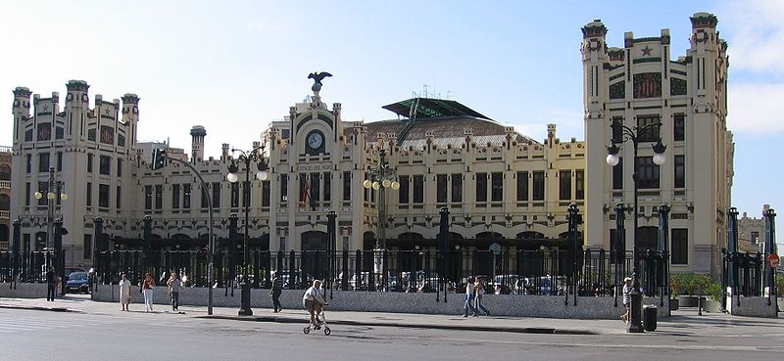
North Train Station

Slide 23
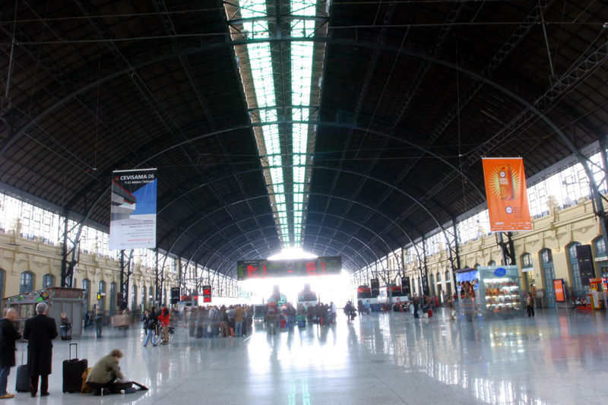
Train station interior

Slide 24
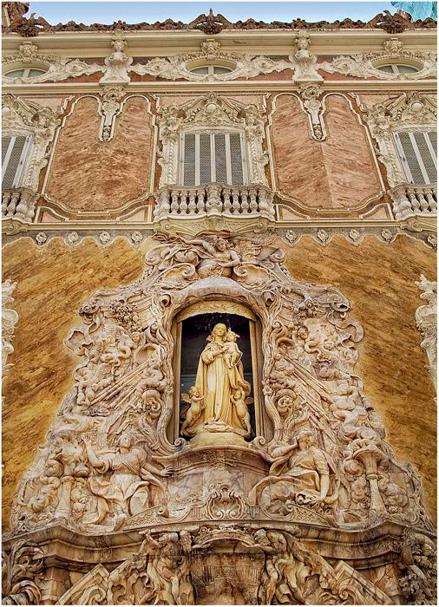
Ceramic Museum - Valencia

Slide 25
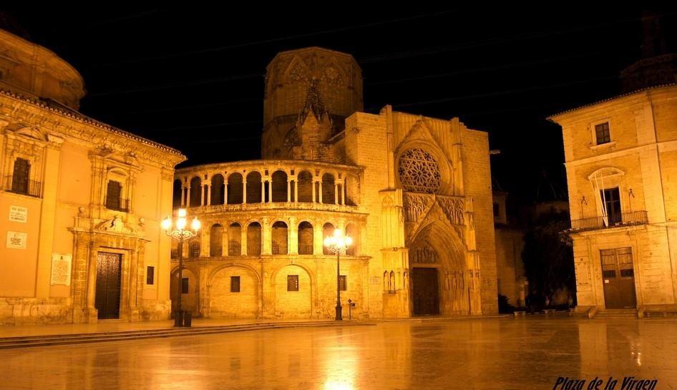
Virgen Square

Slide 26
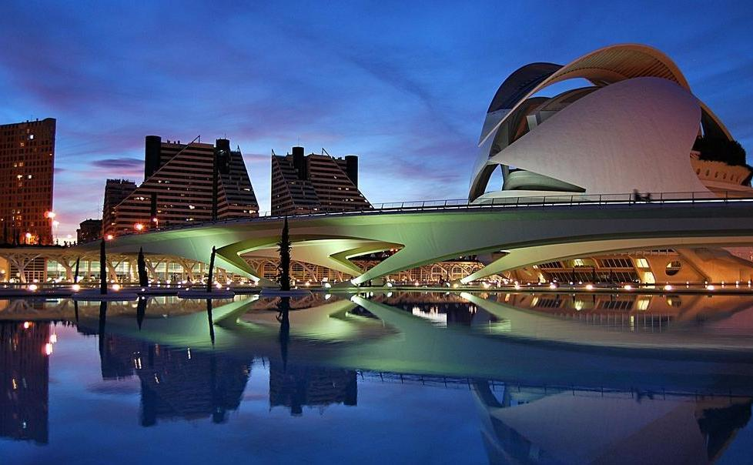
The City of Arts and Sciences is an entertainment -based cultural and architectural complex in the city of Valencia, Spain. It is the most important modern tourist destination in the city of Valencia.

Slide 27
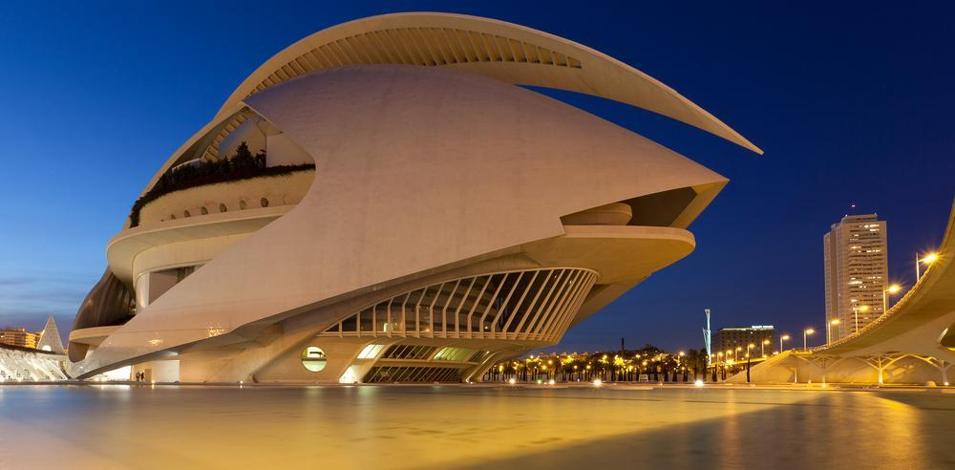

Slide 28
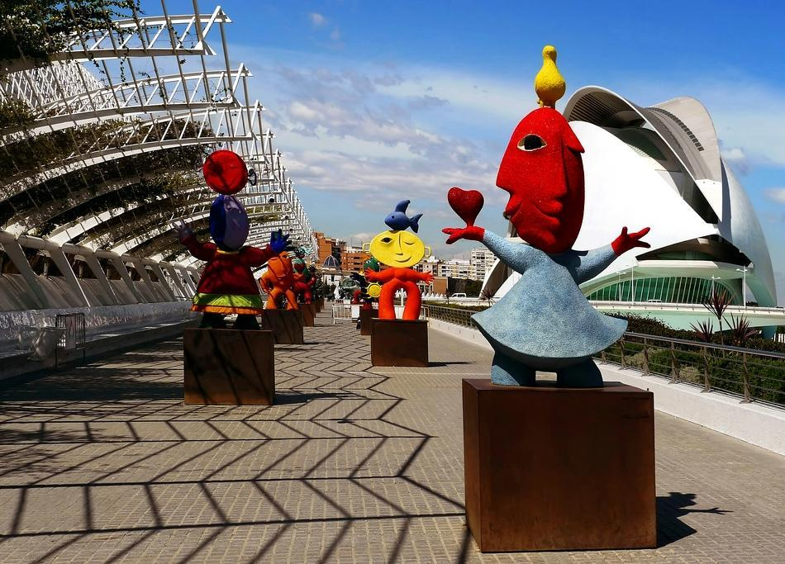

Slide 29
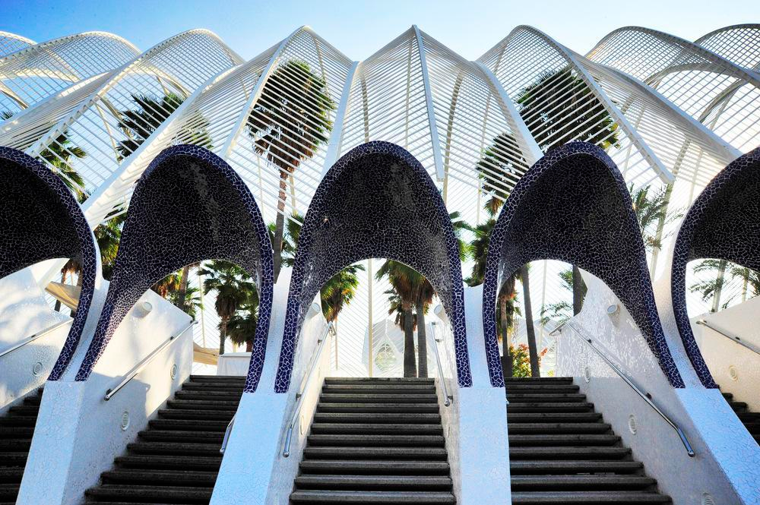

Slide 30
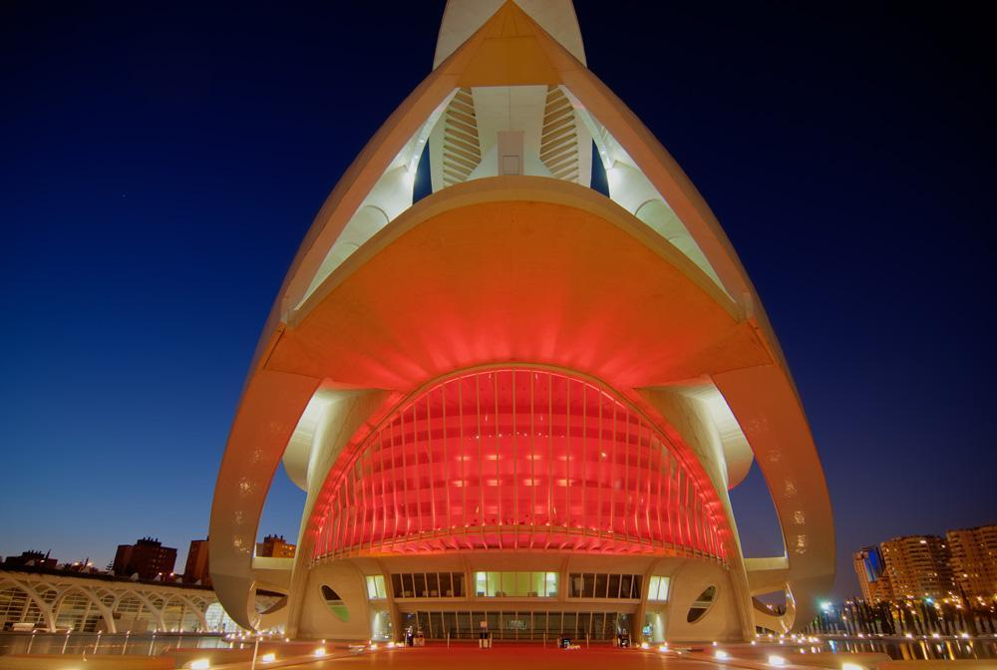

Slide 31
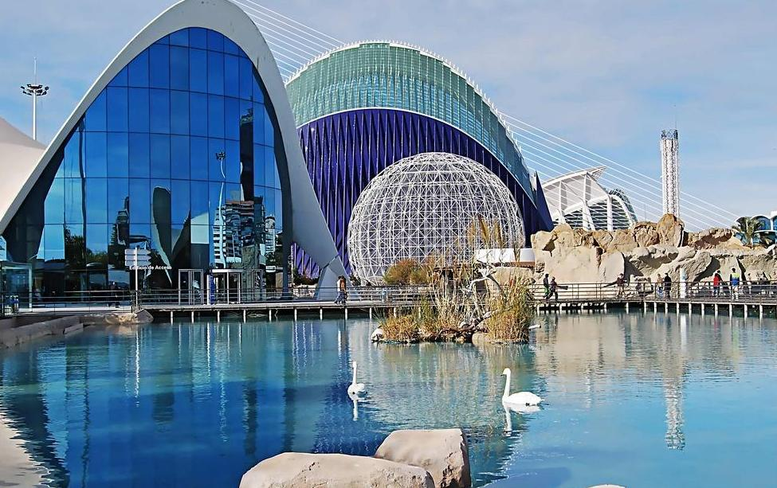

Slide 32
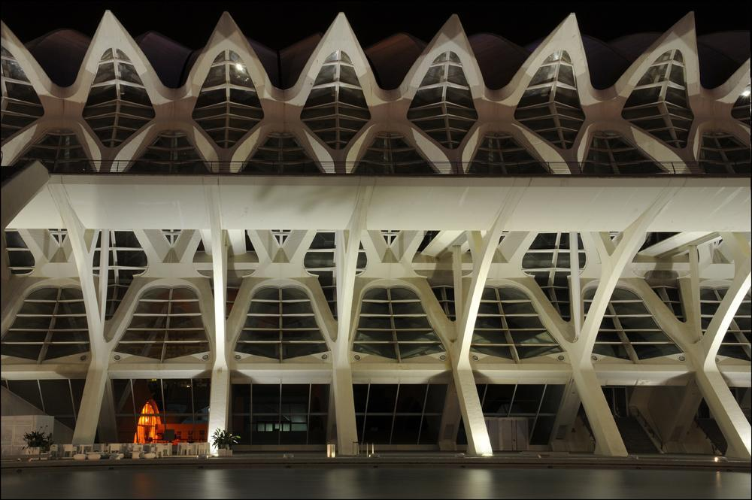

Slide 33
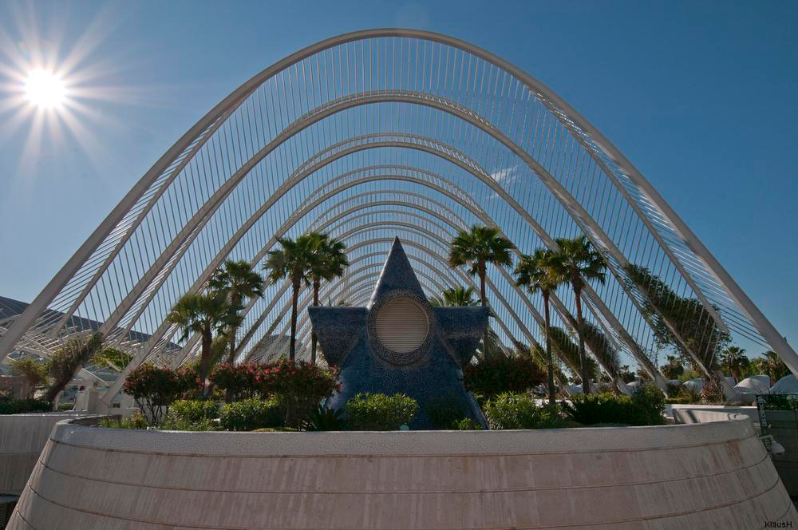

Slide 34
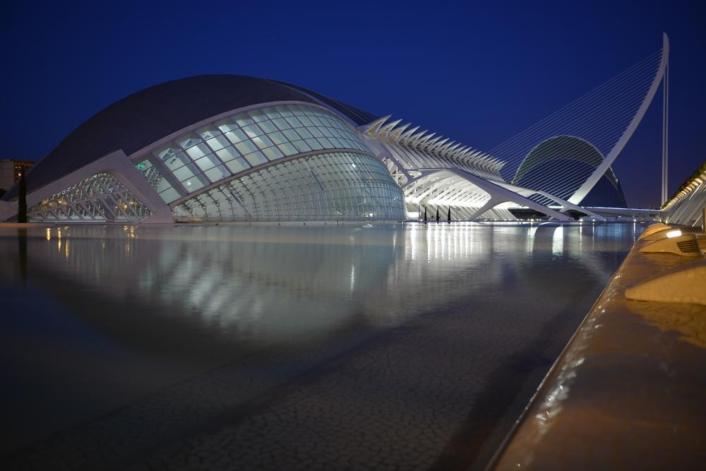

Slide 35
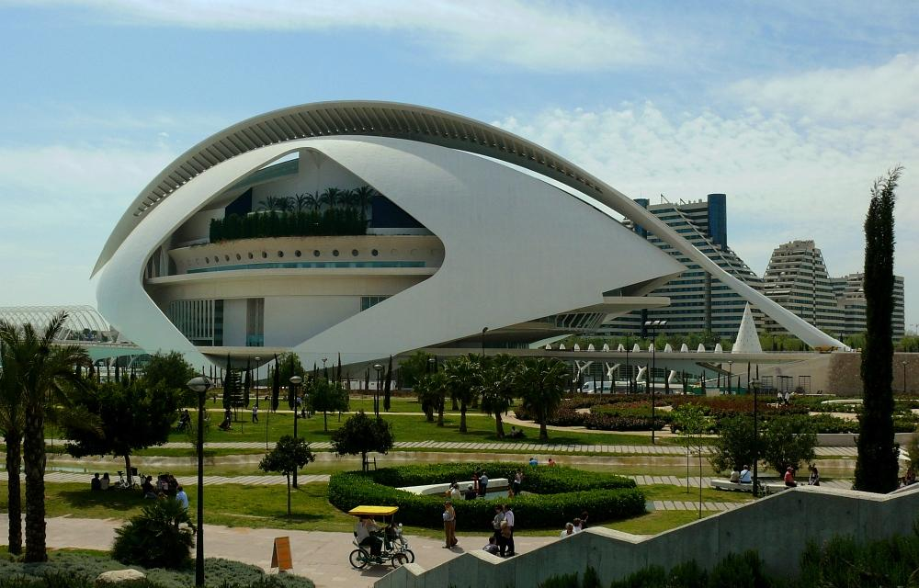

Slide 36
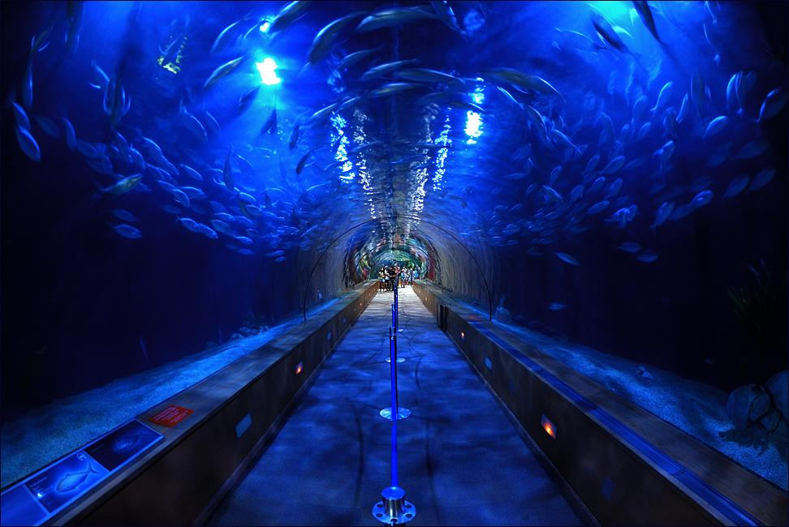

Slide 37
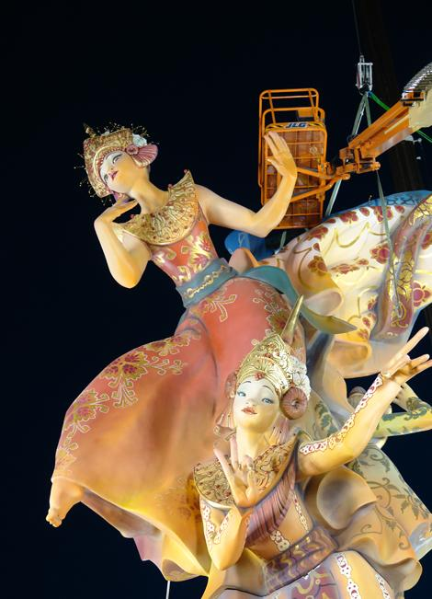
FALLES
The Falles is a traditional celebration held in commemoration of Saint Joseph in Valencia, Spain. The term Falles refers to both the celebration and the monuments created during the celebration. A number of towns in the Valencian Community have similar celebrations inspired by the original in Valencia.

Slide 38
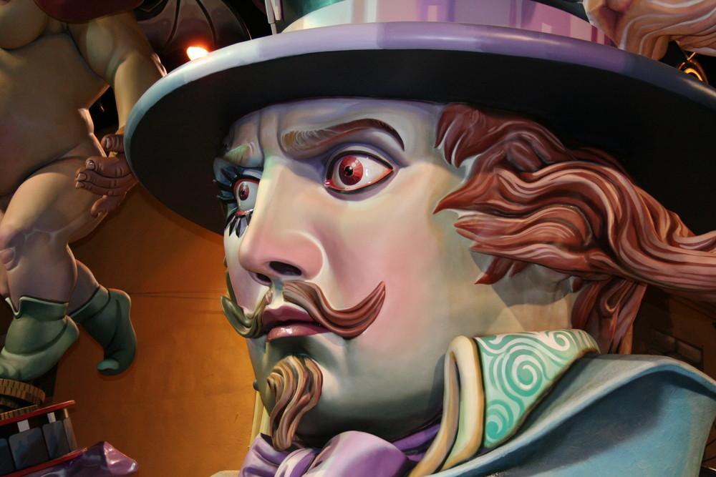

Slide 39
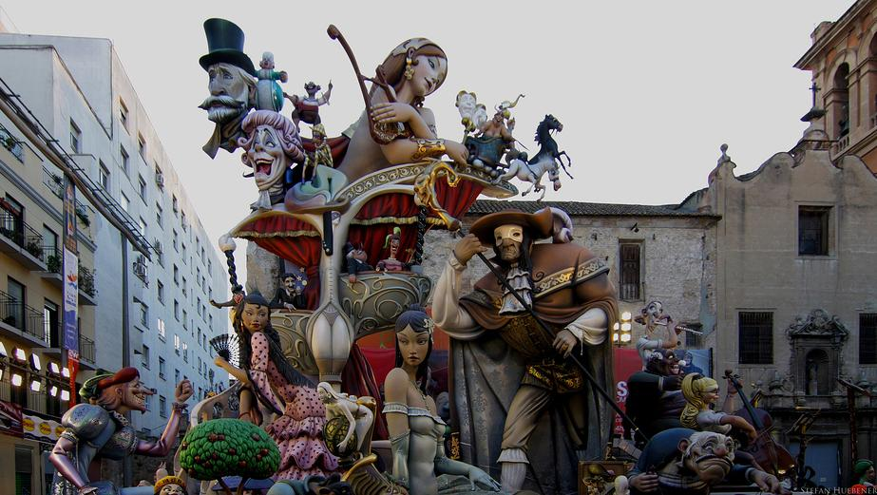

Slide 40
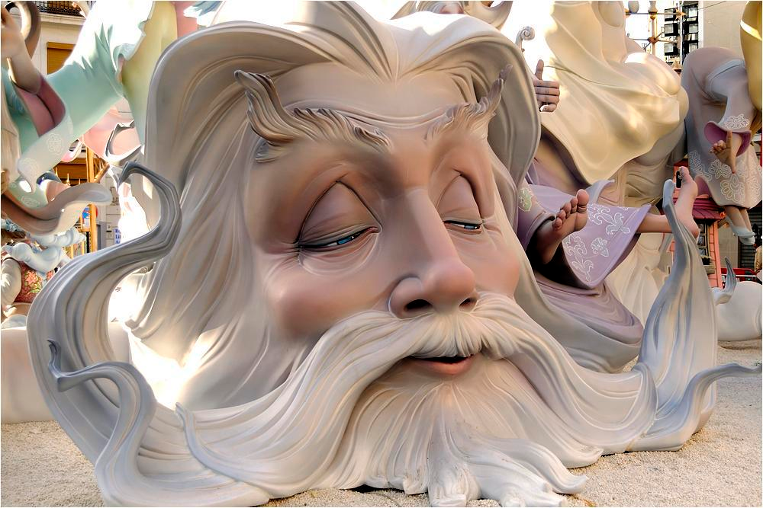

Slide 41
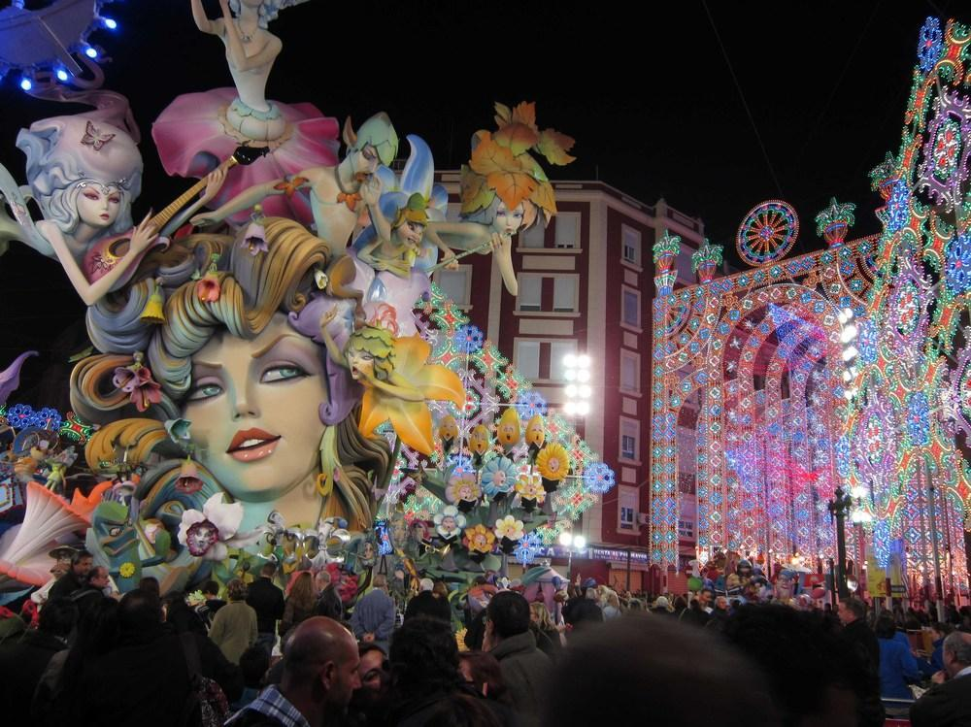

Slide 42
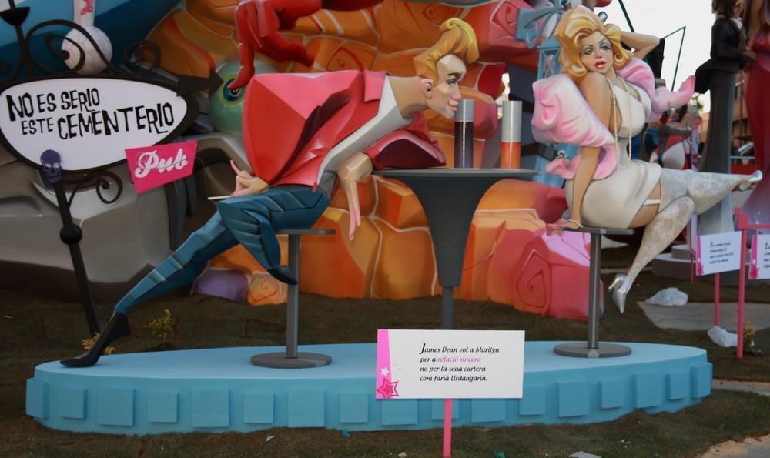

Slide 43
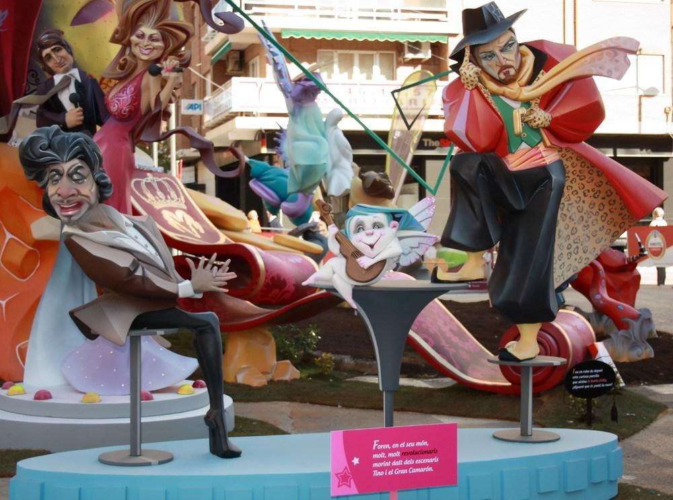

Slide 44
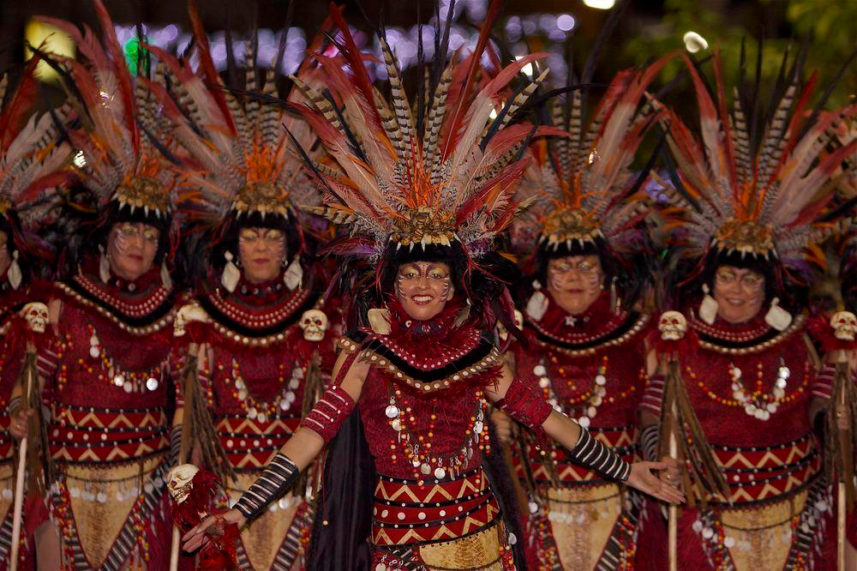
Moros y Cristianos (Moors and Christians)
is a set of festival activities which are celebrated in many towns and cities of Spain, mainly in the southern Valencian Community; according to popular tradition the festivals commemorate the battles, combats and fights between Moors (or Muslims) and Christians during the period known as Reconquista (from the 8th century through the 15th century).

Slide 45
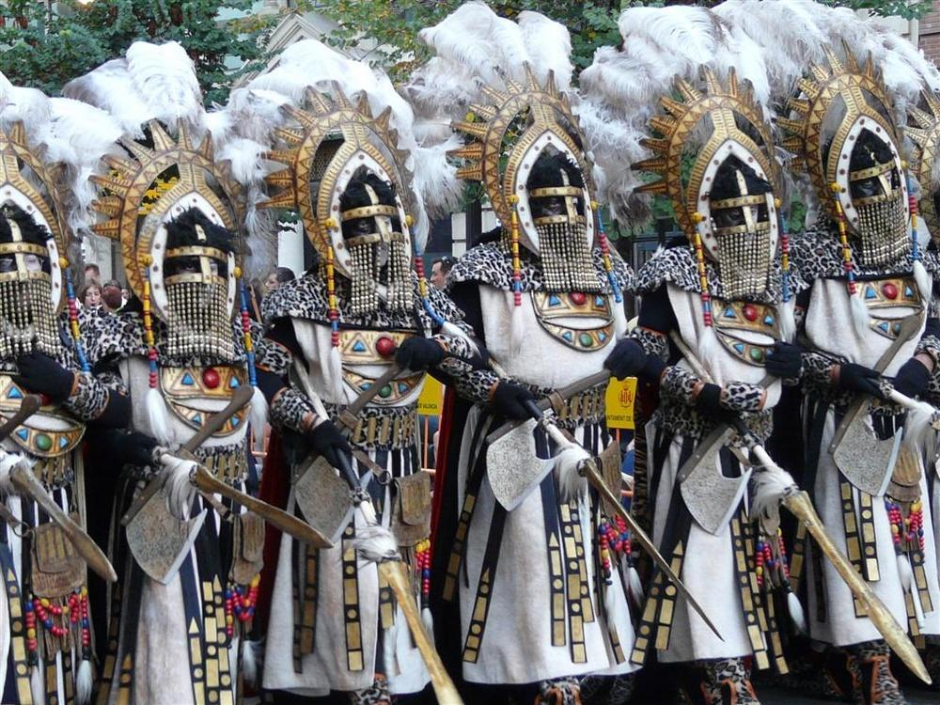

Slide 46
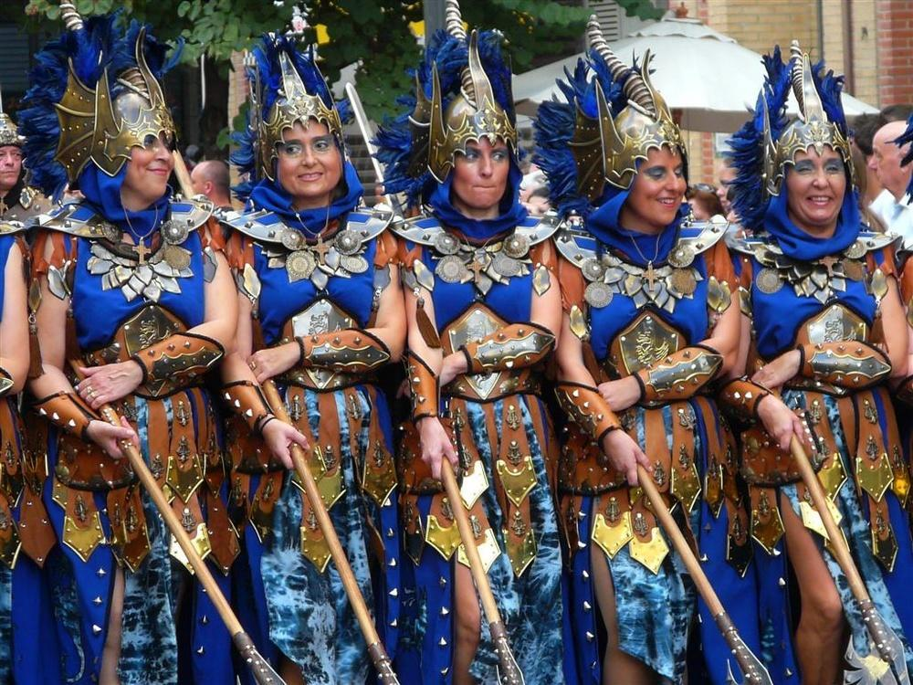

Slide 47
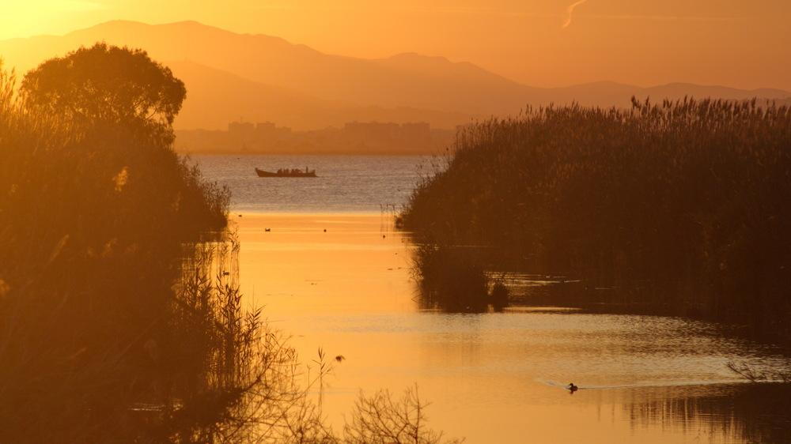
Albufera National Park

Slide 48
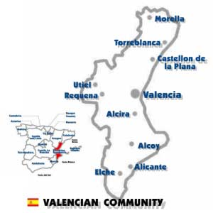
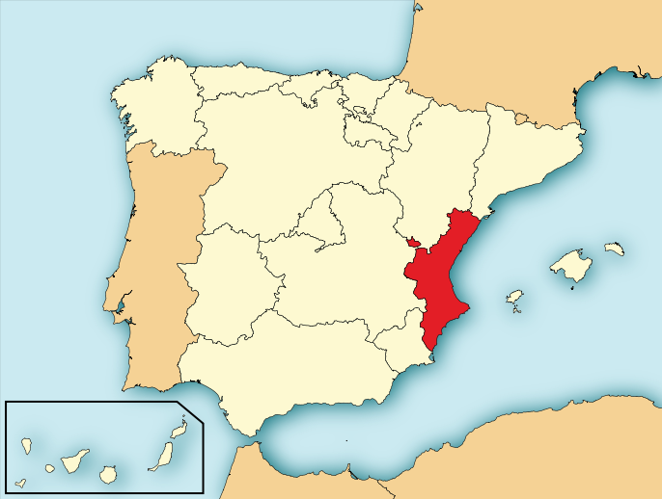
Valencian Autonomous Community

Slide 49

Village of La Nucia Marina Baixa

Slide 50

Puerto de Alicante

Slide 51

Pensicola

Slide 52

Pensicola

Slide 53

Beach of Poniente-Benidorm

Slide 54

Altea

Slide 55

Guadelest-Costa-Blanca

Slide 56


Murcia Region

Slide 57

Sierra de las Moreras

Slide 58

Monteagudo - Murcia

Slide 59

Lands around Moratalla and river Alharabe.

Slide 60

Cañón de Almadenes

Slide 61

Cartegena

Slide 62

Roman Theatre, Cartagena.

Slide 63

Murcia Cathedral.

Slide 64

Castle of Lorca

Slide 65

Castell de Moraira

