Slide 1
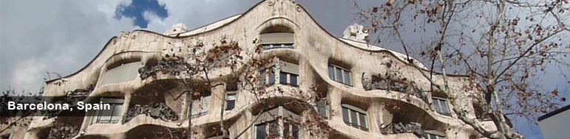
Spain - Antoni Gaudí i Cornet
(25 June 1852–10 June 1926) was a Spanish Catalan architect and figurehead of Catalan Modernism. Gaudí's works reflect his highly individual and distinctive style and are largely concentrated in the Catalan capital of Barcelona, notably his magnum opus, the Sagrada Família.

Slide 2
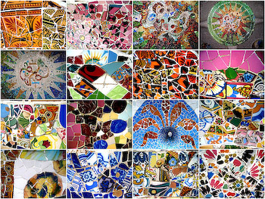
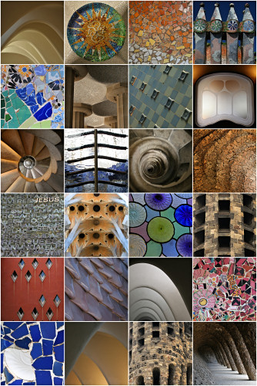
Gaudi structures

Slide 3
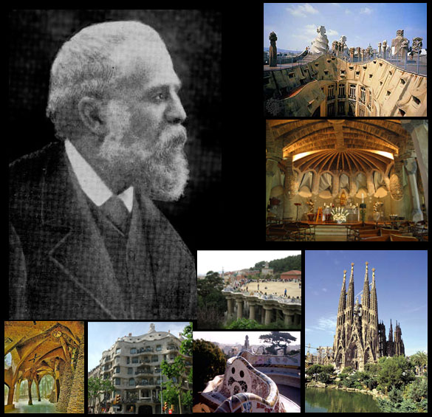

Slide 4
Casa Batlló is a building restored by Antoni Gaudí and Josep Maria Jujol, built in 1877 and remodelled in the years 1904–1906; The local name for the building is Casa dels ossos (House of Bones), as it has a visceral, skeletal organic quality. It was originally designed for a middle-class family and situated in a prosperous district of Barcelona. The building looks very remarkable — like everything Gaudí designed, only identifiable as Modernisme or Art Nouveau in the broadest sense. The ground floor, in particular, is rather astonishing with tracery, irregular oval windows and flowing sculpted stone work.

Slide 5
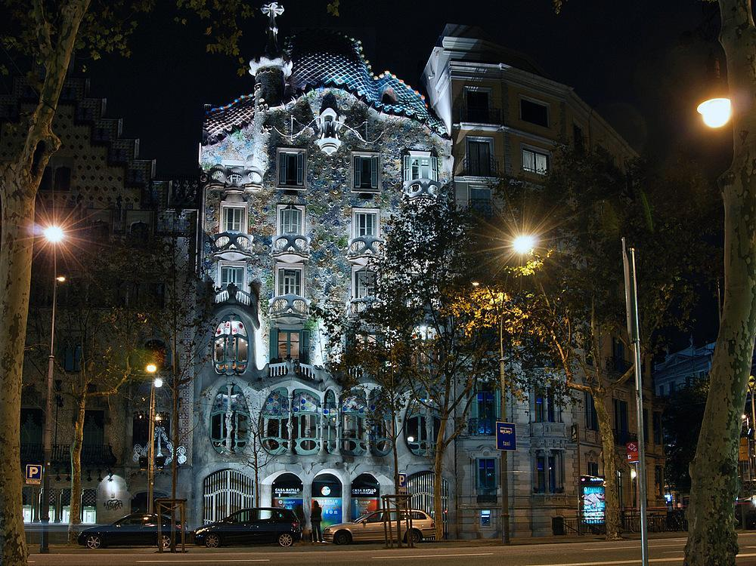

Slide 6
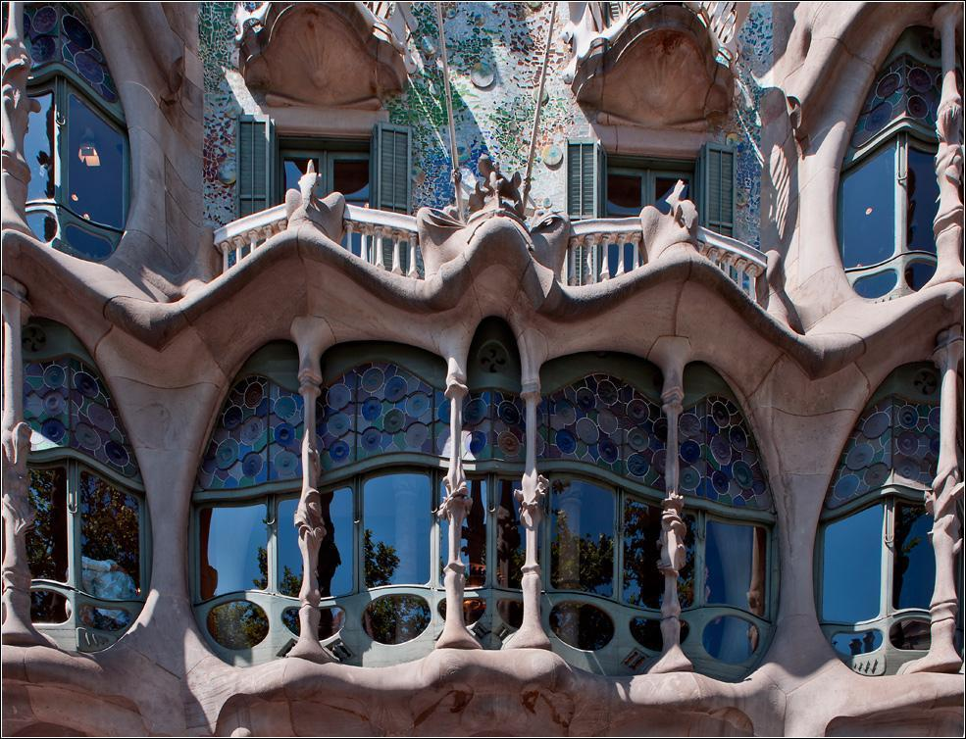

Slide 7
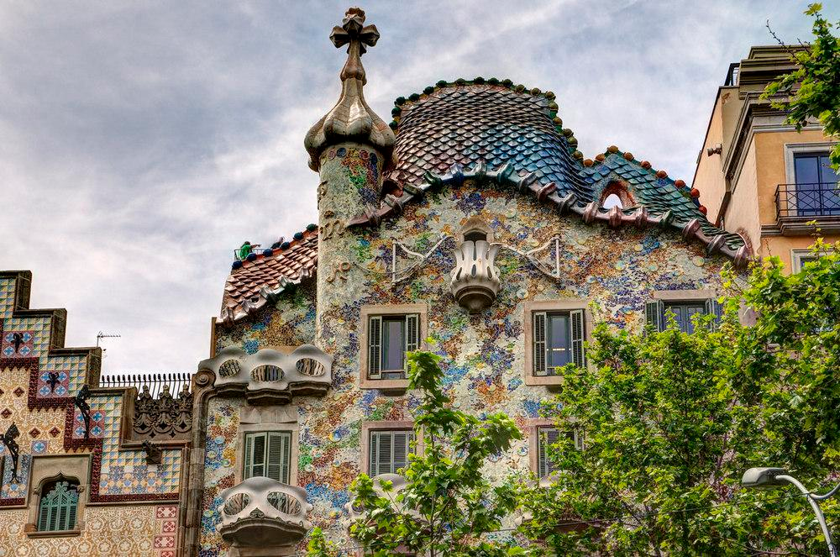

Slide 8
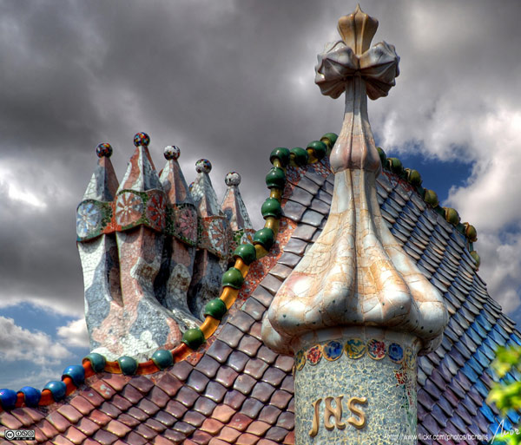

Slide 9
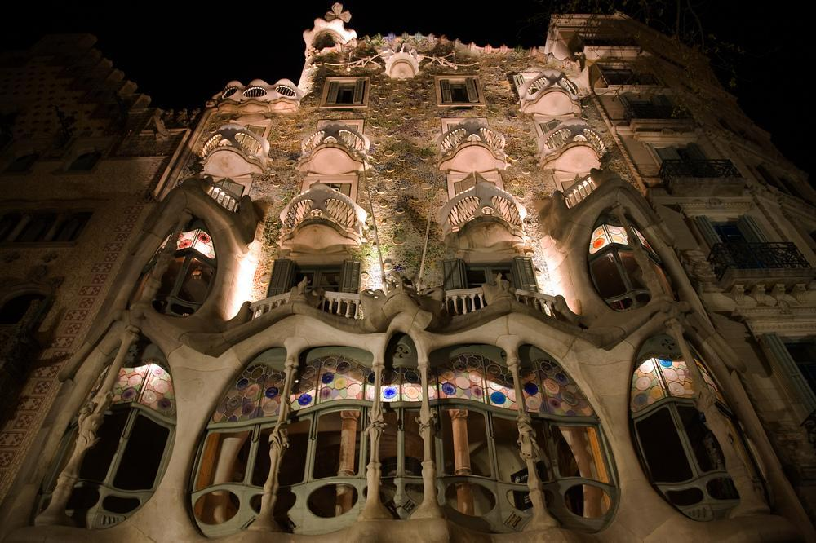

Slide 10
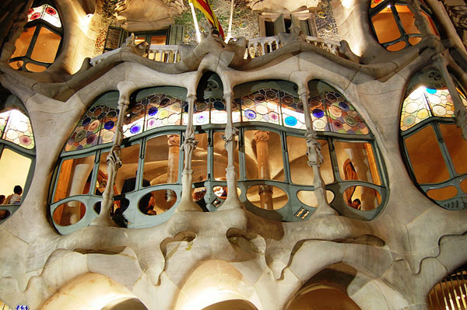

Slide 11
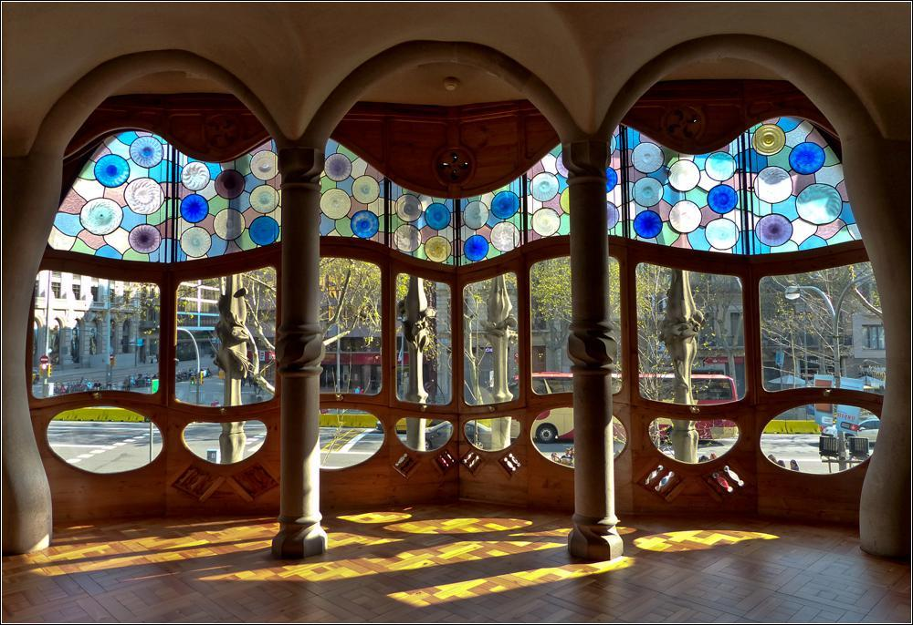

Slide 12
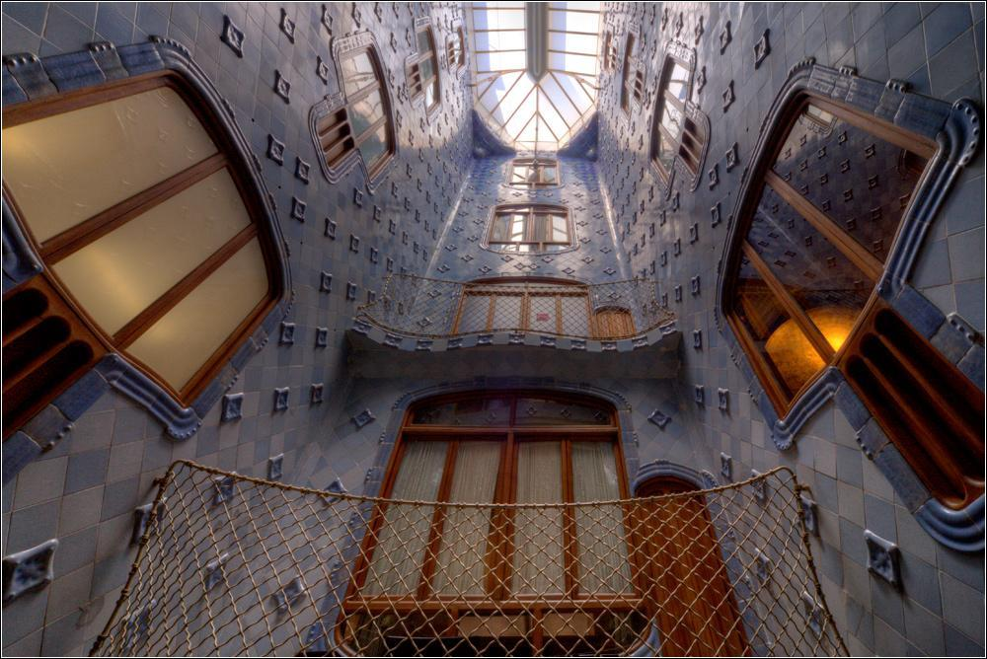

Slide 13
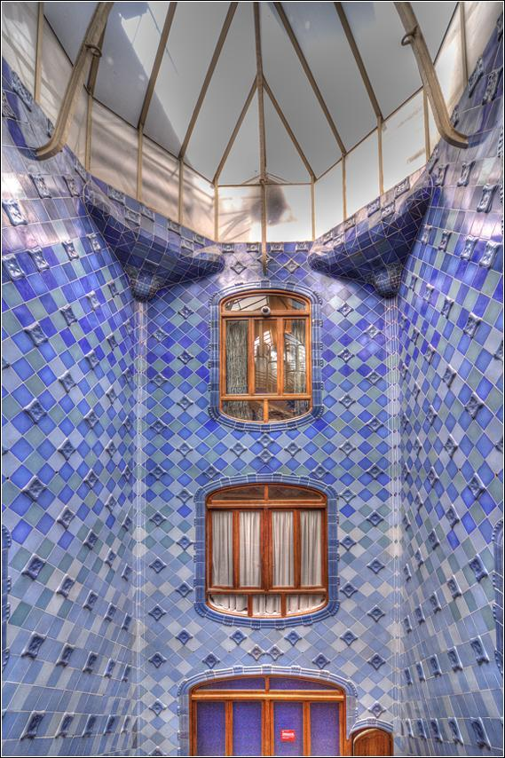

Slide 14
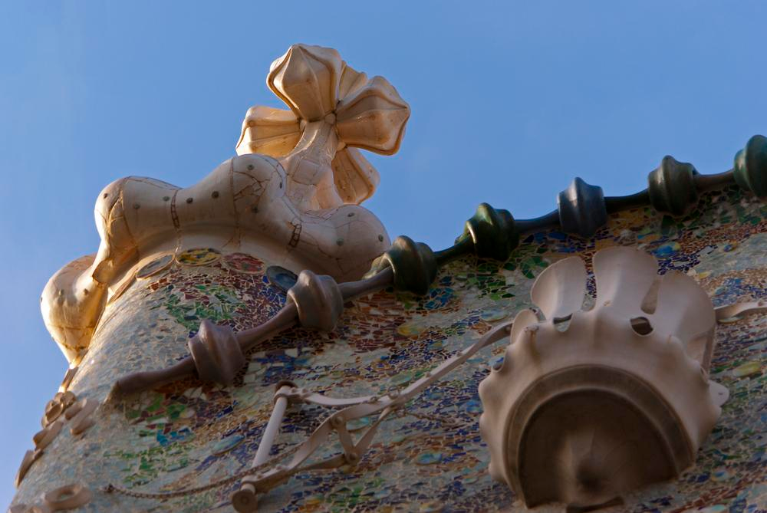

Slide 15
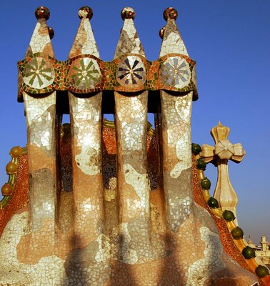

Slide 16
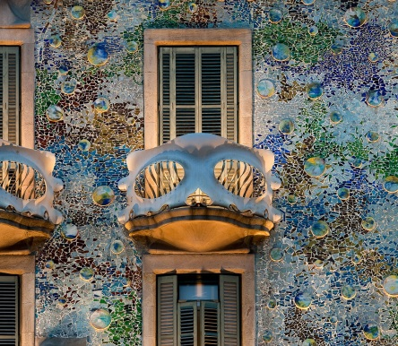

Slide 17
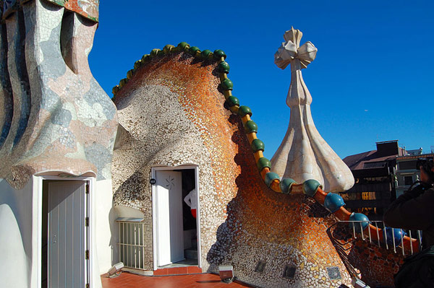

Slide 18
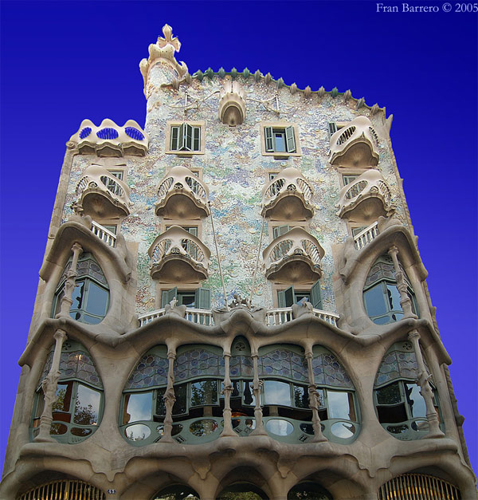

Slide 19
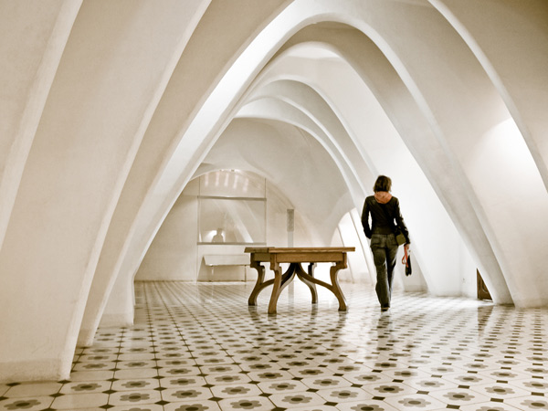
Interior Designs

Slide 20
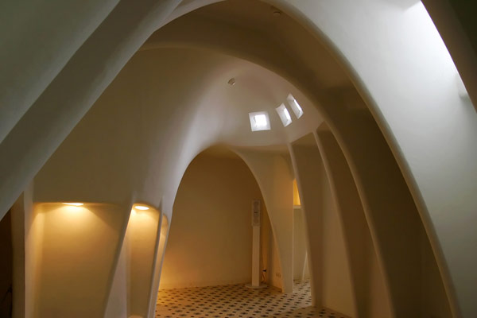

Slide 21
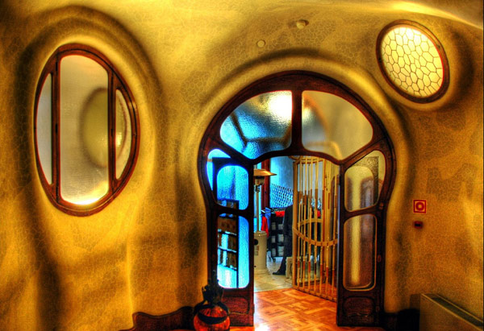

Slide 22
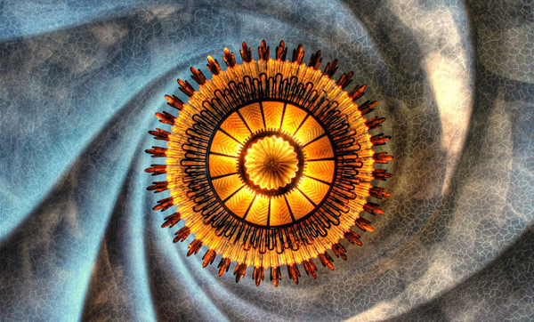

Slide 23
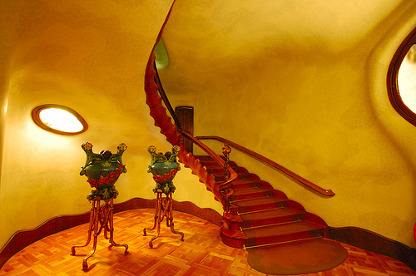

Slide 24
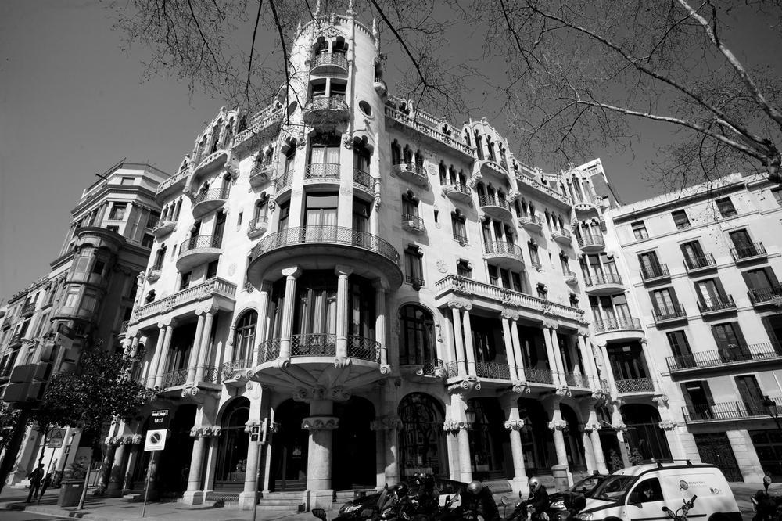
Casa Fuster - Luxury hotel in Barcelona

Slide 25
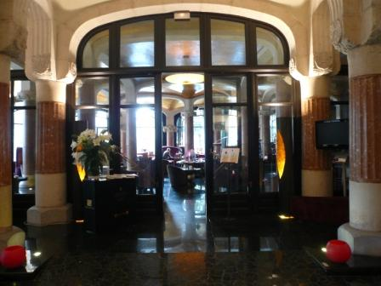

Slide 26
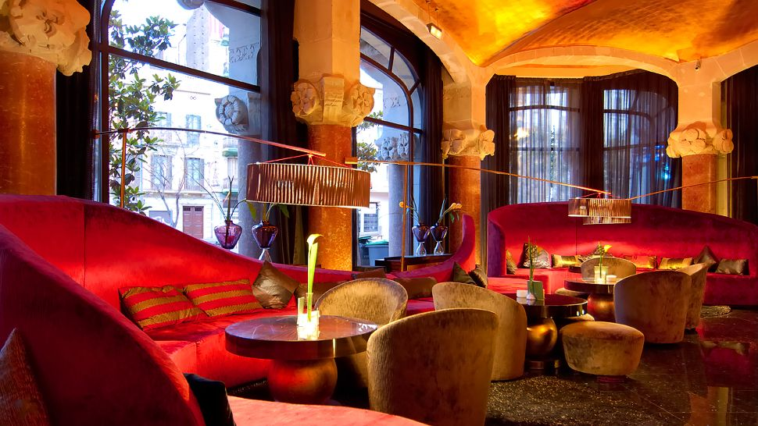

Slide 27
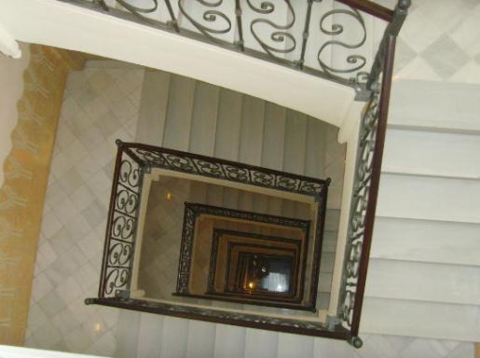

Slide 28
Casa Milà
better known as La Pedrera, meaning the 'The Quarry'), is a building designed by the Catalan architect Antoni Gaudí and built during the years 1905–1910, being considered officially completed in 1912.

Slide 29
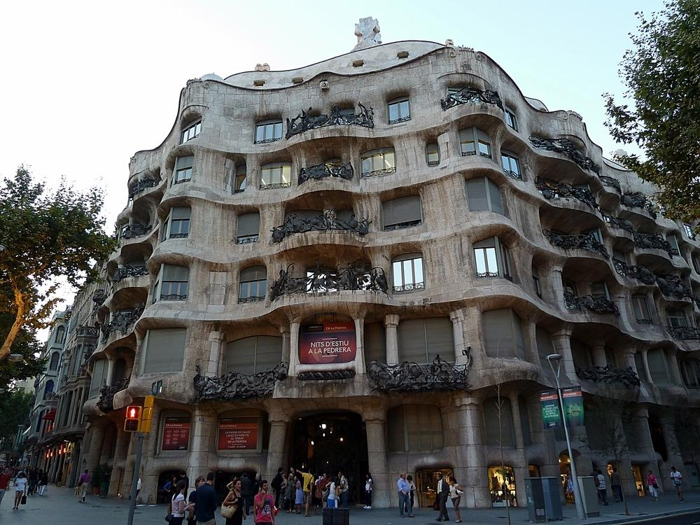

Slide 30
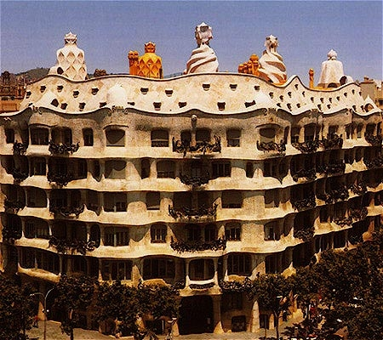

Slide 31
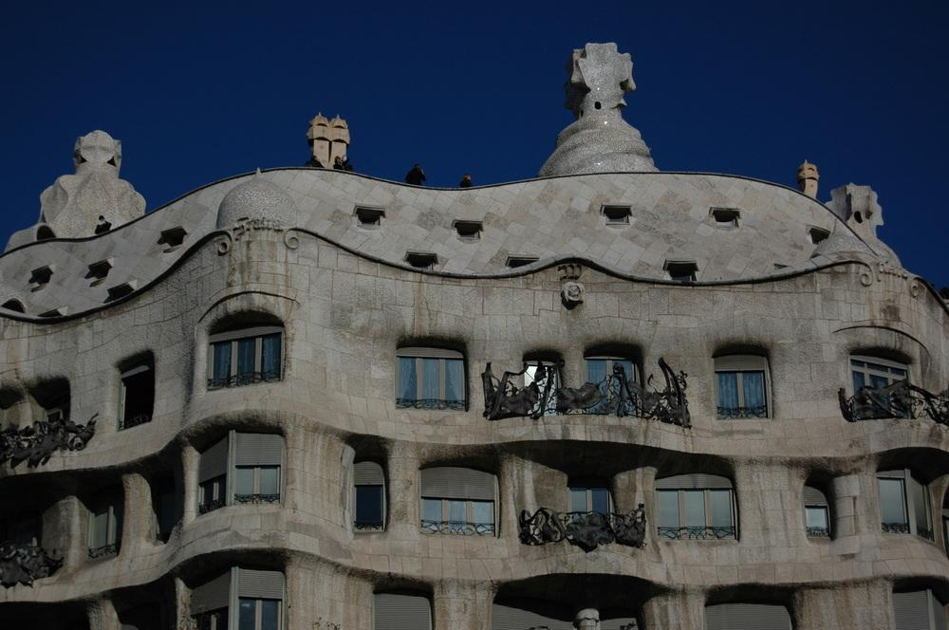

Slide 32
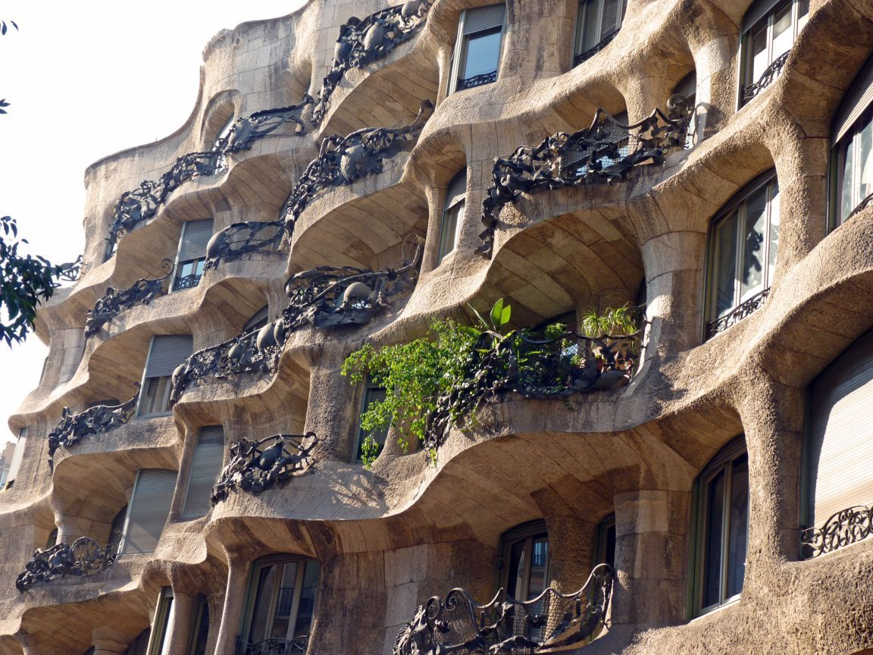

Slide 33
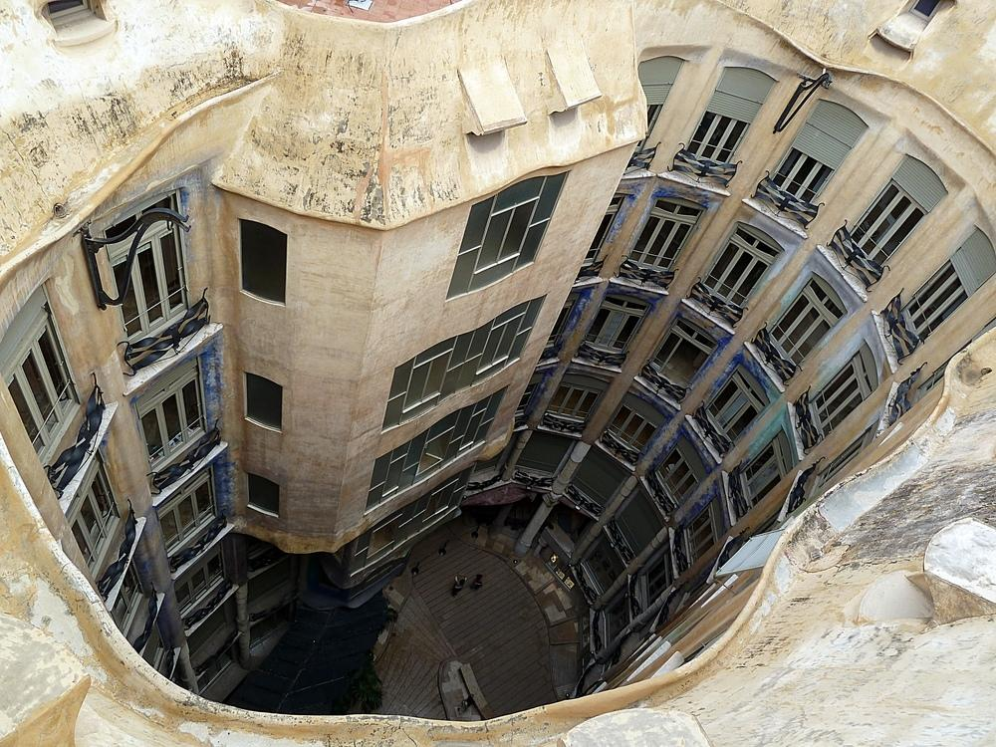
Inner courtyard

Slide 34
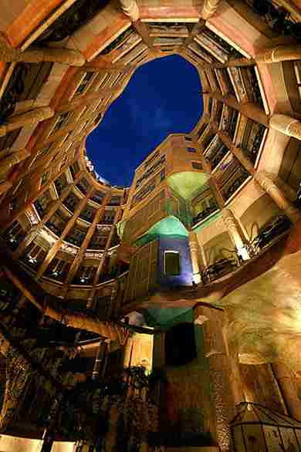

Slide 35
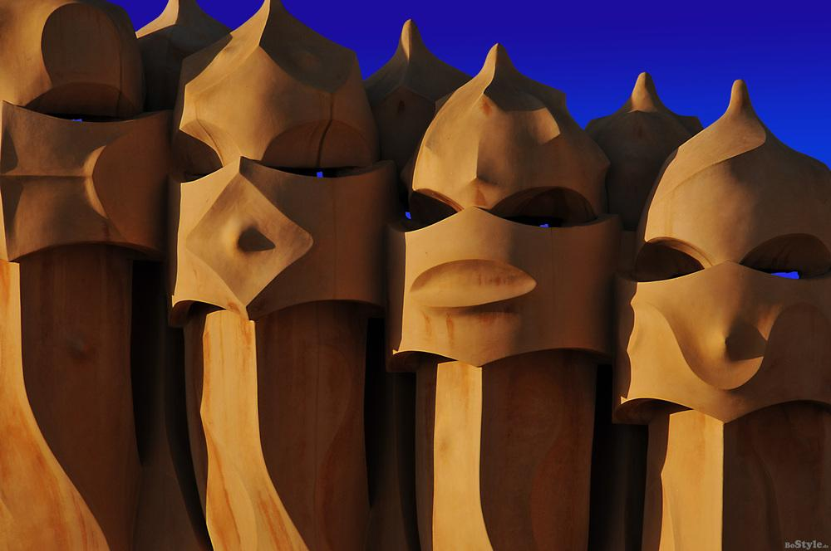

Slide 36
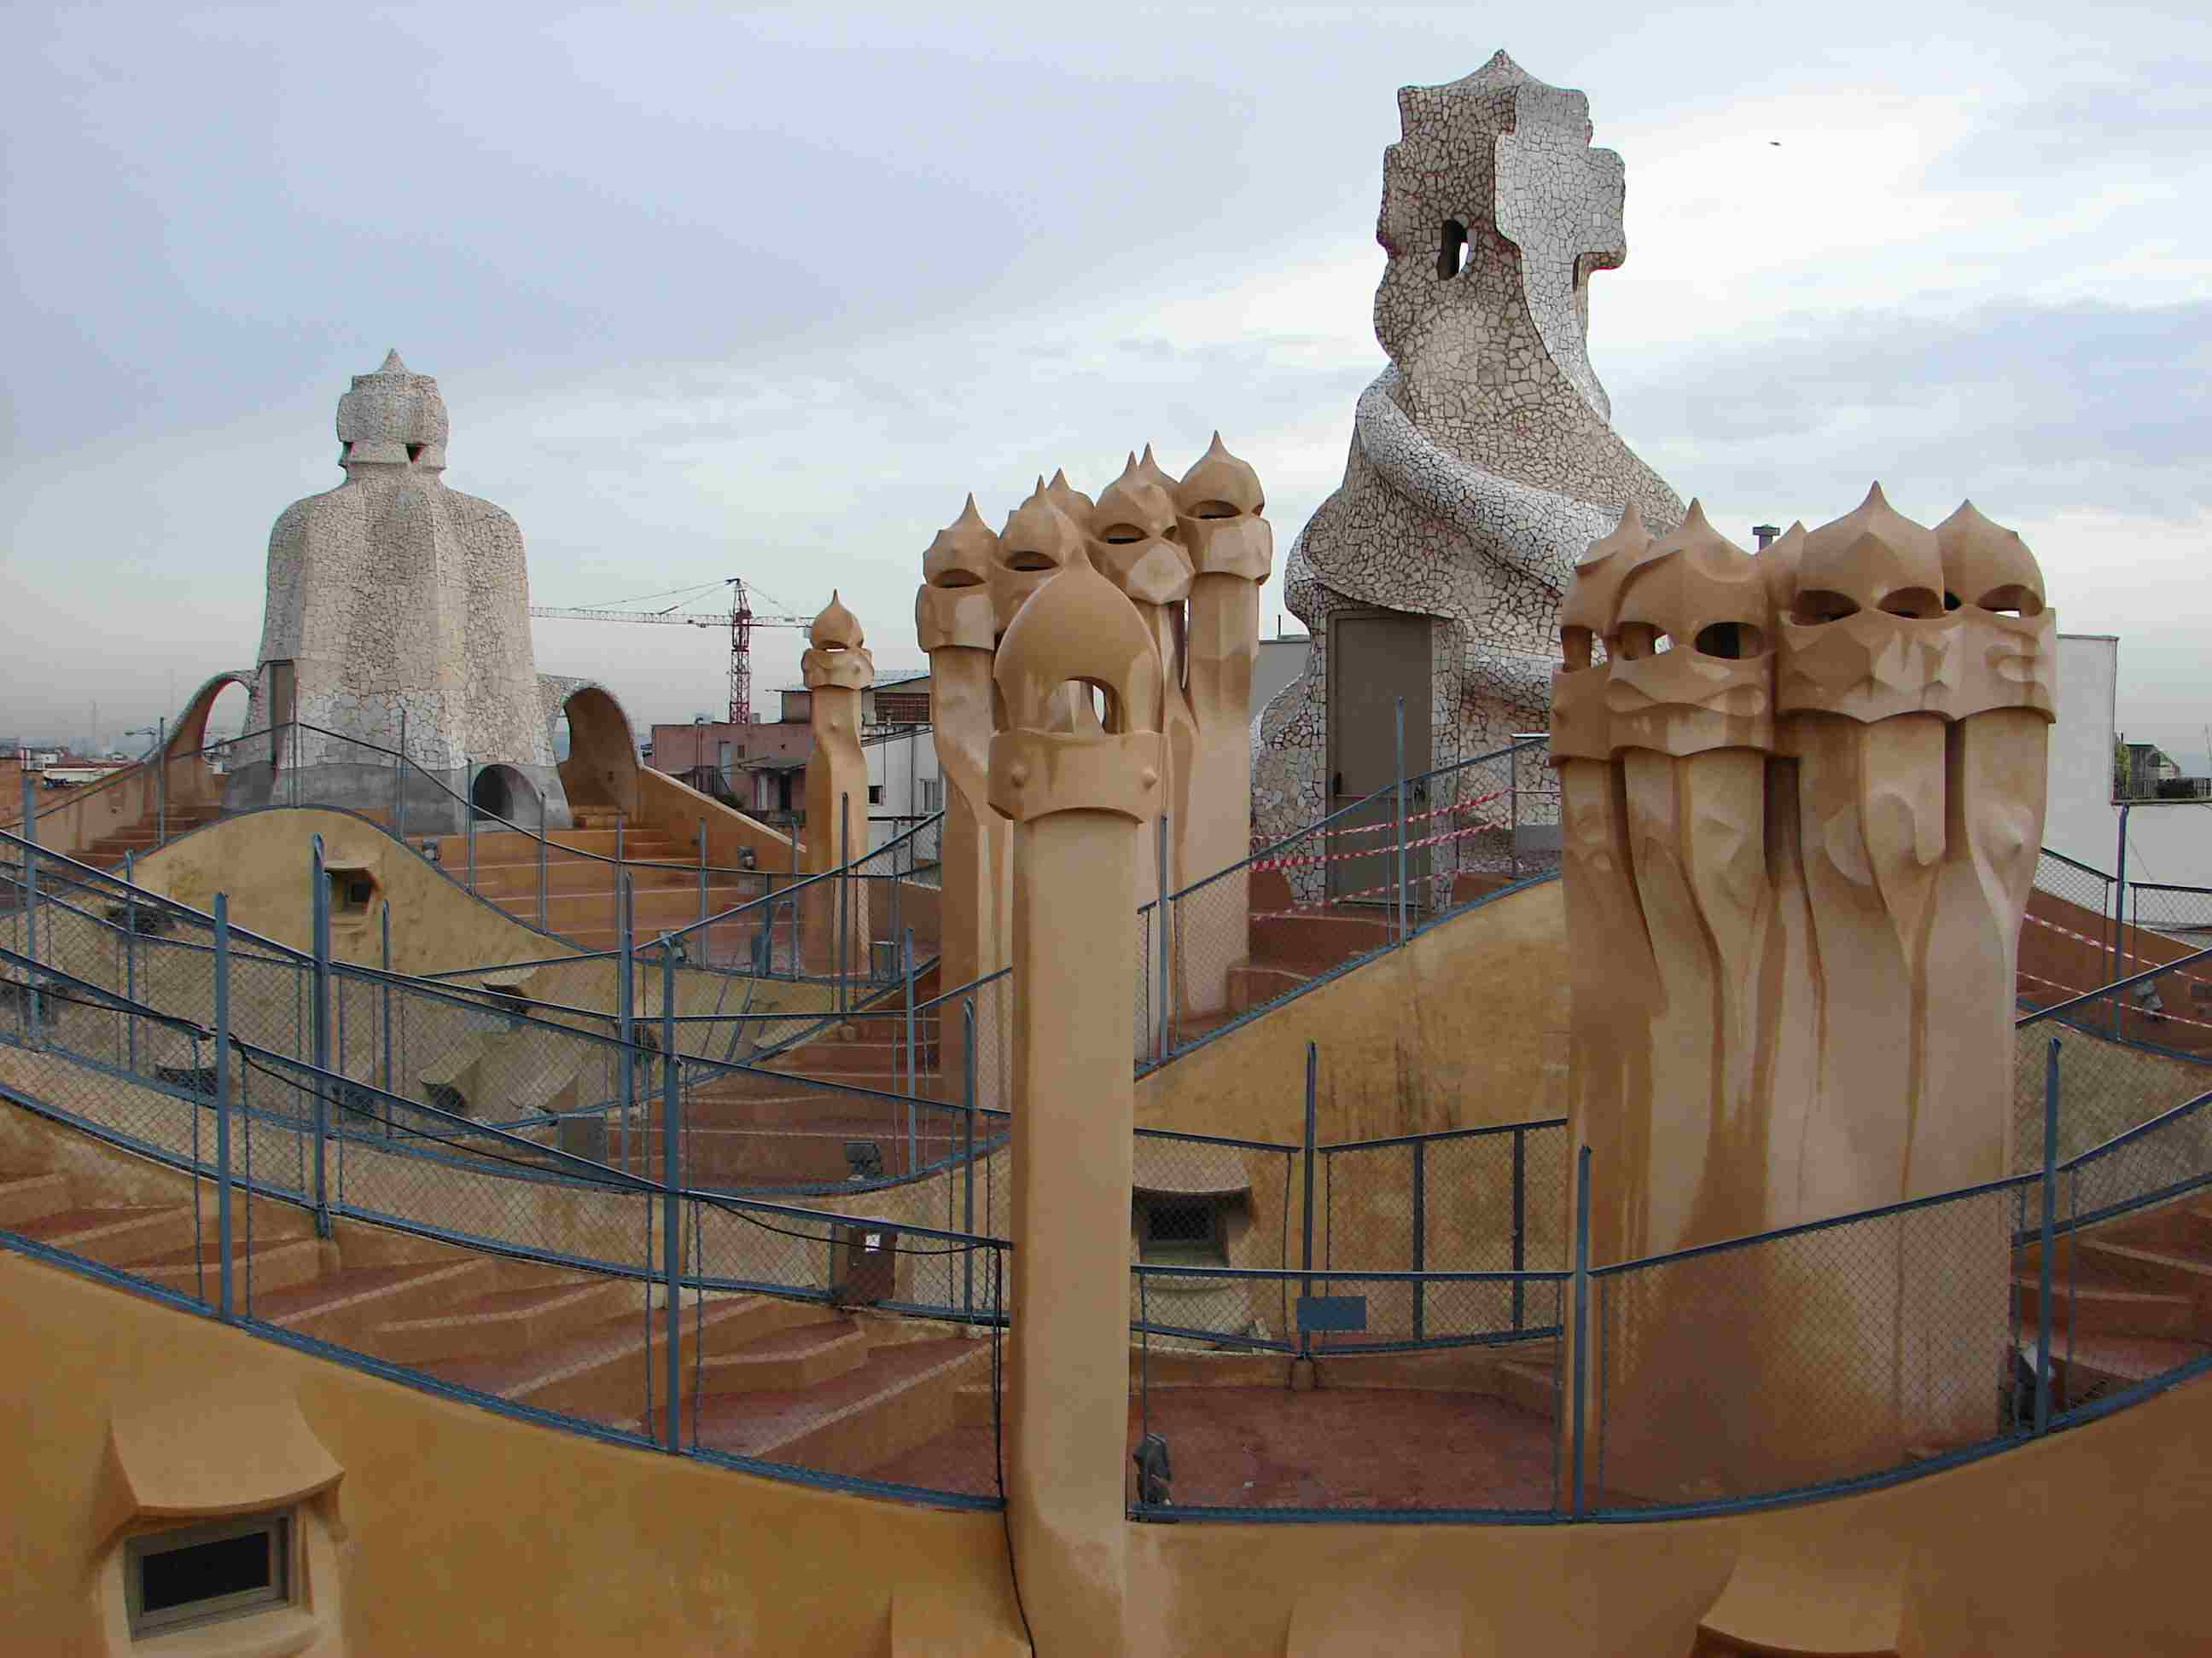

Slide 37
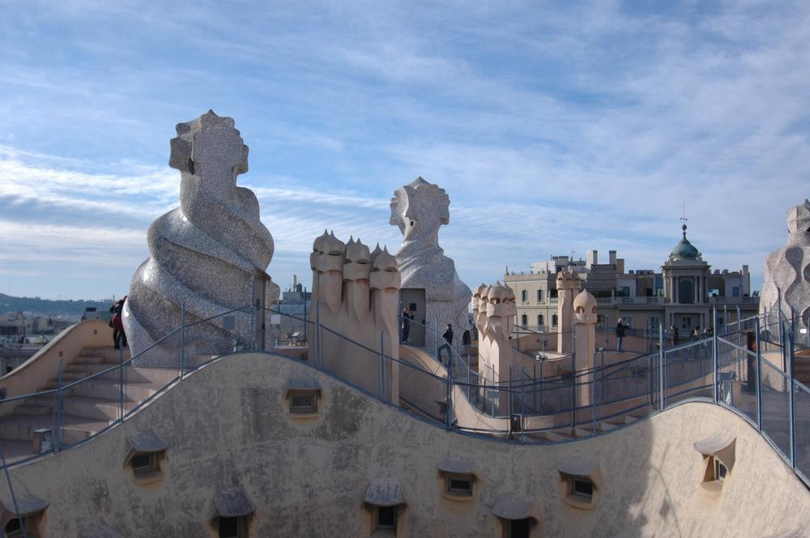

Slide 38
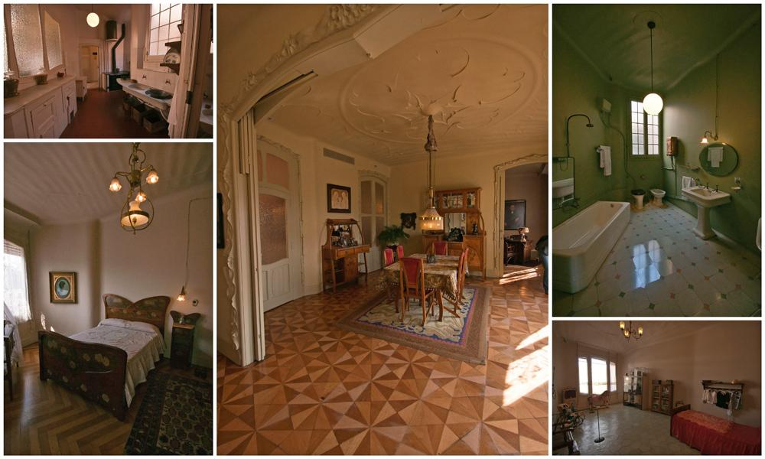
An apartment in the days when the Casa Mila (La Pedrera) is built

Slide 39
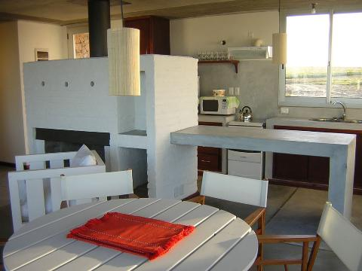

Slide 40
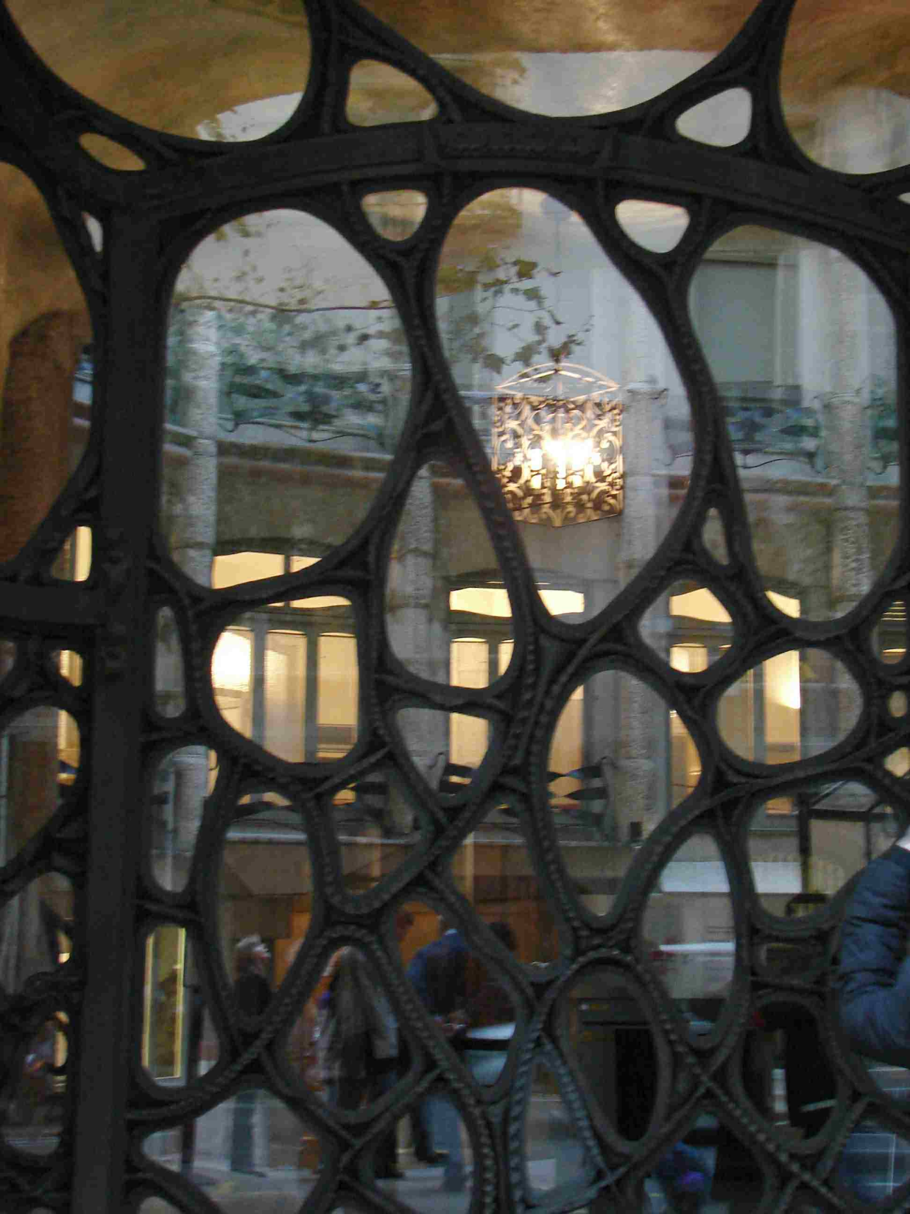

Slide 41
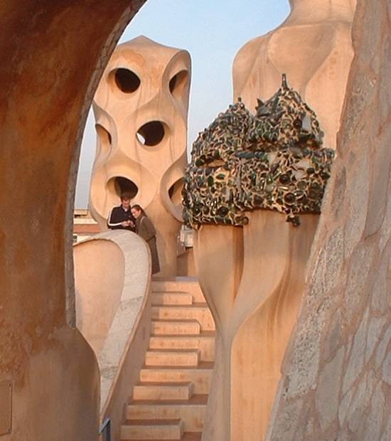

Slide 42
Park Güell
is a garden complex with architectural elements situated on the hill of El Carmel in the Gràcia district of Barcelona, Catalonia, Spain. It was designed by the Catalan architect Antoni Gaudí and built in the years 1900 to 1914. It is part of the UNESCO World Heritage Site "Works of Antoni Gaudí".

Slide 43
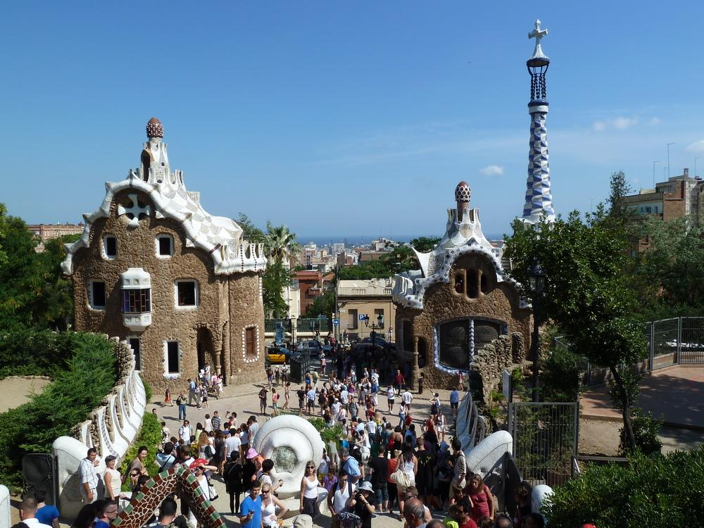

Slide 44
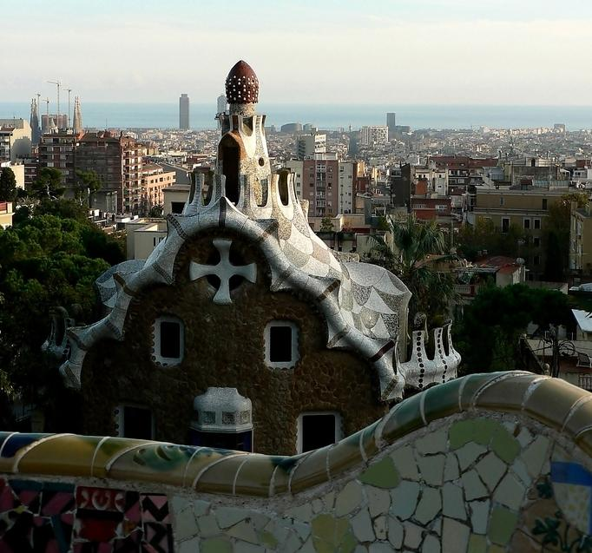

Slide 45
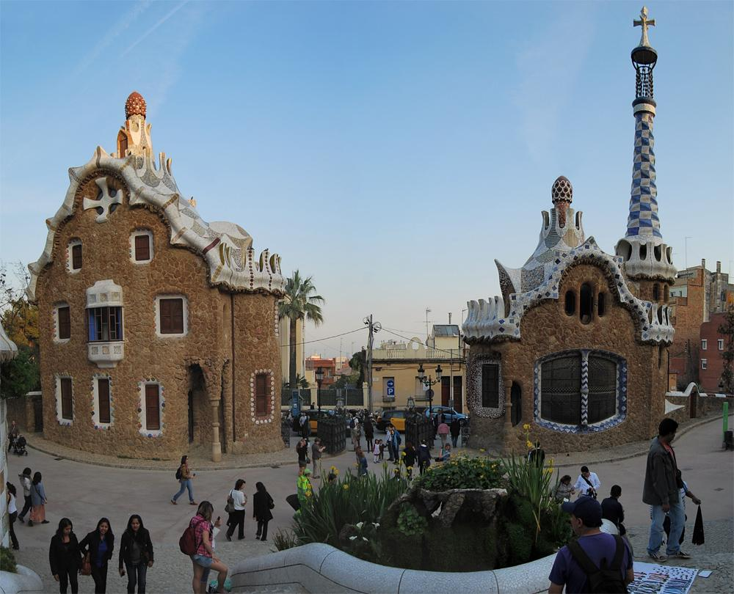

Slide 46
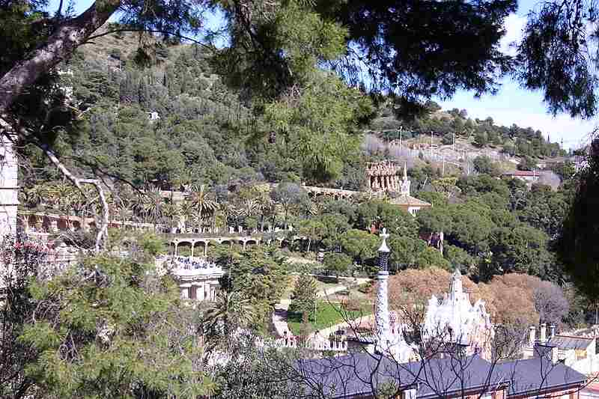

Slide 47
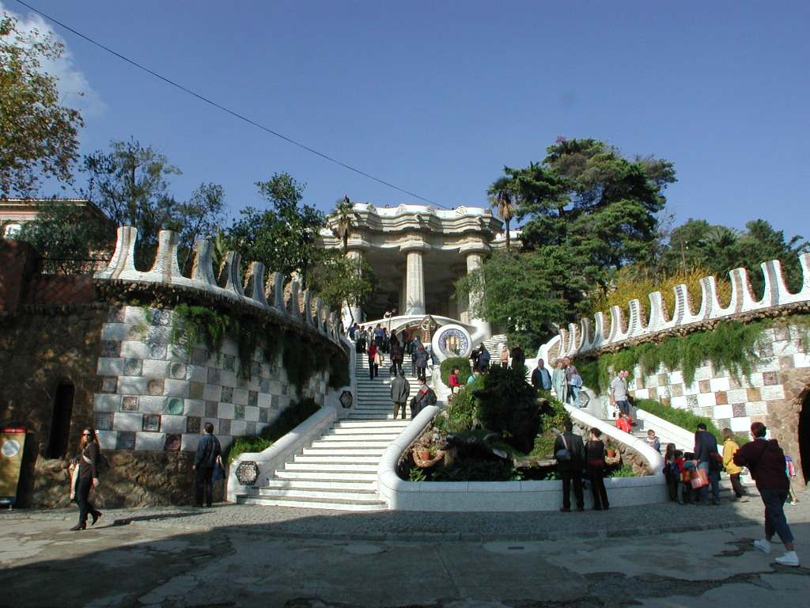

Slide 48
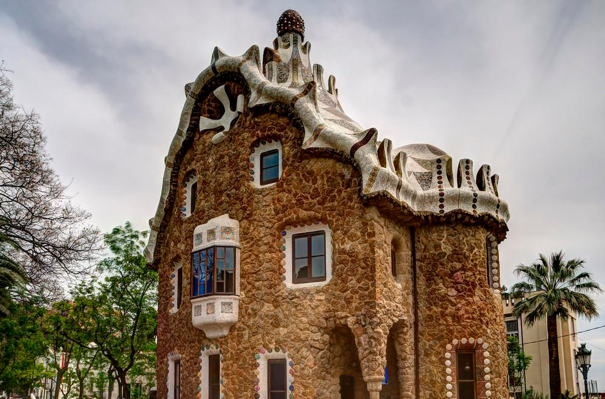

Slide 49
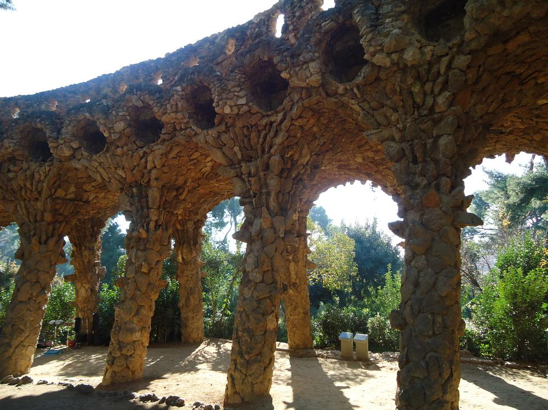

Slide 50
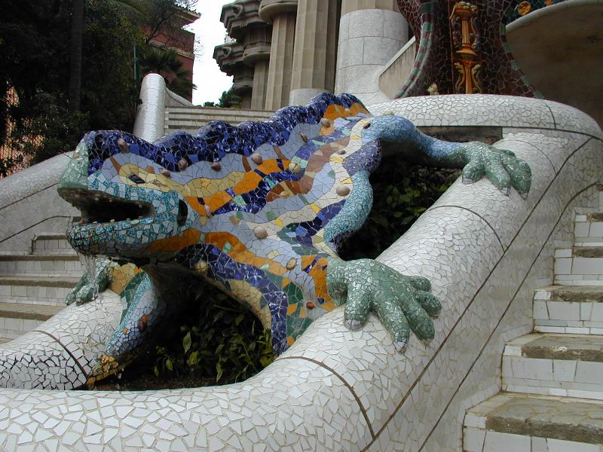

Slide 51
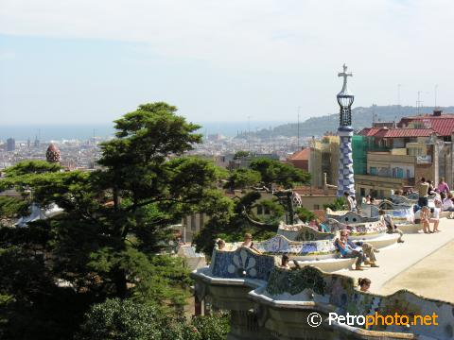

Slide 52
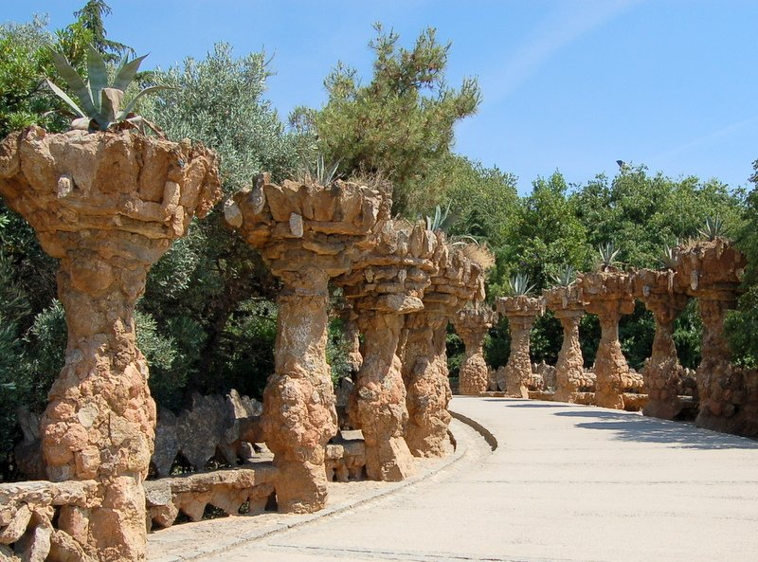

Slide 53


Slide 54


Slide 55





Slide 56


Slide 57
Casa calvet
Casa Calvet is a building, designed by Antoni Gaudí for a textile manufacturer which served as both a commercial property and a residence. It is located at Carrer de Casp 48, Eixample district of Barcelona.

Slide 58



Slide 59


Slide 60


Slide 61


Slide 62


Slide 63



Slide 64

Vestibule

Slide 65

Vestibule elevator entrance

Slide 66

Elevator

Slide 67

Today, the building serves as a restaurant

Slide 68

Palau Guell
The Palau Güell s a mansion in Barcelona, Catalonia, Spain designed by the Catalan architect Antoni Gaudí for the Catalan industrial tycoon Eusebi Güell. It is part of the UNESCO World Heritage Site "Works of Antoni Gaudí"

Slide 69

Front entrance allowed horse drawn carriages to enter the home through one door and exit through the other

Slide 70


Slide 71



Slide 72

Interior looking up

Slide 73


Architectural Details of Palau Guell

Slide 74



Slide 75



Slide 76



Slide 77


Slide 78


Slide 79

Other Gaudi Designs

Slide 80

Bathroom Fixtures by Gaudi

Slide 81

Luxury Caravan (RV)
Inspired by Gaudi
created by etherwarrior

Slide 82

The Gaudi bishop's palace in Astorga

Slide 83

Casa Botines by Antoni Gaudí, 1891 to 1892, León, Spain

Slide 84

Furniture designed by Gaudi for his buildings

Slide 85


Slide 86



Slide 87





