Slide 1
Spain (Part 7)

Slide 2
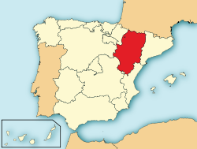
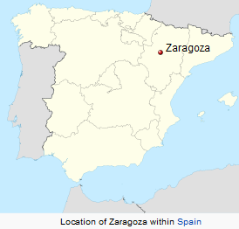
Aragon Autonomous Community - zaragoza
Aragon

Slide 3
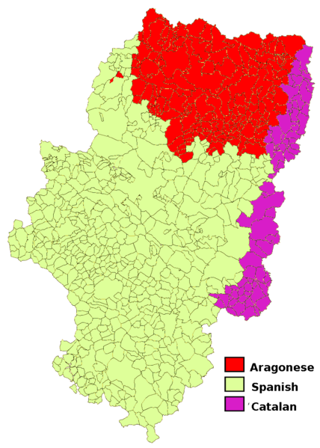
Language Distribution in Aragon

Slide 4
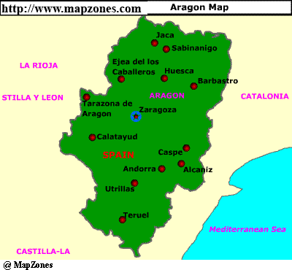
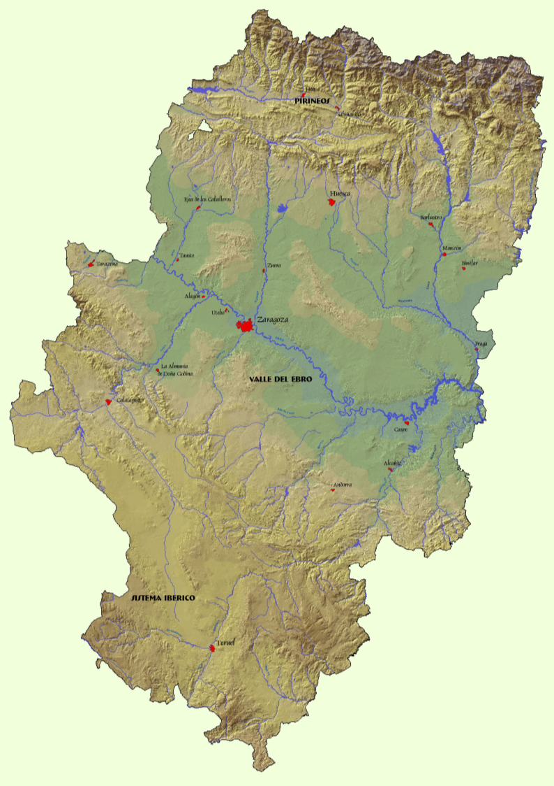

Slide 5
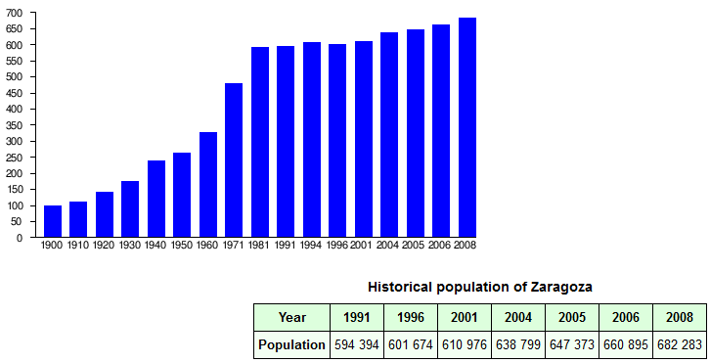

Slide 6
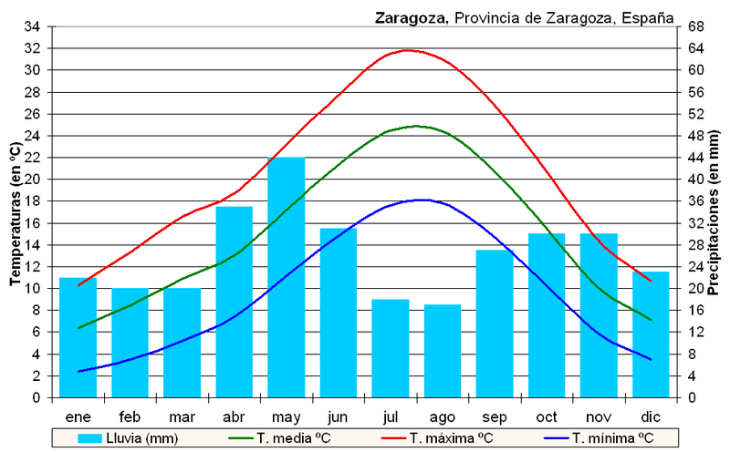
Climate - Zaragoza

Slide 7
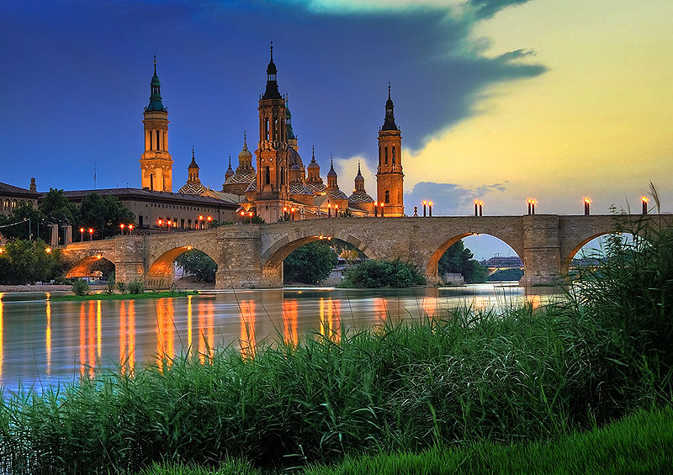
Basilica of Our Lady of the Pillar and the Ebro River

Slide 8
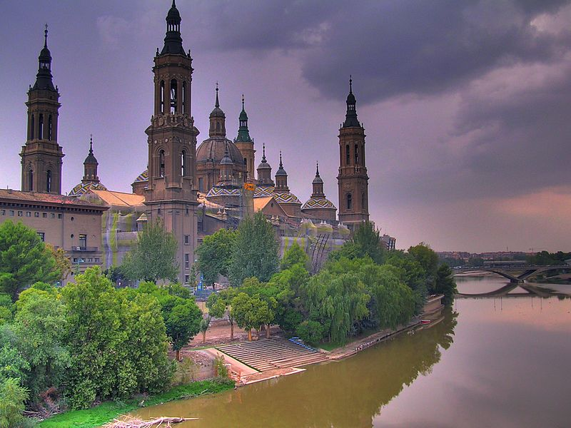

Slide 9
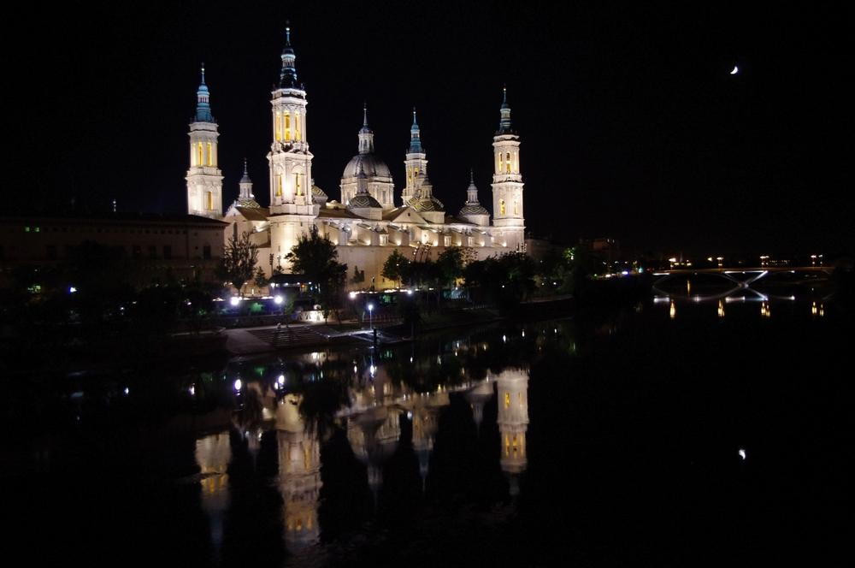

Slide 10
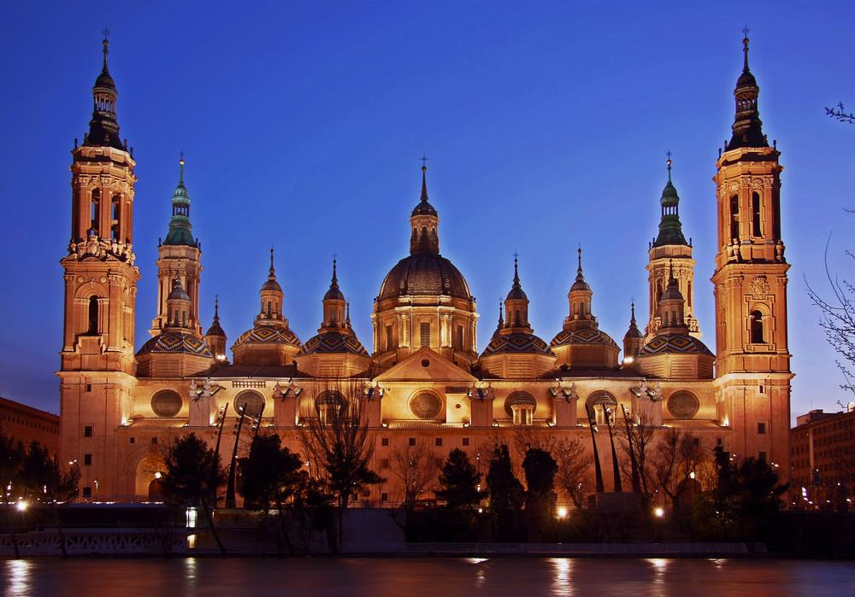
Our Lady of the Pillar

Slide 11
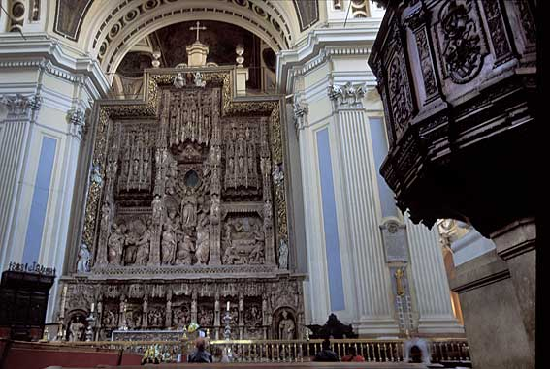
Interior

Slide 12
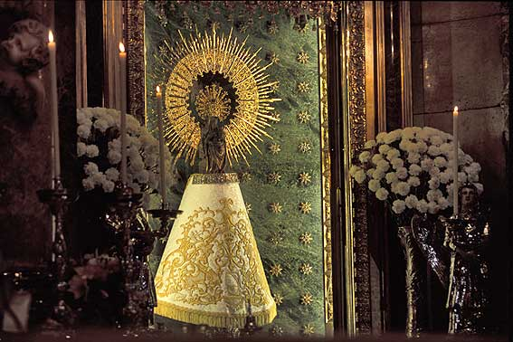

Slide 13
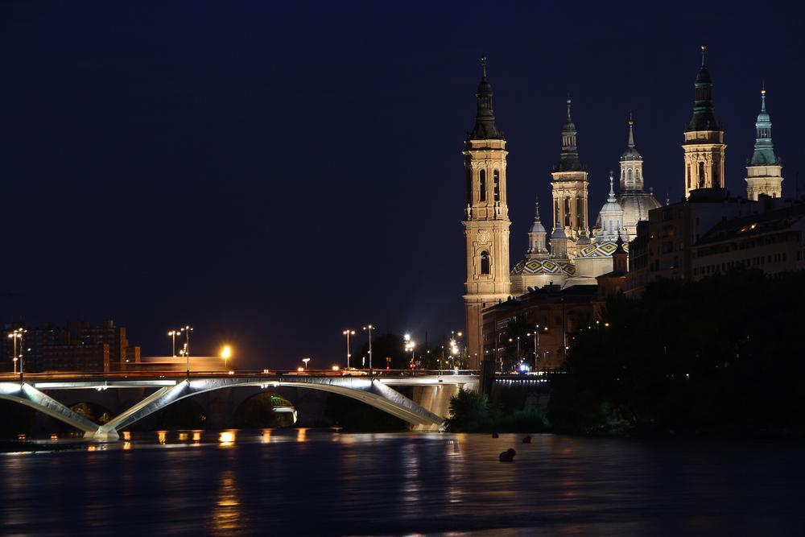
Basilica of Our Lady of the Pillar - Zaragoza

Slide 14
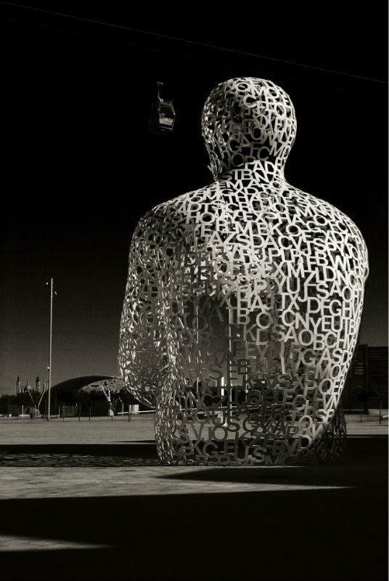
El alma del Ebro, Zaragoza

Slide 15
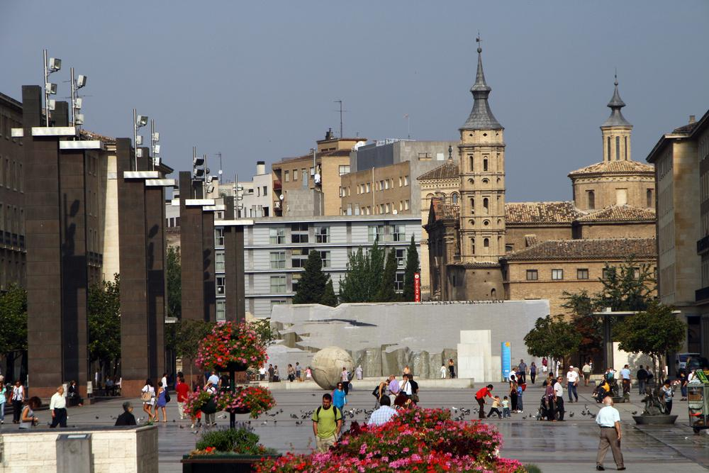
Pillar Square

Slide 16
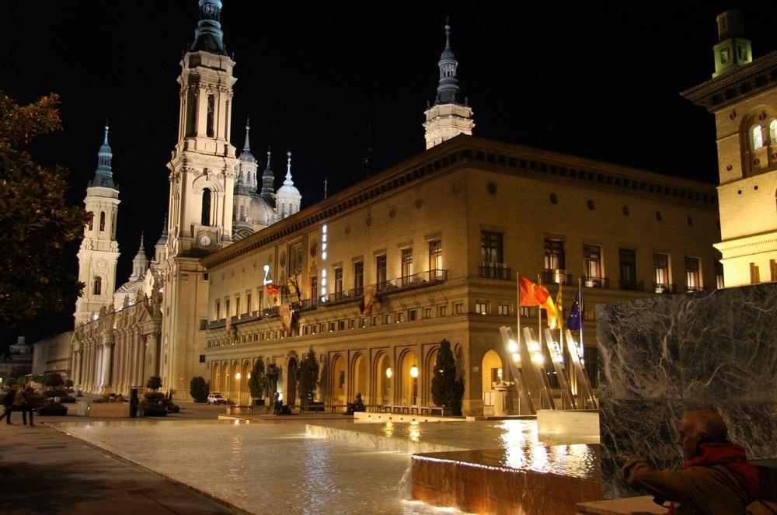
La plaza del Pilar

Slide 17
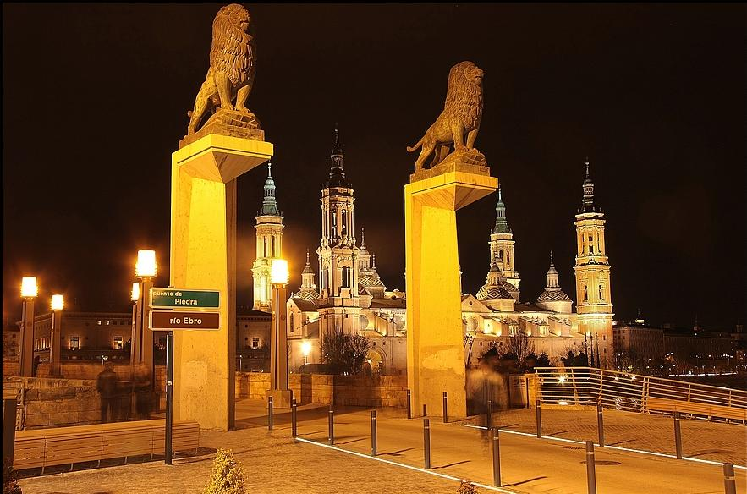
Piedra Bridge

Slide 18
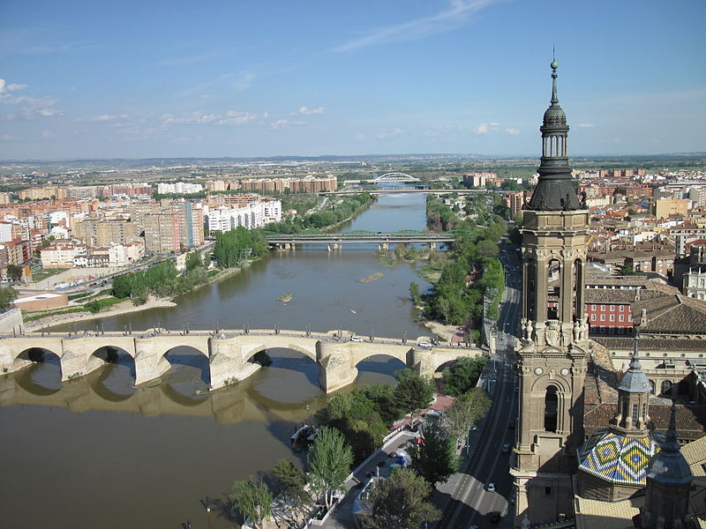
Piedra Bridge

Slide 19
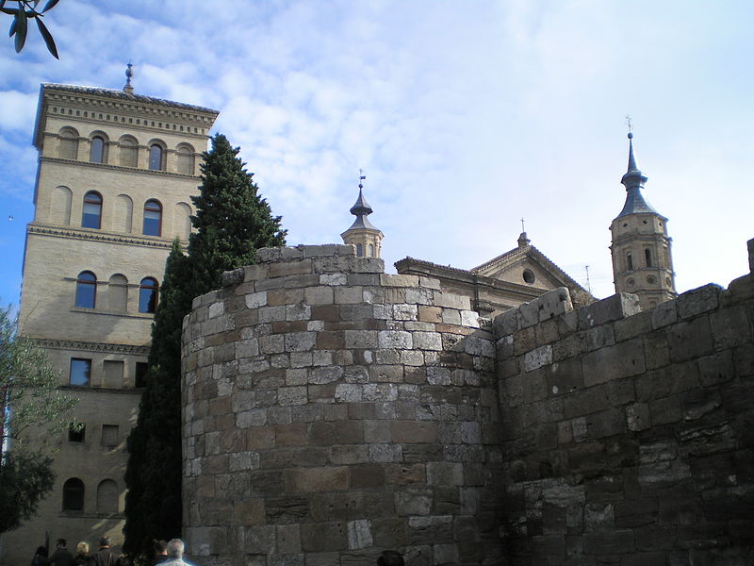
Roman Wall

Slide 20
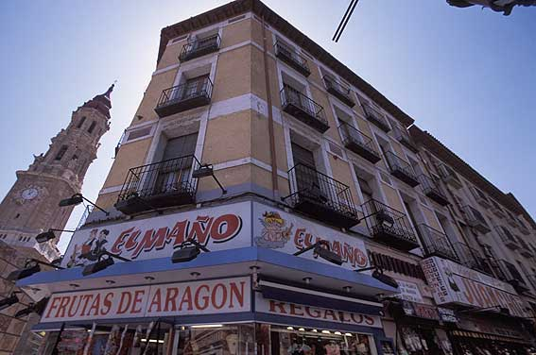
Zaragoza – commercia/residential building

Slide 21
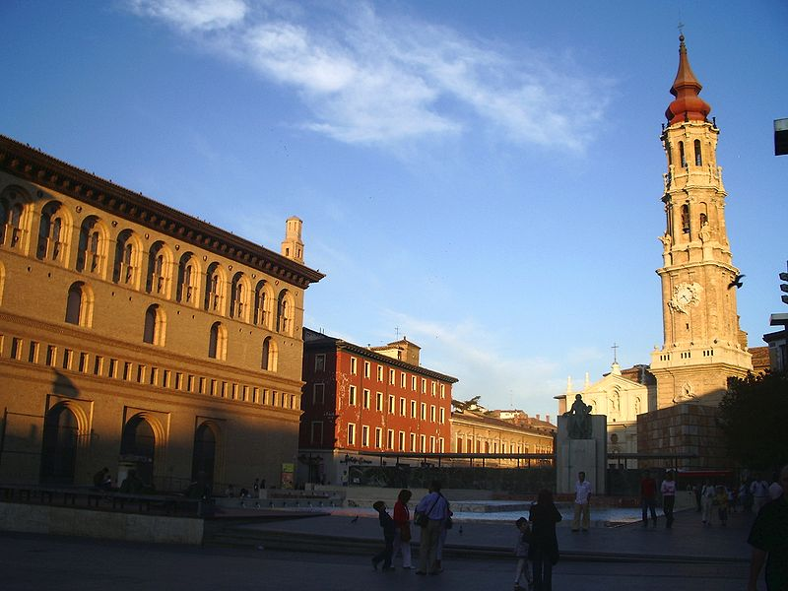
La Seo Cathedral

Slide 22
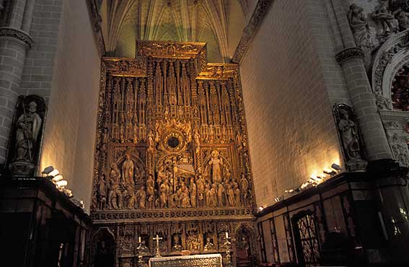
LA SEO. CATEDRAL DE SAN SALVADOR

Slide 23
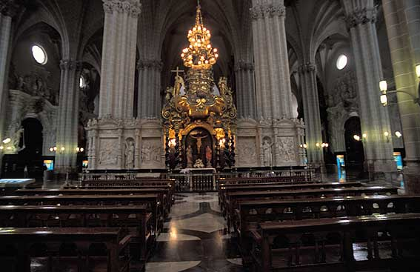
LA SEO. CATEDRALDE SAN SALVADOR

Slide 24
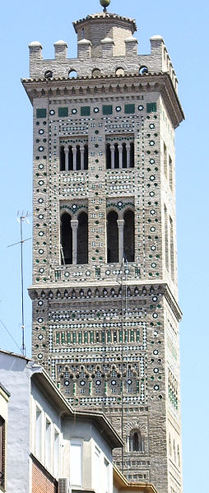
Santa María Magdalena church.

Slide 25
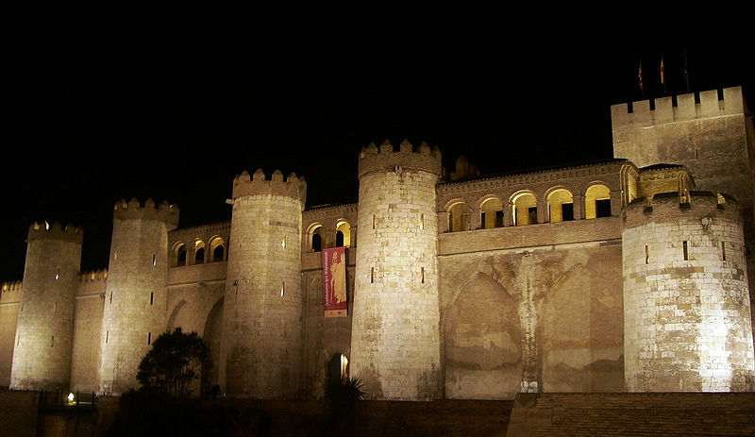
Aljafería Palace (at night), built in the 11th century.

Slide 26
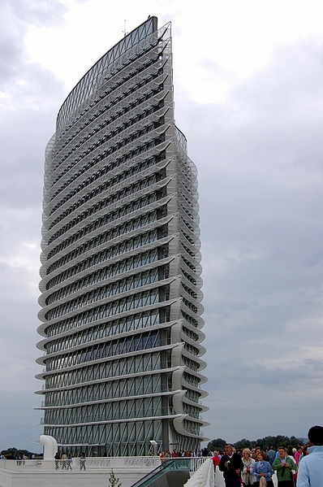
Water tower at the Expo 2008 site.

Slide 27
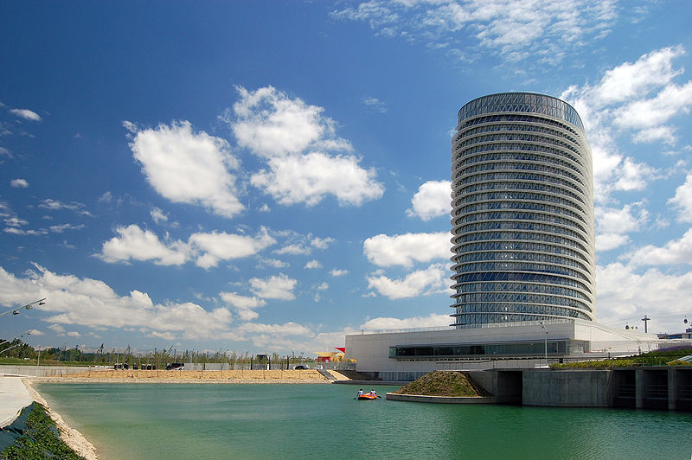
Water tower in the Luis Buñuel Metropolitan Water Park

Slide 28
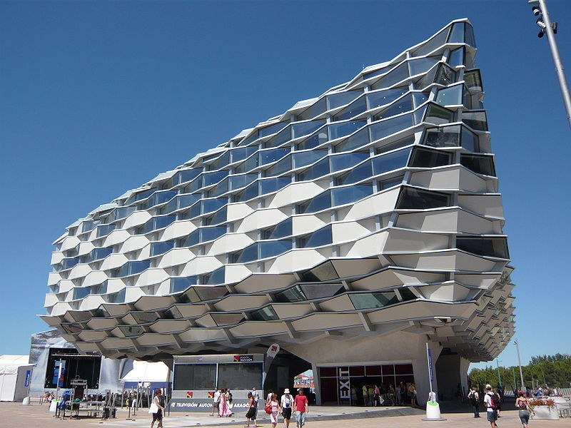
Pavilion of Aragon in the Expo 2008

Slide 29
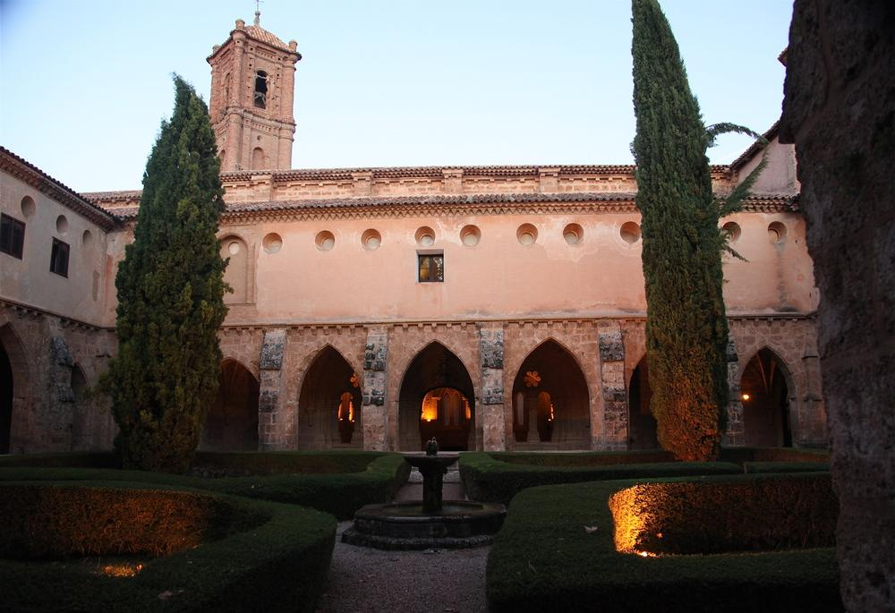
Monastery of Piedra

Slide 30
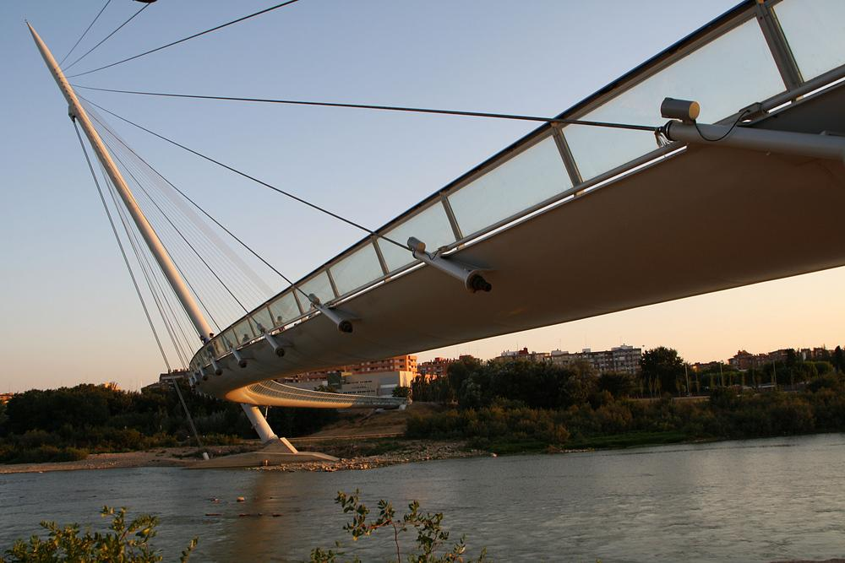
Zaragoza

Slide 31
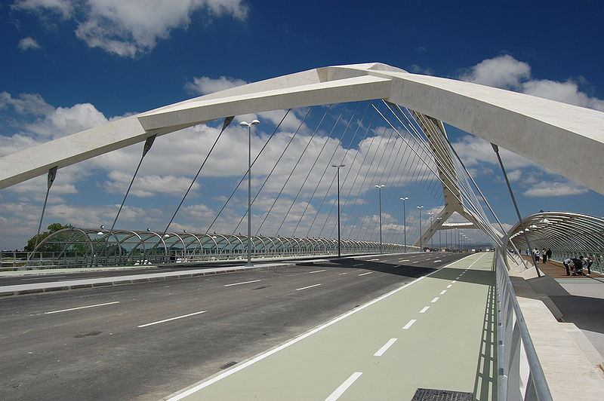
Third Millennium Bridge

Slide 32
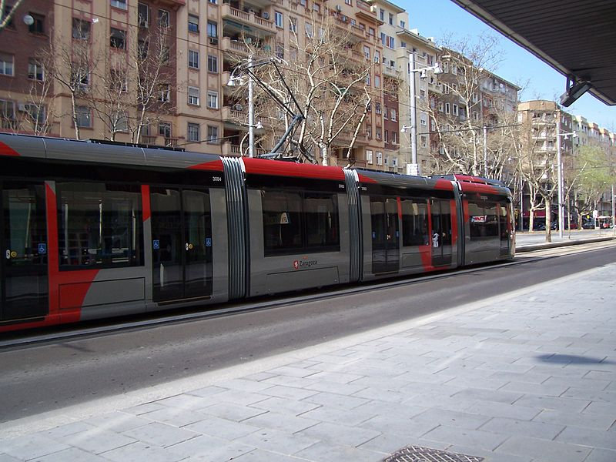
Zaragoza tram

Slide 33
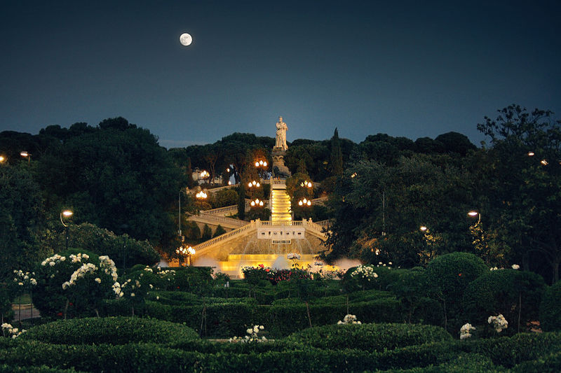
Labordeta Grand Park

Slide 34
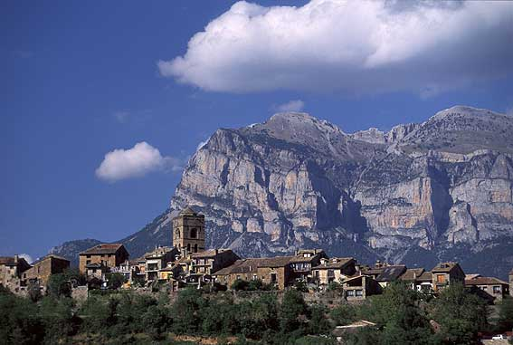
Scenes around aragon

Slide 35
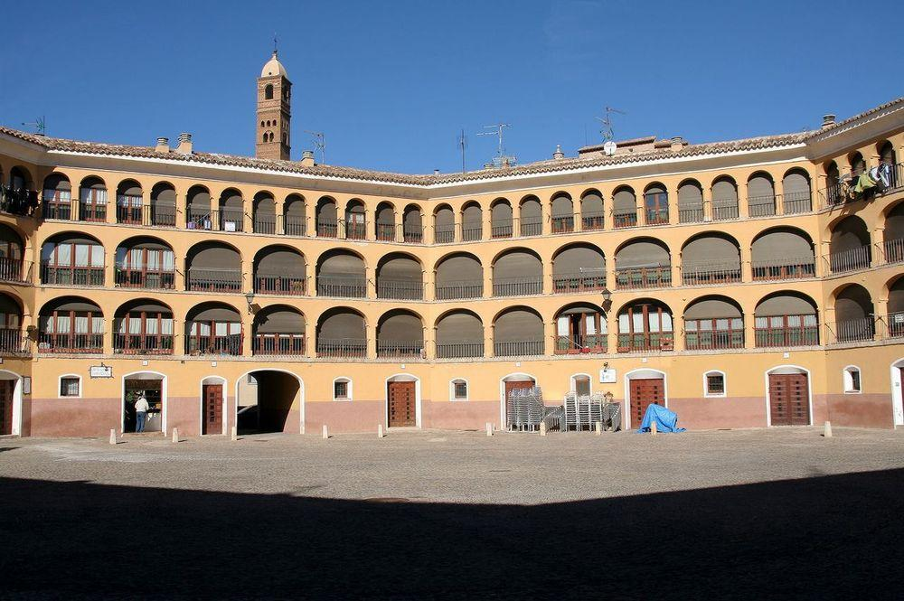
Tarazona-Plaza-de-Toros-Vieja

Slide 36
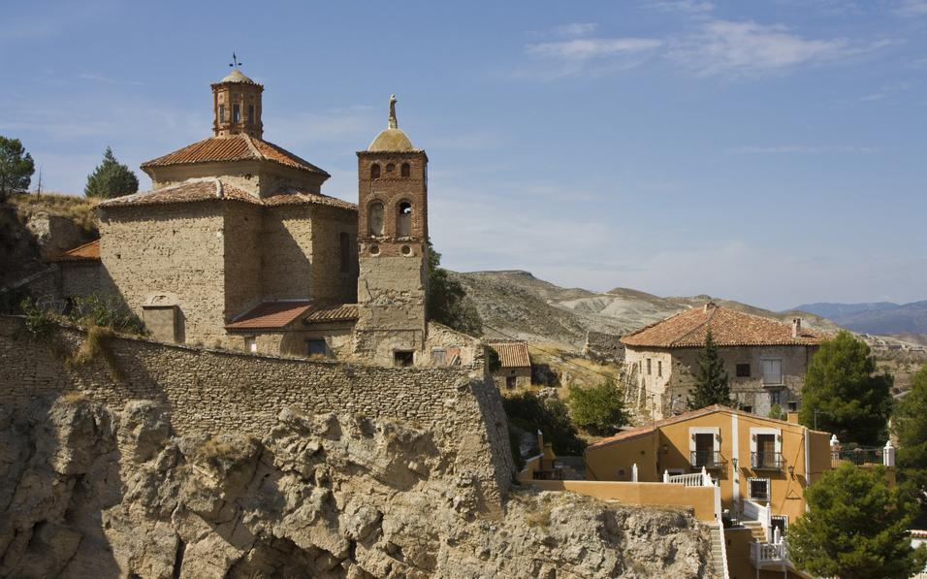
Hermitage of la Virgen del Castillo - Belmonte

Slide 37
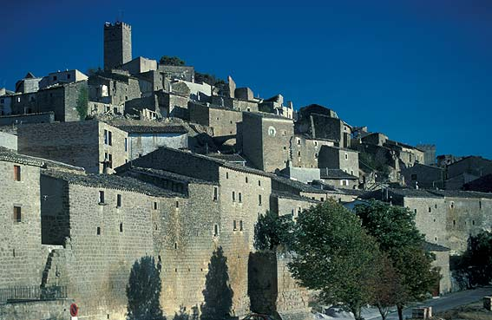

Slide 38
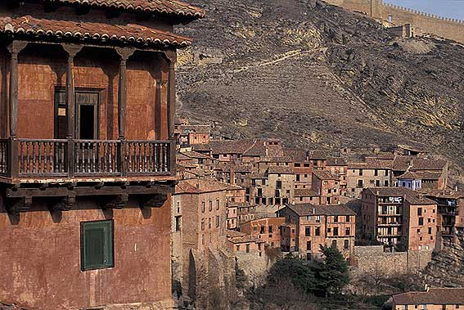

Slide 39
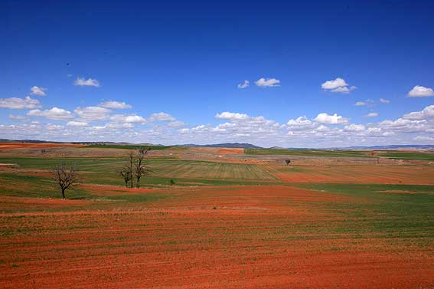

Slide 40
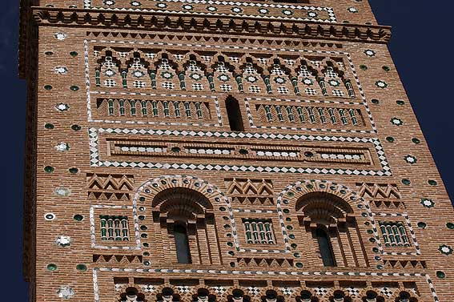

Slide 41
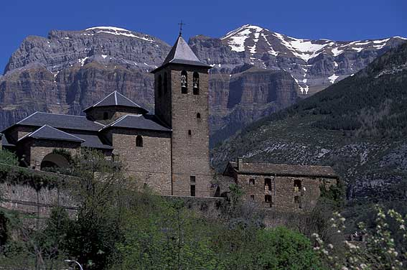

Slide 42
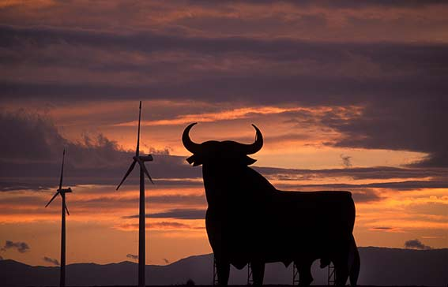

Slide 43
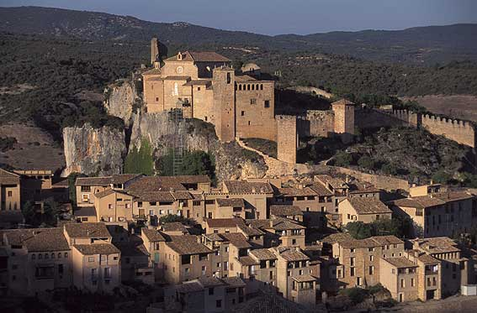
ALQUÉZAR

Slide 44
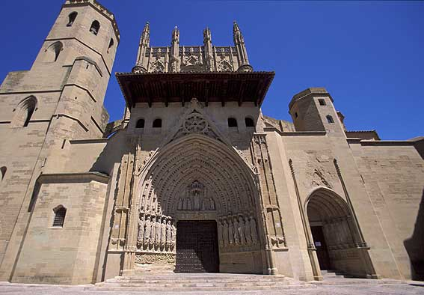
Huesca Cathedral

Slide 45
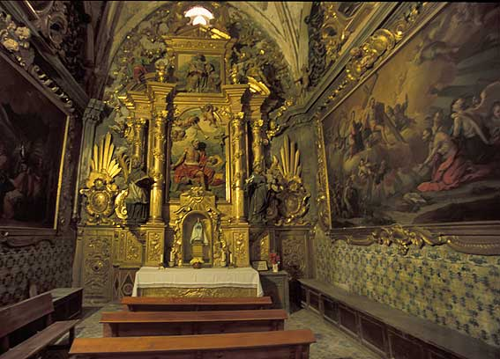
Chapel in the Cathedral in Huesca

Slide 46
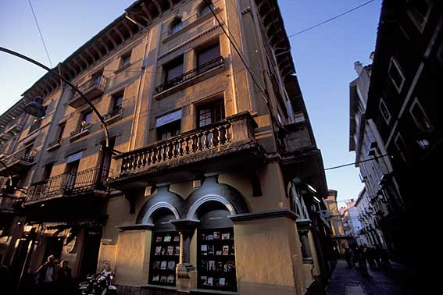
Huesca – Commercial/residential building

Slide 47
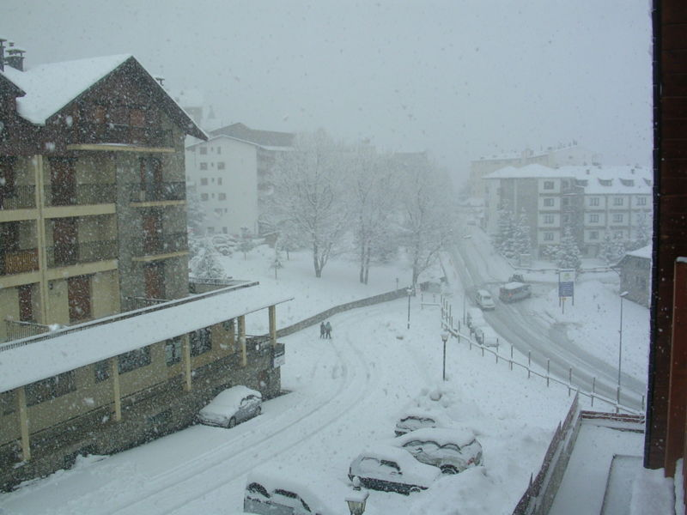
Winter in Huesca

Slide 48
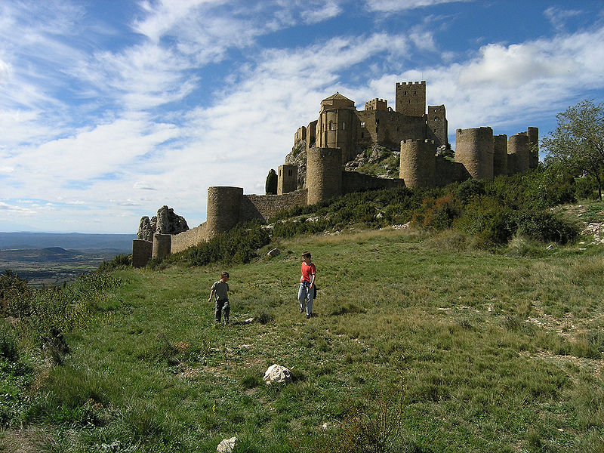
Loarre, one of the most important Romanesque castles in Europe

Slide 49
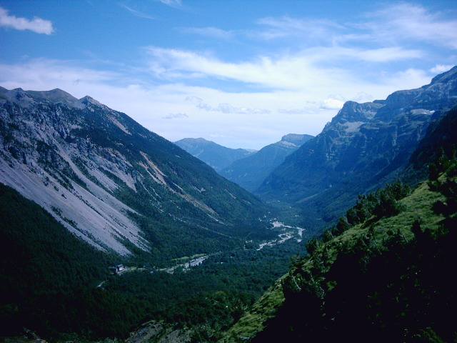
View from Ordesa valley in the Aragonese Pyrenees

Slide 50

Circo de Soaso in Ordesa y Monte Perdido National Park

Slide 51

The Moncayo Massif seen from Alcalá de Moncayo.

Slide 52

Castle of San Pedro in Jaca.

Slide 53

The city of Teruel is known for its numerous old Mudéjar buildings

Slide 54


Slide 55


Slide 56


Slide 57

Canary Islands

Slide 58


Slide 59

Volcanic Islands – Caldera of Corazoncillo, Lanzarote

Slide 60

Caldera de Bandama, Gran Canaria

Slide 61

Caldera de los Marteles, Gran Canaria

Slide 62

Pico Viejo; Tenerife

Slide 63

Strange shapes created by the erosion of pumice layers, originating from explosive eruptions of the ancient "Cañadas" stratovolcano

Slide 64

Mogan port

Slide 65

Puerto-de-Mogan

Slide 66

Port Morgan

Slide 67

Port Mogan apartments

Slide 68

Arrecife

Slide 69

Moon over the Atlantic in Anaterve

Slide 70

Old city in Las Palmas

Slide 71


Slide 72


Slide 73

Gran Canaria Casa de Colon

Slide 74

Fuerteventura

Slide 75

Nature of Canary Islands

Slide 76


Slide 77


Slide 78

Loro Park-Tenerife

Slide 79

Botanic Garden

Slide 80

Jameos del Agua in Lanzarote

Slide 81

Festival of Julio - Tenerife

Slide 82

Lanzarote

Slide 83

Beach in El Hierro-Canary Islands

Slide 84

El Pinar de Tamadaba-Canary Islands

Slide 85

Loro Park

Slide 86


Slide 87

Beach in Teresitas

Slide 88

U-Boats for tourists in Puerto Calero in Lanzarote

Slide 89

Gran Canary

Slide 90

Gran Canary nights

Slide 91

Castillo del Mar

Slide 92

Taxi

Slide 93

Palma Cathedral

Slide 94

Valle Gran Rey

Slide 95

La Salemera

