Slide 1
Spain (Part 5) - Catalonia

Slide 2
Catalonia
Catalonia is an autonomous community of Spain, with the official status of a "nationality". Catalonia comprises four provinces: Barcelona, Girona, Lleida, and Tarragona. Its capital and largest city is Barcelona, which is the second largest Spanish city by population after Madrid. Catalonia covers an area of 32,114 km² and has an official population of 7,535,251.
In 2008 the regional GDP of Catalonia was €216.9 billion ($314.4 billion), the highest in Spain, and per capita GDP was €30,700 – similar to that of countries such as the United Kingdom or Austria. However, it had the fourth per capita GDP in Spain, considerably behind the Basque Country (€34,100), Madrid (autonomous community) (€34,100) and Navarra (€32,900). In that year, the GDP growth was 3.7%.

Slide 3
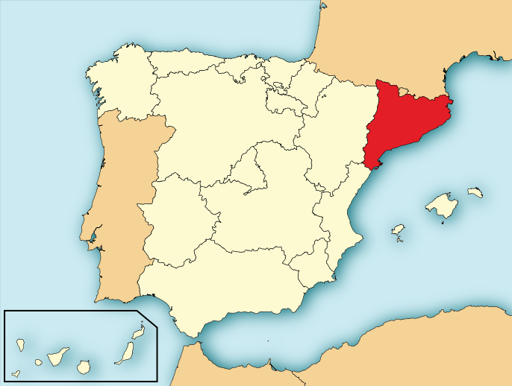

Slide 4
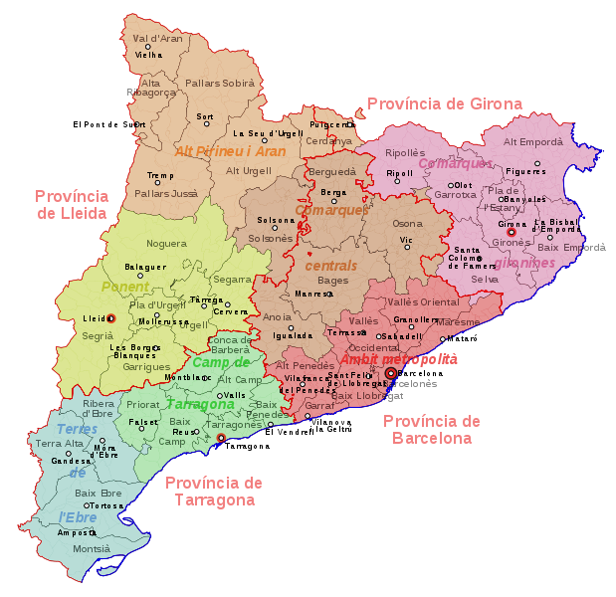
Provinces of Catalonia

Slide 5
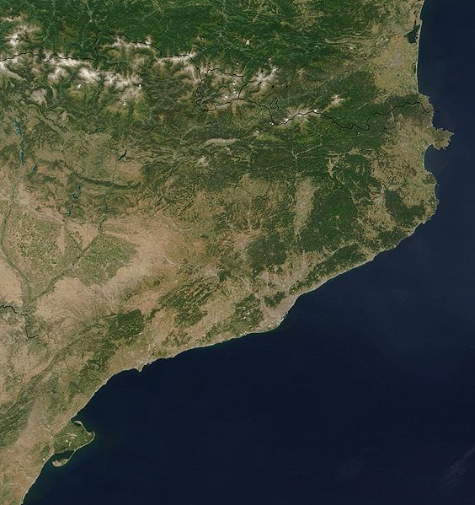
NASA Satellite View of Catalonia

Slide 6
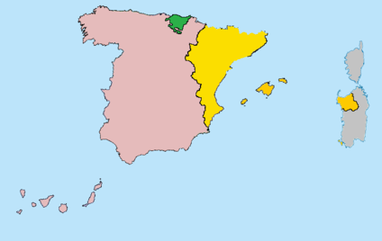
Areas where Catalan is spoken in yellow, Basque Country in green, and rest of Spain in pink

Slide 7
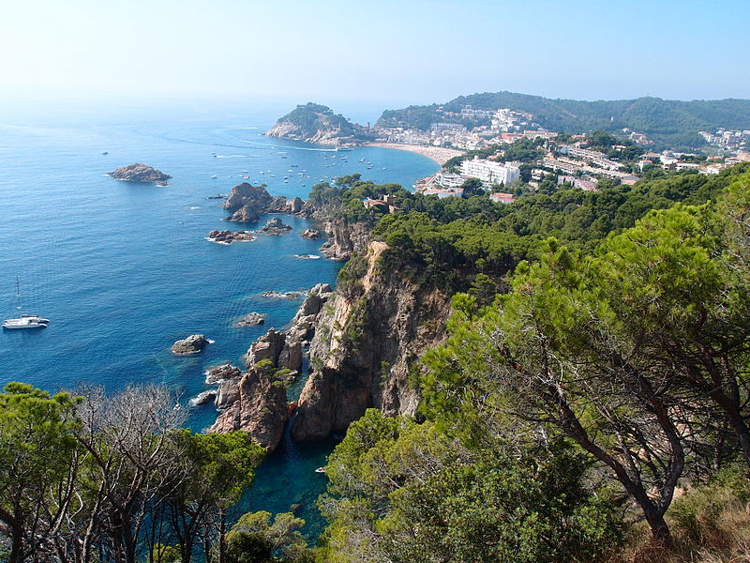
Sea of Tossa

Slide 8
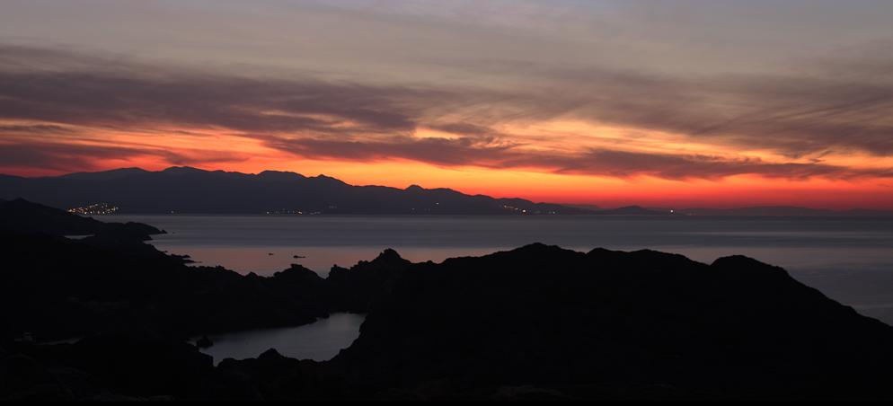
Cap de Creus

Slide 9
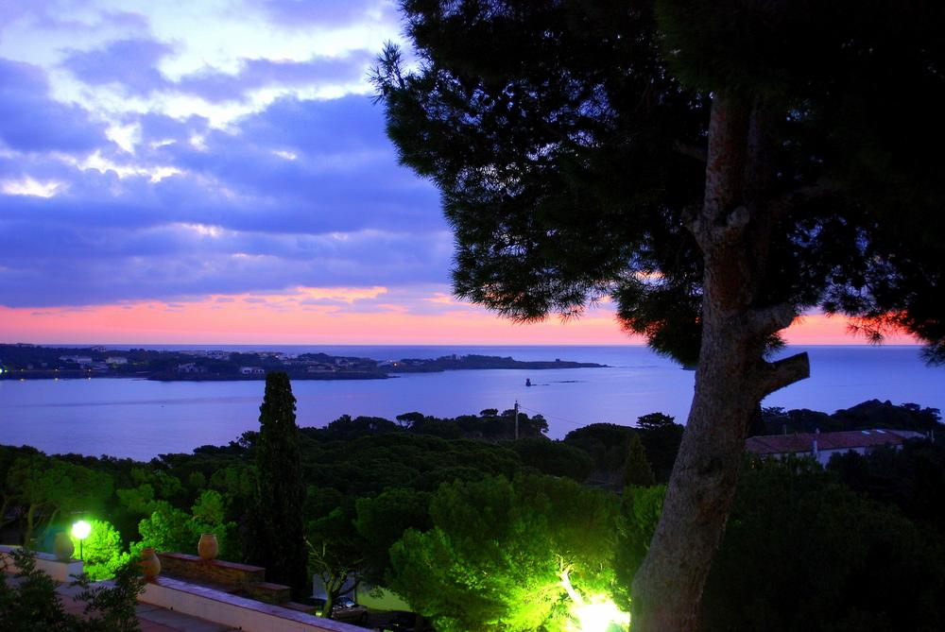
Bay Cadaques

Slide 10
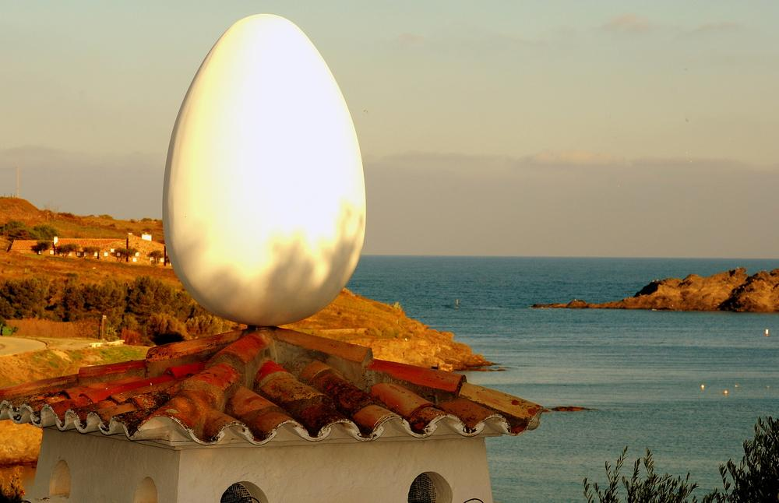
Home of Salvador Dali, Cadaques

Slide 11
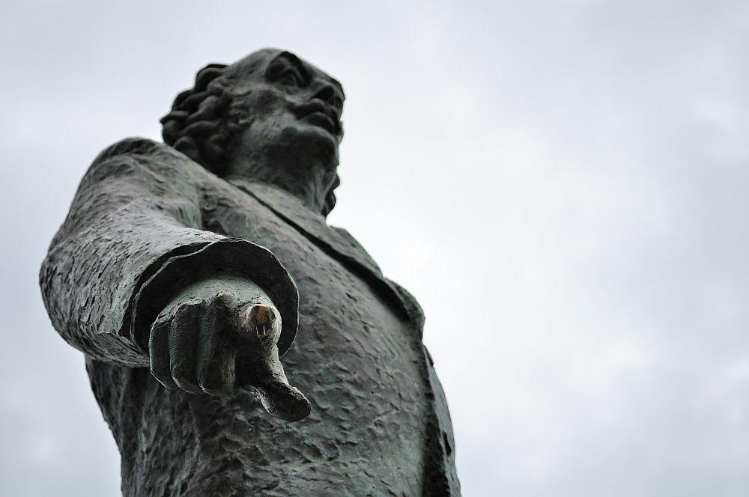
Salvador Domingo Felipe Jacinto Dalí i Domènech (May 11, 1904 – January 23, 1989), known as Salvador Dalí, was a prominent Spanish surrealist painter born in Figueres, Spain.

Slide 12
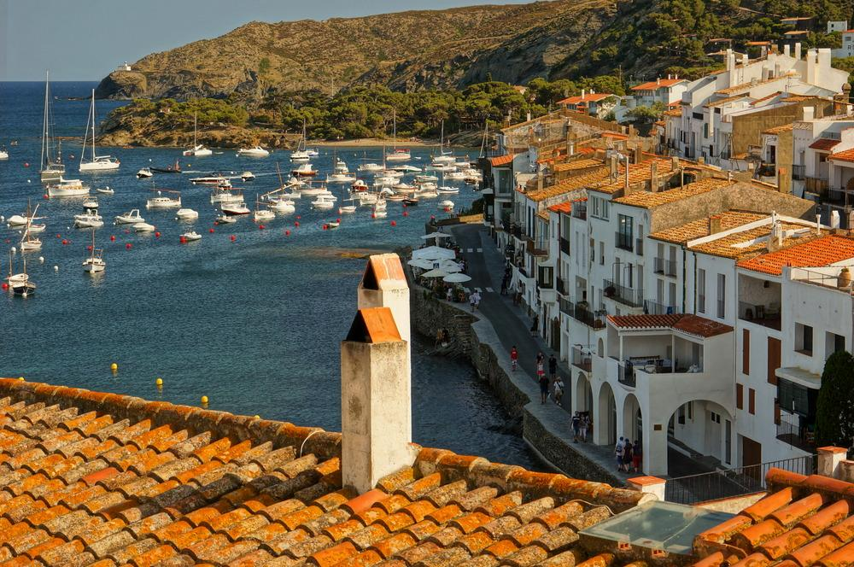
Cadaques

Slide 13
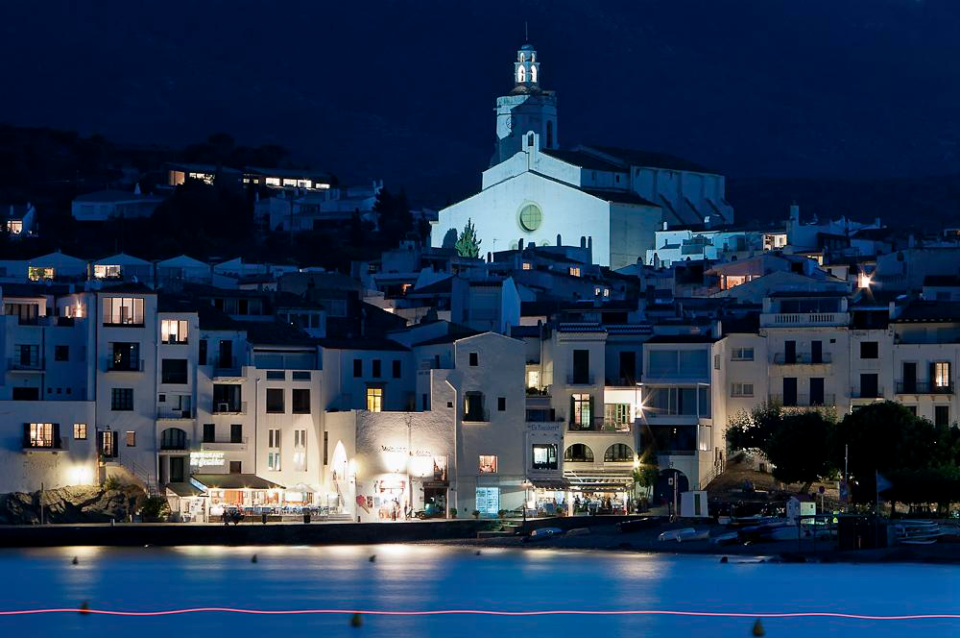
Cadaques

Slide 14
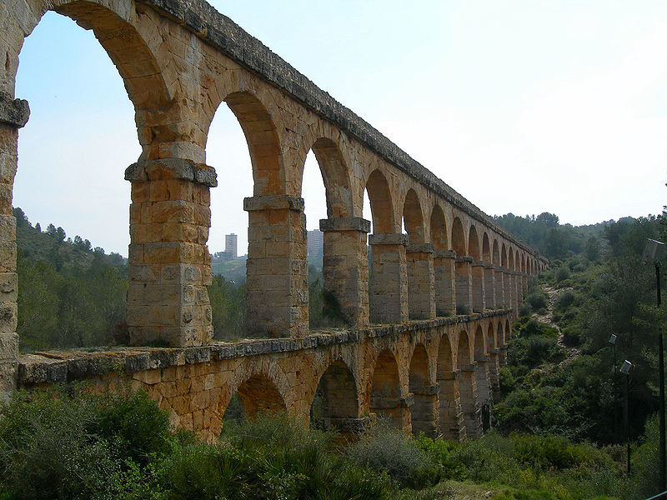
Roman aqueduct in Tarragona

Slide 15
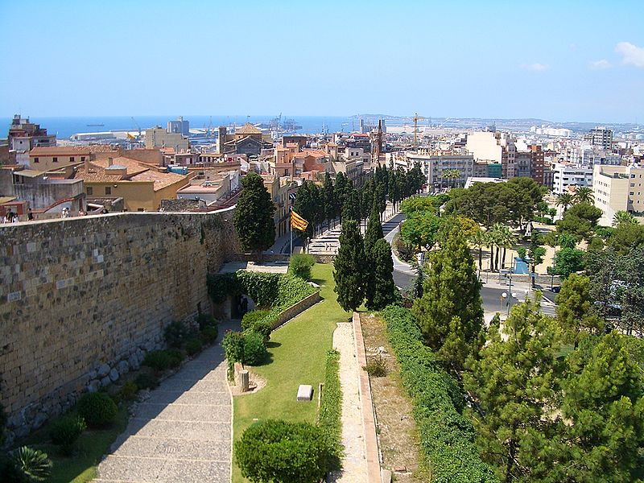
City of Tarragona

Slide 16
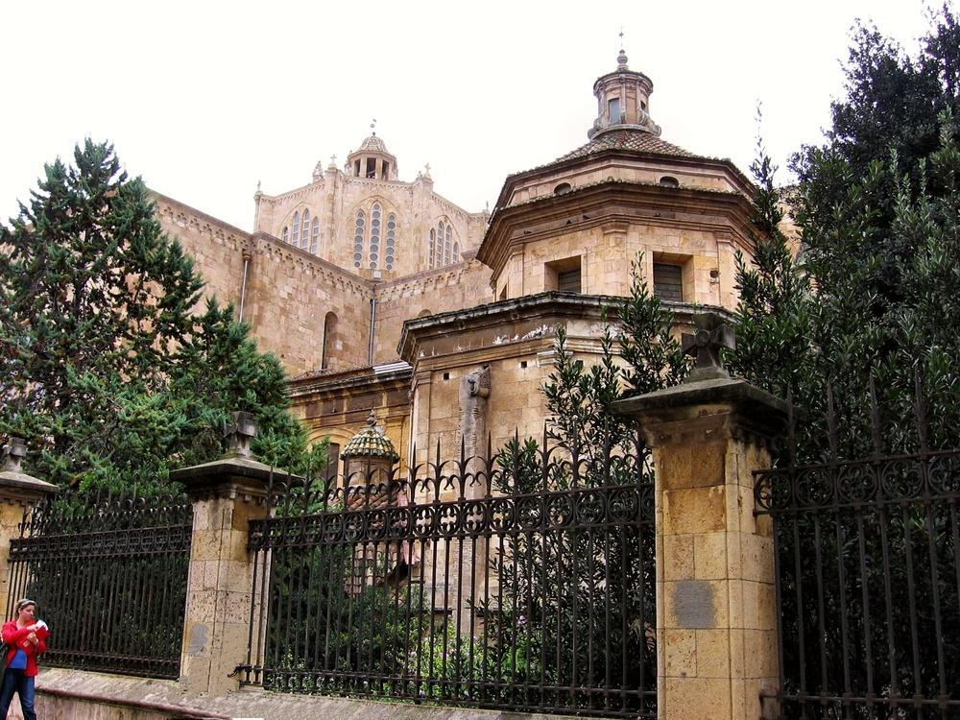
Cathedral in Tarragona

Slide 17
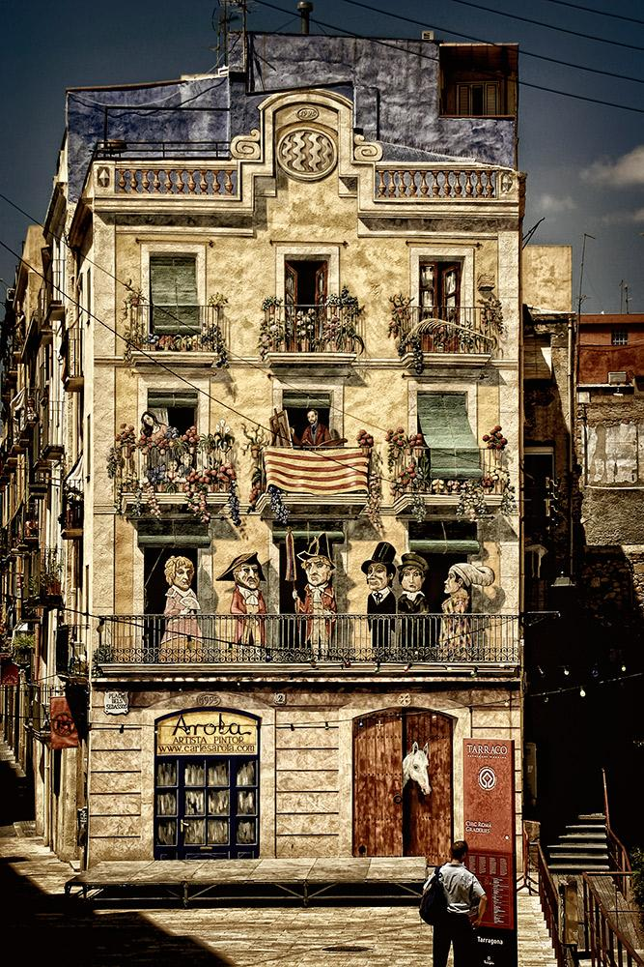
Old Town of Tarragona

Slide 18
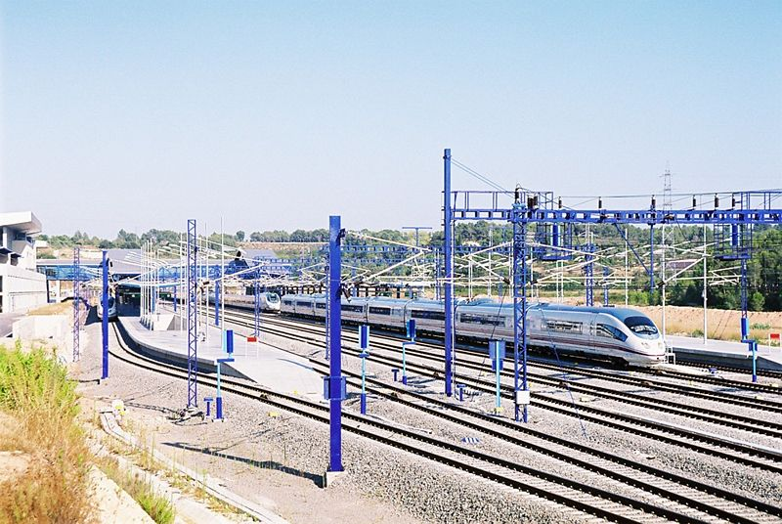
Siemens Velaro E at the railway station of Camp de Tarragona

Slide 19
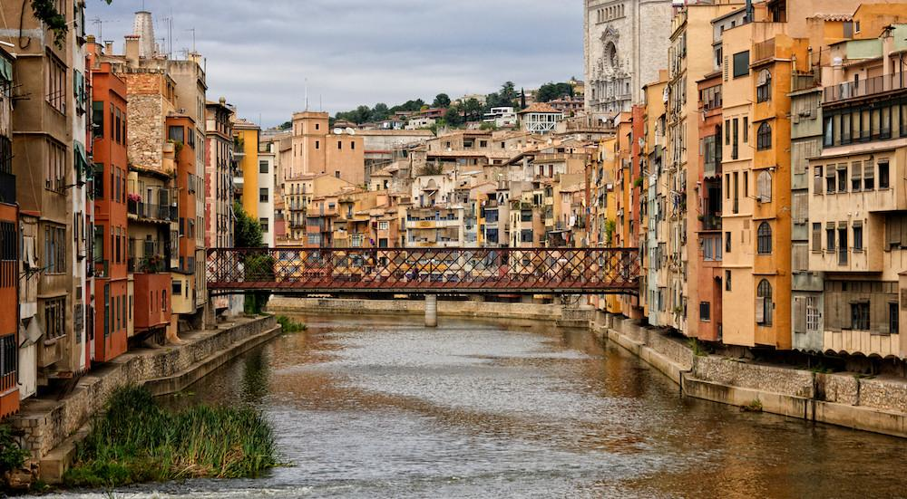
Girona

Slide 20
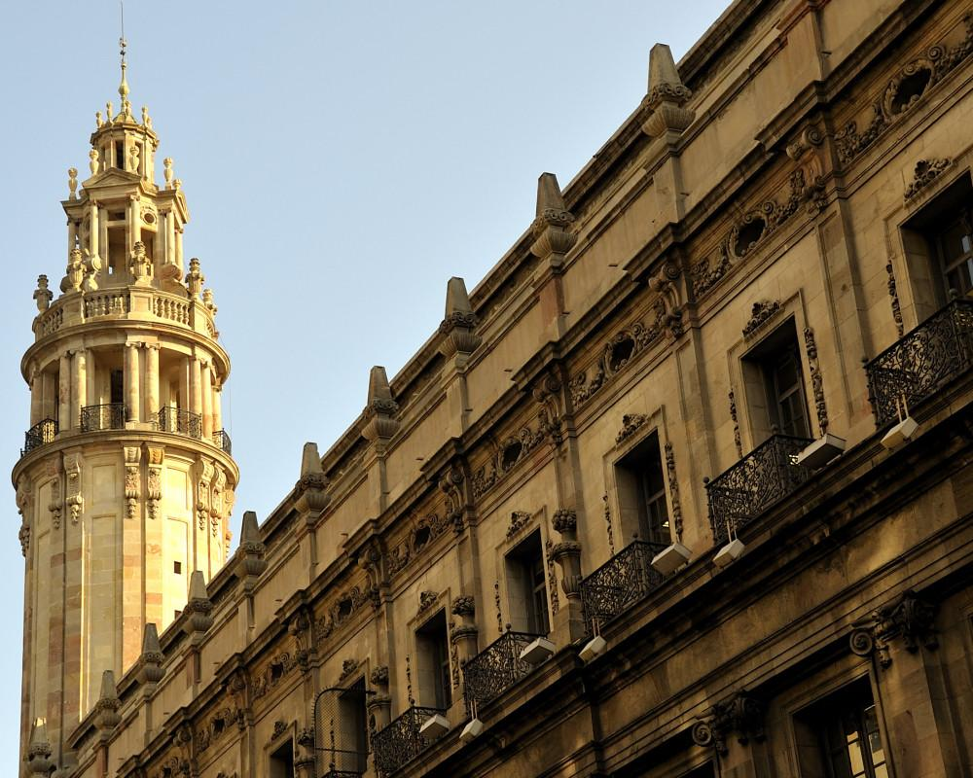
Girona

Slide 21
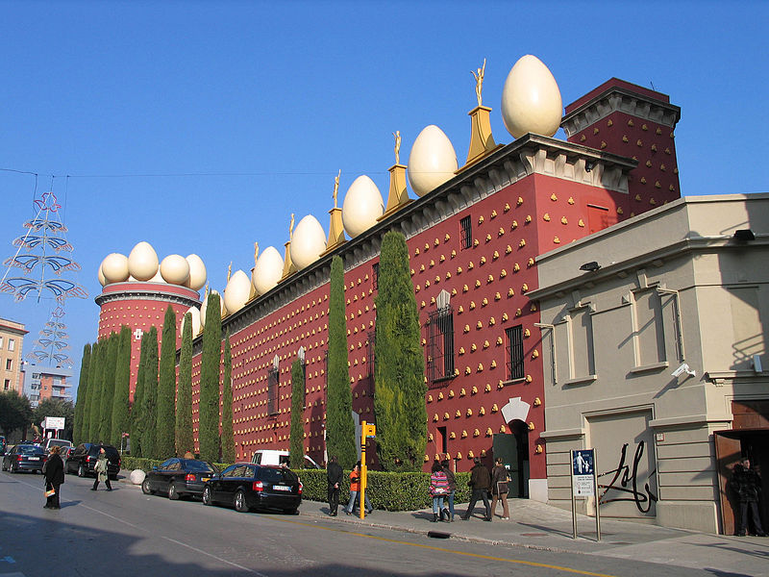
Dalí Museum, Figueres

Slide 22
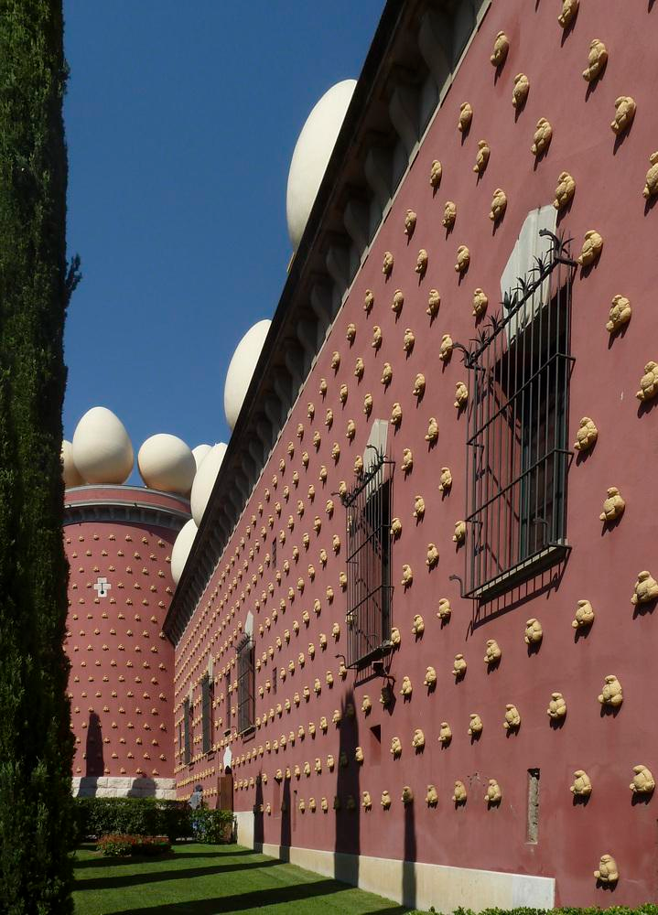
Dalí is buried in a crypt in the Teatre-Museu basement.

Slide 23
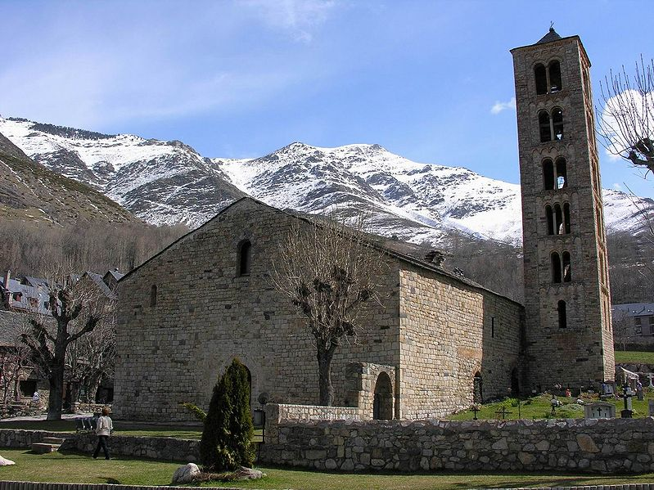
The Medieval church of Sant Climent in Taüll, located at the foothills of the Pyrenees

Slide 24
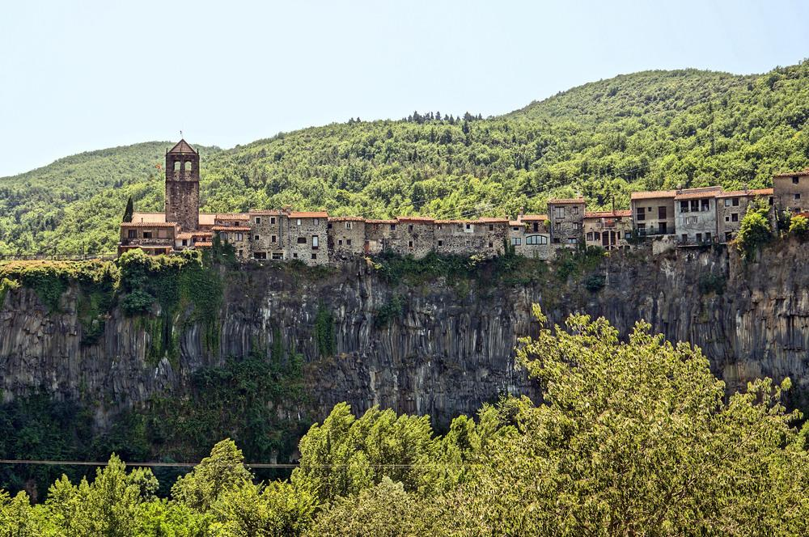
Castellfollit de la Roca

Slide 25
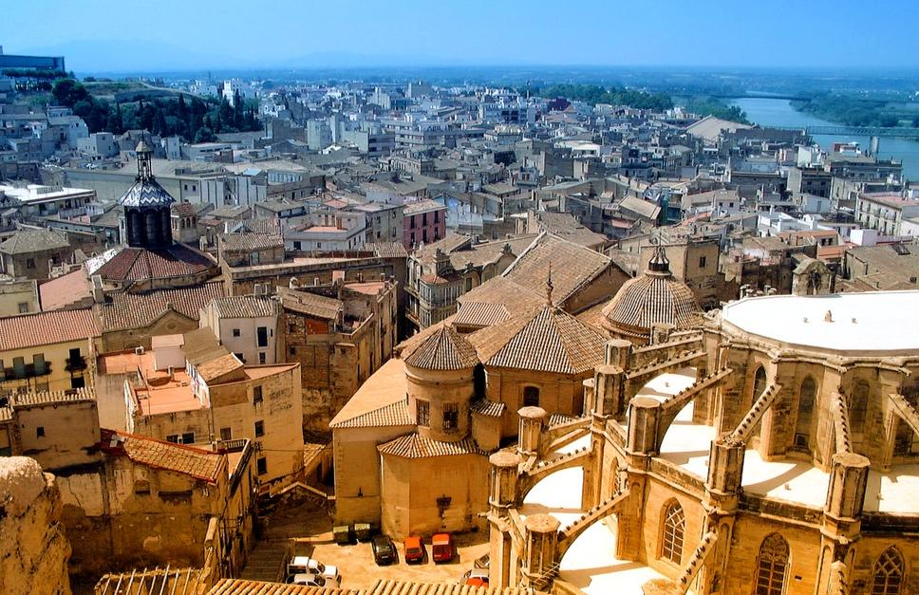
Tortosa

Slide 26
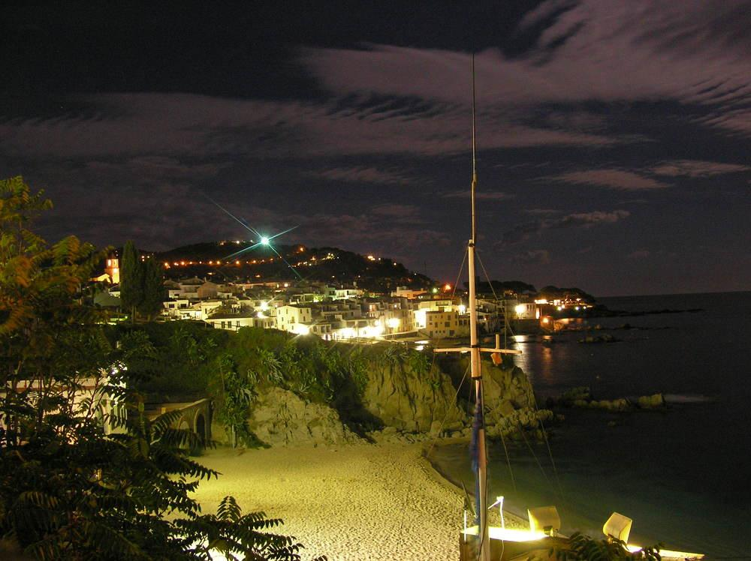
Calella

Slide 27
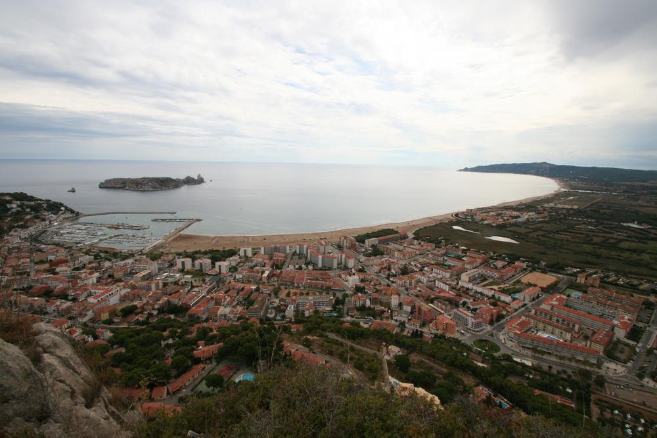
Estartit

Slide 28
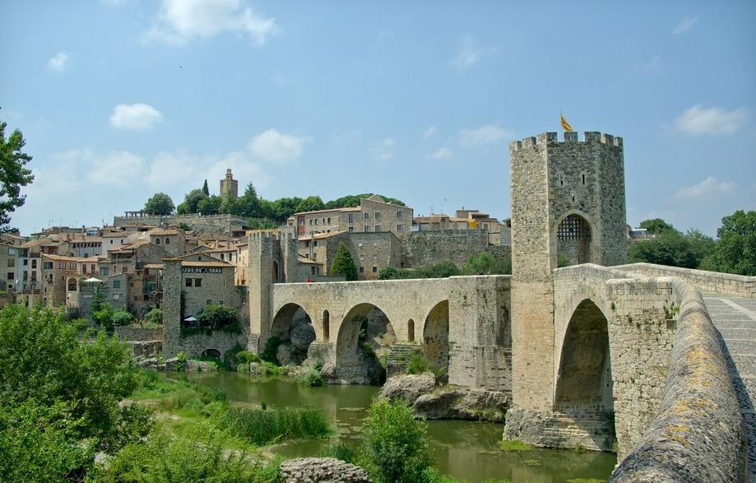
Besalu

Slide 29
Tossa de Mar

Slide 30
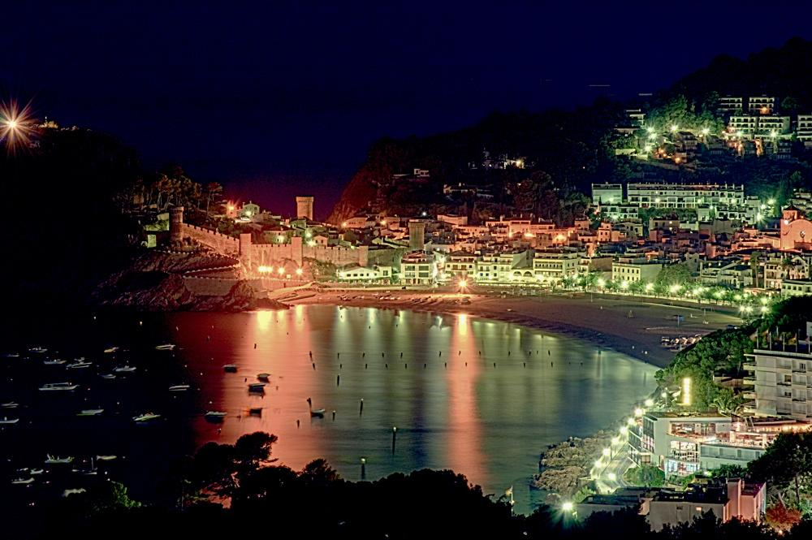
Tossa de Mar

Slide 31
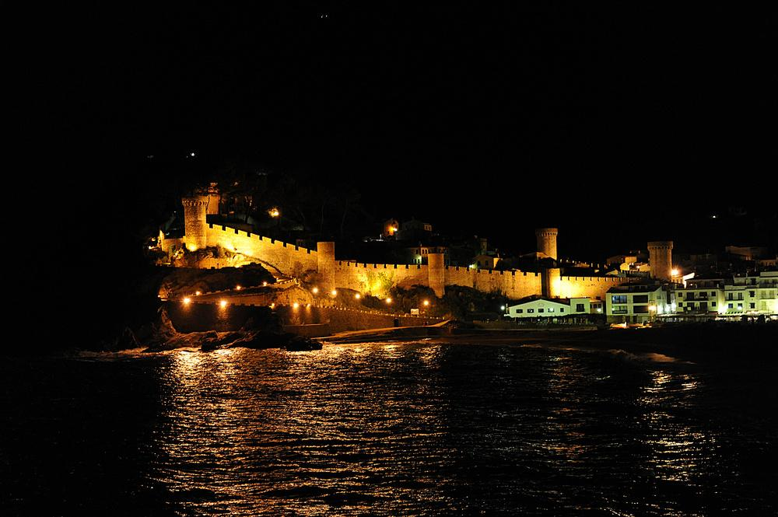
Tossa de Mar

Slide 32
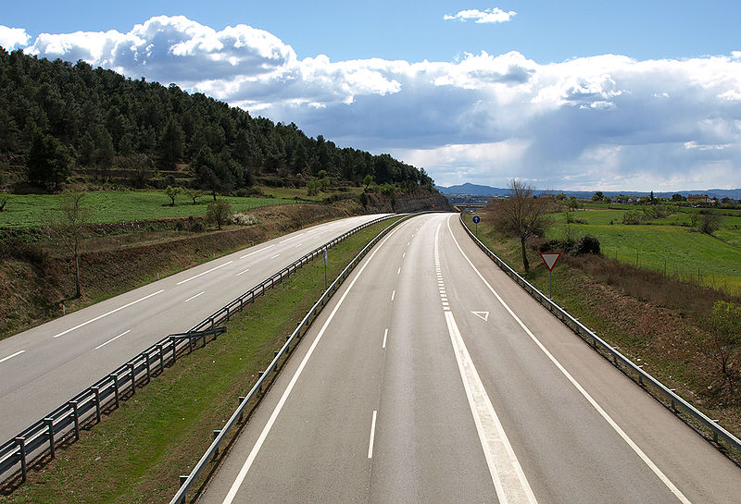
C-16 (highway) - Sant Fruitós (Manresa)

Slide 33
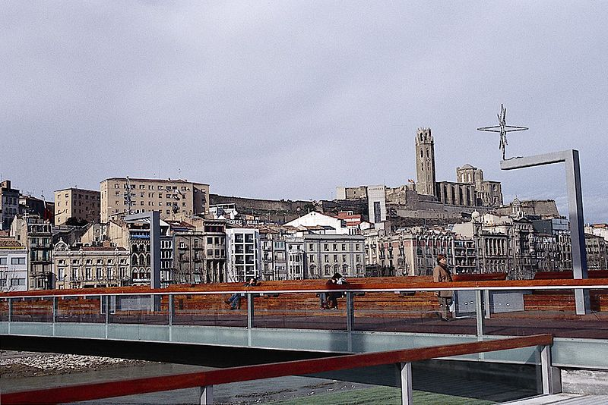
City of Lleida

Slide 34
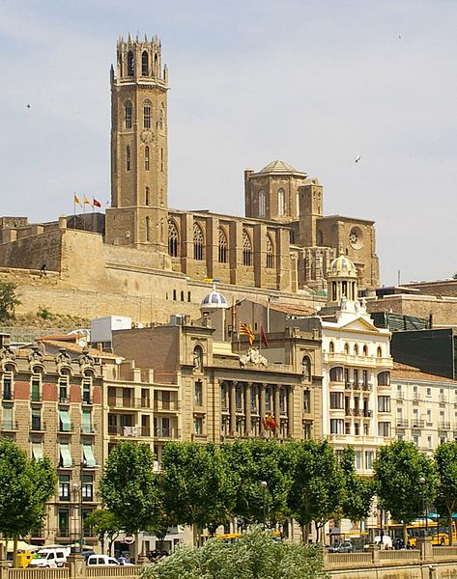
La Seu Vella, Lleida

Slide 35
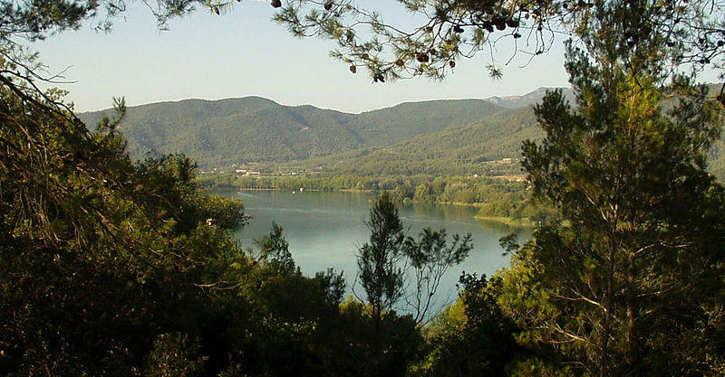
Lake of Banyoles

Slide 36
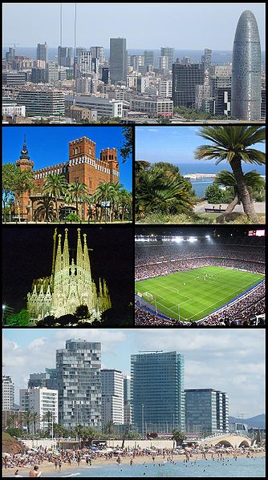
Barcelona

Slide 37
Barcelona is the capital of Catalonia and the second largest city in Spain, after Madrid, with a population of 1,621,537 within its administrative limits on a land area of 39 sq mi. The urban area of Barcelona extends beyond the administrative city limits with a population of between 4,200,000 and 4,500,000 within an area of 803 km2 (310 sq mi), being the sixth-most populous urban area in the European Union after Paris, London, the Ruhr, Madrid and Milan. About five million people live in the Barcelona metropolitan area. It is also Europe's largest metropolis on the Mediterranean Sea. It is the main component of an administrative area of Greater Barcelona, with a population of 3,218,071 in an area of 636 km² (density 5,060 hab/km²). It is located on the Mediterranean coast between the mouths of the rivers Llobregat and Besòs and is bounded to the west by the Serra de Collserola ridge (1,680 ft).

Slide 38
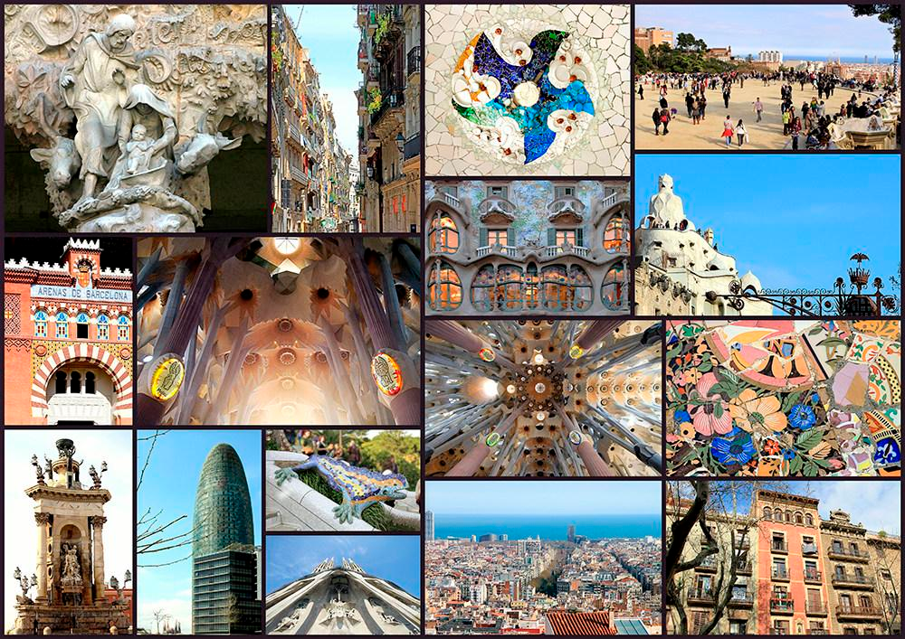

Slide 39
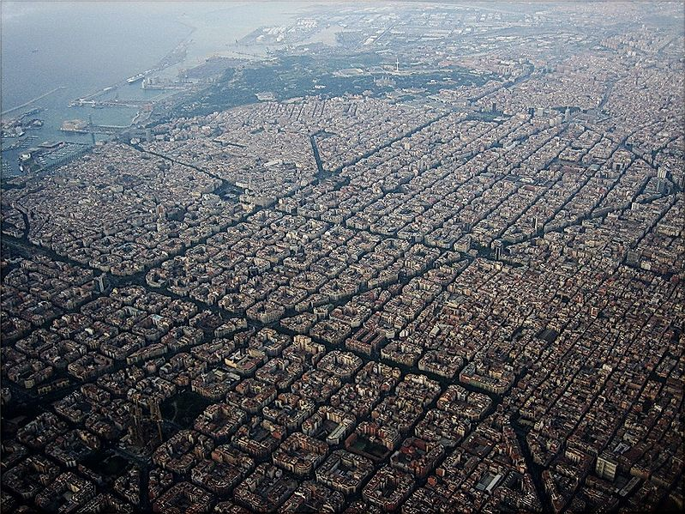
Barcelona

Slide 40
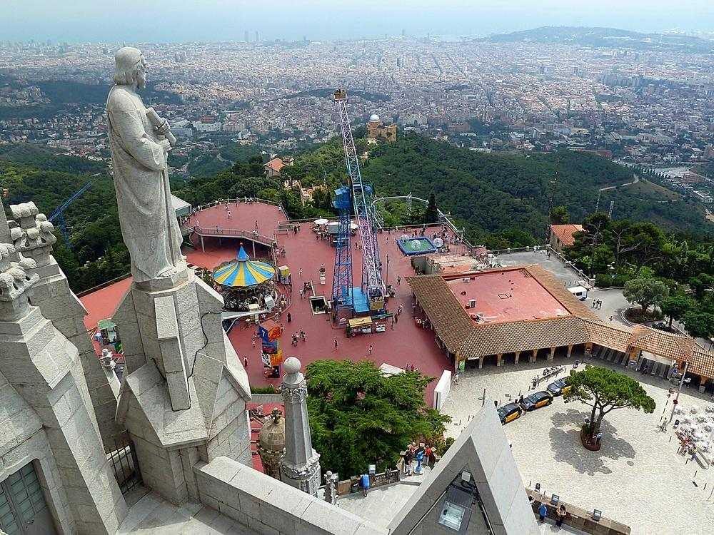
view from Tibidabo

Slide 41
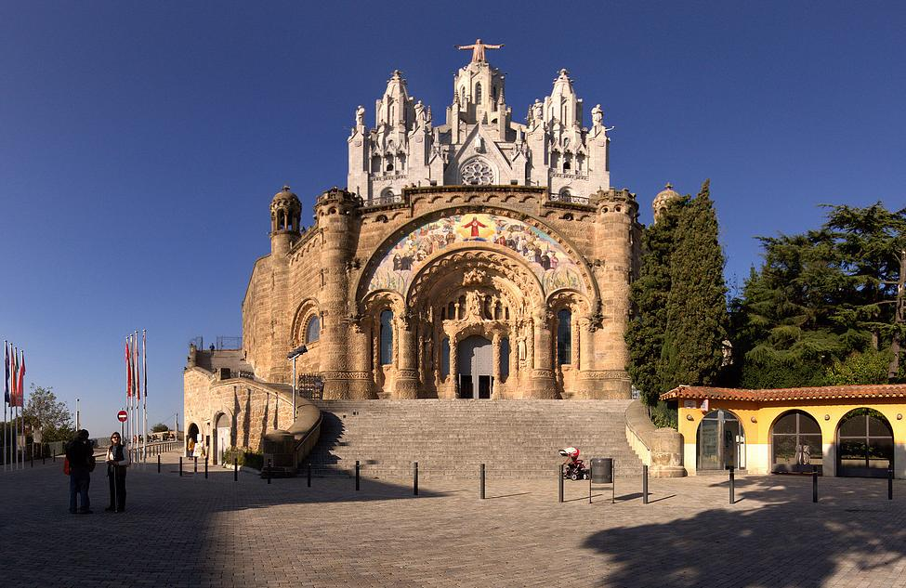
Sagrat Cor located on the summit of Mount Tibidabo - Barcelona

Slide 42
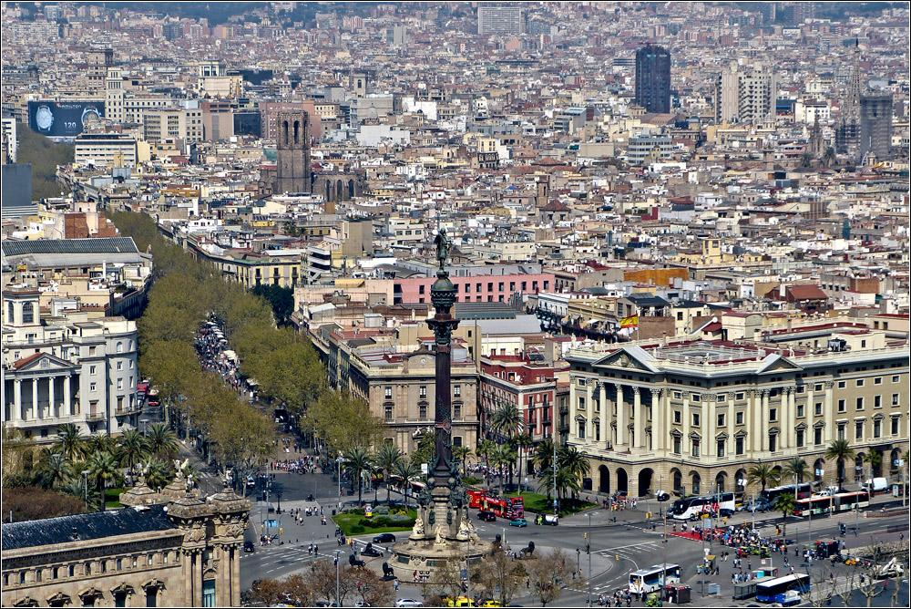

Slide 43
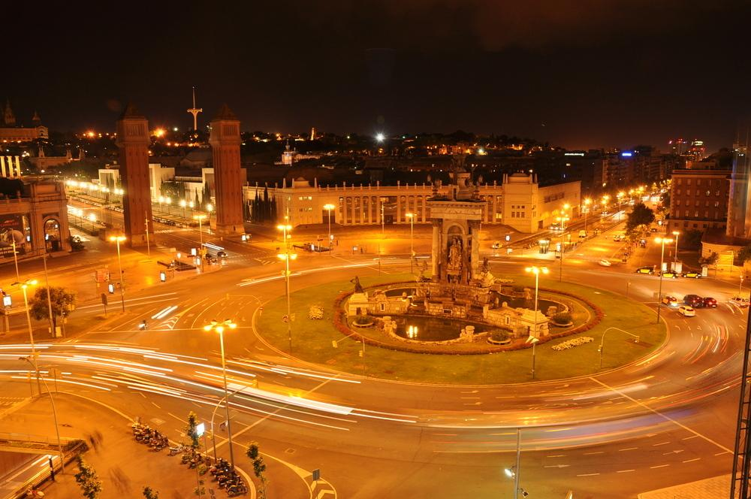
Plaza de España - Barcelona

Slide 44
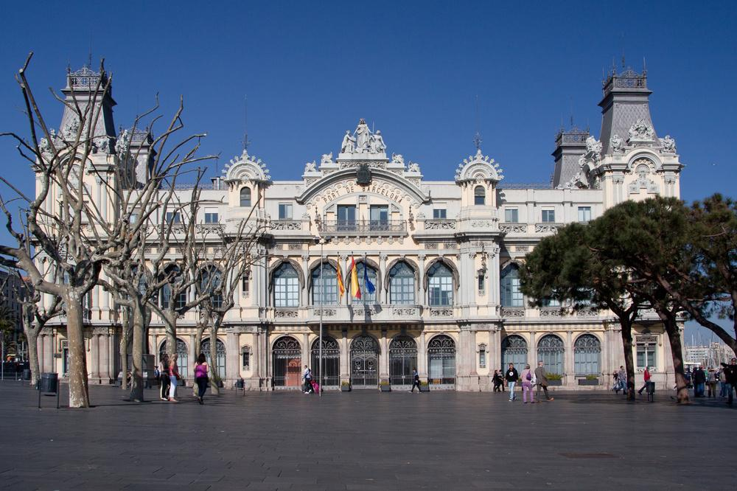
Port of Barcelona

Slide 45
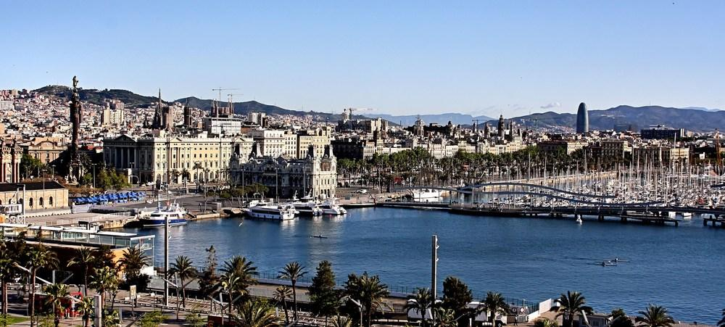

Slide 46
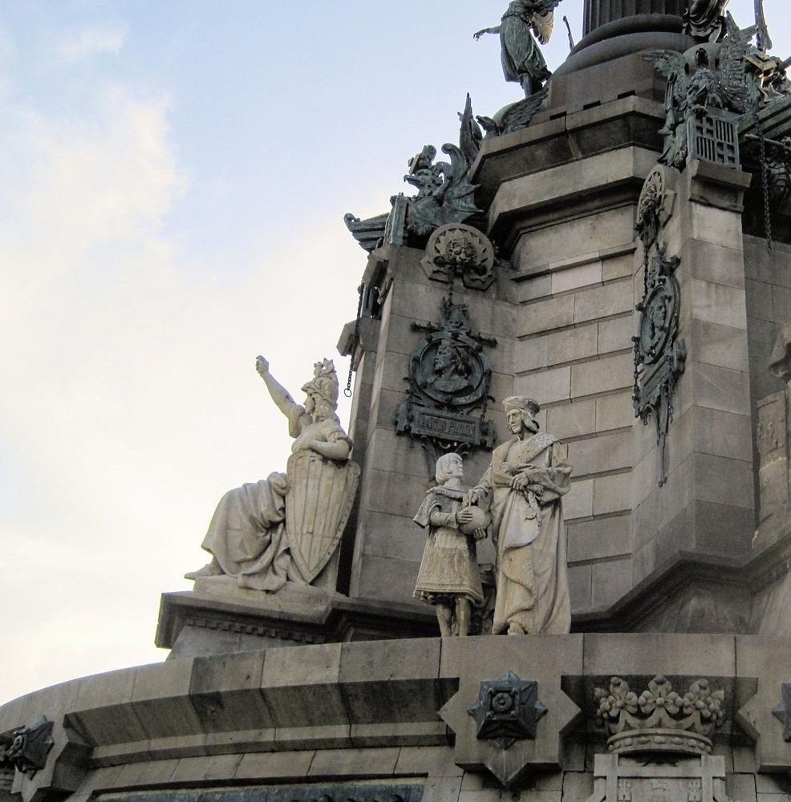
Christopher Colombus statue at the port

Slide 47
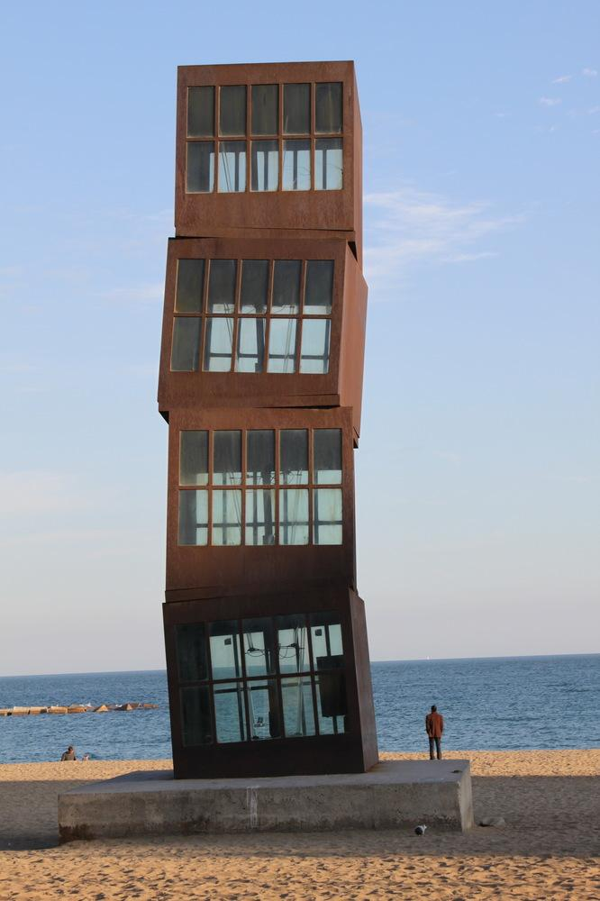
Barceloneta (Rebecca Horn's Homage to Barceloneta)

Slide 48
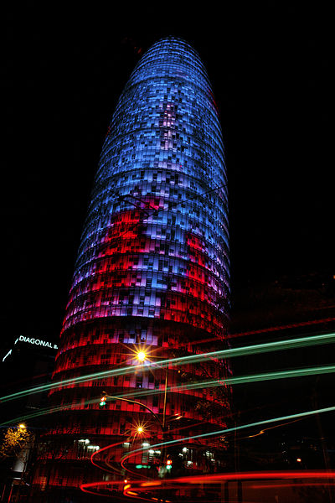
Agbar Tower, Barcelona

Slide 49
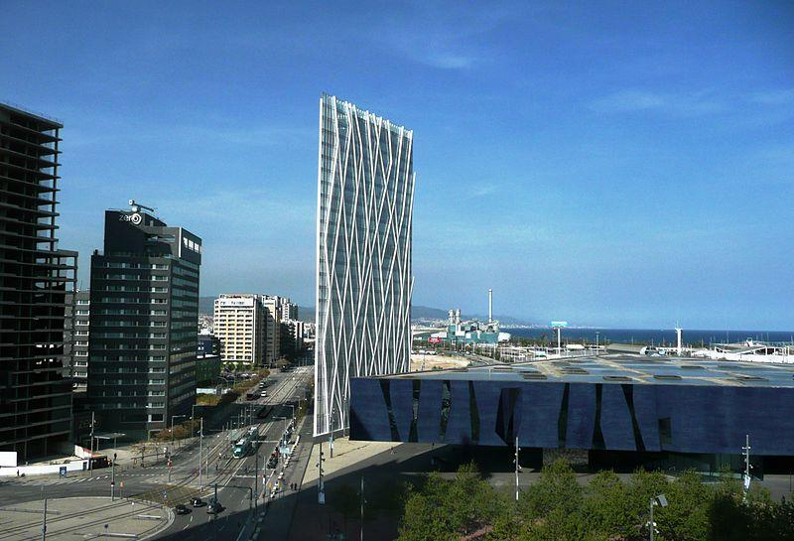
Ice tower - Barcelona

Slide 50
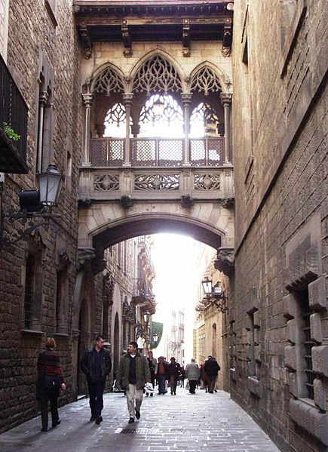
Carrer del Bisbe (Bishop Street) in Barcelona's Gothic Quarter

Slide 51
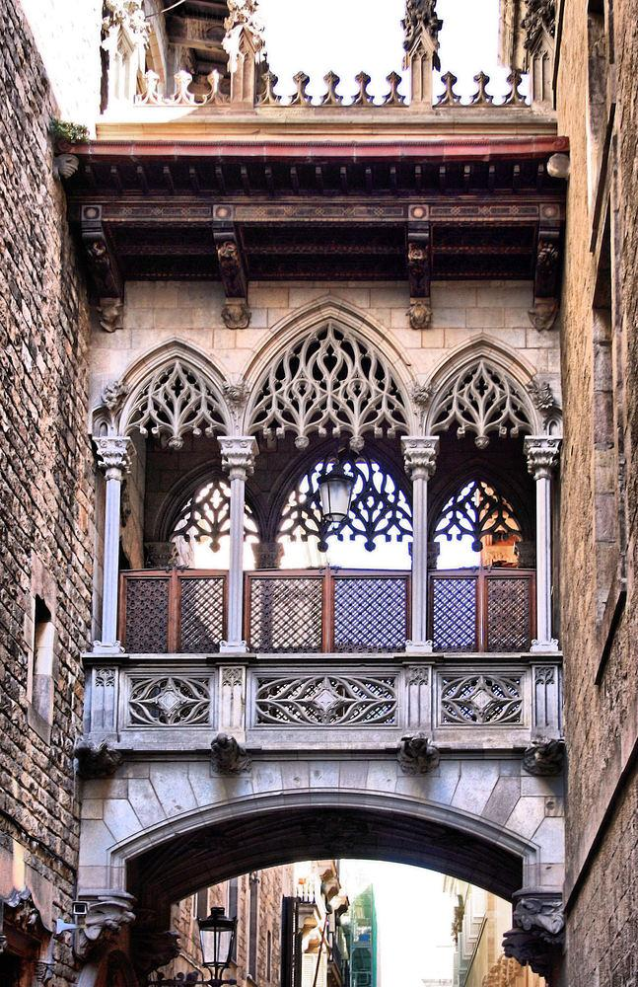

Slide 52
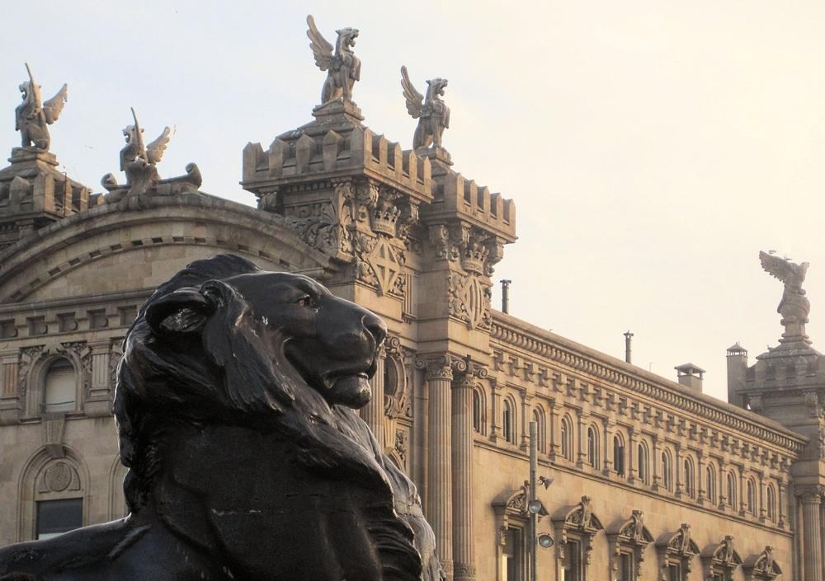

Slide 53
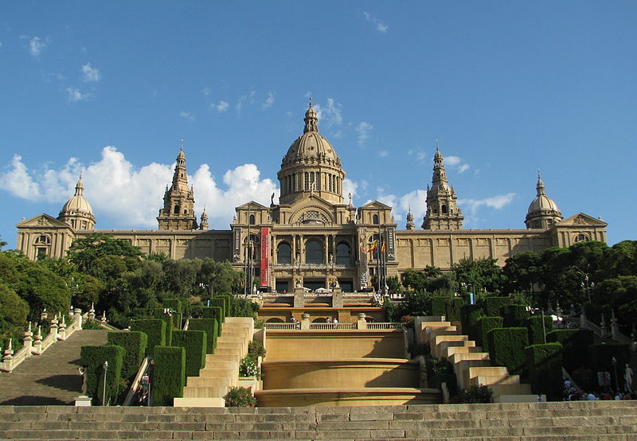
National Museum of Catalonian Art, Barcelona

Slide 54
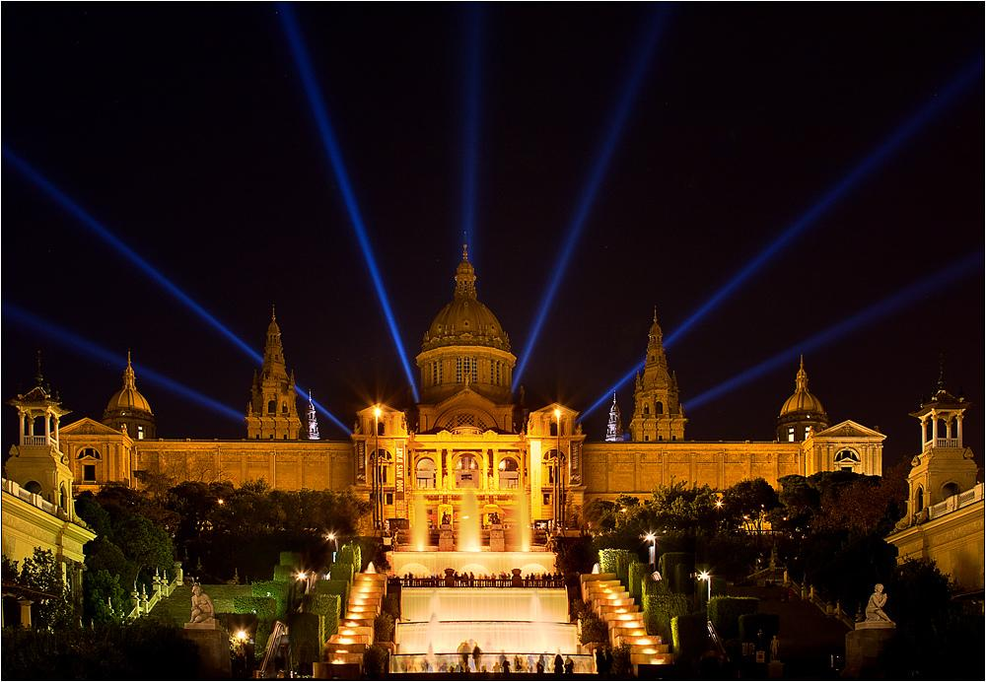
Palau National(National Art Museum of Catalonia)

Slide 55

Palau National

Slide 56

Arena square - Barcelona

Slide 57

National Museum

Slide 58

Joan Miro Foundation in Barcelona

Slide 59

Palace of Catalan Music

Slide 60

Palace of Catalan Music

Slide 61

Palace of Catalan Music inner

Slide 62

Museu de Cera - Wax Museum

Slide 63

Park Güell, Barcelona

Slide 64

Hospital de Sant Pau in Barcelona

Slide 65

Cathedral of Saint Eulàlia, Barcelona

Slide 66

Santa Maria del Mar - Barcelona

Slide 67

Montserrat monastery

Slide 68

Catalonian Parliament

Slide 69

Catalonian Palace of Justice

Slide 70

Greek Theatre - Barcelona

Slide 71

Bullring of Barcelona

Slide 72

Triumph arch

Slide 73


Slide 74

Interesting house

Slide 75

Nice Buildings in Barcelona

Slide 76


Slide 77


Slide 78

Passeig de Gràcia is one of the major avenues in Barcelona (regarded as the most expensive street in Barcelona and second in Spain.)

Slide 79

Magical fountain - Barcelona

Slide 80

The oldest park of Barcelona

Slide 81

Parc de la Ciutadella

Slide 82

Marble sculpture of Queen Maria Christina

Slide 83

Villa Olímpica - Barcelona

Slide 84

Villa Olímpica - Barcelona

Slide 85

The Olympic Stadium

Slide 86

Telefonica tower-Olympic stadium garden - Barcelona

Slide 87

Barcelona airport tower

Slide 88
Sagrada Familia
The Basílica i Temple Expiatori de la Sagrada Família, commonly known as the Sagrada Família, is a large Roman Catholic church in Barcelona, Catalonia, Spain, designed by Catalan architect Antoni Gaudí (1852–1926). Although incomplete, the church is a UNESCO World Heritage Site.

Slide 89


Slide 90
Antoni Gaudí i Cornet
(25 June 1852–10 June 1926) was a Spanish Catalan architect and figurehead of Catalan Modernism. Gaudí's works reflect his highly individual and distinctive style and are largely concentrated in the Catalan capital of Barcelona, notably his magnum opus, the Sagrada Família.
Much of Gaudí's work was marked by his four life passions: architecture, nature, religion and love for Catalonia. Gaudí studied every detail of his creations, integrating into his architecture a series of crafts in which he was skilled: ceramics, stained glass, wrought ironwork forging and carpentry. He introduced new techniques in the treatment of materials, such as trencadís, made of waste ceramic pieces.

Slide 91


Slide 92
After a few years under the influence of neo-Gothic art and Oriental techniques, Gaudí became part of the Catalan Modernista movement which was reaching its peak in the late 19th and early 20th centuries. His work transcended mainstream Modernisme, culminating in an organic style inspired by nature. Gaudí rarely drew detailed plans of his works, instead preferring to create them as three-dimensional scale models and molding the details as he was conceiving them. Gaudí’s work enjoys widespread international appeal and many studies are devoted to understanding his architecture. Today, his work finds admirers among architects and the general public alike. His masterpiece, the still-uncompleted Sagrada Família, is one of the most visited monuments in Spain. Between 1984 and 2005, seven of his works were declared World Heritage Sites by UNESCO. Gaudí’s Roman Catholic faith intensified during his life and religious images permeate his work. This earned him the nickname "God's Architect" and led to calls for his beatification.

Slide 93


Slide 94


Slide 95


Slide 96


Slide 97


Slide 98


Slide 99


Slide 100


Slide 101


Slide 102


Slide 103


Slide 104


Slide 105



Slide 106


Slide 107


