Slide 1
Spain (Part 4)

Slide 2
Asturias
Asturias is an autonomous community of Spain. It is coextensive with the province of Asturias, and contains nearly all of the territory that was part of the Kingdom of Asturias in the Middle Ages. The autonomous community of Asturias is bordered by Cantabria to the east, by Castile and León to the south, by Galicia to the west, and by the Bay of Biscay to the north.
The most important cities are the communal capital, Oviedo, the seaport and largest city Gijón, and the industrial town of Avilés. Other popular municipalities include Cangas de Onís, Cangas del Narcea, Gozón, Grado, Langreo, Laviana, Lena, Llanes, Mieres, Siero, Valdés, Vegadeo and Villaviciosa

Slide 3
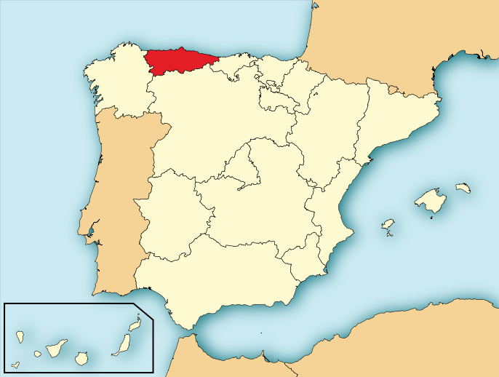

Slide 4
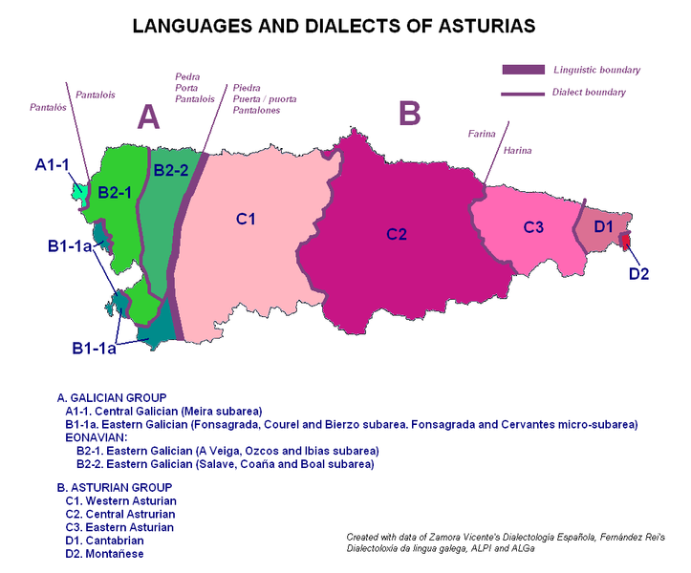

Slide 5
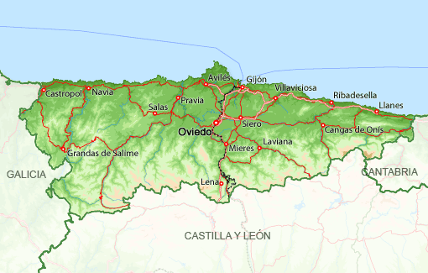

Slide 6
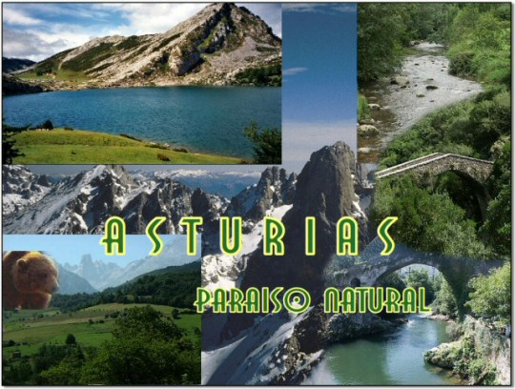

Slide 7
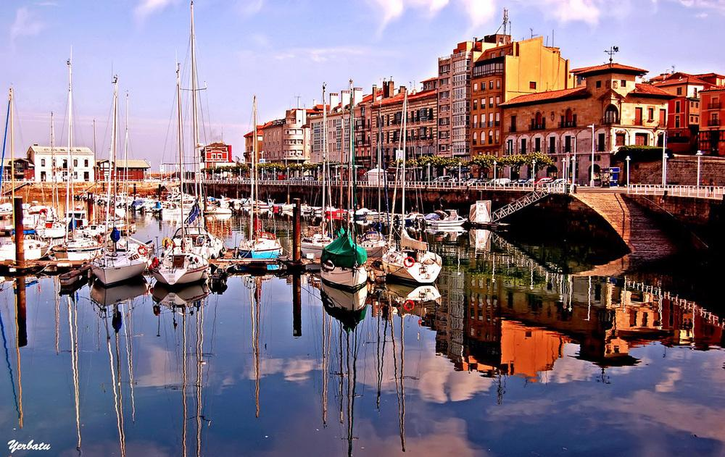
Gijon-Asturias

Slide 8
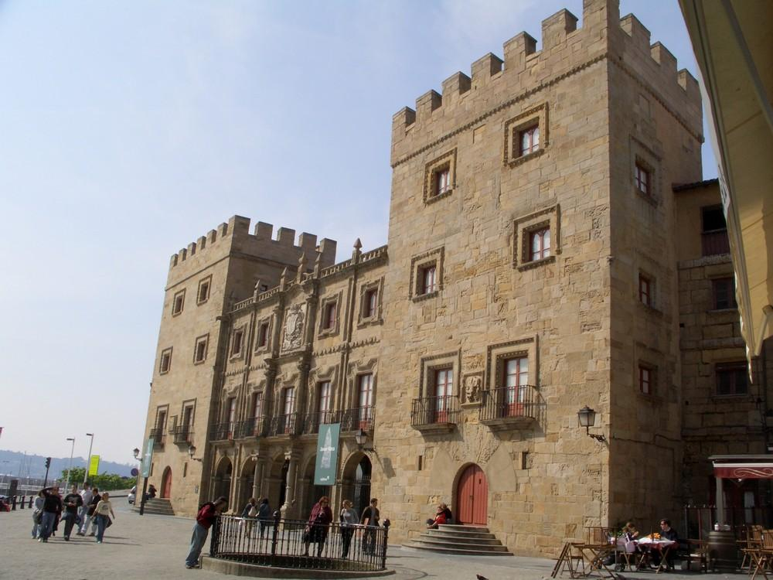
Gijon-Asturias

Slide 9
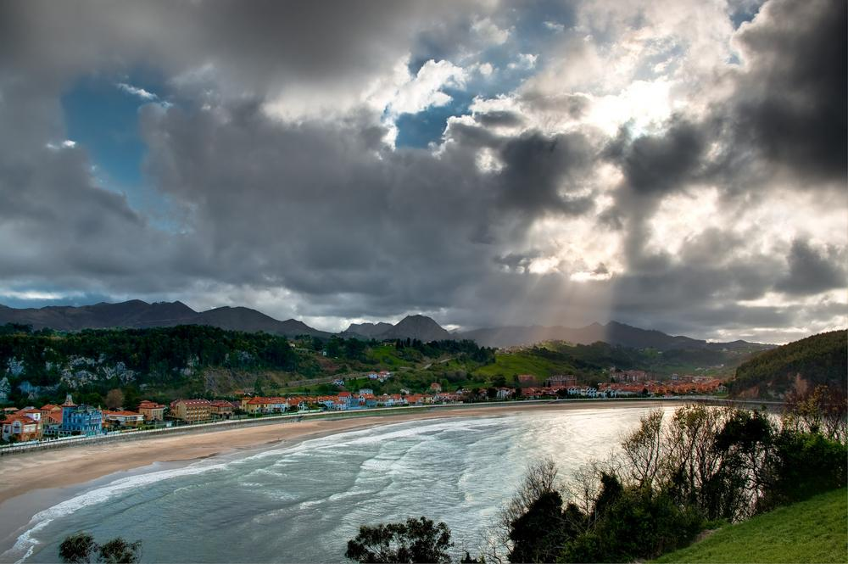
Ribadesella-Asturias

Slide 10
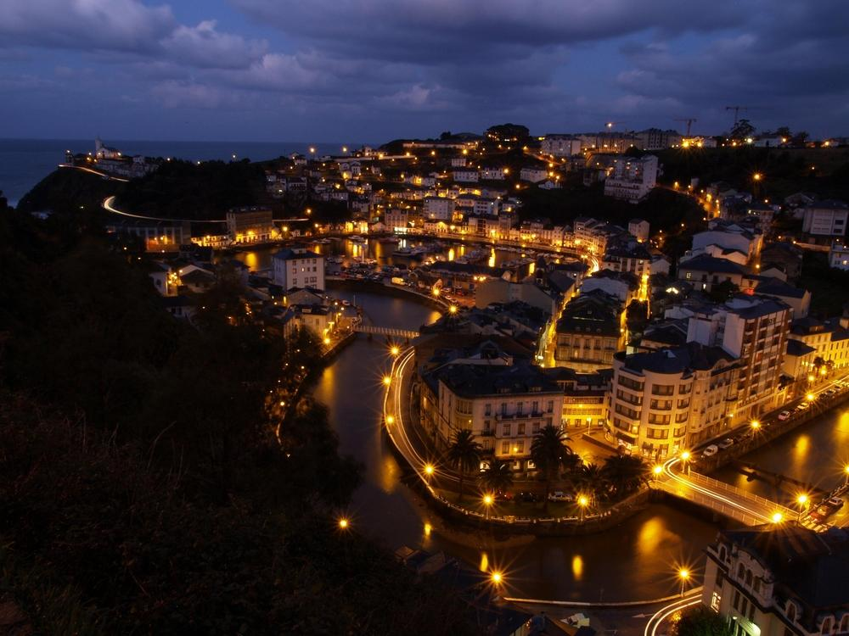

Slide 11
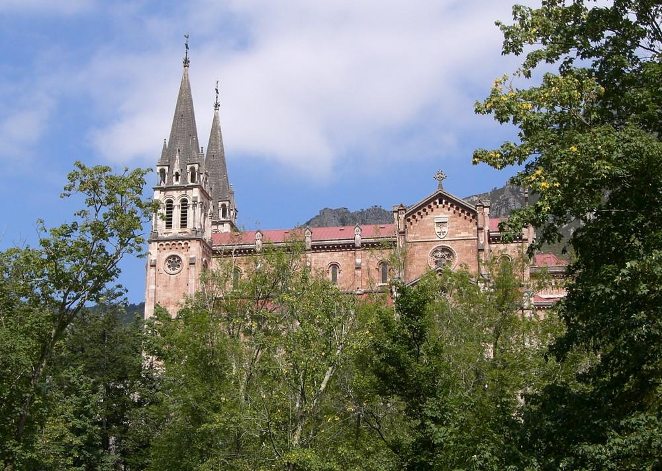
Basilica de Covadonga-Asturias

Slide 12
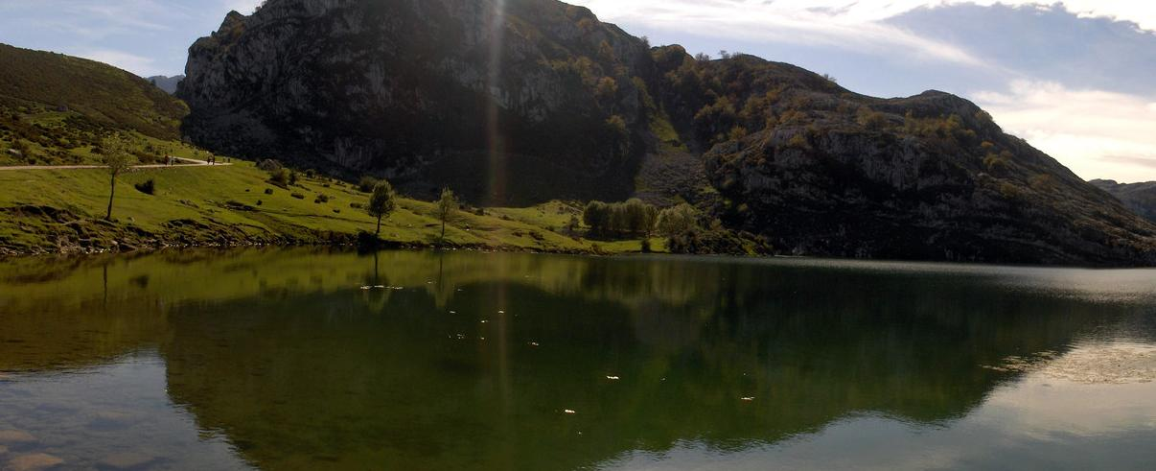
Lake of Covadonga-Asturias

Slide 13
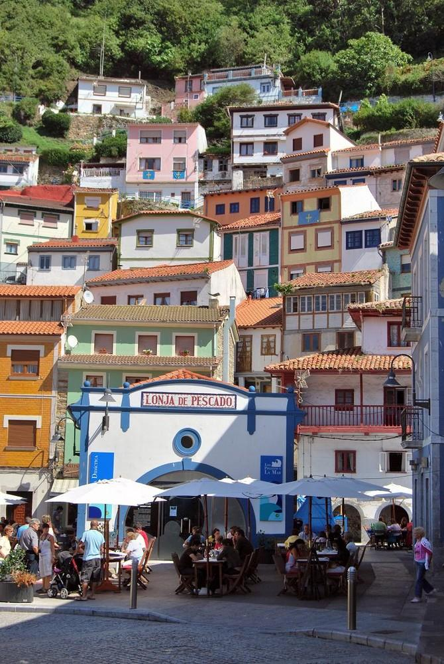
Cudillero-Asturias

Slide 14
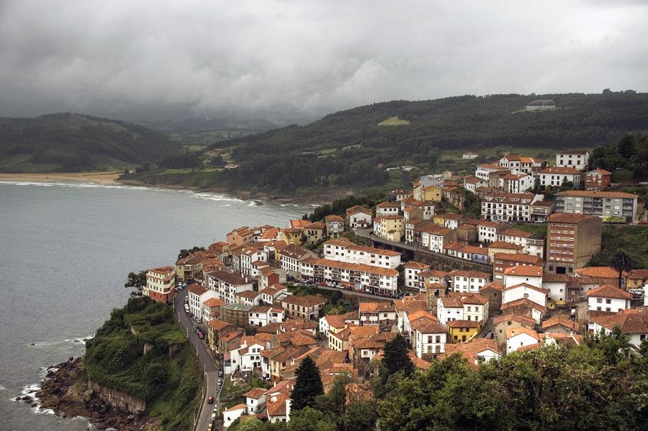
Lastres-Asturias

Slide 15
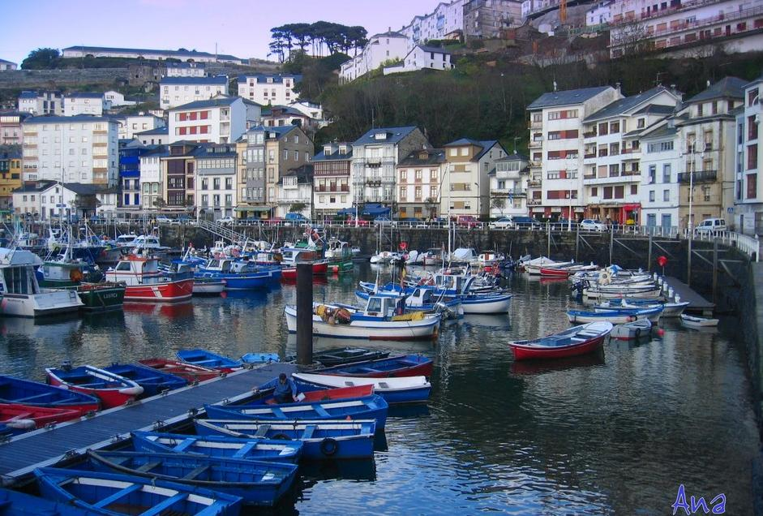
Luarca-Asturias

Slide 16
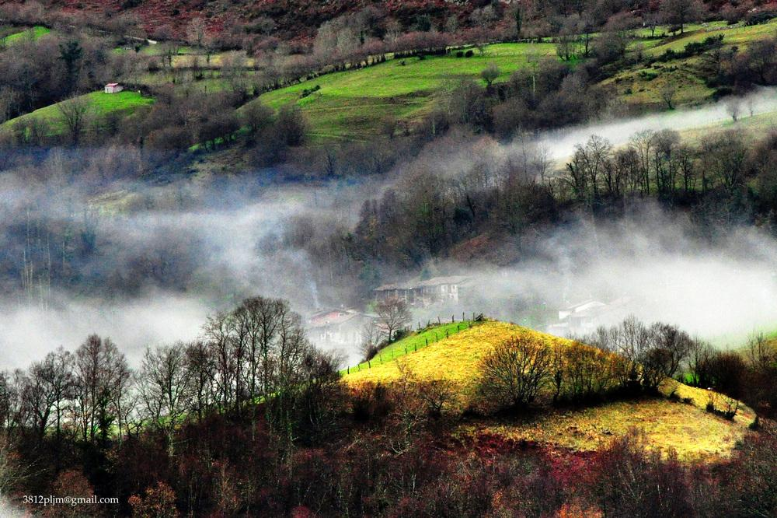
Niebla-Asturias

Slide 17
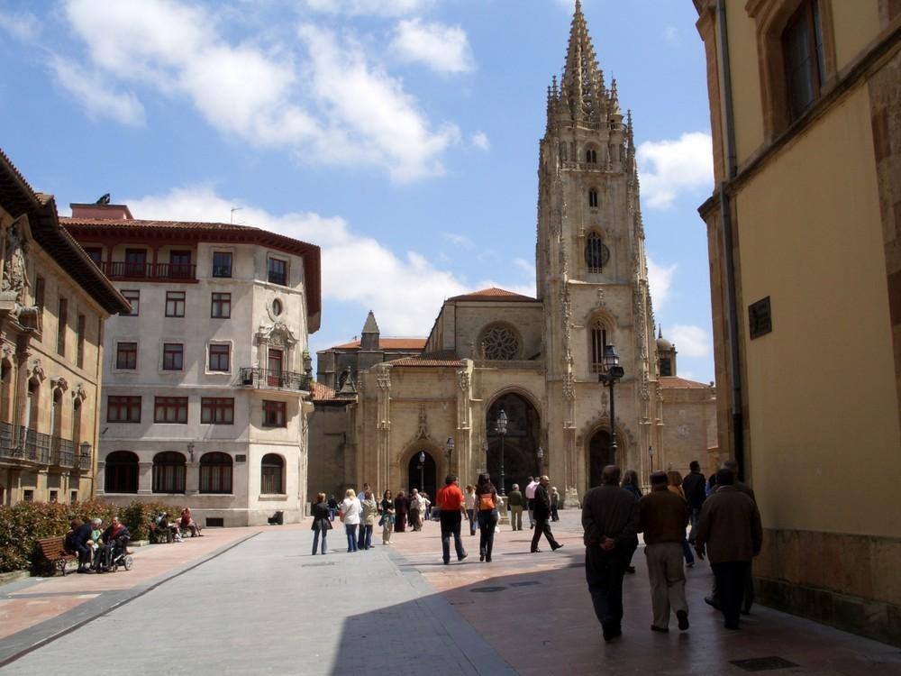
Oviedo Cathedral-Asturias

Slide 18
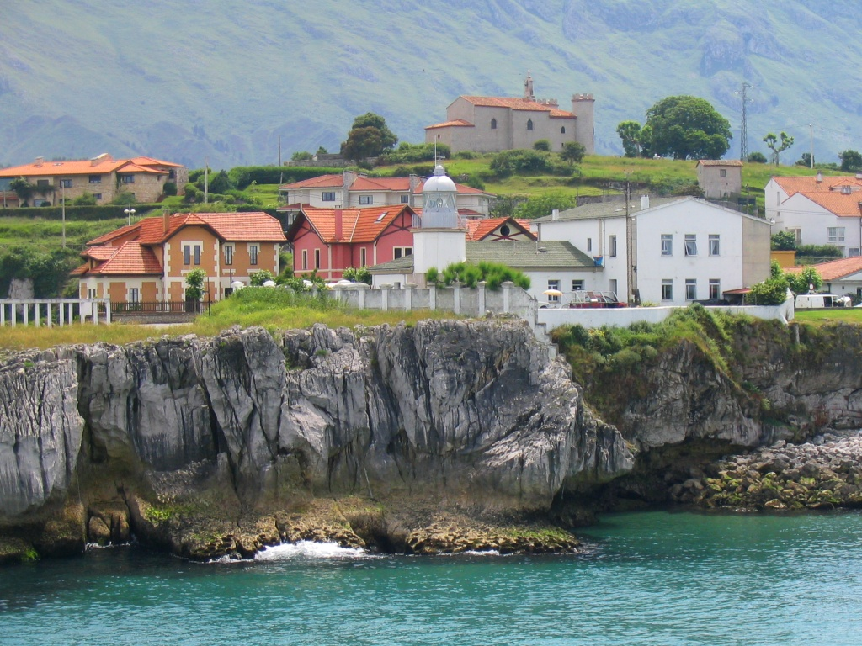
Llanes in Asturias

Slide 19
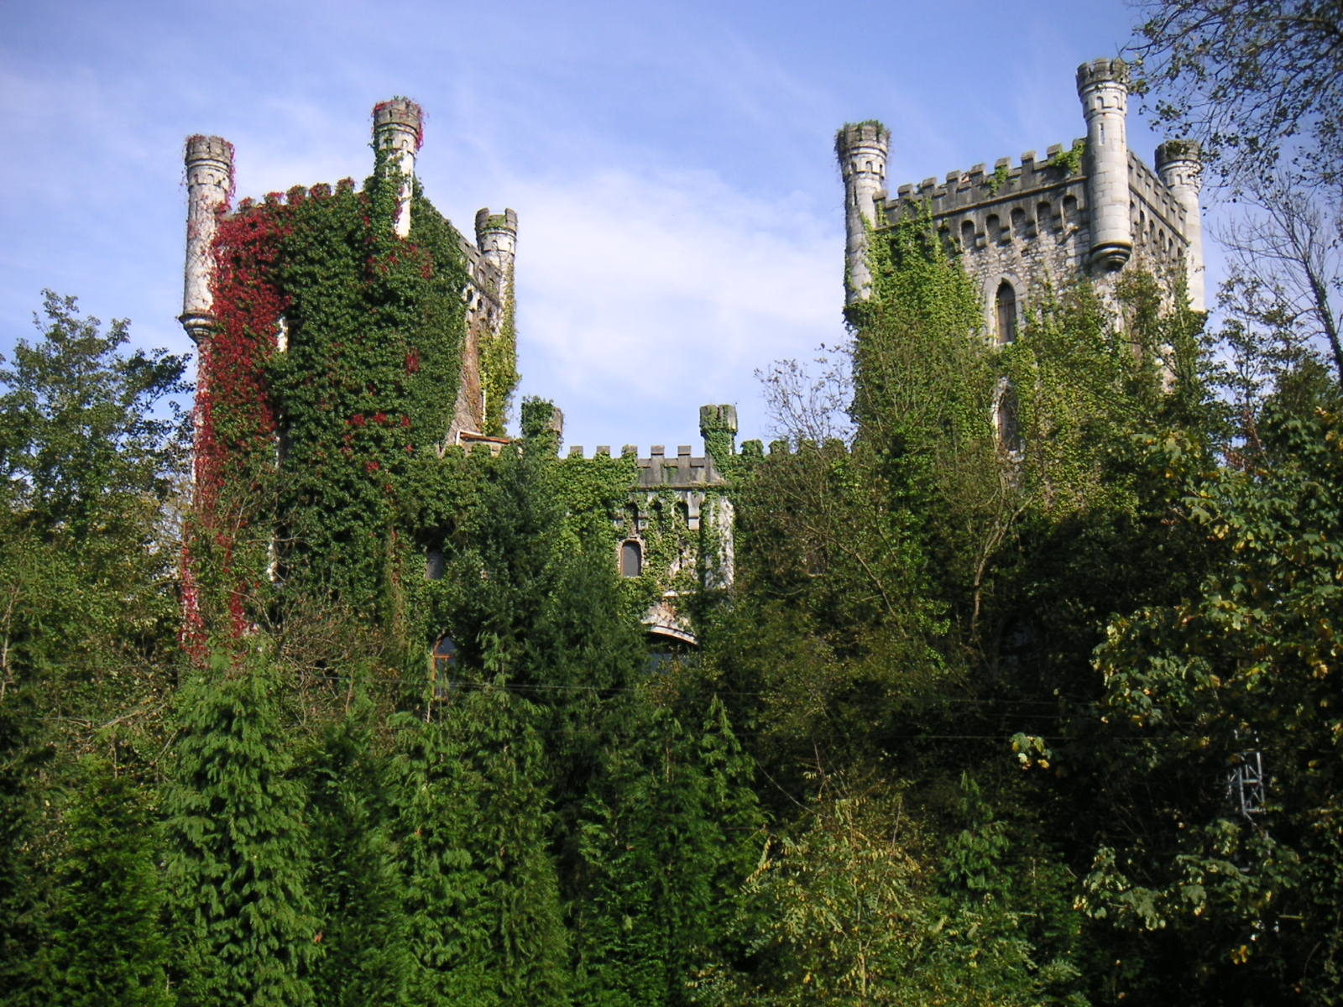
Castillo de San Juan de Priorio

Slide 20
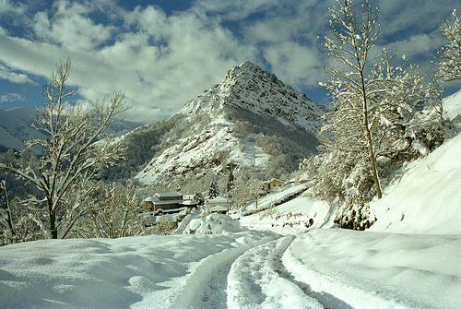
Asturias Landscapes

Slide 21
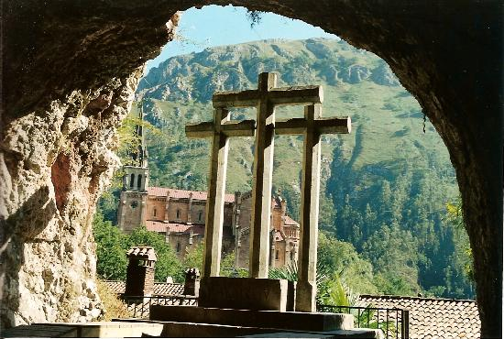

Slide 22
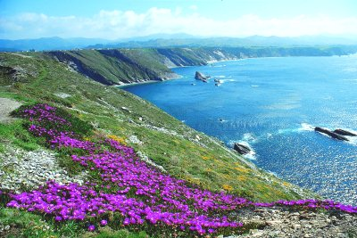

Slide 23
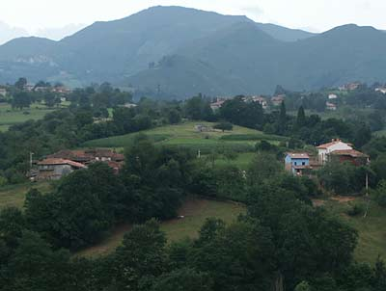

Slide 24
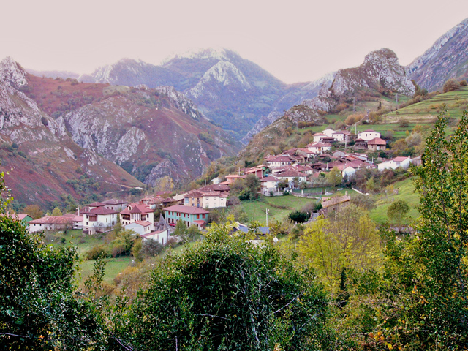

Slide 25
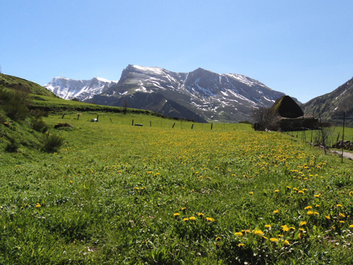

Slide 26
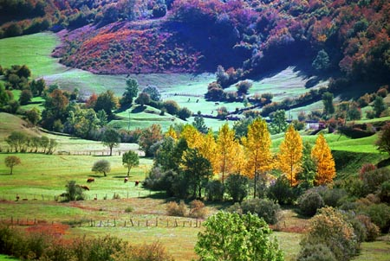

Slide 27
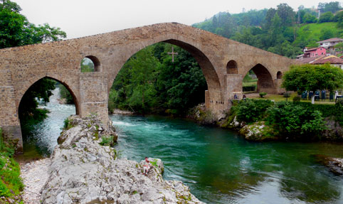

Slide 28
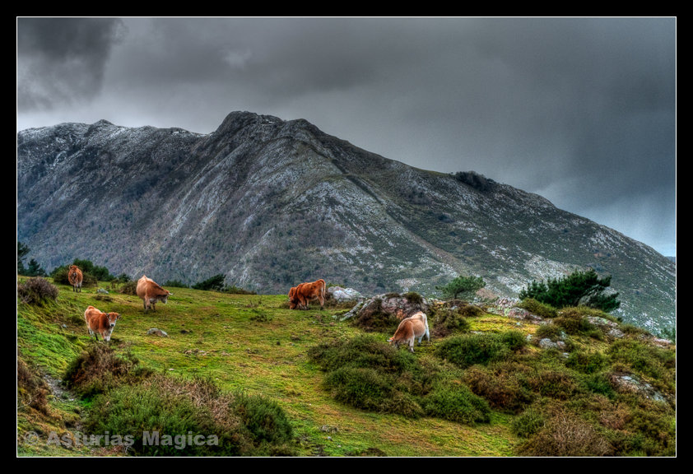

Slide 29
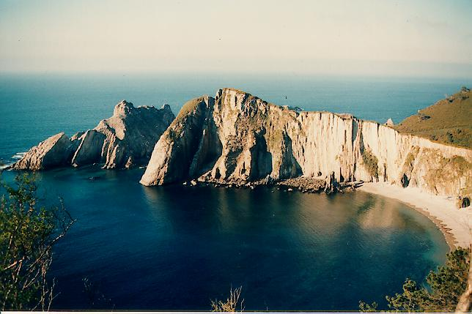

Slide 30
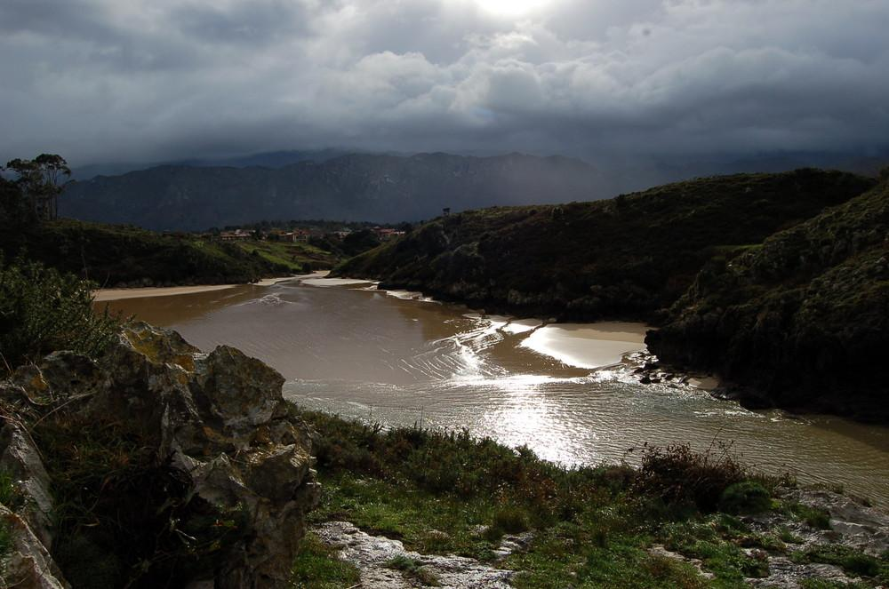
Ria

Slide 31
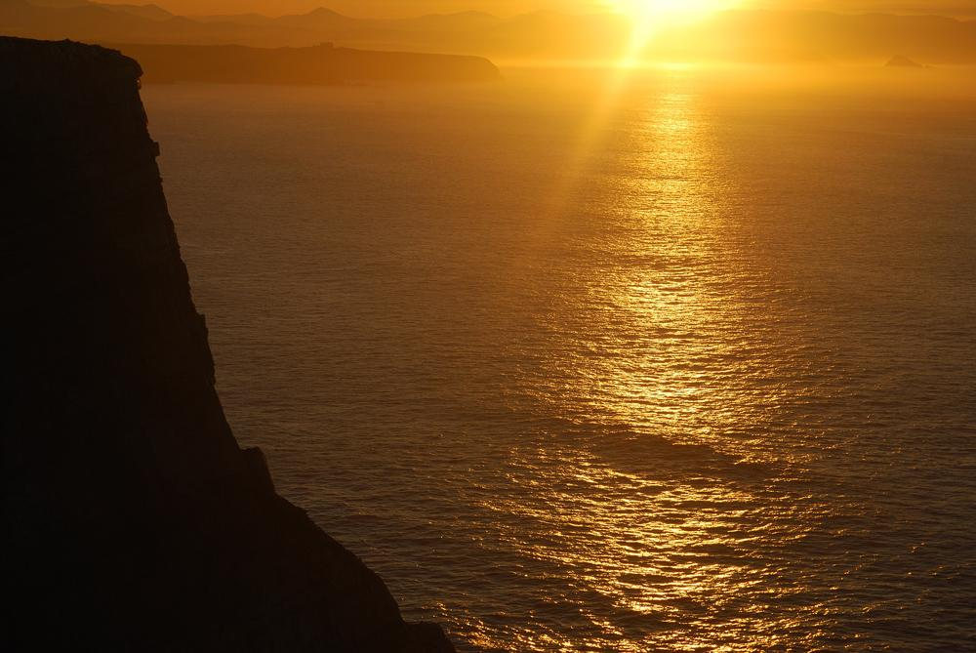
Asturias

Slide 32
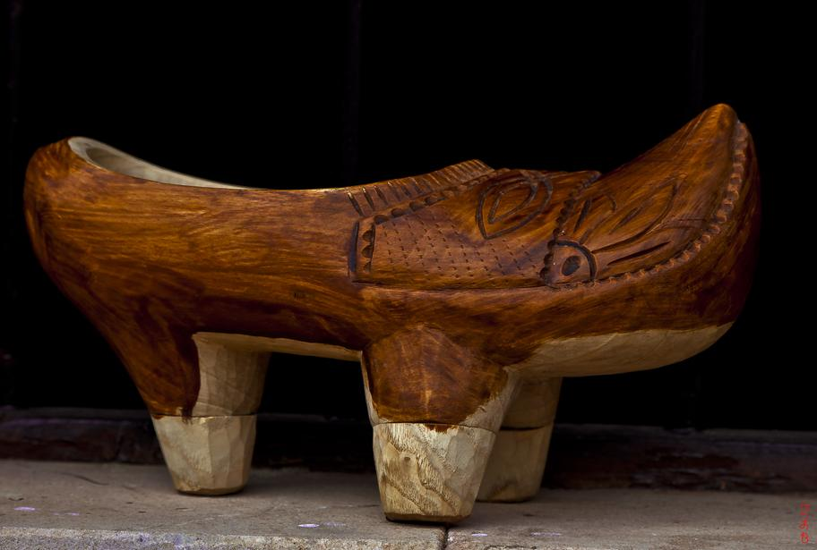
Sabot traditional

Slide 33
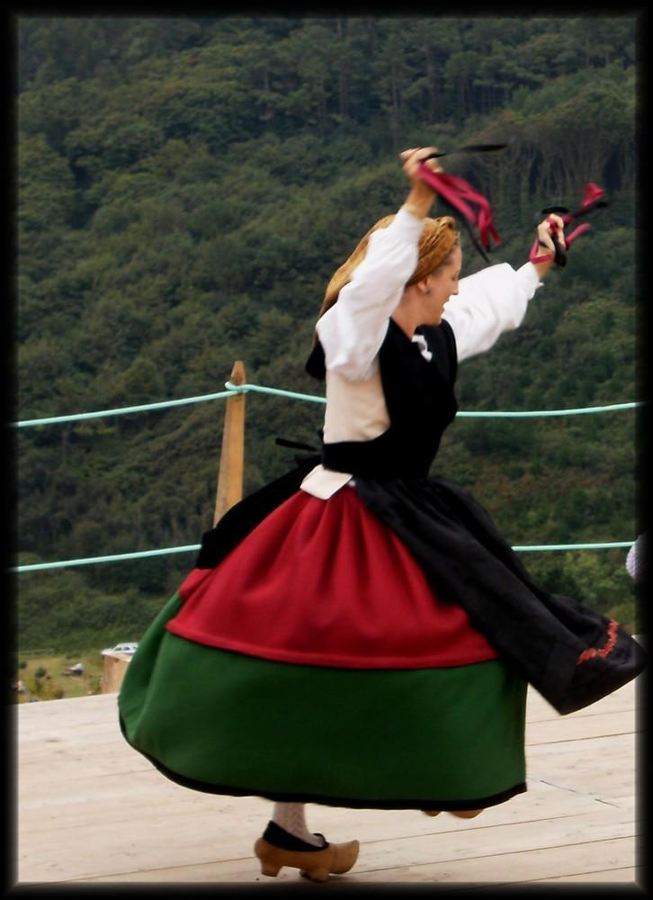

Slide 34
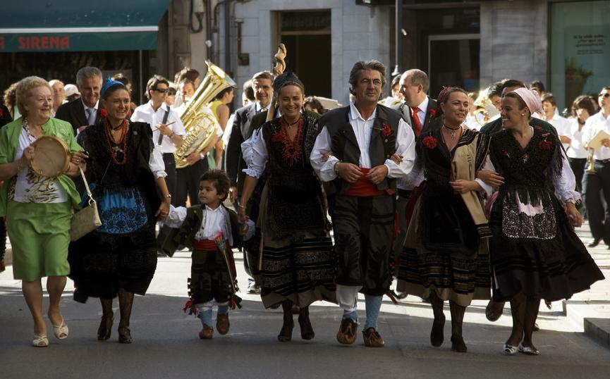
Fiestas de la Magdalena - Asturias

Slide 35
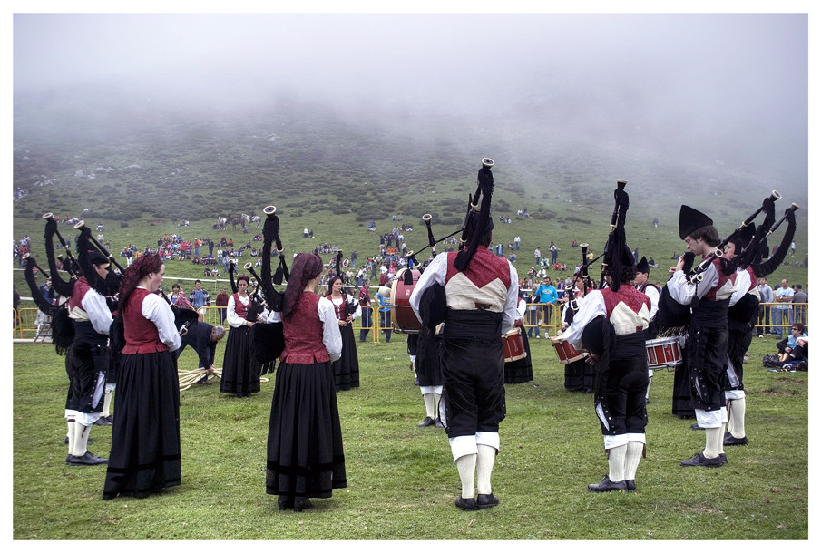
Lakes of Covadonga - Lake Enol - Pastor fest - Asturias

Slide 36
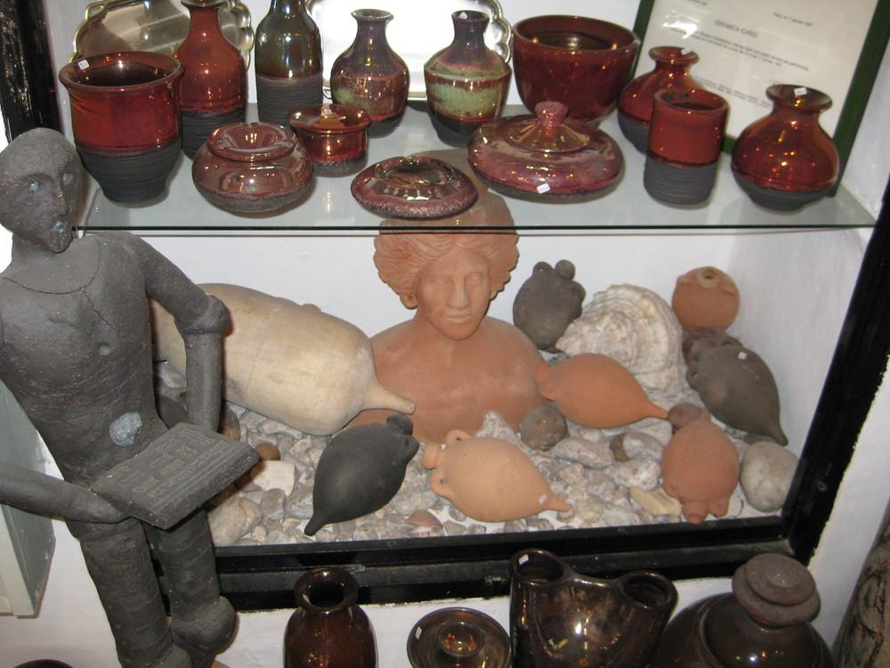

Slide 37
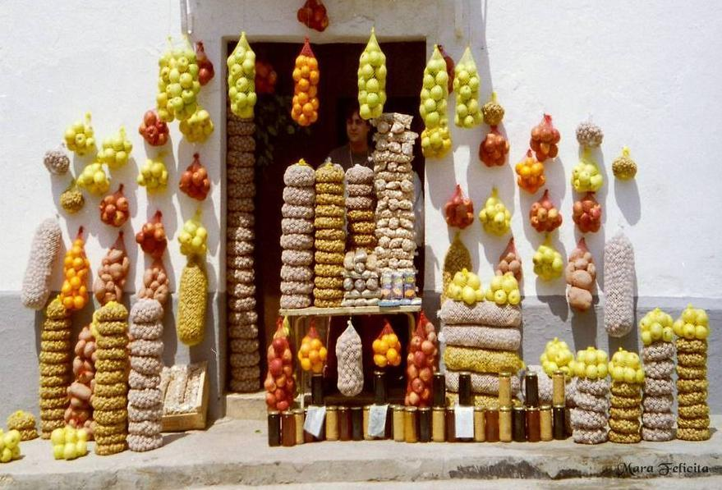

Slide 38
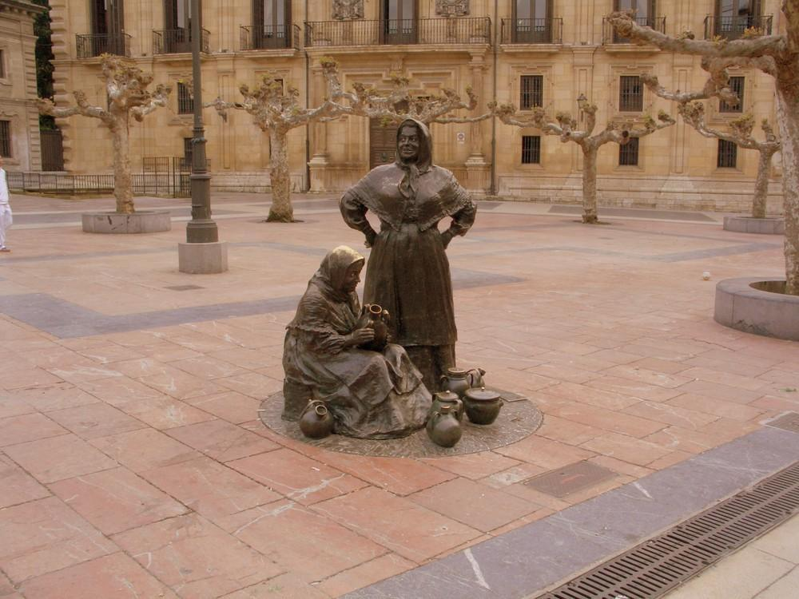
Asturias OVIEDO

Slide 39
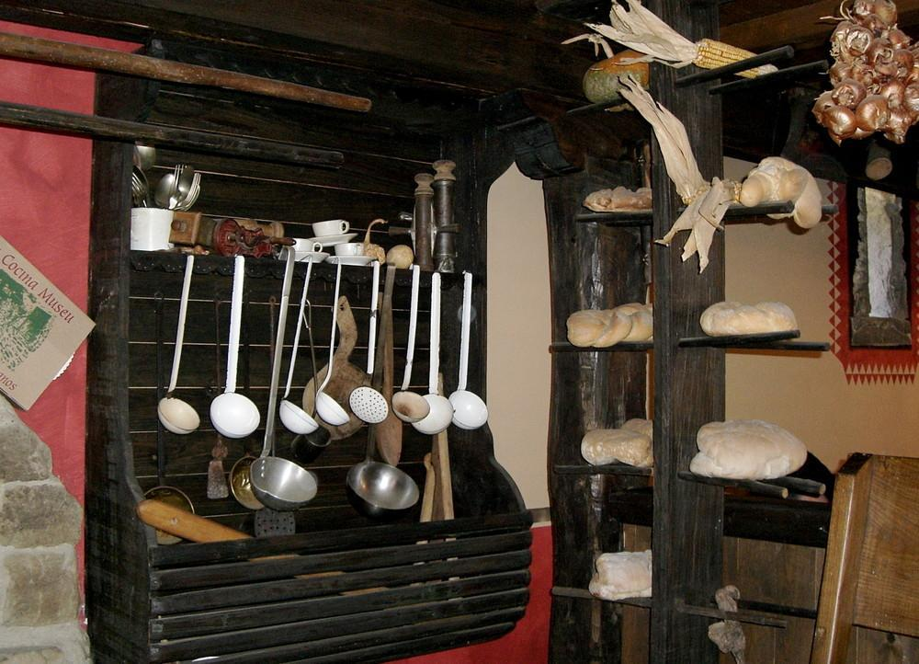
Museum of La Cocina, Cuérigo - Asturias

Slide 40
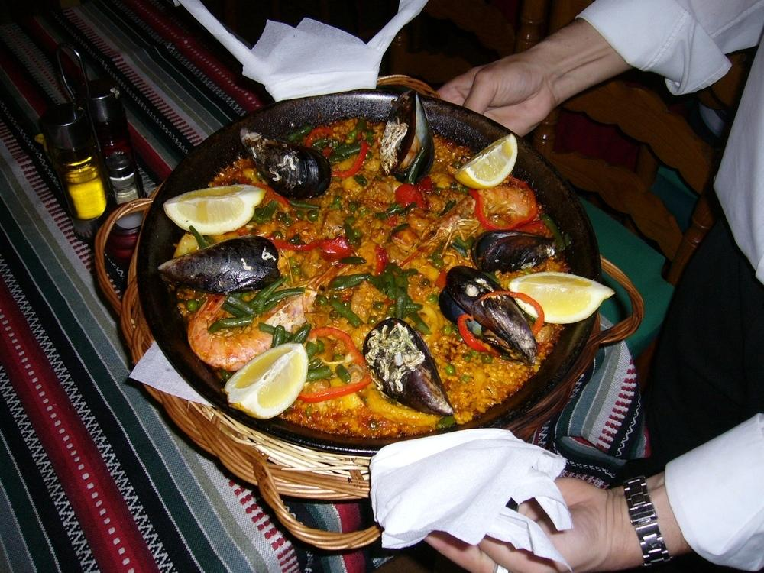

Slide 41
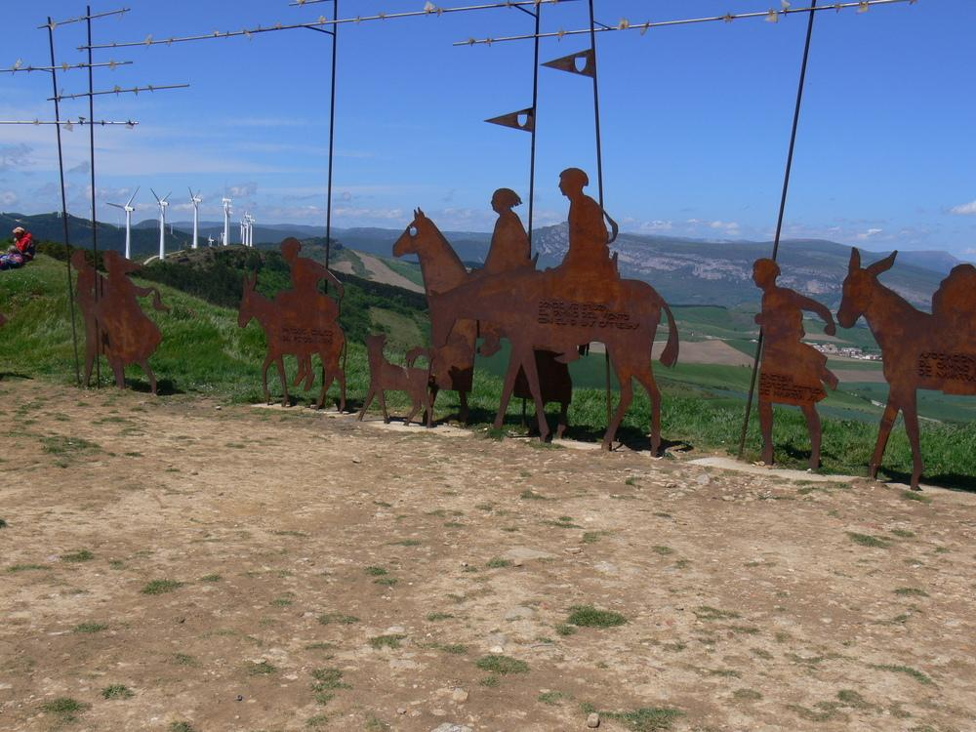
Alto del Perdon

Slide 42
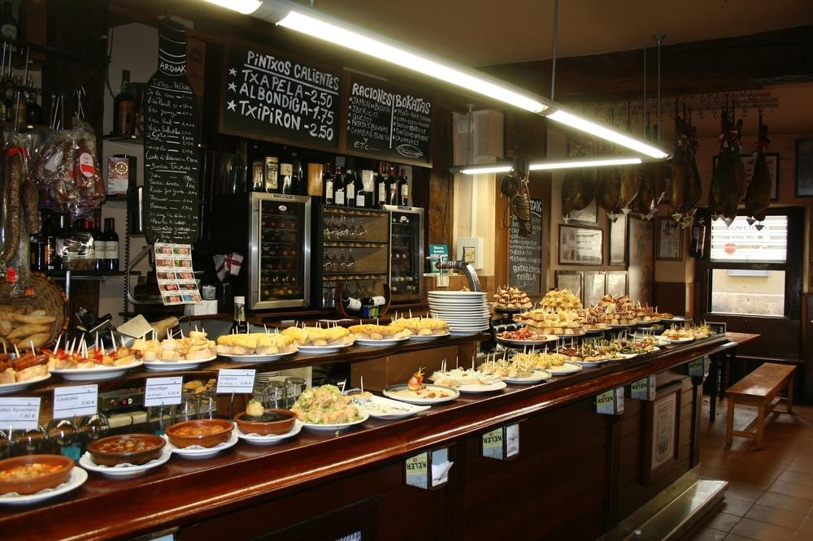
Tapas

Slide 43
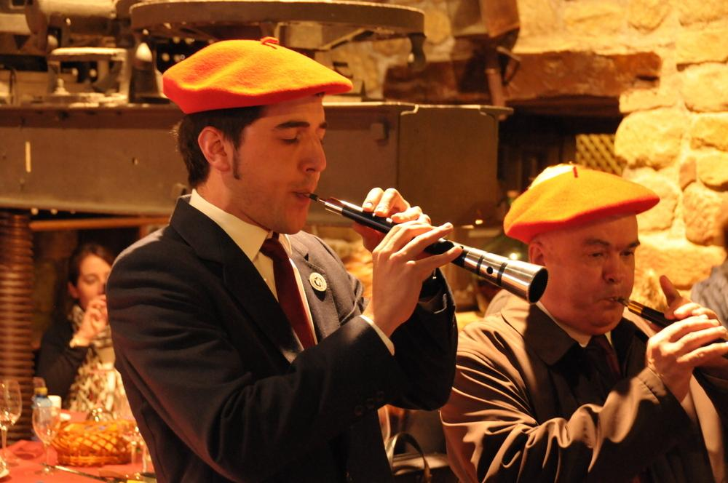
Pipers

Slide 44
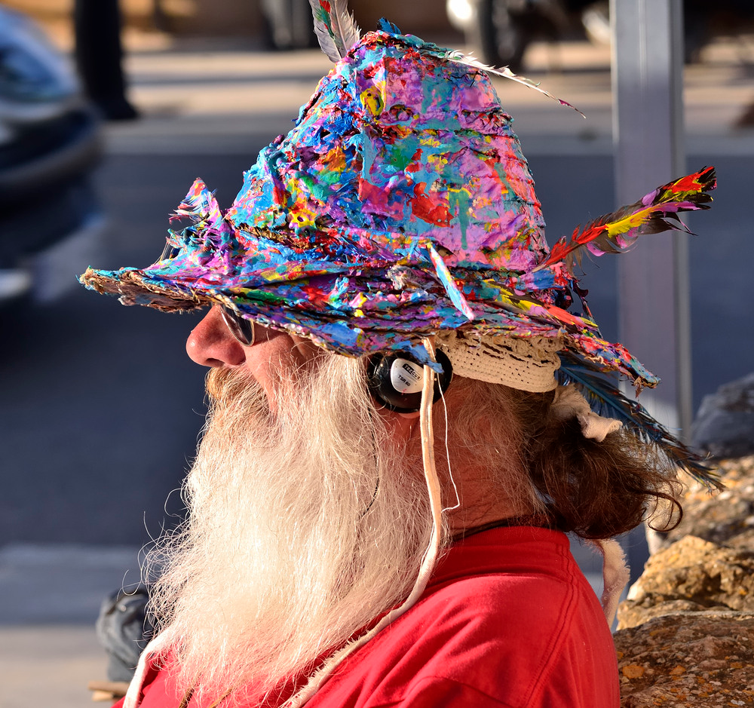
Artist

Slide 45
Galicia
Galicia is an autonomous community in northwest Spain, with the official status of a nationality of Spain. Galicia has roughly 2.79 million inhabitants as of 2011, with the largest concentration in two coastal areas, from Ferrol to A Coruña in the north-west, and from Vilagarcía to Vigo in the south-west. The capital is Santiago de Compostela, in the province of A Coruña. Vigo, in the province of Pontevedra, is the most populous municipality with 297,332 inhabitants and the second most populous city with 206,411 habitants; while A Coruña is the most populous city with 220,581 habitants and the second most populous municipality with 246,056 habitants in its municipality (INE 2009). Both cities are the cores of the two major metropolitan areas of Galicia.

Slide 46
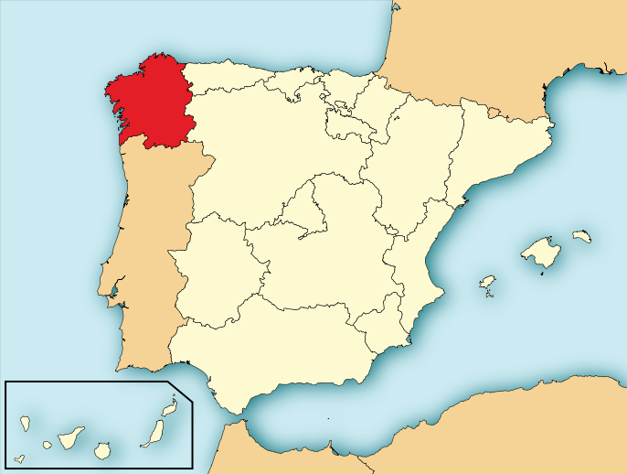

Slide 47
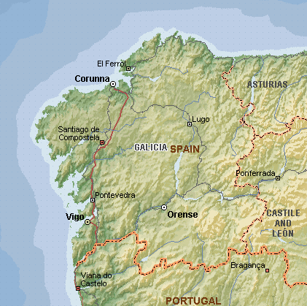

Slide 48
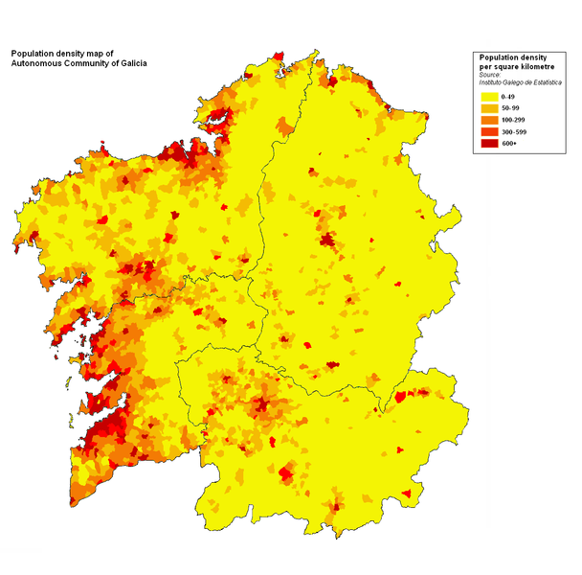

Slide 49
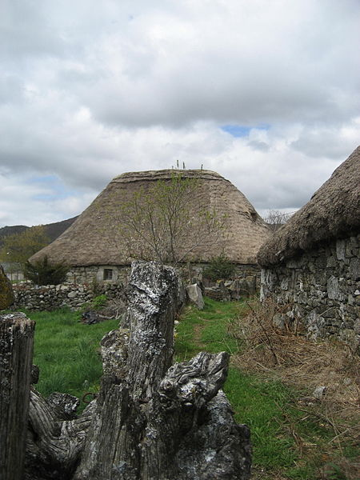
A palloza house in eastern Galicia, an evolved form of the Iron Age local houses

Slide 50
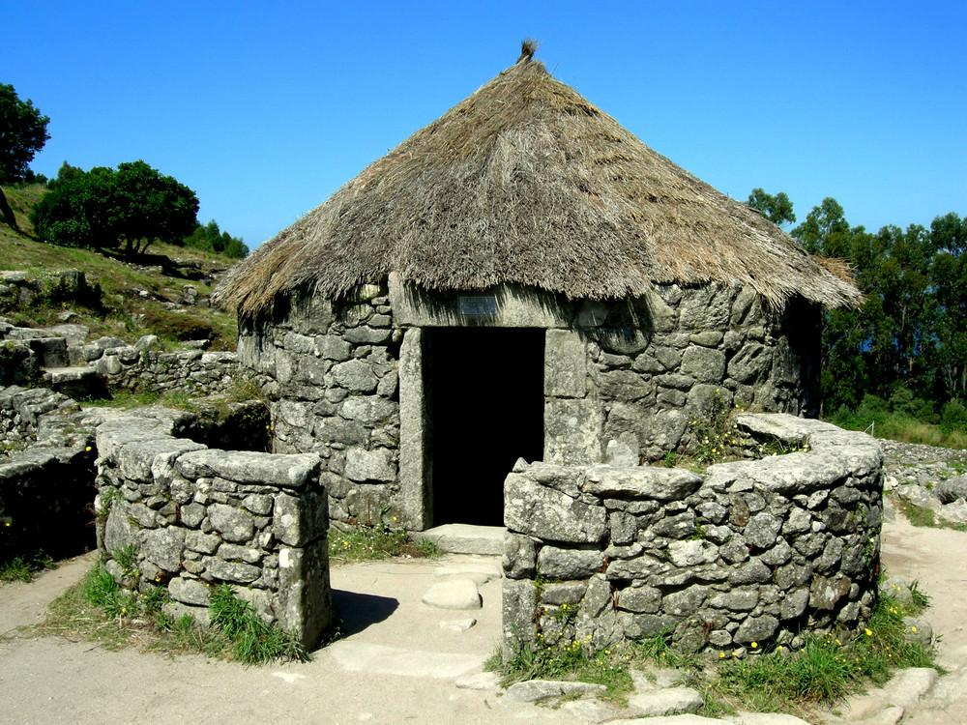

Slide 51
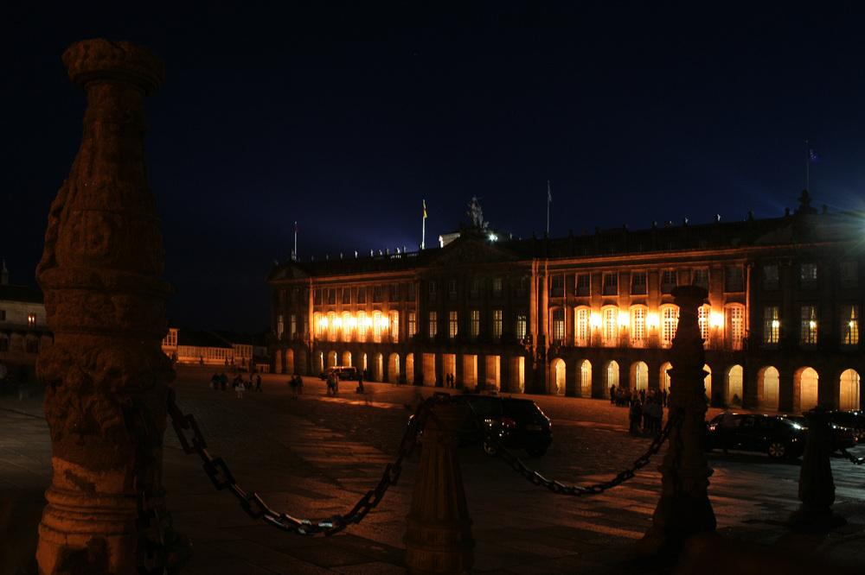
Rajoy Palace - Santiago de Compostela - Galicia

Slide 52
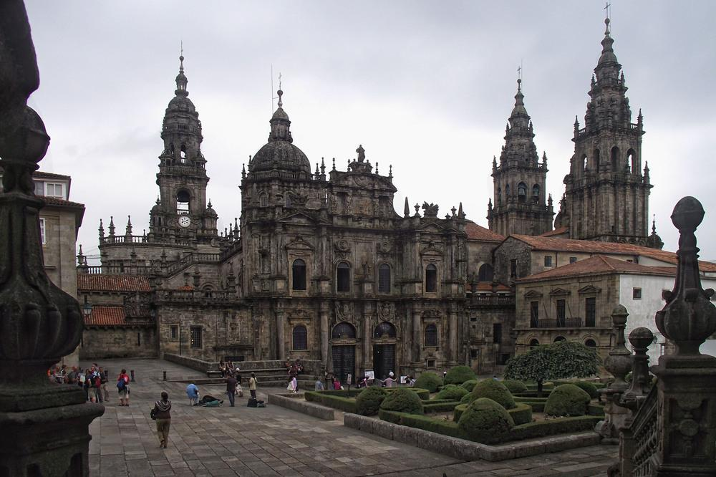
Cathedral of Santiago de Compostella - Galicia

Slide 53
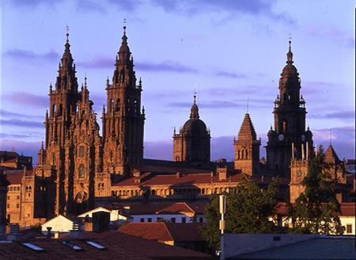

Slide 54

Pontevedra-Galicia

Slide 55

Cathedral of Ourense-Galicia

Slide 56

Baiona-Galicia

Slide 57

The Roman walls of Lugo-Galicia
World Heritage site by UNESCO

Slide 58

Beach of The Cathedrals - Galicia

Slide 59

Sil River - Galicia

Slide 60

The Tower of Hercules is an ancient Roman lighthouse on a peninsula about 2.4 kilometers from the centre of A Coruna, Galicia

Slide 61

Vivero - Lugo - Galicia

Slide 62

Puerto de Muros - Galicia

Slide 63

Cabo Vilan - Galicia

Slide 64

Ribadavia - Galicia

Slide 65

Islas Ons - Galicia

Slide 66

Castillo de Pampre, Palas de Rei, Galicia

Slide 67

Galician Landscapes

Slide 68

Pontenova

Slide 69


Slide 70


Slide 71


Slide 72


Slide 73


Slide 74

Miscellaneous Scenes of Spain

Slide 75


Slide 76


Slide 77


Slide 78


Slide 79


Slide 80


Slide 81


Slide 82


Slide 83


Slide 84


Slide 85


Slide 86


