Slide 1
Spain (Part 3)

Slide 2
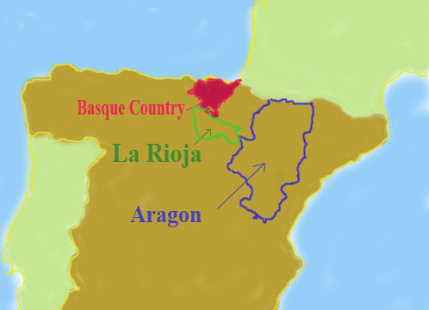
basque spain

Slide 3
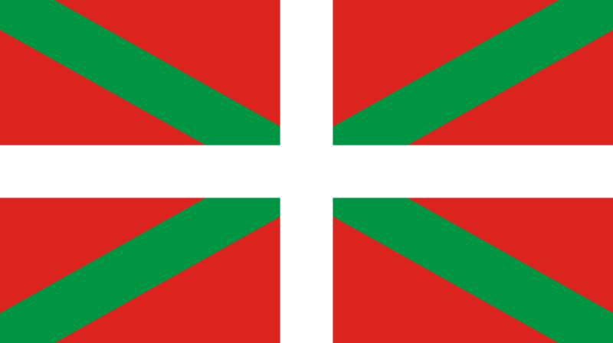
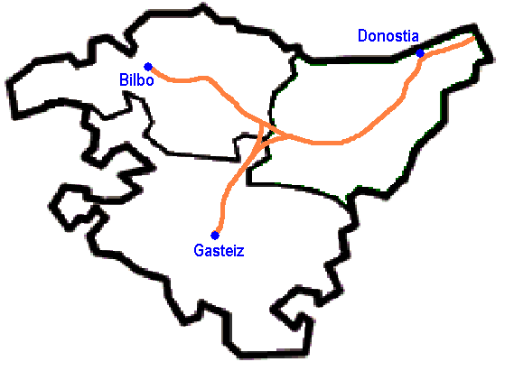
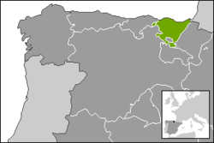
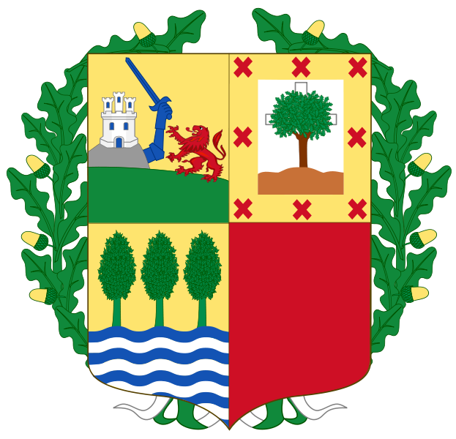
Autonomous Community of the Basque Country

Slide 4
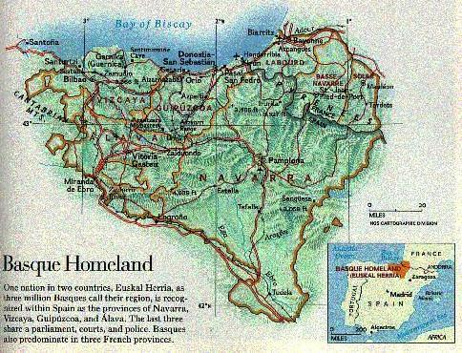

Slide 5
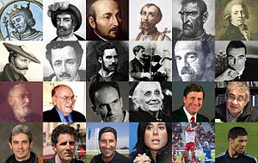
The People

Slide 6
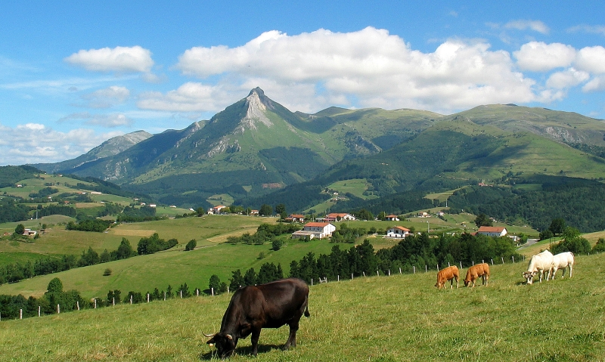
Txindoki mountain from Lazkaomendi

Slide 7
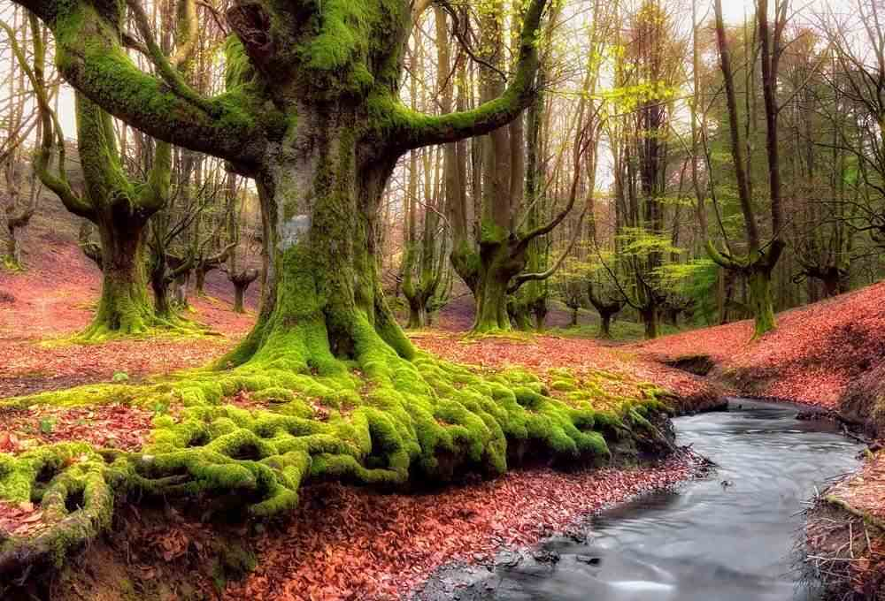

Slide 8
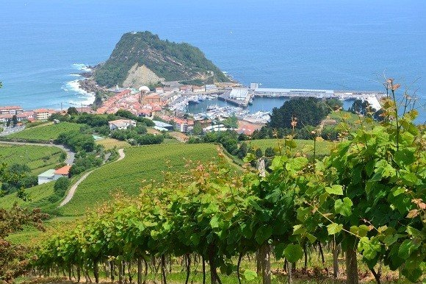

Slide 9
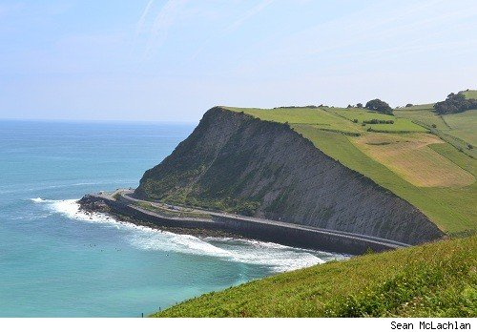

Slide 10
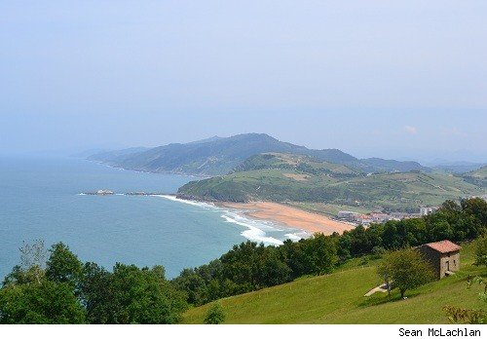

Slide 11
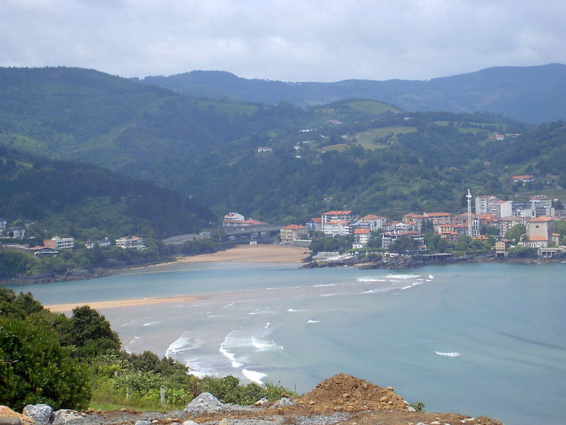
Basque coast near Mundaka

Slide 12
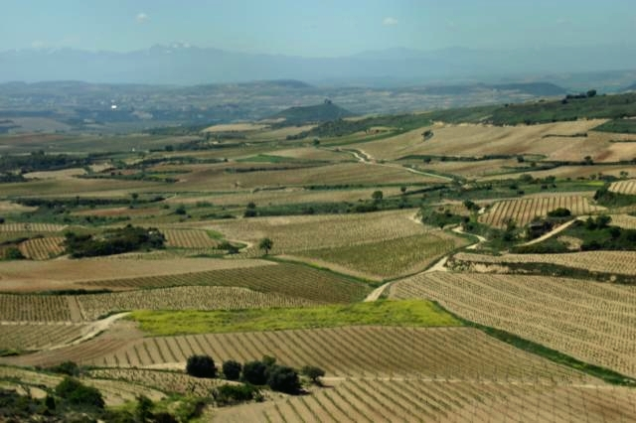
Rioja vineyards near the Ebro

Slide 13
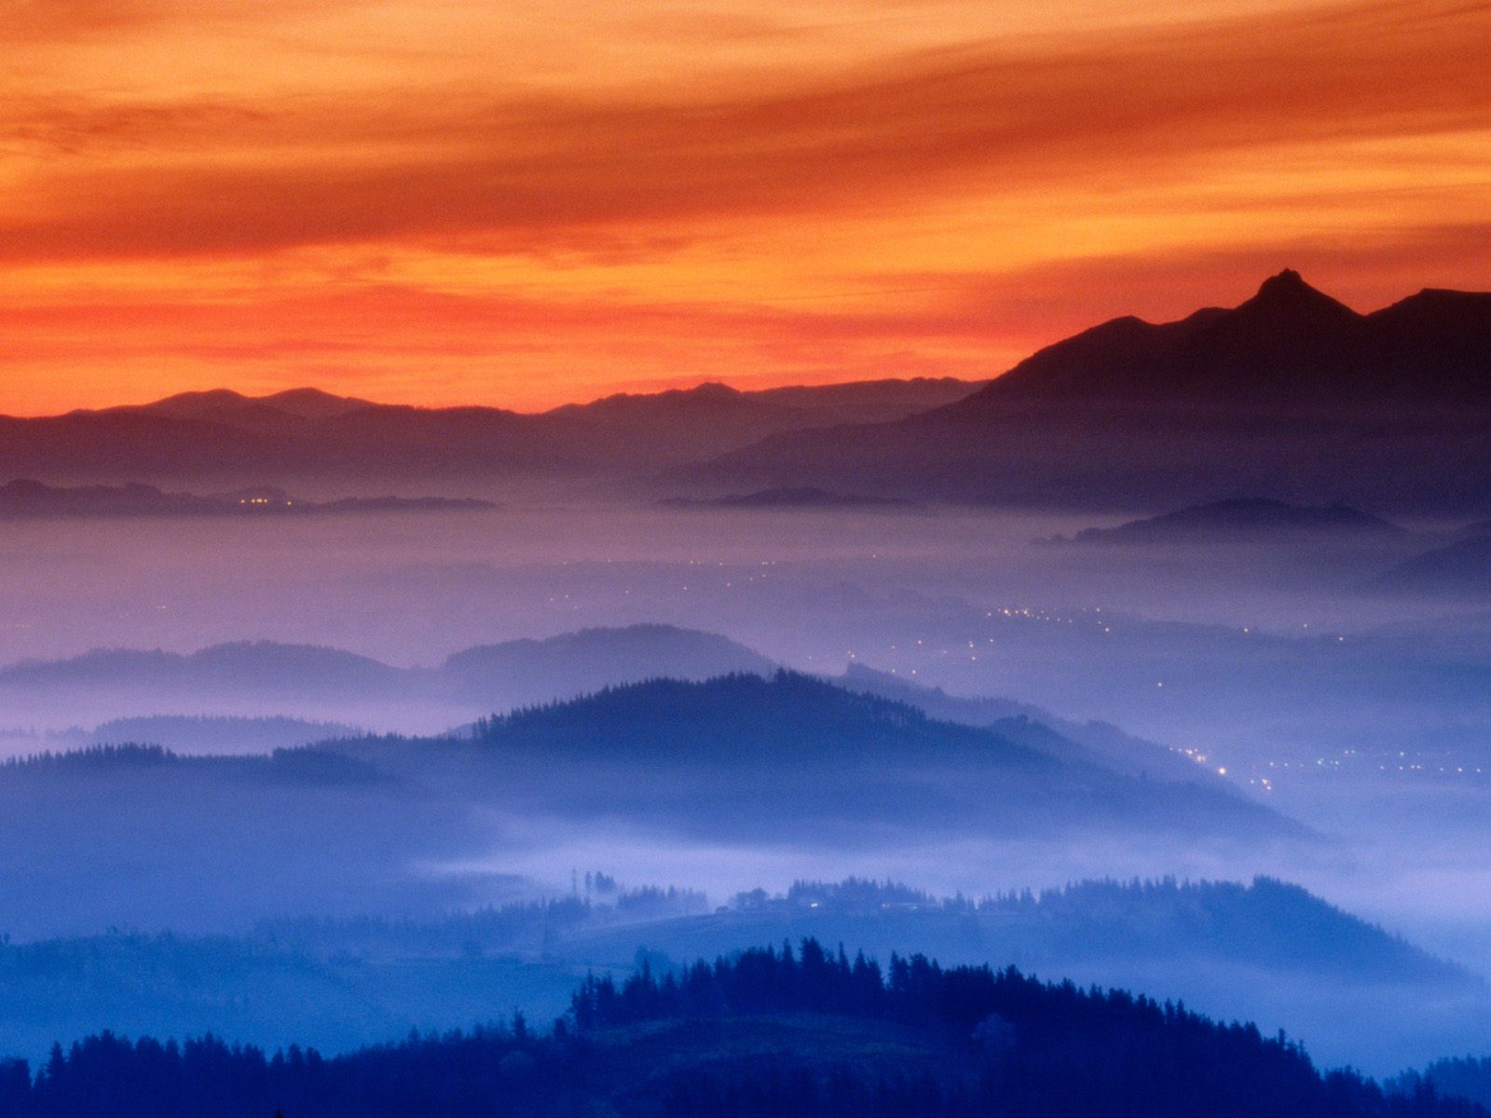
Fog in Guipuzcoa Valley

Slide 14
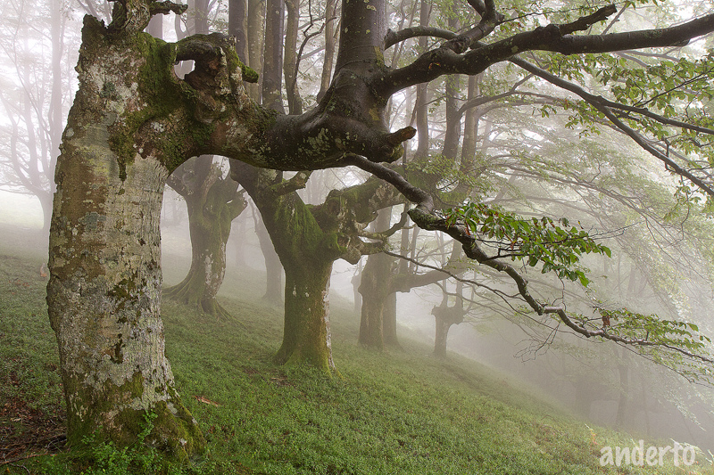

Slide 15
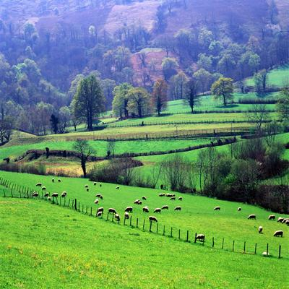
Sheep grazing

Slide 16
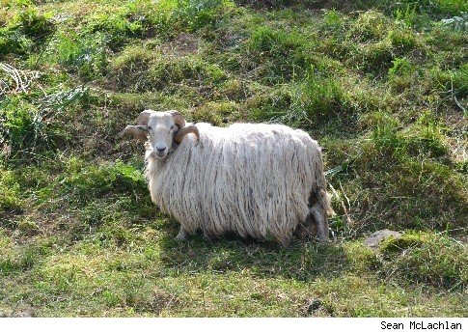

Slide 17
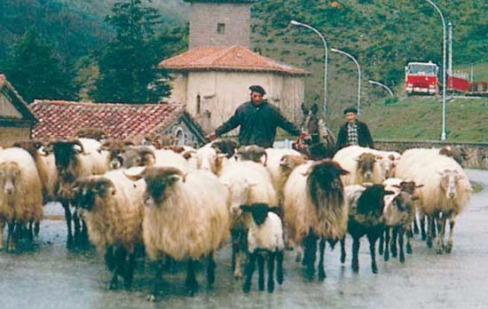
Basque shepherds, Navarra, Spain.

Slide 18
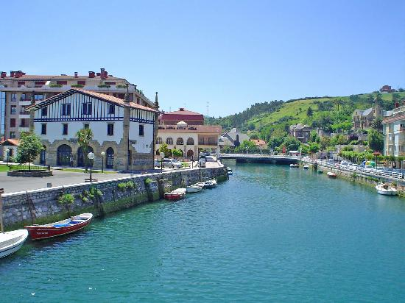
Zumaia

Slide 19
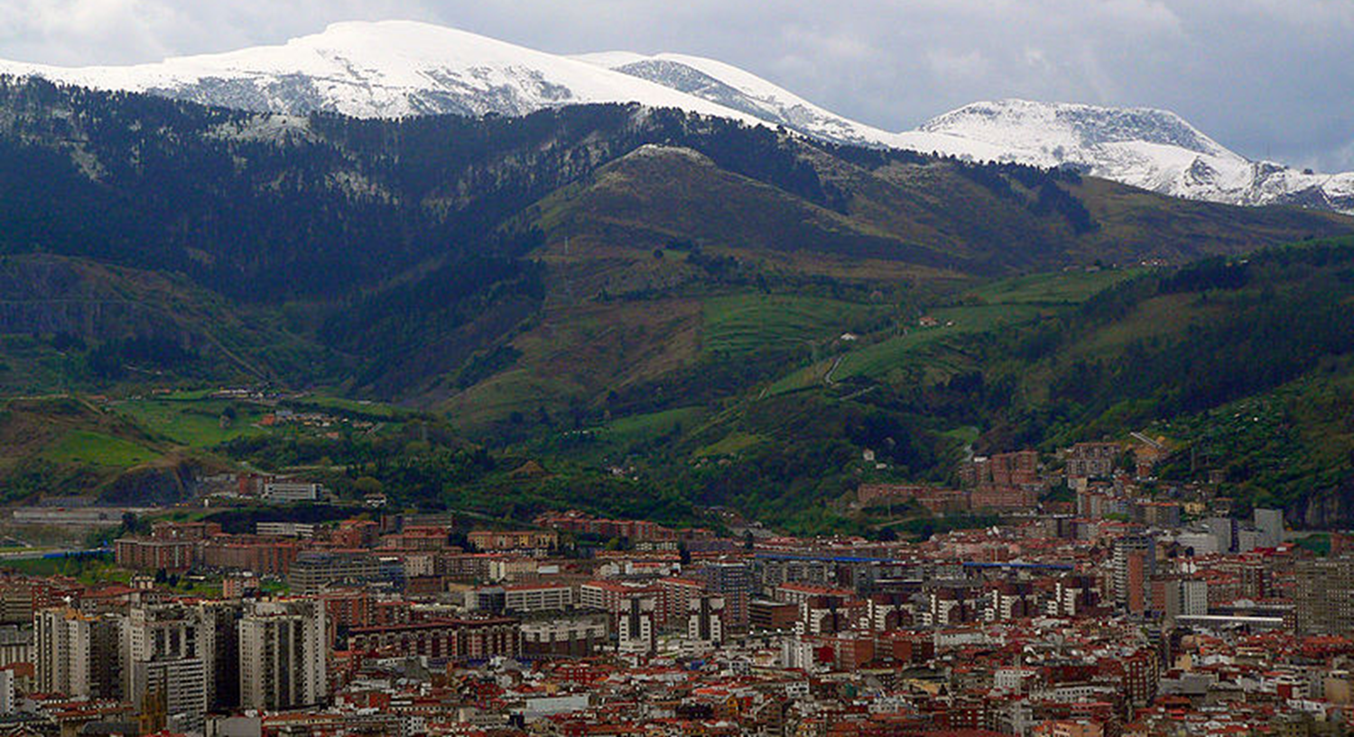
Bilbao (Basque Capital)

Slide 20
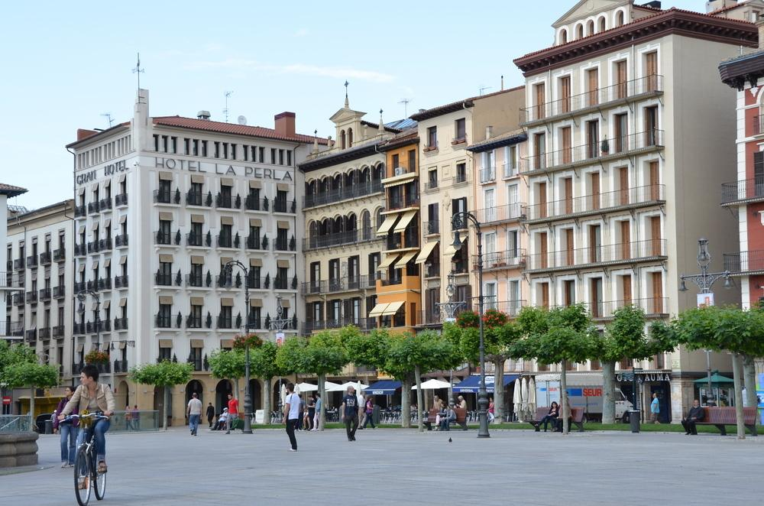
Bilbao (capital city)

Slide 21
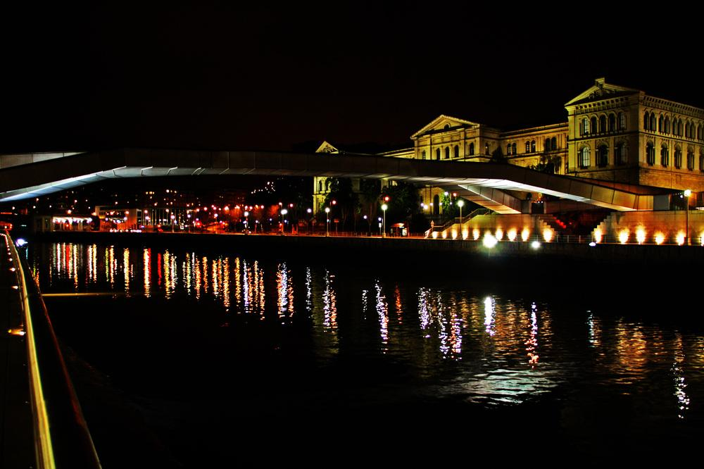
Bilbao at night

Slide 22
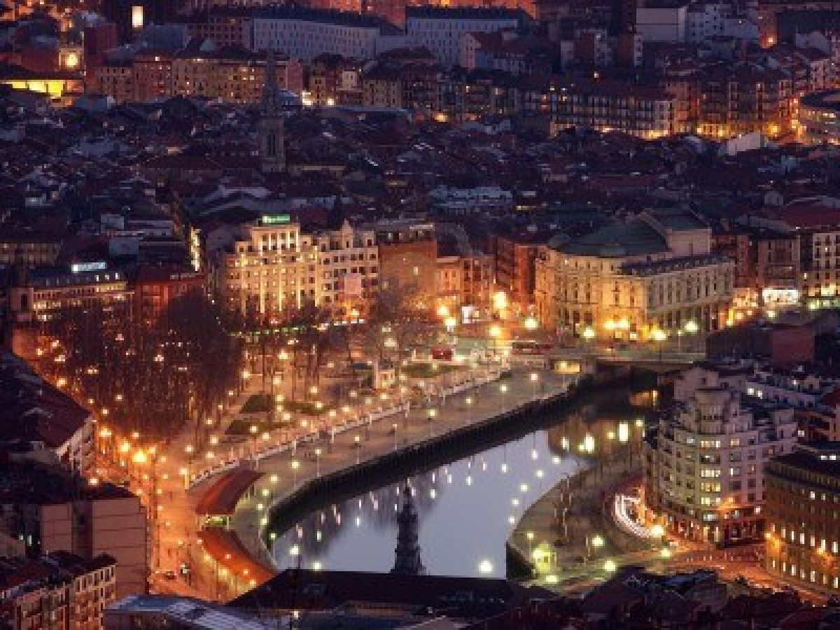

Slide 23
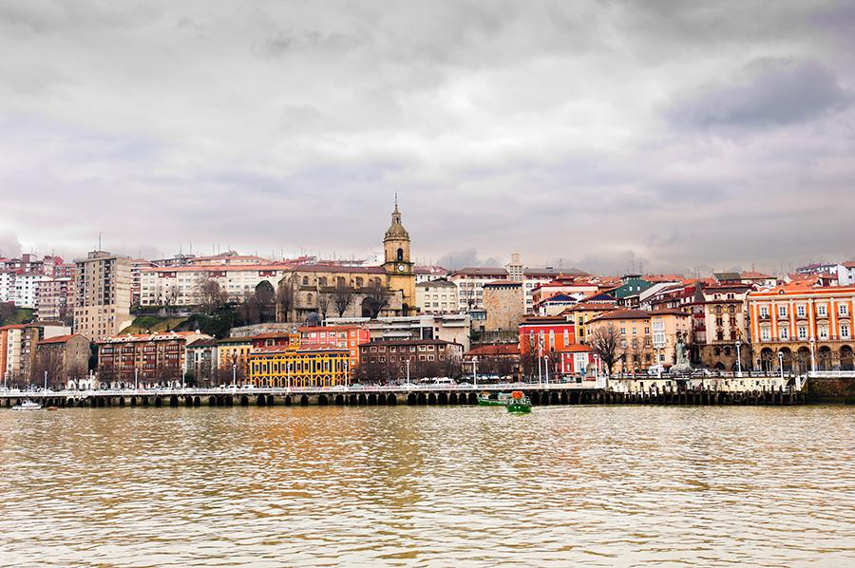
Estuary of Bilbao

Slide 24
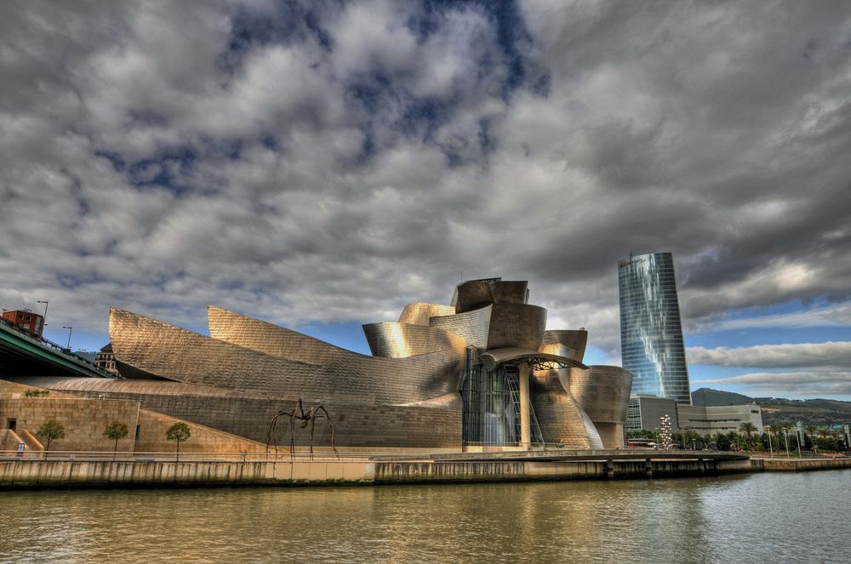
Guggenheim Museum - Bilbao

Slide 25
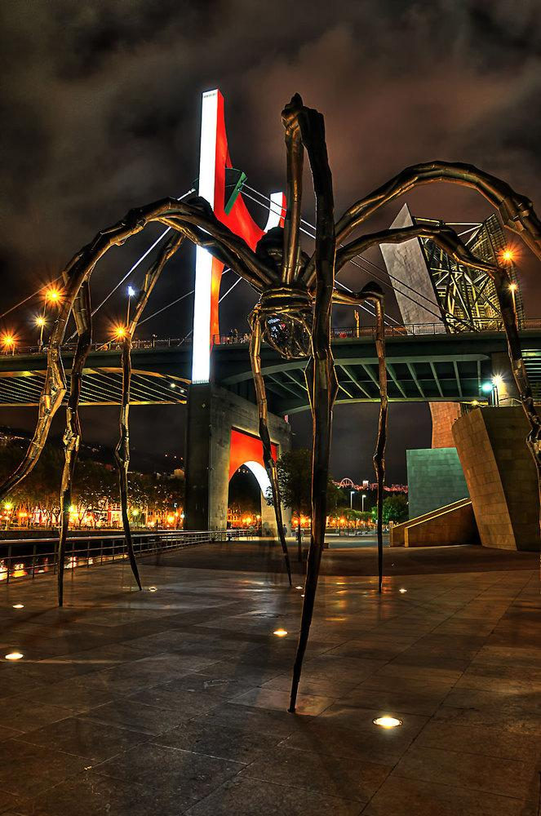
Guggenheim Museum - Bilbao

Slide 26
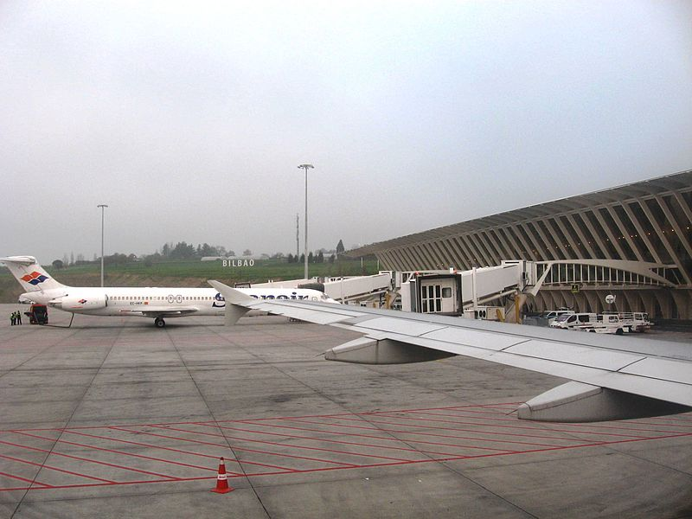
Bilbao Airport

Slide 27
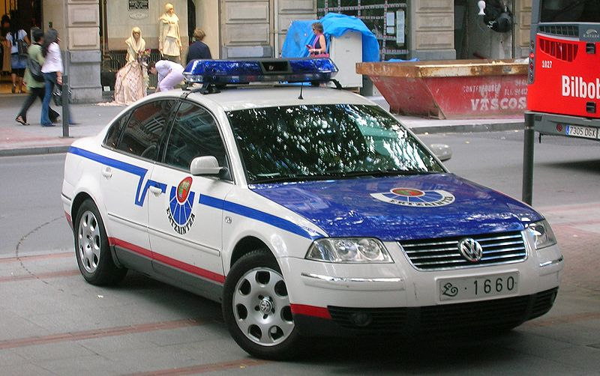
Police car in Bilbao

Slide 28
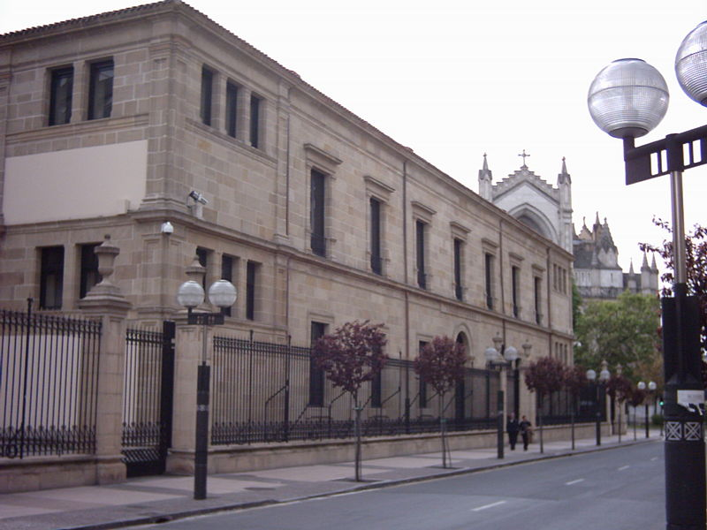
Basque parliament building in Vitoria-Gasteiz.

Slide 29
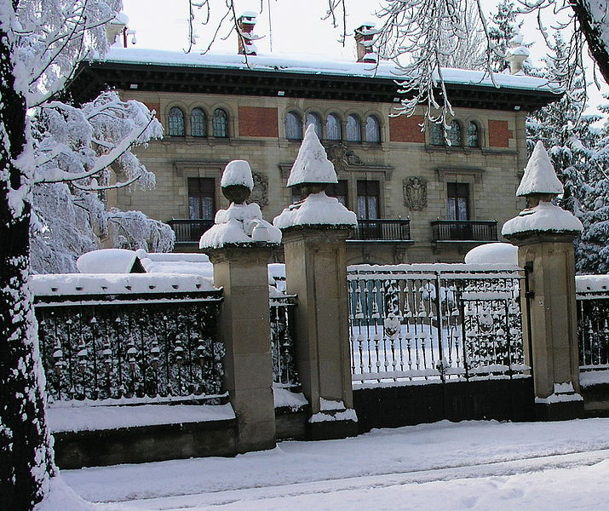
Ajuria Enea Palace, official residence of the President in Vitoria-Gasteiz

Slide 30
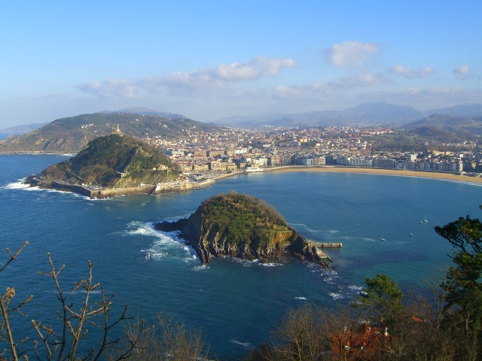
View of San Sebastián

Slide 31
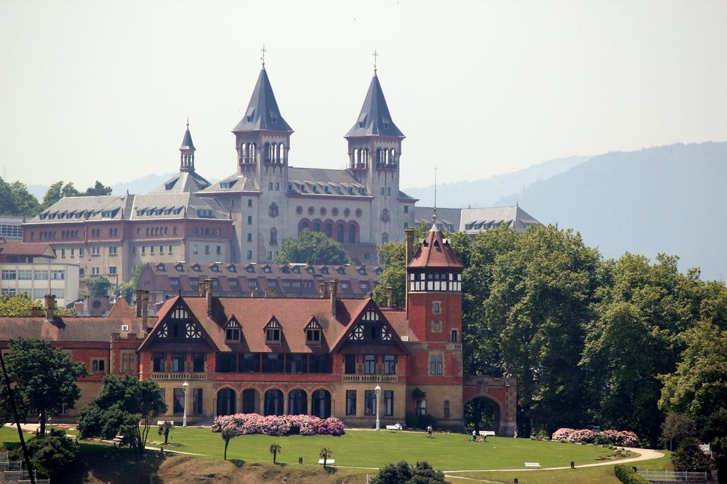
San Sebastian

Slide 32
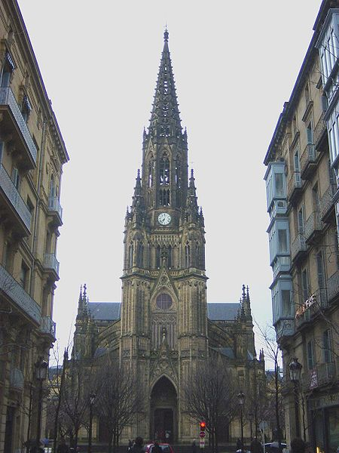
Good Shepherd Cathedral of San Sebastián

Slide 33
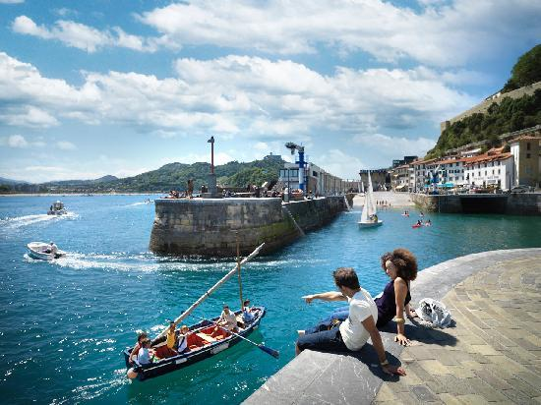
The Port of San Sebastián

Slide 34
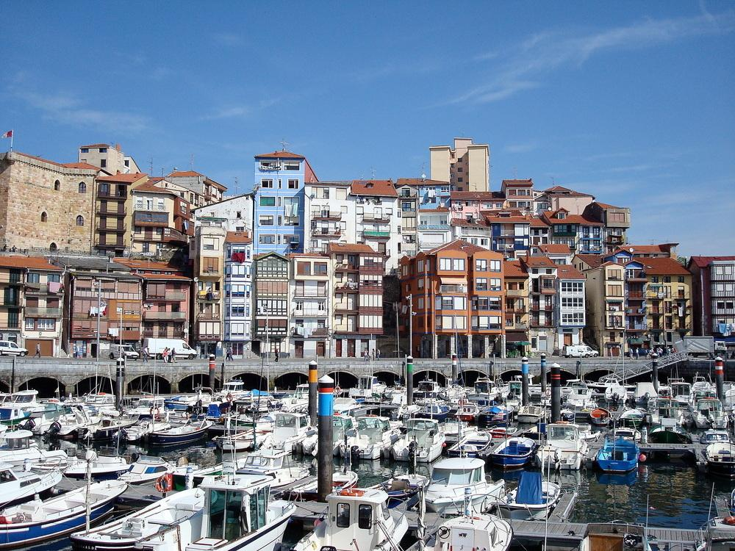
Bermeo

Slide 35
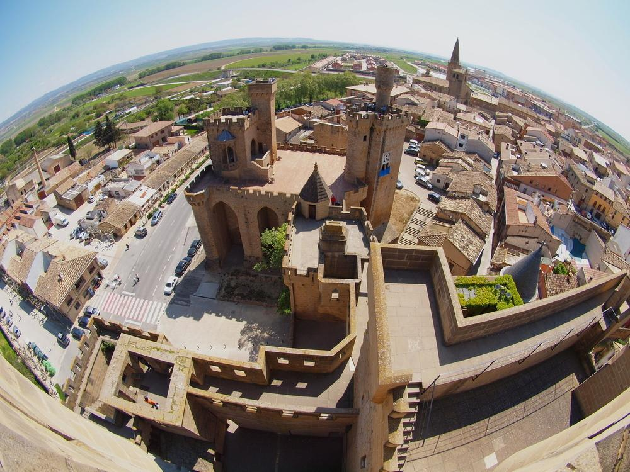
Castle of Olite - Navarre

Slide 36
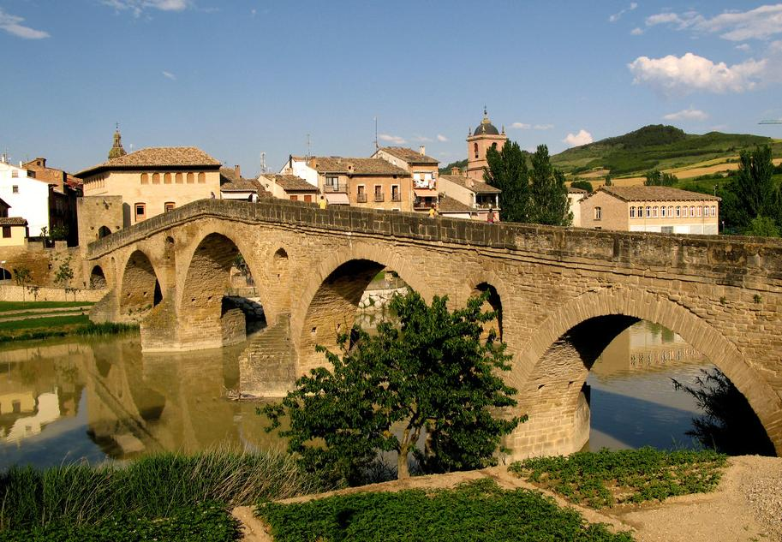
Puente La Reina - Navarre

Slide 37
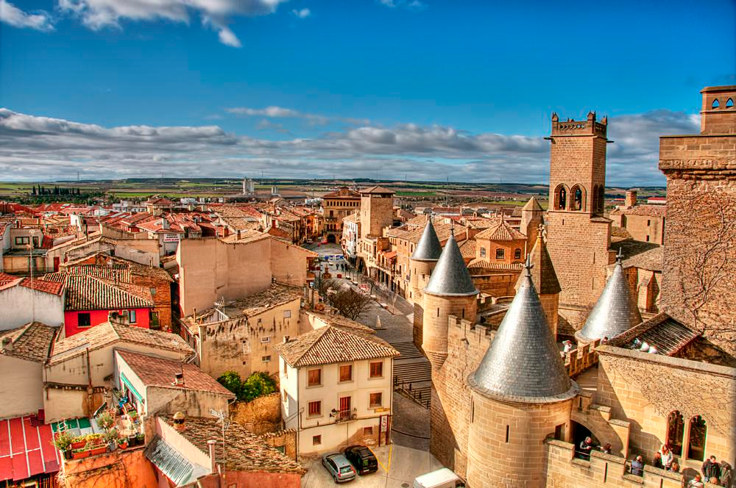
Olite-navarre

Slide 38
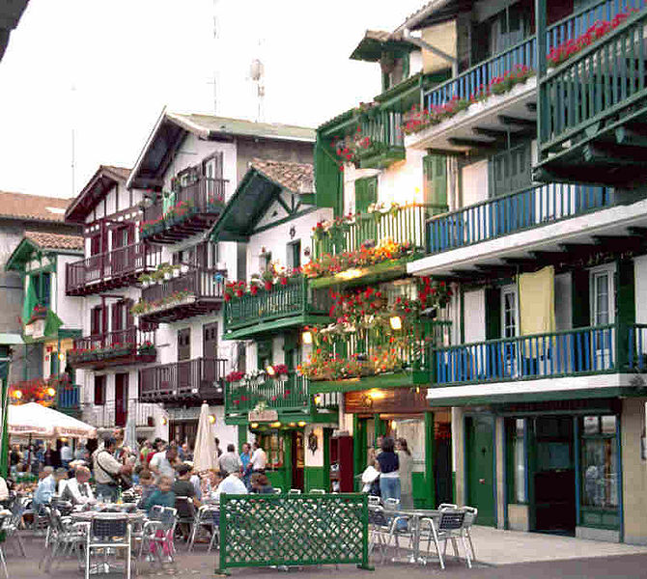
Hondarribia town

Slide 39
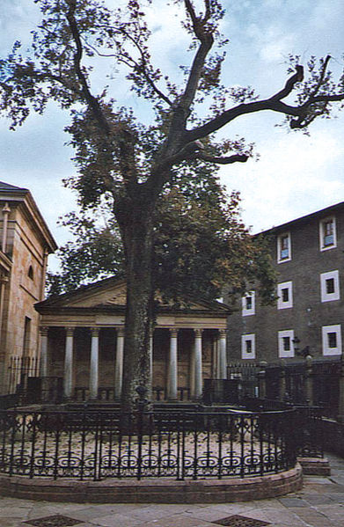
The historic Oak of Gernika, symbol of the Basque institutions.

Slide 40
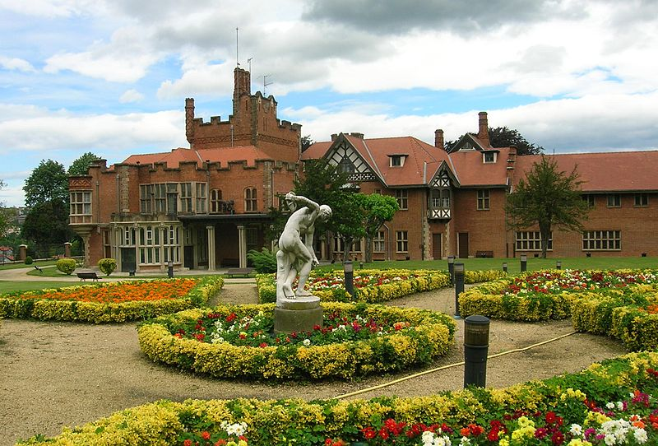
Back side and gardens of Artaza Palace, in Leioa, Biscay.

Slide 41
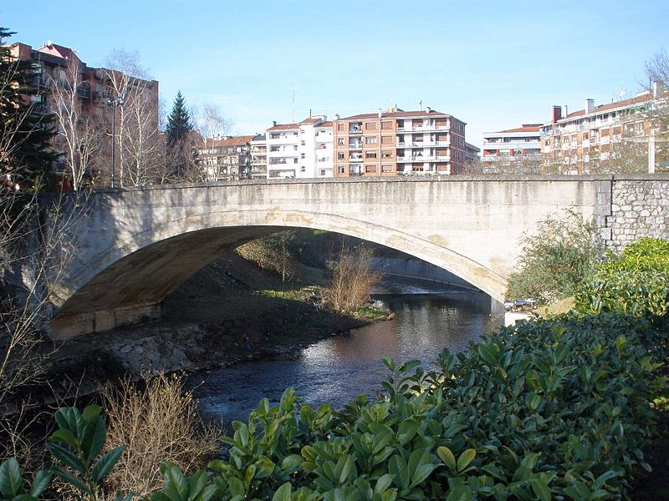
Bridge in Biscay

Slide 42
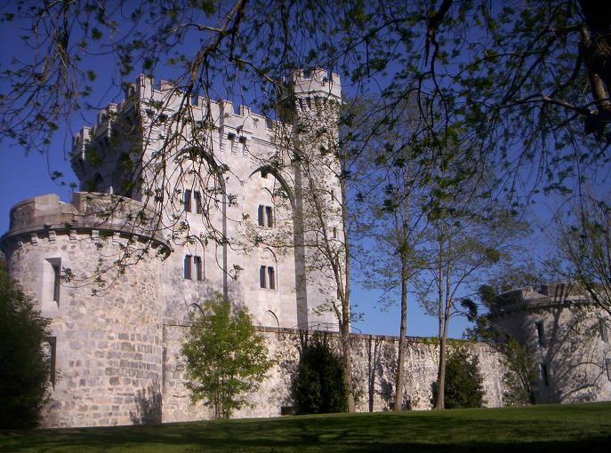
Arteaga Tower

Slide 43
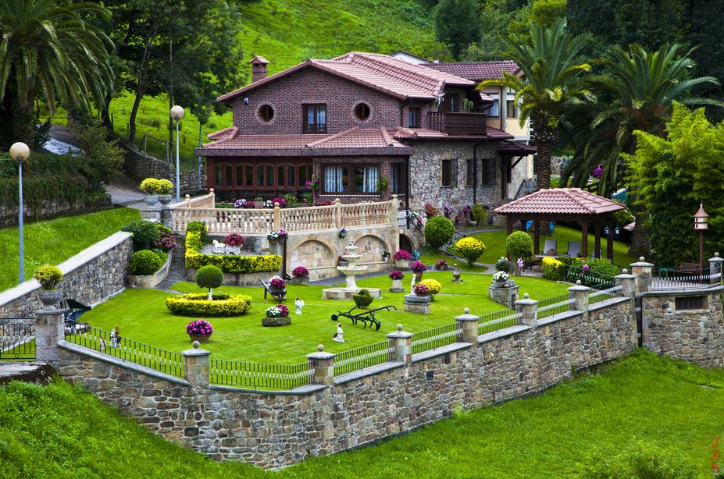
Liérganes - Cantabria

Slide 44
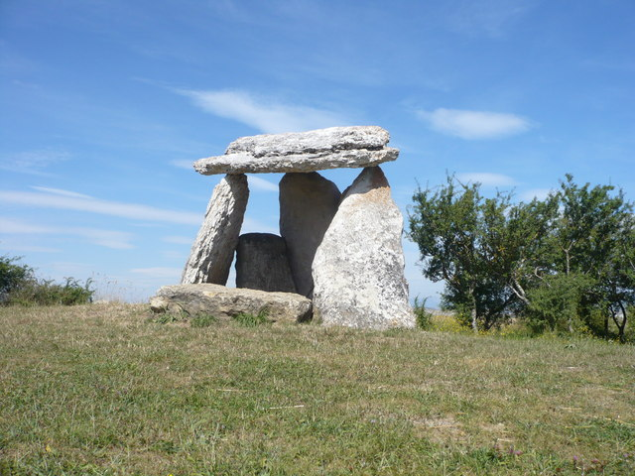
Archaeology in the Basque Autonomous Community

Slide 45
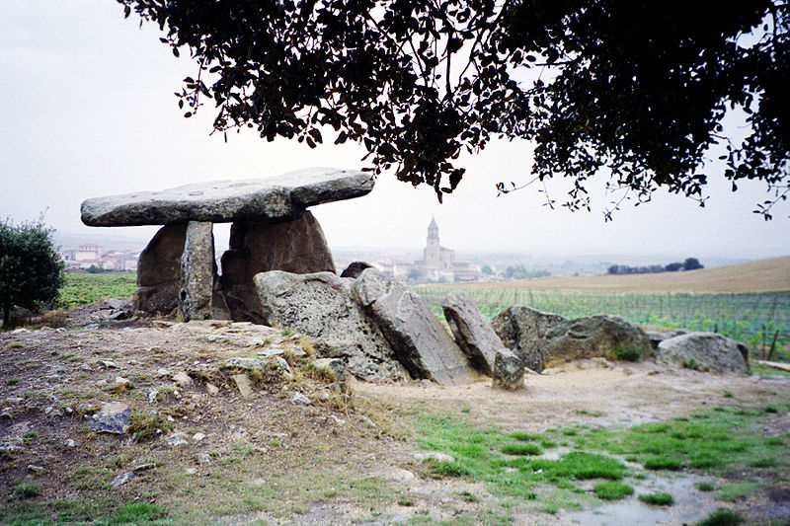

Slide 46
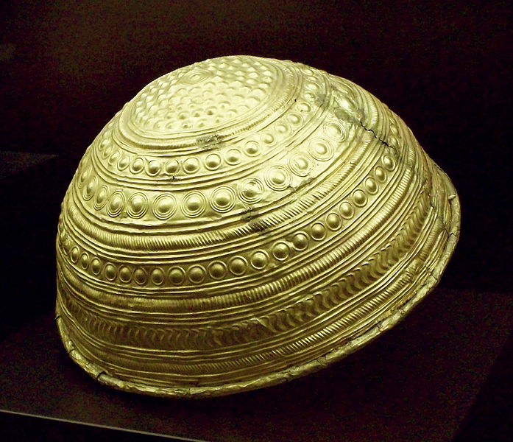
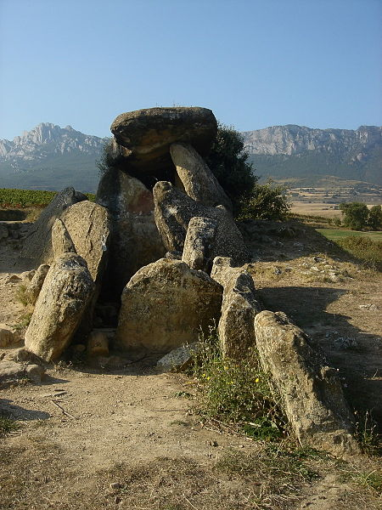
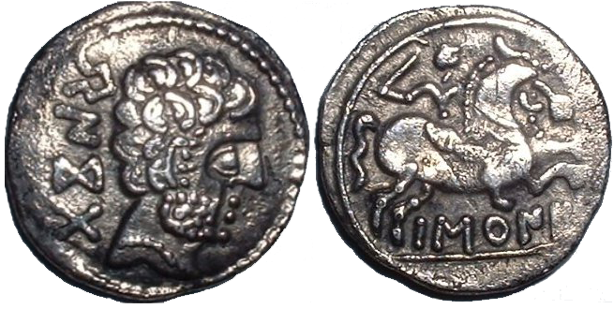

Slide 47
Balearic islands
The Balearic Islands are an archipelago of Spain in the western Mediterranean Sea, near the eastern coast of the Iberian Peninsula. The four largest islands are: Majorca, Minorca, Ibiza and Formentera.

Slide 48


Slide 49


Slide 50

Formentera

Slide 51

Formentera

Slide 52

Formentera

Slide 53

Cala Blanca - Ibiza

Slide 54

Ibiza

Slide 55

Cala Benirras - Ibiza

Slide 56

Eivissa-Ibiza

Slide 57

Ibiza

Slide 58

Ibiza streets

Slide 59

Majorca

Slide 60

Port d'Andratx on the blue hour-Majorca

Slide 61

Cathedral of Saint Mary (La Seu)-Majorca

Slide 62

Majorca

Slide 63

Menorca

Slide 64

People and culture

Slide 65


Slide 66


Slide 67

In Jerez de la Frontera, famous for its horse breeding

Slide 68


Slide 69

Irish Pub

Slide 70

La Fontanilla Taverna

Slide 71


Slide 72


Slide 73


Slide 74


Slide 75


Slide 76

Dragon Fruit La Boqueria

Slide 77


Slide 78


Slide 79

The Rinconcillo

Slide 80

Churros with Chocolate

Slide 81


Slide 82


Slide 83


Slide 84


Slide 85


Slide 86


Slide 87


Slide 88

Flamenco

Slide 89


Slide 90


Slide 91


Slide 92


Slide 93


Slide 94


Slide 95


Slide 96


Slide 97


Slide 98

Tile bench in Marabella

Slide 99

Andalusian patterns

Slide 100


Slide 101


Slide 102


Slide 103


Slide 104


Slide 105


Slide 106


Slide 107

Siesta

Slide 108


Slide 109


Slide 110


Slide 111


Slide 112


Slide 113


Slide 114


Slide 115


Slide 116


Slide 117


Slide 118


Slide 119


