Slide 1
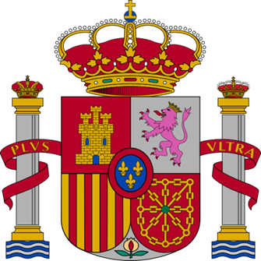
Spain (Part 2)

Slide 2
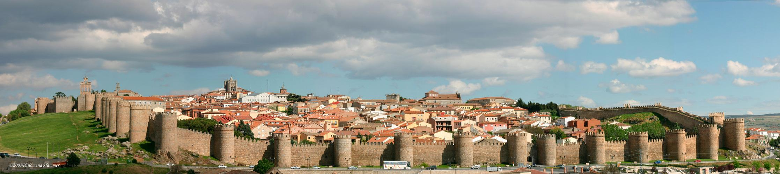
Other places to visit
Roman city walls - Avila (World Heritage Site by Unesco)

Slide 3
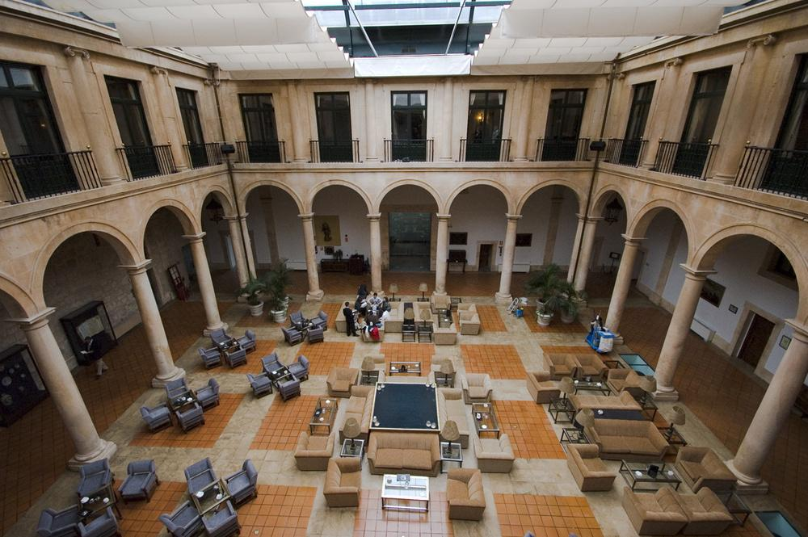
Courtyard of the Ducal Palace of Lerma, national Parador today

Slide 4
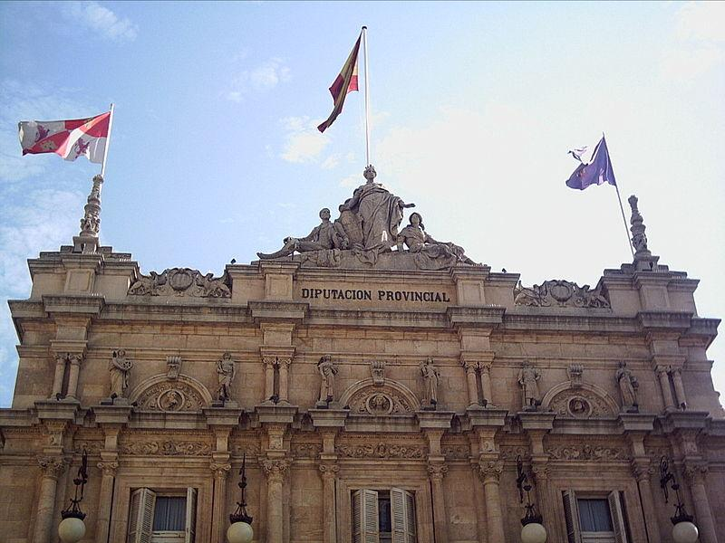
Palacio Diputación Provincial. - Palancia

Slide 5
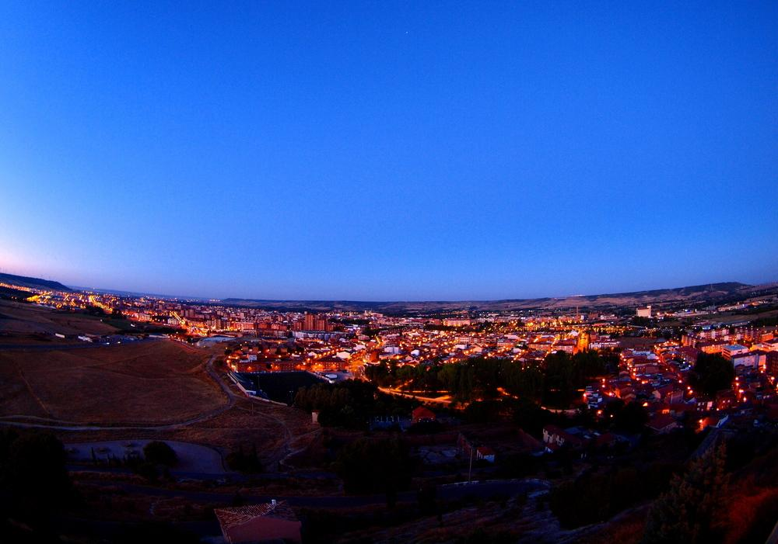
Palancia at night

Slide 6
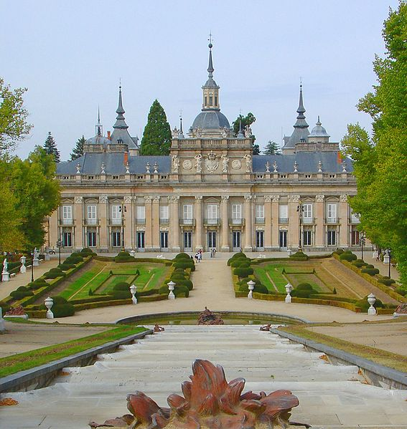
La Granja Palace

Slide 7
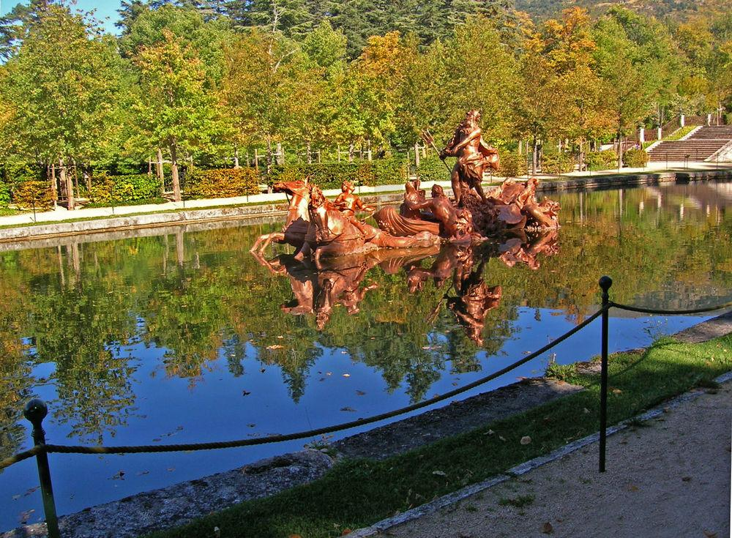
La Granja Palace

Slide 8
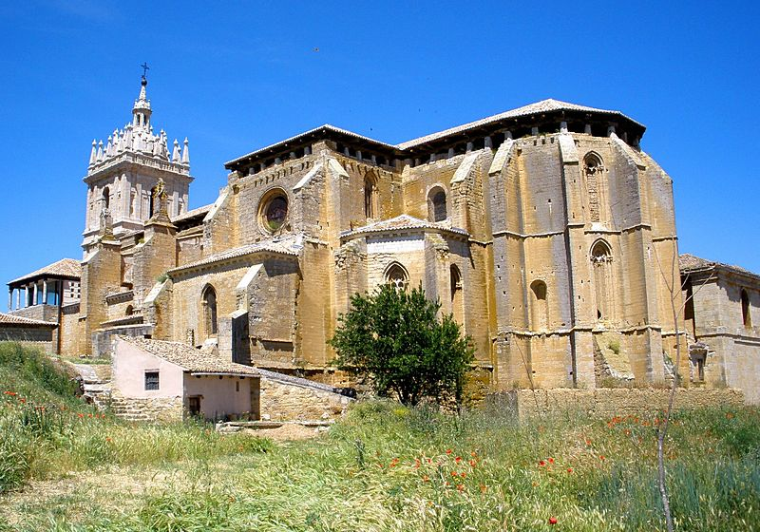
Tamara de Campos - Iglesia de San Hipolito el Real.

Slide 9
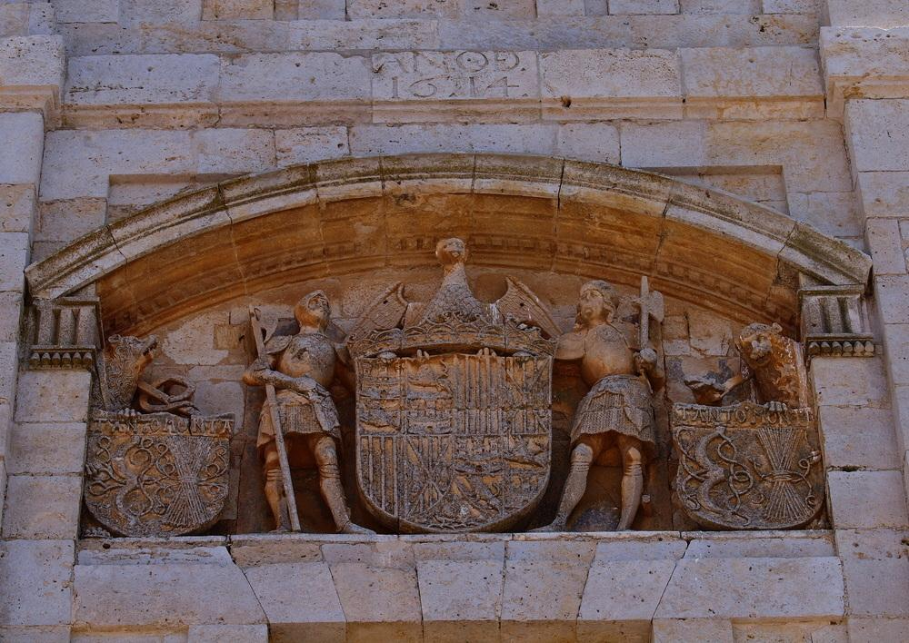
San Hipolito

Slide 10
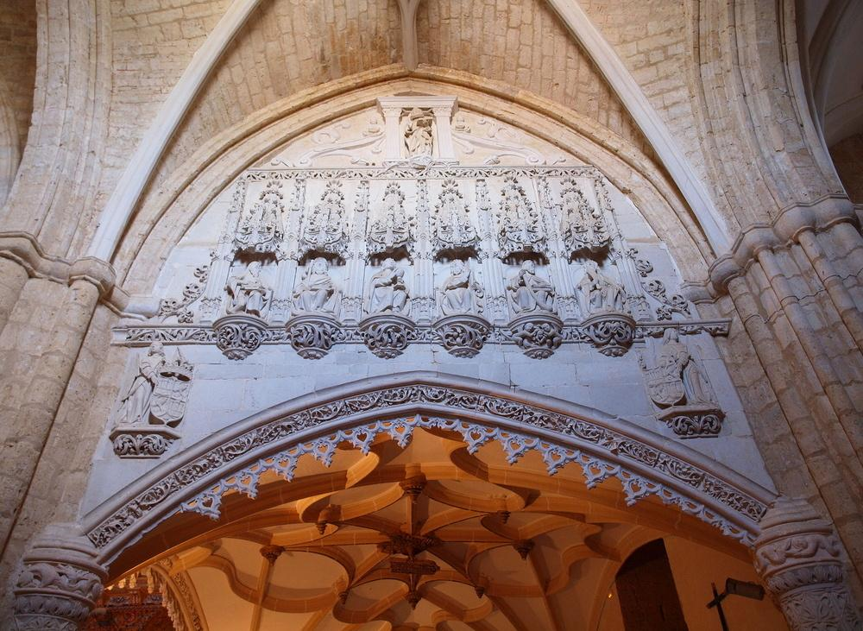
San Hipolito

Slide 11
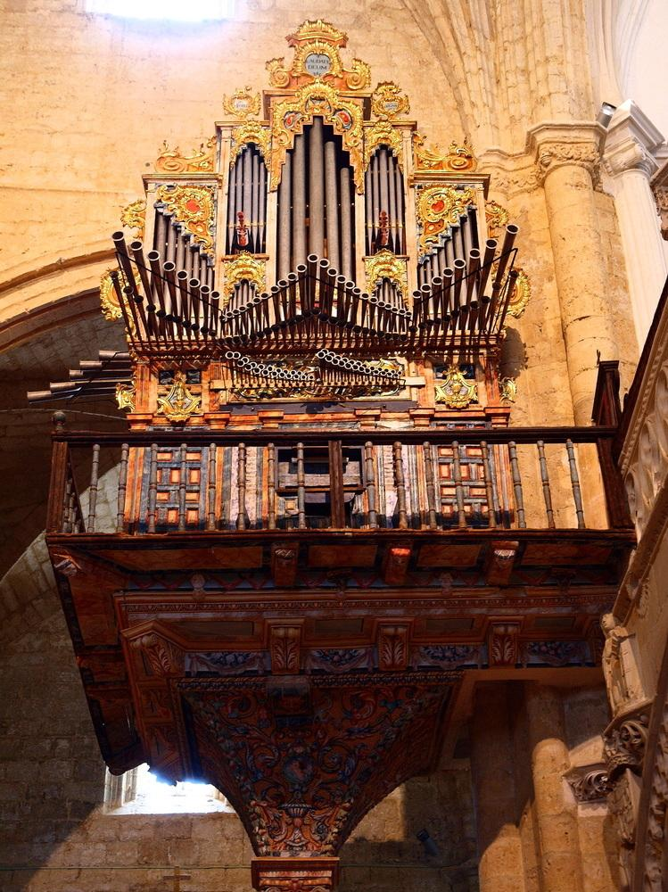
San Hipolito

Slide 12
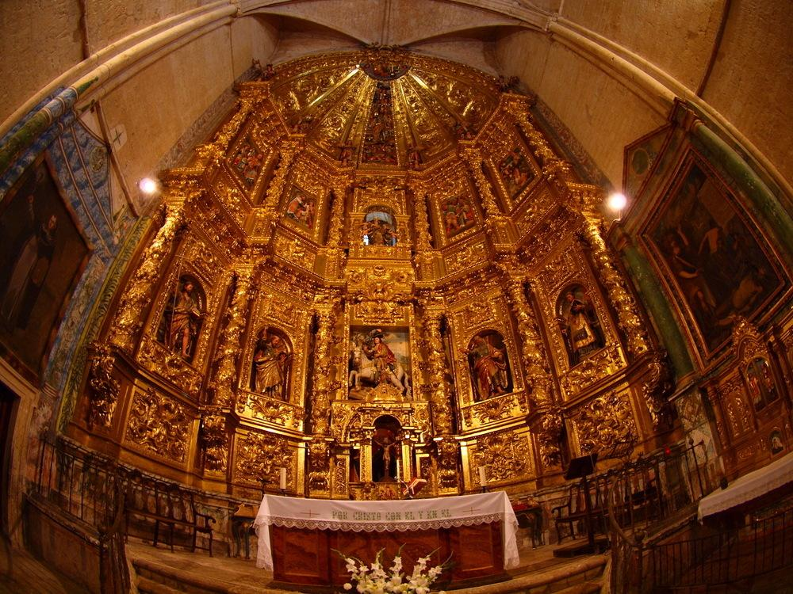
San Hipolito

Slide 13
ANDALUSIA
Andalusia is the most populous and the second largest in area of the autonomous communities in Spain after Castilla and Leon. The Andalusian autonomous community is officially recognised as a nationality of Spain. The territory is divided into eight provinces: Almería, Cádiz, Córdoba, Granada, Huelva, Jaén, Málaga and Seville. Its capital is the city of Seville.

Slide 14
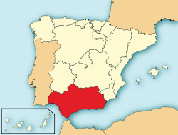
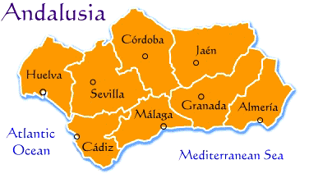

Slide 15
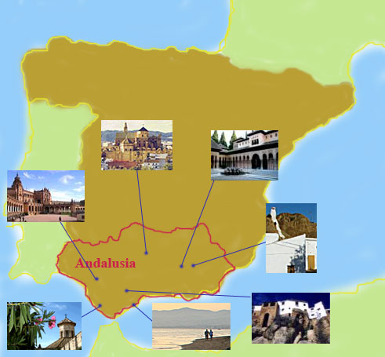

Slide 16
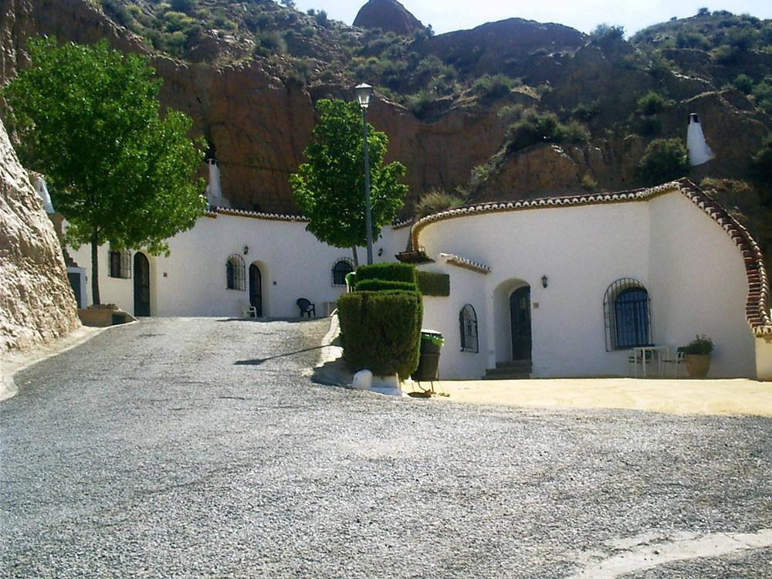
Cave dwellings in Guadix Andalusia

Slide 17
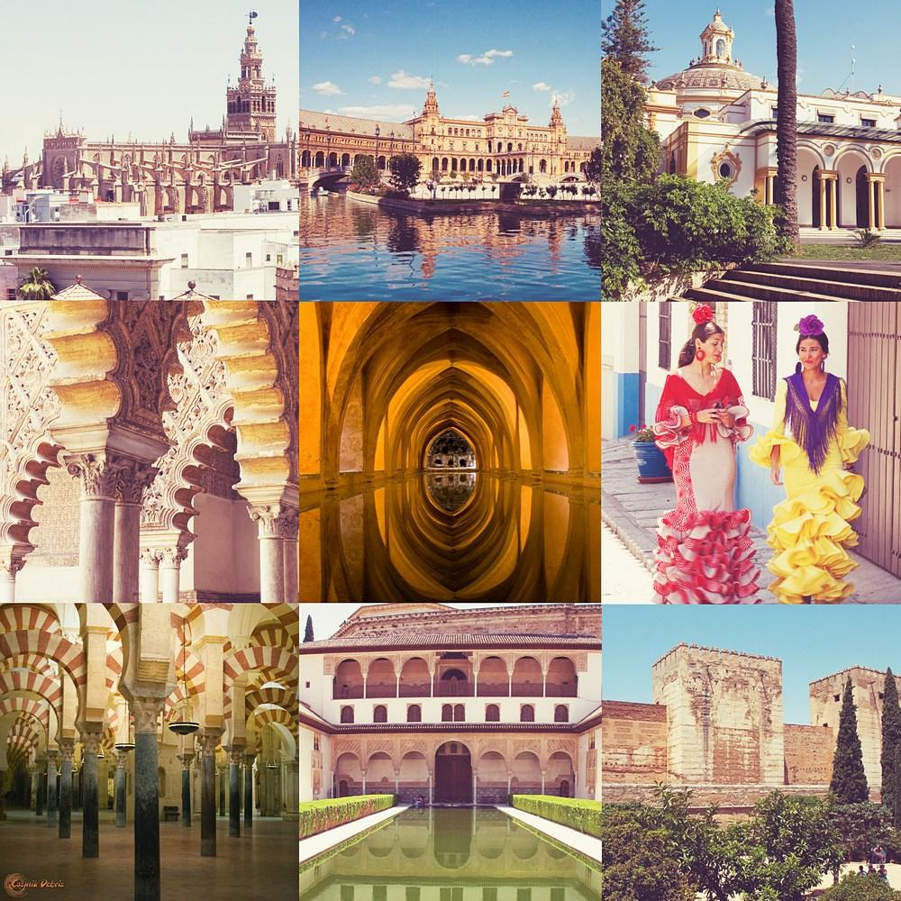

Slide 18
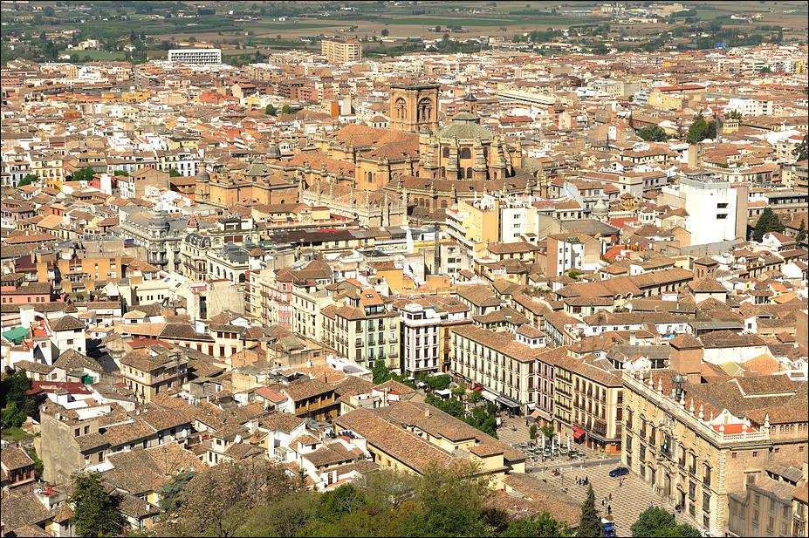
Granada

Slide 19
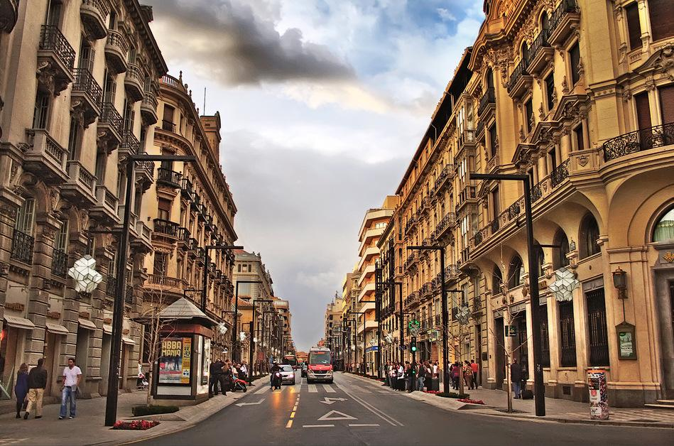

Slide 20
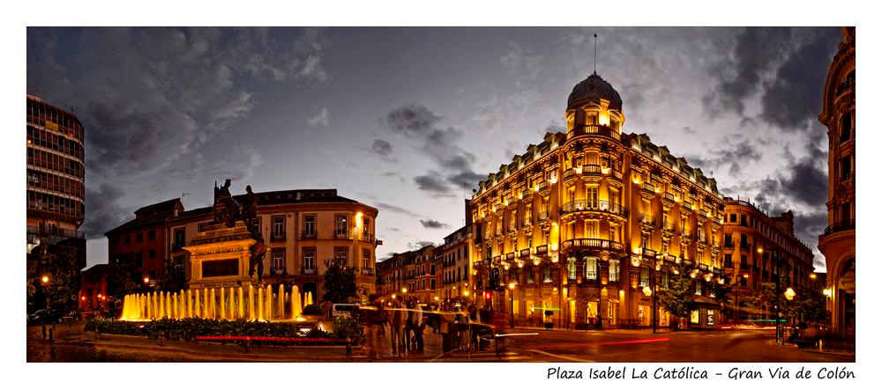

Slide 21
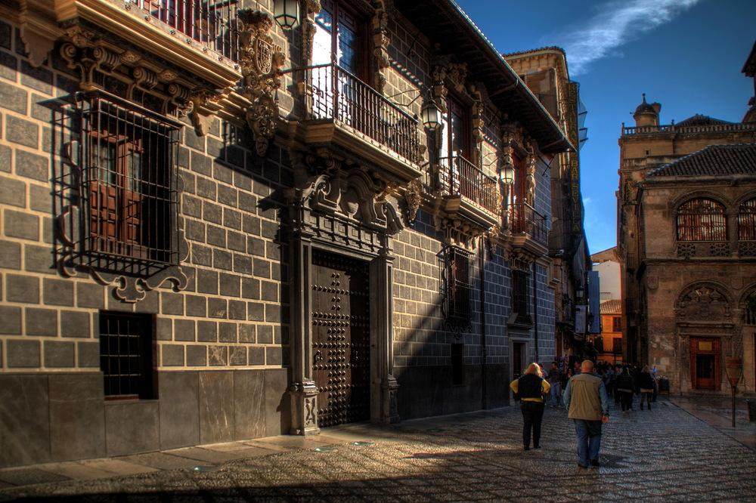

Slide 22
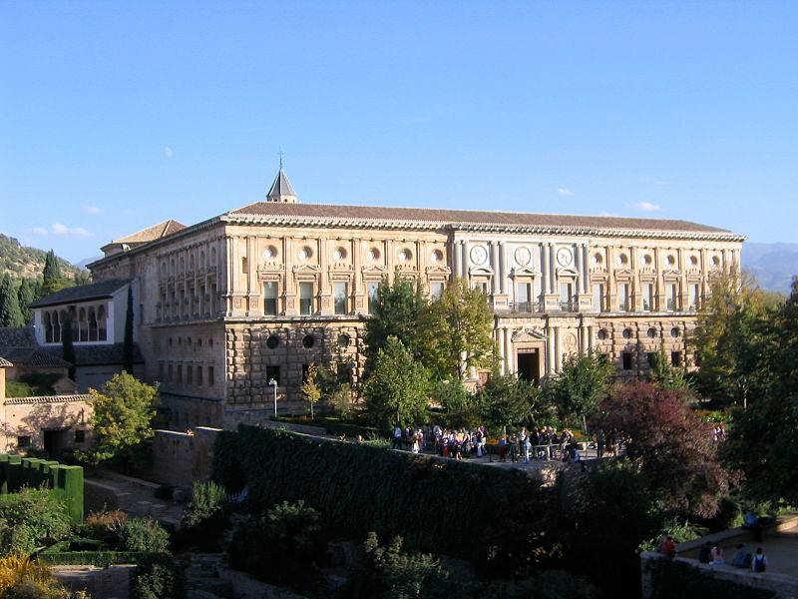
The Palace of Charles V is a Renacentist construction in Granada, southern Spain, located on the top of the hill of the Assabica, inside the Nasrid fortification of the Alhambra.

Slide 23
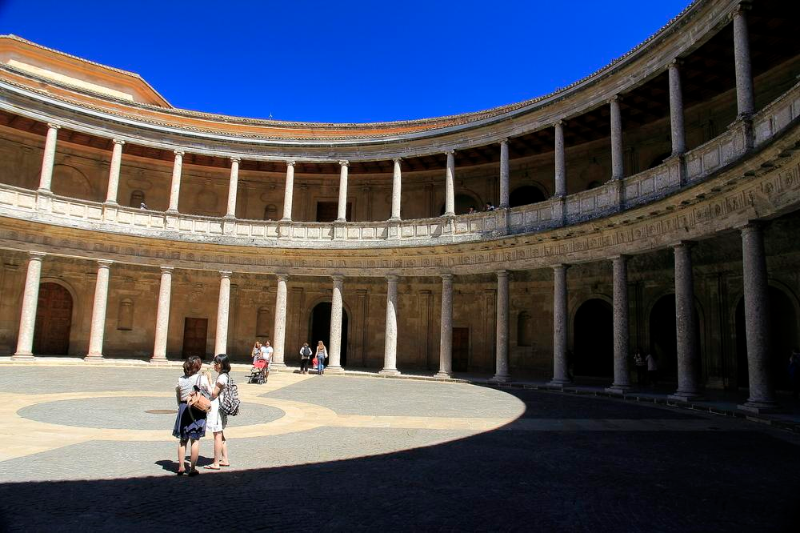
The courtyard of the palace of Charles V, which is considered as part of the Alhambra in Granada as the most important building of the High Renaissance in Spain.

Slide 24
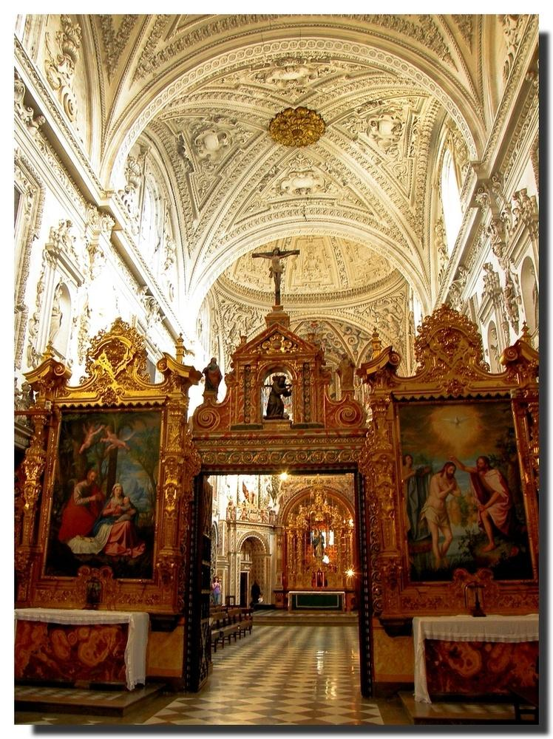
Granada- Monastery La Cartuja.

Slide 25
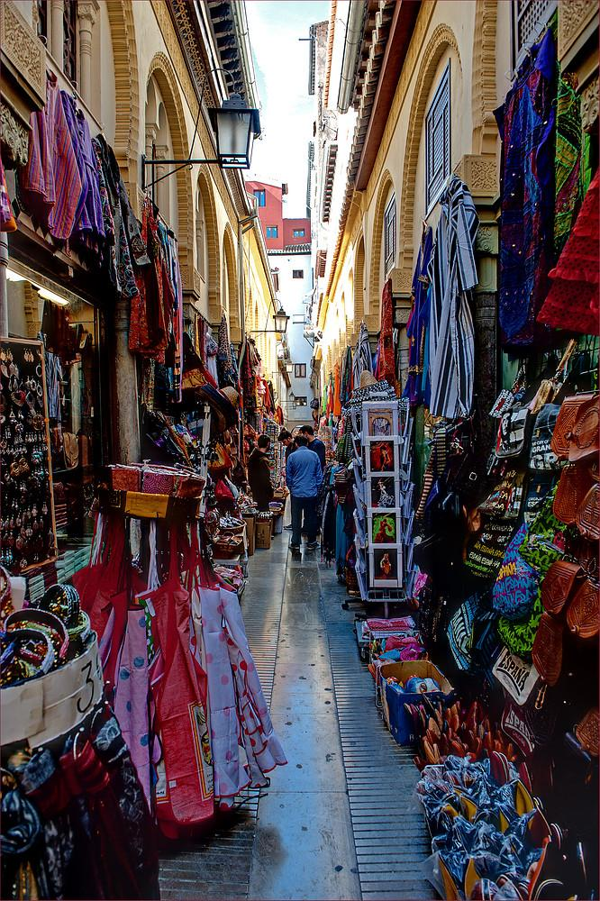

Slide 26
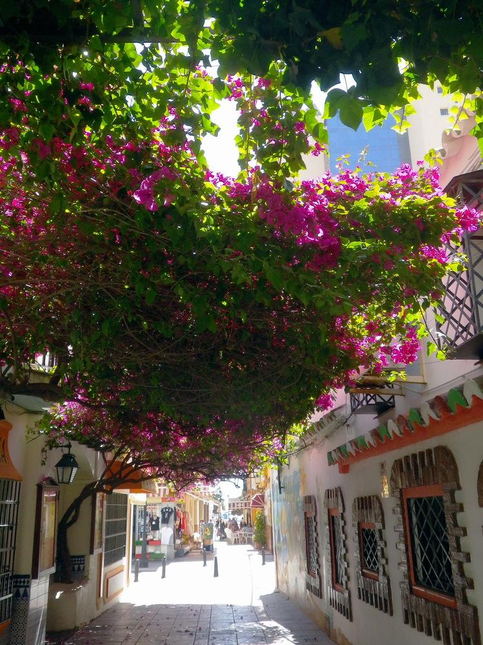

Slide 27
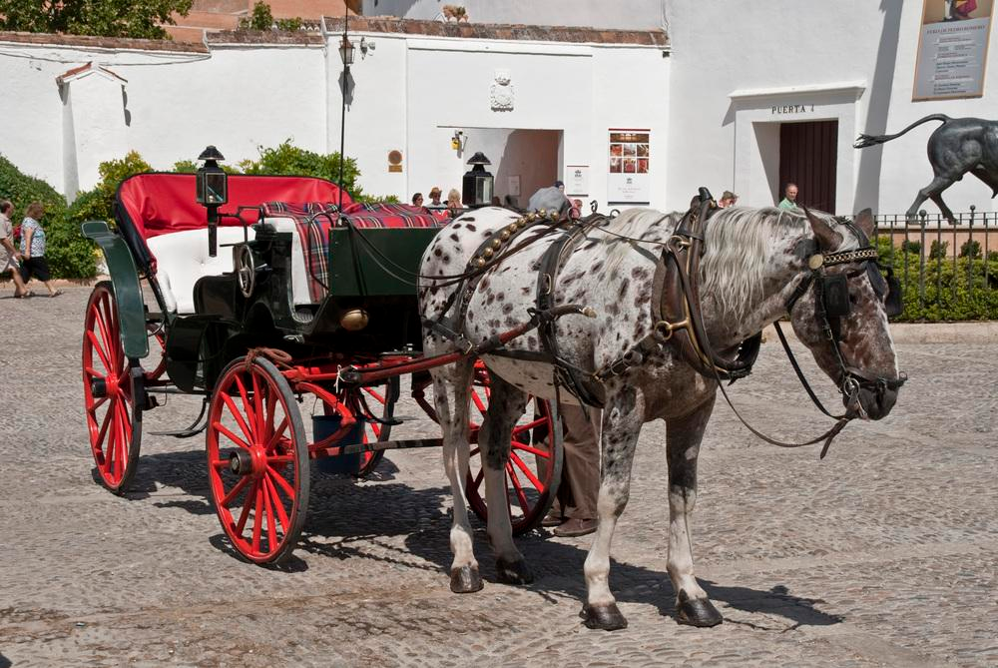

Slide 28
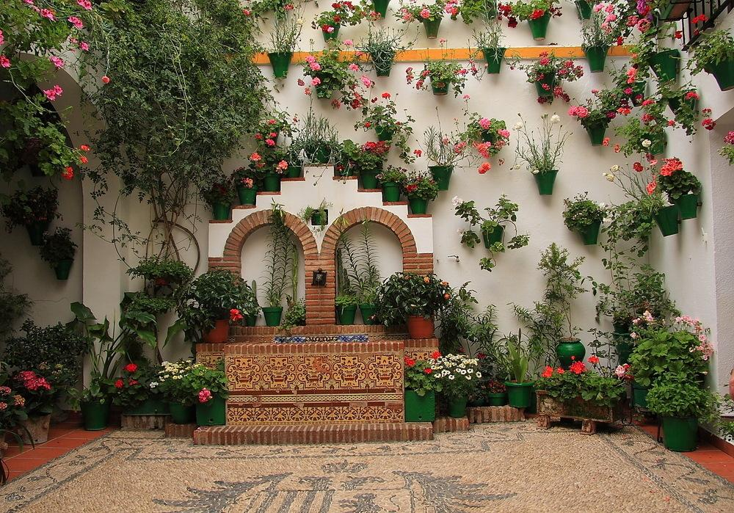

Slide 29
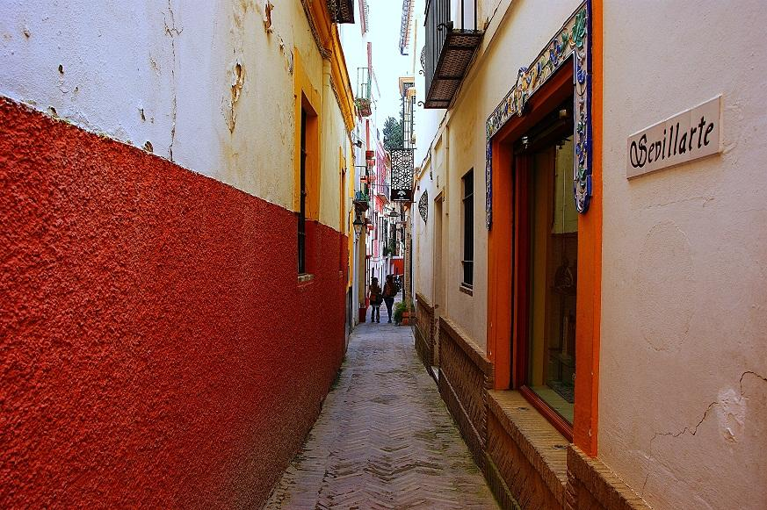

Slide 30
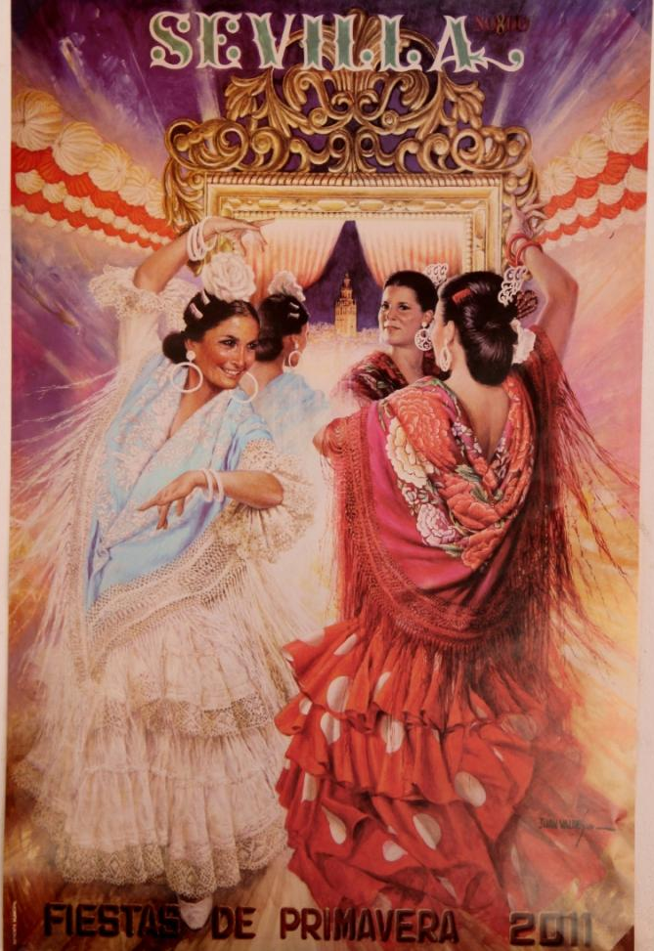
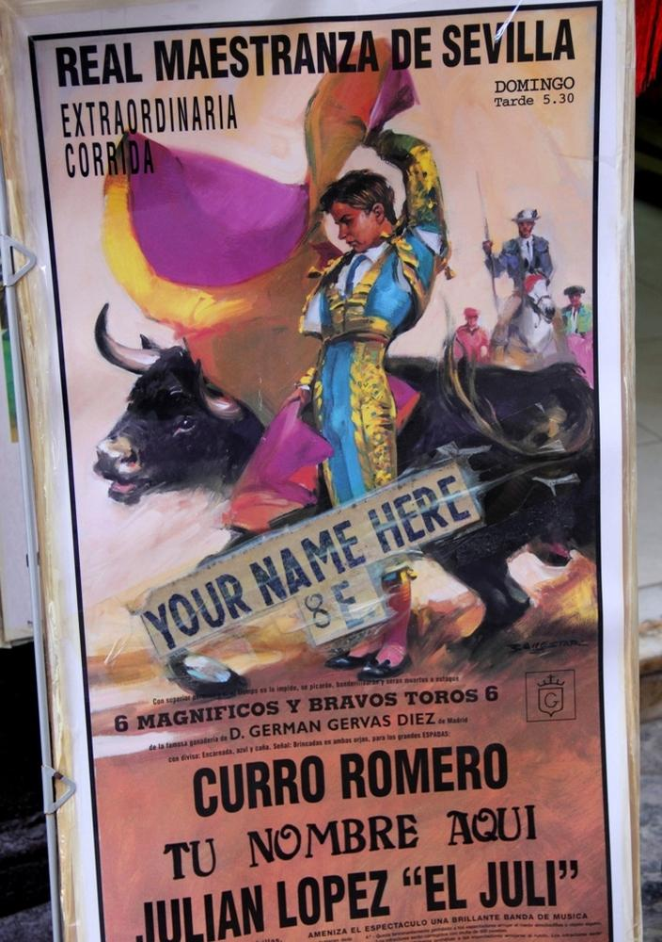

Slide 31
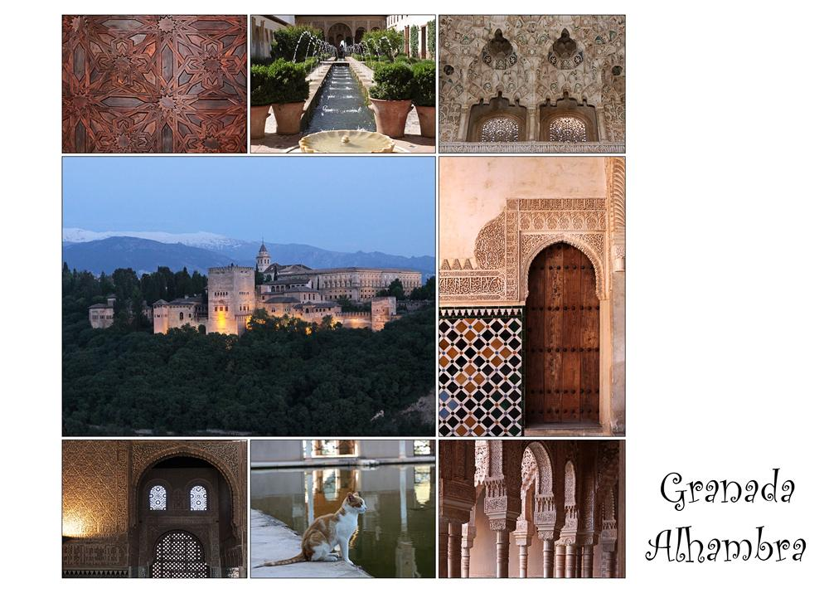

Slide 32
Alhambra Palace
Alhambra literally "the red one", the complete form of which was Calat Alhambra "the red fortress", is a palace and fortress complex located in Granada, Andalusia, Spain. It was constructed during the mid 14th century by the Arab rulers of the Emirate of Granada in al-Andalus, occupying the top of the hill of the Assabica on the southeastern border of the city of Granada. (next slide)

Slide 33
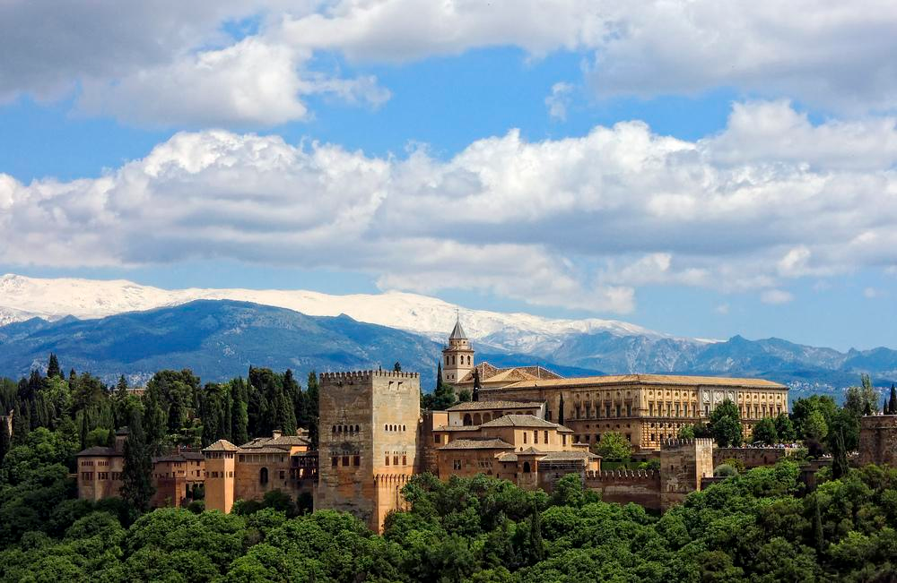

Slide 34
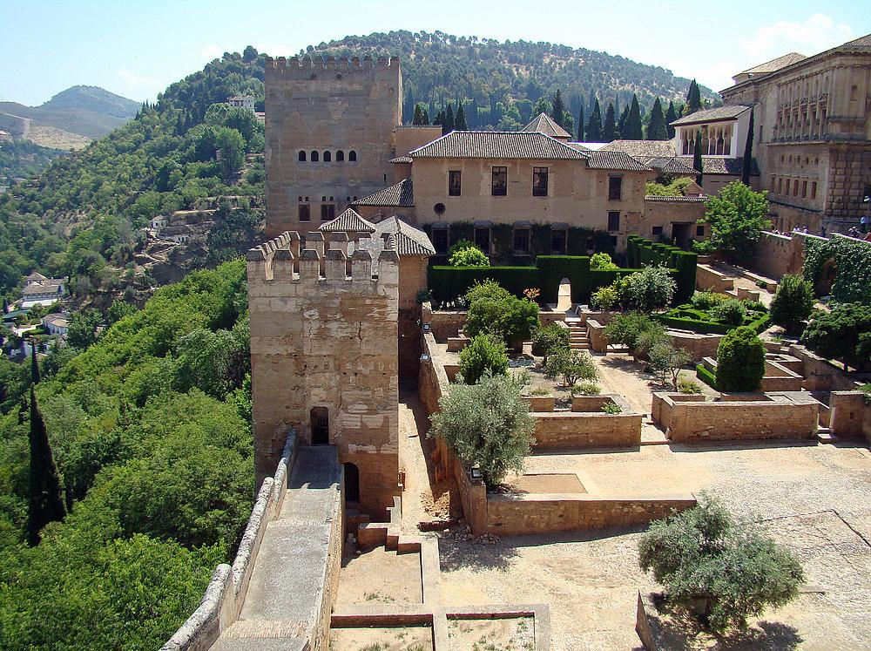

Slide 35
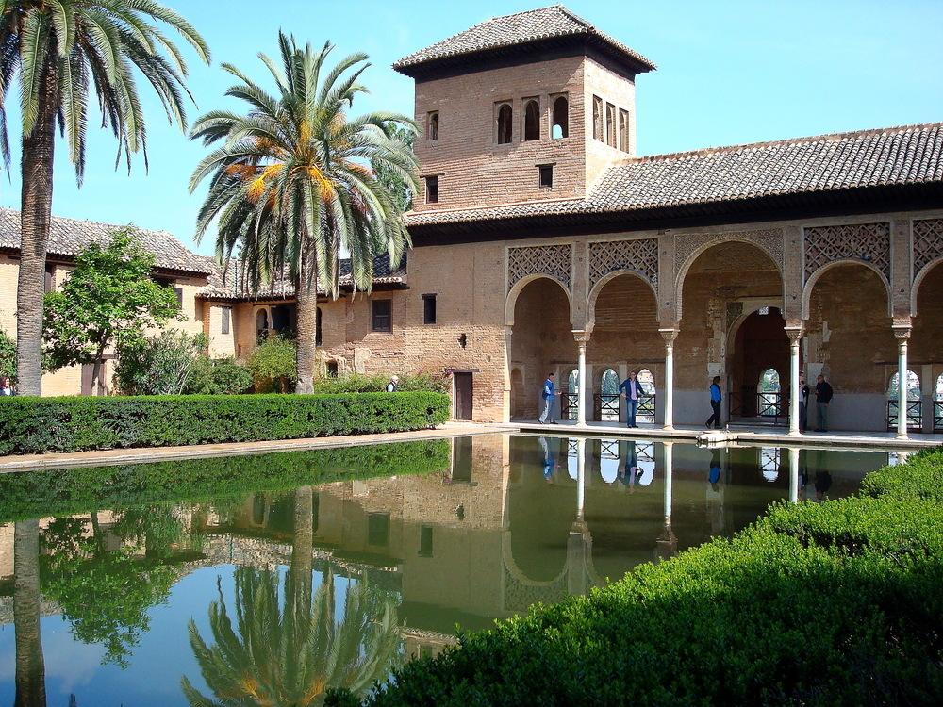

Slide 36
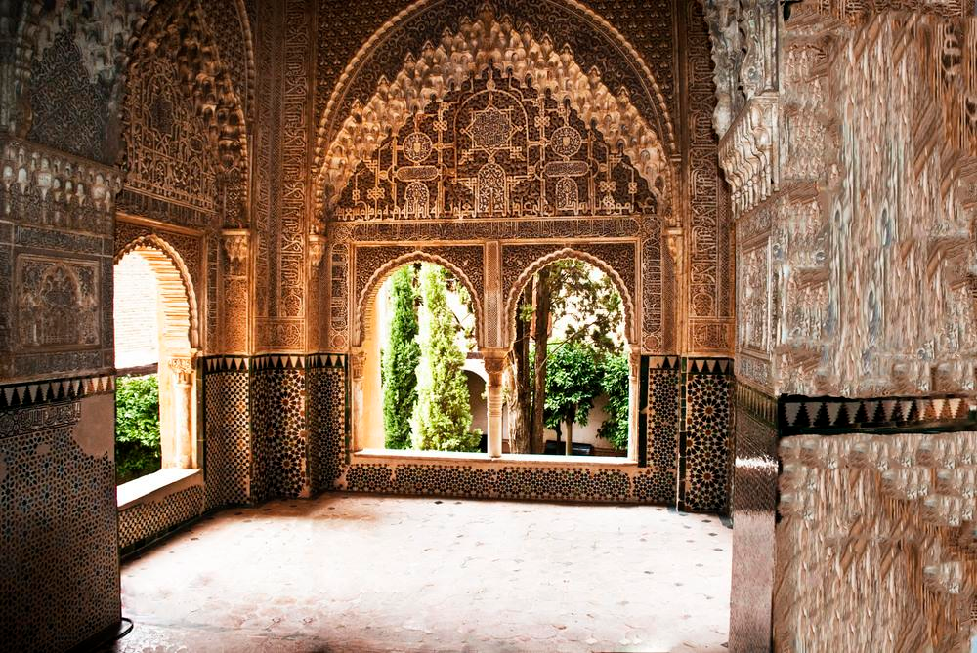

Slide 37
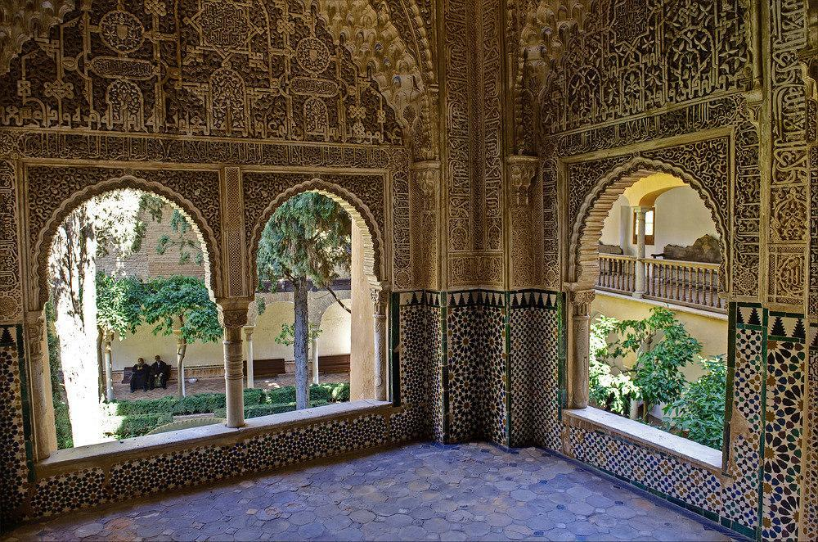

Slide 38
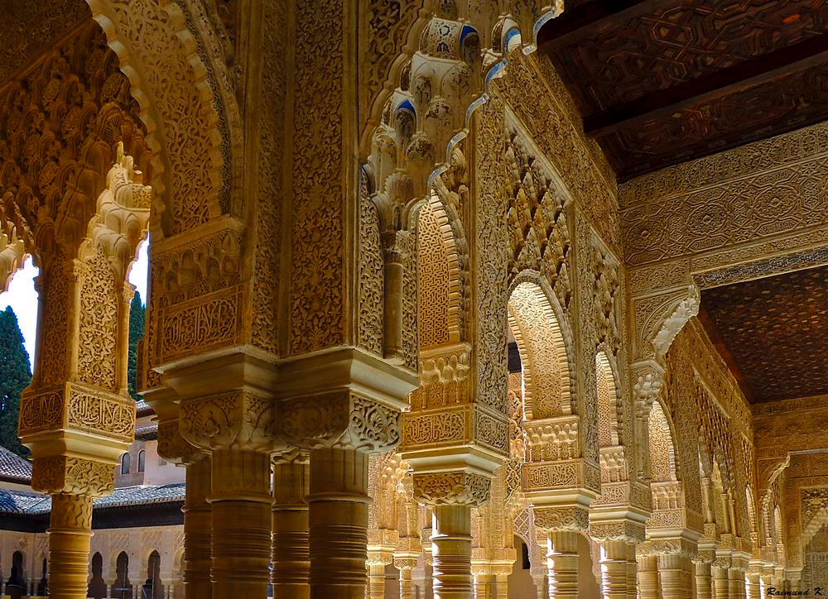

Slide 39
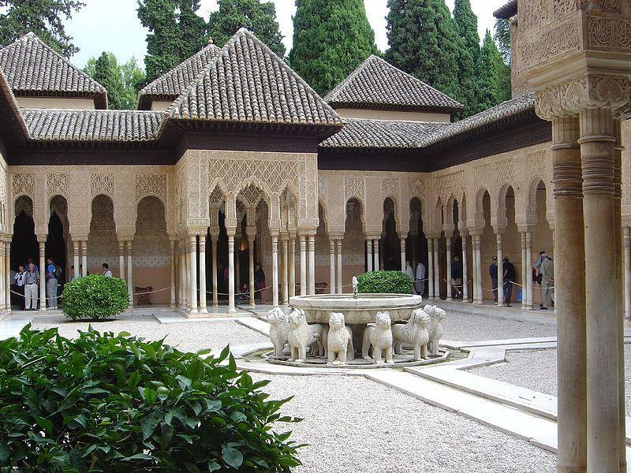
Alhambra-The Court of the Lions, a unique example of Muslim art

Slide 40
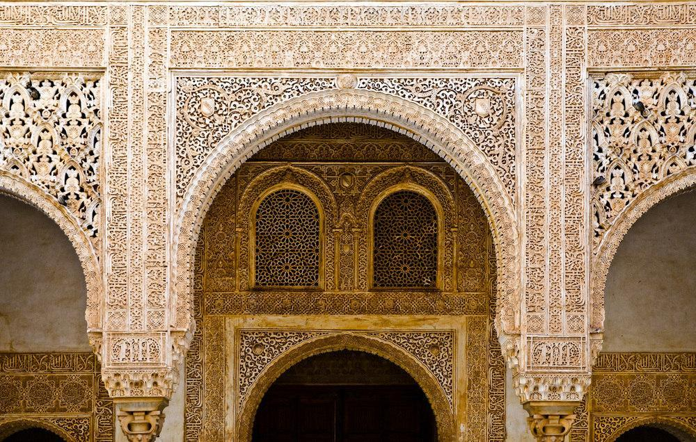

Slide 41
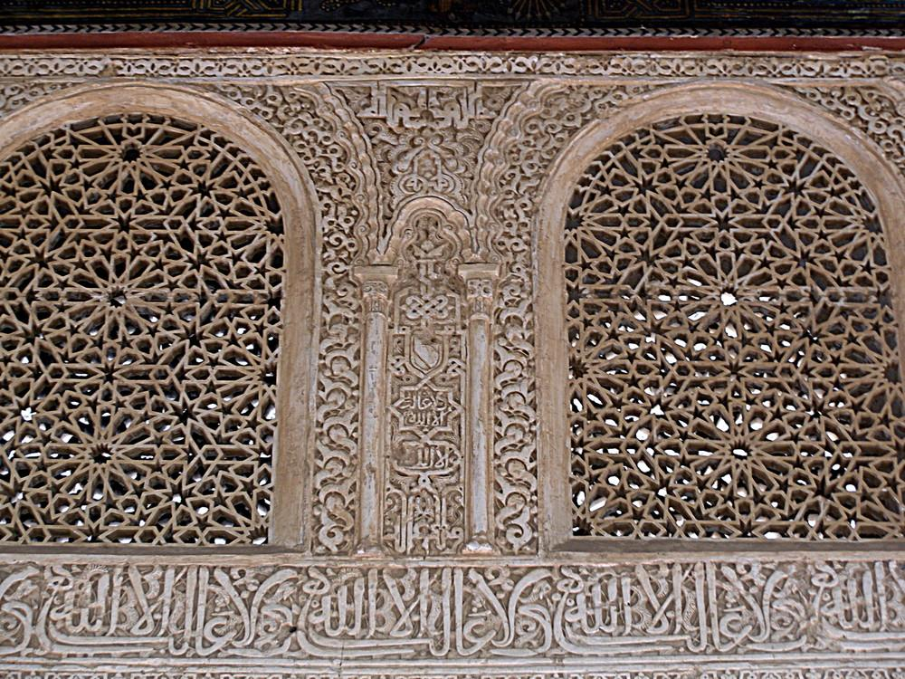

Slide 42
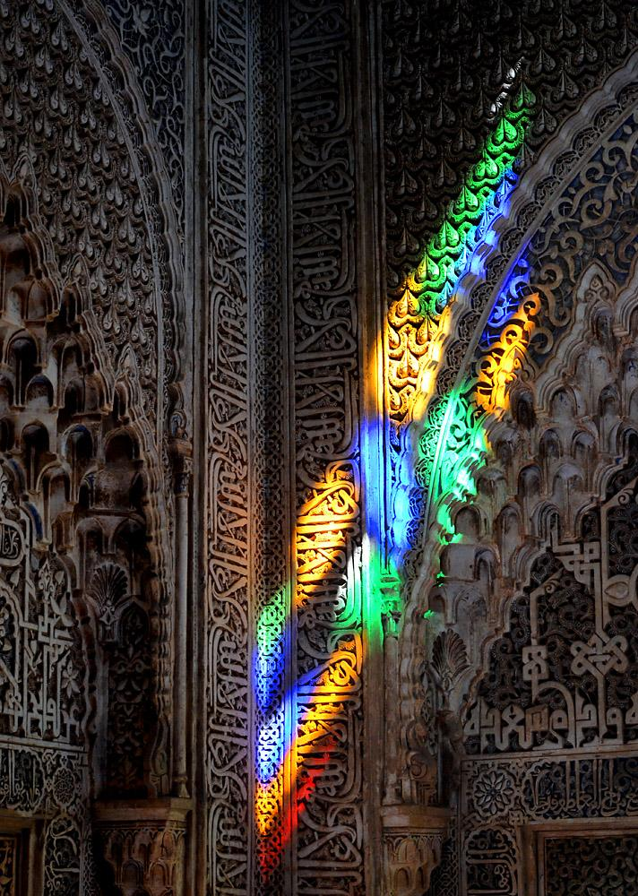

Slide 43
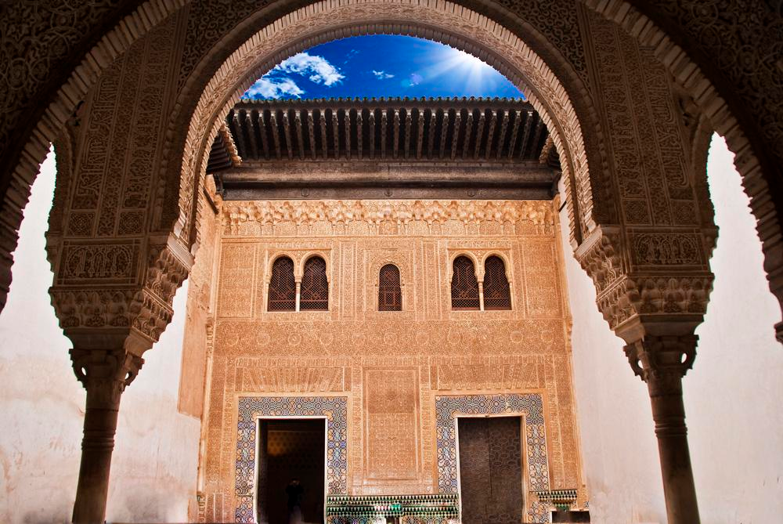

Slide 44
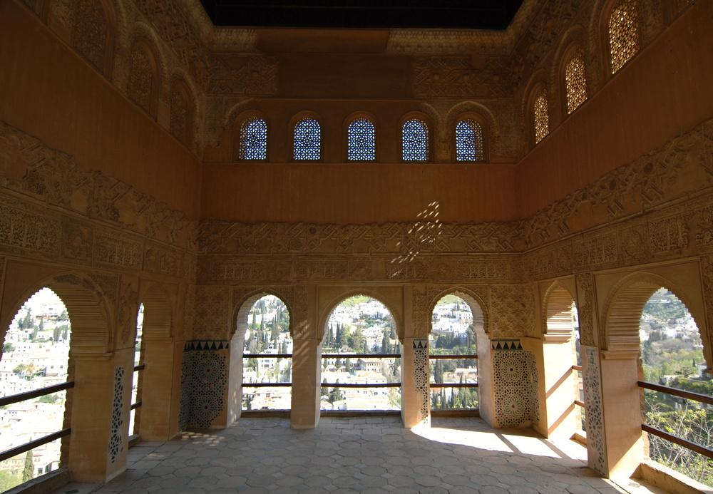

Slide 45
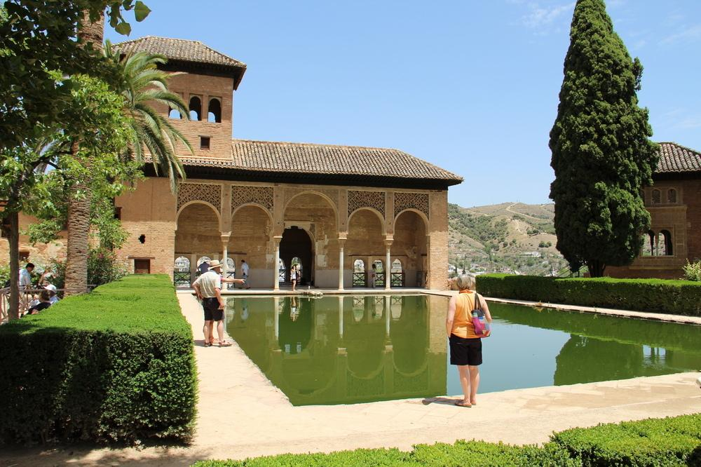

Slide 46
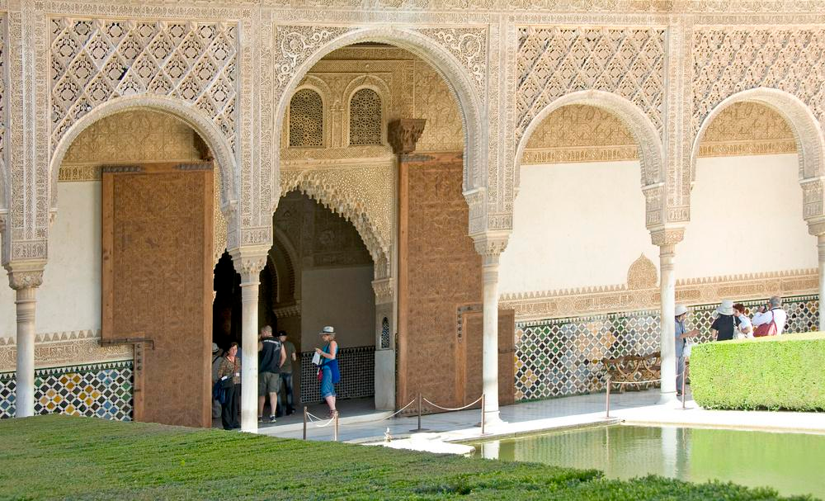

Slide 47
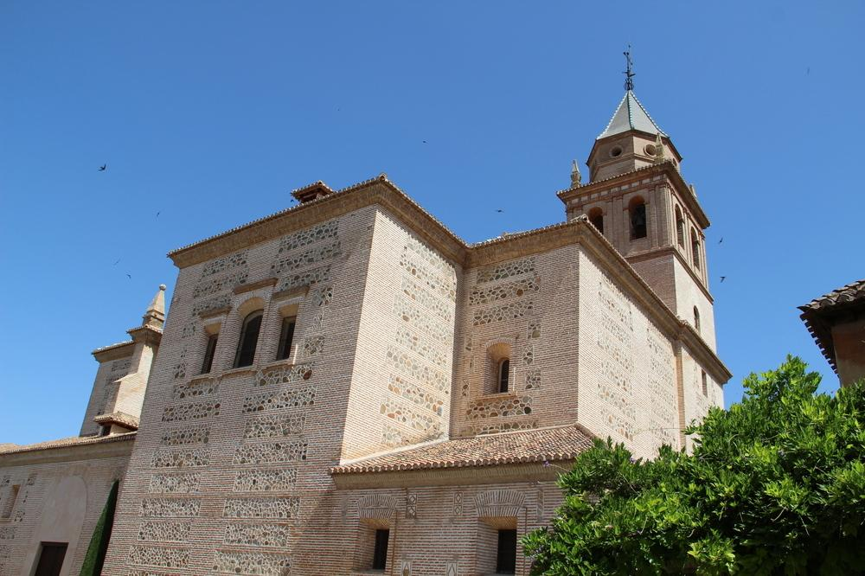

Slide 48
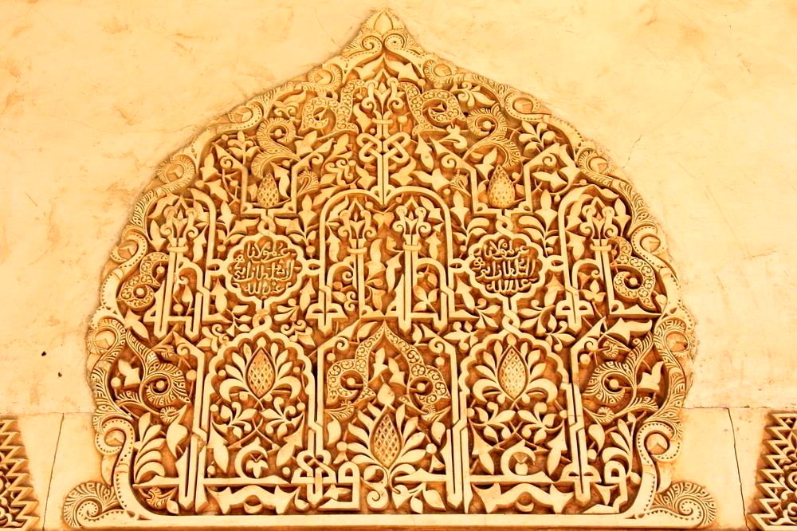

Slide 49
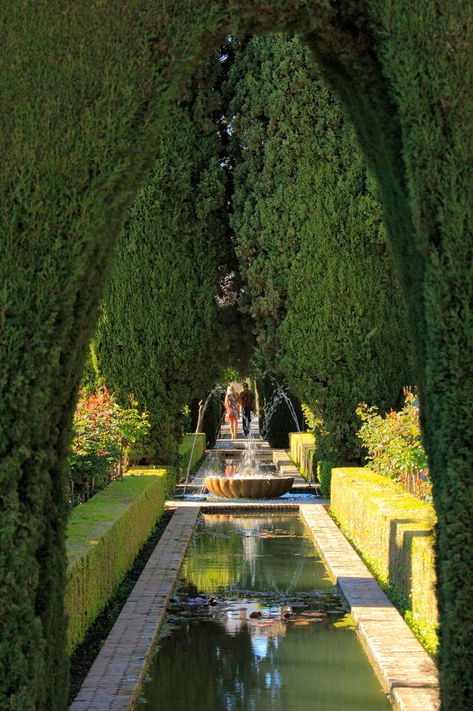

Slide 50
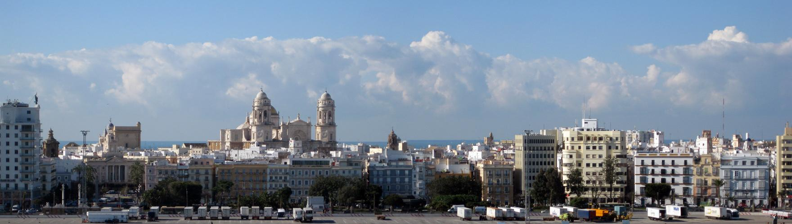
Cadiz

Slide 51

Cadiz

Slide 52


Slide 53


Slide 54

Cathedral of Cadiz

Slide 55

Organ in the Cathedral of Cadiz

Slide 56

Cape Trafalgar

Slide 57
The Battle of Trafalgar
The Battle of Trafalgar (21 October 1805) was a naval engagement fought by the British Royal Navy against the combined fleets of the French Navy and Spanish Navy, during the War of the Third Coalition (August–December 1805) of the Napoleonic Wars (1803–1815). The battle was the most decisive British naval victory of the war. Twenty-seven British ships of the line led by Admiral Lord Nelson aboard HMS Victory defeated thirty-three French and Spanish ships of the line under French Admiral Pierre-Charles Villeneuve off the south-west coast of Spain, just west of Cape Trafalgar. The Franco-Spanish fleet lost twenty-two ships, without a single British vessel being lost.

Slide 58

Chipiona

Slide 59

Zahara de la Sierra

Slide 60


Slide 61

Marbella

Slide 62

Marbella - Old town

Slide 63

Cordoba
An Iberian and Roman city in ancient times, in the Middle Ages it became the capital of an Islamic caliphate.

Slide 64


Slide 65
Cathedral–Mosque of Córdoba and Roman bridge The Cathedral and former Great Mosque of Córdoba, in ecclesiastical terms the Catedral de Nuestra Señora de la Asunción (English: Cathedral of Our Lady of the Assumption), and known by the inhabitants of Córdoba as the Mezquita-Catedral (Mosque–Cathedral), is today a World Heritage Site and the cathedral of the Diocese of Córdoba. (next 2 slides)

Slide 66


Slide 67


Slide 68

Alley in Cordoba

Slide 69

Moses-Maimonides-The monument of the Jewish philosopher, theologian and physician is in the Jewish Quarter in Cordoba

Slide 70

Bell tower of the Mosque-Cathedral

Slide 71

Cathedral Interior

Slide 72

This mix is unique in the world. In the middle of the mosque (Mezquita in Cordoba) stands in the midst of the many columns of a Christian altar with a crucifix from the 16th Century.

Slide 73


Slide 74


Slide 75

Moorish ornaments with Christian figures

Slide 76


Slide 77

Arabian dome in the Mosque-Cathedral of Córdoba

Slide 78


Slide 79


Slide 80

Roman gate of Cordoba

Slide 81

Roman Mausoleum in the Paseo de la Victoria

Slide 82

The gardens of the Alcázar of Córdoba

Slide 83

Patio of Cordoba
Seville.
Seville.
Seville.

Slide 84

Seville

Slide 85


Slide 86


Slide 87

A commemorative plaque for Cervantes, the creator of Don Quixote and Sancho Panza in Seville.

Slide 88

SEVILLE’S SOLAR POWER TOWER

Slide 89

Seville Cathedral

Slide 90

Seville Cathedral

Slide 91

Seville Cathedral front entrance

Slide 92


Slide 93

Seville Cathedral (Catedral de Santa María de la Sede)

Slide 94

Seville Cathedral - the coffin of Christopher Columbus

Slide 95


Slide 96

Seville

Slide 97

Monument to Christopher Colombus-Seville

Slide 98

Monument to Christopher Colombus-Seville

Slide 99

Cathedral Giralda

Slide 100

Spanish square - Seville

Slide 101

Spanish square - Seville

Slide 102

Maria Luisa Park - Spanish Square - Seville

Slide 103

Spanish square - Seville

Slide 104

Spanish square - Seville

Slide 105


Slide 106

Spanish square - Seville

Slide 107

Details of Spanish Square

Slide 108

Spanish square - marble bridge - Seville

Slide 109

Alcazar - Seville

Slide 110

Alcazar - Seville

Slide 111

Gardens of Alcazar - Seville

Slide 112

Gardens of Alcazar - Seville

Slide 113

Baths of Lady Maria de Padilla - Royal palace Alcazar - Seville

Slide 114

Patio de las doncellas

Slide 115

The Palace Archbishop of Seville

Slide 116

Museum of Arts and folk traditions in Seville at the Plaza de America

Slide 117

Tile art - Seville

Slide 118

Plaza in Seville

Slide 119

Parasol - Seville

Slide 120

The Torre del Oro (Gold Tower) is a dodecagonal military watchtower in Seville, southern Spain, built by the Almohad dynasty in order to control access to Seville via the Guadalquivir river.

Slide 121

Triana Bridge - Seville

