Slide 1
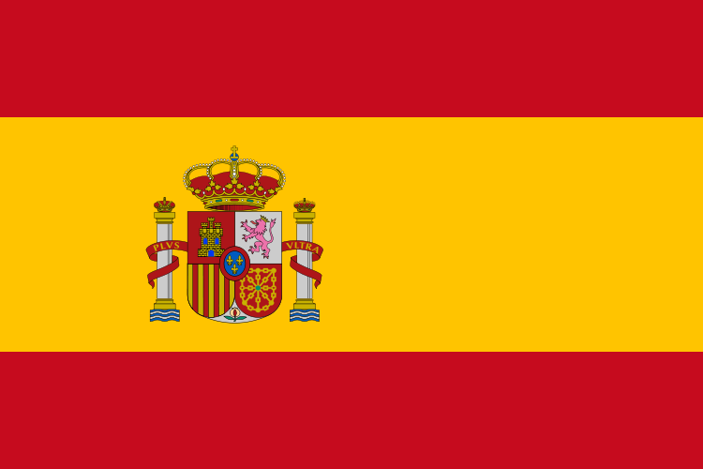
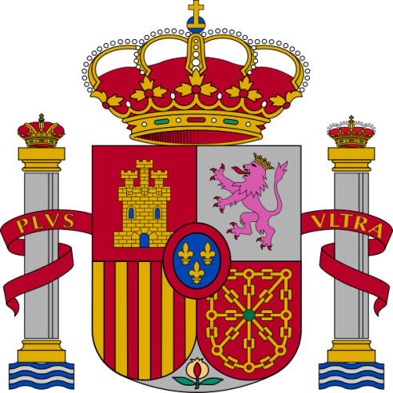
Spain (Part 1)

Slide 2
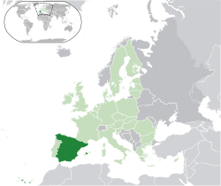
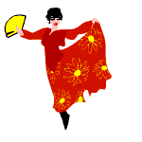
Region: Southwestern Europe
Coast Line: Atlantic Ocean & Mediterranean Sea
Area: 505,992 km2
Capital: Madrid

Slide 3
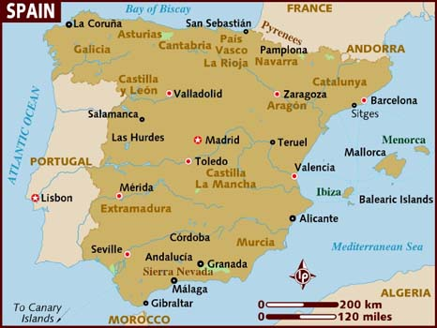

Slide 4
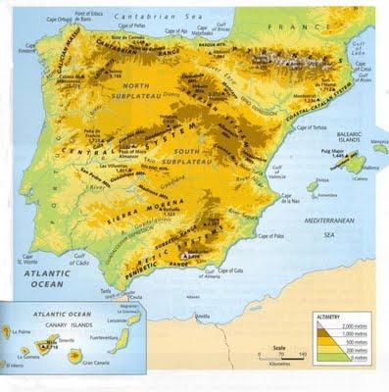

Slide 5
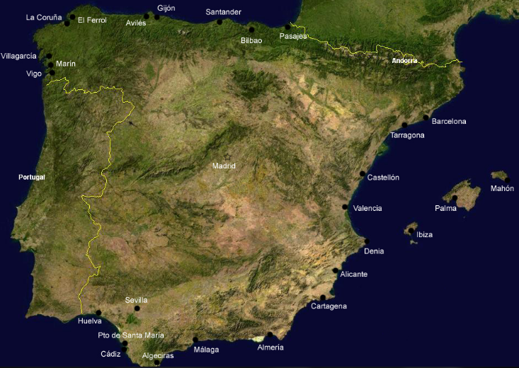

Slide 6
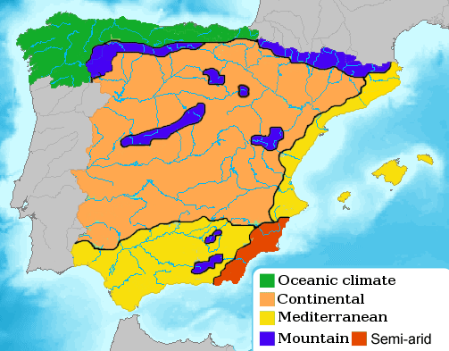

Slide 7
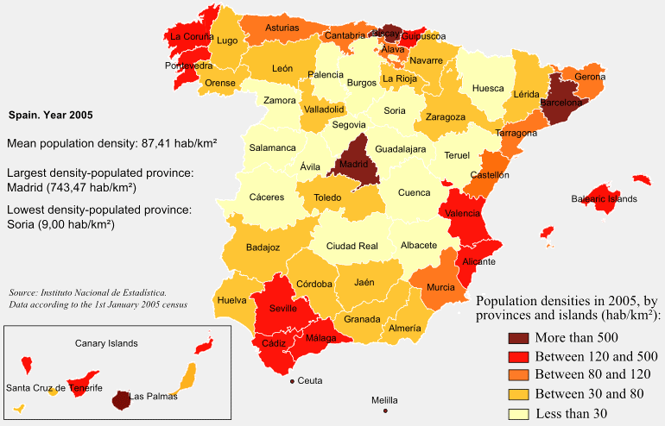

Slide 8
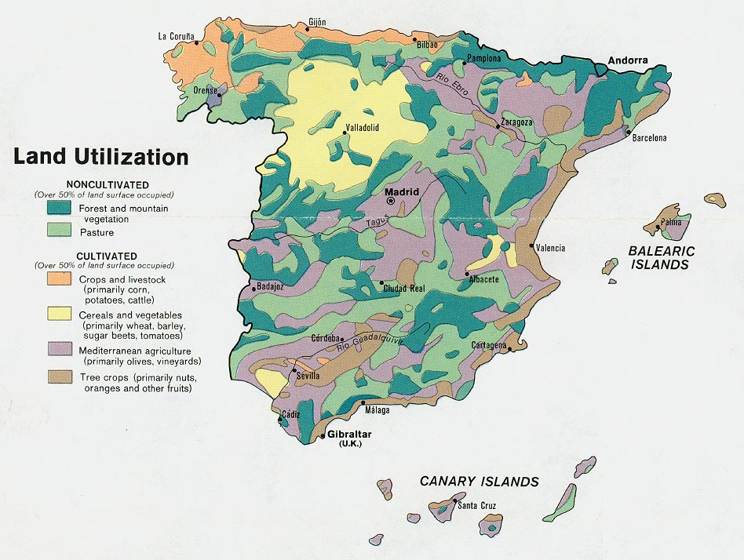

Slide 9
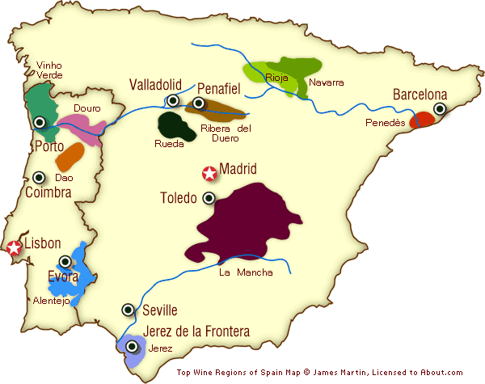

Slide 10
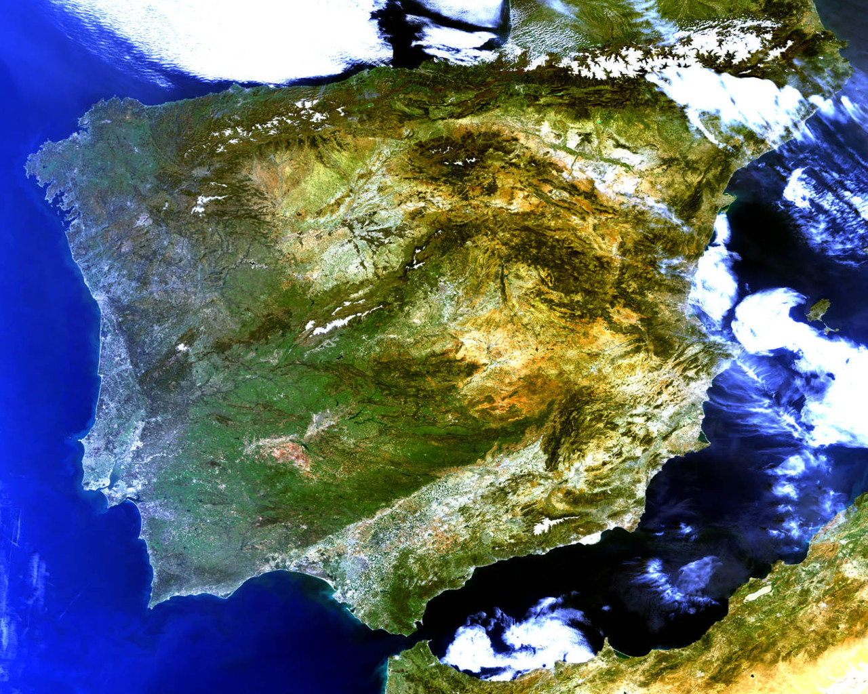
The Meseta (Central Plateau)
Meseta

Slide 11
The Meseta Central ("Inner Plateau") is a vast plateau in the heart of peninsular Spain, has elevations that range from 610 to 760 m. Rimmed by mountains, the Meseta Central slopes gently to the west and to the series of rivers that form some of the border with Portugal. The Sistema Central, described as the "dorsal spine" of the Meseta Central, divides the Meseta into northern and southern subregions, the former higher in elevation and smaller in area than the latter.

Slide 12
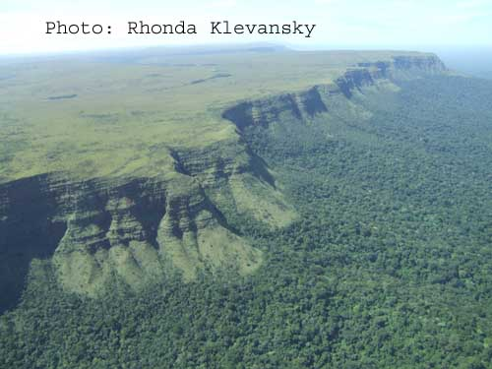
Meseta Escarpment

Slide 13
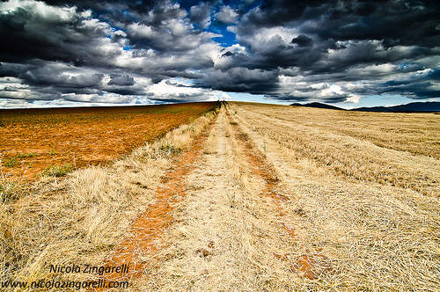
Spanish Meseta – Dark sky and bright field

Slide 14
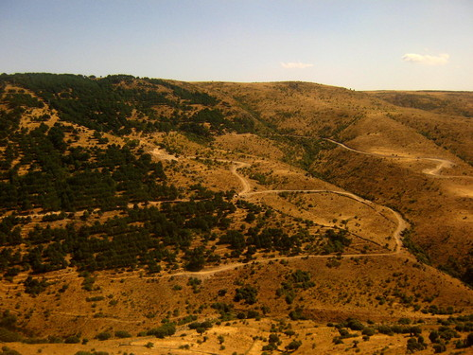

Slide 15
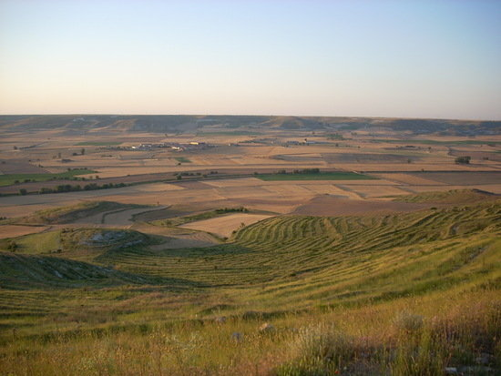

Slide 16
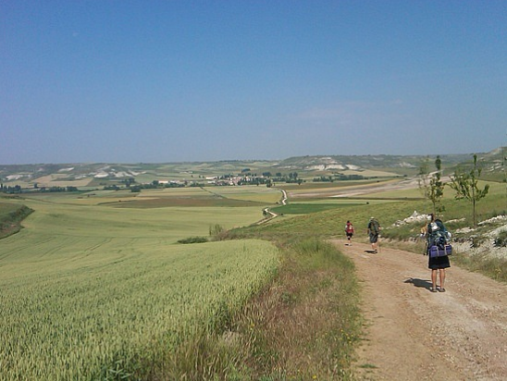

Slide 17
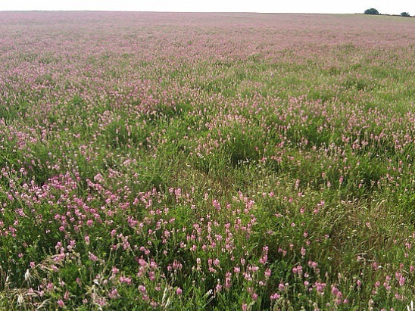

Slide 18
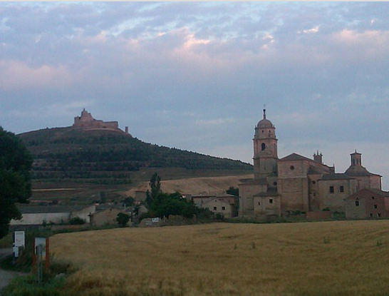

Slide 19
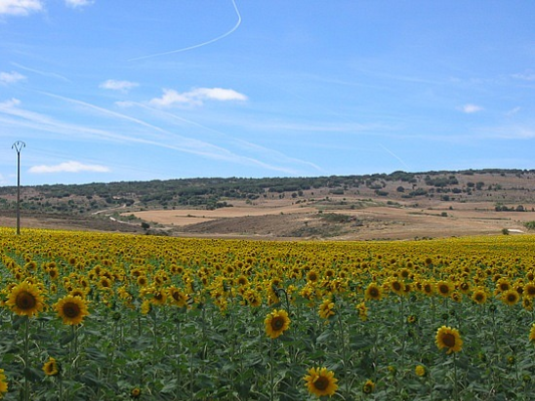

Slide 20
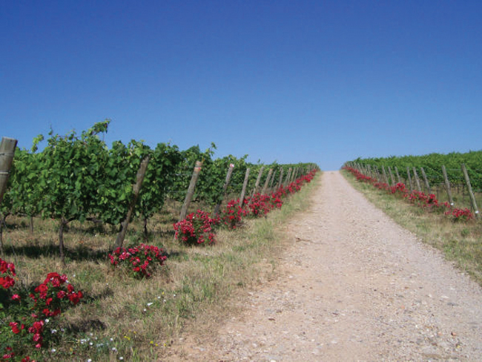

Slide 21
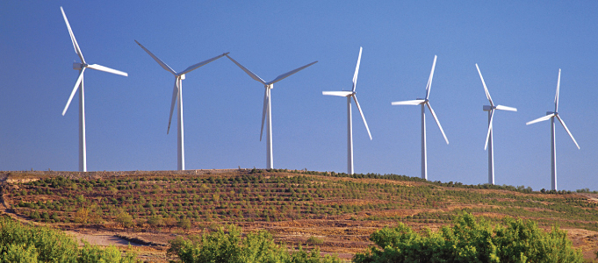

Slide 22
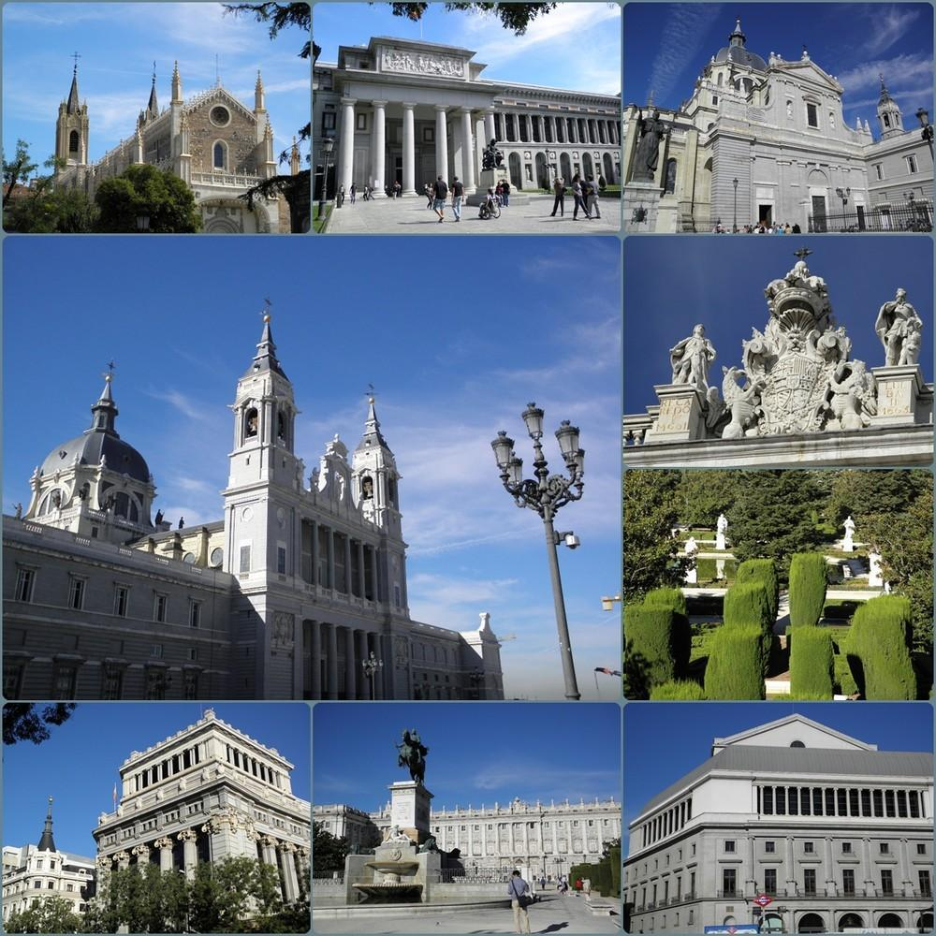
madrid

Slide 23
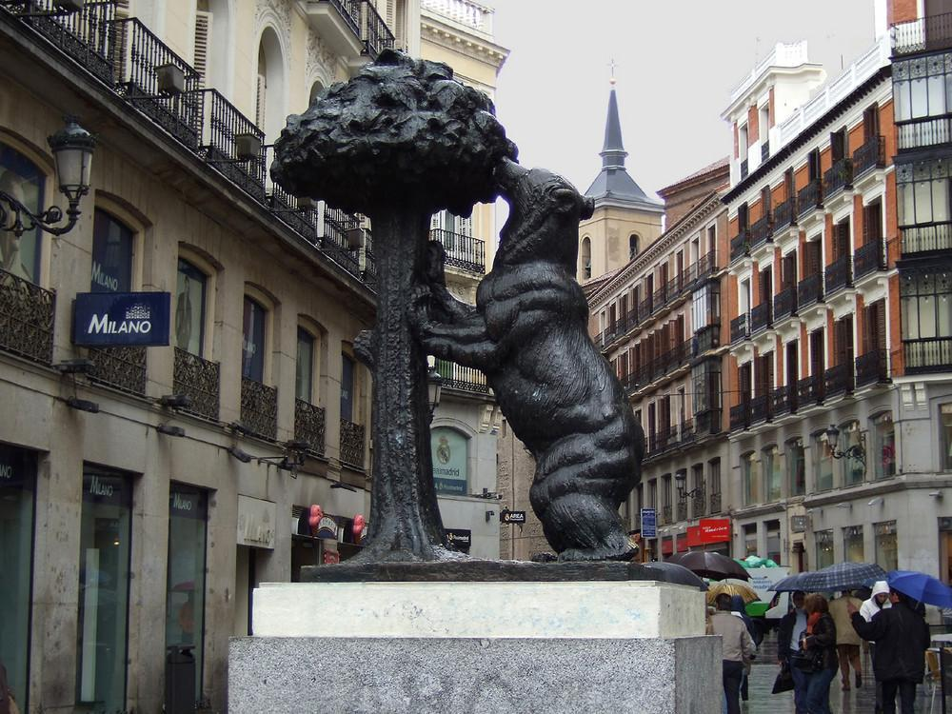
Bear and Arbutus – The symbol of Madrid-Puerta del Sol

Slide 24
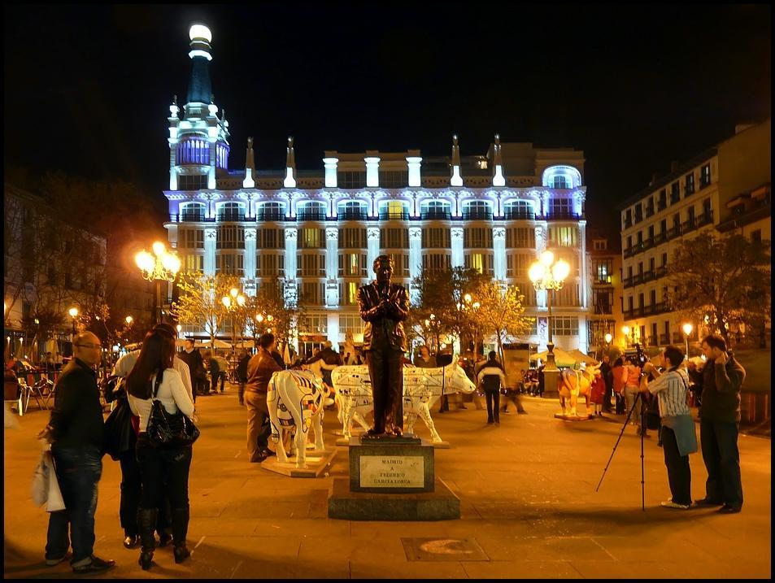

Slide 25
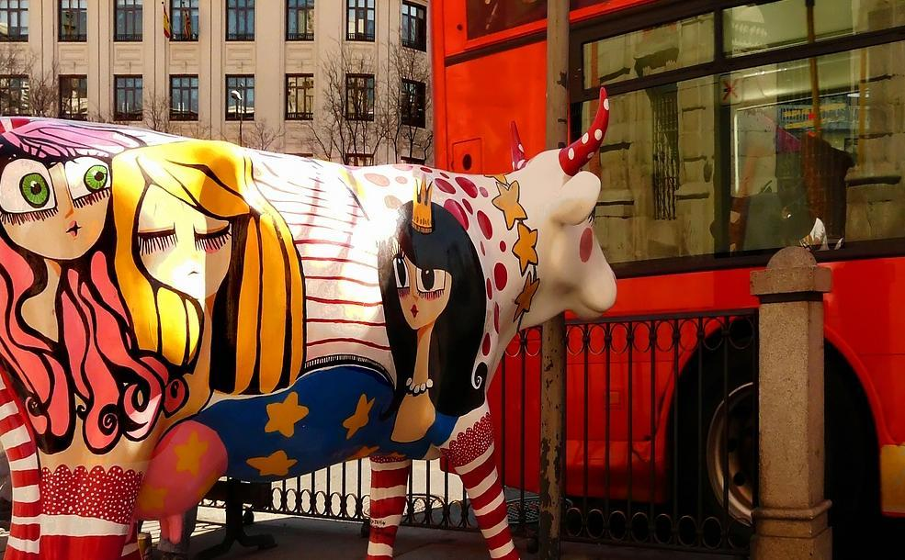

Slide 26
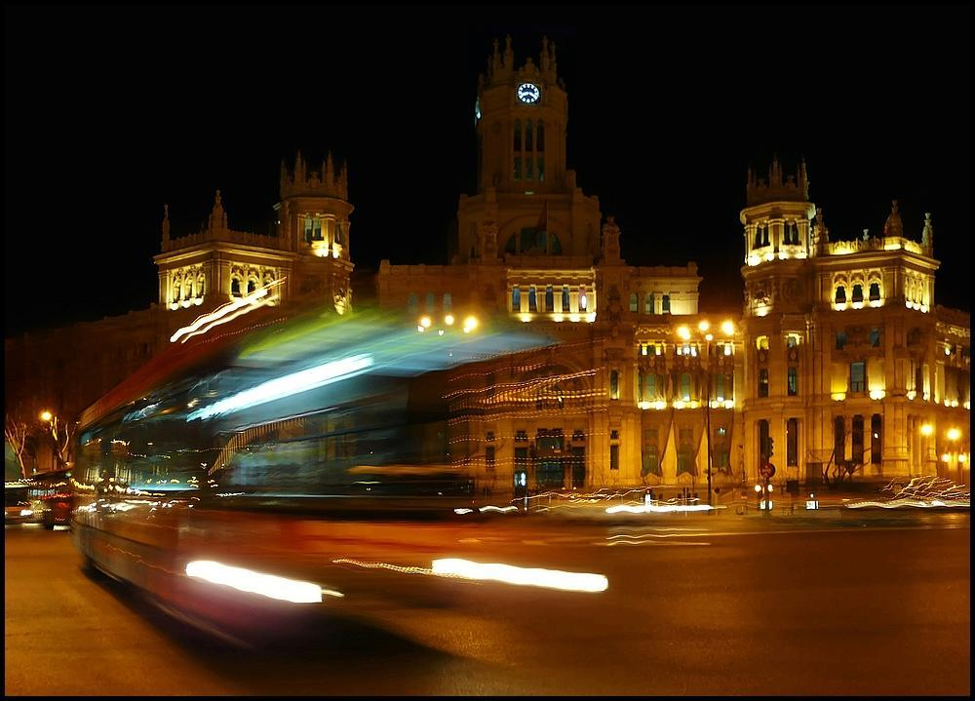

Slide 27
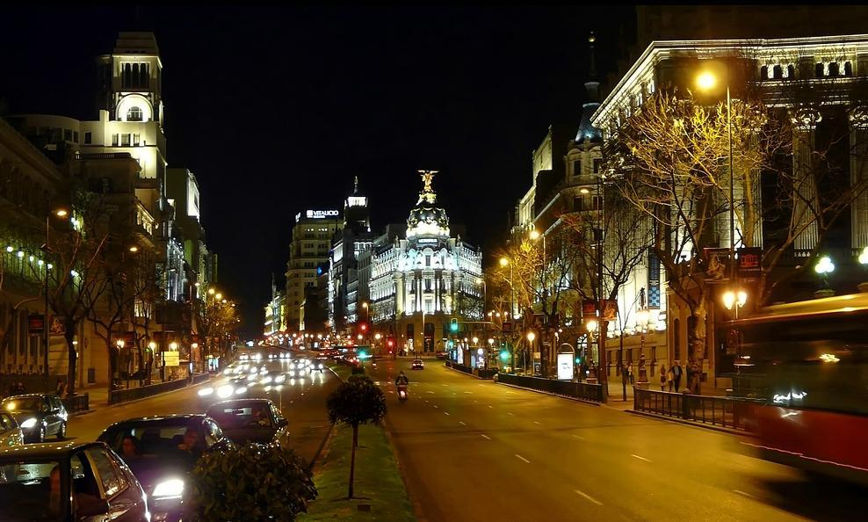

Slide 28
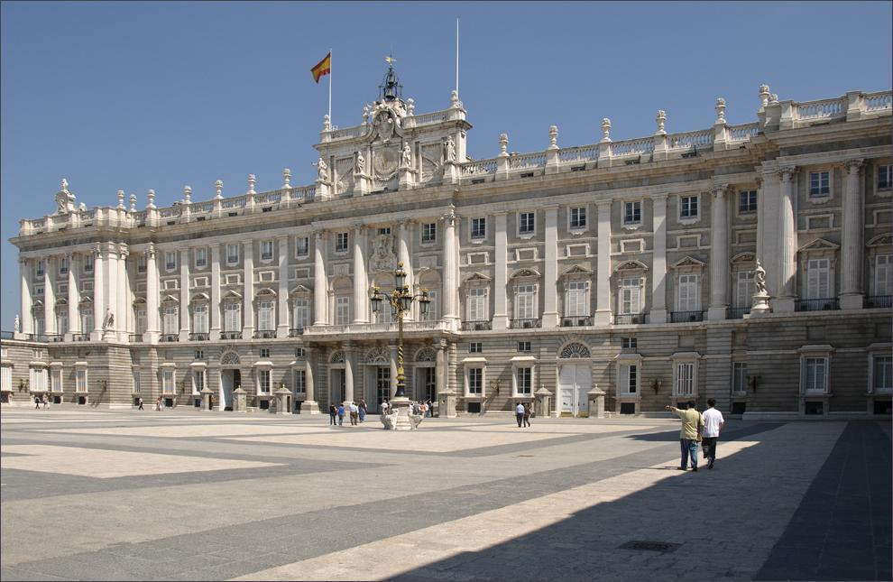
Royal Palace

Slide 29
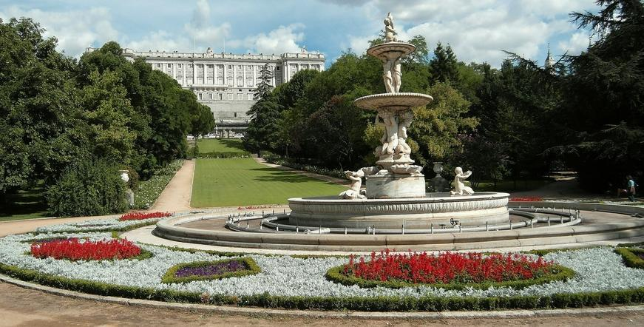
Royal Palace

Slide 30
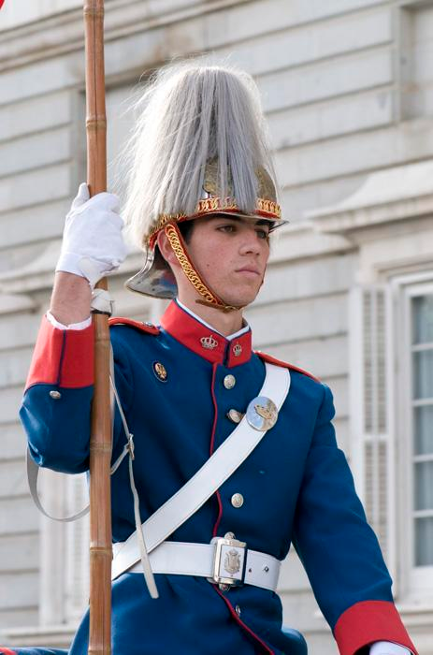
Guarding the palace

Slide 31
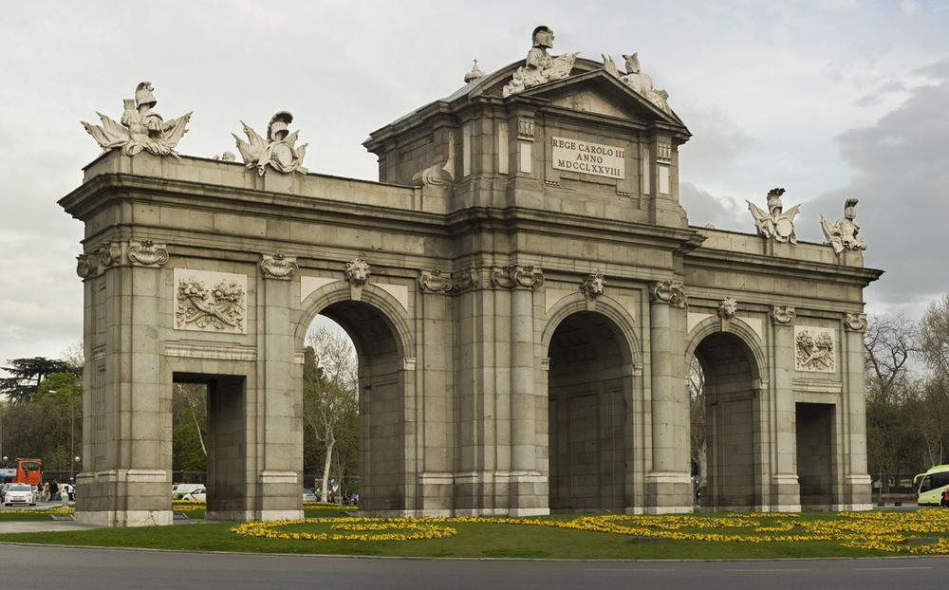
Puerta de Alcalá - Neo classical moument in the Independence Square

Slide 32
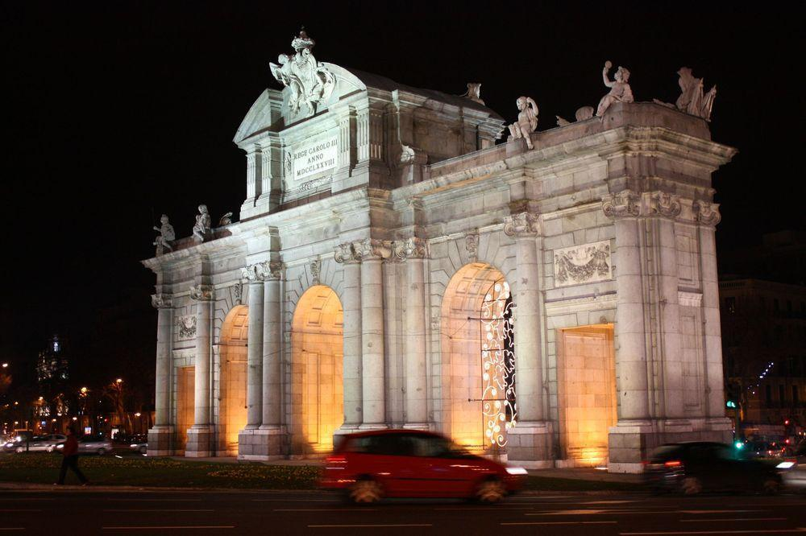
Puerta de Alcalá

Slide 33
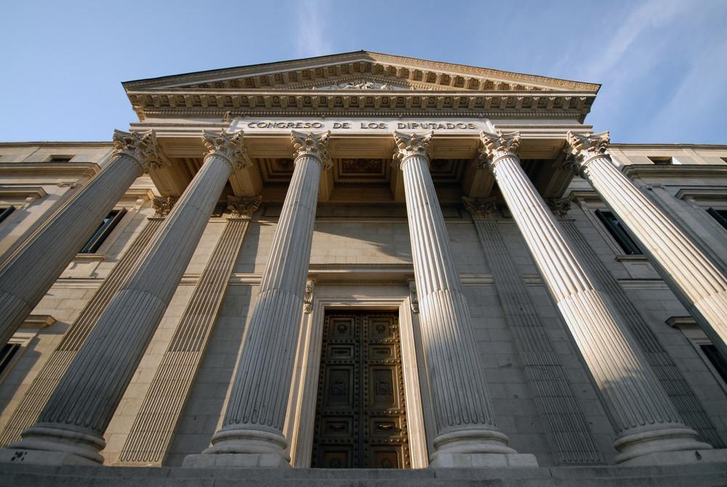
Congress of Deputies

Slide 34
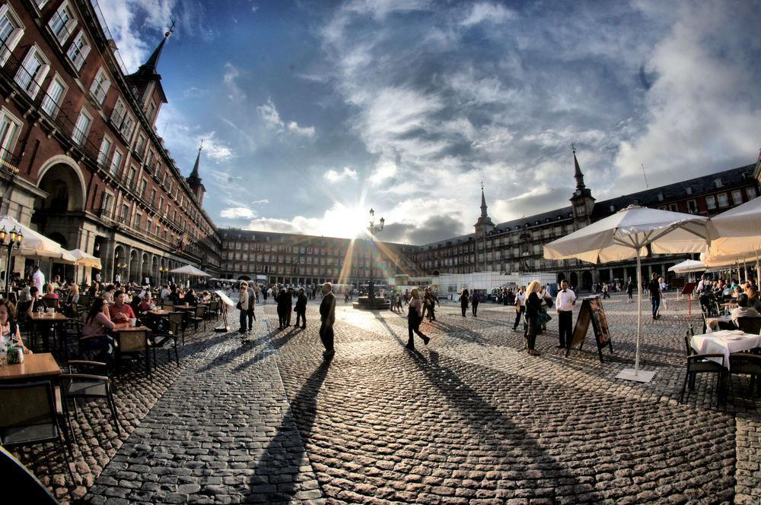
Plaza Mayor

Slide 35
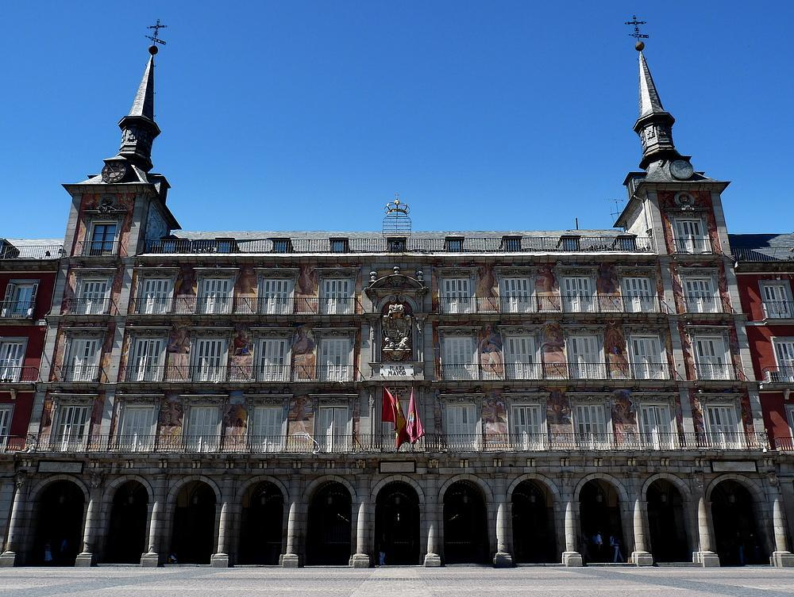
The Casa de la Panadería (Bakery House) Plaza Mayor Municipal and cultural building

Slide 36
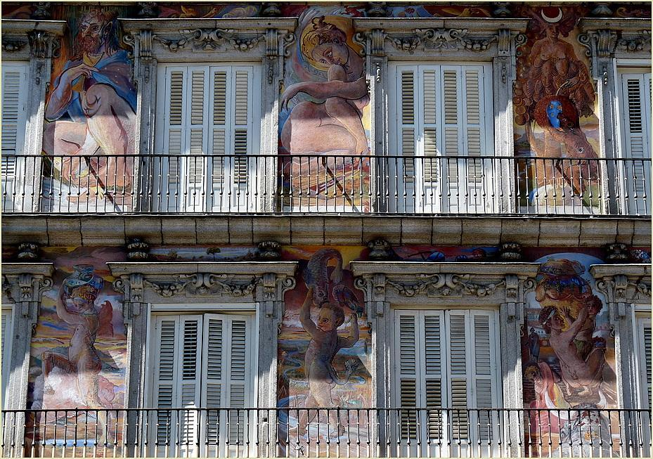
Paintings of Casa de la Panadería

Slide 37
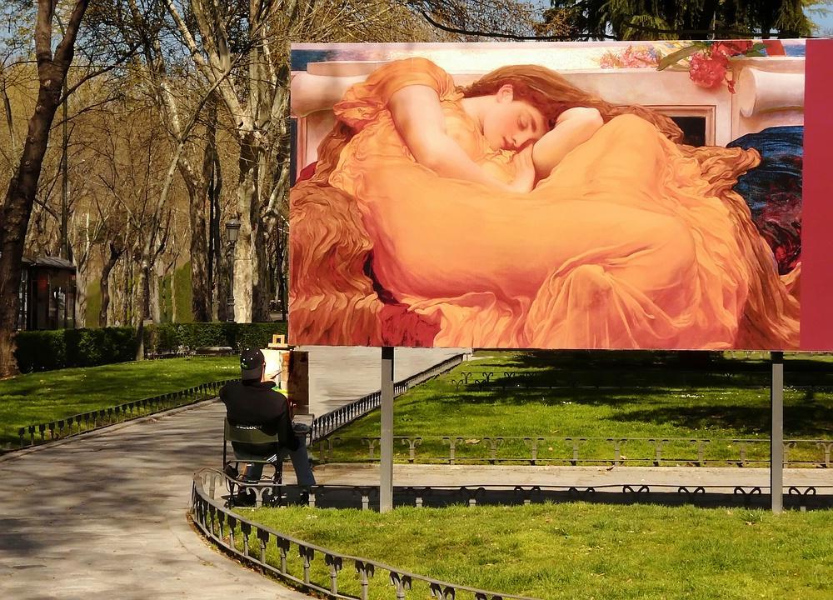

Slide 38
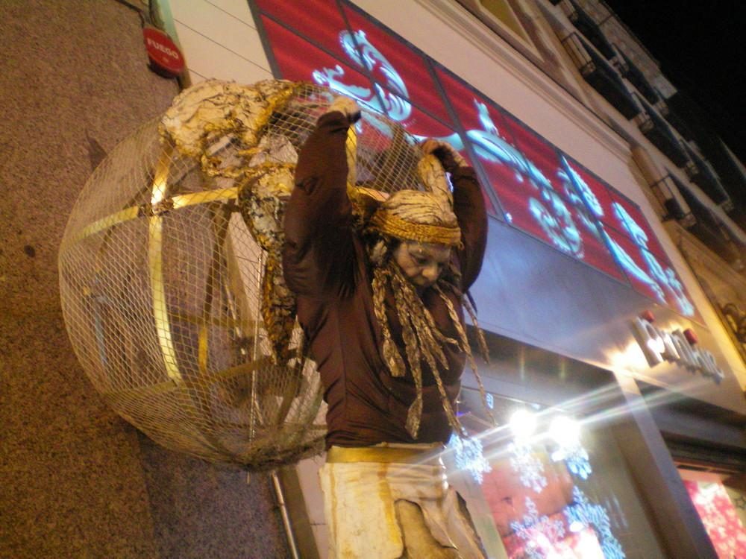
The moument carrying the world

Slide 39
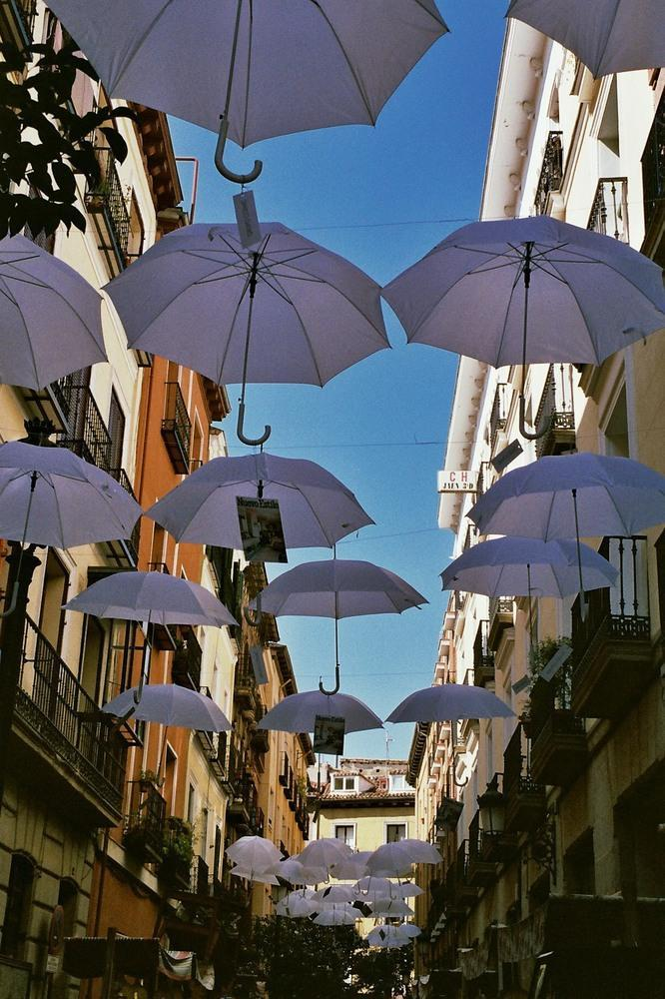

Slide 40
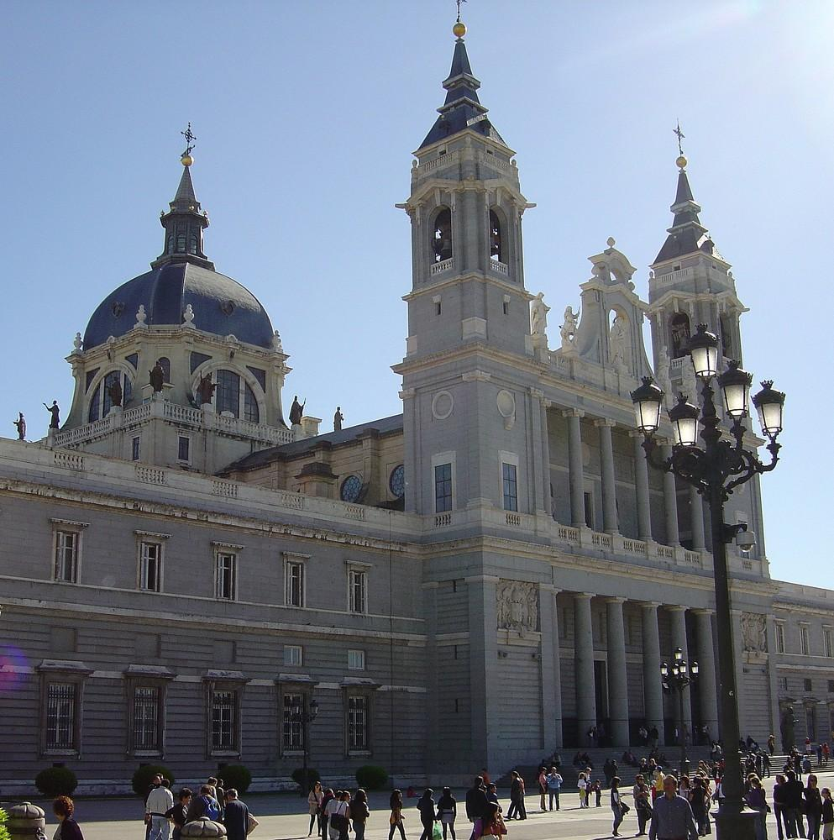
Almudena Cathedral - Madrid

Slide 41
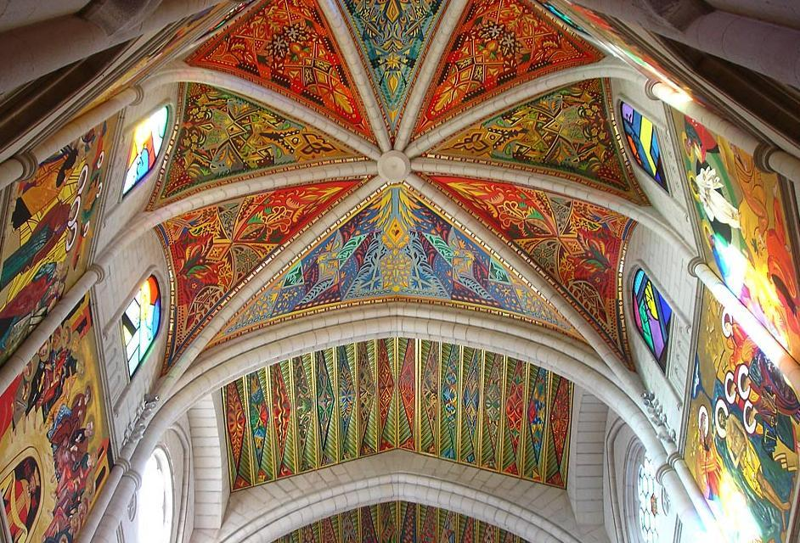
Almudena Cathedral interior

Slide 42
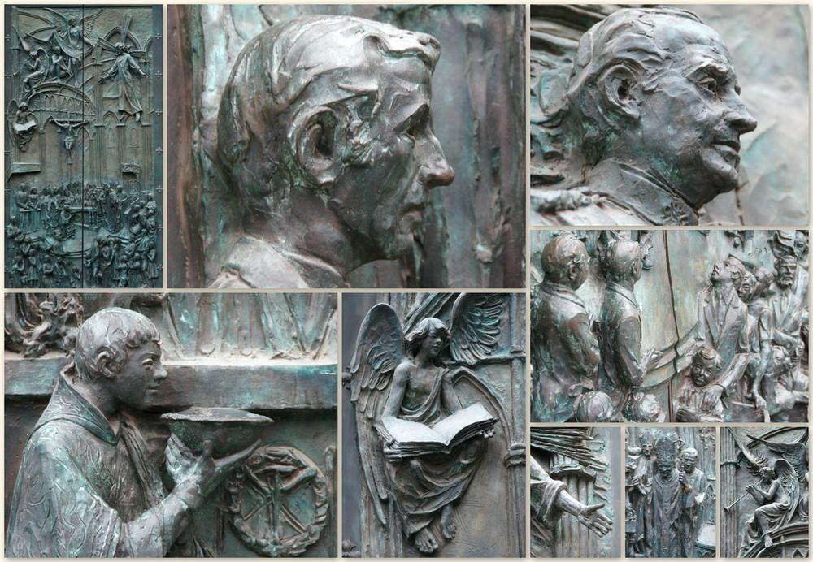
Reliefs of Almudena Cathedral

Slide 43
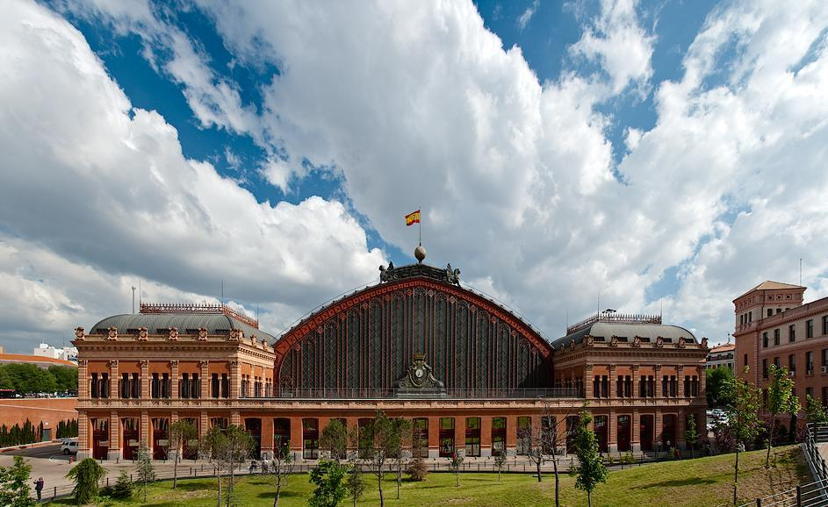
Atocha station - Madrid

Slide 44
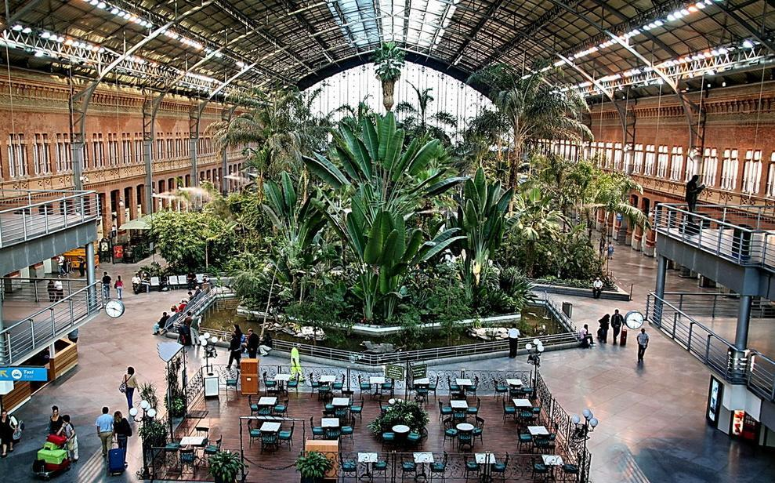
Atocha station interior

Slide 45
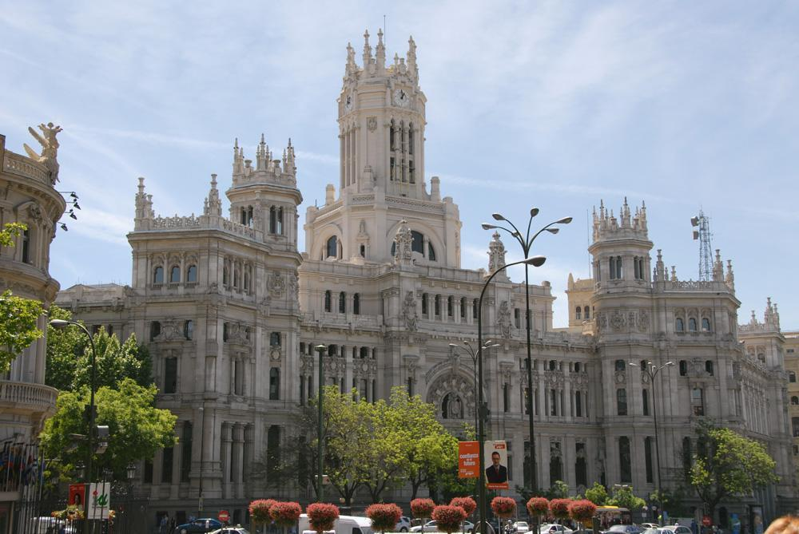
La Cibeles - Madrid

Slide 46
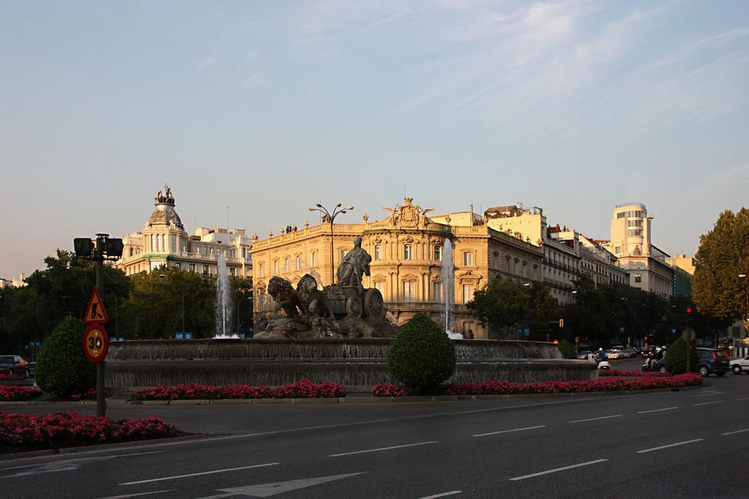
Plaza Cibeles

Slide 47
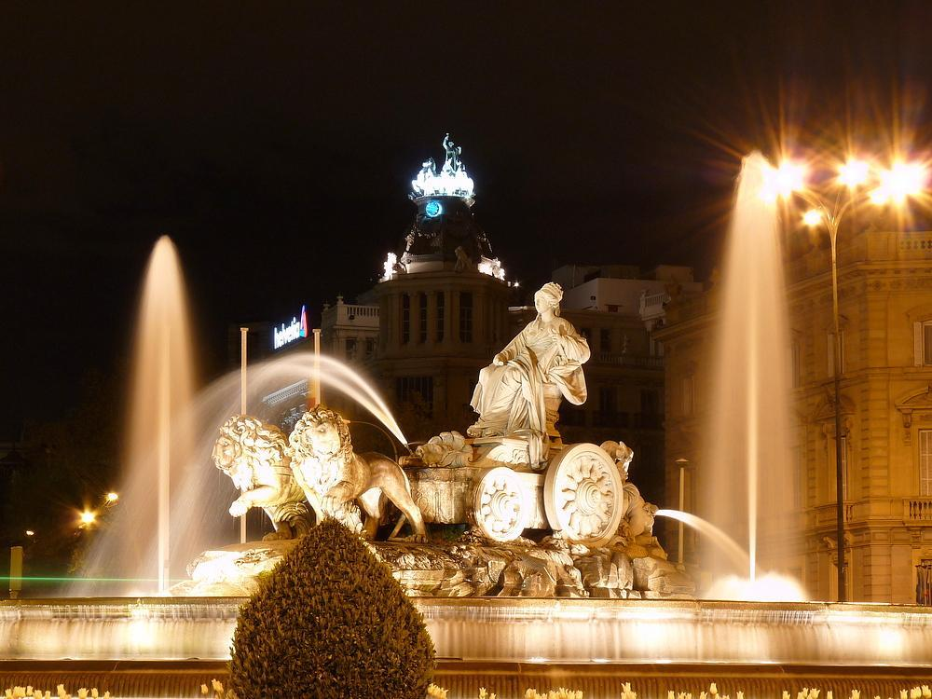
Cibeles fountain

Slide 48
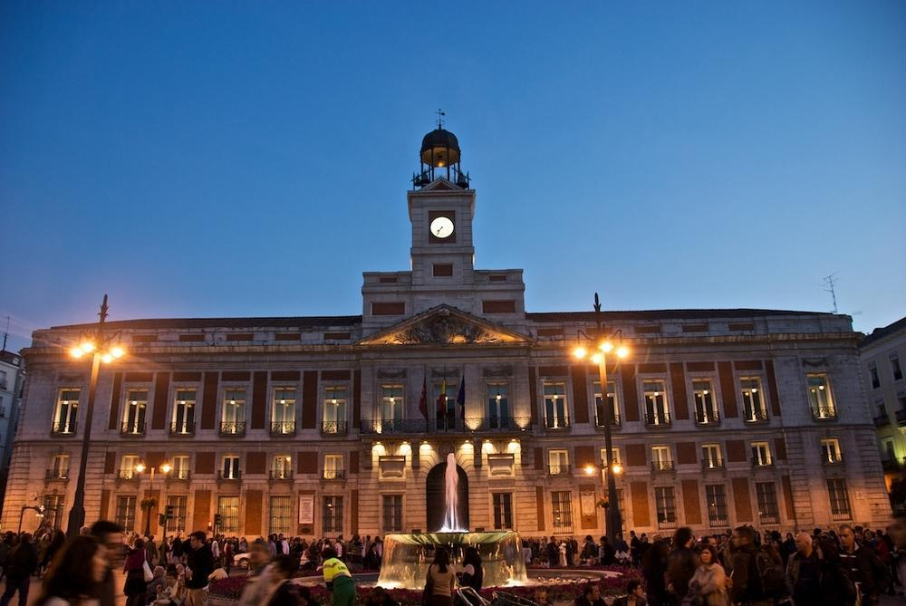
Puerta del Sol -Madrid

Slide 49
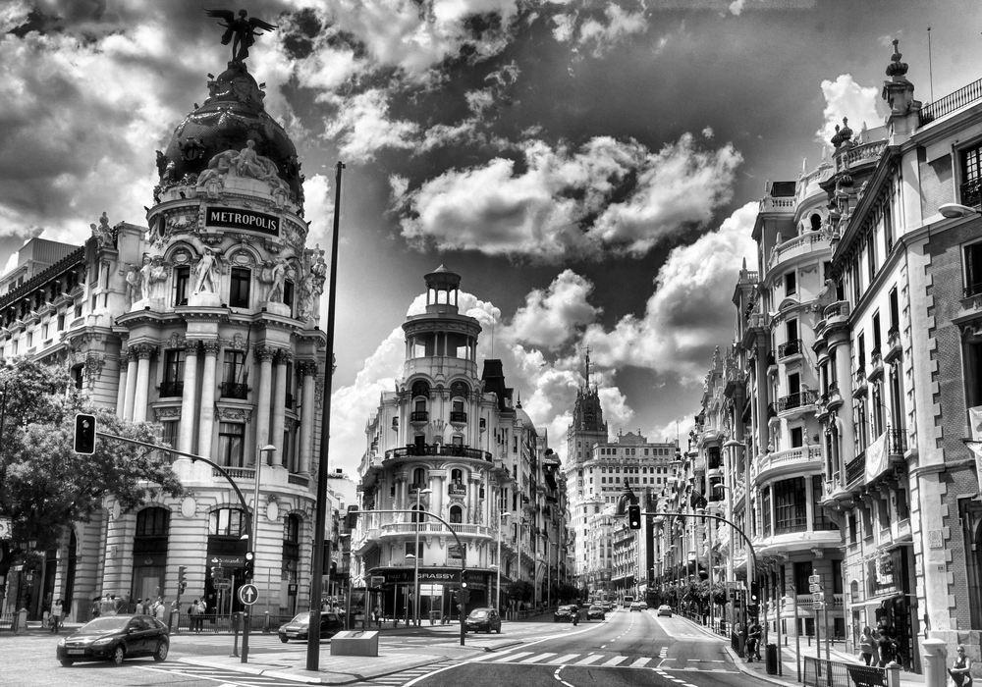
Gran Via - Metropolis - Madrid

Slide 50

Metropolis details

Slide 51

Alcala street and Metropolis

Slide 52

City hall of Madrid

Slide 53

Madrid

Slide 54

The Buen Retiro Park - Crystal Palace – Madrid. The park belonged to the Spanish Monarchy until the late 19th century, when it became a public park.

Slide 55

Crystal Palace Interior

Slide 56

Retiro Park-Monument to AlfonsoXII

Slide 57

Plaza de Espana - Madrid

Slide 58
Cervantes and his creation (Don Quixote and Sancho Panza) – Picture on the next slide.
Miguel de Cervantes Saavedra (29 September 1547 – 22 April 1616)[2] was a Spanish novelist, poet, and playwright. His magnum opus, Don Quixote, considered the first modern European novel, is a classic of Western literature, and is regarded amongst the best works of fiction ever written. His influence on the Spanish language has been so great that the language is often called la lengua de Cervantes ("the language of Cervantes"). He was dubbed El Príncipe de los Ingenios ("The Prince of Wits").

Slide 59


Slide 60

Don Quixote and Sancho Panza

Slide 61

Rocinante is the name of Don Quixote's horse, in the novel Don Quixote by Miguel de Cervantes.

Slide 62

Don Quixote-by Pablo Picasso

Slide 63

Cervantes Institute

Slide 64
Aranjuez-Royal Palace (picture on next slide)
The Royal Palace of Aranjuez is a residence of the King of Spain, located in the town of Aranjuez, Community of Madrid, Spain. The palace is open to the public as one of the Spanish royal sites.
The Concierto de Aranjuez is a composition for classical guitar and orchestra written by Spanish composer Joaquín Rodrigo, who was inspired by the palace gardens.
The work attempts to take the listener through sounds of nature in and around the gardens during the period in which it was written.

Slide 65


Slide 66

The plaza, originally called "Plaza de Santiago" (St. James Square), was renamed "Plaza de Colón" in 1893 to honour Christopher Columbus.

Slide 67
Monument to Christopher Columbus-Plaza de Colon
Christopher Columbus (Spanish:Cristobal Colón; before 31 October 1451 – 20 May 1506) was an explorer, colonizer, and navigator, born in the Republic of Genoa, in what is today northwestern Italy. Under the auspices of the Catholic Monarchs of Spain, he completed four voyages across the Atlantic Ocean that led to general European awareness of the American continents. Those voyages, and his efforts to establish permanent settlements in the island of Hispaniola, initiated the process of Spanish colonization, which foreshadowed the general European colonization of what became known as the "New World". (picture on the next slide)

Slide 68


Slide 69

Caixa Forum. Madrid. Photographic Exhibition of Isabel Muñoz

Slide 70

Caixa Forum and the hanging gardens of Madrid

Slide 71

Stadium-Santiago-Bernabeu

Slide 72

Stadium-Santiago-Bernabeu

Slide 73

Kio Towers

Slide 74

Las Ventas

Slide 75

Memorial to the victims of the attacks of 11 March 2004

Slide 76

Plaza de Oriente and Opera House

Slide 77

Prado-National Art Museum

Slide 78

Rastro-open air flea market

Slide 79


Slide 80


Slide 81

Royal Theatre

Slide 82

Shoes as art in the Reina Sofia Museum in Madrid

Slide 83

The Templo de Debod or Temple of Debod is an ancient Egyptian temple which was rebuilt in Madrid, Spain

Slide 84


Slide 85

The Plaza de Toros de Las Ventas is a famous bullring in Madrid

Slide 86


Slide 87


Slide 88

Stylish buildings of Madrid

Slide 89


Slide 90


Slide 91


Slide 92


Slide 93


Slide 94


Slide 95


Slide 96


Slide 97

Stylish buildigs of Madrid

Slide 98
The Royal Seat of San Lorenzo de El Escorial is a historical residence of the King of Spain, in the town of San Lorenzo de El Escorial, about 45 kilometres (28 mi) northwest of the capital, Madrid, in Spain. It is one of the Spanish royal sites and functions as a monastery, royal palace, museum, and school. It is also known shorthand as El Escorial or the Escorial. (see the next two slides)

Slide 99

The Monastery of El Escorial

Slide 100

Façade of the Monastery of El Escorial

Slide 101
Toledo
Toledo is a municipality located in central Spain, 70 km south of Madrid. It is the capital of the province of Toledo. It is also the capital of autonomous community of Castile–La Mancha. It was declared a World Heritage Site by UNESCO in 1986 for its extensive cultural and monumental heritage as one of the former capitals of the Spanish Empire and place of coexistence of Christian, Jewish and Muslim cultures, as well as the place where harsh religious persecutions were held against the Jews by the Visigoths.

Slide 102


Slide 103

Toledo Gate

Slide 104
Leon

Slide 105

The Casa de los Botines (built 1892-1893) is a Modernist building in León, Spain designed by Antoni Gaudí. Today, it serves as the headquarters of the Caja España bank.

Slide 106

Leon Cathedral

Slide 107

Leon Cathedral

Slide 108

Leon Cathedral Interior

Slide 109

Convent of San Marcos, León.
The convent of San Marcos in León, Spain is today an operating luxury parador hotel. It also contains a consecrated church and museum, and is one of the most important monuments of the Renaissance in Spain. It is one of the greatest architectural jewels of León, together with the Cathedral, the Basilica of San Isidoro and la Casa Botines. It has a highly ornamental plateresque facade.

Slide 110

Details of Hostal San Marcos

Slide 111

Plaza de Santo Domingo - Leon

Slide 112

Plaza Mayor - Leon

Slide 113

Facade of the Templar Castle, built in the 12th century

Slide 114

The Palacio de los Guzmanes in the city of León, seat of the regional parliament or Diputación

Slide 115

Astorga Palacio Episcopal

Slide 116

Town hall of Astorga-Leon.

Slide 117

Castillo de Coca

Slide 118
Burgos

Slide 119

Arco de Santa María, the medieval entrance at the city was built in the XIV century.Burgos

Slide 120

Burgos Cathedral

Slide 121

Puerta del Sarmental Burgos Cathedral

Slide 122

Details of the tomb of Juan II and Isabella of Portugal in the Carthusian Monastery of Miraflores (Burgos)

Slide 123
Segovia

Slide 124

The Cathedral of Segovia

Slide 125

Aqueduct - Segovia

Slide 126

Alcázar de Segovia-Segovia Castle

Slide 127

Castillo de Cuellar-Segovia

Slide 128

Church and monastery of San Frutos in Sepúlveda, Segovia

Slide 129


Slide 130

Salamanca
Plaza Mayor - Salamanca

Slide 131

Salamanca at night

Slide 132


Slide 133

Convent of San Esteban II. Salamanca

Slide 134

New cathedral - Salamanca.

Slide 135

Patio de La Casa de las Concha - Salamanca

Slide 136

The La Clerecía Building - Salamanca

Slide 137

Statue of Fray Luis de Leon in front of the facade of the University of Salamanca

Slide 138

University of Salamanca

Slide 139

School Courtyard in the University - Salamanca

Slide 140


Slide 141

Clergy-The Holy Spirit Church Ministry - Salamanca

Slide 142

Malaga

Slide 143

Puerto-Benalmadena-Malaga

Slide 144

Cathedral of Malaga

Slide 145

Iglesia-San-Ignazio-in-Malaga

Slide 146

Bullring-Malaga

Slide 147

Tribuene

Slide 148

Center of Malaga

Slide 149

Puerto-de-La-Duquesa

Slide 150

Juzcar-Blue village

Slide 151

Ronda

Slide 152


Slide 153


Slide 154

Bullring in Ronda, the oldest in Spain

Slide 155


