Slide 1
Metropol Parasol
Seville, Spain

Slide 2
About It
Metropol Parasol redefines the potential of Plaza de la Encarnacion to become the contemporary urban centre of Seville. Its role as a unique open urban space within the dense fabric of the city of Seville allows for a great variety of activities such as contemplation, leisure or commerce. The architecture proposed here will thus not only create a new place of identification for the people of Seville but also articulate Seville’s role as one of Spain’s most fascinating destinations.

Slide 3
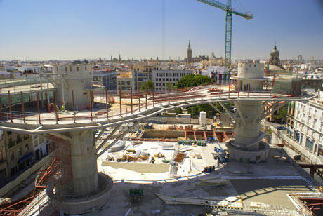

Slide 4
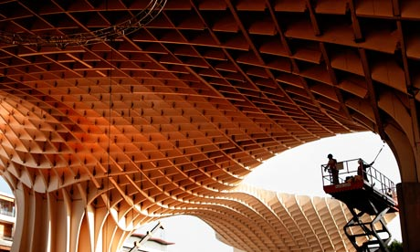

Slide 5
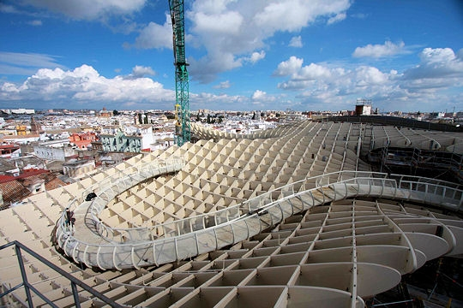

Slide 6
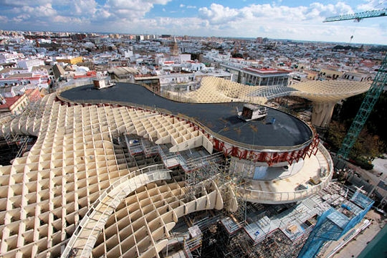

Slide 7
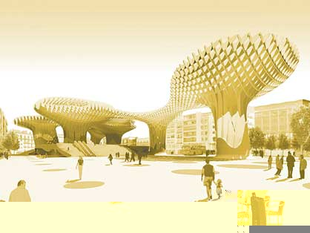

Slide 8
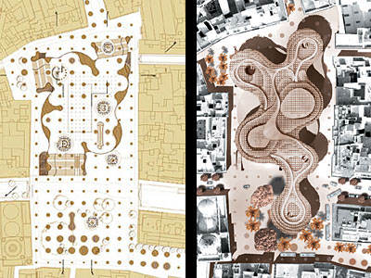

Slide 9
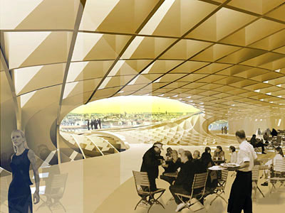

Slide 10
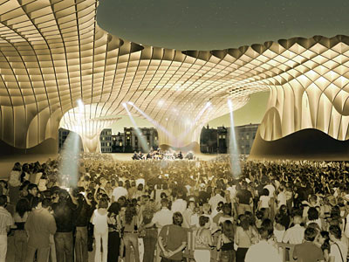

Slide 11
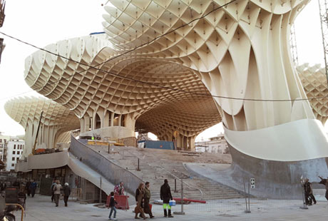

Slide 12
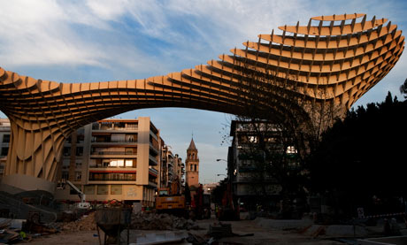

Slide 13
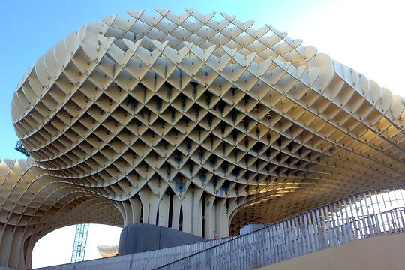

Slide 14
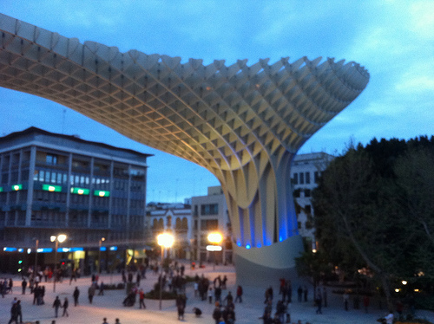

Slide 15
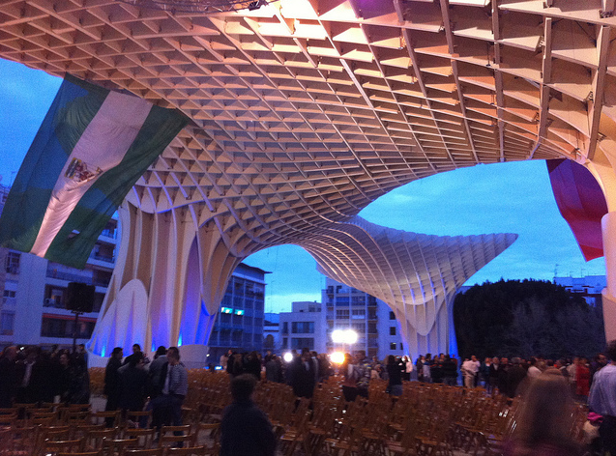

Slide 16
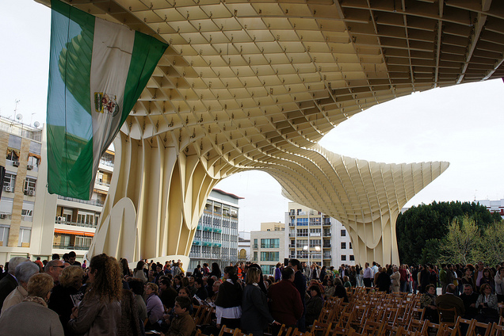

Slide 17
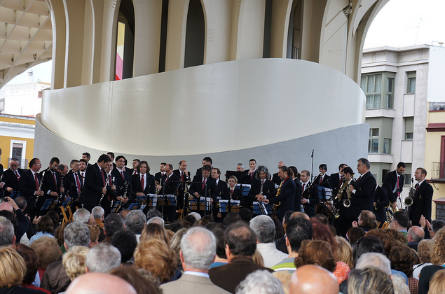

Slide 18
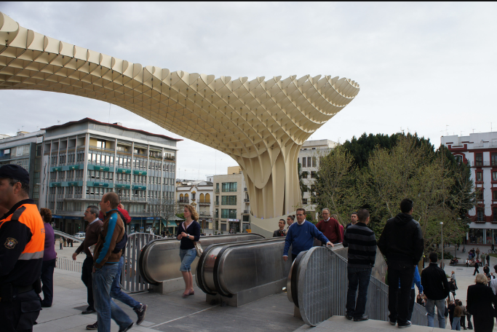

Slide 19
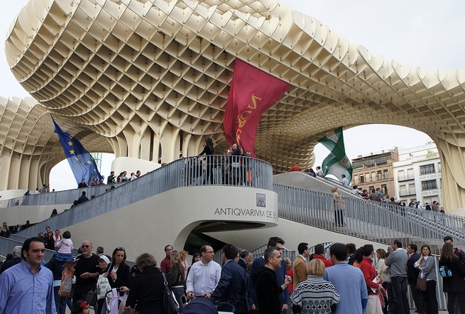

Slide 20
