Slide 1
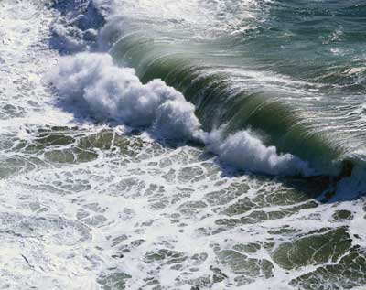
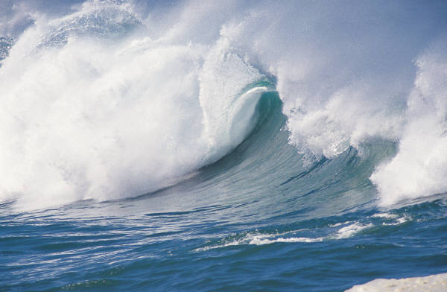
Ocean Motions
Pg. 215-235, but remember I always give you more!

Slide 2
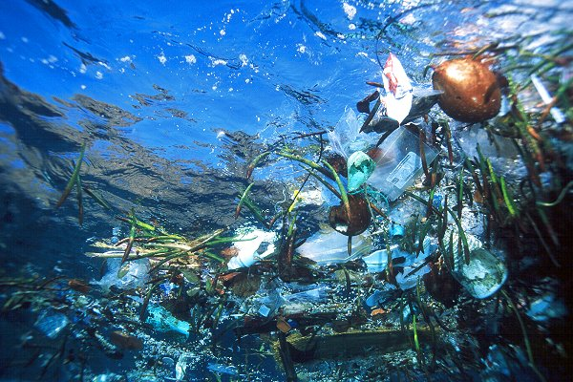
I. Currents (Not in the textbook)
Ocean water contains horizontal, stream-like movements of water called ocean currents.
Driven by prevailing wind patterns and affected by weather, Earth’s rotation, and the position of the continents.
Importance:
moves drifting organisms from place to place – plankton, disperse young
carries eggs and larvae of organisms that have external fertilization
brings food, oxygen
carries away waste, pollutants (threat to the biome)
5. Moderates ocean temperatures

Slide 3
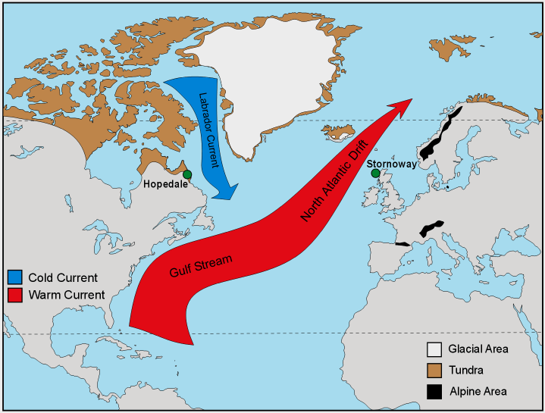
D. Three Main Types
1. Surface Currents
Horizontal movements of ocean water caused by wind and occurring at or near the ocean’s surface are called surface currents.
Can reach depths of several hundred meters and lengths of several thousand kilometers.
The Gulf Stream is one of the longest surface currents, transporting 25 times more water than all the rivers in the world combined. Moderates temperatures in the British Isles and Western Europe
Controlled by 3 factors:
Global winds
Continental barriers
Coriolis Effect

Slide 4
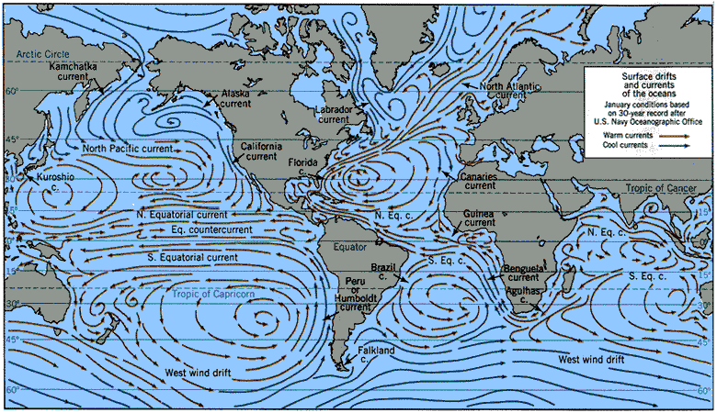

Slide 5
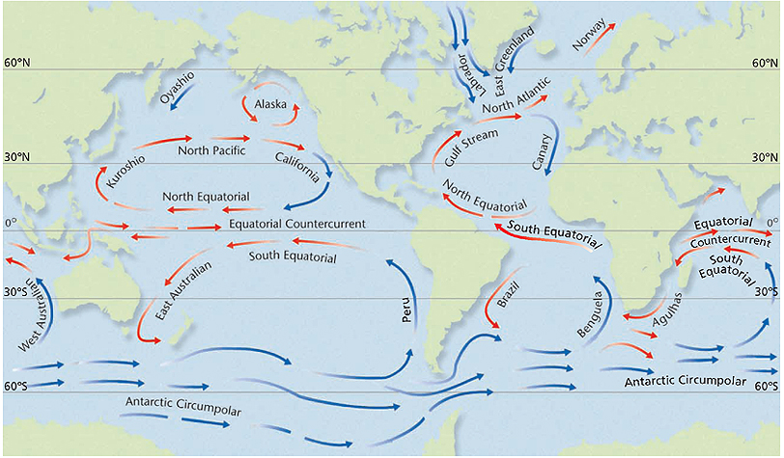
The terms warm current and cold current are relative terms – relative to the temperatures around them.

Slide 6
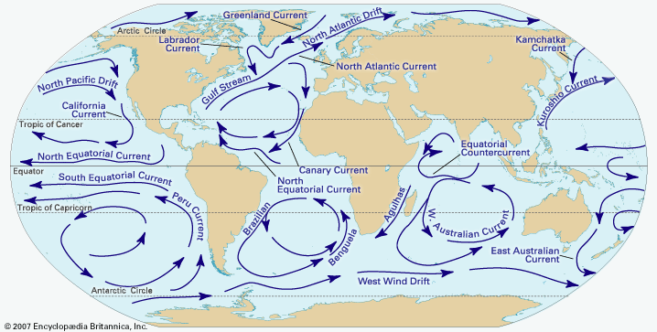

The gyre is the center of a circular system of ocean currents. The water there is very still. This is where tons of trash have collected over the years creating huge “islands” of floating trash.
GYRE

Slide 7
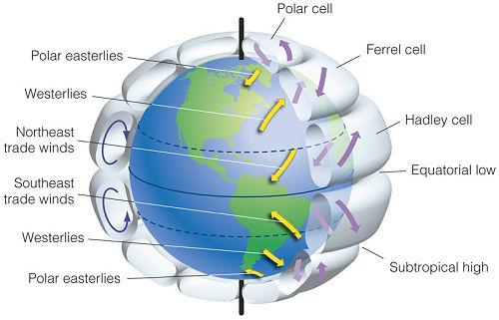
Global Winds
Different winds cause currents to flow in different directions.
The trade winds are located just north and south of the equator.
In both hemispheres, they push currents westward across the tropical latitudes.
The westerlies are located in the middle latitudes.
Wind: the horizontal (relatively parallel to the surface of the Earth) movement of air from a high air pressure area to a low air pressure area.

Slide 8
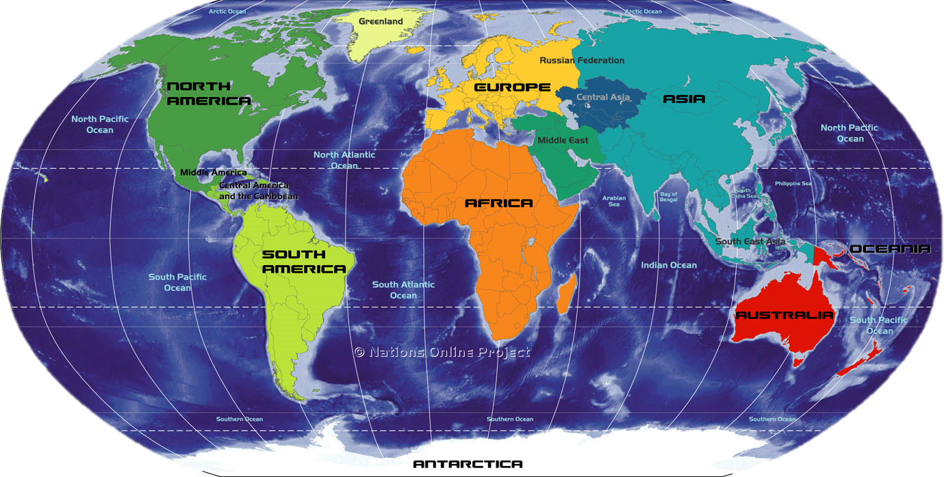
Continental Barriers
The continents are another major influence on surface currents.
They act as barriers to these currents.
When a surface current flows against a continent, the current is deflected and divided.

Slide 9
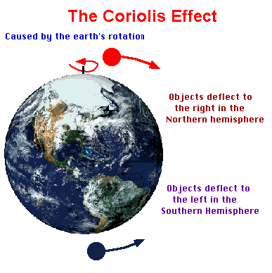
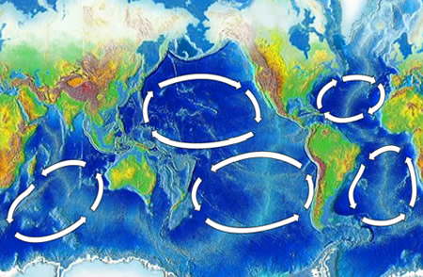
d3. Coriolis Effect
As Earth rotates, ocean currents and wind belts curve.
The curving of the paths of ocean currents and winds due to Earth’s rotation is called the Coriolis Effect.
The wind belts and the Coriolis Effect create huge circles of moving water, called gyres.

Slide 10
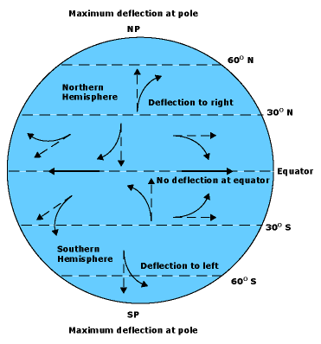
See Appendix 2 in your textbook

Slide 11
Deep Currents
Stream-like movements of ocean water located far below the surface are called deep currents.
Move much slower than surface currents (no wind down there).
Form as cold, dense water of the polar regions sinks and flows beneath warmer ocean water.
The density of ocean water is affected by temperature and salinity.
Decreasing temperature and increasing salinity will increase the water’s density.
Cold water is more dense than warm water!

Slide 12
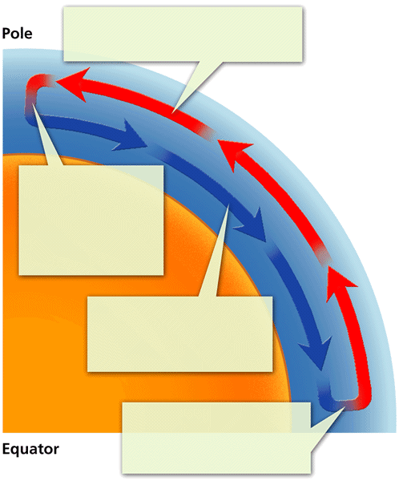

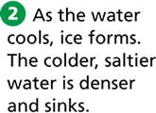


Somewhat similar to the circulation of air moving from the denser, high-pressure are to the less dense low-pressure area.

Slide 13
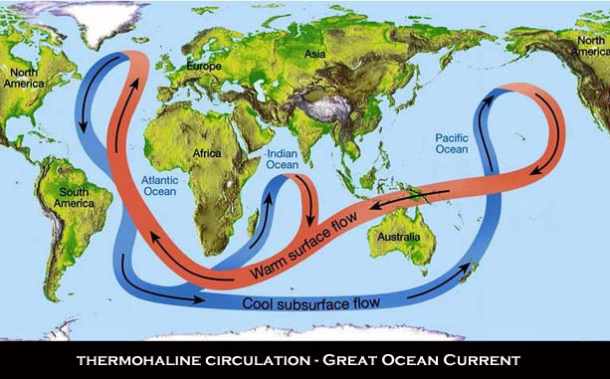
d. when combined with surface currents, results in conveyor belt movement of water around globe

Slide 14
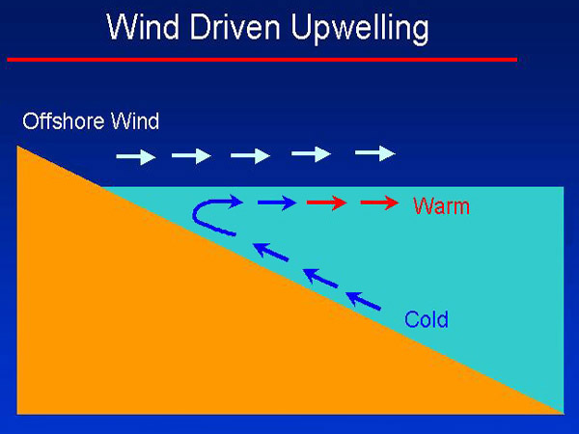
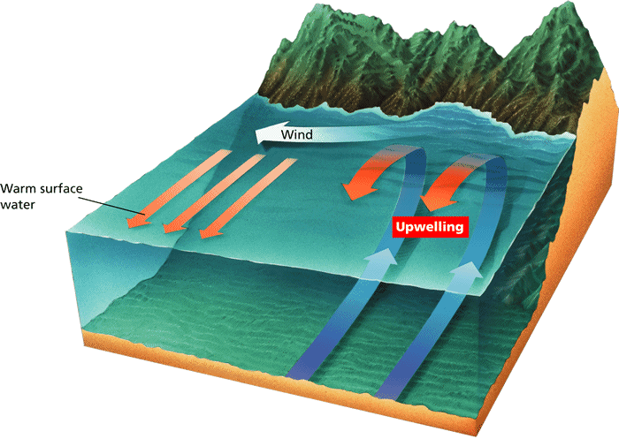
3. upwelling
wind blows, moves water away, causes new water to rise up to replace it
brings up tiny ocean organisms, minerals, and other nutrients from the deeper layers of the water.

Slide 15
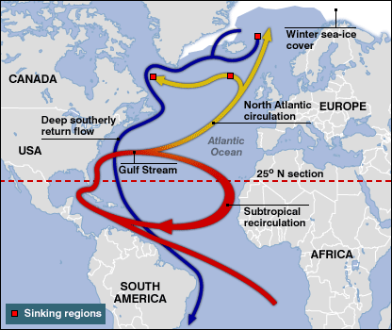
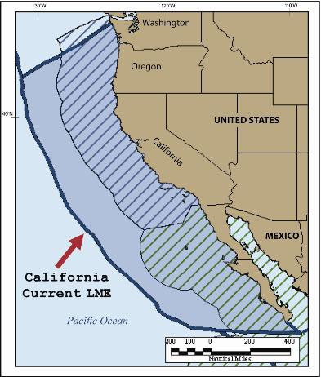
Currents and Climate
1. Currents can greatly affect the climate in many parts of the world.
Warm-water currents:
The Gulf Stream carries warm water from the Tropics to the North Atlantic Ocean. Keeps Western Europe from being as cold as one would expect for its latitude.
Cold-water currents:
For example: The California current carries cold water from the North Pacific Ocean toward Mexico along the western coast of the USA → therefore, cooler climate year-round than inland states. They also make it less likely that the winds will bring rain to the coastal areas adjacent to them.

Slide 16
2. Every 2 to 12 years, the South Pacific trade winds move less warm water to the western Pacific than they usually do.
El Niño-Pacific Ocean trade winds slow and almost stop which brings warmer conditions and weak upwelling currents to the eastern Pacific which hurts fishing in Peru. And affects weather patterns in much of the Pacific Basin.
La Niña-winds blow stronger than normal pushing warm water out and allowing cold water in. A stronger upwelling occurs. Somewhat the reverse of El Niño. Places that were extra wet during El Niño may become extra dry, etc.

Slide 17
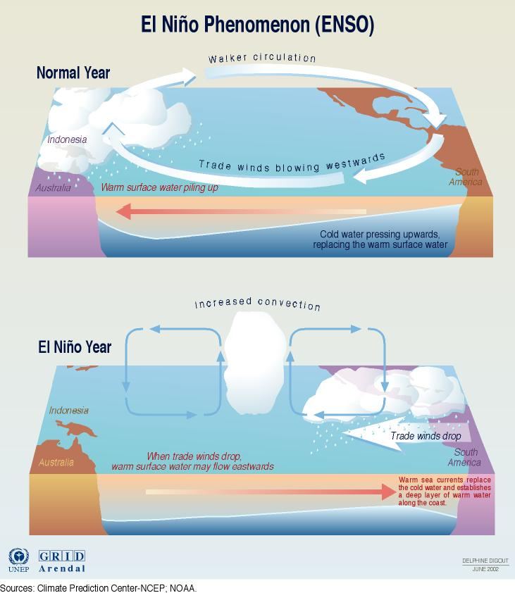

Slide 18
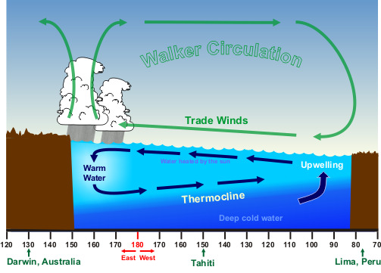
Normal Conditions

Slide 19
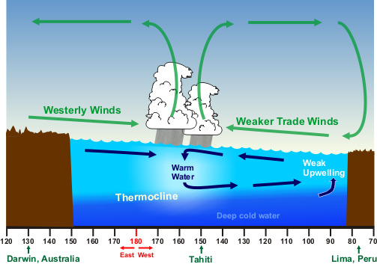
El Niño Conditions

Slide 20
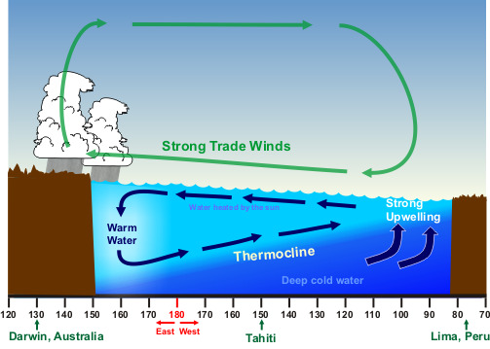
La Niña Conditions

Slide 21
Waves
A Wave is a rhythmic movement that carries energy through matter or space.
When a wave passes through the ocean, individual water molecules move up and down in a circular motion but they do not move forward or backward
As waves approach shore, the wave length decreases and wave height increases
When a wave breaks against the shore, the crest outruns the trough and the crest collapses-this is called a breaker (water moves forward and backward at this point).

Slide 22
5. Parts of a Wave
Crest – highest point of a wave
Trough – lowest point of a wave
Wave Height – vertical distance between the crest and the trough
Wavelength – horizontal distance between two crests or two troughs

Slide 23
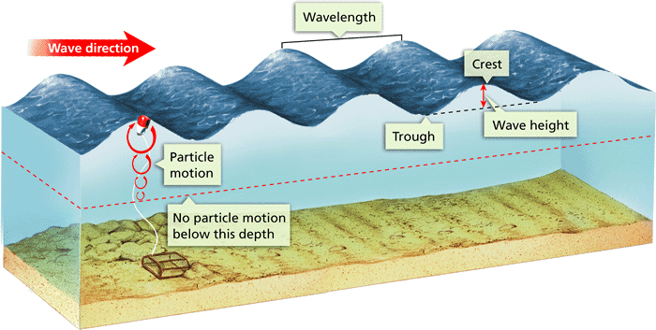

Slide 24
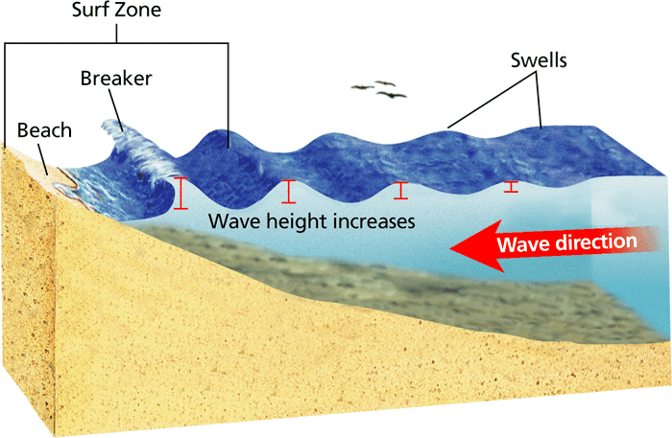
The deeper water is slowed down by the friction of the land surface, so the water near the surface piles up because it isn’t affected by that friction. The waves get higher the closer they are to the shore.
That’s why tsunami waves get taller and taller as they approach the coast of a land body.

Slide 25
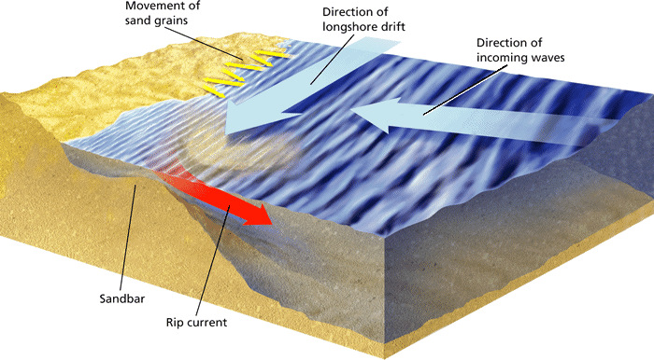
Effects of Waves on Shore
a. Longshore current- As waves come into shore, water washes up the beach at an angle, carrying sand grains. The water and sand then run straight back down the beach.

Slide 26
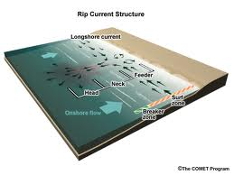
Rip Current-long ridges or piles of sand create sand bars. A break in a sand bar allows a fast-moving narrow stream of water through

Slide 27
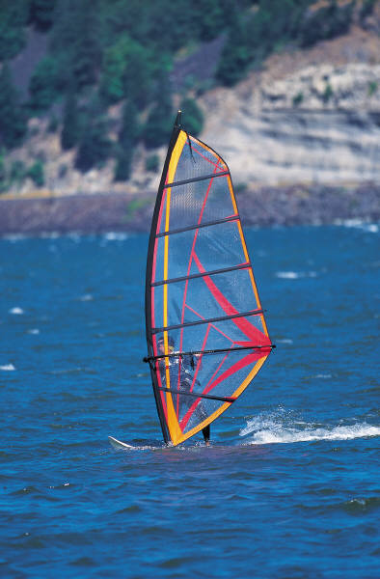
Cause of Waves
Wind
When wind blows across a body of water, friction causes the water to move along with the wind.
Wave Height depends on –
Wind speed
Distance over which the wind blows
Length of time the wind blows

Slide 28
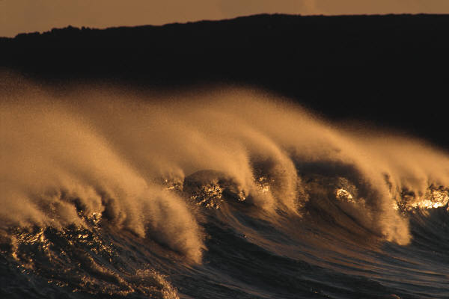
Earthquakes- Waves caused by earthquakes are called Tsunamis
Tsunamis were once called Tidal waves, but they have nothing to do with the tides.
They are produced by earthquakes and other seismic disturbances. That’s why they’re also called seismic sea waves.
Sudden outflow of water then it returns much higher

Slide 29
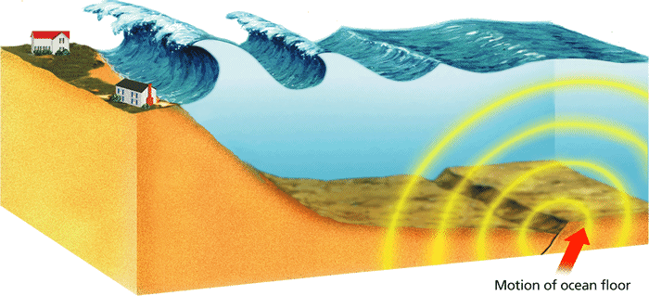
Tsunamis are very long, fast moving waves!
They can have wavelengths of 150 miles, wave heights of 100 ft and move as fast as 450 mph (jet speed!).

Slide 30
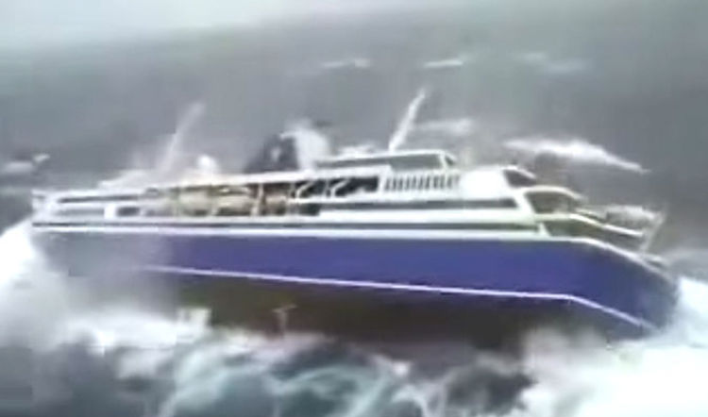
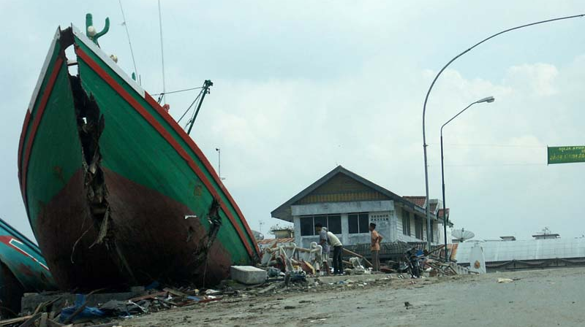
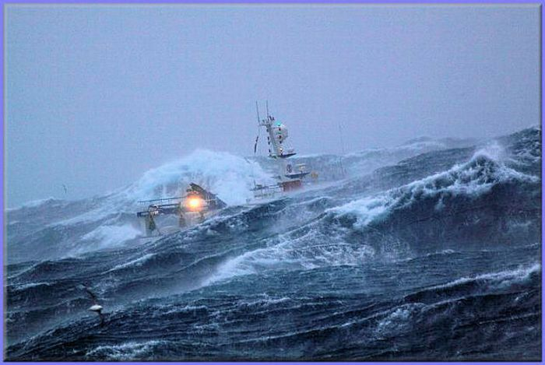
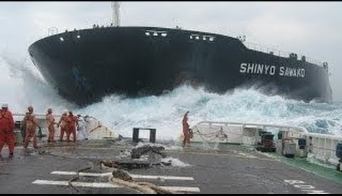

Slide 31
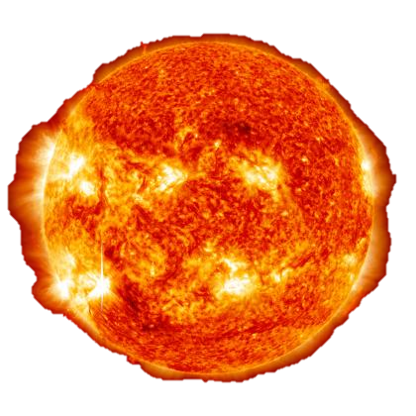
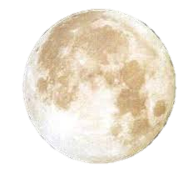
Gravitational force of the Moon and Sun creates tides
The rise and fall in sea level is called a tide.
One low-tide/high-tide cycle takes about 12 hrs and 25 min.
Tidal range is the difference in ocean level between high-tide and low-tide

Slide 32
What is the Tidal Range?
HT = 30 ft, LT = 20 ft
HT = 20 ft, LT = 12 ft
HT = 50 ft, LT = 20 ft
10 ft
8 ft
30 ft

Slide 33
Gravitational Effect of the Moon
Two big bulges of water form on the Earth:
one directly under the moon
another on the exact opposite side
As the Earth spins, the bulges follow the moon.
These are normal daily tides

Slide 34
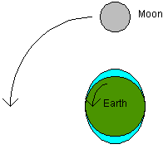

Slide 35
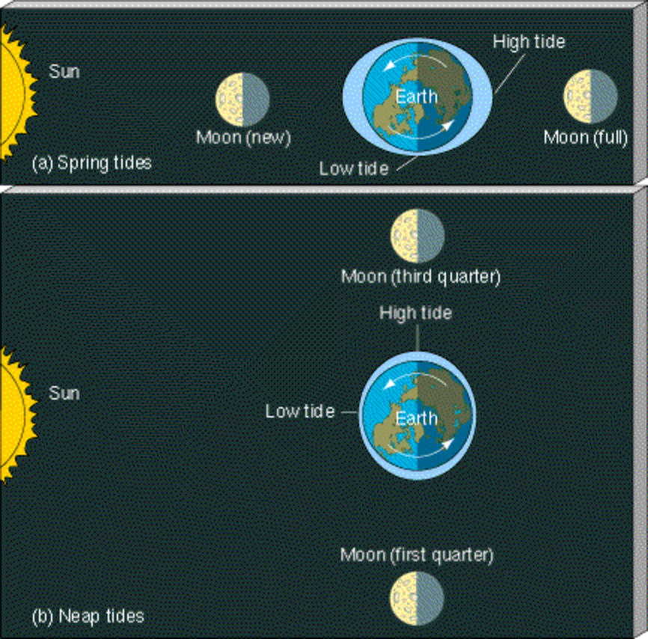
Gravitational Effect of the Sun
Spring Tides
Earth, Moon, and Sun are lined up and work together
High Tides are higher and Low Tides are lower than normal

Slide 36
Neap Tides
Earth, Moon, and Sun form right angles and work against each other
High Tides are lower and Low Tides are higher than normal

