Slide 1
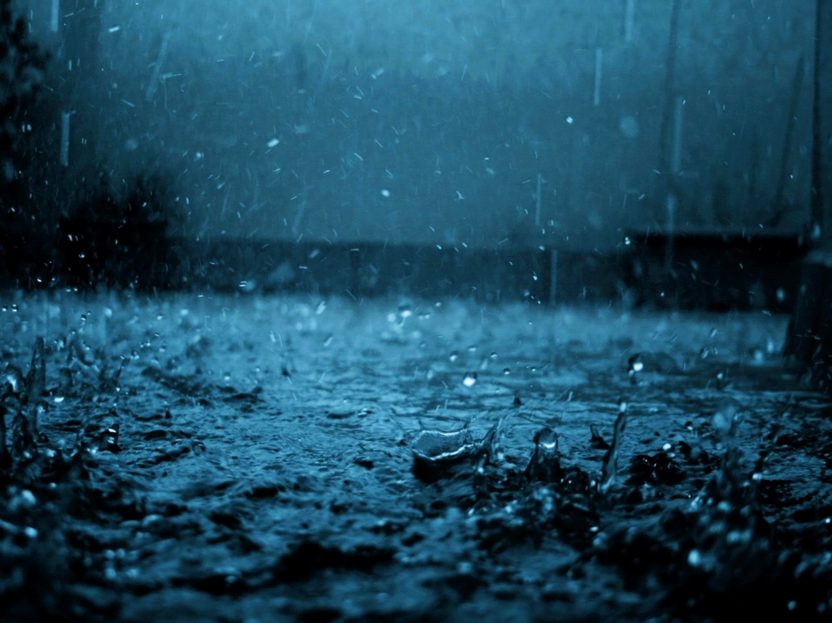
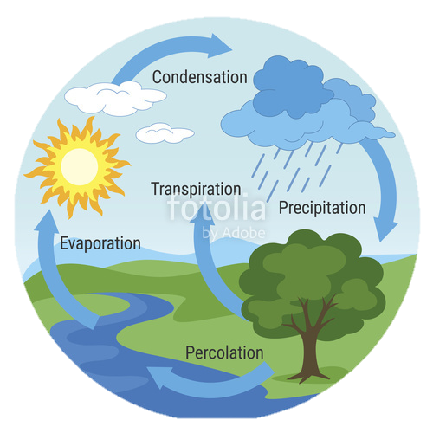
Water: Water Table, Ground Water, & Karst Topography
Physical Geography

Slide 2
The Water Cycle

Slide 3
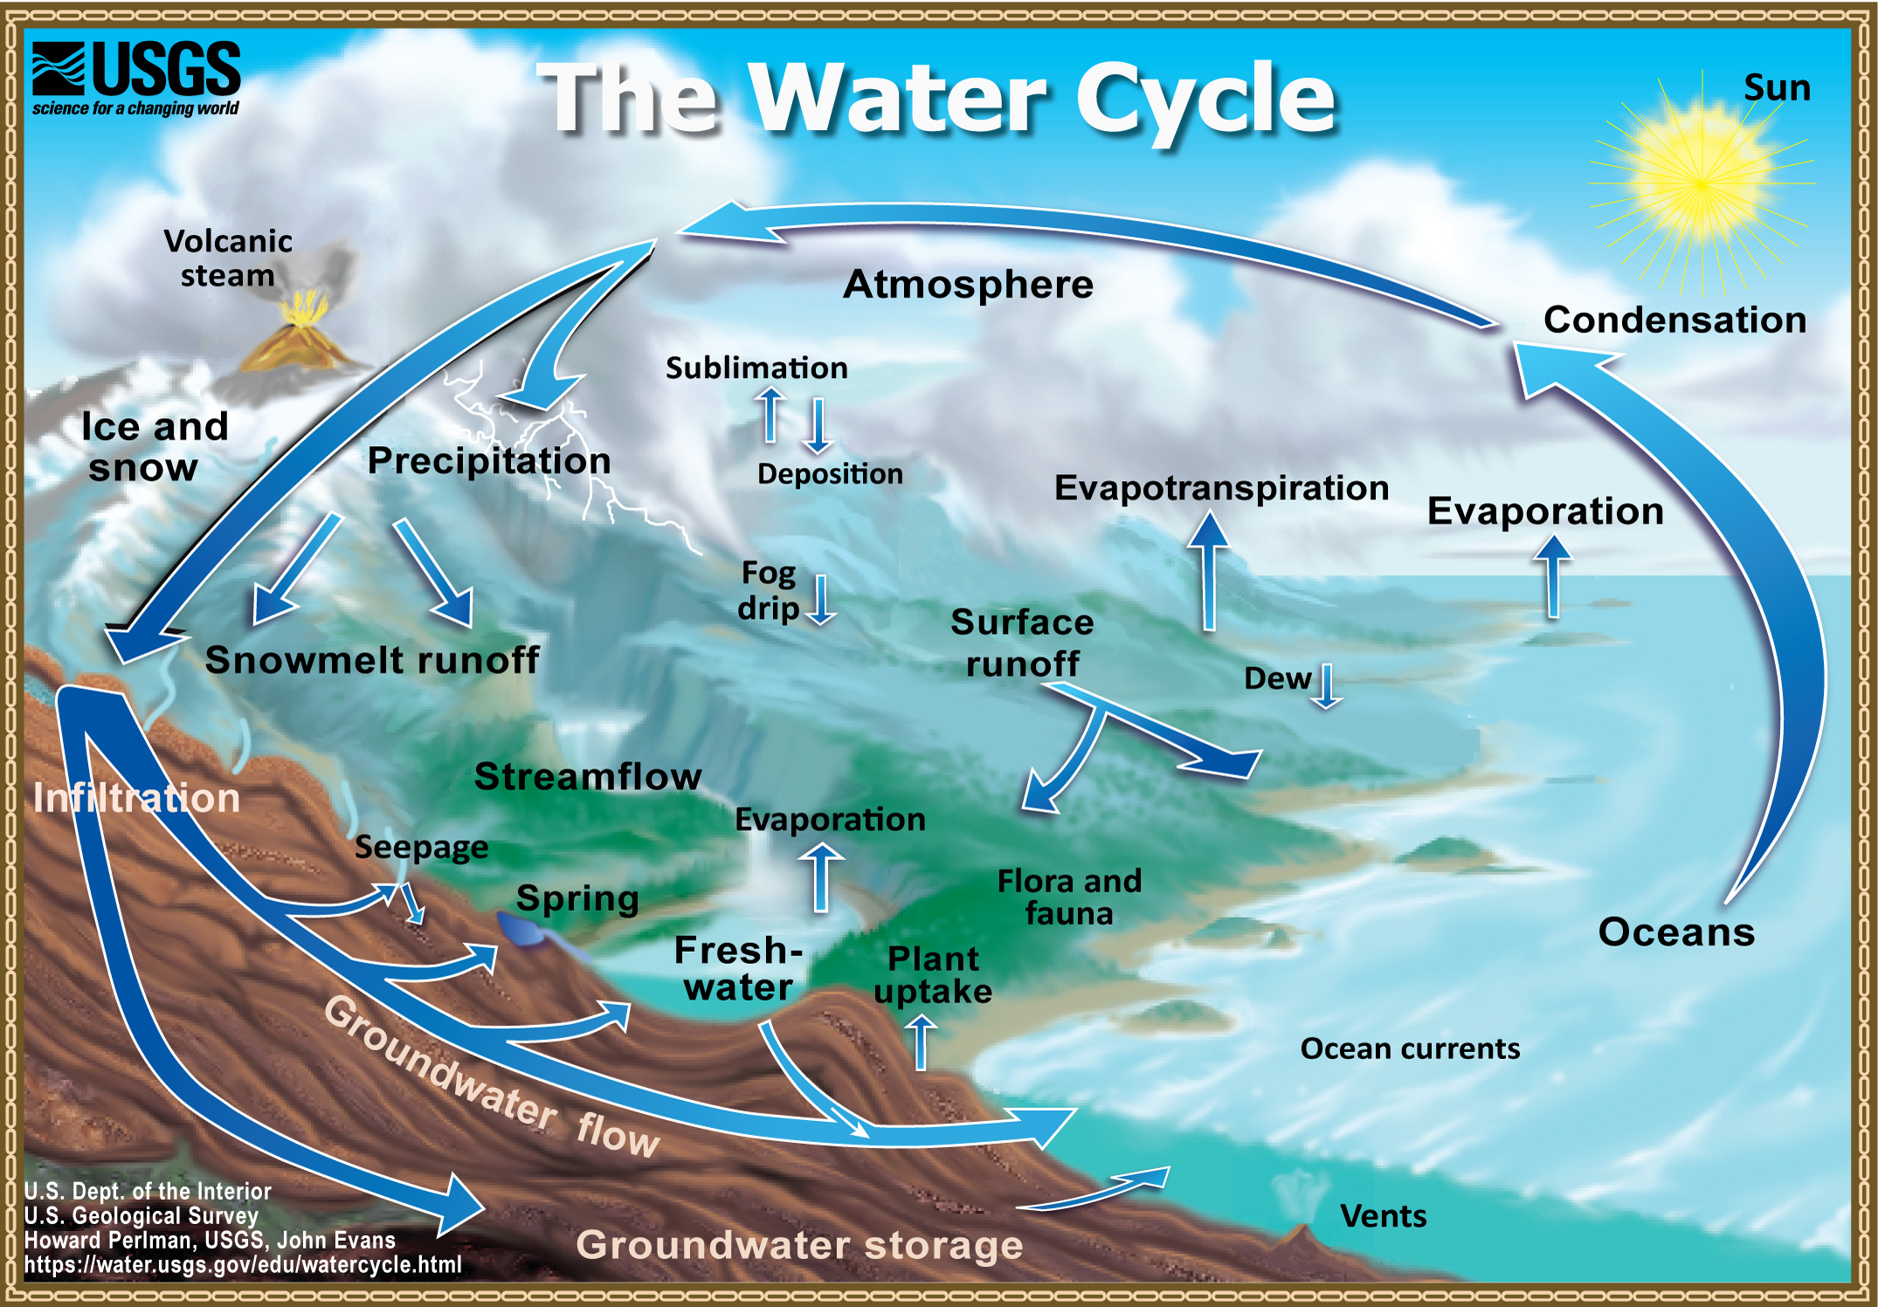
As long as the Sun shines on the Earth, the Earth’s water supply will continue to be recycled over and over.

Slide 4
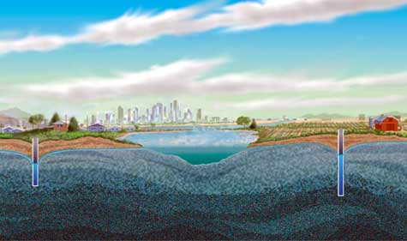
Groundwater

Slide 5
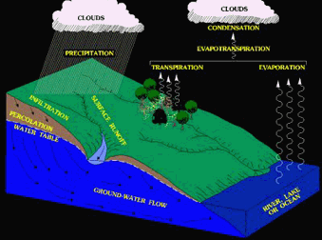
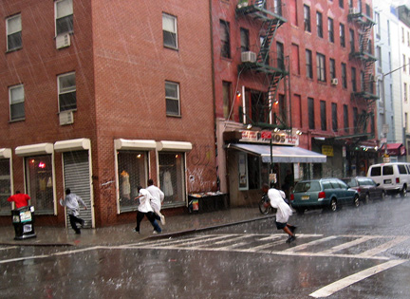
Groundwater
INFILTRATEs = sinks into (soak into).
When precipitation falls, it will runoff of IMPERMEABLE surfaces, and it will INFILTRATE PERMEABLE surfaces.
Permeable
Impermeable

Slide 6
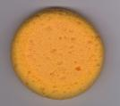
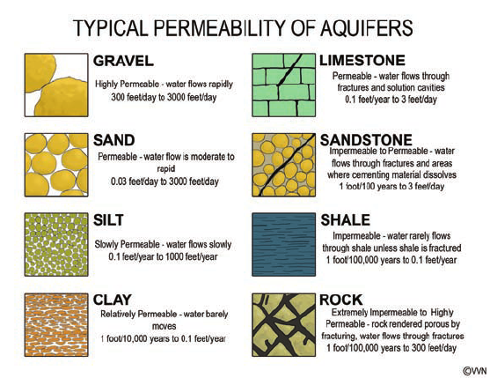
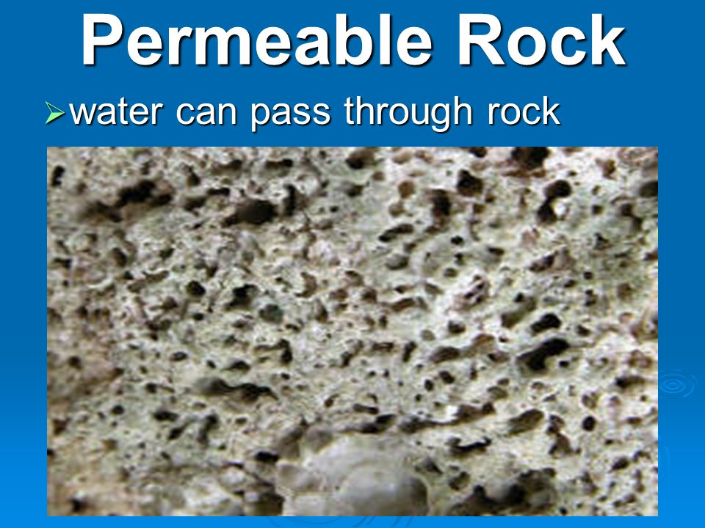
Permeable
Permeable- water CAN move through the material
Example: Sponge

Slide 7
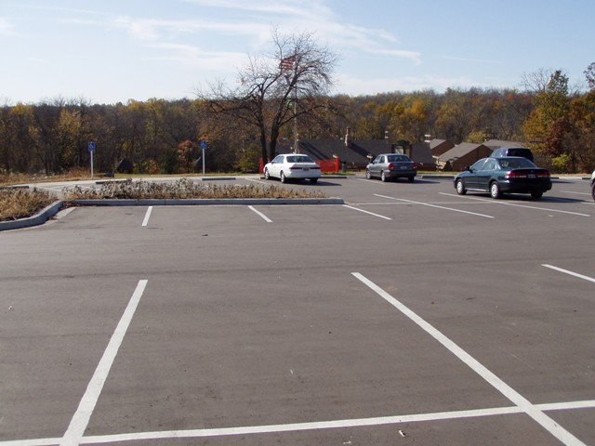
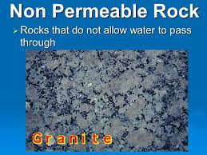
Impermeable
Impermeable- water CANNOT move through the object
Impermeable
Example: Asphalt or Concrete
Granite
Marble
Slate
Basalt

Slide 8
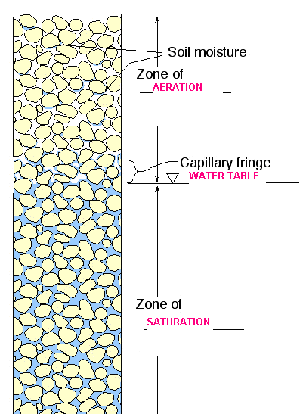
Zones of Groundwater
Zone of Aeration – pores filled w/ air & Water
Zone of saturation – all pores filled w/ Water
Water Table – division b/w zone of aeration & zone of saturation

Slide 9
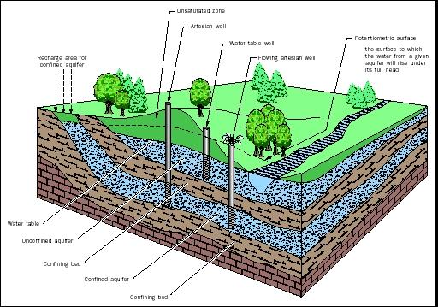
Water table well: a well that reaches the water table, the water must be pumped out.
Artesian well: a well that reaches a confined aquifer, the water flows due to pressure.

Slide 10
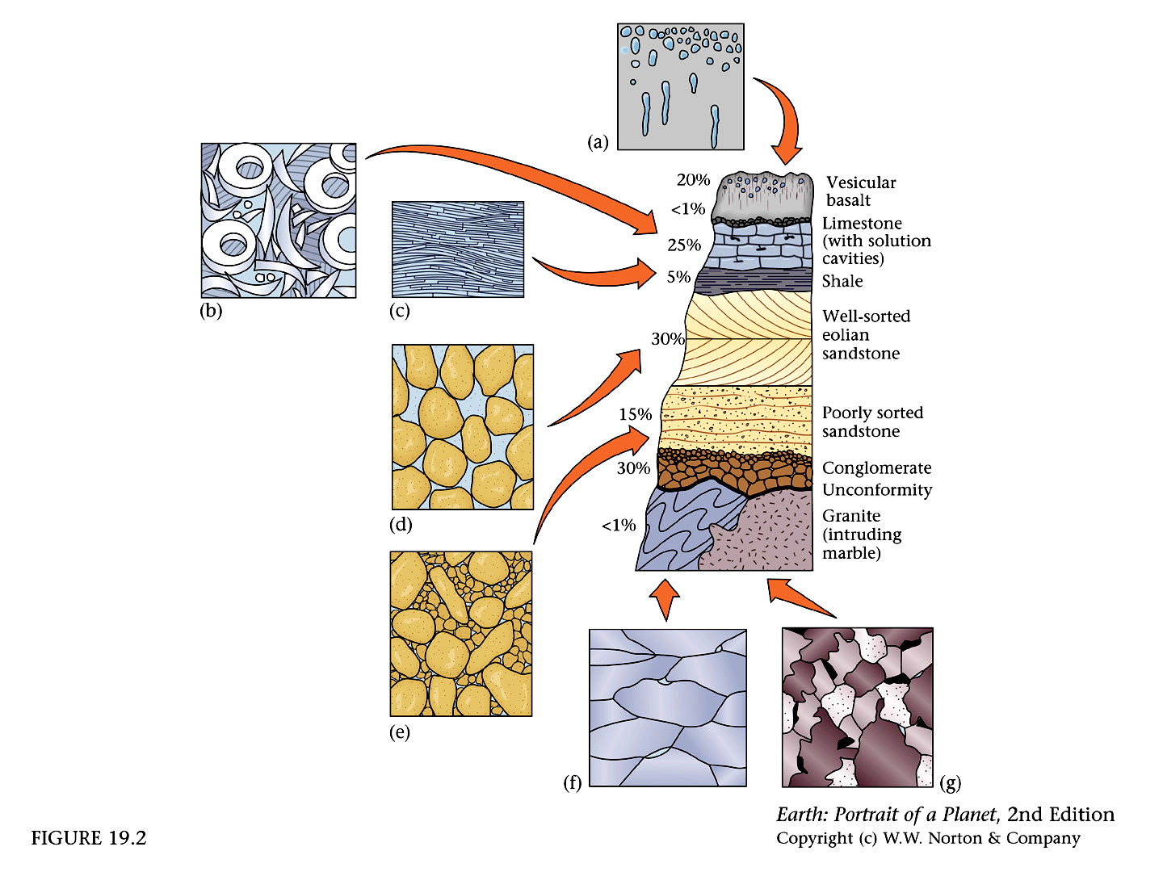
Porosity
Porosity: Amount of open space in rocks and sediment that can hold water (and air).
Rounded sediments of the same size can hold more water than odd shaped sediments of different sizes.
High porosity
Low porosity

Slide 11
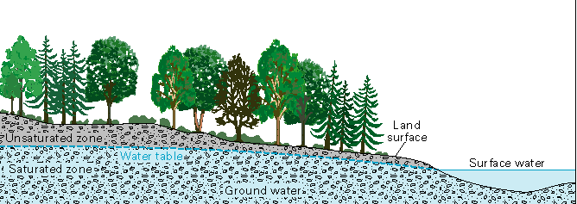
Groundwater intersects the surface
Water comes out of the ground when the groundwater meets the surface. It can be a spring, a lake, or a stream.

Slide 12
Aquifers
What is an Aquifer? A layer of permeable rock with high porosity that lets water move freely
Why are they so important? Most drinking water comes from aquifers.
Wells dug into a confined aquifer will give the most consistent supply of fresh water. Confined: impervious rock layer above the aquifer and also below it so water cannot move either up or down but only flow in the aquifer.
Water flows in an aquifer the same way it would flow on earth’s surface. It flows down slope. It react to the force of gravity.
Ogallala Aquifer: In large areas, more water is pumped than nature can recharge, so they have to keep drilling deeper. If they run out of water, there will be serious economic consequences

Slide 13
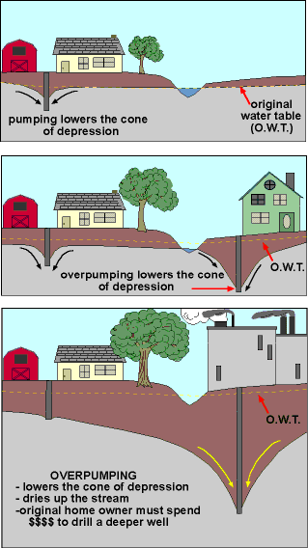
A cone of depression (dips down) forms along the water table when a well is dug.
Over pumping will lower the cone of depression.
If well water is pumped out faster than nature can recharge the groundwater or the aquifer, there will be trouble ahead.

Slide 14
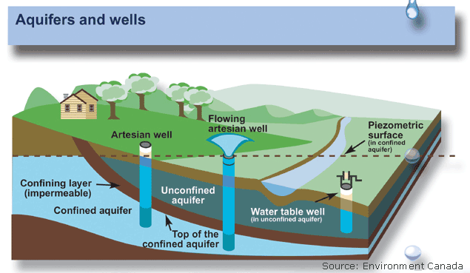

Aquifers
An aquifer is a geologic layer of porous and permeable material such as sand and gravel, limestone, or sandstone, through which water flows and is stored. An artesian aquifer is a confined aquifer containing groundwater under positive pressure. A well drilled into such an aquifer is called an artesian well. If water reaches the ground surface under the natural pressure of the aquifer, the well is termed a flowing artesian well.

Slide 15
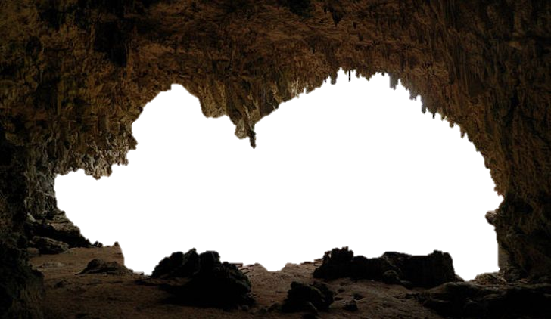
Caverns and Karst Topography

Slide 16
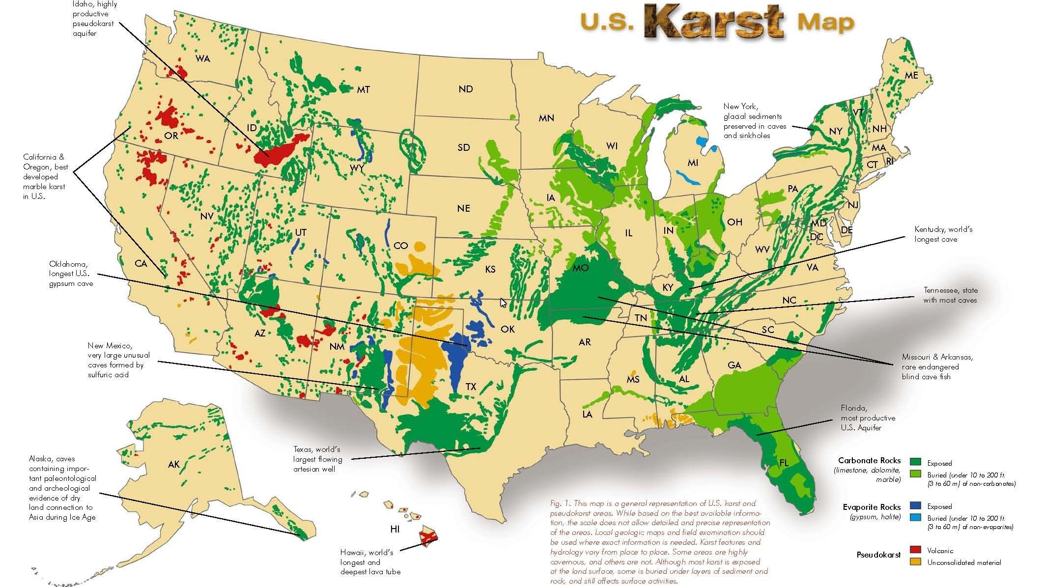

Slide 17
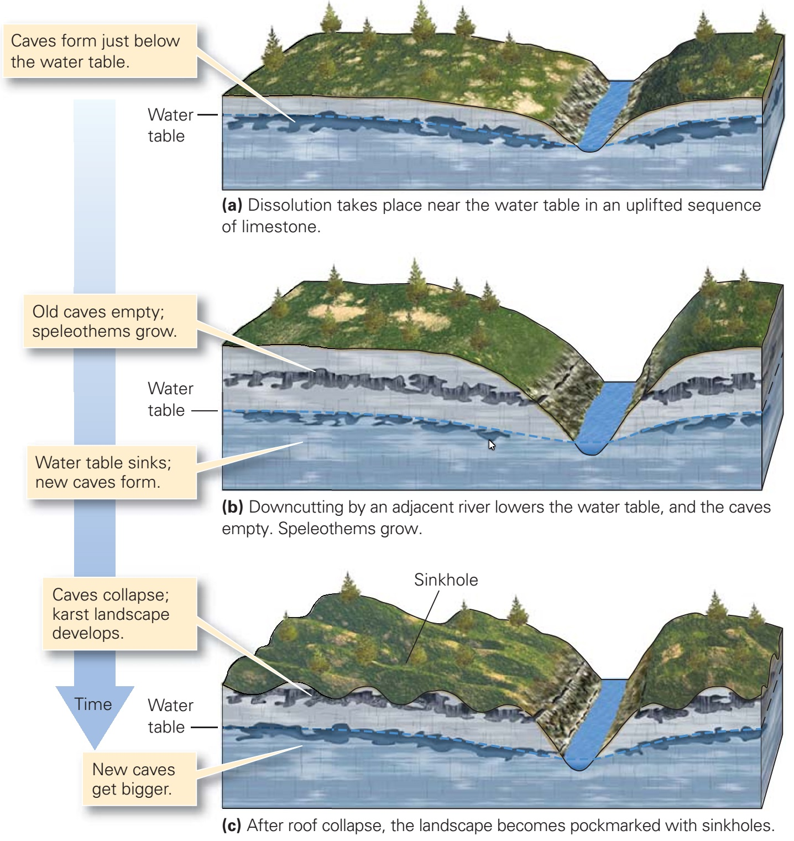
Cave Formation
Caves are made from carbonic acid dissolving cracks in limestone
  Water passing through decaying organic matter reacts with the carbon compounds and carbon dioxide and becomes a mild acid with a lower Ph.
Caves are a big part of karst topography
Karst Topography - land with lots of caves and sinkholes.

Slide 18
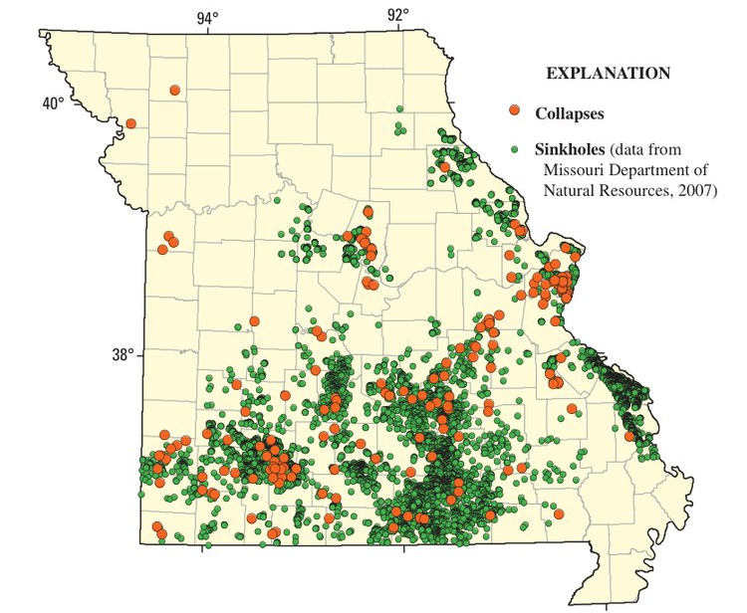
Karst in Missouri
Collections of sinkholes and collapses are clear indicators of cavern formation and the development of Karst topography.
St. Louis once had many beer brewers and they often used caves under St. Louis to store their product because the caves maintained an even, cool temperature. There used to be a commercial cave in south St. Louis called Cherokee Cave.

Slide 19
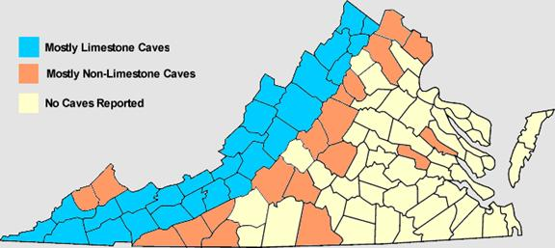
Karst counties in Virginia: depend on groundwater
Water passing through porous limestone (particularly when the limestone has cracks in it) it dissolves some of the limestone and creates openings and passages in the limestone, which we call caves. We call the topography associated with cave formation Karst topography.
Caves
Disappearing streams
Sink holes
Karst valley
Dolines
Springs

Slide 20
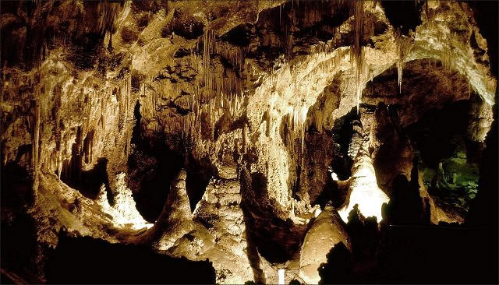
Carlsbad Caverns

Slide 21
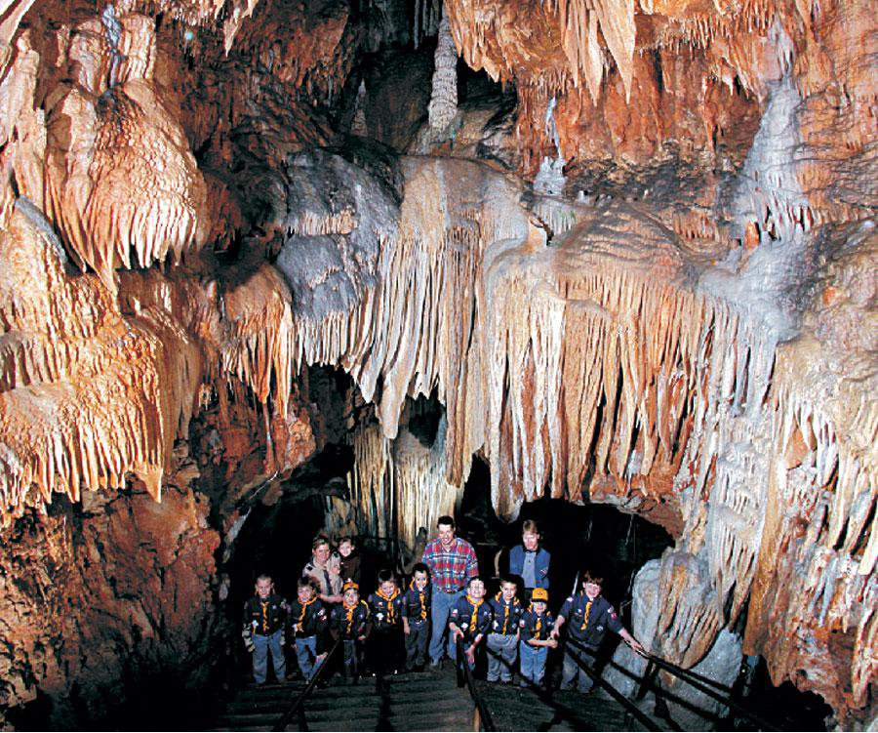
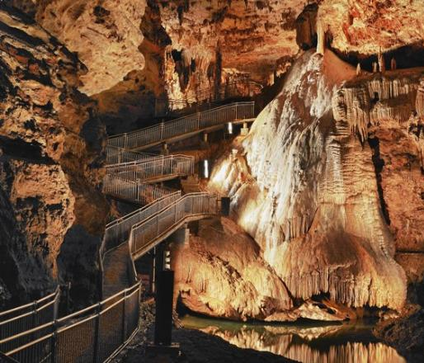
Meramec Caverns
Onondaga Caverns
Missouri Commercial Caverns

Slide 22
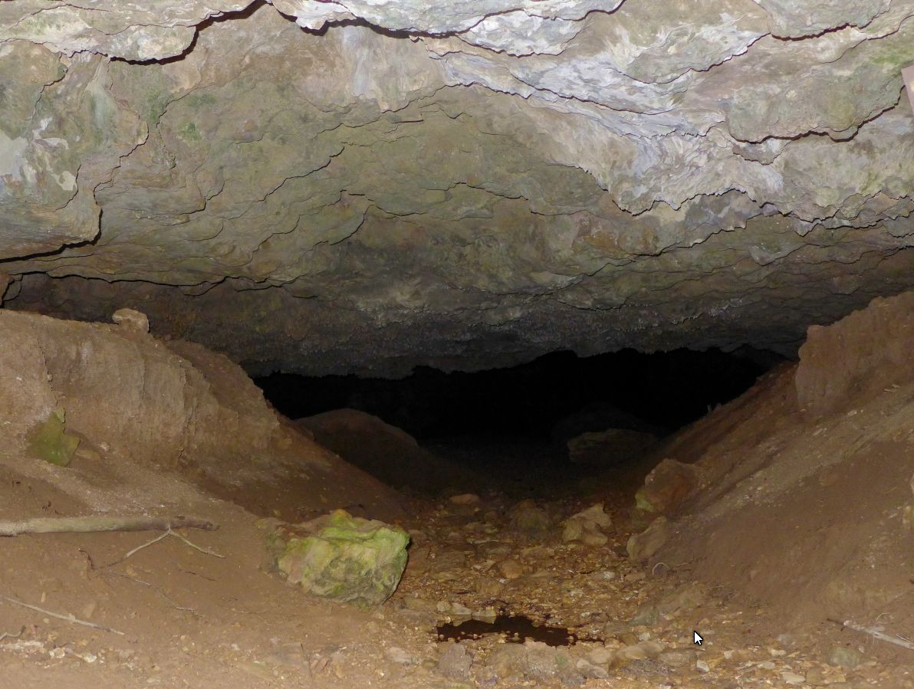
This looks like the entrance to the cave in Meramec State Park that I went spelunking in the early 1960s. We went about three times – quite an adventure. There are many caves in that park.

Slide 23
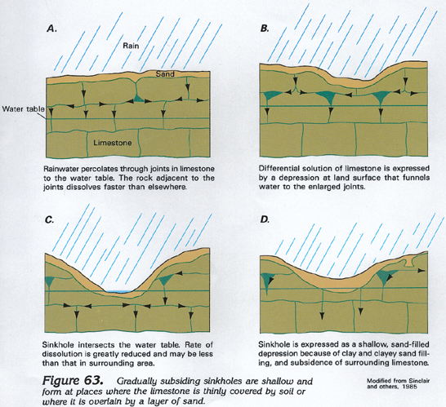
Sometimes, a sinkhole can connect with a cavern system. Entering through a sinkhole can be dangerous and is not recommended for amateurs.

Slide 24
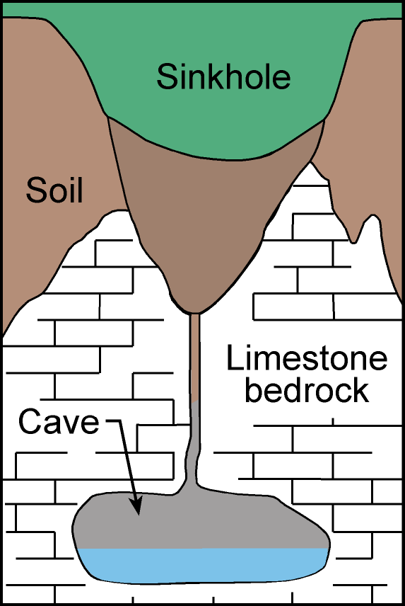
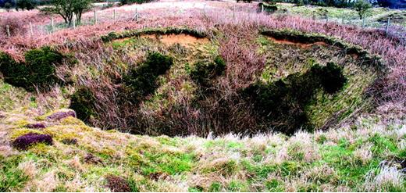
One danger of entering a cavern through a sinkhole like this is that there may be dangerous critters hidden in the plants and debris. I know a fellow who was bitten by a copperhead snake as he was descending into the cave. Bad news, big time!

Slide 25
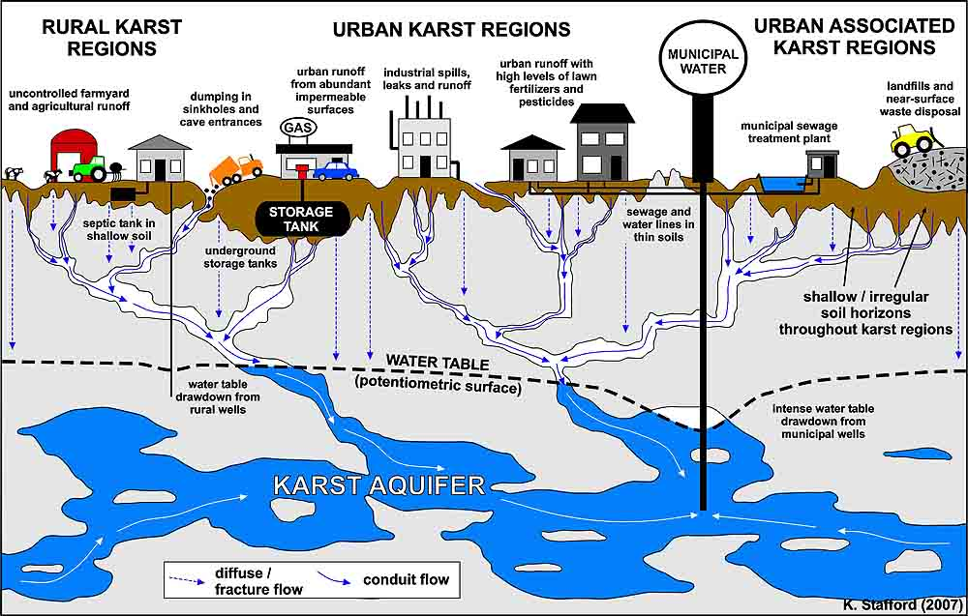
Building over Karst regions can be a tricky business. If something collapses below, there will be consequences above.

Slide 26
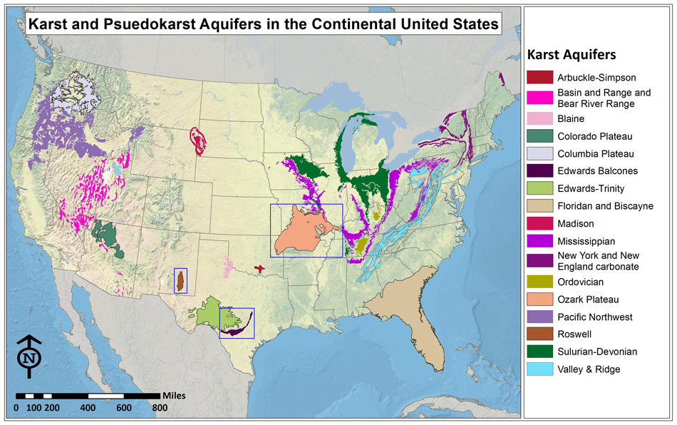

Slide 27
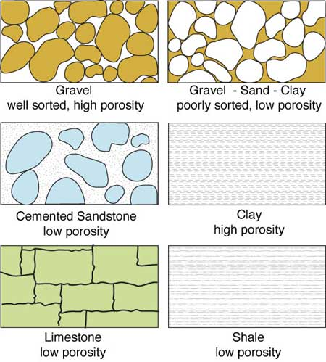
The impact of water on the surface of the land and below it has a lot to do with the porosity of the soil and the bedrock below.

Slide 28
Artesian well: An aquifer is a geologic layer of porous and permeable material such as sand and gravel, limestone, or sandstone, through which water flows and is stored. An artesian aquifer is a confined aquifer containing groundwater under positive pressure. A well drilled into such an aquifer is called an artesian well.

Slide 29
