Slide 1
Major Landform Categories

Slide 2
Mountain
They usually have steep, sloping sides and sharp or rounded ridges, and a high point, called a peak or summit. Most geologists classify a mountain as a landform that rises at least 1,000 feet (300 meters) or more above its surrounding area, and attaining an altitude greater than that of a hill, usually greater than 2000 feet (610 meters). A mountain range is a series or chain of mountains that are close together. Mountains are formed through tectonic forces or volcanism.

Slide 3
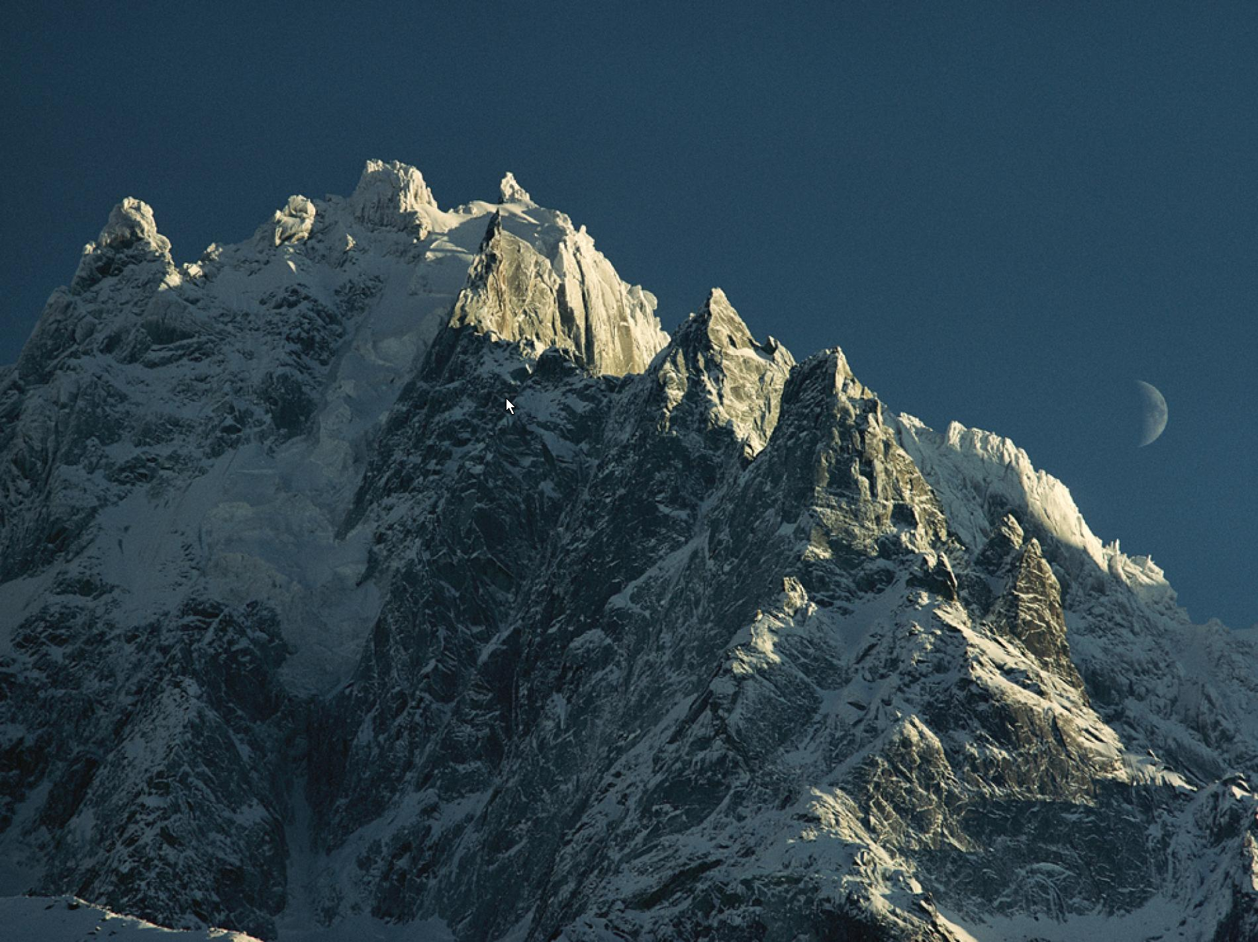
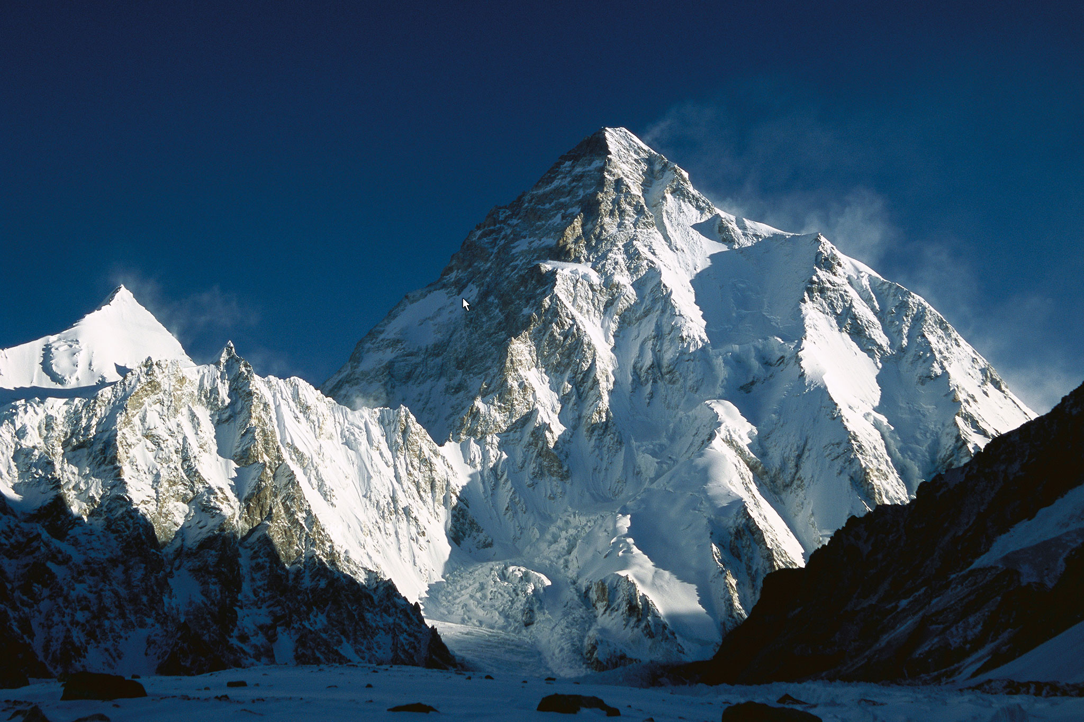
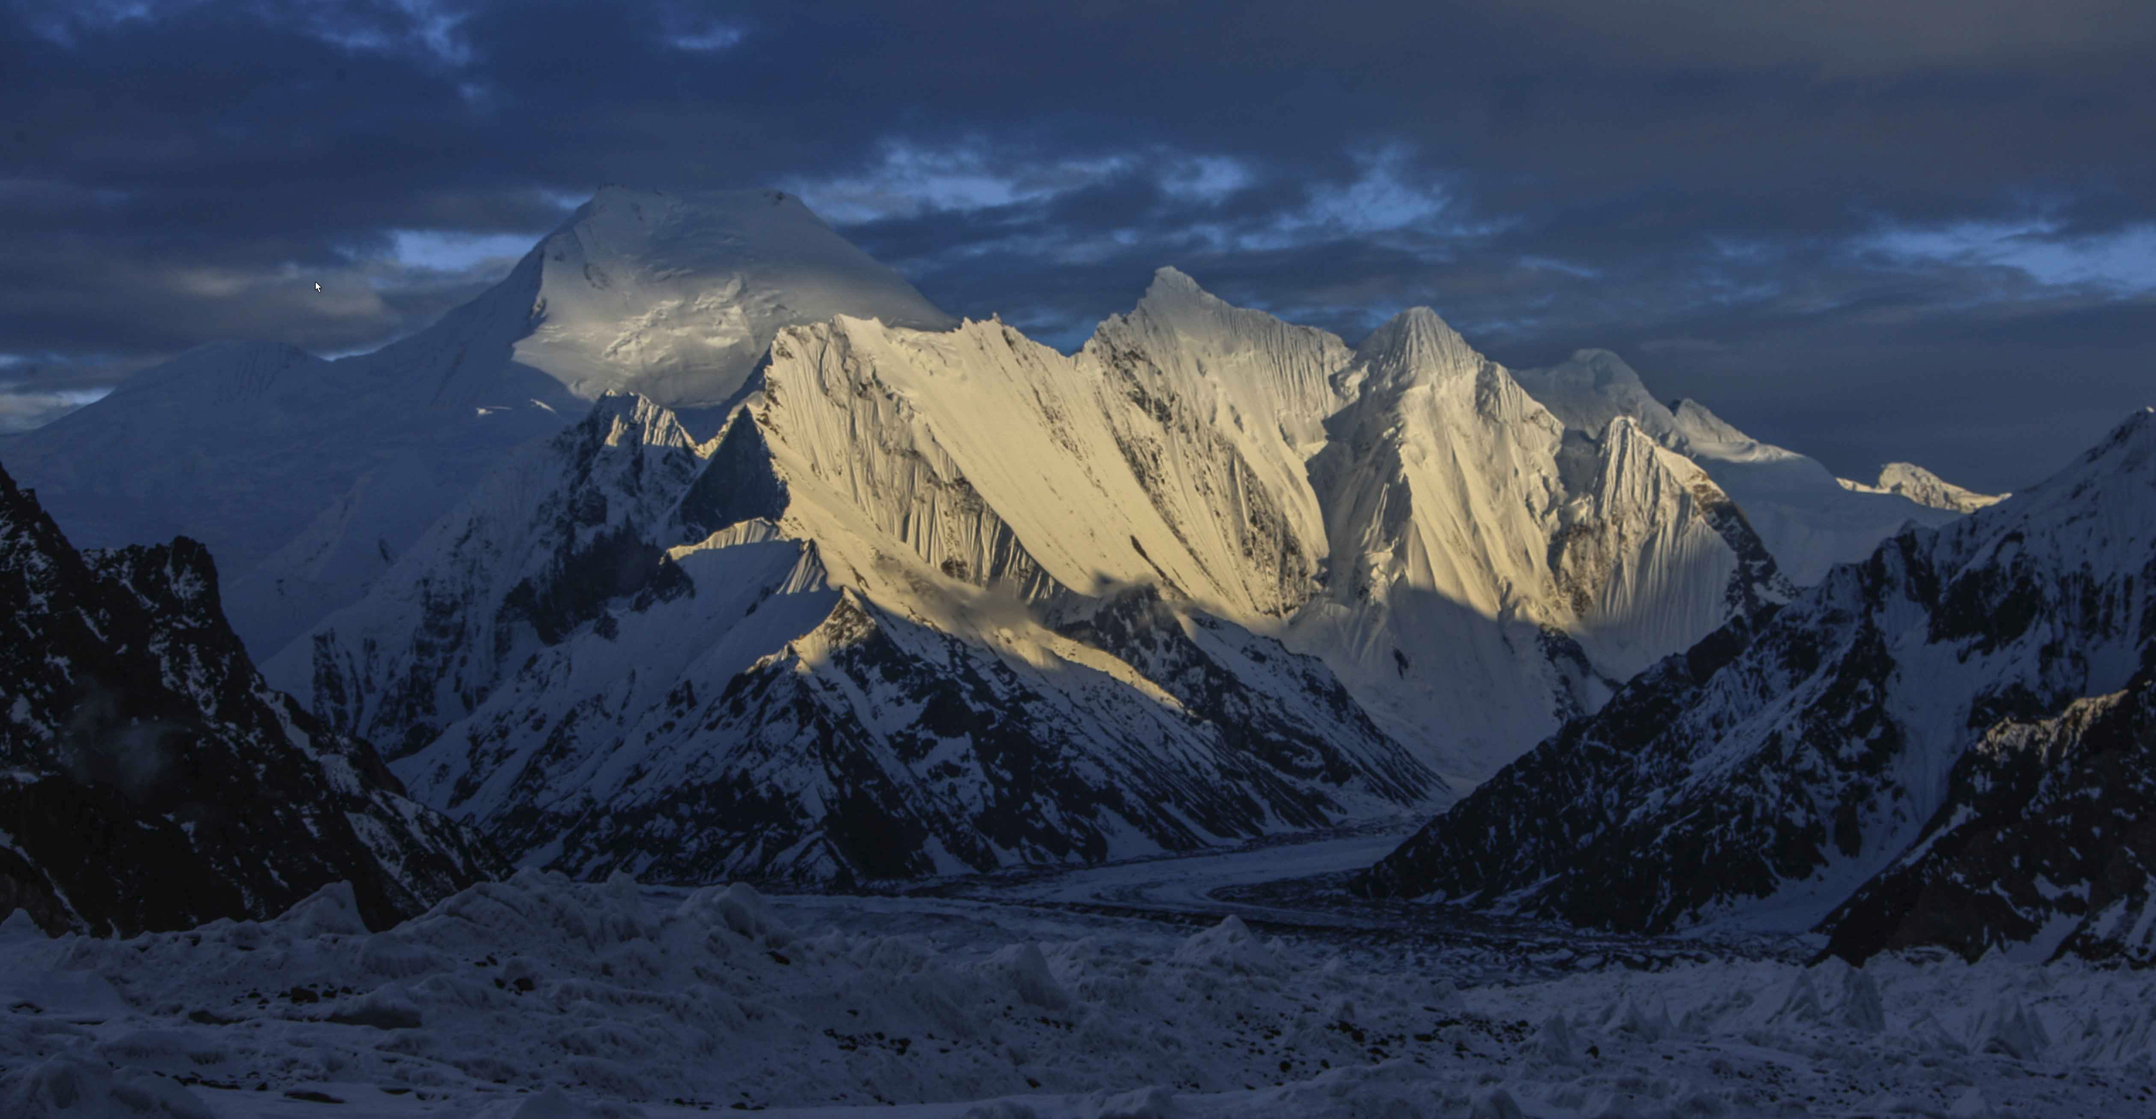

Slide 4
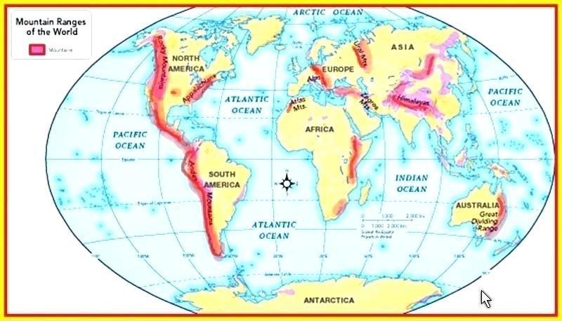

Slide 5
Hill
A hill is a landform that extends above the surrounding terrain. It often has a distinct summit, although in areas with scarp/dip topography a hill may refer to a particular section of flat terrain without a massive summit (e.g. Box Hill, Surrey). Hills are easier to climb than mountains. They are less steep and not as high.
A natural mound of earth created either by faulting or erosion.
A 'bump' in the landscape, rising gradually from its surroundings.
Low altitude and elevation, often less than 984-1968 feet (300-600 meters).
A rounded top with no well-defined summit.

Slide 6
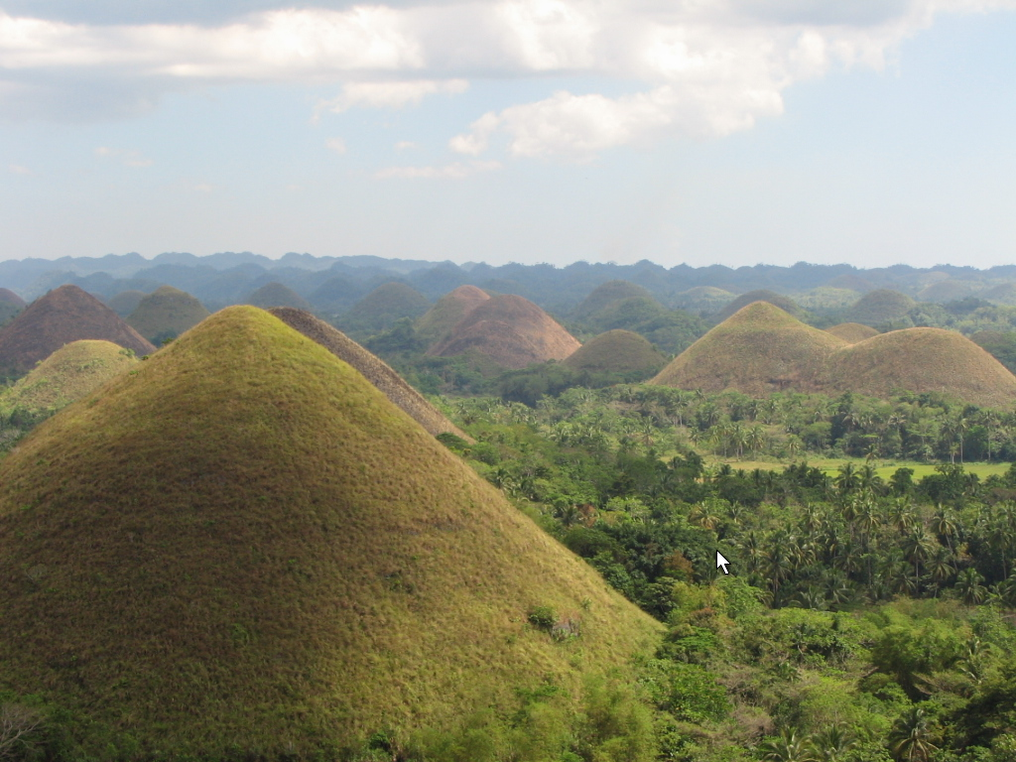
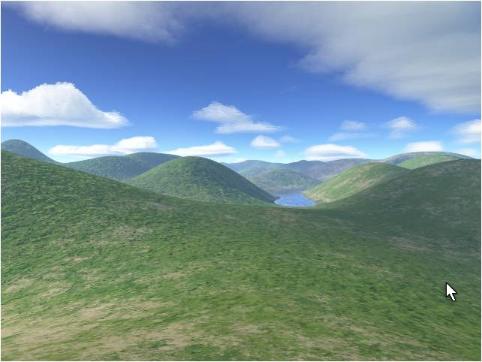
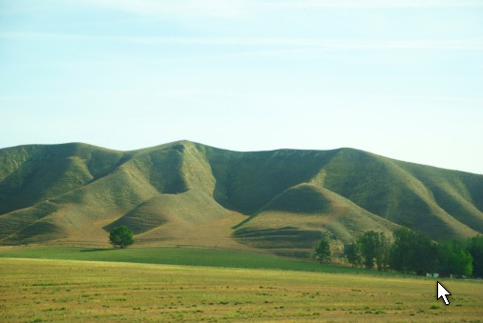

Slide 7
Mountain Versus Hill
There are characteristics typically associated with mountains; for example, most mountains have steep slopes and a well-defined summit - hills tend to be rounded. This, however, is not always the case. Some mountain ranges, such as the Pocono Mts. in Pennsylvania, are geologically old and therefore smaller and more rounded than "classic" mountains such the Rocky Mts. in the western United States. Leaders in geography, like the United States Geological Survey, do not have an exact definition of a mountain and a hill. Instead, the organization's Geographic Names Information System uses broad categories for most land features, including mountains, hills, lakes, and rivers.

Slide 8
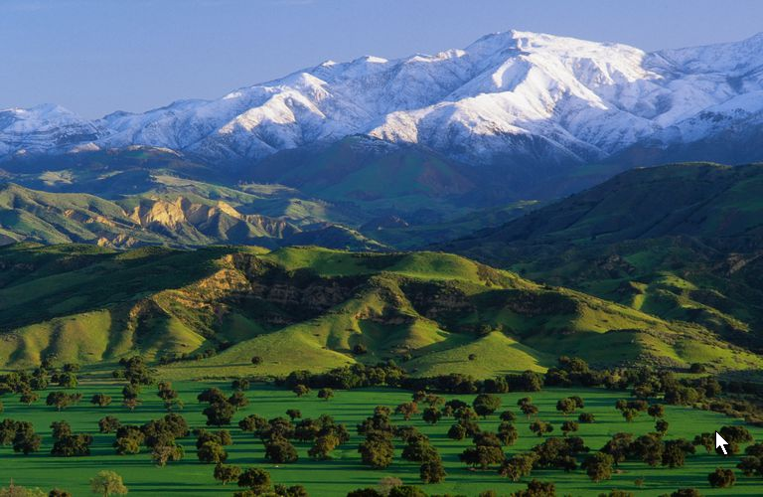
Mountains
Hills

Slide 9
Plateau
A plateau is a flat, elevated landform that rises sharply above the surrounding area on at least one side. Plateaus occur on every continent and take up a third of the Earths land. There are two kinds of plateaus: dissected plateaus and volcanic plateaus.
  A dissected plateau forms as a result of upward movement in the Earths crust. The uplift is caused by the slow collision of tectonic plates – the Colorado Plateau.
  A volcanic plateau is formed by numerous small volcanic eruptions that slowly build up over time, forming a plateau from the resulting lava flows. The North Island Volcanic Plateau covers most of the central part of the North Island of New Zealand.

Slide 10
Erosion
Erosion can influence the shape of a plateau. Soft rock often erodes away on the top of a plateau. Many plateaus are therefore topped with a hard, durable surface called caprock – it protects the plateau from erosion of the soil underneath it.
Valleys form when river water cuts through the plateau. The Columbia Plateau, between the Cascade and Rocky mountains in the northwestern United States, is cut through by the Columbia River. The Ozarks was once a plateau, but it has been dissected by so many streams that it now has the shape (morphology) of hills.

Slide 11
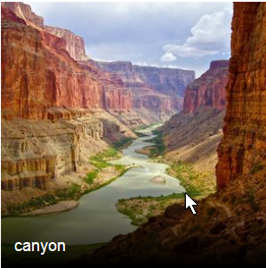
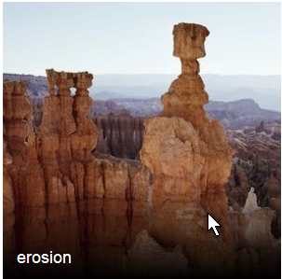
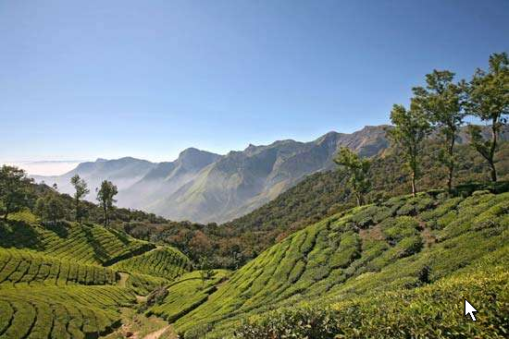
Erosion of Plateaus
valley

Slide 12
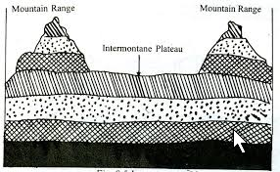
An exception
Intermontane plateaus are wide tablelands that are formed or situated between mountain ranges, when a plateau is surrounded by mountains on all sides, it is refers to an Intermontane plateau. Examples can be found between the Sierra Nevada and Rocky Mountains and the Altiplano in South America.

Slide 13
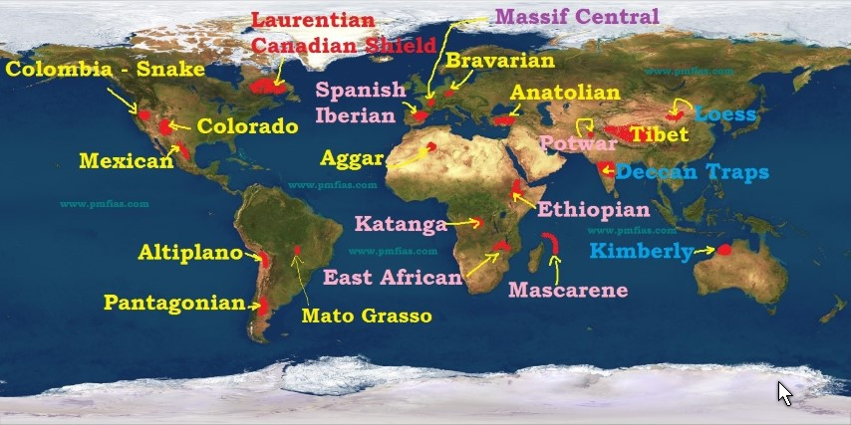
Major Plateaus

Slide 14
Plains
In geography, a plain is a flat, sweeping landmass that generally does not change much in elevation. Plains occur as lowlands along the bottoms of valleys or on the doorsteps of mountains, as coastal plains, and as plateaus or uplands. They cover more than one-third of the world's land area. Plains exist on every continent.
  Contain a large portion of the world’s population
  Easy to build on
  Great for agriculture depending on the climate

Slide 15
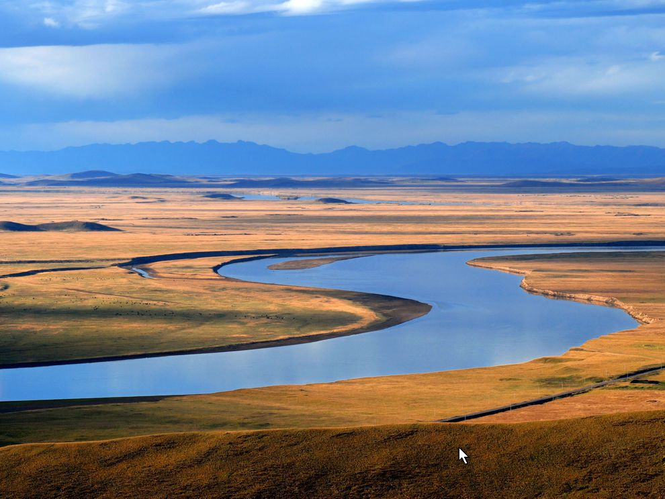
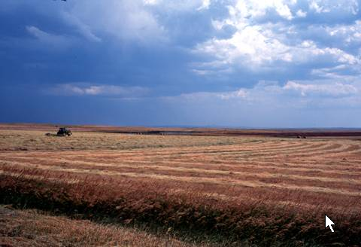
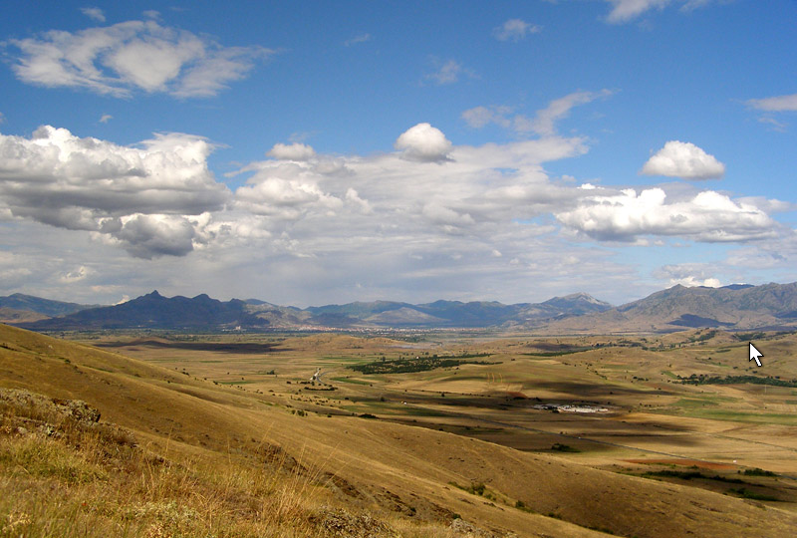
Plains

Slide 16
Floodplains
These are nature’s relief valves when there is excessive precipitation, producing more water than a river can contain within its banks. Floodplains should never be intensively developed with high value construction – yes, they do it all the time. Just drive out Highway 370 in St. Charles county. Even housing has been build – New Town. In 1993 all that land was flooded. They are depending on levies to hold back flood water. In 1993, the levy protecting Chesterfield Valley failed – other levies failed too. The greedy people who finance this development get their money and are gone when the levy fails 15 or 20 years later.

Slide 17
What does a levy do?
It may protect a community or farmland from being flooded.
If it does its job effectively, it causes problems for other people.
  If there is no levy across the river, more water will flow there increasing the area that ends up flooded (the water has to go somewhere)
  If both sides are protected by levies that “hold,”
    The river gets deeper and flows faster (more erosive that way)
    The flood south of the “protected” areas ends up with a higher flood level and a larger area of flooded land.
Levies and flood walls just make the problem worse for other people. Is that fair or decent?

Slide 18
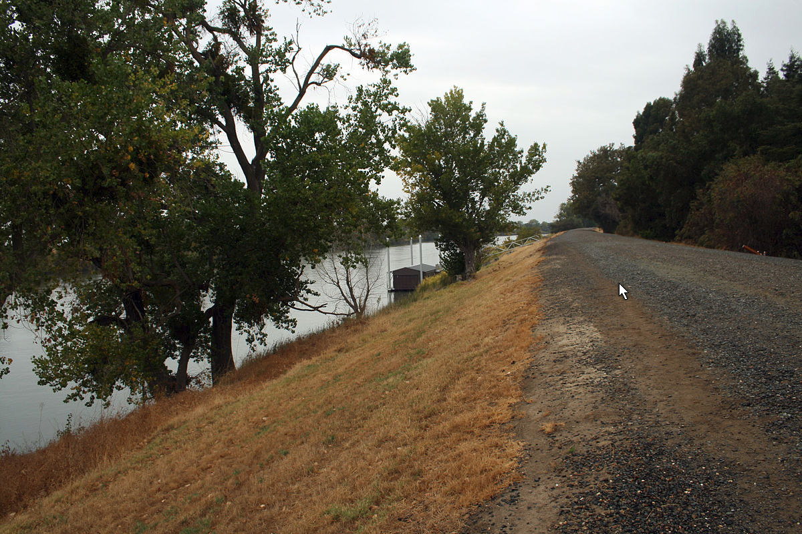
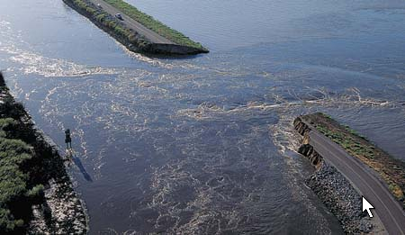
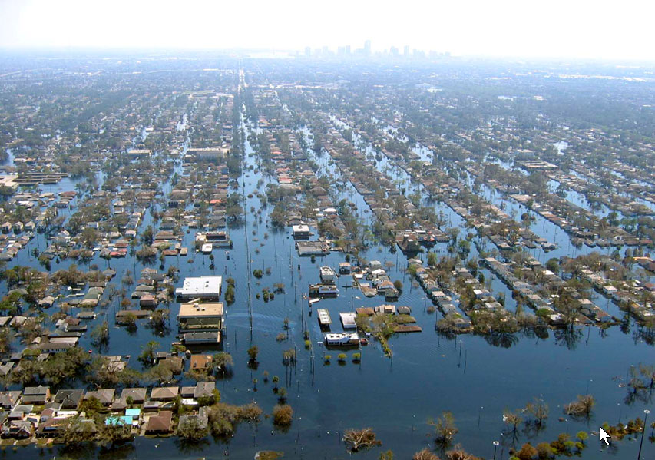
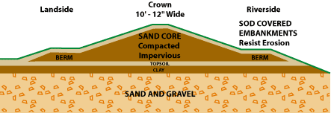
Failed Levy
The Levy Failed in New Orleans
EARTH CITY
Founding the city more than 200 years agi was not an abuse. Rebuilding after Hurricane Katrina was a terrible mistake – the city is lower than the river bottom.

Slide 19
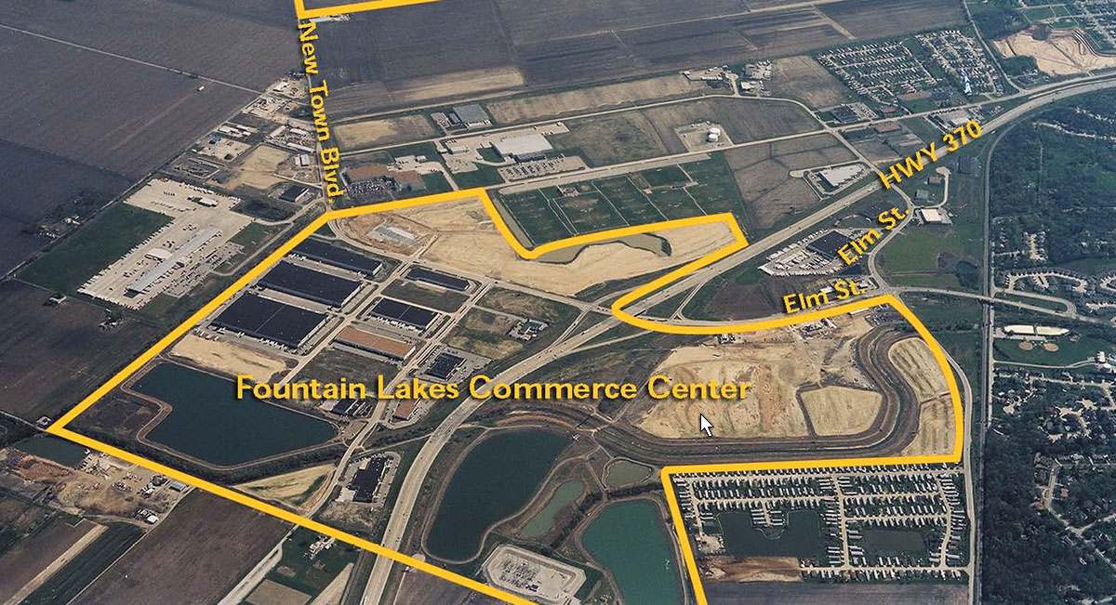
ABUSE OF THE FLOODPLAIN

Slide 20
Additional Problem
Levies, etc., usually result in reducing the area of natural wetlands along rivers. Why is this a problem?
  Many species of animals depend on wetlands for breeding grounds and feeding grounds, thus threatening those species with possible extinction.
    Remember: Everything is connected; Everything goes somewhere, etc.
    Every species of plant and animal plays some role in the ecosystem where it exists. If they are gone, their role in the ecosystem may not be done, affecting everything that depended on that. And, there may not be another species that can step in and do that job or do it as well.

Slide 21
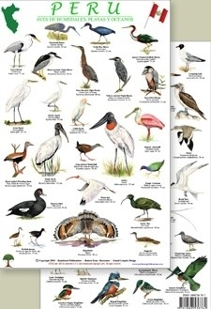

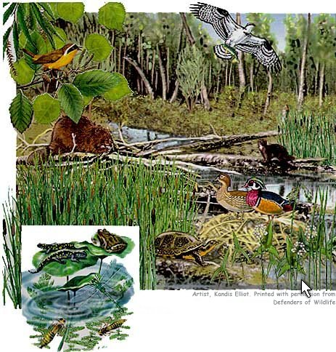

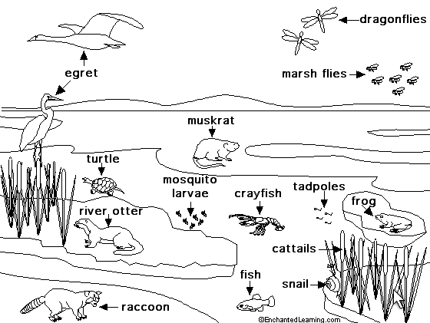
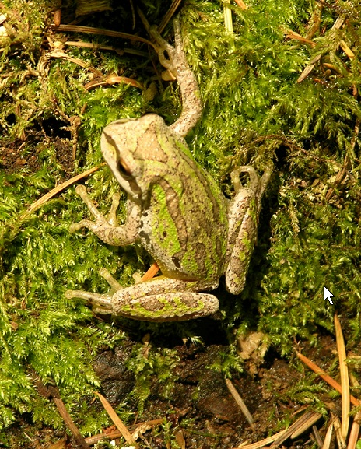
A Few of the Plants and Animals of the Wetlands

