Slide 1
Weathering and Erosion
Weathering - processes at or near Earth’s surface that cause rocks and minerals to break down
Erosion - process of removing Earth materials from their original sites through weathering and transport

Slide 2
Weathering
Mechanical Weathering - processes that break a rock or mineral into smaller pieces without altering its composition
Chemical Weathering - processes that change the chemical composition of rocks and minerals

Slide 3
Processes and Agents of Mechanical Weathering
These are actions or things that break down Earth materials
frost wedging
thermal expansion and contraction
mechanical exfoliation
abrasion by wind, water or gravity
plant growth

Slide 4
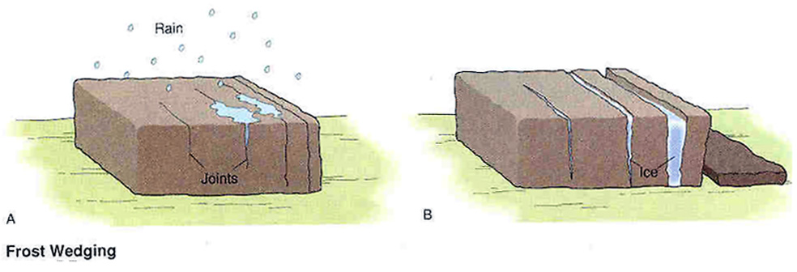
Processes and Agents of Mechanical Weathering
Frost Wedging – cracking of rock mass by the expansion of water as it freezes in crevices and cracks
http://www.uwsp.edu/geo/faculty/ozsvath/images/frost%20wedging.jpg

Slide 5
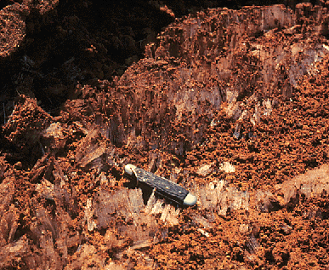
Frost Wedging (in soil)
Ice crystals

Slide 6
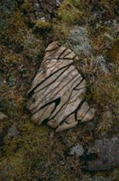
Processes and Agents of Mechanical Weathering
Thermal expansion and contraction –
repeated heating and cooling of materials cause rigid substances to crack and separate
http://content.answers.com/main/content/wp/en-commons/thumb/d/dc/250px-Weathering_freeze_thaw_action_iceland.jpg

Slide 7
Processes and Agents of Mechanical Weathering
Exfoliation – As underlying rock layers are exposed, there is less pressure on them and they expand. This causes the rigid layers to crack and sections to slide off (similar to peeling of outer skin layers after a sunburn). The expanding layers often form a dome.

Slide 8
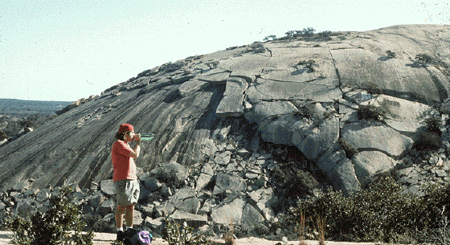
Dome Exfoliation

Slide 9
Processes and Agents of Mechanical Weathering
Abrasion – Moving sediments or rock sections can break off pieces from a rock surface they strike. The sediments can be moved by wind or water and the large rock sections by gravity.

Slide 10
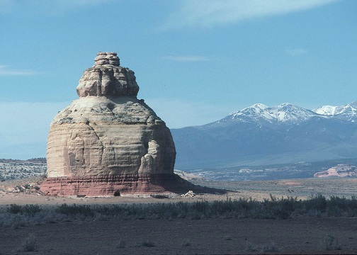
Wind Abrasion
http://www.uwsp.edu/geo/faculty/ritter/geog101/textbook/images/lithosphere/eolian/rock_wind_abrasion_p0772932441_NRCS.jpg

Slide 11
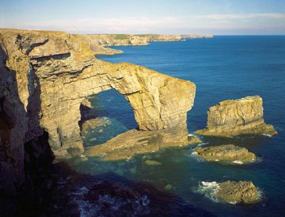
Wind and Water Abrasion
http://www.gsi.ie/Education/European+Landscapes/United+Kingdom.htm Photo Ref: P211442, "IPR/52-34CW BGS©NERC

Slide 12
Processes and Agents of Mechanical Weathering
Plant Growth – As plants such as trees send out root systems, the fine roots find their way into cracks in the rocks. As the roots increase in size, they force the rock sections apart, increasing the separation and weathering.

Slide 13
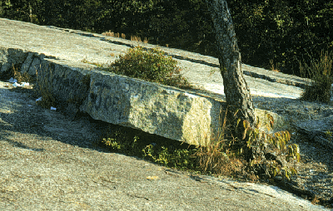
Plant Wedging

Slide 14
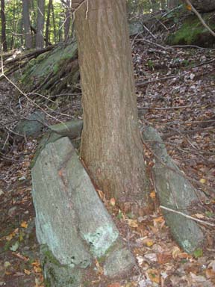
Plant Wedging

Slide 15
Processes of Chemical Weathering
dissolving (dissolution)
oxidation
hydrolysis

Slide 16
Processes of Chemical Weathering
Dissolving (dissolution)
Water, often containing acid from dissolved carbon dioxide, will dissolve minerals from a rock body leaving cavities in the rock. These cavities may generate sinkholes or cave features such as stalactites and stalagmites.

Slide 17
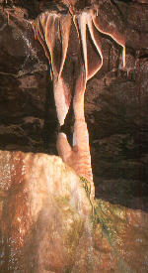
Limestone cave feature result of dissolution

Slide 18
Processes of Chemical Weathering
Oxidation
Minerals may combine with oxygen to form new minerals that are not as hard. For example, the iron-containing mineral pyrite forms a rusty-colored mineral called limonite.

Slide 19
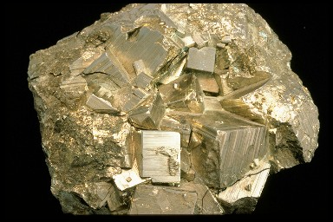
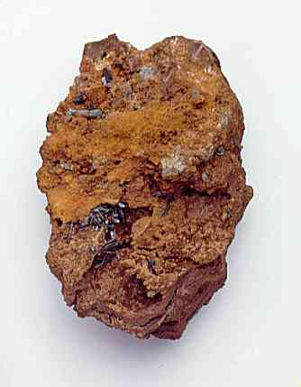
Pyrite Oxidation
http://www.windows.ucar.edu/earth/geology/images/pyrite_sm.jpg
Pyrite
http://www.dkimages.com/discover/previews/965/75014124.JPG
Limonite

Slide 20
Processes of Chemical Weathering
Hydrolysis
Minerals may chemically combine with water to form new minerals. Again these are generally not as hard as the original material.

Slide 21
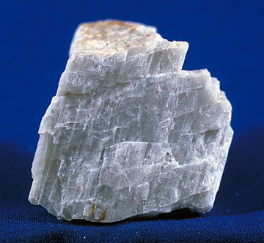
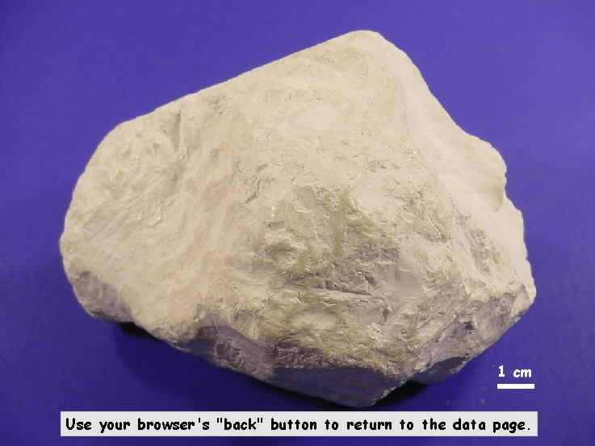
Feldspar Hydrolysis
http://www.mii.org/Minerals/Minpics1/Plagioclase%20feldspar.jpg
http://www.uwm.edu/Course/422-100/Mineral_Rocks/kaolinite1.jpg
Feldspar
Kaolinite (clay)

Slide 22
Factors in Chemical Weathering
Climate – wet and warm maximizes chemical reactions
Plants and animals – living organisms secrete substances that react with rock
Time – longer contact means greater change
Mineral composition – some minerals are more susceptible to change than others

Slide 23
Weathering and Erosion
Weathering produces regolith (“rock blanket”) which is composed of small rock and mineral fragments.
When organic matter is mixed into this material it is called soil.

Slide 24
Erosion Transport Agents or Forces
Water
rain
streams and rivers
ocean dynamics
ice in glaciers
Wind
Gravity

Slide 25
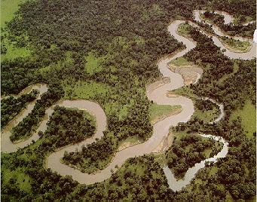
Streams
Flowing water will lift and carry small
sediments such as silt and sand.

Slide 26
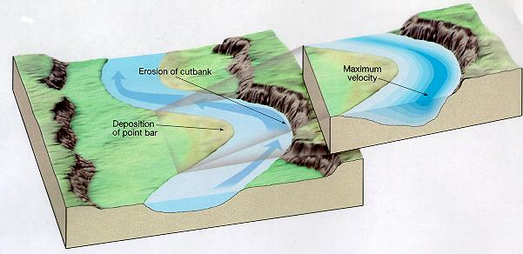
Stream Erosion and Deposition
Where water moves more swiftly there will be more
erosion.
Where the water slows down, sediments will be
deposited.

Slide 27
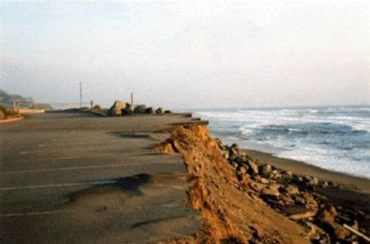
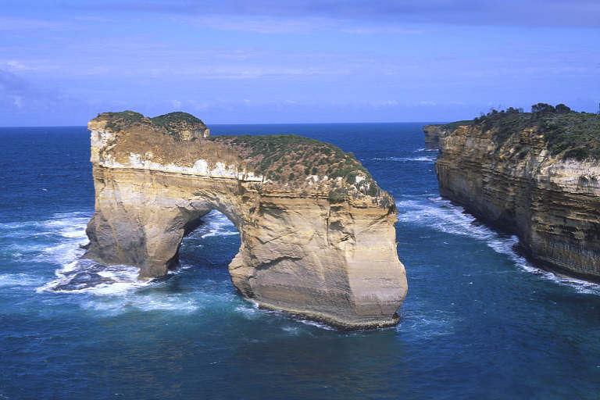
Ocean Dynamics
Tidal action and waves carry away weathered materials.
http://edge.tamu.edu/waves2001/PC_tour/erosion_files/image002.jpg
http://www.dkimages.com/discover/previews/1000/50195183.JPG

Slide 28
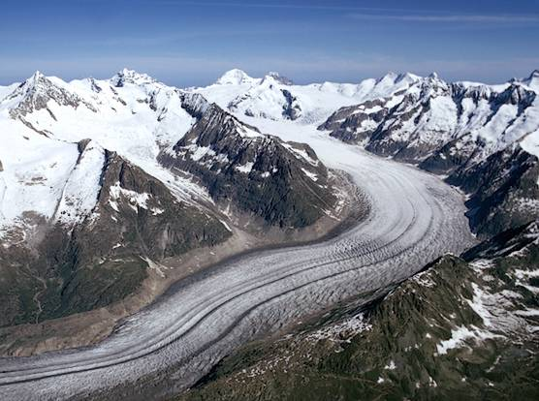
Glaciers
Glaciers are large ice fields that slowly flow downhill over time.
http://images.encarta.msn.com/xrefmedia/sharemed/targets/images/pho/t628/T628797A.jpg

Slide 29
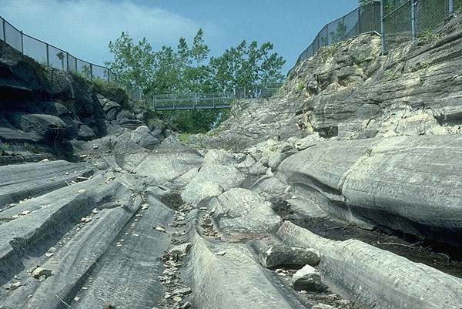
Glaciers
Glacial ice drags rocky material that scours the surface it flows over . The glacier deposits debris as it melts.
http://www.geology.um.maine.edu/user/Leigh_Stearns/teaching/kelley_island.jpg

Slide 30
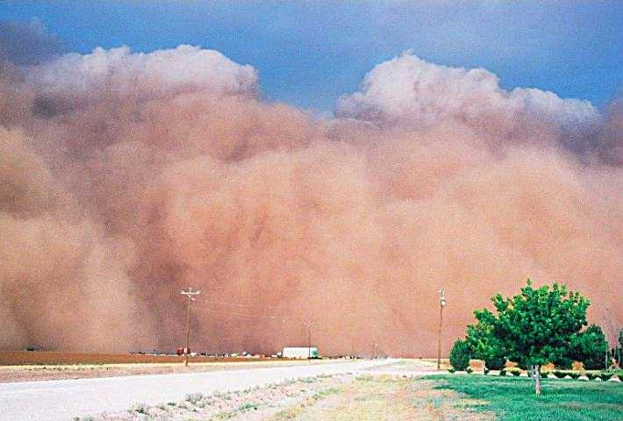
Wind Transport of Sediments
Wind will carry fine, dry sediments over
long distances.

Slide 31
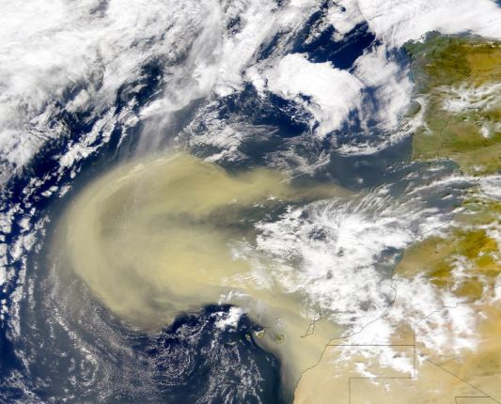
Wind Transport of Dust
Photo shows Sahara Desert sand being transported over
the Atlantic Ocean.

Slide 32
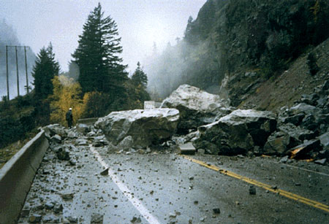
Transport by Gravity
When sediments are weathered they may be transported downward by gravity. The general term for this is mass wasting.
http://en.wikipedia.org/wiki/Mass_wasting

Slide 33
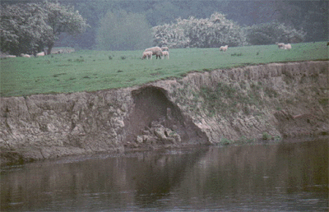
Transport by Gravity
When sediments are weathered they may be transported downward by gravity as a slump.
Slump
http://new.filter.ac.uk/database/image.php?id=594

Slide 34
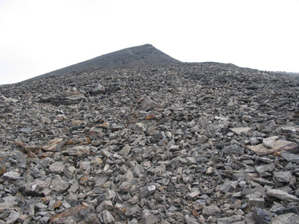
Transport by Gravity
Loose sediments transported by gravity are called scree.
Scree field
http://www.dave-stephens.com/scrambles/banff/aylmer/aylmer013.jpg

Slide 35
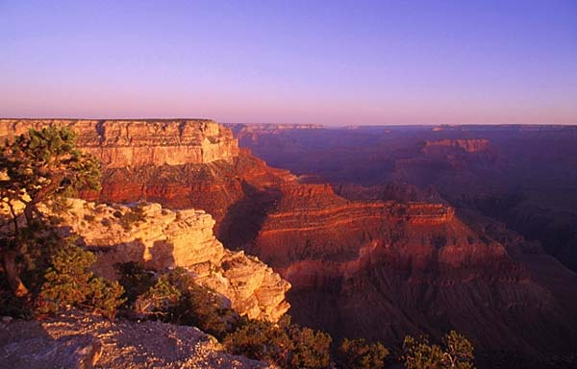
Deposition Formation
Transported sediments are deposited in
layers and generate strata like those found
in the Grand Canyon.

Slide 36
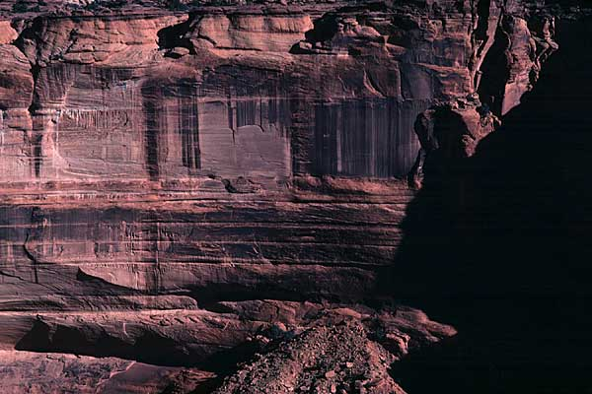
Deposition Formation

Slide 37
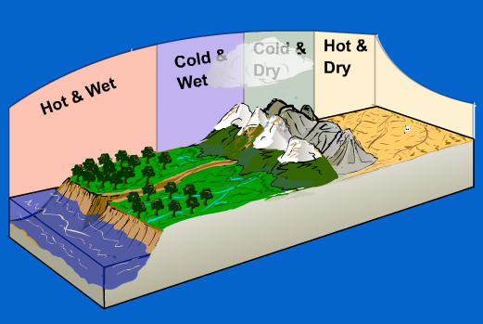
Weathering Tutorial
This tutorial requires Flash but is a nice review of mechanical and chemical weathering with some animations.
http://www.as.uky.edu/academics/departments_programs/EarthEnvironmentalSciences/EarthEnvironmentalSciences/Educational%20Materials/Documents/elearning/module07swf.swf

