Slide 1
Physical geography
Land forming processes and landforms of arid lands.

Slide 2
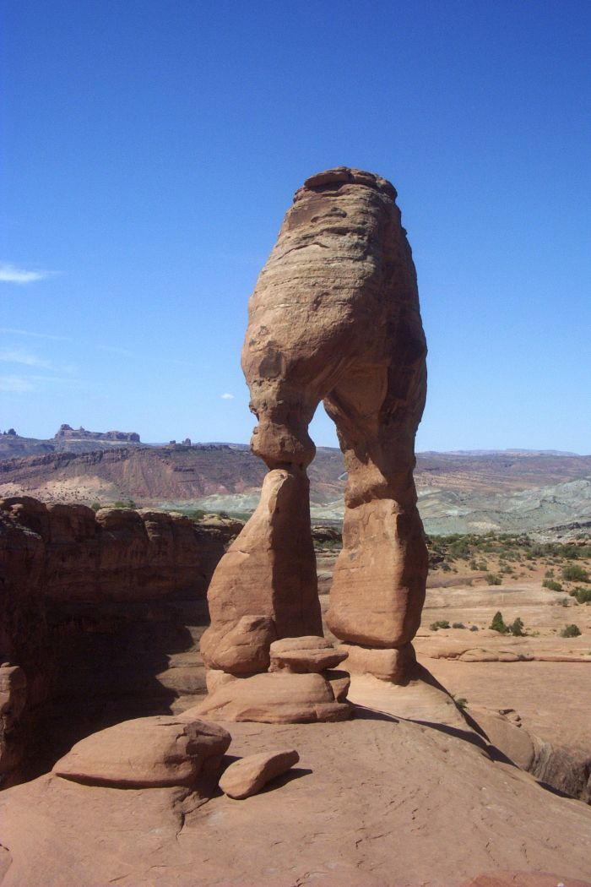
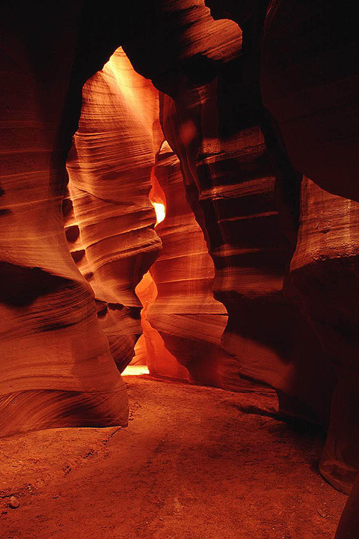
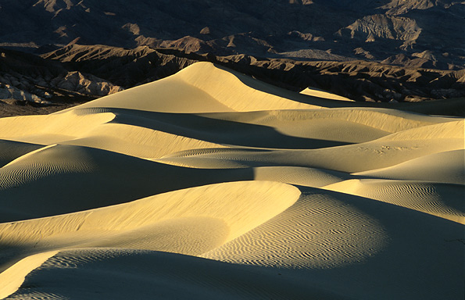
Arid Landforms

Slide 3
Basic Concepts
I. Most deserts exhibit highly angular landscapes.
mechanical weathering dominates
angular particles of weathered rock; bedrock outcrops
little soil or vegetation to soften landscape
II. Softer, more rounded landscapes appear where deposition is predominant.
dunes
III. Desert rainfall is infrequent, intense, and unreliable.
intense flash flooding, intense erosion
ephemeral streams

Slide 4
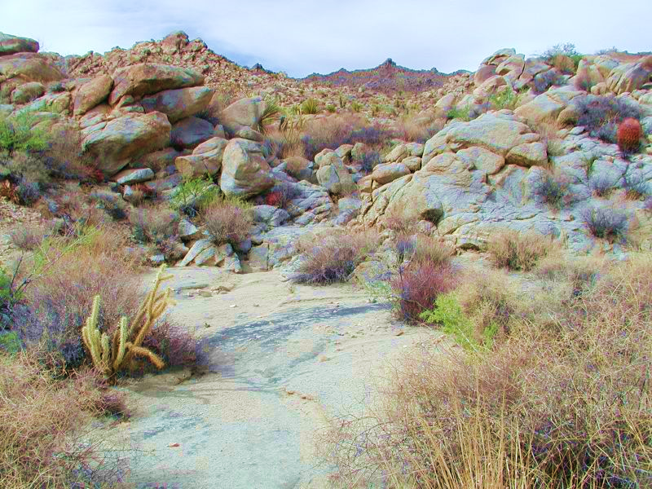

Slide 5
Definitions
A hamada (Arabic, حمادة ḥammāda) is a type of desert landscape consisting of high, largely barren, hard rocky plateaus, where most of the sand has been removed by deflation.
An erg is a broad, flat area of desert covered with wind-swept sand with little or no vegetative cover. The term takes its name from the Arabic word ʿarq, meaning "dune field“
A desert pavement, also called reg, serir, gibber, or saï is a desert surface covered with closely packed, interlocking angular or rounded rock fragments of pebble and cobble size. They typically top alluvial fans. Desert varnish collects on the exposed surface rocks over time.

Slide 6
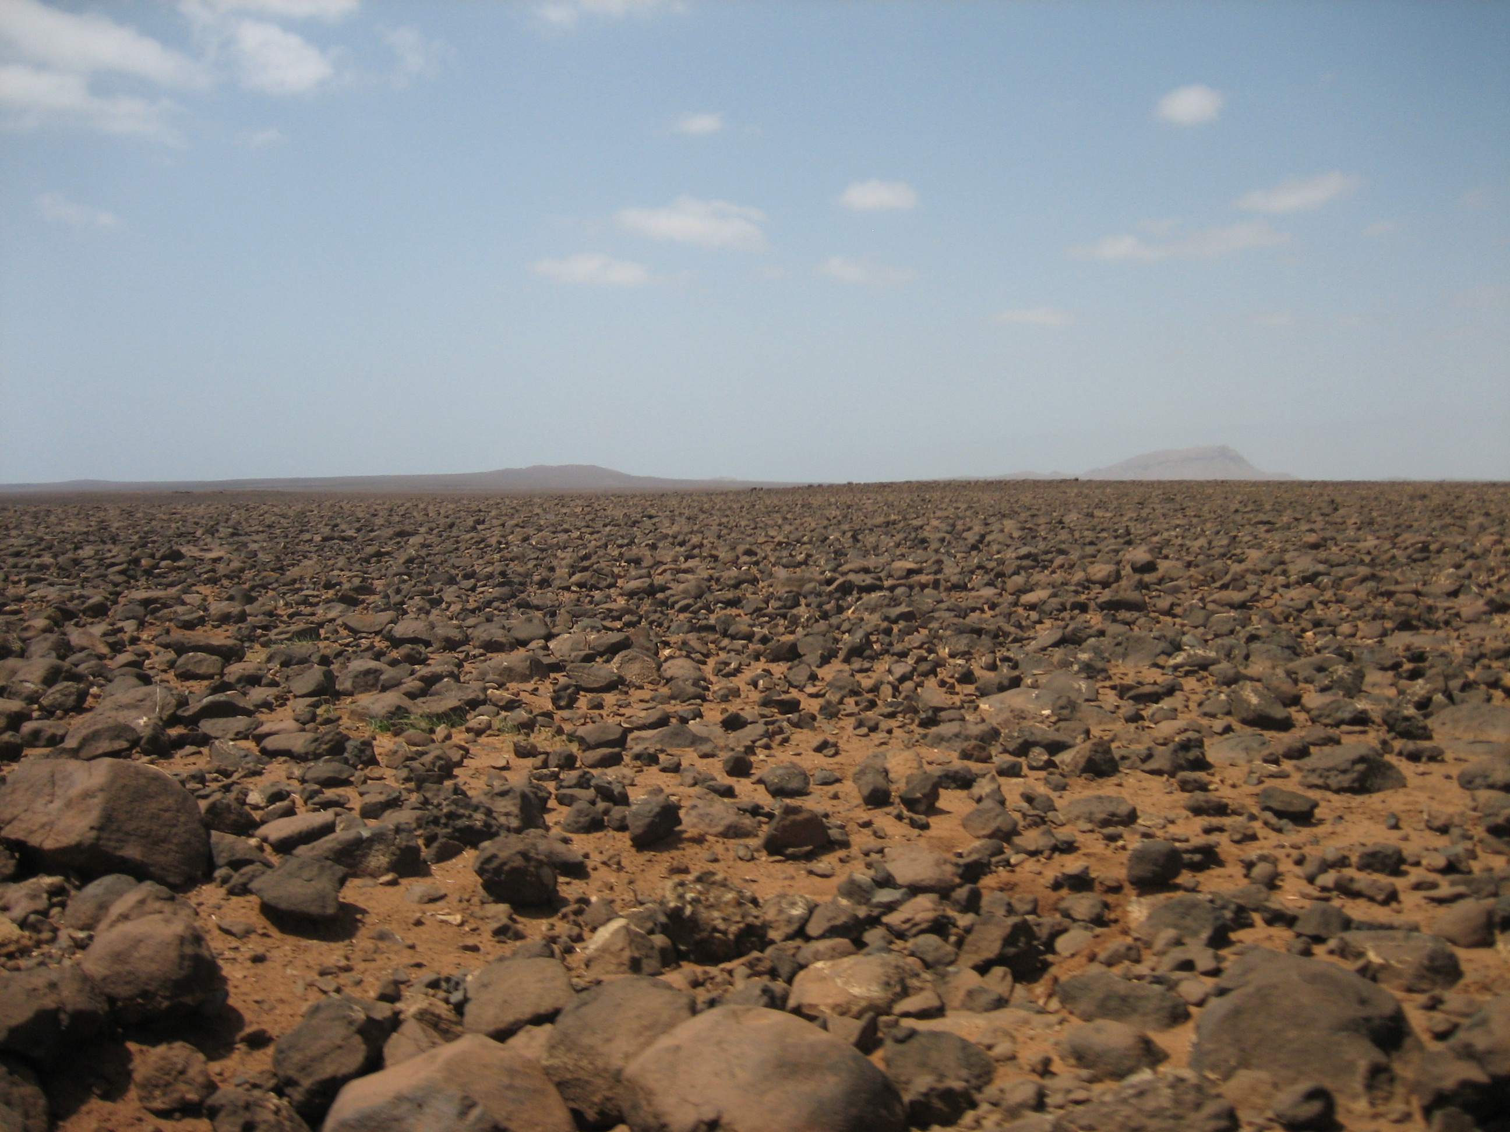
Hamada desert

Slide 7
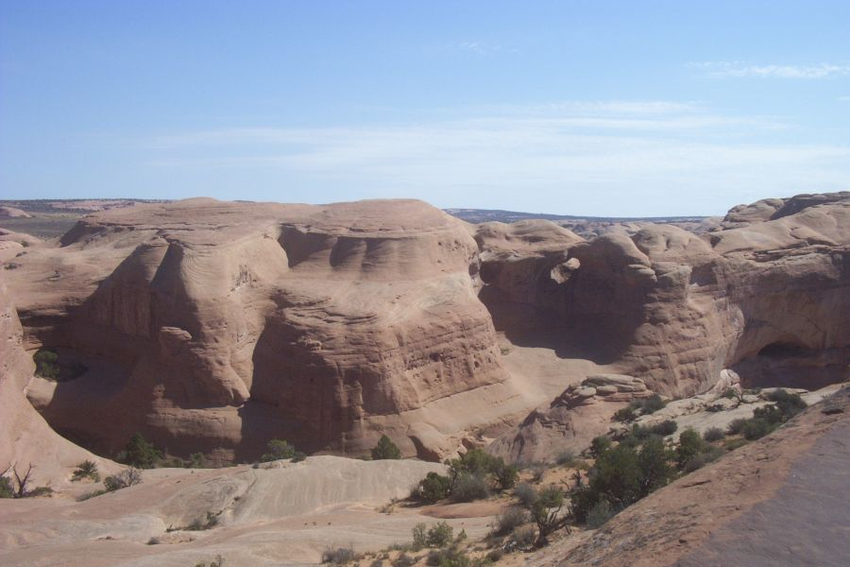
Hamada - bedrock predominates

Slide 8
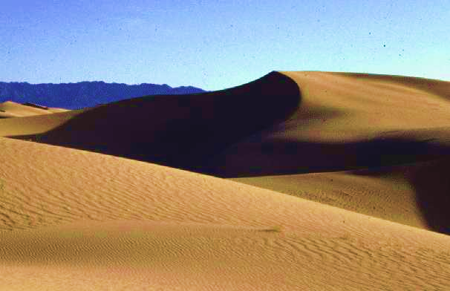
Erg desert, not the most common kind, despite what you see in the movies.

Slide 9
Death Valley, California

Slide 10
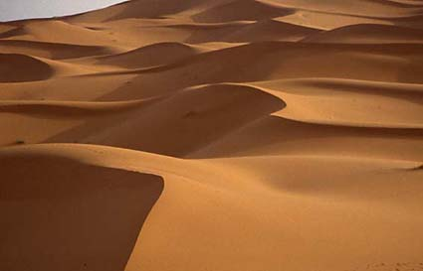
Erg - sea of sand
largest are in Sahara and Arabian Deserts, sand covers about 20% of world’s deserts
vegetation rare
sand probably formed during more humid climate

Slide 11
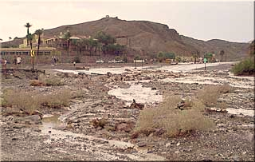
Reg desert, the most common type
Death Valley, July 15, 1999

Slide 12
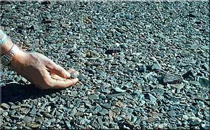
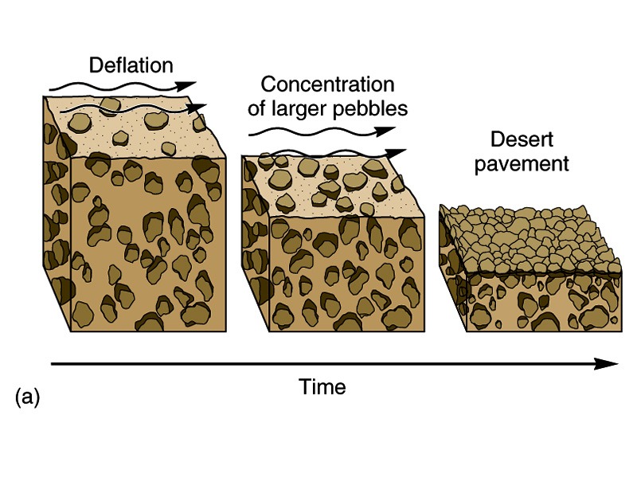
Reg - desert “pavement” of pebbles and stones
all small materials and sand removed by wind
may be very thin coating of stones

Slide 13
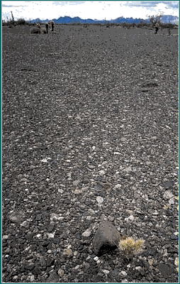
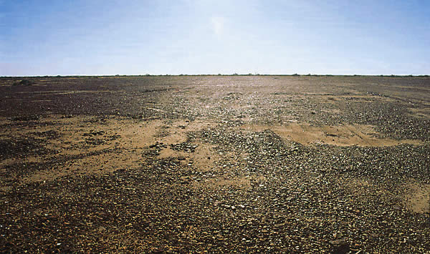
A gibber plain in Australia
Desert pavement

Slide 14
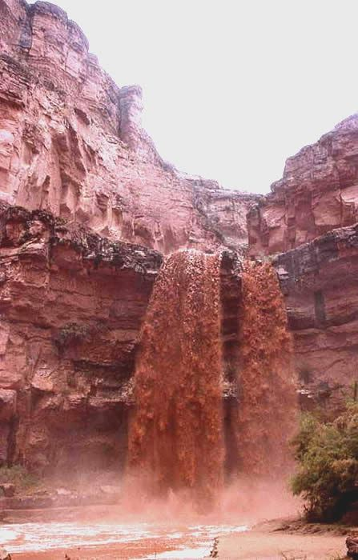
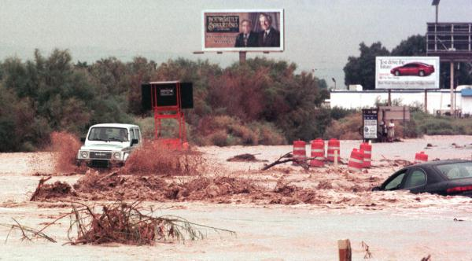
Surprisingly, the most active land forming force in arid lands is moving water.
Las Vegas Flash Flood

Slide 15
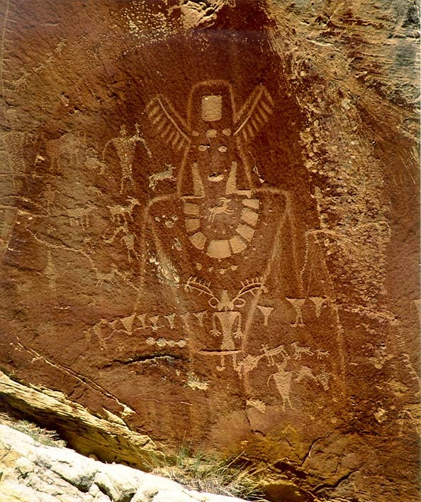
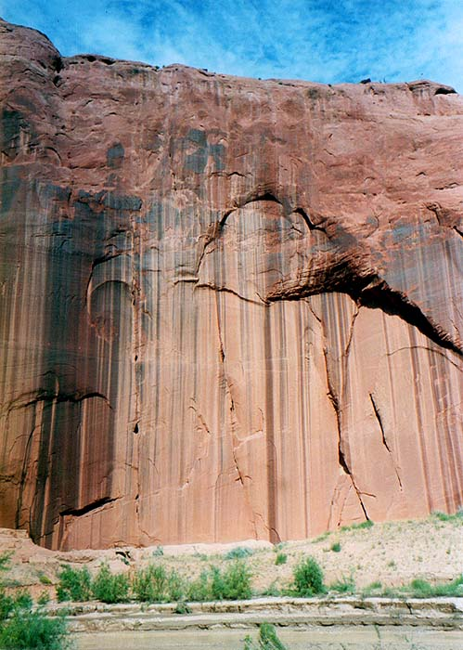
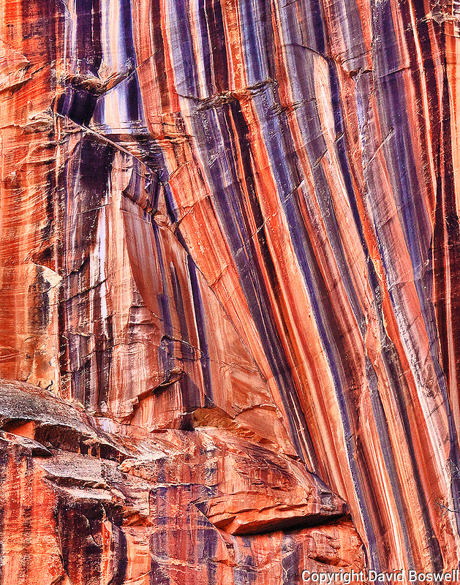
Desert varnish - oxidation of iron and manganese, useful for dating desert surfaces

Slide 16
DESERT FLUVIAL PROCESSES/LANDFORMS
Fluvial Erosion - rare, intense flash floods.
steep slopes; steep-walled canyons; washes, wadis, arroyos, canyons.
fluvial systems decrease in discharge downstream
Fluvial Transportation - large amounts of rock and sand moved short distances.
Fluvial Deposition – where water slows on flat playas material is deposited and sorted by size.
alluvial fans
rock debris in piedmont region
Gravity in action: the heavier particles settle first, and down the line till the smallest (lightest) particles settle.

Slide 17
The process of erosion/deposition
Weathering – chemical or mechanical effect on rock that weakens it or breaks it into smaller pieces.
Erosion – weathered earth material is moved because the force of moving air, moving water, or gravity is strong enough to move the material (overcome inertia)
Deposition – occurs when the moving force weakens – particularly the wind or water slow down (losing power) and the force of gravity is strong enough to cause the particles in suspension to settle to the kind surface, The heavier particles settle first.
If there is erosion in one place, there will be deposition somewhere else.

Slide 18
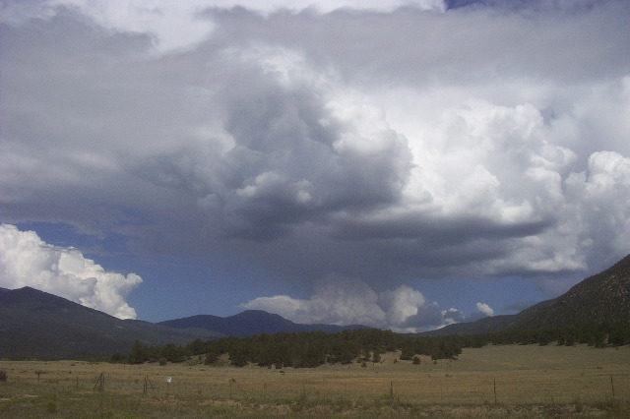
In meteorology, a virga is an observable streak or shaft of precipitation falling from a cloud that evaporates or sublimates before reaching the ground. A shaft of precipitation that doesn't evaporate before reaching the ground is a precipitation shaft.
Virga
Hot dry air can absorb a lot of water

Slide 19
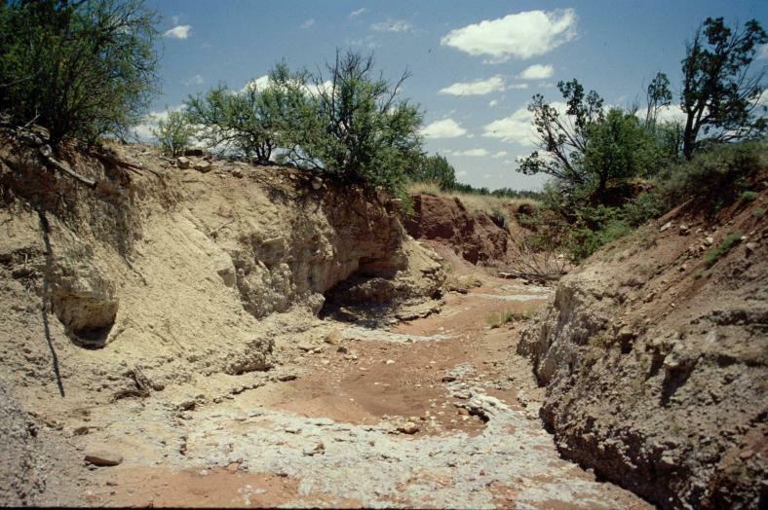
An arroyo (/əˈrɔɪoʊ/; Spanish: [aˈroʝo], "brook"), also called a wash, is a dry creek, stream bed or gulch that temporarily or seasonally fills and flows after sufficient rain. Flash floods are common in arroyos following thunderstorms.
Arroyo called a wadi in the Middle East

Slide 20
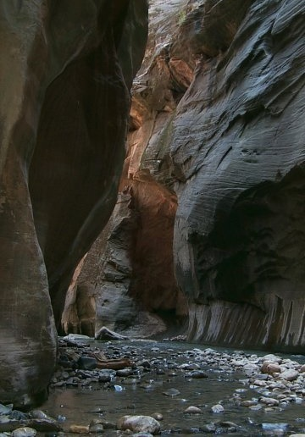


The Narrows, Zion N.P., Utah

Slide 21
AEOLIAN (WIND) PROCESSES/LANDFORMS
Aeolian Erosion - much less effective than fluvial
deflation - the movement of small particles
abrasion - polishes and etches exposed surfaces
Aeolian Transportation - moves nothing bigger than sand
dust storms - can extend thousands of feet up
sand storms - only very near the surface
Aeolian Deposition - dunes form and shift where winds and terrain combine to slow the winds or block the movement of dunes.

Slide 22
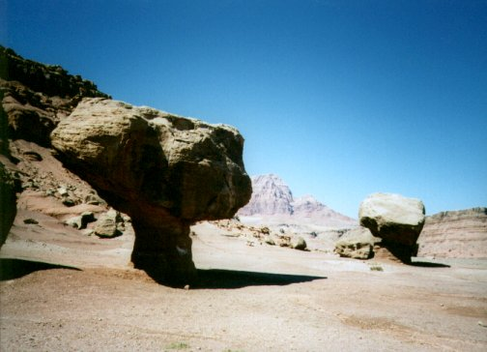

Slide 23
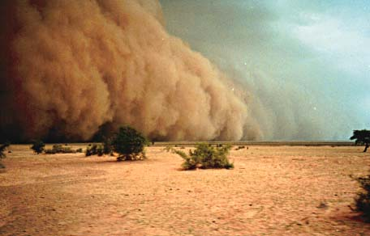
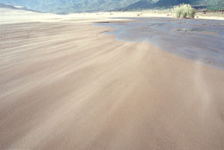
You don’t want to be caught in either one of these storms.
Dust Storm, Senegal
Sand Storm

Slide 24
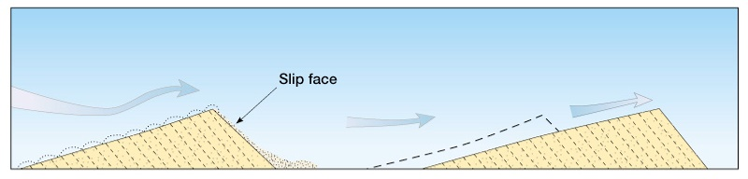
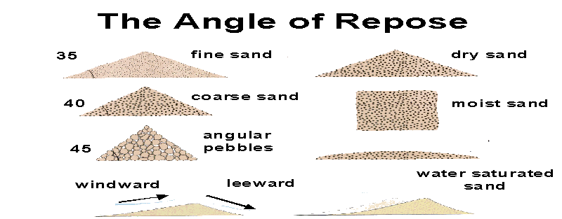
AEOLIAN (WIND) PROCESSES/LANDFORMS

Slide 25
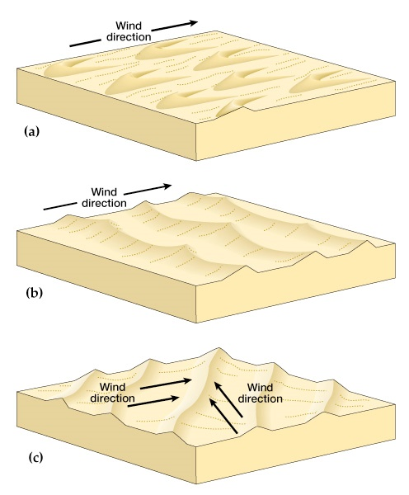
Types of Dunes
In physical geography, a dune is a hill of loose sand built by aeolian processes (wind) or the flow of water. Dunes occur in different shapes and sizes, formed by interaction with the flow of air or water.
BARCHAN
TRANSVERSE DUNES
SEIFS

Slide 26
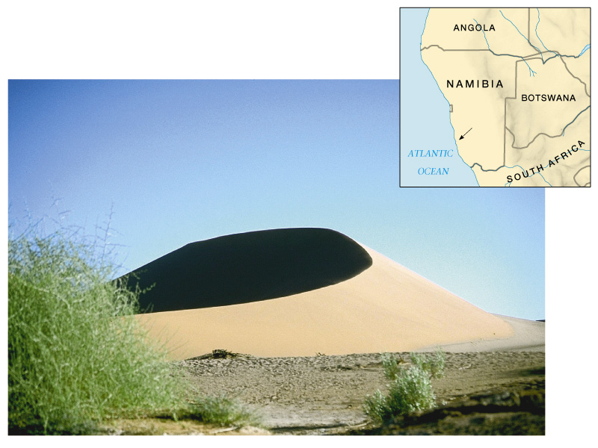
Types of Dunes
Barchans - migrating crescent dune with horns pointing downwind; form where strong winds blow in a consistent direction. Move fast. Common in central Asia and Sahara. Can reach hundreds of feet in height.

Slide 27
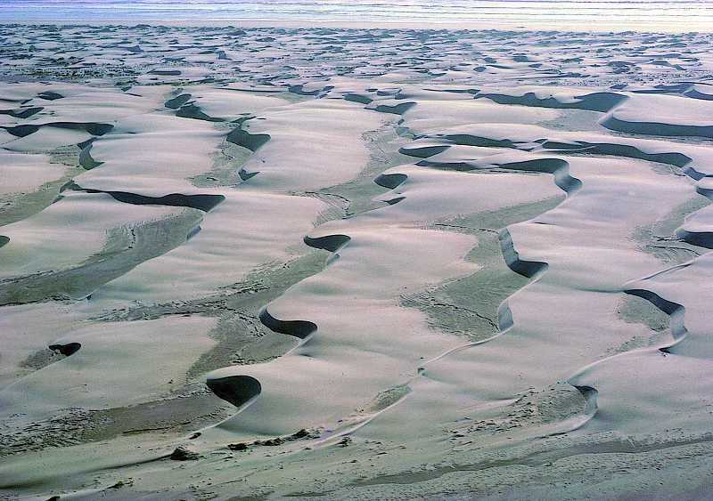
Transverse Dunes - parallel waves of crescent dunes perpendicular to wind direction; migrate downwind. Found in areas with large supply of sand.

Slide 28
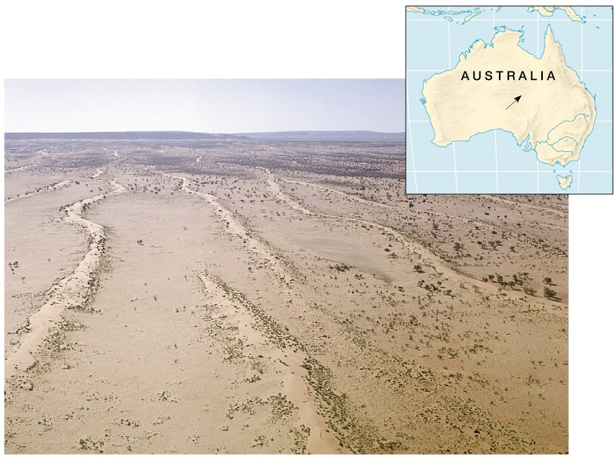
Seifs - multiple very long narrow, parallel dunes. May be caused in areas with at least two dominant wind directions. Can be tens of miles long. Common outside of U.S.

Slide 29
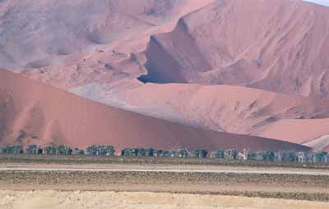
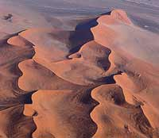
Namib Desert
Star Dunes

Slide 30
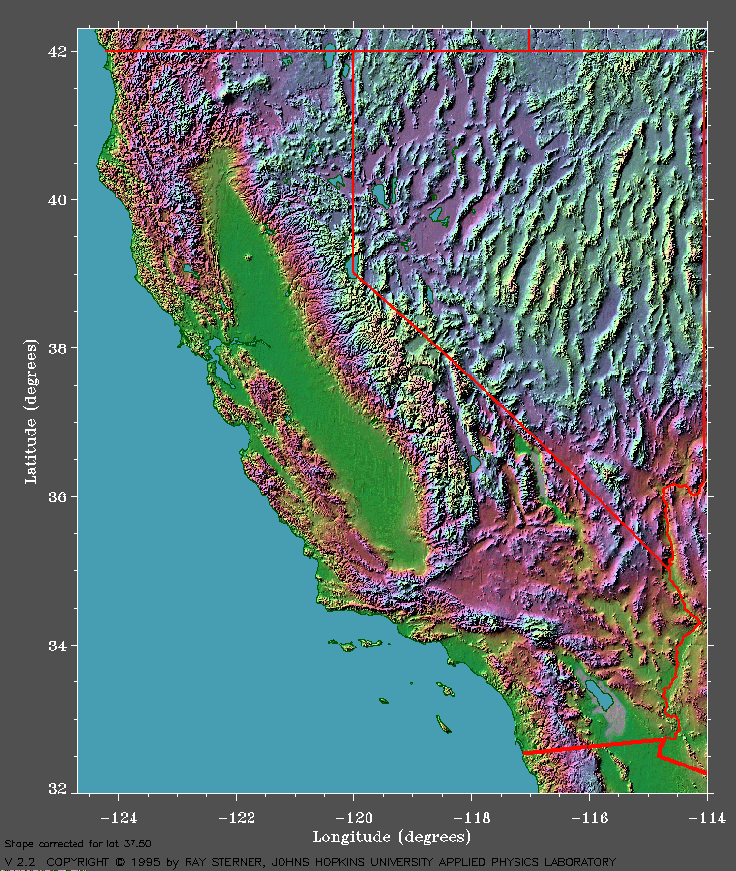
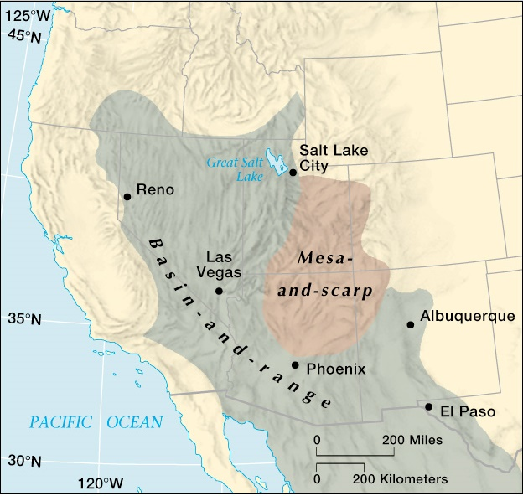
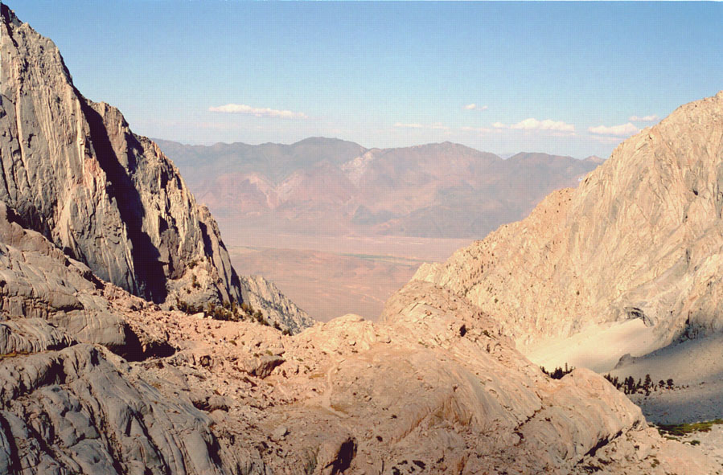
BASIN AND RANGE TOPOGRAPHY

Slide 31
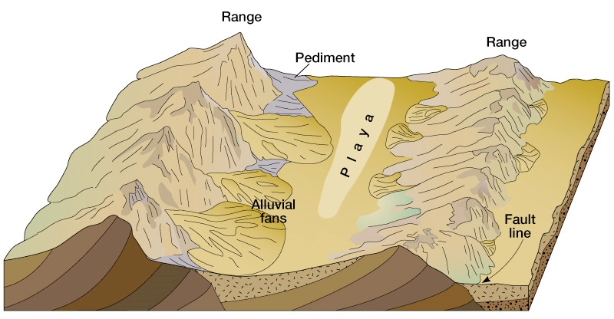
Piedmont - gently sloping land that extends out from base of mountains.
Pediment - a broad, gently sloping expanse of rock debris extending outward from the foot of a mountain slope, especially in a desert.

Slide 32
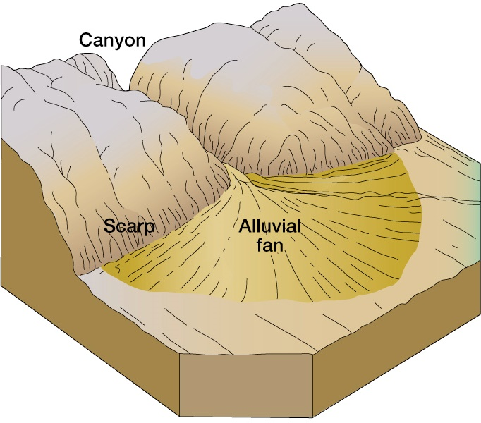
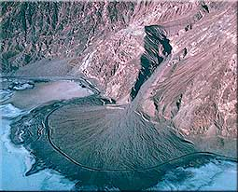
Badwater, Death Valley, CA
An alluvial fan is a triangle-shaped deposit of gravel, sand, and even smaller pieces of sediment, such as silt. This sediment is called alluvium. Alluvial fans are usually created as flowing water interacts with mountains, hills, or the steep walls of canyons.

Slide 33
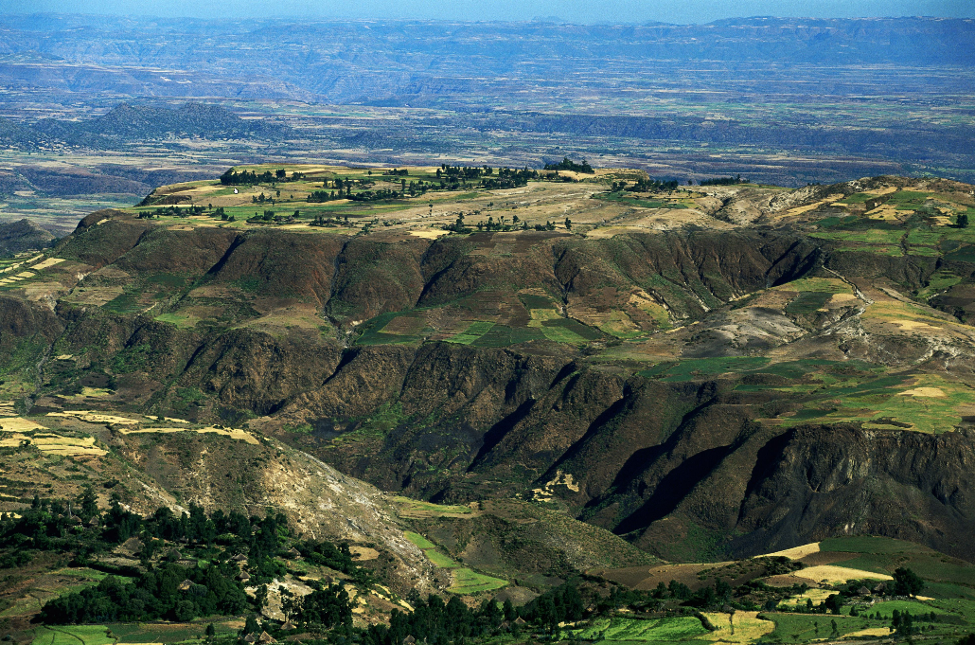
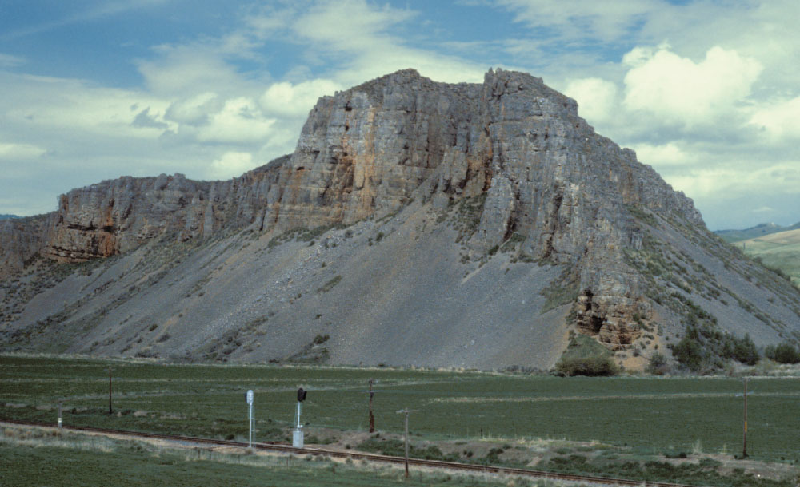
Definitions
An escarpment is a steep slope or long cliff that forms as an effect of faulting or erosion and separates two relatively leveled areas having differing elevations. Usually escarpment is used interchangeably with scarp.
Geologists define talus as the pile of rocks that accumulates at the base of a cliff, chute, or slope. The formation of a talus slope results from the talus accumulation. As weathering weakens earth materials of the cliff or slope face, gravity eventually overcomes inertia and the materials fall to the base and accumulate as a talus slope.
Talus Slope

Slide 34
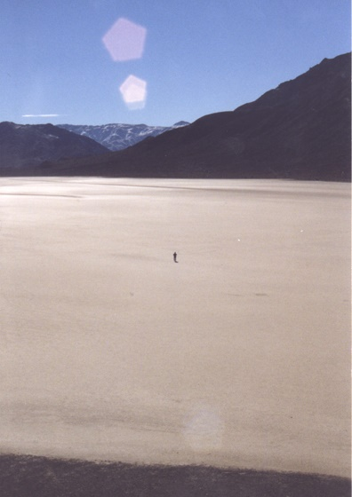
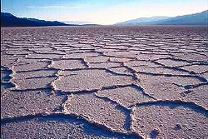
playa (plural playas) (geology, US) a level spot temporarily covered with water which subsequently becomes dry by evaporation; an alkali flat or salt pan.
Playas

Slide 35
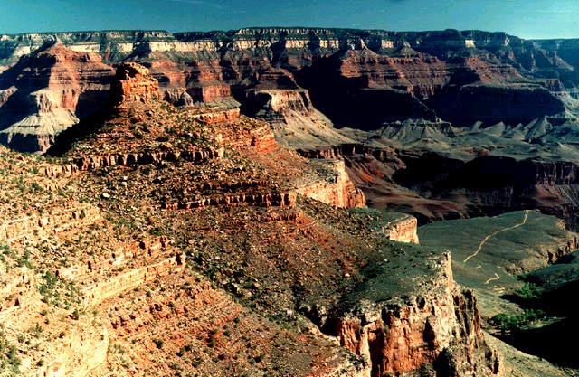
Mesa and Scarp Topography
Grand Canyon
What is the difference between (basin & range) and (mesa & scarp) topography?
Basin and Range topography is characterized by large scale geologic movements over a wide area, while mesas and scarps are generally formed by erosion.

Slide 36
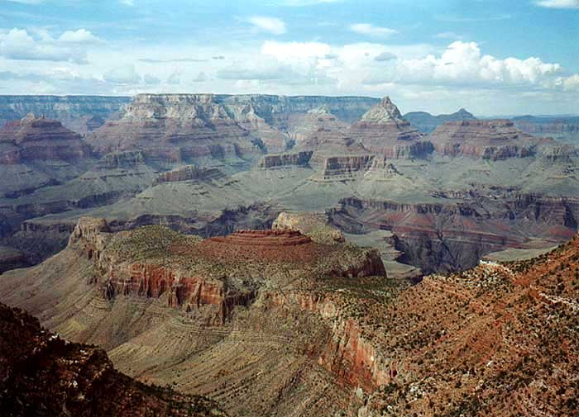
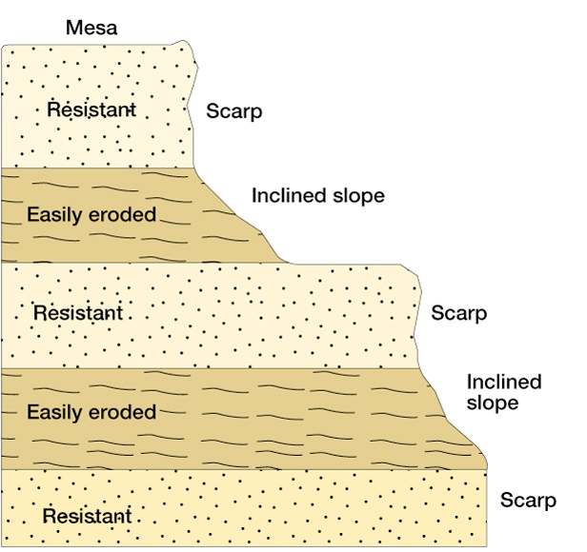
Differential Erosion as is in the Grand Canyon

Slide 37
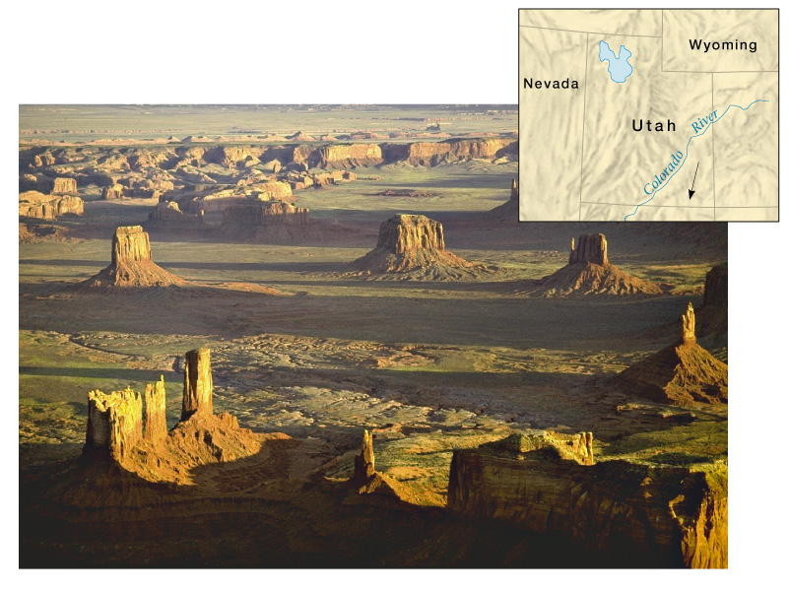

Slide 38
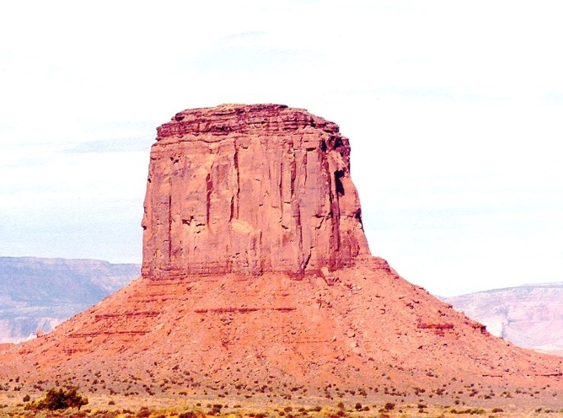
In geomorphology, a butte (/bjuːt/) is an isolated hill with steep, often vertical sides and a small, relatively flat top; buttes are smaller landforms than mesas. Not all buttes are volcanic plugs
Hard, volcanic plug
Talus slope

Slide 39
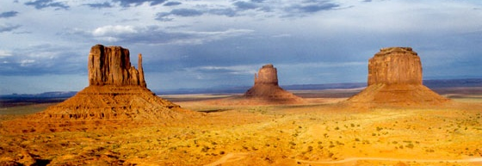
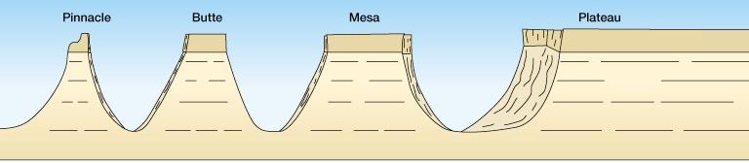

Slide 40
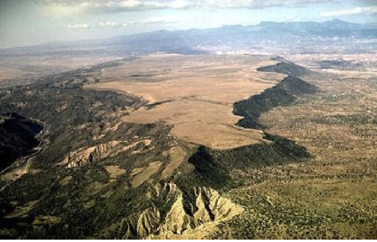


In geology and physical geography a plateau, is also called a high plain or a tableland. It is an area of a highland, usually consisting of relatively flat terrain that is raised significantly above the surrounding area, often with one or more sides with steep slopes (escarpments).

Slide 41


Inselberg - “island mountains” rise abruptly out of desert landscapes
Bornhardt - highly resistant rock landform; a type of inselberg.
Kata Tjuta (The Olgas), Australia

Slide 42

Uluru (Ayer’s Rock), Australia

Slide 43

Bornhardt, Arches National Park, Utah

Slide 44


A natural arch, natural bridge, or (less commonly) rock arch is a natural rock formation where an arch has formed with an opening underneath. ... By contrast, the Dictionary of Geological Terms defines a natural bridge as a "natural arch that spans a valley of erosion."
Delicate Arch, Arches National Park, Utah

Slide 45


Slide 46



Definitions
Intermittent Stream: Seasonal streams (intermittent) flow during certain times of the year when smaller upstream waters are flowing and when groundwater provides enough water for stream flow. Runoff from rainfall or other precipitation supplements the flow of seasonal stream
Exotic Stream: Exotic streams are those that originate in a humid region but flow through an arid region. Such is the case of the Nile and Colorado Rivers. The headwaters of the Nile River is in the wet Ethiopian Highlands, and travels through the eastern portion of the Sahara Desert on its way to the Mediterranean Sea.

Slide 47
Flora and fauna

Slide 48



Xerophytic vegetation
Xerophyte, any plant adapted to life in a dry or physiologically dry habitat (salt marsh, saline soil, or acid bog) by means of mechanisms to prevent water loss or to store available water. Succulents (plants that store water) such as cacti and agaves have thick, fleshy stems or leaves. Other xerophytic adaptations include waxy leaf coatings, the ability to drop leaves during dry periods, the ability to reposition or fold leaves to reduce sunlight absorption, and the development of a dense, hairy leaf covering.

Slide 49

Joshua Tree Nationalk Park

Slide 50

When precipitation reaches the ground, the desert blooms

Slide 51
Adaptations to dryness
Wide, dense root system near the surface to catch any precipitation
Waxy surfaces to reduce transpiration (loss of water)
Thorns to dissuade animals from breaking the outer surface by biting them
Accordion pleated surfaces to allow them to expand to store water and then shrink when water is scarce – all without creating a break in the surface of the plant
Dormancy – loss of leaves when it gets dry.
Tiny leaves to reduce transpiration
Deep roots (tap roots) that can reach the deep water table.
Rapid life cycles – seeds remain viable for years. When rain comes the seeds germinate quickly, produce flowers, produce seeds, then die. The seeds are left to wait for the next rain.

Slide 52







Slide 53

Most fauna is nocturnal – The desert comes alive at night.
Rest in burrows or in shady areas in the heat of the day to reduce loss of body moisture.
Become active at night when it is cooler and they lose less body moisture.
Metabolisms that can function with lack of moisture – Urinate small quantity but concentrated urine

