Slide 1
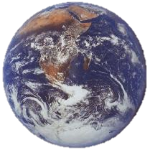
Water Biomes

Slide 2
Water Biomes
Approximately 70% of the Earth’s surface is covered by water – it is more a water planet than a land one. The biggest supplier of oxygen to the world is the phytoplankton of the oceans. There is much about the oceans we don’t understand. We need today more attention to our water bodies.
The limiting factors in water biomes are:
Amount of salt (salinity)
Amount of dissolved oxygen
Sunlight

Slide 3
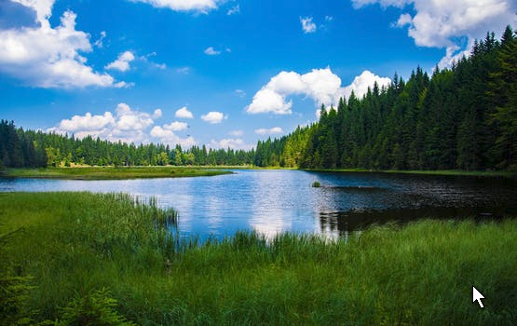
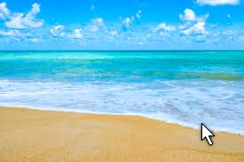
2 Types of Water Biomes
Freshwater
Rivers and Streams
Lakes and Ponds
Saltwater
Ocean
Estuaries
Seashores (tidal areas)

Slide 4
Freshwater Biomes
Freshwater contains little or no salt, so it has a LOW salinity.
Flowing freshwater = rivers and streams
Still Freshwater = lakes and ponds

Slide 5
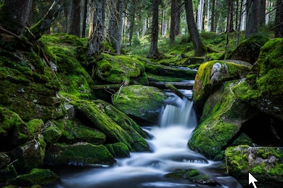
Flowing Freshwater
Streams
The faster a stream flows the greater the amount of dissolved oxygen in it.
Faster water flows = oxygen

Slide 6
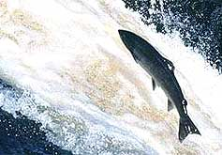
Flowing Freshwater
Streams
The fish that live in streams are adapted to fast moving water

Slide 7
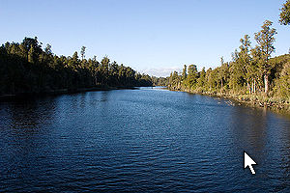
Flowing Freshwater
Rivers
Water moves slower in a river and debris settles on the bottom.
Because of this, rivers tend to have more nutrients and less dissolved oxygen.
nutrients and oxygen

Slide 8
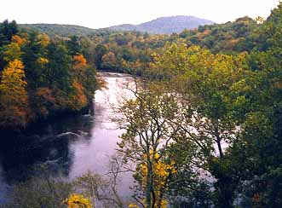
Flowing Freshwater
Rivers

Slide 9
Freshwater
Ponds
Small, shallow bodies of water
Sunlight penetrates all the way to the bottom
Most completely filled with plant material
Very high amount of nutrients

Slide 10
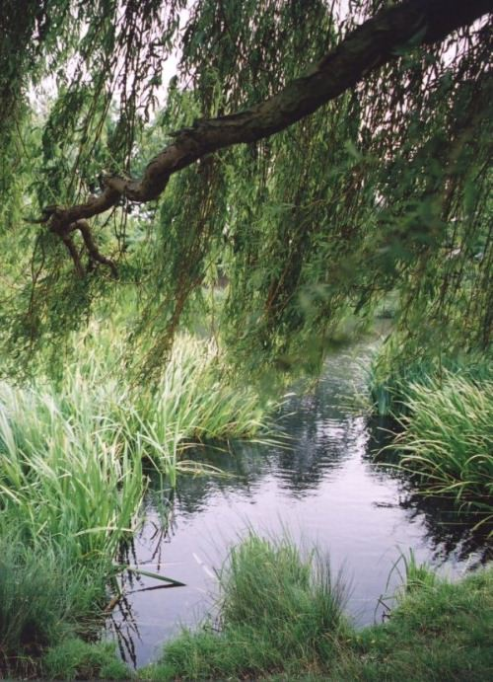
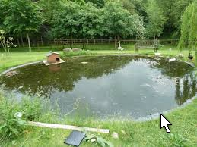
Freshwater
Ponds

Slide 11
Freshwater
Lakes
Larger and deeper than ponds
Plant growth is limited to the shoreline
Sunlight does NOT penetrate to the bottom= no plants after a certain depth!
World’s deepest lake – Lake Baikal, Russia
Lake with the greatest volume of water in the world – Lake Baikal, Russia

Slide 12
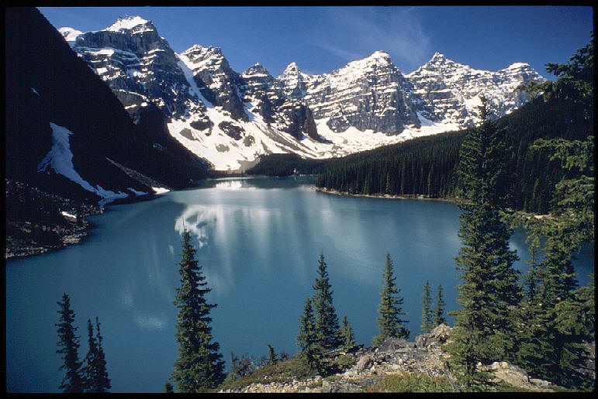
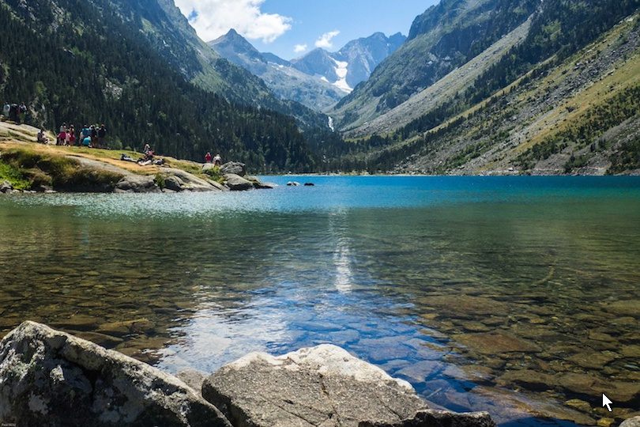
Freshwater
Lakes

Slide 13
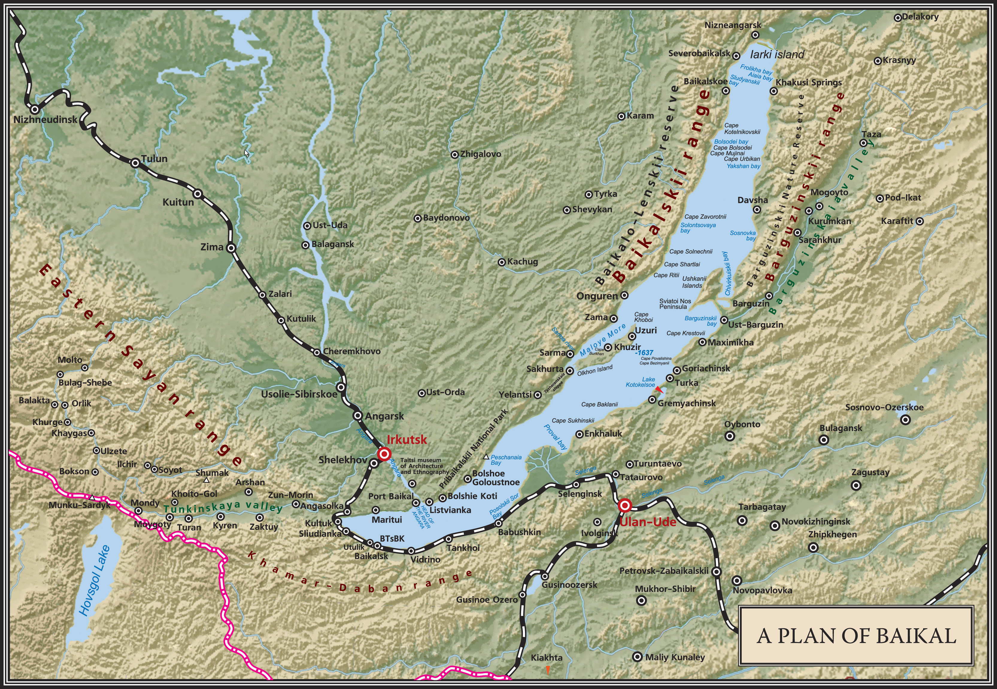
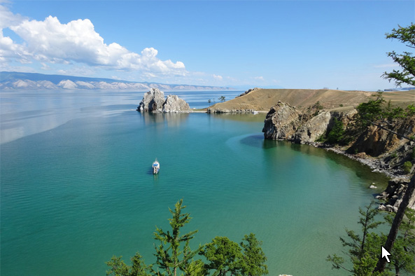
Lake Baikal

Slide 14
Lake Baikal Stats.
Lake Baikal
Length 395 mi
Depth 5,387 ft
Volume 5,670 cu mi
Lake Michigan
Length 307 mi
Depth 923 ft
Volume 1,180 cubic mi

Slide 15
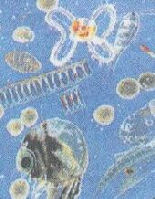
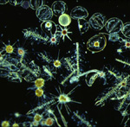
Water Biomes
Plankton are microscopic algae, plants, and other organisms that float on the surface of water biomes.
They need sunlight to survive.

Slide 16
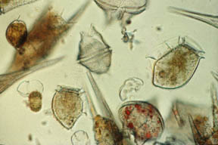
Water Biomes
Phytoplankton are important producers in water biomes.
They are the first step in many aquatic food chains

Slide 17
Phytoplankton -
Phytoplankton are the autotrophic components of the plankton community and a key part of oceans, seas and freshwater basin ecosystems. The name comes from the Greek words meaning "plant", and meaning "wanderer" or "drifter“. These microscopic cells begin the marine food chain. They are so numerous they account for 50% of photosynthesis on Earth.

Slide 18
Zooplankton
Zooplankton are heterotrophic plankton. Plankton are organisms drifting in oceans, seas, and bodies of fresh water. The word "zooplankton" is derived from the Greek zoon, meaning "animal", and planktos, meaning "wanderer" or "drifter". Individual zooplankton are usually microscopic, but some (such as jellyfish) are larger and visible with the naked eye. They are consumers and feed on phytoplankton.

Slide 19
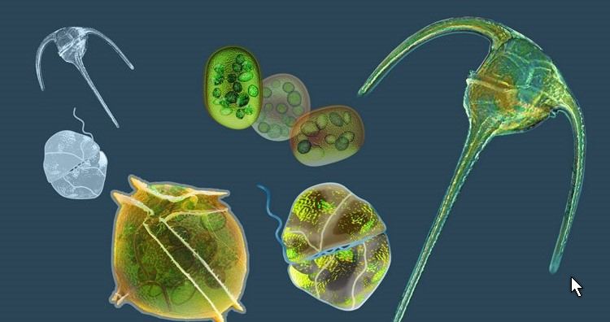
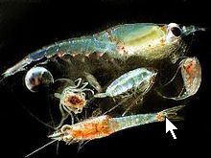
Plankton
Phytoplankton
Zooplankton

Slide 20
Saltwater Biomes
About 95% of the water on Earth has a high concentration of salt. (High salinity)
Melting mountain glaciers and continental glaciers is adding fresh water to the ocean and salinity is decreasing slightly. How will this affect the ocean biome is not clear.

Slide 21
Saltwater
Estuaries (Wetlands)
Area where a river meets an ocean
Mix of salt and freshwater
Located near coastlines, border land
Extremely fertile
Nutrient levels are higher than both salt and freshwater
A feeding and breeding area for many species both land and water

Slide 22
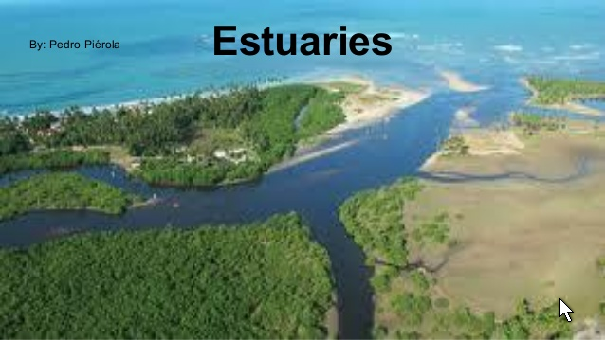

Slide 23
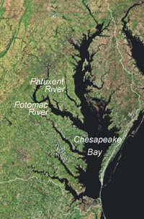
Saltwater
Estuaries - An estuary is a partially enclosed coastal body of brackish water with one or more rivers or streams flowing into it, and with a free connection to the open sea.
Chesapeake Bay

Slide 24
Saltwater
SEASHORES - an area of sandy, stony, or rocky land bordering and level with the sea.
Tides have a huge influence on life here
INTERTIDAL ZONE- portion of the shoreline that is covered with water at high tide and exposed to the air at low tide.

Slide 25
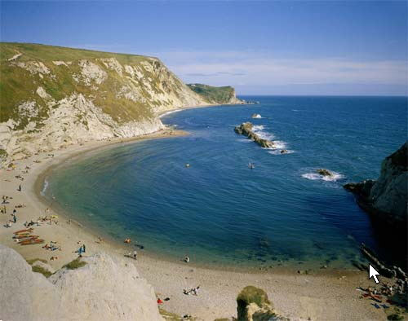
Seashore

Slide 26
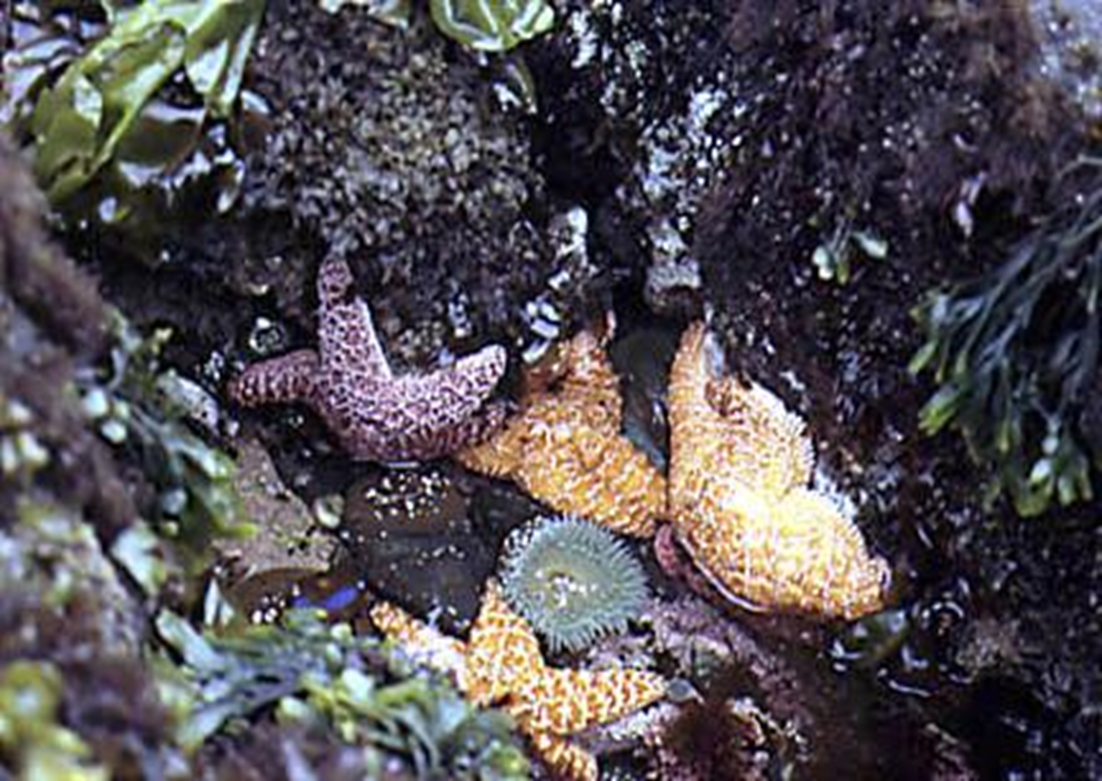
Intertidal Zone
Can be sandy or rocky
Small fish, clams, crabs, other mussels are trapped in the TIDAL POOLS during low tide

Slide 27
Saltwater
Oceans
Can be divided into 2 main life zones
1. Photic zone- sunlight penetrates
2. Aphotic zone- so deep there is NO sunlight

Slide 28
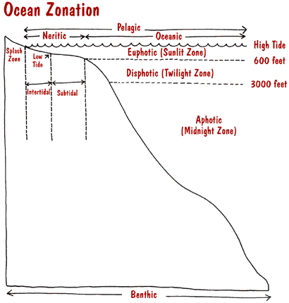

Slide 29
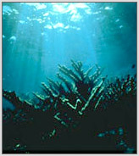
Photic Zone- above 200m
Made up of the euphotic & disphotic zones
Sunlight penetrates
Plant life and animal life is abundant

Slide 30
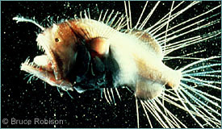
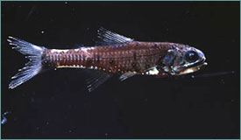
Aphotic Zone- below 200m
Sunlight DOES NOT penetrate
There are no plants
Animal life is highly specialized

Slide 31
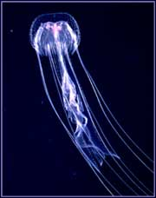
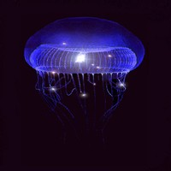
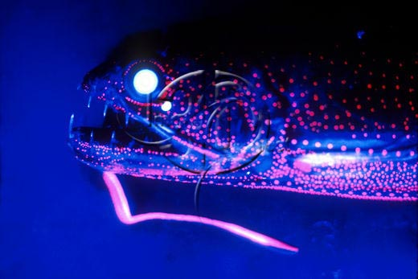
Aphotic Zone- below 200m
Many of the denizens of the deep ocean have a special adaptation known as bioluminescence

Slide 32
Aquatic plant life

Slide 33
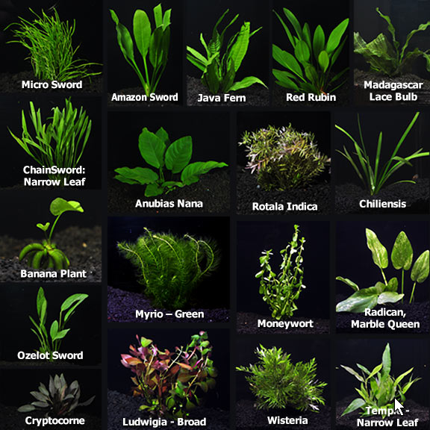
Fresh water aquatic plants

Slide 34
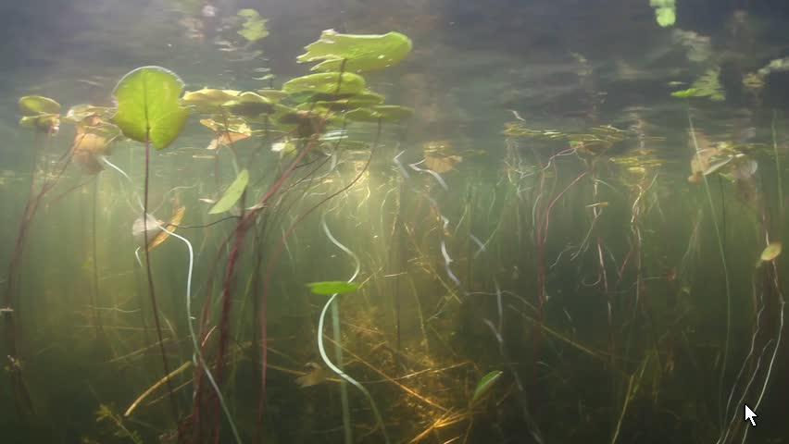
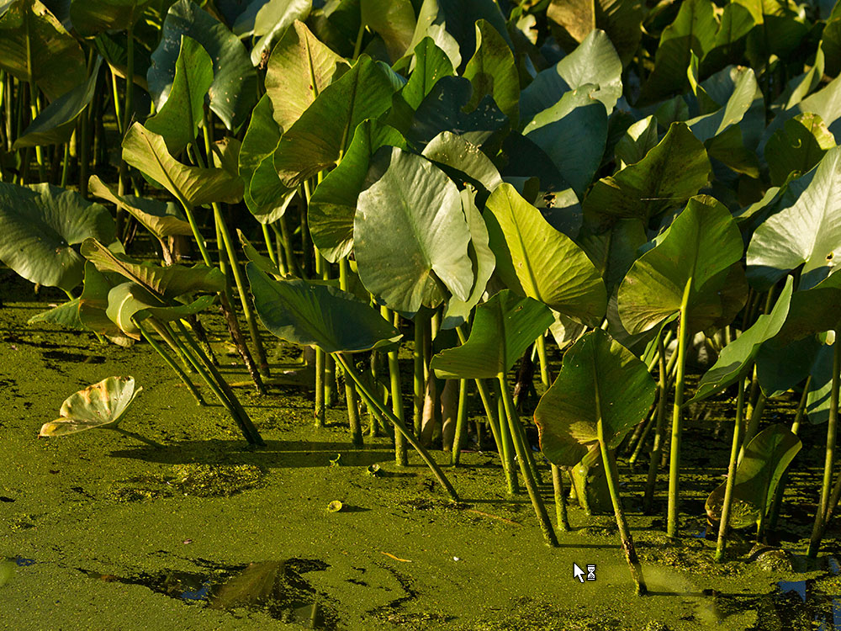

Slide 35
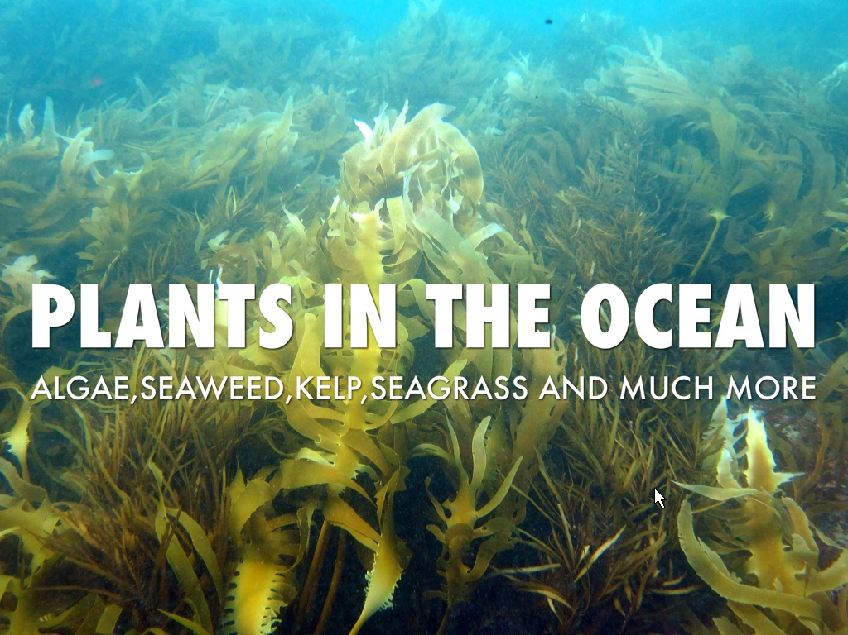
Saltwater Plants

Slide 36
