Slide 1
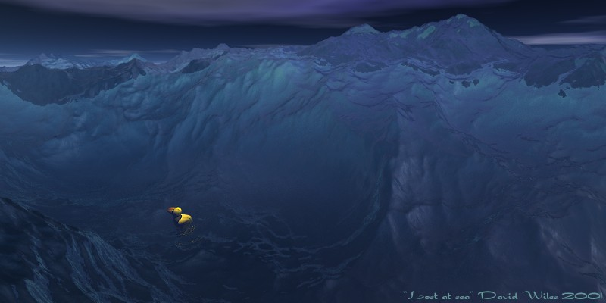
Ocean Currents

Slide 2
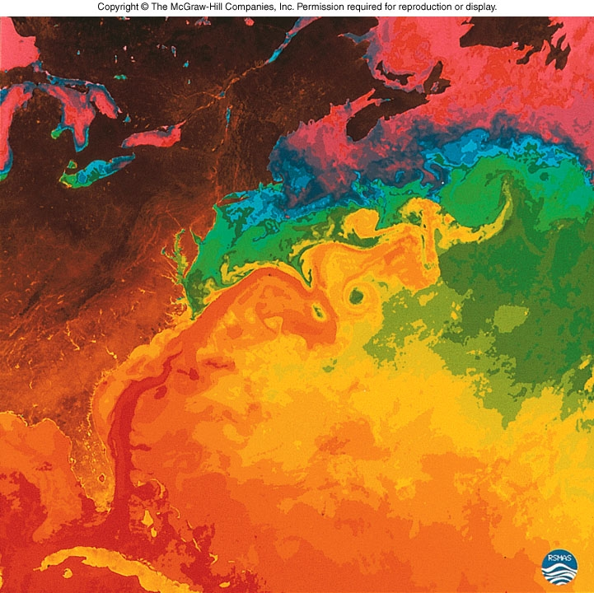
Why is Ocean Circulation Important?
Transport heat
Equator to poles
Transport nutrients and organisms
Influences weather and climate
Influences commerce
Notes:
4 th century BC ,Pytheas of Massalia, a Greek ship captain, explored eastern Atlantic
Okeanos (Greek for “Great River”) because he found the ocean flowing south (Canary Current) and thought it was a river too wide to cross.

Slide 3
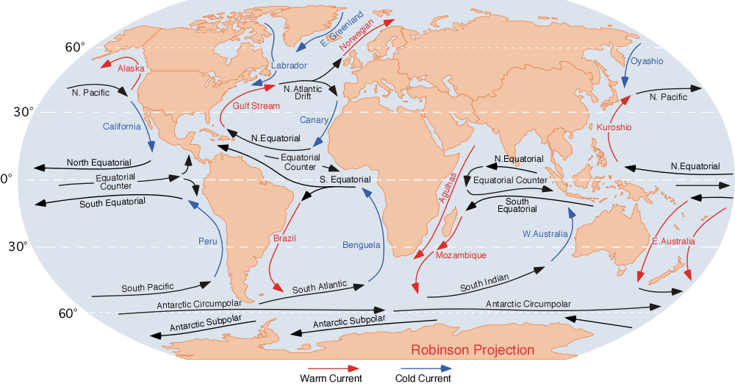
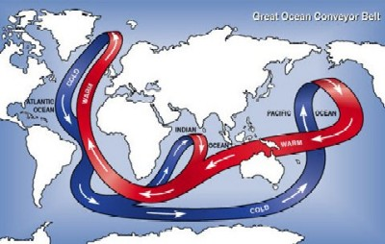
Ocean Currents
Surface Currents
The upper 400 meters of the ocean (10%).
Deep Water Currents
Thermal/Salinity currents (90%)

Slide 4
Wind-driven surface currents

Slide 5
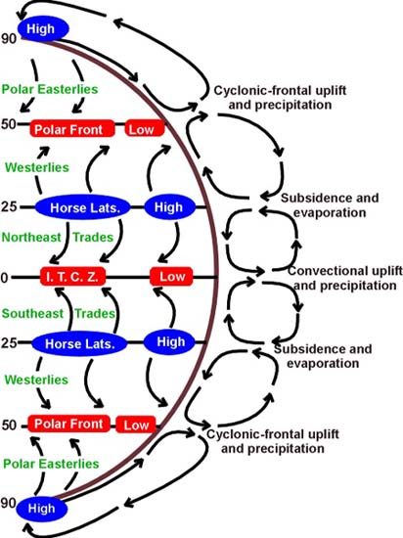
90º
60º
Surface Currents
Forces
Solar Heating (temp, density)
Winds
Coriolis
30º
0º
30º
60º
90º

Slide 6

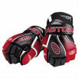

What do Nike shoes, rubber ducks, and hockey gloves have to do with currents?

Slide 7
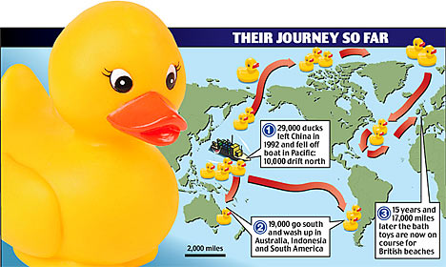
Lost at Sea
Notes:
It began Jan. 10, 1992, when a container ship, en route from Hong Kong to Tacoma, ran into a hurricane near the international dateline. The waves were so powerful that they broke some of the steel cables holding the huge containers, releasing 12 of them over the side. One that was lost held 28,800 Friendly Floatee bathtub toys, made in China for The First Years Inc. of Avon, Mass. They were red beavers, green frogs, blue turtles and, of course, yellow ducks.
We might expect that elaborate wrapping around the toys would have dragged them straight to the bottom. But they managed to escape five levels of packing, from the heavy steel containers (violent waves opened the door latches) to the plastic and paper boxes (water pulped the cardboard) before finally floating free.
It took 10 months for the first 10 Floatees to reach shore near Sitka, Alaska, having been swept along by the Subpolar Gyre, the ocean current in the Bering Sea. By then they had covered about 3,200 km and two oceanographers in Seattle, Ebbesmeyer and James Ingraham, were tracking their progress. (Ebbesmeyer and Ingraham were already studying 61,000 Nike running shoes that had fallen in the ocean two years earlier.)
A few months later another 20 toys reached Alaska. By August 1993, 400 more had been found along the shores of the Gulf of Alaska. Ingraham logged them in his OSCUR (Ocean Surface Currents Simulation), a program that calculates the course of wind and currents. Other toys, after following a circuitous route to Washington state, began arriving there in 1996.
The oceanographers predicted that some toys would drift north, get locked in Arctic ice, then eventually be released. In a few years they could move across the Pole to the Atlantic. Then where would they go? Eventually they arrived in Maine, Iceland, Newfoundland, the U.K. and Germany.
The last of the survivors continued to float, Ebbesmeyer says, “bleached and battered but still recognizable after 16 years.” Well, the manufacturer said they were designed to survive 52 dishwasher cycles.
Ebbesmeyer approaches this narrative with a cheerful buoyancy: “These high-seas drifters offer a new way of looking at the seas. Call it ‘flotsametrics.’ It’s led me to a world of beauty, order and peril I could not have imagined even after decades as a working oceanographer.” He loves his status as flotsam headquarters for data sent back by the world’s 1,000 or so dedicated beachcombers.
It’s a joyful story of discoveries he tells in his book. But he brings the reader back to Earth, and starts us thinking again about BP, when he describes the seabed slowly filling with bits of plastic that poison the fish and eventually the humans who eat them. Thousands of containers fall into the sea every year, creating an oceanic junkyard.
And the junk never disappears. These days beachcombers keep coming across flotsam antiques, like a plastic ball decorated with 40-year-old cartoon characters or Japanese glass buoys for fishing nets that haven’t been used in half a century. These relics are fascinating bits of the past, but when it comes to the fate of the oceans, perhaps beachcombers have stumbled upon the melancholy truth.
Read more: http://www.nationalpost.com/arts/Robert+Fulford+Plenty+rubber+ducks/3238158/story.html#ixzz13Y813VEs
January 1992 - shipwrecked in the Pacific Ocean, off the coast of China
November 1992 - half had drifted north to the Bering Sea and Alaska; the other half went south to Indonesia and Australia
1995 to 2000 - spent five years in the Arctic ice floes, slowly working their way through the glaciers
2001 - the duckies bobbed over the place where the Titanic had sunk
2003 - they were predicted to begin washing up onshore in New England, but only one was spotted in Maine
2007 - a couple duckies and frogs were found on the beaches of Scotland and southwest England.

Slide 8
Duckie Progress
January 1992 - shipwrecked in the Pacific Ocean, off the coast of China
November 1992 - half had drifted north to the Bering Sea and Alaska; the other half went south to Indonesia and Australia
1995 to 2000 - spent five years in the Arctic ice floes, slowly working their way through the glaciers 2001 - the duckies bobbed over the place where the Titanic had sunk
2003 - they were predicted to begin washing up onshore in New England, but only one was spotted in Maine
2007 - a couple duckies and frogs were found on the beaches of Scotland and southwest England.

Slide 9
2004-2007
Barber’s Point
Notes:
A team of volunteers and experts from the National Oceanic and Atmospheric Administration (NOAA) Hazardous Materials
Division has released drift cards off Barber’s Point as part of a two-year study of the movement of surface currents off the Hawaiian Islands.
The purpose of the study is to learn where floating pollutants might go
if released from the south shore of O‘ahu. Made out of light wood and covered with non-toxic paint, the
4x6-inch cards are designed to biodegrade within a few months. NOAA is asking the public to help by reporting the date and location of
the cards when they float ashore. Instructions and contact information
are printed on the cards. Watabayashi said the study will help determine where future research
should be directed. “The results will be used by academia, private industry, government, conservation groups, and others for
various purposes. City managers, for instance, might use the information
to aid in wastewater management decisions. Biologists might use it to characterize larval transport patterns which help identify habitat areas,” Watabayashi
said. The data also may be used to verify trajectory models and track derelict fishing gear.
The study is a collaborative
effort of the NOAA National Weather Service, NOAA Coral Reef Conservation Program, the Clean Island Council Spill Response
Cooperative, Chevron, Tesoro, and the U.S. Coast Guard.

Slide 10
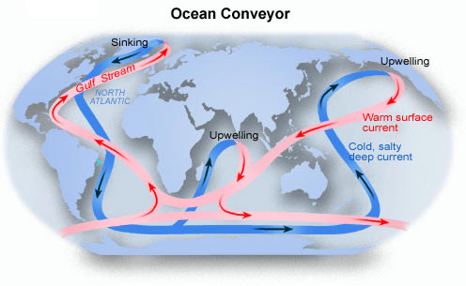
Surface and Deep-Sea Current Interactions
“Global Ocean Conveyor Belt”

Slide 11
Transport by Currents
Surface currents play significant roles in transport heat energy from equatorial waters towards the poles, and visa versa.
Currents also involved with gas exchanges, especially O₂ and CO₂
Nutrient exchanges important within surface waters (including outflow from continents) and deeper waters (upwelling and downwelling)
Pollution dispersal
Impact on fisheries and other resources

Slide 12
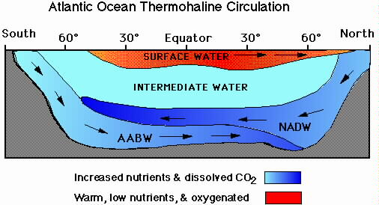
Thermohaline Circulation
Global ocean circulation that is driven by differences in the density of the sea water which is controlled by temperature and salinity.

Slide 13
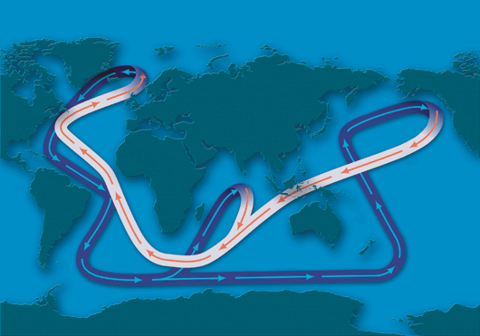
The global ocean circulation system, often called the Ocean Conveyor, transports heat throughout the planet. White sections show warm surface currents. Purple sections show deep cold currents. WHOI Graphic Services
Thermohaline Circulation
Notes:
The global ocean circulation system, often called the Ocean Conveyor, transports heat throughout the planet. White sections represent warm surface currents. Purple sections represent deep cold currents. (Illustration by Jayne Doucette, WHOI Graphic Services).

Slide 14
Upwelling and downwelling
Vertical movement of water
Upwelling = movement of deep water to surface
Hoists cold, nutrient-rich water to surface
Produces high productivities and abundant marine life
Downwelling = movement of surface water down
Moves warm, nutrient-depleted surface water down
Not associated with high productivities or abundant marine life

Slide 15
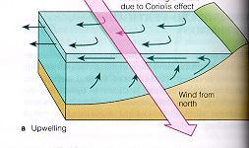
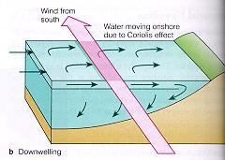
upwelling
downwelling

Slide 16
El Niño-Southern Oscillation (ENSO)
El Niño = warm surface current in equatorial eastern Pacific that occurs periodically around December
Southern Oscillation = change in atmospheric pressure over Pacific Ocean accompanying El Niño
ENSO describes a combined oceanic-atmospheric disturbance

Slide 17
El Niño
Oceanic and atmospheric phenomenon in the Pacific Ocean
Occurs during December
2 to 7 year cycle
Atmospheric Winds
Upwelling

Slide 18
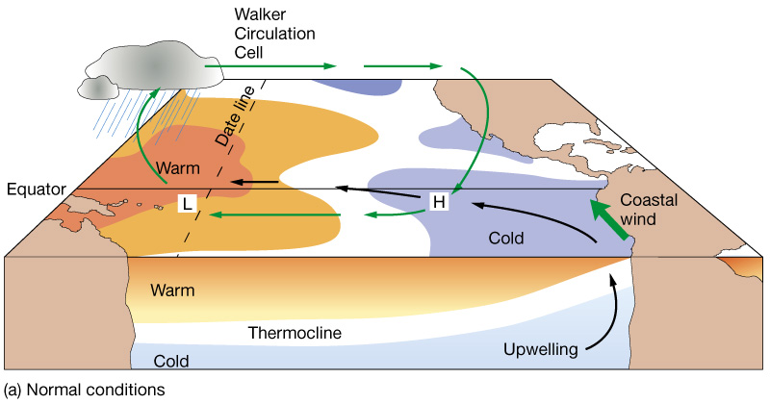
Normal conditions in the Pacific Ocean

Slide 19
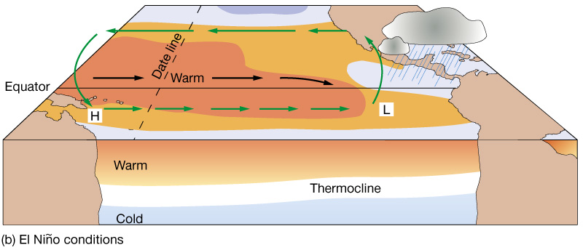
El Niño conditions (ENSO warm phase)

Slide 20
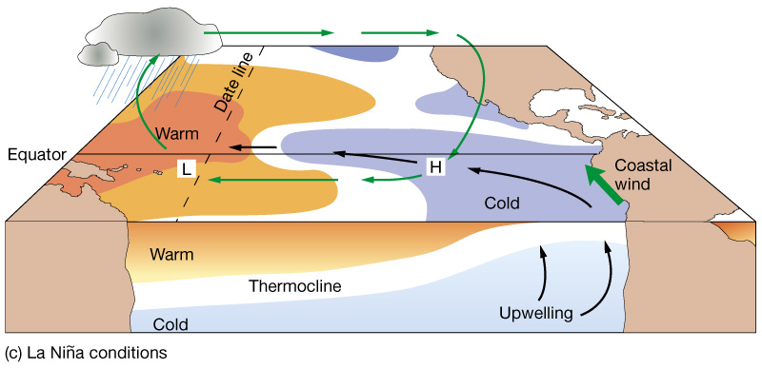
La Niña conditions (cool phase; opposite of El Niño)

Slide 21
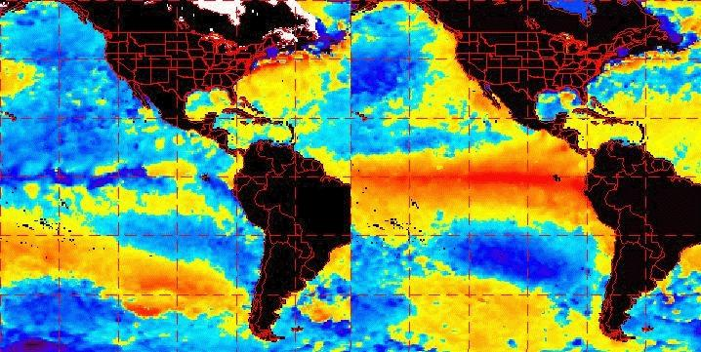
Non El Niño
El Niño
1997

Slide 22
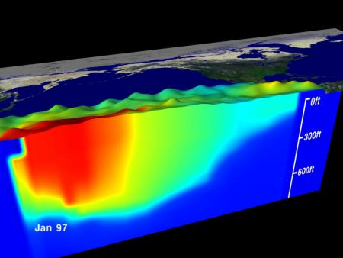
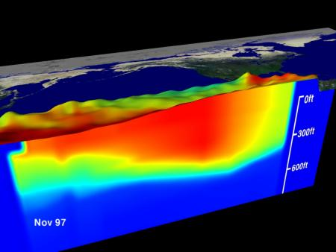
Non El Niño
upwelling
El Niño
Thermocline –
layer of ocean right beneath the “mixed layer” where temperatures decrease rapidly.

Slide 23
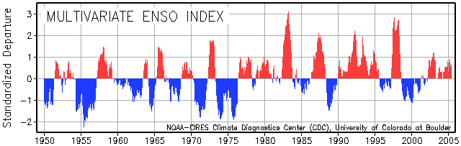
El Niño events over the last 55 years
El Niño warmings (red) and La Niña coolings (blue) since 1950. Source: NOAA Climate Diagnostics Center

Slide 24
World Wide Effects of El Niño
Weather patterns
Marine Life
Economic resources
El Nino Animation
Notes:
Floods
El Niño Sea-Level Rise Wreaks Havoc in California's San Francisco Bay Region (31-Jan-2000)
1998 California Floods (11-Mar-1998)
The Spring Runoff Pulse from the Sierra Nevada (14-Jan-1998)
Effects of El Niño on Streamflow, Lake Level, and Landslide Potential (16-Dec-1997)
Climate and Floods in the Southwestern U.S. (10-Jul-1997)
Real-time flows on rivers and streams
More USGS information on Floods
Landslides
Recent landslide events--News and Information (updates regularly)
Landslide publications and reports (14-Oct-2003)
USGS Circular 1244 (26-Sep-2003) "National Landslide Hazards Mitigation Strategy—A Framework for Loss Reduction"
USGS Landslide Hazards web site
More USGS information on Landslides
Information on Landslides during the 1997-98 El Niño:
Map Showing Locations of Damaging Landslides in Alameda County, California, Resulting From 1997-98 El Niño Rainstorms (10-Jan-2000)
El Niño and 1998 California Landslides (20-Mar-1998)
Geologic mapping and El Niño: Landslide and debris-flow susceptibility maps, including southern California, Mojave Desert, and San Francisco Bay Area (02-Feb-1998)
Landslide Recognition and Safety Guidelines (29-Jan-1998)
USGS Producing Landslide Hazard Maps for Emergency Services in San Francisco Bay Area (16-Dec-1997)
Potential San Francisco Bay Landslides During El Niño (16-Dec-1997)
El Niño and the National Landslide Hazard Outlook for 1997-1998 (16-Dec-1997)
Effects of El Niño on Streamflow, Lake Level, and Landslide Potential (16-Dec-1997)
Coastal hazards
El Niño Sea-Level Rise Wreaks Havoc (31-Jan-2000) in California's San Francisco Bay Region
Coastal Erosion Along the U.S. West Coast During 1997-98 El Niño (12-August-99)
Coastal Erosion From El Niño Winter Storms (31-Aug-1998) with before and after air photos from Southern Washington, Northern Oregon, Central California, and Southern California
1982-1983 El Niño Coastal Erosion, San Mateo County, California (6-May-1998)
1997-98 El Niño Coastal Monitoring Program (31-Mar-1998) with before and after photos of Santa Cruz County, California beach erosion.
Hydroclimatology of San Francisco Bay Freshwater Inflows and Salinity, with weather and salinity movies (14-Jan-1998)
El Niño Effects on Sea-Level Near San Francisco Bay (16-Dec-1997)
Coastal Impacts of an El Niño Season (3-Nov-1997)
More USGS information on Coastal hazards
Climate
Long-term climate variation in the Mojave Desert (15-Jan-1998)
The Spring Runoff Pulse from the Sierra Nevada (14-Jan-1998)
El Niño Effects on Sea-Level Near San Francisco Bay (16-Dec-1997)
Effects of El Niño on Streamflow, Lake Level, and Landslide Potential (revised 16-Dec-1997)
Climate and Floods in the Southwestern U.S. (10-Jul-1997)

Slide 25
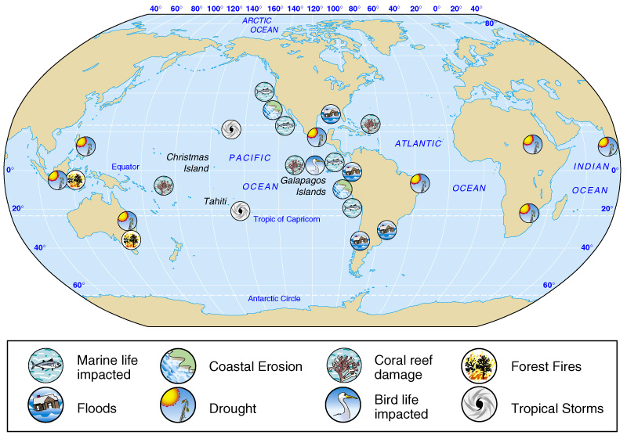
Effects of severe El Niños

