Slide 1
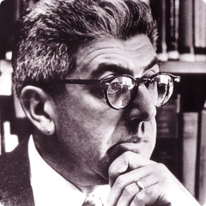
The Four Laws of Ecology
Formulated by physicist and ecologist, Barry Commoner (he taught at Washington U. in St. Louis, Missouri).
Source: http://emilymorash07.tripod.com/id12.html

Slide 2
His book may still be available – certainly in used books.
Barry Commoner wrote many books.
In The Closing Circle, he explained the four laws of ecology. It should be reissued because it is one of the most important books of the 20th century and possibly the 21st.
I took a 2-semester course in ecology (biogeography) in 1964 which opened my eyes and mind to a greater appreciation of nature.
Around 1971, I read The Closing Circle and it spoke to my heart and soul.

Slide 3
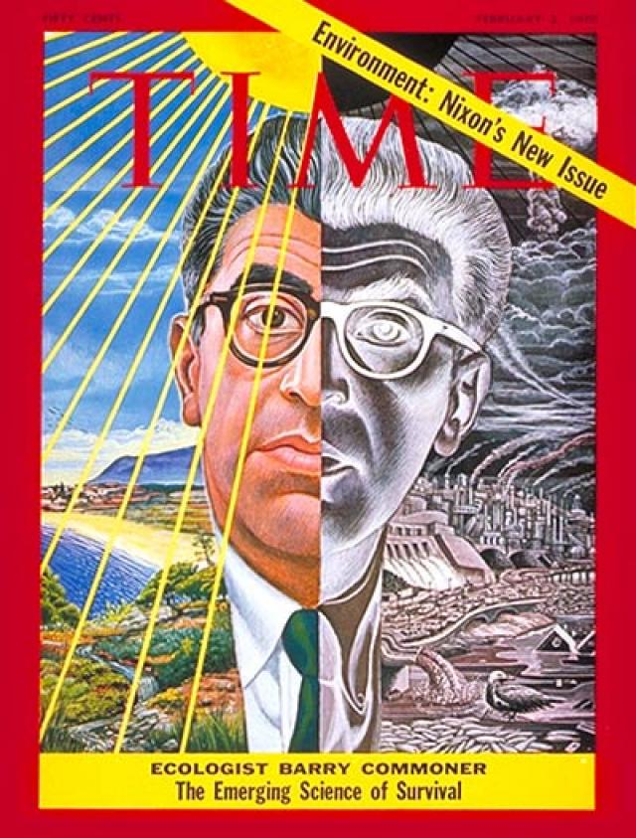
We must come to realize that all this talk about ecology is important because we are talking about human survival

Slide 4
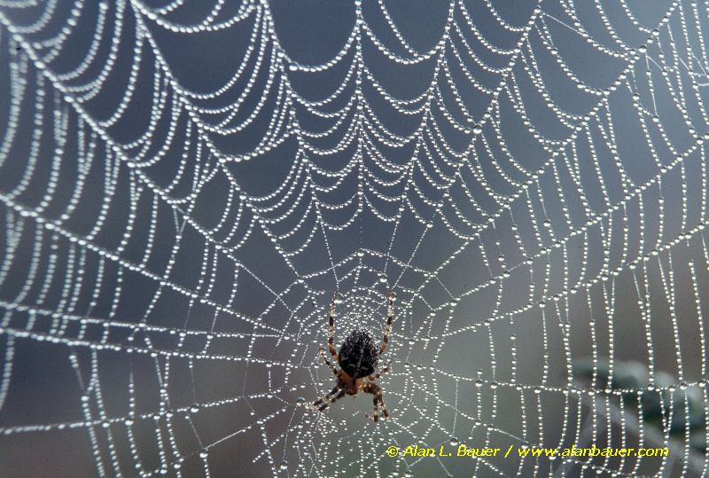
Law One
Everything is connected

Slide 5

Humans and other species are connected (dependent) on a number of other species.

Slide 6
Everything is connected to everything else - humans and other species are connected to & dependant on a number of other species, as well as the inanimate environment.
The Four Laws of Ecology
Formulated by physicist and ecologist, Barry Commoner.

Slide 7
1st Law: Everything is connected to everything else
Making connections:
What is the connection between the rise of McDonalds outlets in China and the massive deforestation in the Amazon forest in Brazil.
Answer: forests are cut down to provide more pasture land for cattle grazing. The cattle are raised to be slaughtered and to provide beef to sell. More burgers sold in China means China wants to buy more beef, encouraging Brazilians to cut down more forests so they can sell more beef.

Slide 8
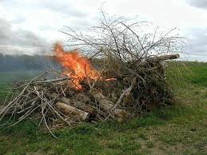
2nd Law: Everything must go somewhere
No matter what you do, and no matter what you use, it has to go somewhere.
For example, when you burn wood, it doesn't disappear, it turns into smoke (water vapor, CO², & gasses) which rises into the air, and ash, which settles down to the earth surface.

Slide 9
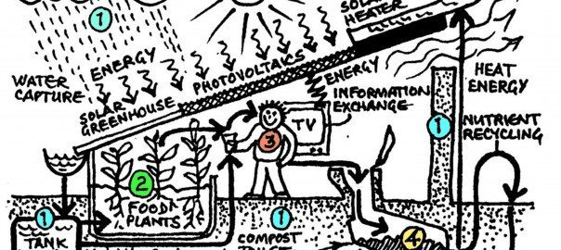
Indicates connectedness too
Illustrates energy transfers and recycling reusable resources.

Slide 10
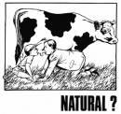
3rd Law: Nature knows best
Law #3:
Real food vs. vitamins http://www.youtube.com/watch?v=Cti0dfsSEyY&feature=related
Pesticides vs. natural enemies: http://www.youtube.com/watch?v=UXvmrD99mMw
Wild (or prescribed) fires vs. stopping fires
http://www.youtube.com/watch?v=1hQvxq5XC-E
Biodgradable versus non-biodegradable molecules

Slide 11
Biodgradable versus non-biodegradable molecules
Somehow some way, nature (natural processes and organisms) are able to reduce complex biodegradable molecules which nature has made to simpler molecules or elements so that they can be recycled.
Humans have created molecules which are non-biodegradable, so natural processes cannot reduce them to simpler, reusable parts. Many of these are harmful to living things: DDT, dioxin, etc.

Slide 12
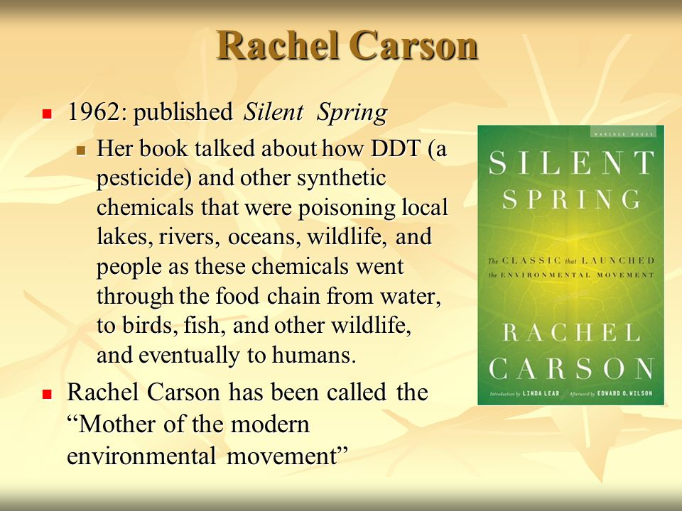

Slide 13
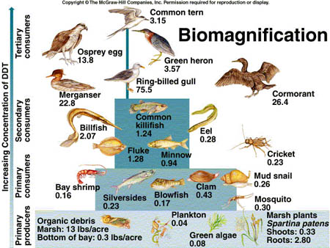

Slide 14
So what are the consequences of having a lot of DDT stored in fat cells?
Biomagnification occurs when a substance enters the body and does not pass through it when the animal urinates or defecates. No, it stays stored in the body, often in fat cells, and the amount continues to increase as the animal continues to take in food containing DDT.

Slide 15
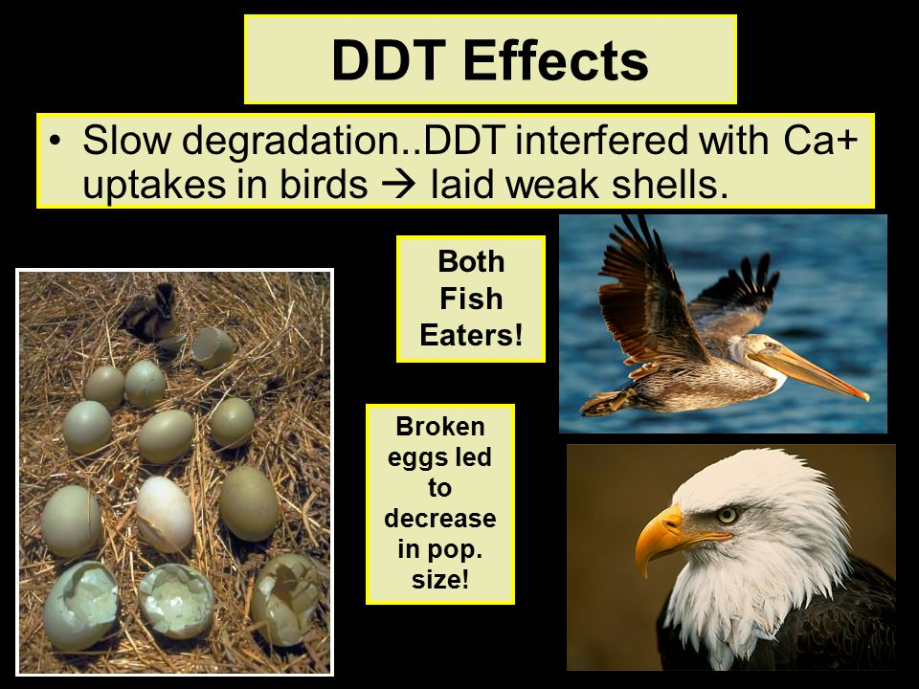
Recycling of things like DDT

Slide 16
Returning the DDT to the food chain
When the animals with DDT stored in their fat cells die, the DDT returns to the soil to be taken up by grass and reenter the food chain.
If the birds, and fish for that matter, die in or on a water body, as their body decays, the DDT reenters the water and is taken in by phytoplankton and thus reenter the food chain.
And so the cycle goes on and on and on …..

Slide 17
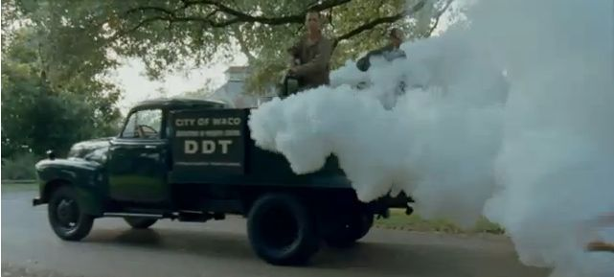
Before they understood the dangers, this is what they did
They were trying to control insect disease vectors, and children often ran back and forth through the “fog.”

Slide 18
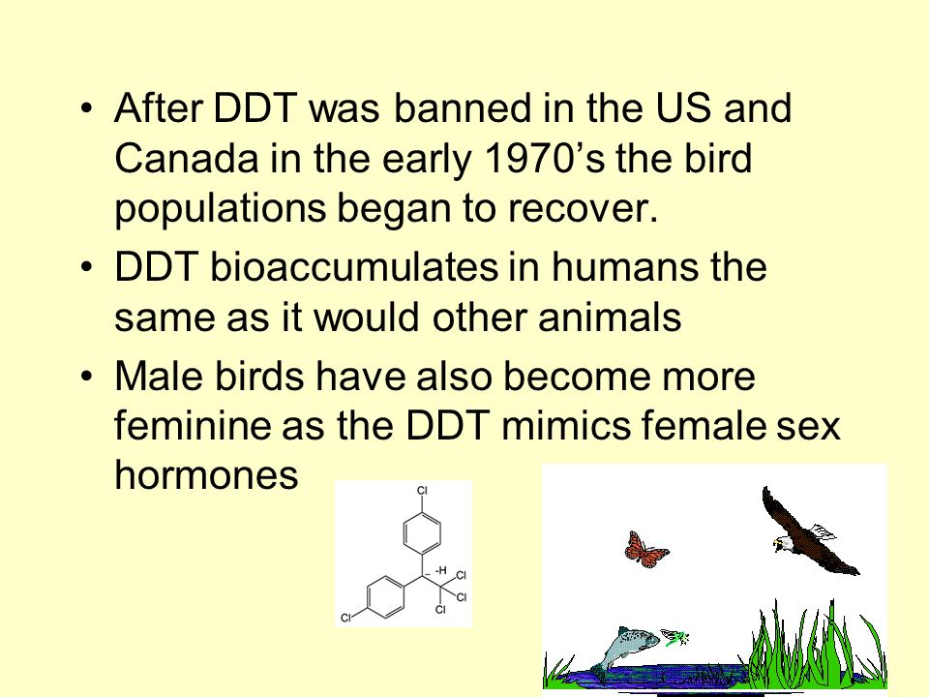

Slide 19
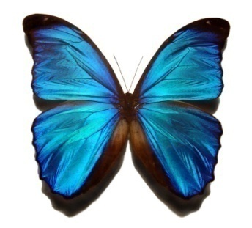
Nature knows best: How the natural world is inspiring new innovations
When we look at the world around us, we see what has survived the test of time. In other words, nature doesn't just show us results - it shows us the most optimal ideas available.
As a result, scientists are creating more products that are inspired by nature.
The BlackBerry phone was inspired by a butterfly's wing.

Slide 20
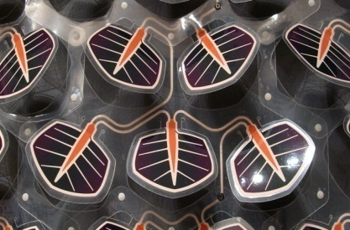
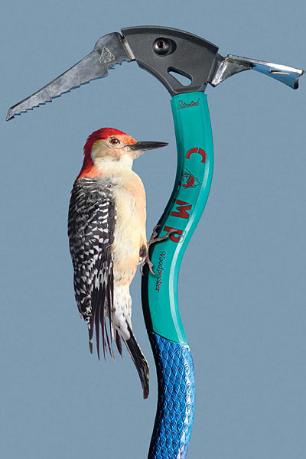
Nature-inspired designs
Solar Leaf
Bio-inspiration, also known as biomimicry, is a discipline that studies and learns from nature's best ideas to generate breakthrough products and technologies.

Slide 21
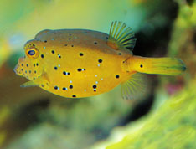
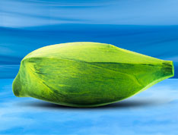
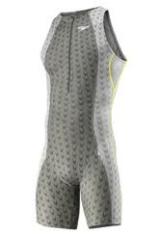
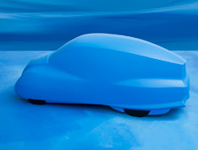
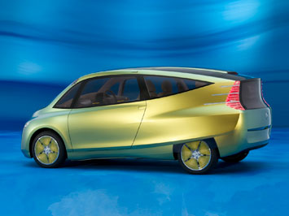
Nature knows best: How the natural world is inspiring new innovations
Go to the Following Website for Examples: http://brainz.org/15-coolest-cases-biomimicry/
A new car design
inspired by a boxfish
A Speedo swimsuit line
inspired by shark's skin

Slide 22
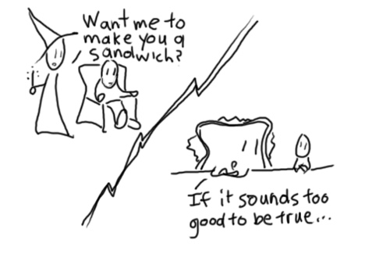
4th Law: “There is no such thing as a free lunch”
Everything you do, must have a reason behind it.
This law basically means you have to do something in order to get something in return.
OR
Everything has consequences.
For example, a “free” pizza party.
In order to win the party, you have to fill out a survey.
Survey info gets sold off… you get annoying texts from companies ….

Slide 23
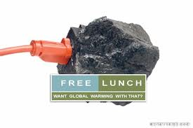
“There is no such thing as a free lunch”
This ecological law embodies the previous 3 laws.
Because the global
ecosystem is a connected
whole, in which nothing
can be gained or lost,
  anything extracted from it by human effort
  must be replaced.
  Payment of this price cannot be avoided; it can only be delayed.

Slide 24
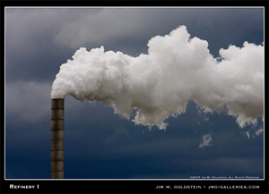
EXAMPLE #1: Tall smokestacks
Tall stacks were originally designed to take local pollutants that resulted from manufacturing processes and put them just high enough into the atmosphere that they would be dispersed away from the local area.
  The phrase used at the time to describe this process was “The solution to pollution is dilution.”

Slide 25
EXAMPLE: Tall smokestacks
Over time, however, people in downwind locations
complained that they were the victims of pollutants from
elsewhere and they reacted politically to have the process
stopped.
Hence, there was a call for the enforcement of a “polluter pays” principle: those causing the harm from pollution to others must pay for the cleanup and removal of the pollutants and the repair of their adverse impacts on the built as well as natural environment.

Slide 26
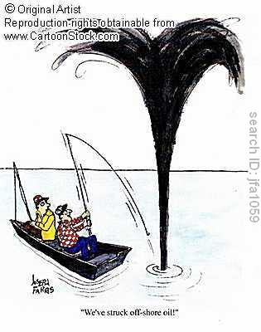
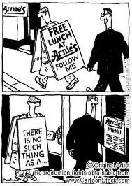
EXAMPLES: Things may seem free, but have hidden “costs”. HOW?
Oil comes shooting out of the ground.
Free phones with a 3 year plan.
Free samples at grocery stores.
Love. Admiration. Respect.

Slide 27
EXAMPLE #2: OIL
Oil comes shooting out of the ground.
It seems “free”, but it costs us. HOW?

Slide 28
Hidden Costs
Things may seem free, but have hidden “costs”.
Other examples:
Free phones with a 3 year plan.
Free samples at grocery stores.
Magazine subscription with automatic renewal on you credit card.

Slide 29
The Columbian Exchange
The European discovery of the Americas began a great transfer of species from one side of the Atlantic Ocean to another. Other than seeing Europeans as an invasive species in the Americas, they brought many new species to the Americas and took many species from the Americas to Europe. In some cases the results were desirable, in others the results were harmful to the ecosystems. Unknowingly, Europeans were vectors for many serious diseases so that 90% of the Native Americans died from them, as they had no resistance to those bacteria or viruses.

Slide 30
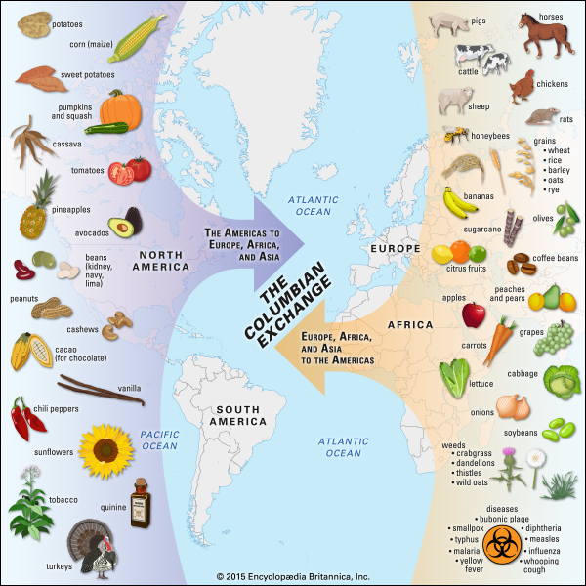
Columbian Exchange
Brought to the Americas
Europeans
Syphilis & other diseases
Cows & sheep
Horses & oxen
Wheat, oats, rye, barley
Brought to Eastern Hemisphere
Gonorrhea
Tomato
Potato
Maize (corn)

Slide 31
Invasive species – adding a new component to a system
Kudzu introduced to the United States thinking it could be used for animal fodder.
Result: The plant seems to have no natural enemies here so it grows like crazy and had destroyed thousands of acres of forest in the southeastern USA. The vine covered the trees, cutting off sunlight to the leaves of the trees.

Slide 32
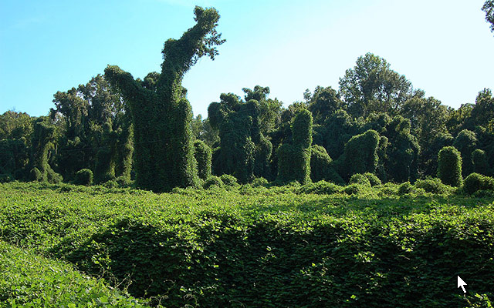
Kudzu covering everything

Slide 33

The U.S. list of Invasive species is long
Kudzu
Common tumbleweed
Privet
Zebra mussels
European starlings
Brown tree snake
Burmese pythons
Africanized bee
Asian carp
Emerald ash borer
Hemlock woolly adelgid
Multiflora rose
Spiny waterflea
Snakehead fish
Giant African Snail
Dutch elm disease
gypsy moth
oak wilt,
house sparrow.
Plantago lanceolata
Click on the links to see Wikipedia articles on them.

Slide 34
A complete list of invasive species
A complete list might contain thousands of entries.
Some species might not be threatening to ecosystems but just be bothersome. The English plantain is just a weed that most people would not like in their lovely lawns. Some may be desirable such as Zoysia grass.
Others, like Kudzu can completely alter the local ecosystem.

Slide 35
Removing a component of a system
Most people found milkweed to be an unwelcome vine and used herbicides to kill the plants.
Unfortunately Monarch Butterflies only feed on milkweed, so the survival of that species was threatened.
Now people are being encouraged to grow milkweed because Monarch Butterflies are beautiful and are among the important pollinators, and many food crops are not self-pollinating and need pollinators like the butterflies, bees, etc.,

Slide 36
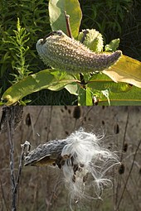
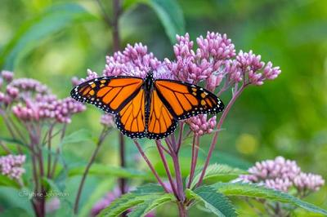
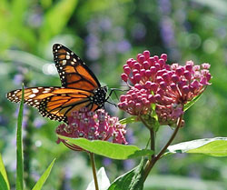

Slide 37
Extinct Animals (very incomplete list)
Japanese Sea Lion
Caspian Tiger
Javan Tiger
Caribbean Monk Seal
Western Black Rhinoceros
Puerto Rican Flower Bat
Dusky Flying Fox
Broad-faced Potoroo
Lake Mackay Hare-Wallaby
Desert Rat-kangarooToolache Wallaby
Pig-footed Bandicoot
Red-bellied Gracile Opossum
Steller's Sea Cow
Oriente Cave Rat
Darling Downs Hopping Mouse
Passenger Pigeon
Bonin Woodpigeon
Liverpool Pigeon
Sulu Bleeding-heart
Thick-billed Ground-Dove
Negros Fruit-Dove
Dodo
New Zealand Greater Short-tailed Bat
Marcano's Solenodon
Balearic Shrew
Chadwick Beach Cotton Mouse
Gould's Mouse
Falkland Island Wolf
Bali Tiger
Tasmanian Tiger
Japanese Wolf
Mexican Grizzly Bear
Sea Mink
Aurochs
Arabian Gazelle
Big-eared Hopping Mous
Bulldog Rat
Panay Giant Fruit Bat
Dusky Flying Fox
Elephant Bird
Upland Moa
King Island Emu
Korean Crested Shelduck
Mauritian Shelduck
Amsterdam Island Duck
Mauritian Duck
Javanese LapwingEskimo Curle
Great Auk
Pemberton's Long-Tailed Hopping Mouse
Deer Mouse

Slide 38
Modern extinctions in Africa (partial list)
Acalypha rubrinervis (1870, Saint Helena)
Aspalathus complicata (1940s, South Africa: Cape Flora) [33]
Aspalathus cordicarpa (1950s, South Africa: Cape Flora) [33]
Aspalathus variegata (1900, South Africa: Cape Flora) [33]
Barleria natalensis (1900, South Africa) [33]
Brachystelma schoenlandianum (1900, South Africa: Cape Flora) [33]
Byttneria ivorensis (1896, Côte d'Ivoire)
Cephalophyllum parvulum (1900, South Africa: Cape Flora) [33]
Ceropegia antennifera (1910, South Africa) [33]
Ceropegia bowkeri (1900, South Africa) [33]
Coffea lemblinii (1907, Côte d'Ivoire)
Conophytum semivestitum (1900, South Africa) [33]
Crassula subulata (1900, South Africa: Cape Flora) [33]
Cyclopia filiformis (1900, South Africa: Cape Flora) [33]
Disa forcipata (1900, South Africa: Cape Flora) [33]
Dryopteris ascensionis (1889, Ascension Island)
Erica alexandri subsp. acockii (1940, South Africa: Cape Flora) [33]
Erica foliacea subsp. fulgens (1900, South Africa: Cape Flora) [33]
Erica pyramidalis var. pyramidalis (1910, South Africa: Cape Flora) [33]
Eugenia pusilla (1920, South Africa) [33]
Helichrysum outeniquense (1950, South Africa: Cape Flora)
Lampranthus vanzijliae (1920, South Africa: Cape Flora) [33]
Leucadendron grandiflorum (1805, South Africa: Cape Flora) [33]
Leucadendron spirale (1930, South Africa: Cape Flora) [33]
Liparia graminifolia (1830, South Africa: Cape Flora) [33]
Macledium pretoriense (1925, South Africa) [33]
Macrostylis villosa subsp. minor (1980, South Africa: Cape Flora) [33]
Nemesia micrantha (1900, South Africa: Cape Flora) [33]
Saint Helena Olive – Nesiota elliptica (2003, Saint Helena)
Oldenlandia adscensionis (1889, Ascension Island)
Orchidea eupolyanthis (1910, Cameroon)
Osteospermum hirsutum (1900, South Africa: Cape Flora) [33]
Pausinystalia brachythyrsum (1898, Cameroon)
Polhillia ignota (1950s, South Africa: Cape Flora) [33]
Psoralea cataracta (1900, South Africa: Cape Flora) [33]
Psoralea gueinzii (1930, South Africa: Cape Flora) [33]
Silphium – Ferula ? (c. 50, Cyrene)
Sporobolus durus (1886, Ascension Island)
Thamnea depressa (1900, South Africa: Cape Flora) [33]
Trochetiopsis melanoxylon (1771, Saint Helena)
Vernonella africana (1900, South Africa) [33]
Willdenowia affinis (1920, South Africa: Cape Flora) [33]
Xysmalobium baurii (1900, South Africa) [33]
Saint Helena Heliotrope – Heliotropium pannifolium (1808, Saint Helena)
Isolepis bulbifera (1950, South Africa: Cape Flora) [33]
There are similar lists for every continent

Slide 39
Threat to biodiversity & biodiversity is very important
Healthy ecosystems and rich biodiversity:
  Increase ecosystem productivity; each species in an ecosystem has a specific niche—a role to play.
  Support a larger number of plant species and, therefore, a greater variety of crops.
  Protect freshwater resources.
  Promote soils formation and protection.
  Provide for nutrient storage and recycling.
  Aid in breaking down pollutants.
  Contribute to climate stability.
  Speed recovery from natural disasters.
  Provide more food resources.
  Provide more medicinal resources and pharmaceutical drugs.
  Offer environments for recreation and tourism.

Slide 40
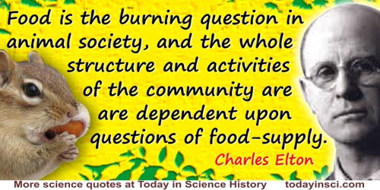
Ultimately all animal life depends on plants for food

Slide 41
Having a sustainable earth for humanity
Before humans make big changes on the earth, they need to understand these laws and make efforts to understand the possible consequences of their actions before they act.
With more than 7 billion people and an extremely powerful technology, humans are capable of doing things with huge consequences. We no longer have the luxury of learning from our mistakes because today mistakes can have disastrous consequences.

Slide 42
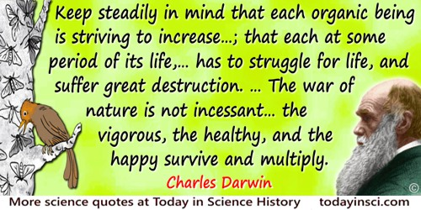

Slide 43
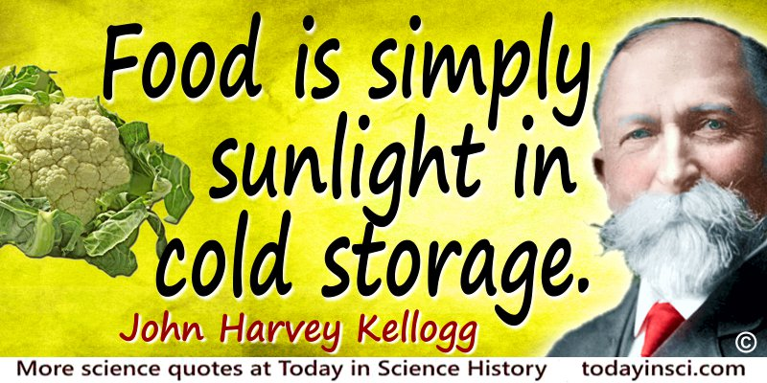
As we’ve seen, it is a solar powered world

Slide 44

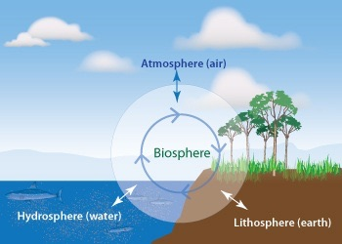
The Four Laws of Ecology are guidelines for maintaining a habitable biosphere
Don’t forget that the sun is the power generator for the earth

Slide 45
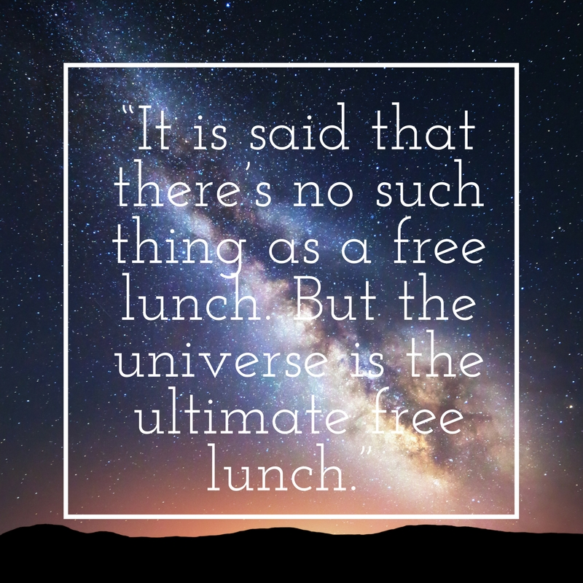
A thought to ponder

