Slide 1
Climate Classifications: Köppen
Great Weather & Climate Site
Check it out!
METEOROLOGY - WEATHER AND CLIMATE: A CONDENSED PRIMER
This Presents the Whole Picture!

Slide 2
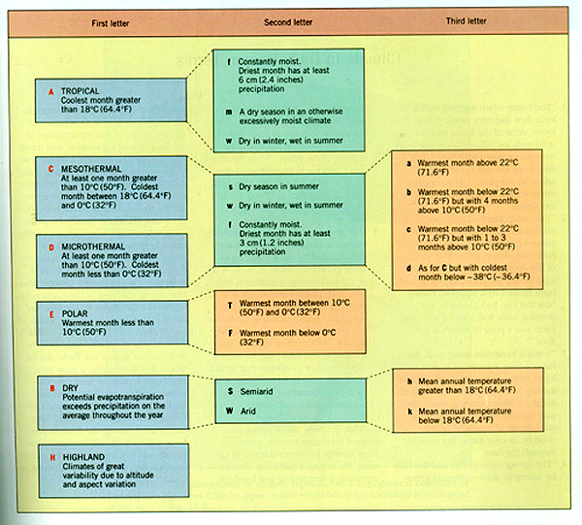
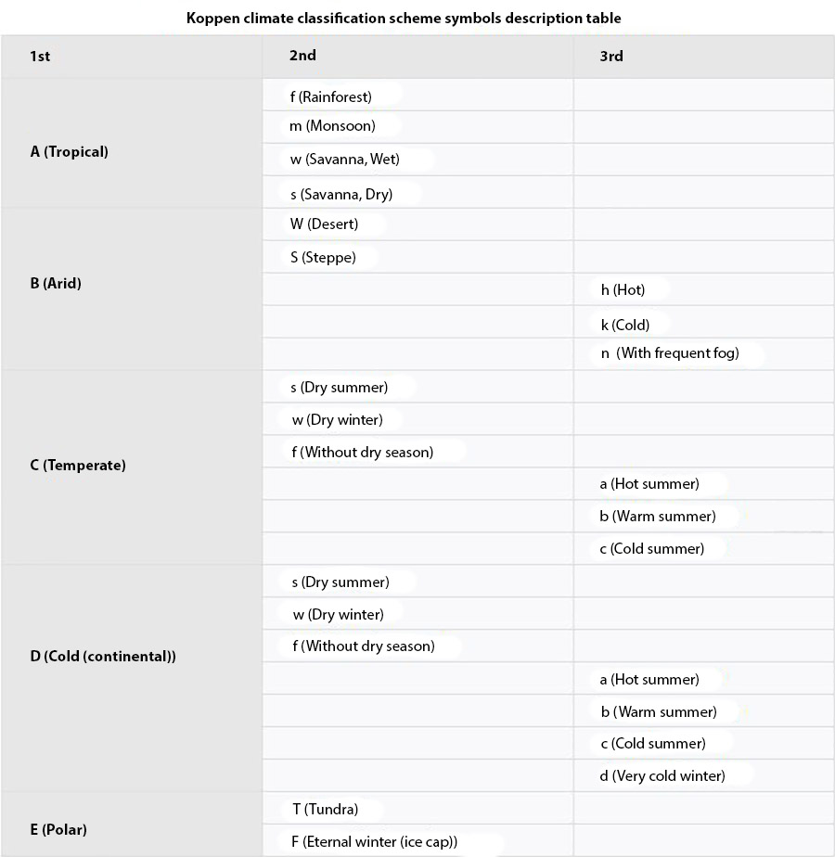
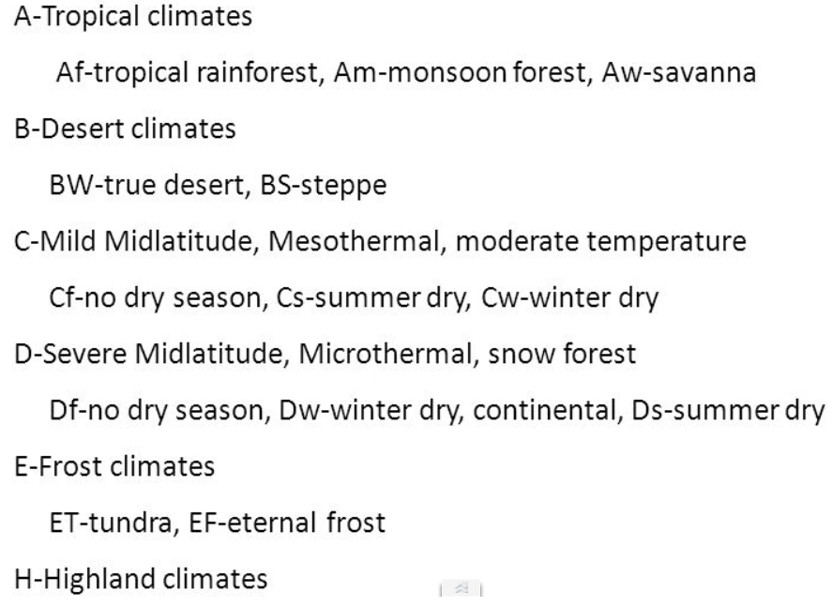
Letter Definitions

Slide 3
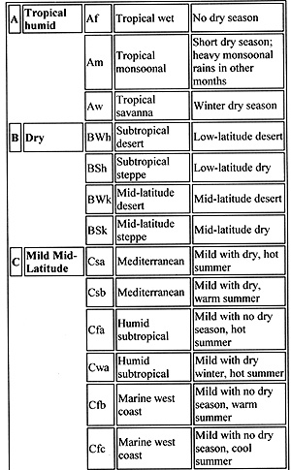
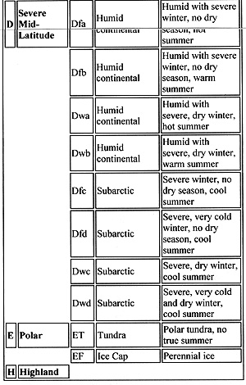
Category, Name & Description

Slide 4
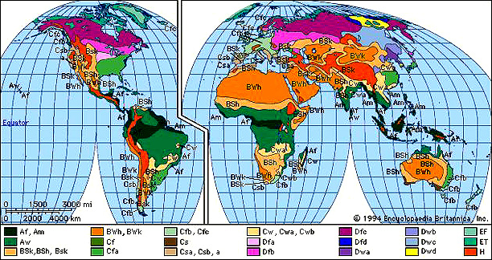
World Map of Climate Types
Check the World Climate Guide for specific locations

Slide 5
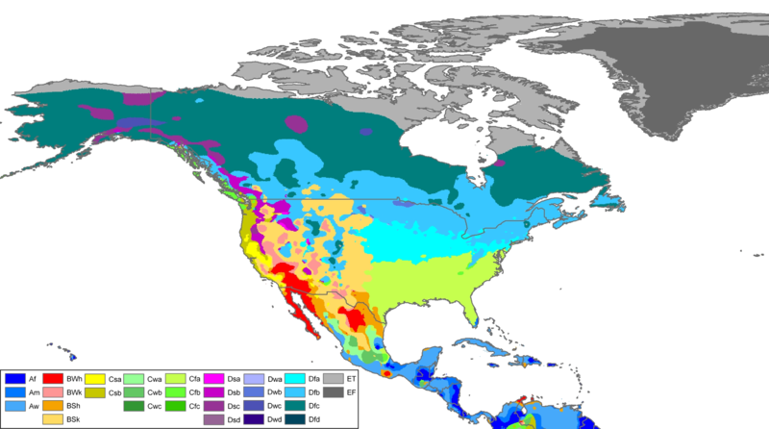
North America Climate Regions
St. Louis
St. Louis is usually located on or very near the border between Cfa and Dfa. It is in a transition zone.

Slide 6
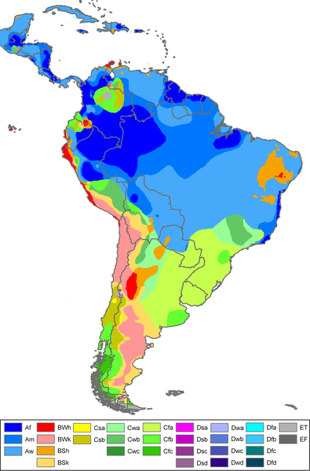
South America Climate Regions

Slide 7
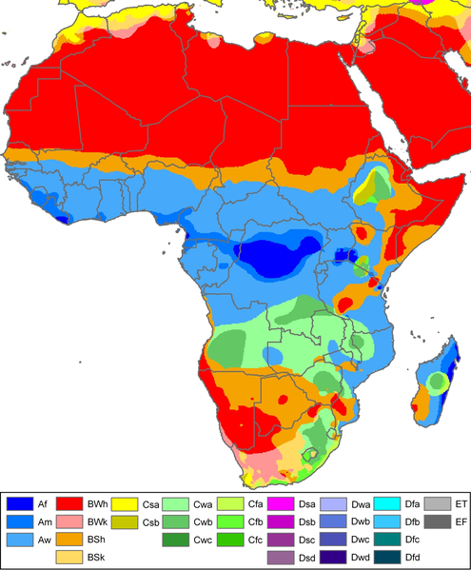
Africa Climate Regions

Slide 8
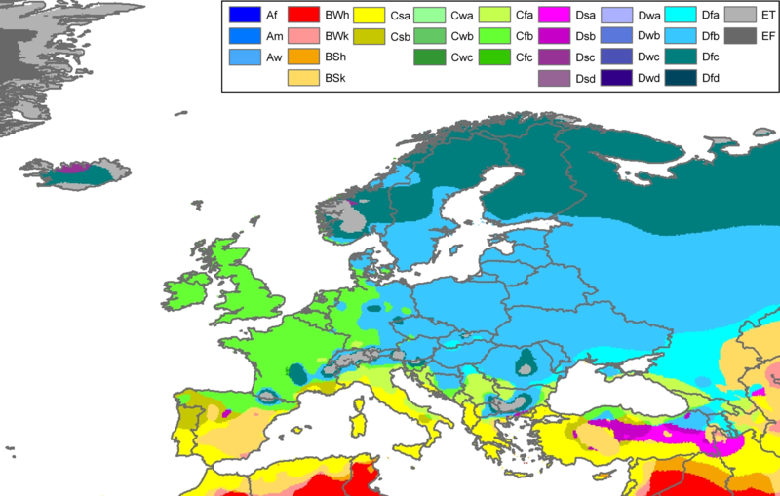
Europe Climate Regions

Slide 9
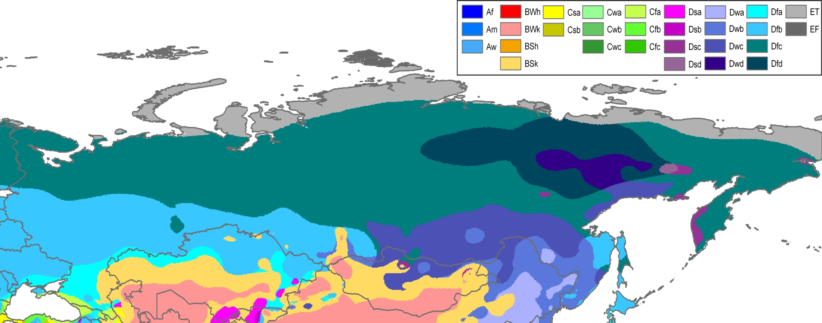
Russian Climate Regions

Slide 10
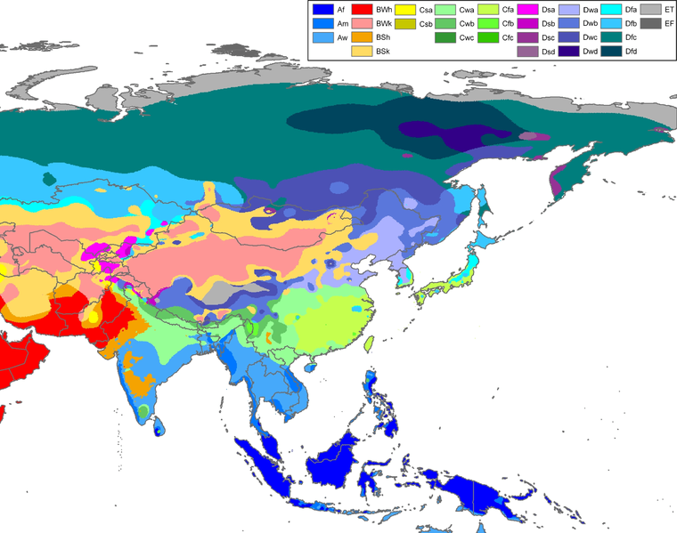
Asian Climate Regions

Slide 11
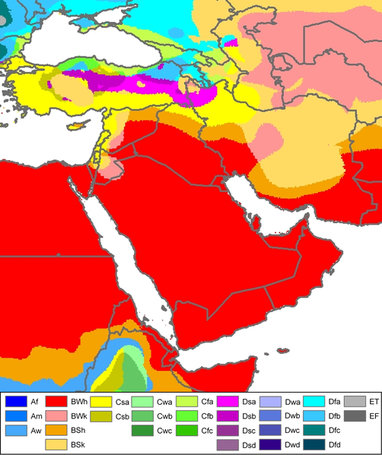
Southwest Asia (Middle East) Climate Regions

Slide 12
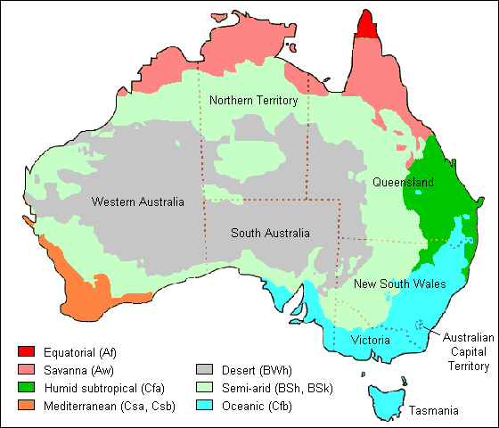
Australia

Slide 13
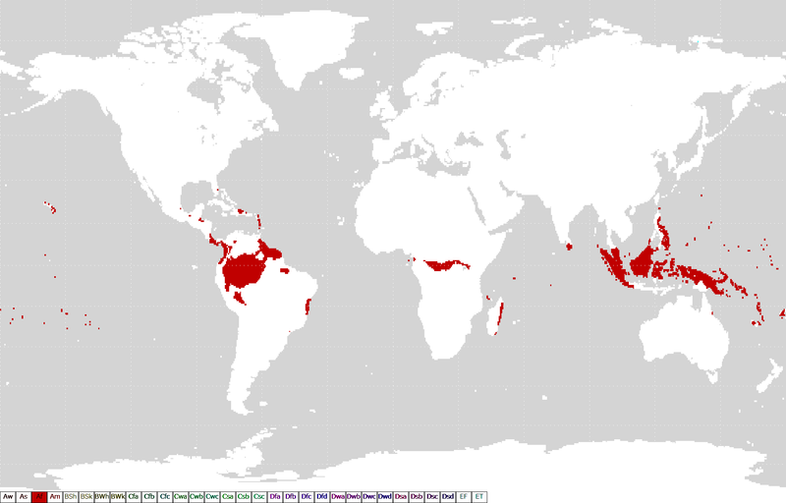
Af – Tropical Wet (Tropical Rainforest)

Slide 14
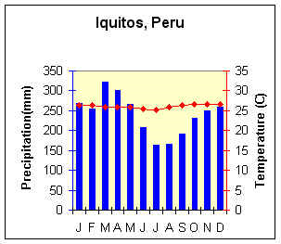
Tropical Rainforest (Af)
Characteristics
  Constant high temperatures.
  "Equal" day length.
  Lowest annual temperature range of any climate.
  Evenly distributed, heavy precipitation.
  Much cloud cover and high humidity.

Slide 15
Af
Geographic Distribution
  Amazon Basin,
  Congo River Basin,
  East coast of Central America,
  East coast and interior of Brazil,
  East coast of Madagascar,
  Malaysia,
  Indonesia,
  Philippines.
Controlling Factors
  High year-round insolation and precipitation of ITCZ.
  Rising air along trade wind coasts.
  mE air masses.

Slide 16
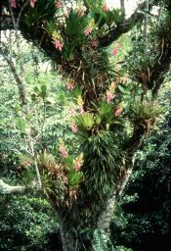
Af Vegetation
Tropical broadleaf evergreen forests with vines (lianas), Bromelias, and epiphytes.

Slide 17
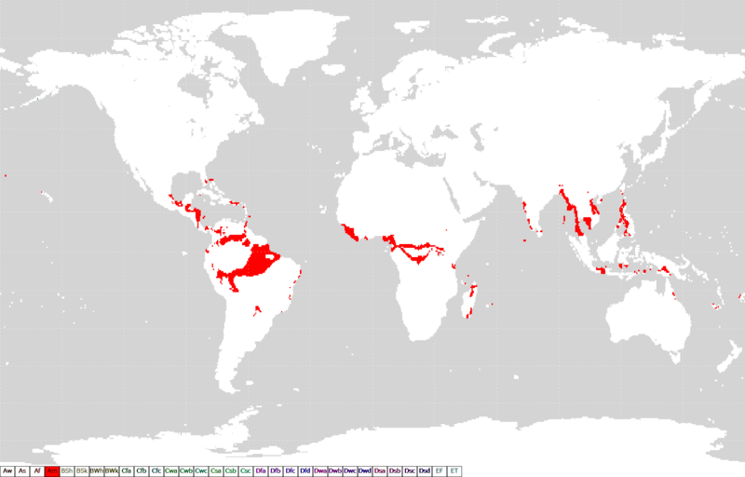
Am Climates – Tropical Monsoon

Slide 18
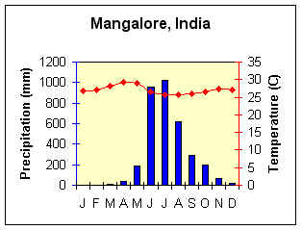
Tropical Monsoon Climate (Am)
Characteristics
  Heavy high-sun rain; short low-sun drought. Highest temperature just before rainy period.

Slide 19
Am
Geographic Distribution
  Coastal areas of southwest India, Sri Lanka, Bangladesh, Mynamar (Burma),
  Southwestern Africa,
  French Guiana,
  northeast and southeast Brazil.
Controlling Factors
  Summer onshore/winter offshore air movement related to shifting ITCZ or monsoon circulation. mE air masses during high-sun; stable mT or cT -> low-sun

Slide 20
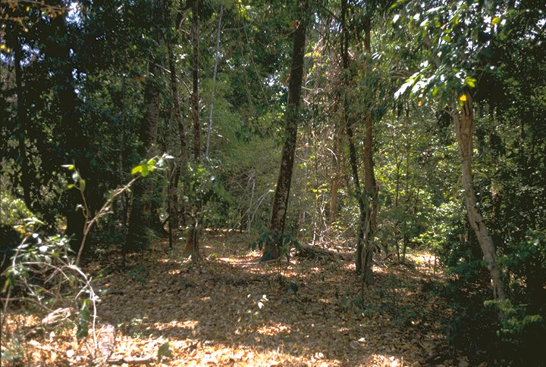
Am Vegetation
Tropical broadleaf evergreen rainforest with some deciduous trees and plants (dormant in the dry season)

Slide 21
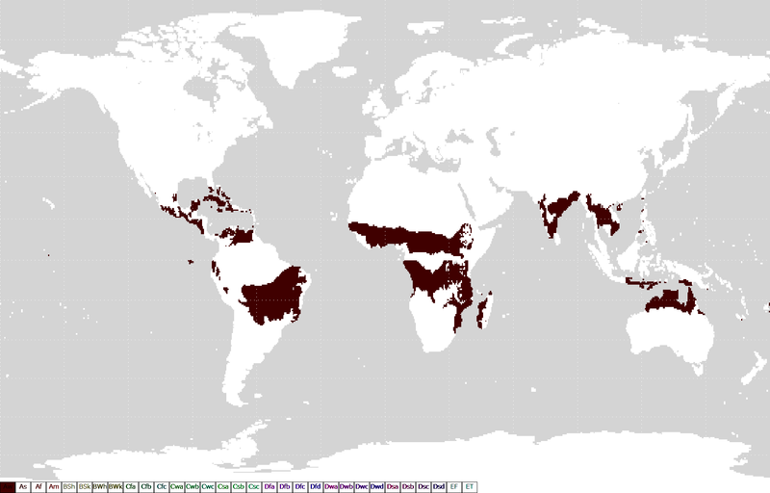
Aw Climate – Tropical Savanna

Slide 22
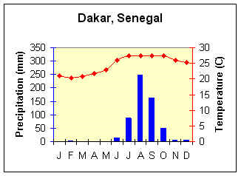
Wet Dry Tropical Climate (Aw)
Characteristics
High-sun wet season, low sun dry periods. Rainfall less than monsoon.
Highest temperature ranges of low latitude wet climates.

Slide 23
Aw
Geographic Distribution
  Northern and eastern India, interior Myanmar (Burma) and Indo-Chinese Peninsula; northern Australia; south central Africa; Ilanos of Venezuela, Campos of Brazil;
  Western Central America; south Florida, and Caribbean Islands.
Controlling Factors
  Shifting influence of high-sun ITCZ and low sun STH influence. High sun mE air masses; low-sun cT air masses

Slide 24
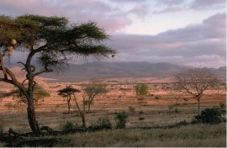
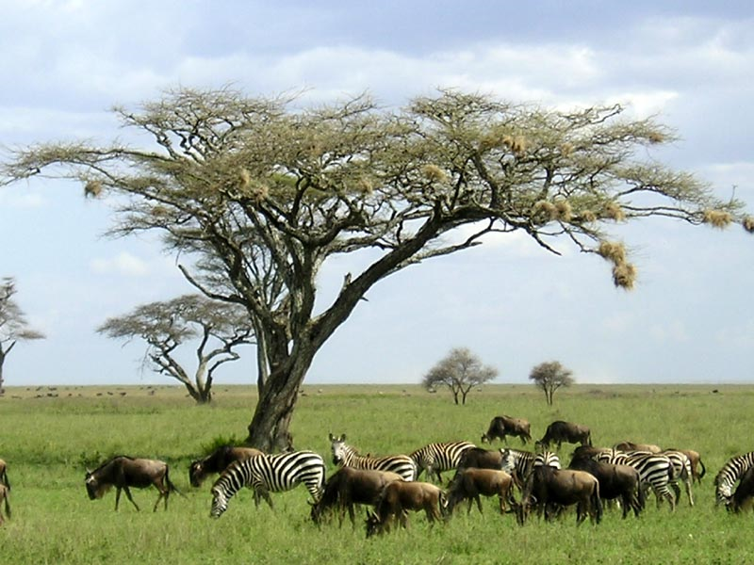
Aw Vegetation
Tall to short continuous grasslands with scattered trees and galleria forests (along the banks of streams, often arching over the river to enclose it unless it is a very wide river.

Slide 25
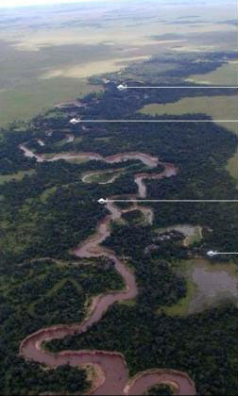
Aw – galleria forest
Forest along the river transitioning to grassland as distance from the river bank increases.

Slide 26
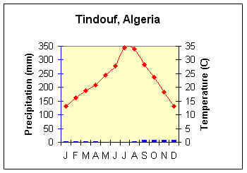
Tropical Desert Climate (BWh)
Characteristics
  Among the driest places on earth Mean annual temperature above 64.4º F (18ºC)
  Low relative humidity
  Irregular and unreliable rainfall
  Highest percentage of sunshine of any climate
  Large diurnal temperature range
  Highest daytime temperature of any climate
  Annual precipitation less than half the annual potential evapotranspiration

Slide 27
BWh
Geographic Distribution
  coastal Chile and Peru southern Argentina
  southwest Africa
  north Africa
  Arabia, Iran
  Pakistan, and western India;
  Baja California and interior Mexico
Controlling Factors
  Descending, diverging, circulation of subtropical highs Continentality linked often with rain shadow location.
  cT air masses

Slide 28
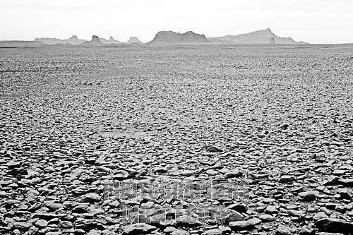
BWh types
Types of desert
  Reg- gravel and rock surface
  Erg – sand dunes
  Hamada – large expanses of unbroken rock
Reg desert surface

Slide 29
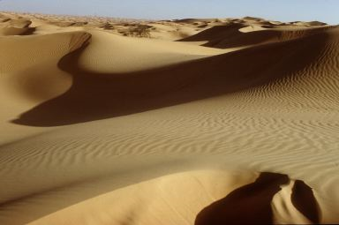
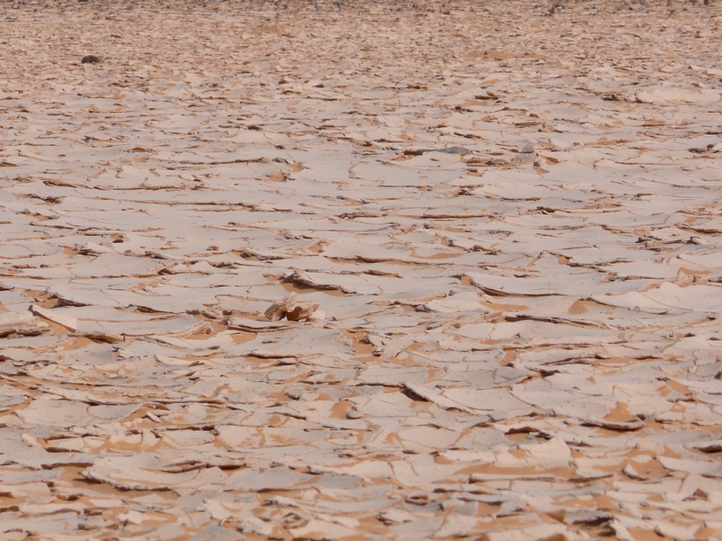
BWh
Erg desert surface
Hamada desert surface

Slide 30
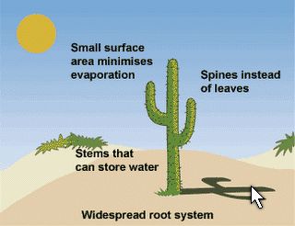
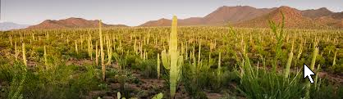
BWh Vegetation (?)
Little or no vegetation (xerophytic plants, if any)
Sonoran Desert in Arizona

Slide 31
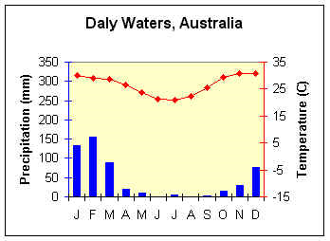
Tropical Steppe Climate (BSh)
Characteristics
  Semiarid Annual rainfall distribution similar to nearest humid climate
  Annual precipitation more than half, but less than annual potential evapotranspiration
  Mean annual temperatures above 64.4ºC (18ºC)

Slide 32
BSh
Geographic Distribution
  Peripheral to deserts especially in:
    Australia
    northern and southern Africa
    southwest Asia
    Argentina
    western United States
Controlling Factors
  Descending, diverging, circulation of subtropical highs Continentality linked often with rainshadow location.

Slide 33
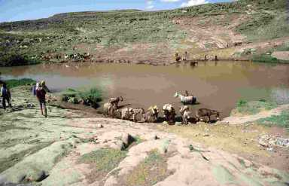
BSh Vegetation
Almost continuous short grass transitioning to bunch grass (bare ground between patches) and then transitioning to desert. It is subject to desertification: permanently transitioning from steppe to desert.

Slide 34
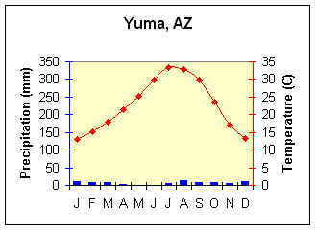
Midlatitude Desert Climate (BWk)
Characteristics
  Aridity; low relative humidity.
  Irregular rainfall.
  High percentage of sunshine.
  Larger temperature range than Tropical Desert.
  More precipitation than Tropical Desert.

Slide 35
BWk
Geographic Distribution
  inner Asia
  (interior) western U.S.
Controlling Factors
  Continentality often linked to rain shadow.
  Subtropical high pressure or high pressure ridging.
  cT air mass during summer.
  mTs air masses; cP air masses especially on northern limits.

Slide 36
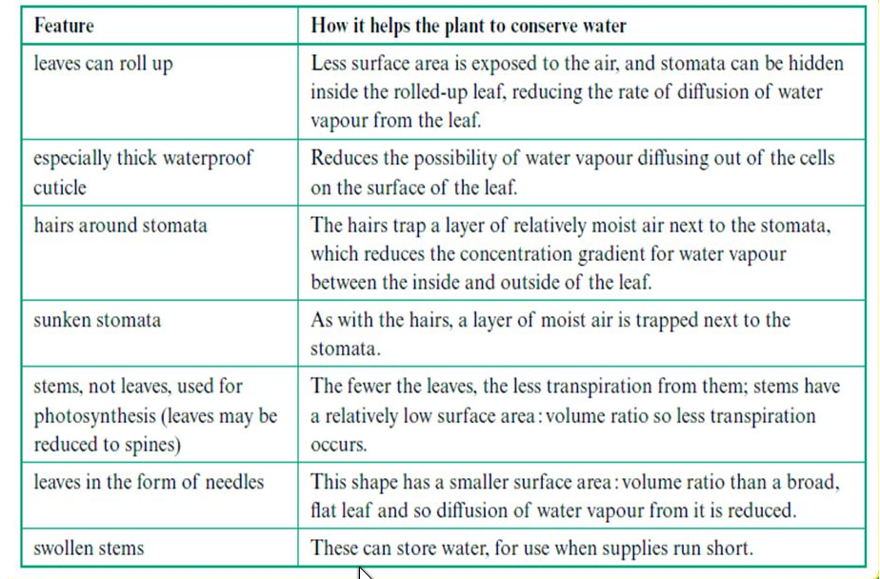
Xerophyte Adaptations

Slide 37
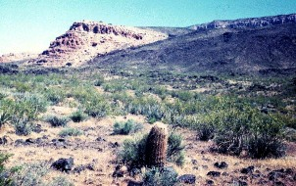
BWk Vegetation
Semidesert and desert vegetation – Xerophytic plants.

Slide 38
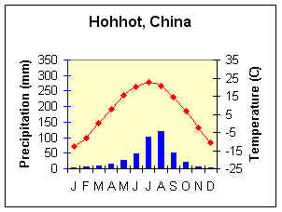
Midlatitude Steppe (BSk)
Characteristics
  Semiarid
  Rainfall distribution similar to nearest humid climate
  Temperatures vary with latitude, elevation, and continentality
  Larger temperature range than Tropical Steppe
  More precipitation than Tropical Steppe

Slide 39
BSk
Geographic Distribution
  Inner Asia;
  Western U.S.
Controlling Factors
  Essentially the same as deserts;
  Transitional to humid climates;
  Leeward orographic influence (rainshadow)

Slide 40
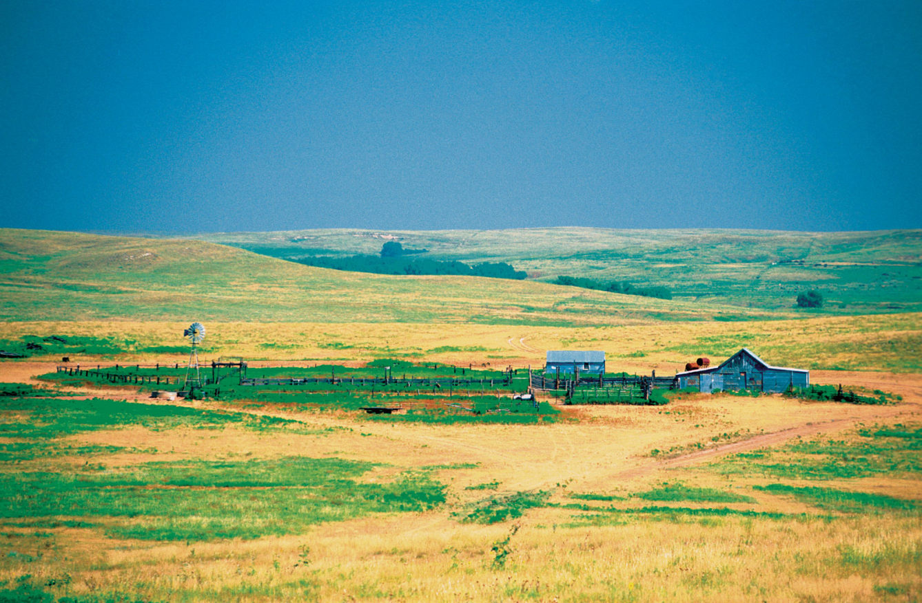
BSk
Short grass with scattered small shrubs transitioning to BWk desert.

Slide 41
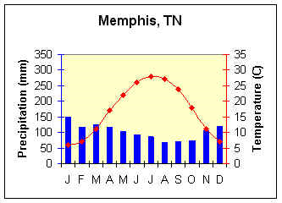
Humid Subtropical Climate (Cfa)
Characteristics
  High humidity; summers like humid tropics. Frost with polar air masses in winter.
  25 to 100 in of precipitation, decreasing inland.
  Monsoon influence in Asia.

Slide 42
Cfa
Geographic Distribution
  Southeastern U.S. southeastern South America;
  coastal southeast South Africa;
  eastern Australia;
  eastern Asia from northern India through south China to Japan.
Controlling Factors
  East coast location between 20º and 40º N and S latitudes. Humid (mTu air masses) onshore air movement in summer.
  Cyclonic storms in winter (cP air masses)

Slide 43
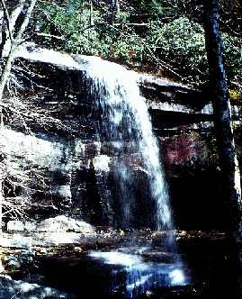
The ample precipitation and generally mild temperatures of the humid subtropical climate support a lush environment of temperate deciduous to temperate evergreen forests.

Slide 44
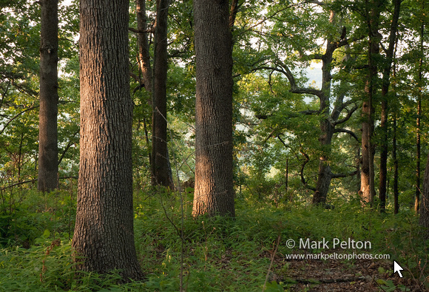
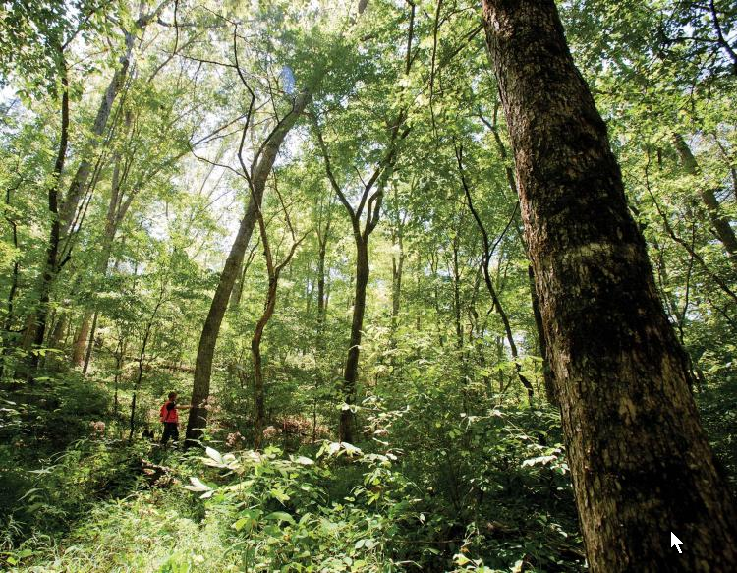
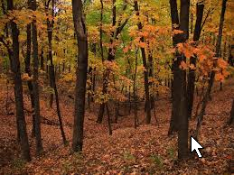
Cfa Vegetation
Missouri & Arkansas Ozark forests

Slide 45
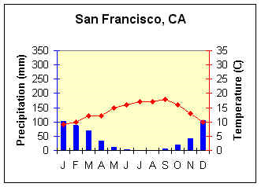
Mediterranean or Dry Summer
Subtropical Climate (Csa, Csb)
Characteristics
  Mild, moist winters, hot dry summers inland
  Cool, often foggy coasts
  High percentage of sunshine
  High summer diurnal temperature range
  Frost danger during winter

Slide 46
Csa; Csb
Geographic Distribution
  Central California
  central Chile
  Mediterranean Sea borderlands
  Iranian Highlands
  Capetown area of South Africa
  southwestern Australia
Controlling Factors
  West coast location between 30º and 40º N and S latitude.
  Alternating between Subtropical High in summer and Polar Front/Westerlies in winter.
  Cyclonic precipitation during the winter.
  Summer air masses: mT_{s}, cT
  Winter air masses: mT, mP, cP

Slide 47
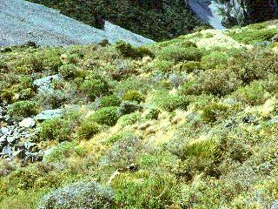
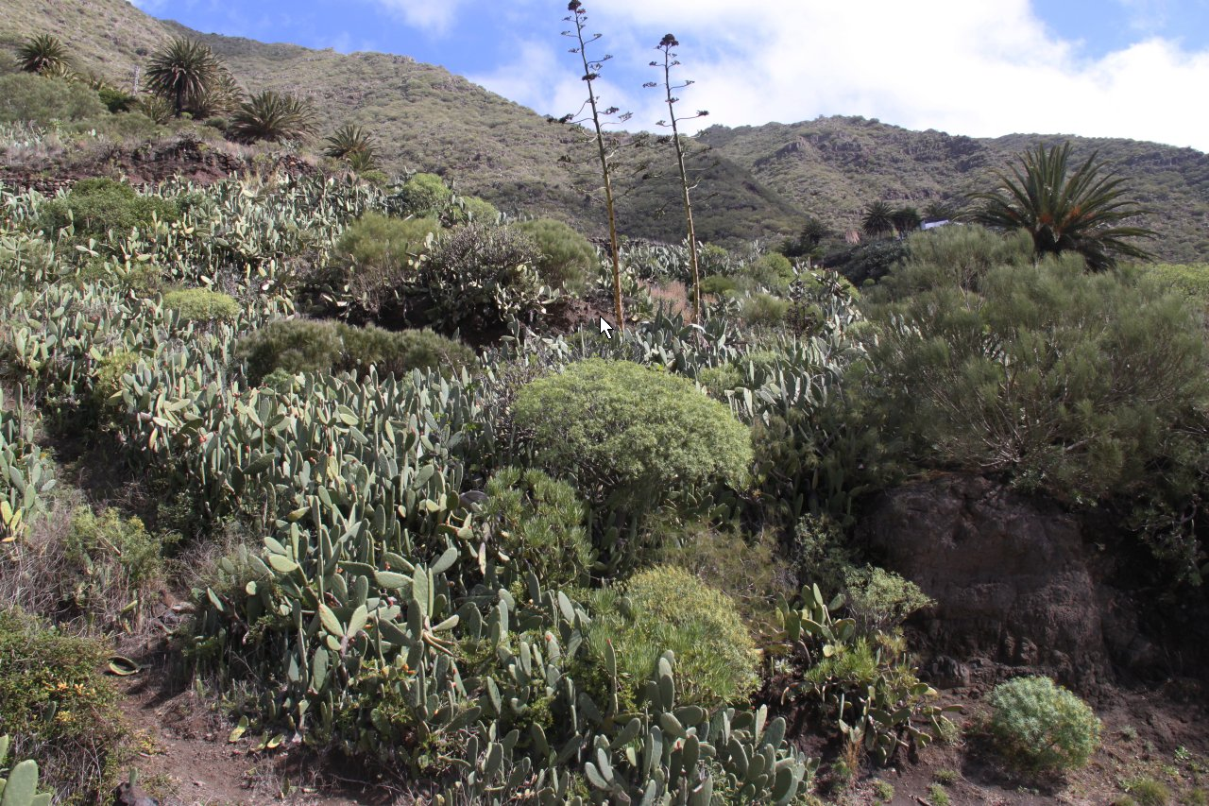
Csa; Csb
Small, thick evergreen leaves of the sclerophyll forest combats water loss during the drought conditions of the dry summer found in the Mediterranean climate. The picture depicts a sclerophyll scrub forest in the subalpine zone in New Zealand.

Slide 48
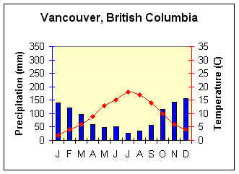
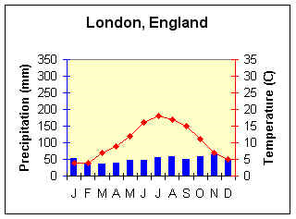
Marine West Coast Climate (Cfb)
Characteristics
  Mild winters, mild summers.
  Low annual temperature range.
  Heavy cloud cover; high humidity.
  Frequent cyclonic storms, with prolonged rain, drizzle and fog.

Slide 49
Cfb
Geographic Distribution
  Coastal Oregon, Washington, British Columbia, and southern Alaska
  Southern Chile; interior South Africa
  southeast Australia and New Zealand
  northwest Europe
Controlling Factors
  West coast location; year round influence of the Westerlies.
  Warm ocean currents along some coasts.
  Windward orographic influence in North America.
  Located further inland in Europe due to east - west orientation of mountains.

Slide 50
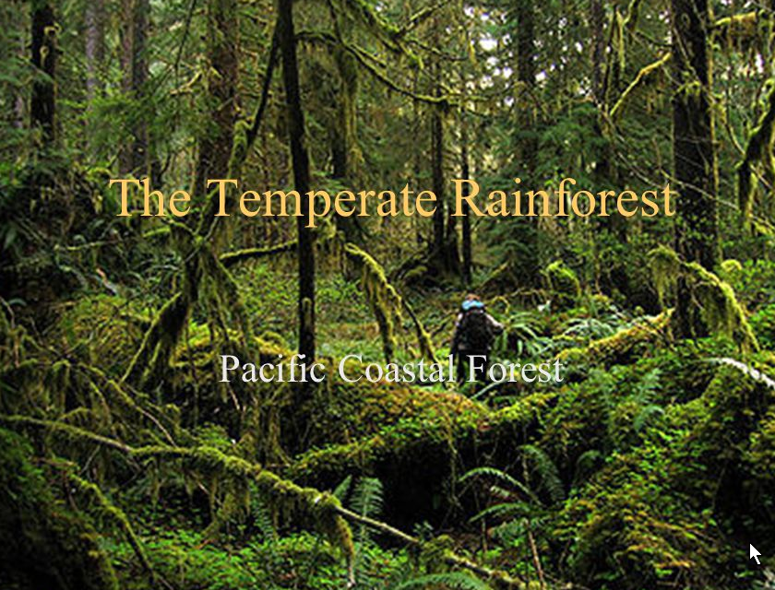
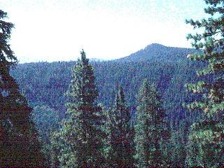
Cfb Vegetation
The significant difference between climate characteristics of Vancouver and London, both Marine West Coast climates, arises from location, local topography, and ocean current influence. The dry summer in Vancouver is due in part to subsiding, subtropical high pressure lying to the south. Precipitation is nearly double that of London due to local orographic uplift of air. Milder winter temperatures in London arise from the moderating influence of the North Atlantic Drift, a warm ocean current.
Due to the north-south orientation of mountain systems along the west coast of North America, the Marine West Coast climate is restricted to coastal locations. The Marine West Coast climate extends further inland in Europe due to the predominate east-west orientation of mountains.

Slide 51

Humid Continental Climate (Dfa, Dfb)
Characteristics
  Warm Summer Subtype: Dfa
    Hot humid summers; occasional winter cold waves.
    Large annual temperature ranges.
    Weather variability.
  Cool Summer Subtype: Dfb
    Moderate summers; long cold winters.
    Large annual temperature ranges.
    Variable weather.
    Less precipitation than warm summer subtype.

Slide 52
Dfa; Dfb
Geographic Distribution
  Warm Summer Subtype - Dfa
    Eastern and Midwestern U.S. from Atlantic coast to 100th meridian.
    east central Europe.
    northern China.
    northern Korea.
  Cool Summer Subtype - Dfb
    New England, Great Lakes region.
    south and central Canada.
    Scandinavia, eastern Europe, Russia
Controlling Factors
  Cyclonic, polar front storm systems.
  Prevailing westerlies dominate.
  Continentality;
  Polar anticyclone in winter.
  cP, mT, mP modified, cA (rare but on poleward limits) air masses

Slide 53

Dfa; Dfb Vegetation
The humid continental climate supports a diversity of ecosystems, from temperate deciduous forests to parklands and grasslands. Alfisols and mollisols are the dominant soils, though spodosols can be found where coniferous vegetation flourishes.

Slide 54

Subarctic Climate (Dfc, Dfd)
Characteristics
  Brief, cool summers; long, bitterly cold winters. Largest annual temperature ranges.
  Lowest temperatures outside of Antarctica.

Slide 55
Dfc; Dfd
Geographical Distribution
  Northern N. America from Newfoundland to Alaska; Northern Eurasia from Scandinavia through most of Siberia.
  Virtually nonexistent in the Southern Hemisphere
Controlling Factors
  Location in the higher middle latitudes (50º to 70º ). Westerlies in summer; strong polar anticyclone and Easterlies in winter.
  Occasional cyclonic storms.
  Extreme continentality.
  cP, cA, mP air masses

Slide 56


Dfc; Dfd
Snow covered coniferous forest, typical natural vegetation of the Subarctic climate. Conical shape of tree helps capture insolation at low angles. Boreal forests - Taiga

Slide 57

Tundra Climate (ET)
Characteristics
  "Summer-less"; at least 9 months average below freezing.
  Low evaporation; precipitation usually below 10 in.

Slide 58
ET
Geographic Distribution
  Arctic ocean border lands of North America;
  Greenland and Eurasia;
  Antarctic Peninsulas;
  some polar islands.
Controlling Factors
  Location in the high latitudes;
  Subsidence and divergence of the polar anticylone
  Arctic front cyclones
  cA, mP, cP

Slide 59


ET Vegetation
Ice mounds are a common feature where permafrost underlies the surface. A fragile ecosystem.

Slide 60

Ice Cap Climate (EF)
Characteristics
  Summerless; all months below freezing. World's coldest temperatures.
  Extremely small amount of precipitation.
  Windy

Slide 61
Geographic Distribution
  Antarctica interior Greenland
  Permanently frozen portions of the Arctic Ocean and associated islands
Controlling Factors
  Location in the interior of high latitude land masses. Year-round influence of polar anticyclone.
  Ice cover - high albedo
  cP, cA air masses

Slide 62


Barren “Ice deserts” – no permanent human inhabitants. No useable vegetation.

Slide 63
Highlands - H
Unclassified areas due to the great variability according to altitude, exposure to sunlight, and exposure to winds. It would be far too complex to be able map.

Slide 64
Credits: Good sites to visit.
World Climates
Meteorology - Weather And Climate: A Condensed Primer
Climate Region Maps From Wickipedia

