Slide 1
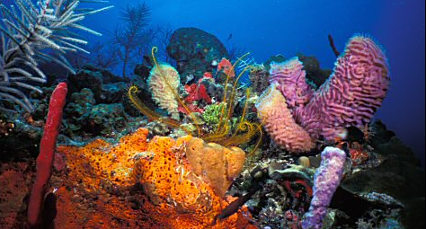
Importance of Biodiversity

Slide 2
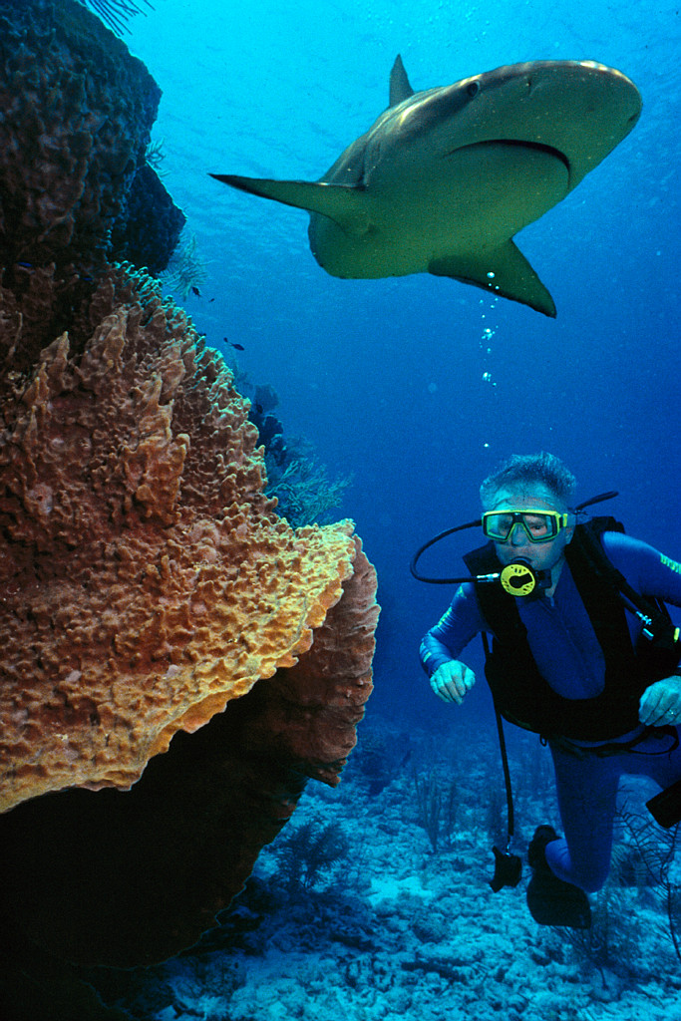
What is biodiversity?
Biodiversity is defined as “the variability among living organisms from all sources including, inter alia, terrestrial, marine and other aquatic ecosystems and the ecological complexes of which they are part; this includes diversity within species, between species and of ecosystems.”- 1992 United Nations Earth Summit
Many different types of organisms
Organisms depend upon one another for survival - interdependence
The more variation of species means the higher biodiversity in an area.

Slide 3
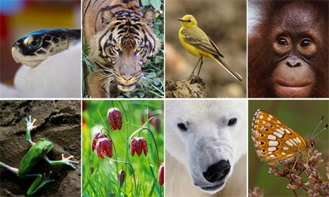
Biological diversity or biodiversity refers to the number and variety of life forms found within a specified geographic region.
This includes the different plants, animals and microorganisms, the genes they contain, and the ecosystems they form.
This living wealth is the product of hundreds of millions of years of evolutionary history.

Slide 4
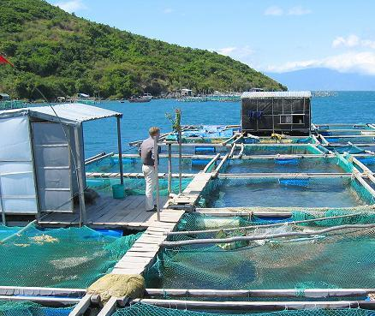
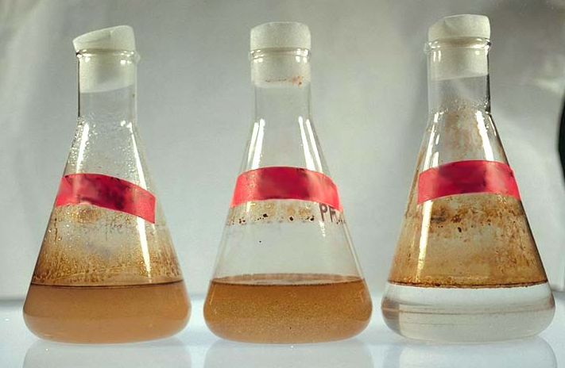
Why is biodiversity important?
Human beings are dependent for their health, well-being and enjoyment of life on basic biological systems and processes.
People get food and many medicines and industrial products from the wild and domesticated components of biological diversity.
Wild life areas like prairie grasslands and rainforests are storehouses of a myriad of varied genetic material which may be useful in finding new drugs and creating improved hybrid plants – that is only if these areas are allowed to continue to exist for our benefit and that of future generations.

Slide 5
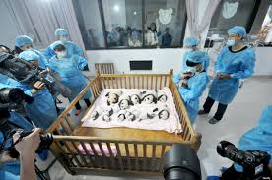
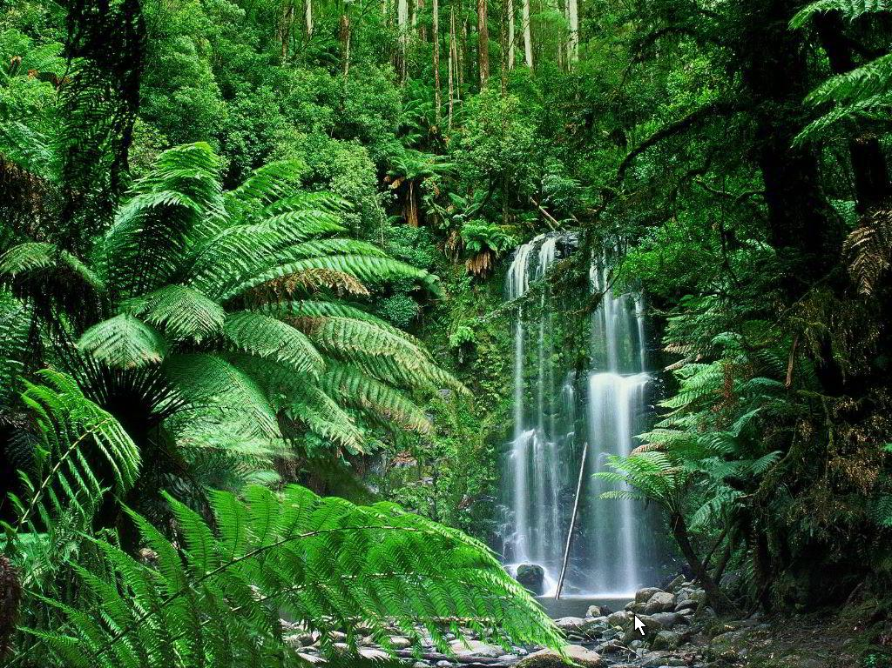
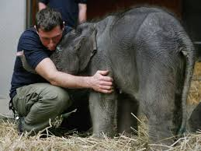
Intrinsic Value
Biodiversity also has value in its own right, and is not something that should simply be viewed for its usefulness to humans. All life benefits from biodiversity.
Human responsibility toward other living things, and obligations to future generations, provide strong reasons for conservation. If humans don’t accept the role of stewards of the world, who will? What if humans refuse?

Slide 6
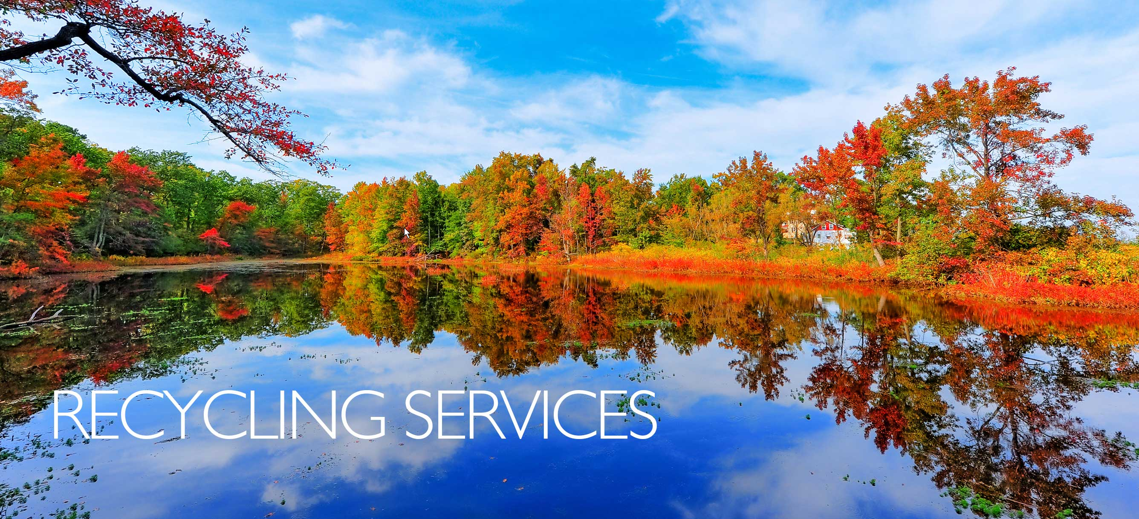
Many species keep us alive!
How?
purifying water and polluted air
fixing nitrogen
recycling nutrients and waste
pollinating crops
Plants and bacteria carry out photosynthesis, which produces the oxygen we breathe. Trees absorb carbon dioxide, the main greenhouse gas given off by human activities. And it all keeps on being recycled! Everything that is natural gets recycled, even the crust of the Earth.

Slide 7
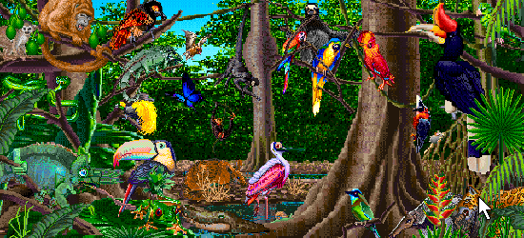
3 Types of Biodiversity
Genetic diversity
Species diversity
Ecosystem diversity

Slide 8
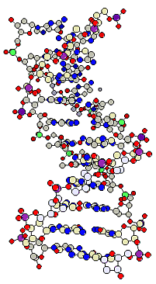

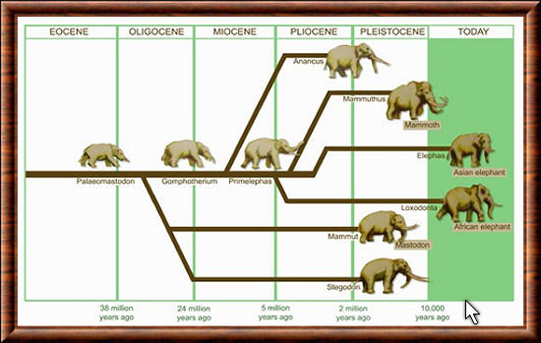
A. Genetic Diversity
Genetic diversity is the total number of genetic characteristics in the genetic makeup of a species. It is distinguished from genetic variability, which describes the tendency of genetic characteristics to vary.
Allows individuals to adapt to different conditions. Thus, high genetic diversity increases ability of populations and species to survive major changes in their environment (e.g. climate change)

Slide 9
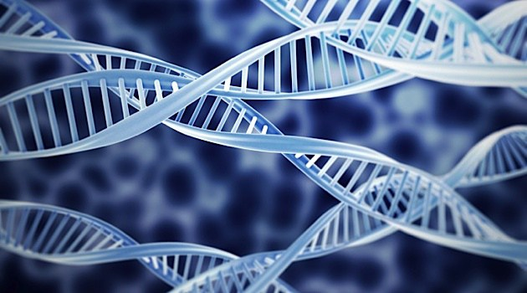


Slide 10
Danger of little genetic diversity
Traditionally, Jewish single persons have sought out other Jewish persons as marriage partners. Over centuries little new genetic material entered the gene pool. So the chance of a man and a woman both having the recessive gene of some genetic disease is relatively higher than for a couple which is part of a much more diverse gene pool. The result is that a number of harmful genetic conditions is greater per 100 people than it is among non-Jewish couples.
In the 19th century European royalty almost always married other members of European royalty. After the recessive gene for hemophilia found its way into the group, via Queen Victoria, the rate of persons born with hemophilia among royalty was much higher than the rate in the general population.

Slide 11
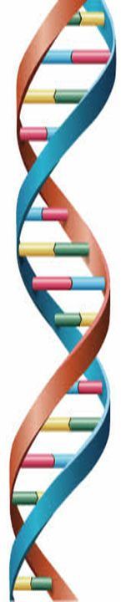
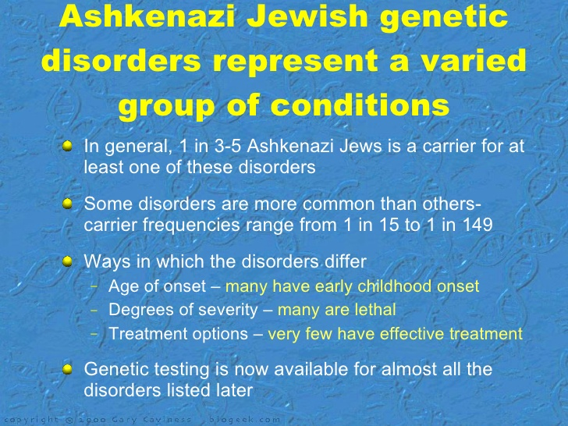

Slide 12
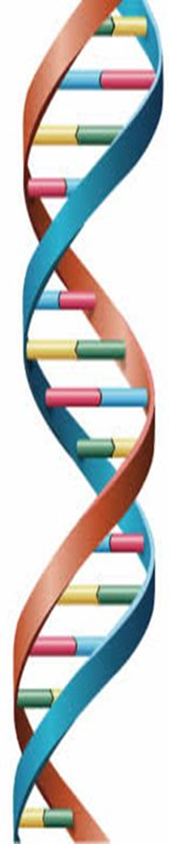
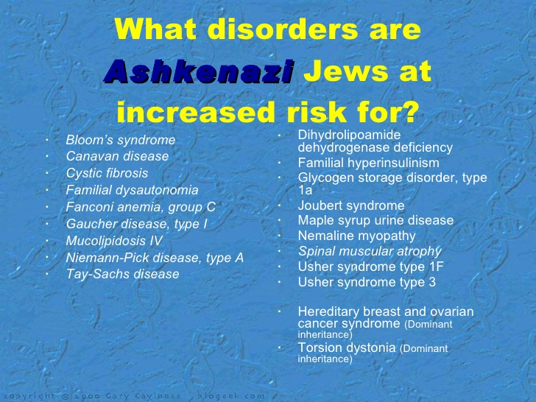

Slide 13
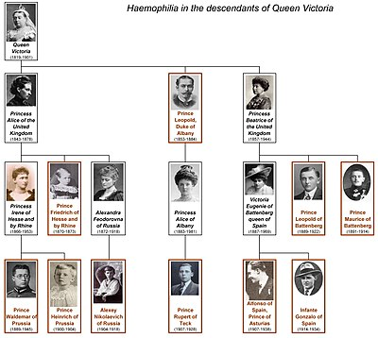
As the descendants of Queen Victoria married members of other European royal families, the gene was carried by some members of almost all the major royal families in Europe.

Slide 14
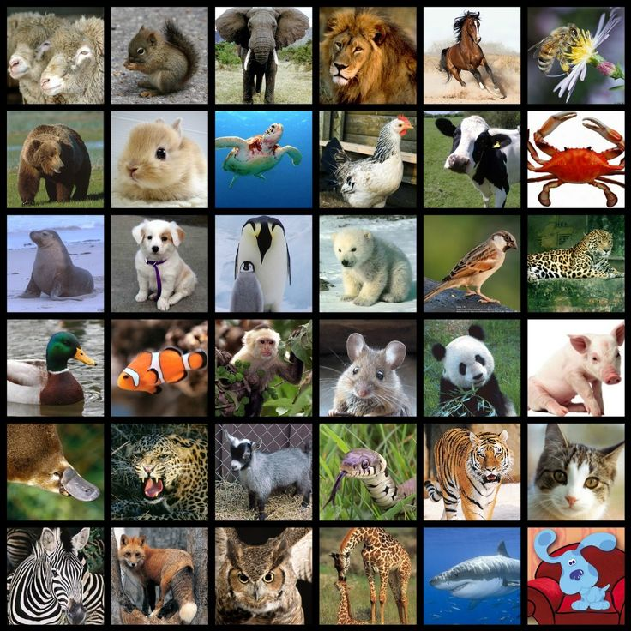
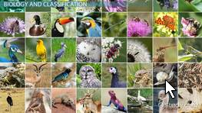
B. Species Diversity
species diversity is defined as the number of species and abundance of each species that live in a particular location. The number of species that live in a particular location is called species richness. Abundance is defined as the number of individuals of each species.
The diversity of the smaller organisms (e.g. phytoplankton, the plants of sea) is less known than the larger organisms (e.g. mammals such as dolphins and whales).

Slide 15
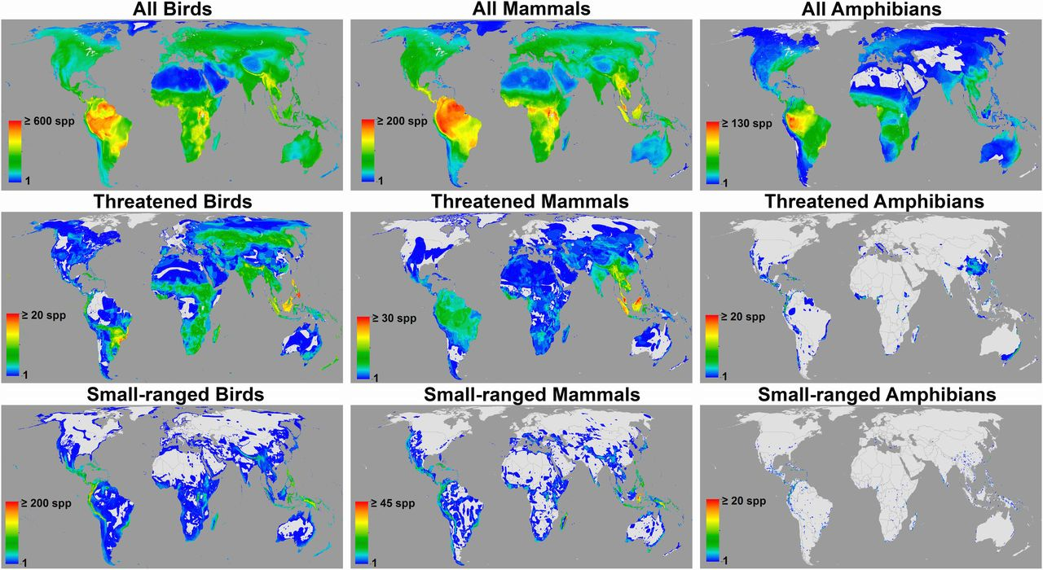
Global patterns of terrestrial vertebrate

Slide 16
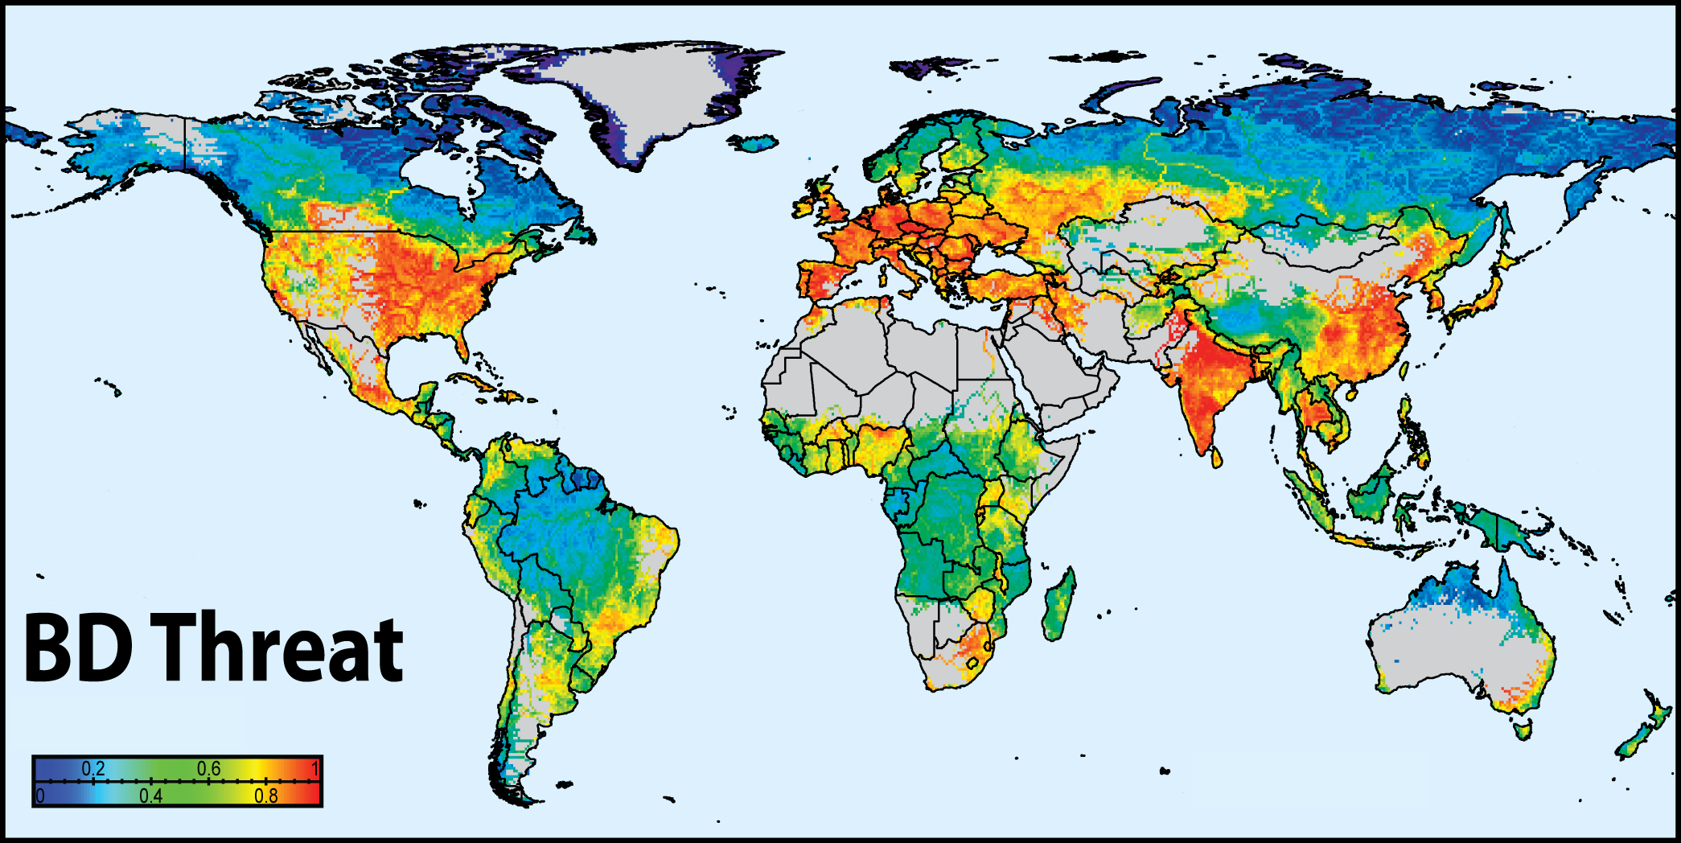
Threat to River Biodiversity

Slide 17
C. Ecosystem Diversity
Ecosystem diversity describes the variation in all living and non-living things in a particular geographic or ecological region (Biome). Ecosystems comprise unique combinations of animals, plants, micro-organisms and physical characteristics that define a location.
EXAMPLE: Within the Temperate Forest Biome, there are many types of forest ecosystems (complex communities of interdependent organic and non-organic elements). The Oak-Hickory community is one of the many forest ecosystems within that biome.

Slide 18
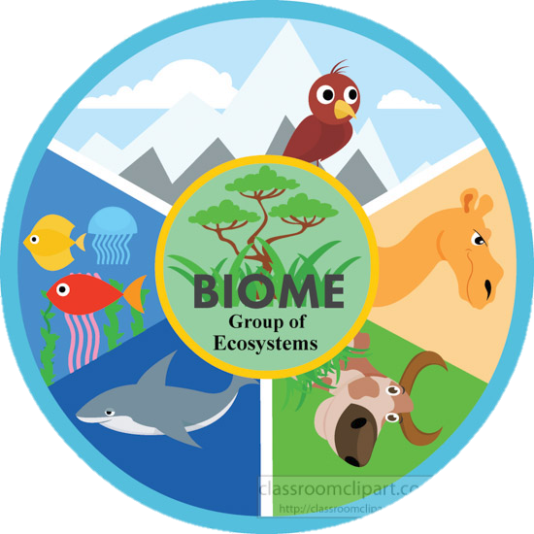
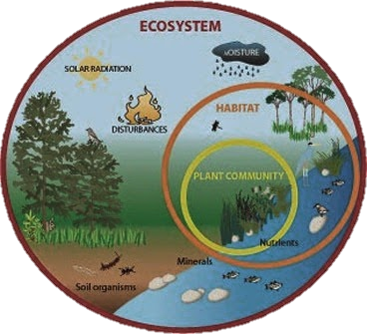

Slide 19
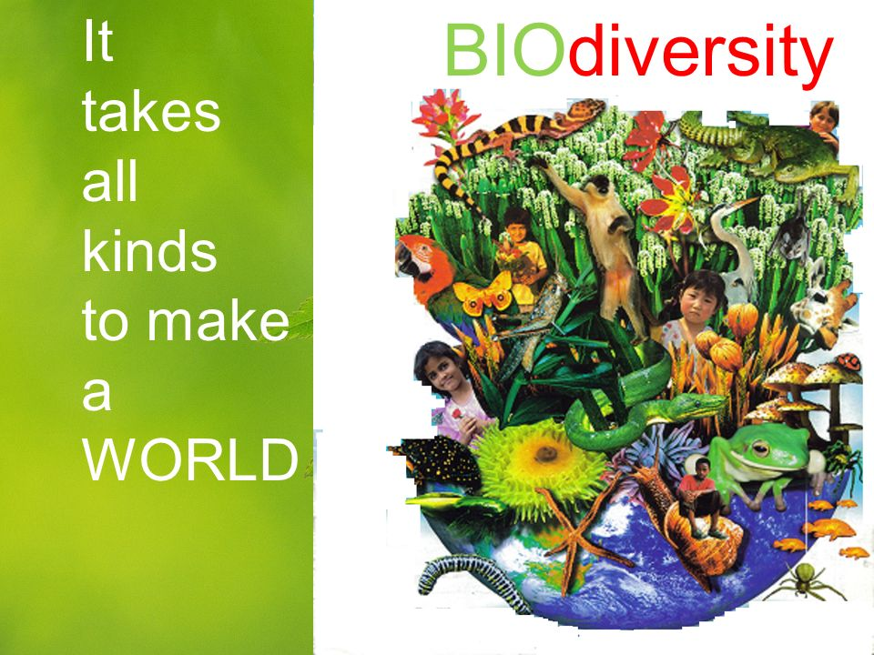
And each element plays a part in the interdependent whole. A change in one element, such as climate, may affect many others.

